Slide 1
ESS Logistics Jörgen Larsson Senior Logistics Officer, Group Leader Warehouse & Logistics
^{6th} Target Technical Board Meeting October 11th, 2016

Slide 2
On the agenda:
ESS Logistics
Services Provided
IRL
Questions

Slide 3
ESS Logistics
Purpose:
Features:
Responsible for all processes related to transportation and logistics in ESS and providing support to in-kind partners as required.
Planning for logistics solutions.
Ensure safe and proper movement, receipt, handling and documentation of goods/material on behalf of ESS.
Secure that all goods/material entering or exiting the ESS perimeter have sufficient control, pre-advise and relevant documentation.
Assure that, from a logistics perspective, ESS is following the necessary laws and regulations related to the ERIC status, Swedish Customs Authority, The Swedish Radiation Safety Authority and others, such as:
ESS inventory management
Documentation of VAT and Customs status
The logistics function is in charge of all processes related to transportation and logistics, such as:
Safe and on-time movement of goods/materials
Large and complex movement of goods/materials
Documentation and processes related to customs and VAT status (ERIC)
Consulting/planning for logistics solution
Coordinating and managing storage and forwarders
Special attention is paid to:
Collaboration and coordination
Quality
Efficiency
Service
Value for money
Documentation
Rules, procedures and regulations
HOLISTIC
APPROACH
Who to contact?
Jörgen Larsson
Senior Logistics Officer
Supply, Procurement & Logistics Division
+46 (0)72-179 2098
jorgen.larsson@esss.se
logistics@esss.se

Slide 4
On the agenda:
ESS Logistics
Services Provided
IRL
Questions

Slide 5
Services Provided:
Strategic
Mapping of inbound deliveries of equipment – forecast
Meeting with ESS WP leaders
Meetings with Inkind partners
Tactical
Regardless of INCOTERM
Benchmark of transportation costs
Executing transports
Coordinate transports
Road surveys
Documentation (Packinglist and Proforma Invoice)
Operational
Service and support to the organization, In-kind and stakeholders
Handling daily shipments inbound/outbound and between partners
Coordinating deliveries
Moving equipment between different addresses

Slide 6
Services Provided – In Practice
FAQ with experience from meetings with in-kind partners;
DAP/DDP including unloading from incoming means of transport…..
ESS Logistics Service provider arranges unloading and invoices the cost to supplier/forwarder
Coordination
According to time schedule / securing unloading resources on SITE and elsewhere
Documents needed
Packinglist declaring the contents in the delivery
Proforma invoice with commercial value for insurance purposes
Pre advice
Any shipment bound fro ESS needs to be confirmed before departure
Keeping stakeholders at ESS up to date with arrival
Goods receipt
Assuring the receipt of goods without transportation damages

Slide 7
On the agenda:
ESS Logistics
Services Provided
IRL
Questions

Slide 8
ESS Inbound forecast – CONSERVATIVE DATA
1 unit = 1 EUR trailer / 22 tons
3 WP ACC not included

Slide 9
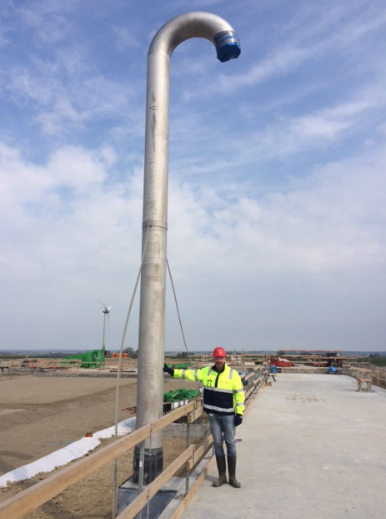
IRL:

Slide 10
Questions:
Thank you for the attention

