Slide 1
Scanning Updates
STFC in-kind December 2015
Owen Arnold

Slide 2
Context
What is the objectives?
Why are we doing this now?
Who is involved on the technical side?
How is it going to work?
Current progress?

Slide 3
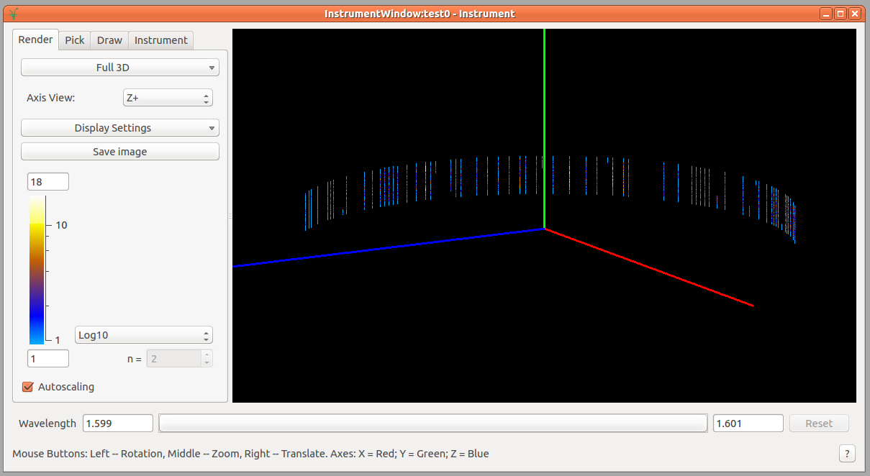
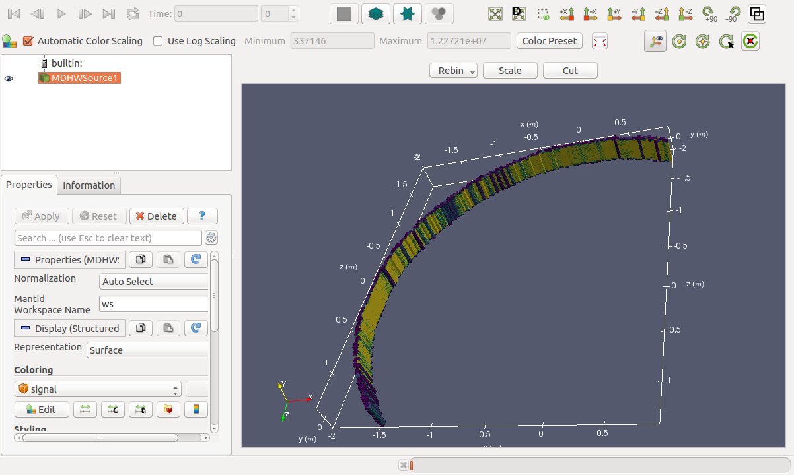
Step Scans
D2B
64 detectors
256 pixels
100 steps
0.025° per step
= 1638400 spectra
D7, D4, D16

Slide 4
How’s it going to work?
We are actively working out the details https://github.com/mantidproject/documents/pull/36
We are actively configuring our Instrument-NG prototype to check and measure design changes to the Instrument
We are generally set on a single approach

Slide 5
New Design
Workspace
SpectrumInfo
New caching layers
DetectorInfo
Instrument
Workspace does not connect to an instrument
SpectrumInfo indexed by spectrum index
DetectorInfo indexes by detector index

Slide 6
New Design
Detector indexes & time index
SpectrumInfo
Spectra list
DetectorInfo
Signatures include time index

Slide 7
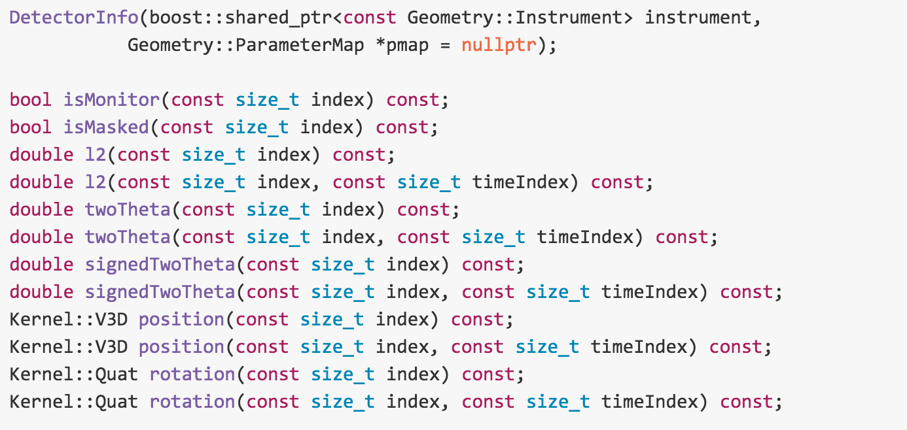
DetectorInfo

Slide 8
Implementation Notes
Instrument access will be discouraged or prevented
Positions, rotations as well as metadata will live directly in the DetectorInfo. Not accessible via the Instrument
Interfaces that currently provide ID access will be reduced and eliminated. Maps will live on “client side”.
ParameterMaps will be gradually eliminated and will go with the introduction of Instrument NG

Slide 9
Plan
Aiming to have implementation working end April 2017.
Update caching layers to be “scanning”
Rollout caching layers across framework
Purge positions, rotations, masking from ParameterMap
Deal with persistence
Write loaders, deal with constructional issues

Slide 10
Current Progress
Design document nearing completion
Instrument prototype under development from a D2B benchmark
Caching layers under development including for scanning modes
Caching rollout only just begun

