Slide 1
Screaming Udder: data streaming at ISIS
Matt Clarke, Matthew Jones, Freddie Akeroyd, Nick Draper, Martyn Gigg and Owen Arnold
c

Slide 2
The collaboration
BrightnESS work package 5.1
STFC in-kind

Slide 3
Data streaming for the ESS
Event Formation
P
Kafka
c
Sample Environment
P
Choppers
P
C
C
Mantid
File Writer

Slide 4
Data streaming at ISIS
Data aggregation already taken care of by the ICP
Detectors
Data Acquisition Electronics
Instrument Control Program
(Aggregator)
Metadata
NeXus File
SE Data
(SECI/IBEX)
SQL Database
Viewers
c

Slide 5
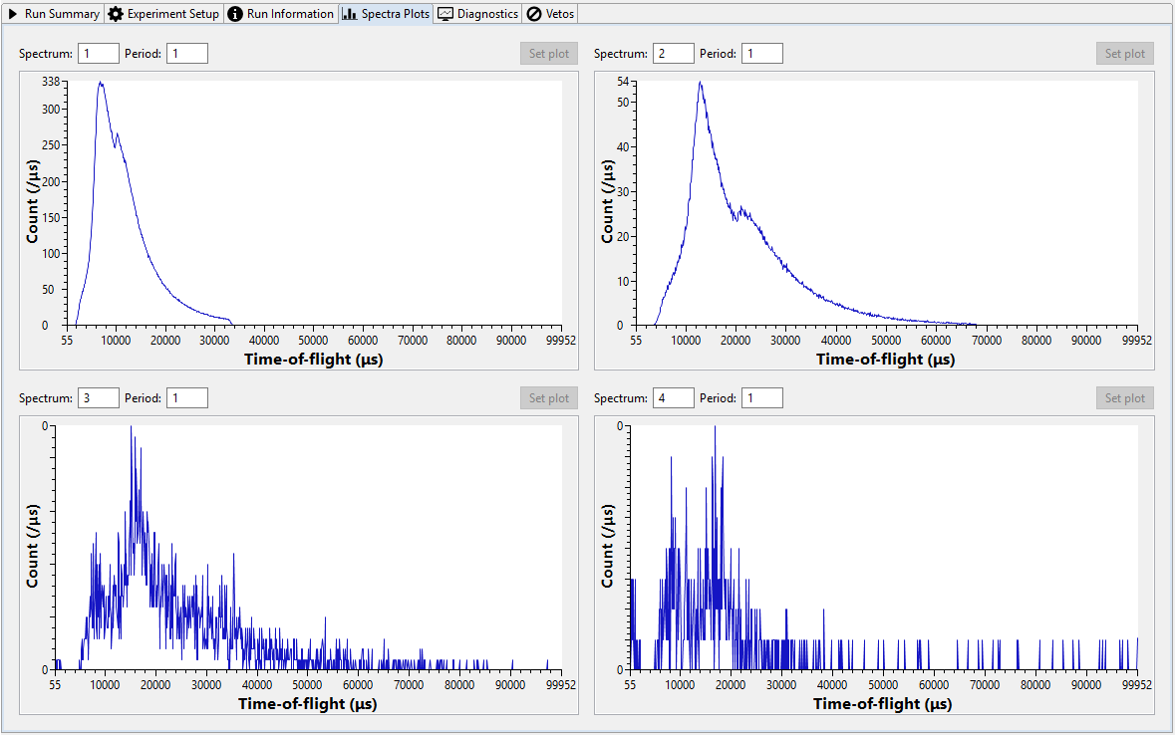
Existing live data views at ISIS
ICP streaming directly to Mantid
TCP socket(s)
Individual spectra via SECI/IBEX
Notes:
Data thrown away if it starts building up in the ICP – for example: if there is a slow connection to Mantid.

Slide 6
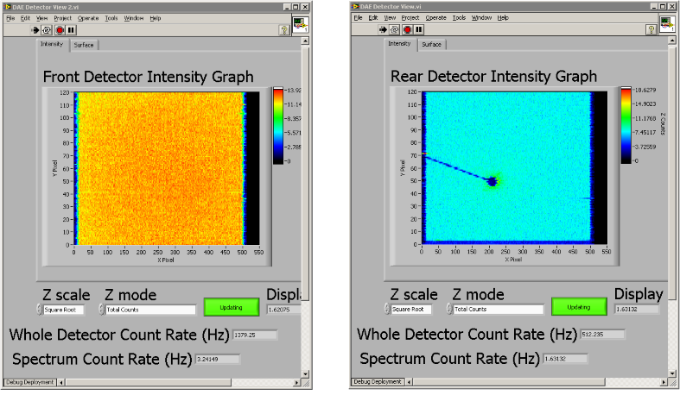
Existing live data views at ISIS
Custom solutions
Notes:
Requires extra cards in the data acquisition electronics to integrate the data. Can be quite expensive and requires space in the crate.

Slide 7
Possible issues
Strain on the ICP
No way to know if data is lost
Doesn’t scale
Late joiners cannot catch up
Extra hardware
Imaging data
…

Slide 8
Prototype data streaming
As part of the in-kind contribution, the plan is to run the data streaming prototype(s) on an ISIS beamline

Slide 9
Proof of concept: historical data
Streaming a NeXus file through Kafka to Mantid

Slide 10
Topics and schema
3 topics used:
Run information
Run number
Instrument name
Stream offset
Updated at beginning of run
Spectra mapping
Mapping of detectors to spectra
Updated at beginning of run if different
Event and sample data
Event and sample data collected in frames
Message(s) send every frame

Slide 11
Run information topic
…
…
Run: 1024
Offset: 145678
Run: 1025
Offset: 145678
Run: 1026
Offset: 288003
Run: 1027
Offset: 451455
Run Information
1024
1025
1026
1027
…
…
…
Run: 1025
Frame n-2
Run: 1025
Frame n-1
Run: 1025
Frame n
Run: 1026
Offset: 288003
Run: 1026
Frame 1
Event Data
288002
288003
288004
288005
288006

Slide 12
Prototype v1
Detectors
Data Acquisition Electronics
Instrument Control Program
(Aggregator)
Metadata
NeXus File
SE Data
(SECI/IBEX)
SQL Database
Kafka
Mantid

Slide 13
The results

Slide 14
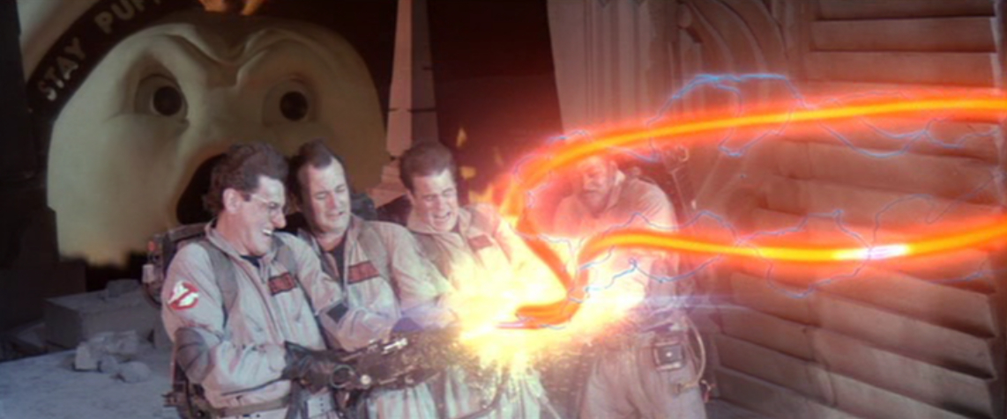
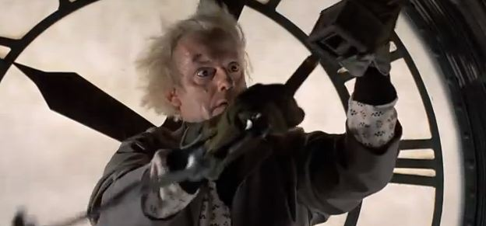
Not production ready
Data Acquisition Electronics
Freddie and Matthew magic
Kafka
Mantid
Martyn and Matthew wizardry

Slide 15
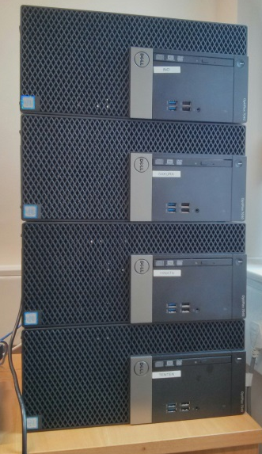
Future plans: short term
Passing SE data into Mantid
Optimising Mantid consumption
De-aggregating SE data from the ICP
Buying a proper cluster for Kafka

Slide 16
Future plans: medium term
Prototype v2 – parallel system?
Detectors
Data Acquisition Electronics
Instrument Control Program
(Aggregator)
SQL Database
NeXus File
SE Data
(IBEX)
Metadata
Neutron Data
Mantid
Kafka
EPICS Forwarder
NeXus File

Slide 17
Future plans: longer term
More in-line with the ESS?
Detectors
Data Acquisition Electronics
New Instrument Control Program
Neutron Data
Imaging
Kafka
?
Mantid
Metadata
SE Data
(IBEX)
NeXus File
EPICS Forwarder

Slide 18
Summary
Successfully streamed neutron data from a real instrument to Mantid via Apache Kafka
Moo-ving forward we* have a plan to produce a working and battle tested data streaming system for the ESS
* The DMSC, Elettra, PSI and STFC

