Slide 1
Motion Control & Automation Review
ESTIA TG2 review
29th November 2016
Thomas Gahl
- Group Leader Motion Control & Automation -

Slide 2
Overview Motion Control & Automation
Standard Motion Axes (Table of Motion)
Bunker feeder (2 ax), virtual source (2 ax)
Instrument shutter (2 ax)
Apertures (8 ax)
Polariser (2 ax)
Sample table (5 ax)
Detector (2 ax)
Selene Guide Alignment System
Guide bearings (6 ax)
Alignment cart (2 ax)
Mirror adjustment (180 ax)
MCAG Checklist for TG2 ESTIA

Slide 3
Result

Slide 4
Risk Analysis

Slide 5
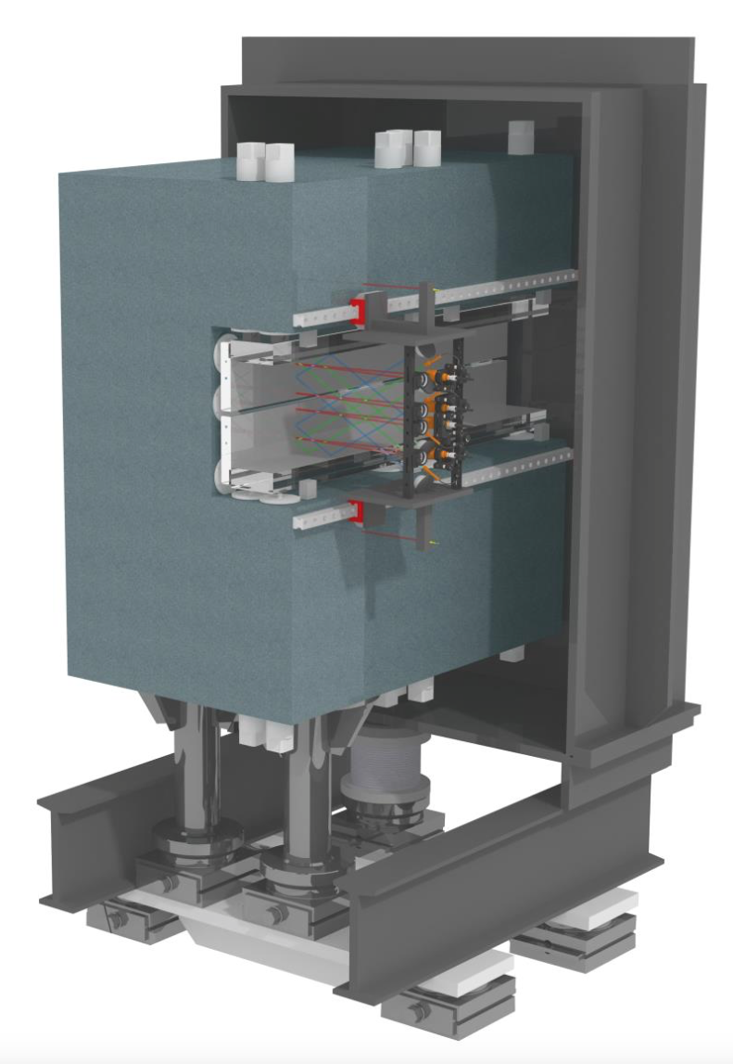
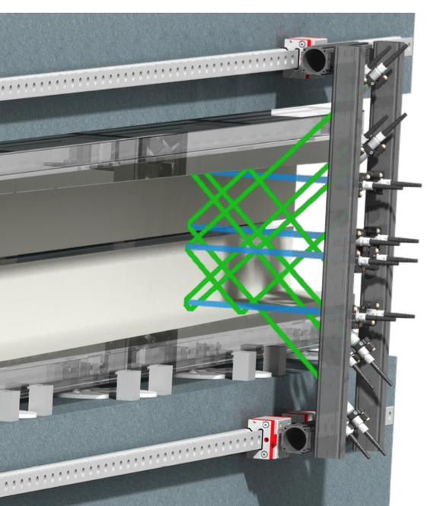
Selene Guide Alignment -Technical Concept

Slide 6
Technical Risks / Questions to ESTIA Team
Precision of mechanical positioning of the interferometer heads (metrology cart).
Multi-axes absolute interferometer: Is Etalon the sole supplier for that kind of measuring system?
Radiation hardness of the interferometer sensors.
Position mechanics for mirror alignment: Have you considered different mechanical solutions?
Failure of one or more motion axes of the mirror alignment: What is the impact on the instruments performance? (180 axes is a high number!)
Precision and long term stability of the granite carrier.
Temperature stability of 0.1°C: Is it feasible, achievable or even easy?
Radiation hardness of the hydrostatic sensors.

Slide 7
R&D Project/ Questions to ESTIA Team
Can you give a little bit more details on the R&D project (technical goals, work package description, project plan, budget & resources)?
How would you consider possible long term technical effects that you can't measure during the testing in the R&D project?
Do you intend to include in the R&D project a work unit to find an effective way to handle the number of 360 axes later in the project (design, drawing, cabling, commissioning), to explore synergies and apply successfully economy of scale?

