Slide 1
Accelerator Division Cryoplant Interconnecting Piping Installation
Ila Sjöholm
Area Supervisor Cryobuildings
(G04, G02 Coldbox Hall and CTL Duct & Gallery )
www.europeanspallationsource.se
AD/CF retreat - 24 November 2016

Slide 2
What is a cryoplant?
“Cryoplant” means various pieces of equipment (cold box, compressors, oil skids, tanks etc.)
Will be delivered from multiple suppliers in different periods.
Scope split of installation between only skid mounting and piping for an economical solution and easier pressure testing.
Accelerator cryoplant contains very special, cutting edge equipment like multi-stage cryogenic turbo compressors —> long commissioning time expected.

Slide 3
High requirements on installation
Helium is the lowest boiling medium in the universe and we operate below boiling point —> any other fluids will freeze inside the cryoplants —> high cleanliness required.
In order to reach 2K (-271°C) we must evacuate to sub-atmospheric pressure —> leaks will not result in helium loss as in other lines (“only” expensive) but in air leaking in to the process —> capacity decreasing until plant goes down —> high leak tightness required.

Slide 4
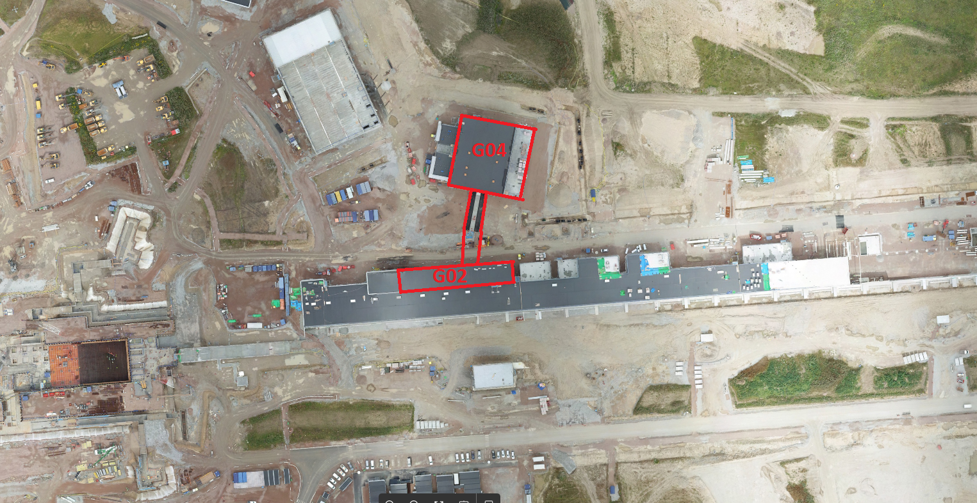
G02-CTL Gallery/Duct-G04

Slide 5
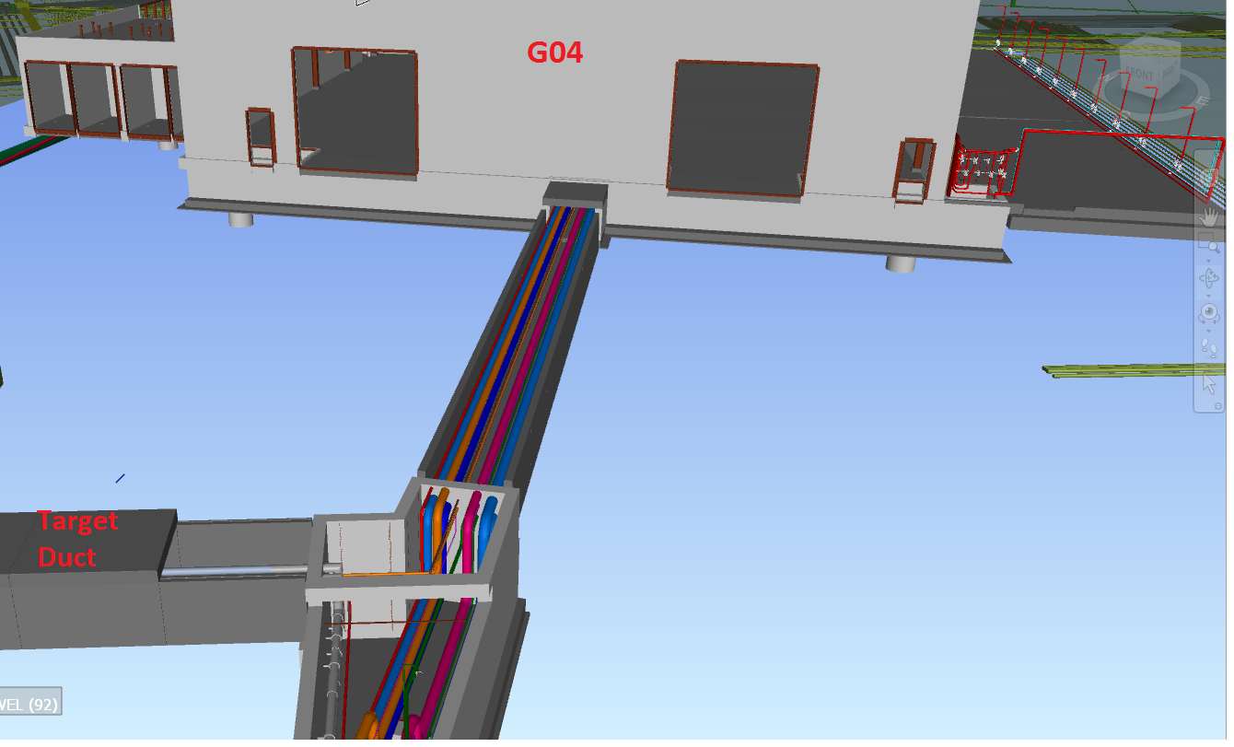
CTL Duct & Gallery pipe installation

Slide 6
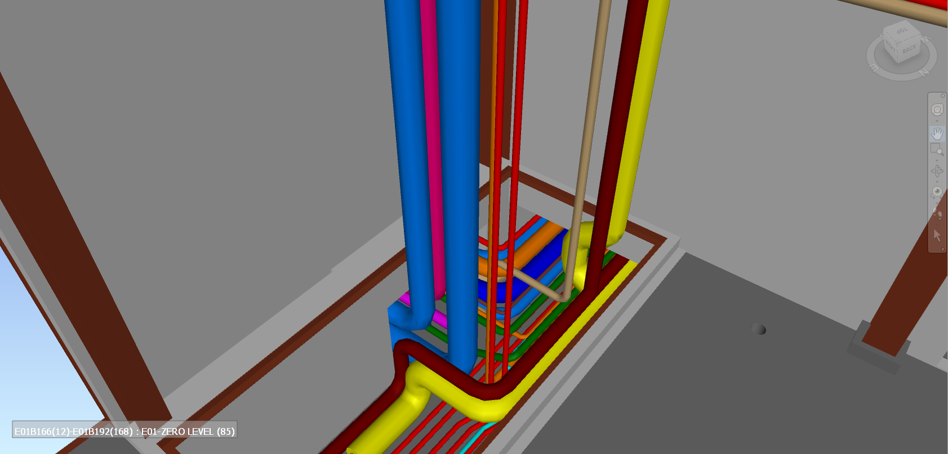
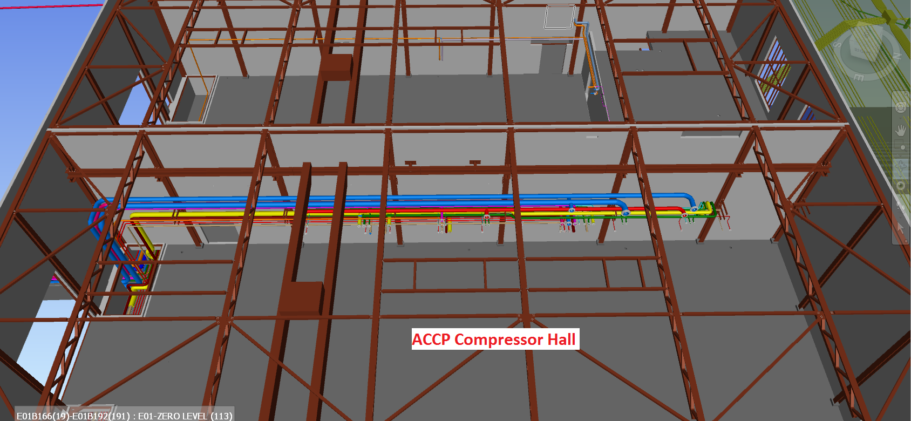
G04 ACCP Compressor Hall

Slide 7
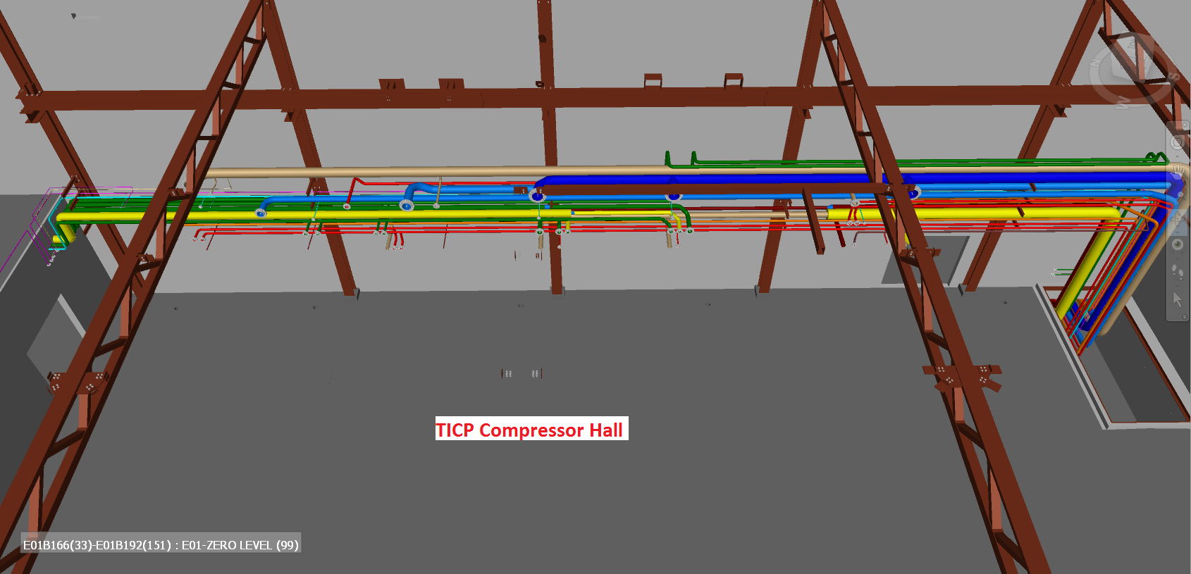
G04 TICP Compressor Hall

Slide 8
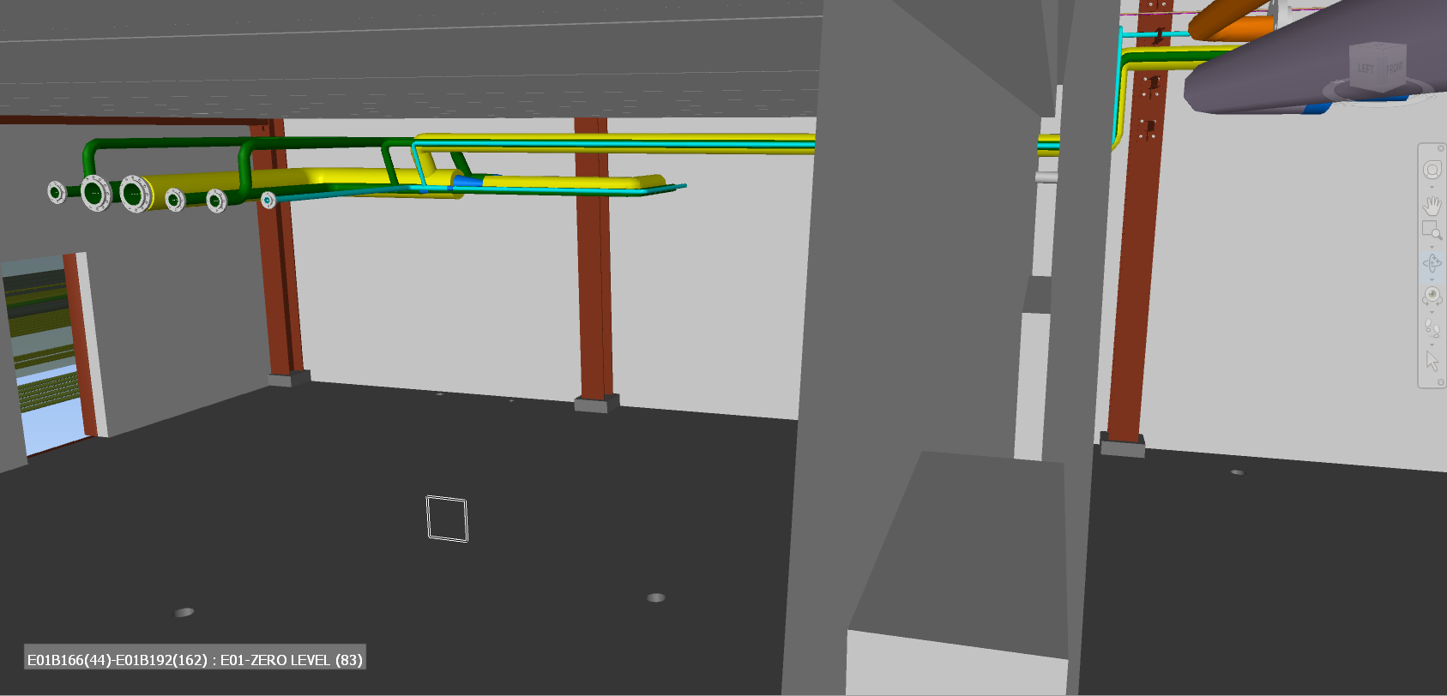
G04 Heating/Cooling Substation

Slide 9
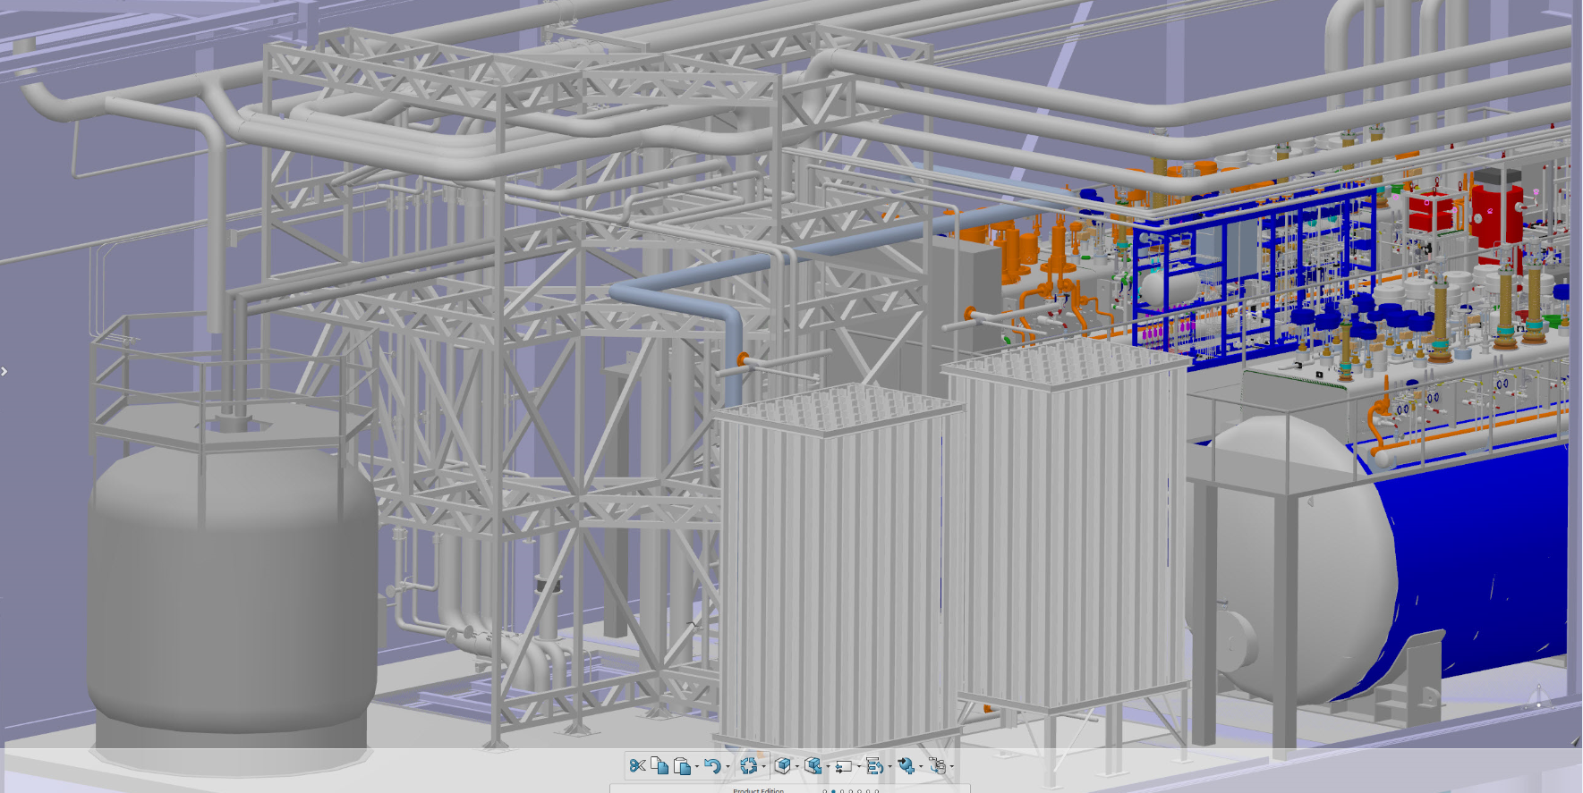
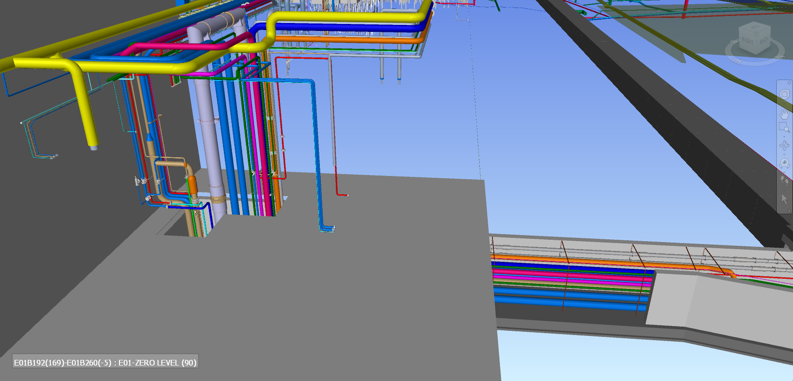
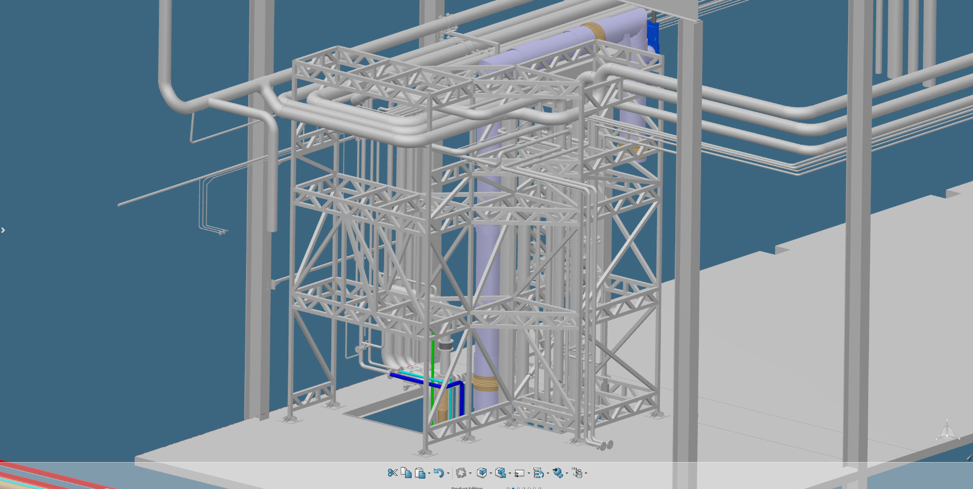
G02 Cold Box Hall

Slide 10
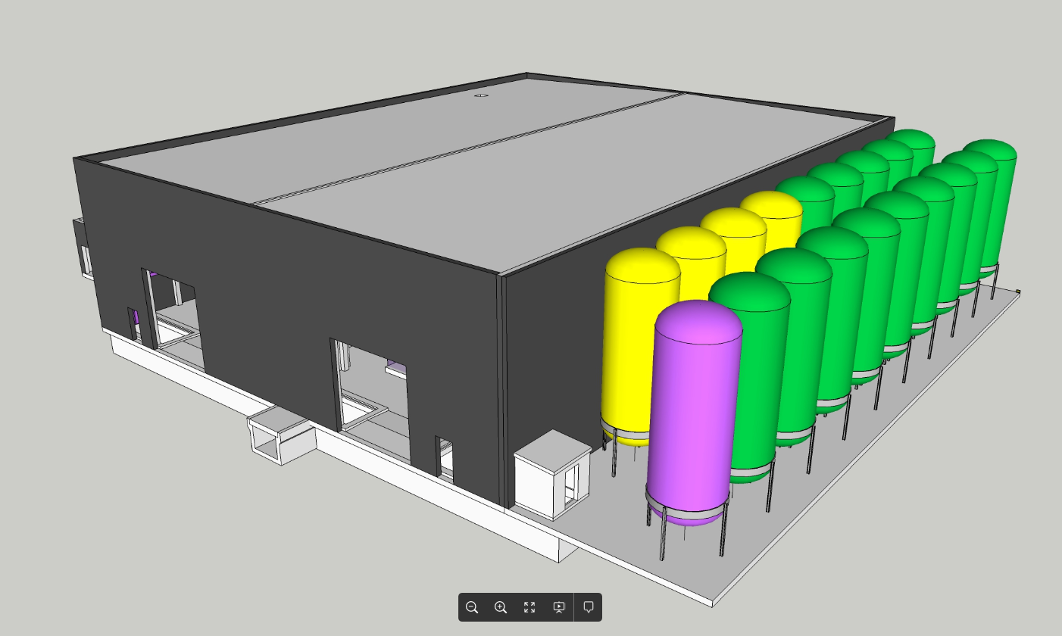
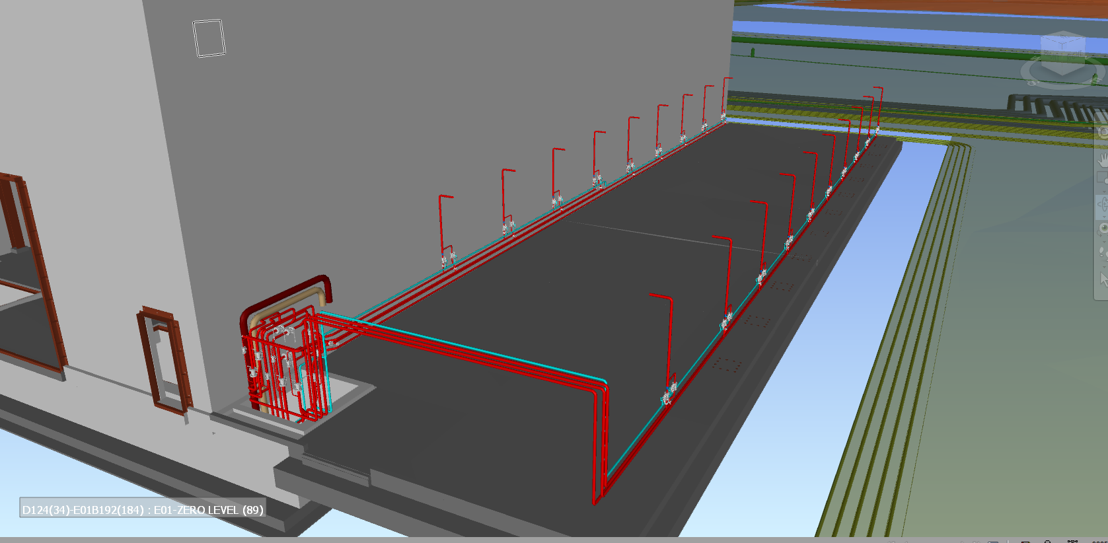
G04 Gas Storage

Slide 11
Thank you for your attention.

