Slide 1



Cryomodule
Test Stand

Slide 2

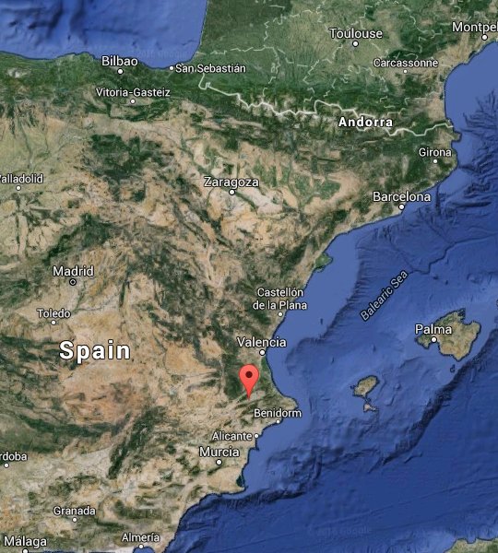





Short Introduction
Who is this guy?
Ontinyent
Emilio Asensi Conejero
Test Stand Engineer @ ESS (201606)
Former CERN, TUT-ASE, AI2
Automation and Industrial Electronics Engineer Polytechnic University of Valencia

Slide 3
Accelerator Division
ACCELERATOR DIVISION
Mats Lindroos
Beam Physics, Operation & Beam Diagnostics
Andreas Jansson – GL
Engineering Resources
David McGinnis – GL
Eugene Tanke
Nick Gazis
Carl-Johan Hårdh (C)
Daniel Lundgren (C)
Mats Pålsson (C)
LINAC
Håkan Danared – GL
Radio Frequency
Anders Sunesson - GL
Admin & QA
Caroline Prabert
Inga Tejedor
Abril Qaraeen
Matthew Conlon
Ebbe Malmstedt (C)
Safety
Lali Tchelidze – GL
Duy Phan
Enric Bargalló
Eder García Etxearte (I)
Frank Kornegay (C 15%)
Mikael Motyka (2016-10-24)
Konstantin Batkov (Target 50%)
Spec. Technical Services
John Weisend II – GL
Wolfgang Hees
Anton Lundmark
Evangelia Vaena
Frithiof Jensen
Emilio Asensi
Gunilla Jacobsson
Akif Coku (C)
Björn Henriksson (C)
Jörgen Jönsson (C)
Beam Physics
Mamad Eshraqi - SL
Marc Munoz
Renato de Prisco
Ryoichi Miyamoto
Yngve Levinsen
Saeid Pirani (at INFN)
Ciprian Plostinar (2017-04-03)
Alexander Lauge Pedersen (S)
Beam Diagnostics
Tom Shea – SL
Benjamin Cheymol
Cyrille Thomas
Hooman Hassanzadegan
Hinko Kocevar
Irena Dolenc Kittelmann
Maurizio Donna
Rafael Baron
Charlotte Roose
Thomas Grandsaert (EIS)
Johan Norin (C)
Linac Hardware
Vacant - SL
Christine Darve
Georg Hulla
Walter Wittmer
Felix Schlander
Oystein Midttun (IK)
Nuno Elias (EIS)
Frank Hellström (C)
Fredrik Håkansson (C)
Accelerator Integration
Stephen Molloy – SL
Aurélien Ponton
Edgar Sargsyan
Iñigo Alonso
Power Converters
Carlos Martins – SL
Göran Göransson
Marko Kalafatic
Paulo Jose Torri
Anders Andersson (C)
RF Sources
Morten Jensen – SL
Rihua Zeng
Rafael Montano
Bruno Lagoguez
Chiara Marrelli
Rutambhara Yogi
Staffan Ekström
Stevo Calic
Iñigo de la Fuente
Cryogenics
Philipp Arnold – SL
Jaroslaw Fydrych
John Jurns
Xilong Wang
Xiaotao Su
Ila Sjöholm (C)
Piotr Tereszkowski (C)
Vacuum
Marcelo Juni Ferreira – SL
Hilko Spoelstra
Simone Scolari
Christophe Jarrige
Fabio Ravelli
Kristell Barthélemy
Peter Ladd (C 50%)
Henrik Felding (I)
Planning
Lena Gunnarsson
Magnus Israelsson
Luisella Lari (C)
Håkan Danared – Deputy Head of Division
John Weisend II – Deputy Head of the Project
Peo Gustafsson – In-kind Manager (C)
69 employees (2016-10-24)
Consultants, IK, Students, Interns and empl from
Eng Integr Sup Div & Target, in Yellow + Planners = 27 people
Specialized Technical Services
Work Packages:
  WP10 Test Stands
  WP11 Cryogenics
  WP12 Vacuum
  WP15 Electrical Support
  WP16 Cooling Water
Notes:
§

Slide 4
WP10 – Test Stands
The ACCSYS work package 10 covers the test stands for main accelerator components in Uppsala and in Lund.
RF Lab Lund concerns the testing of a new design modulator prototype (LTH).
Test Stand 1 concerns the main RF equipment prototype soak tests (Uppsala).
Test Stand 2 concerns the Site Acceptance Tests (SAT) of the series production cryomodules (elliptical cavities).
Uppsala test stand FREIA tests the spoke cavities and the spoke cavity cryomodule series SAT.

Slide 5
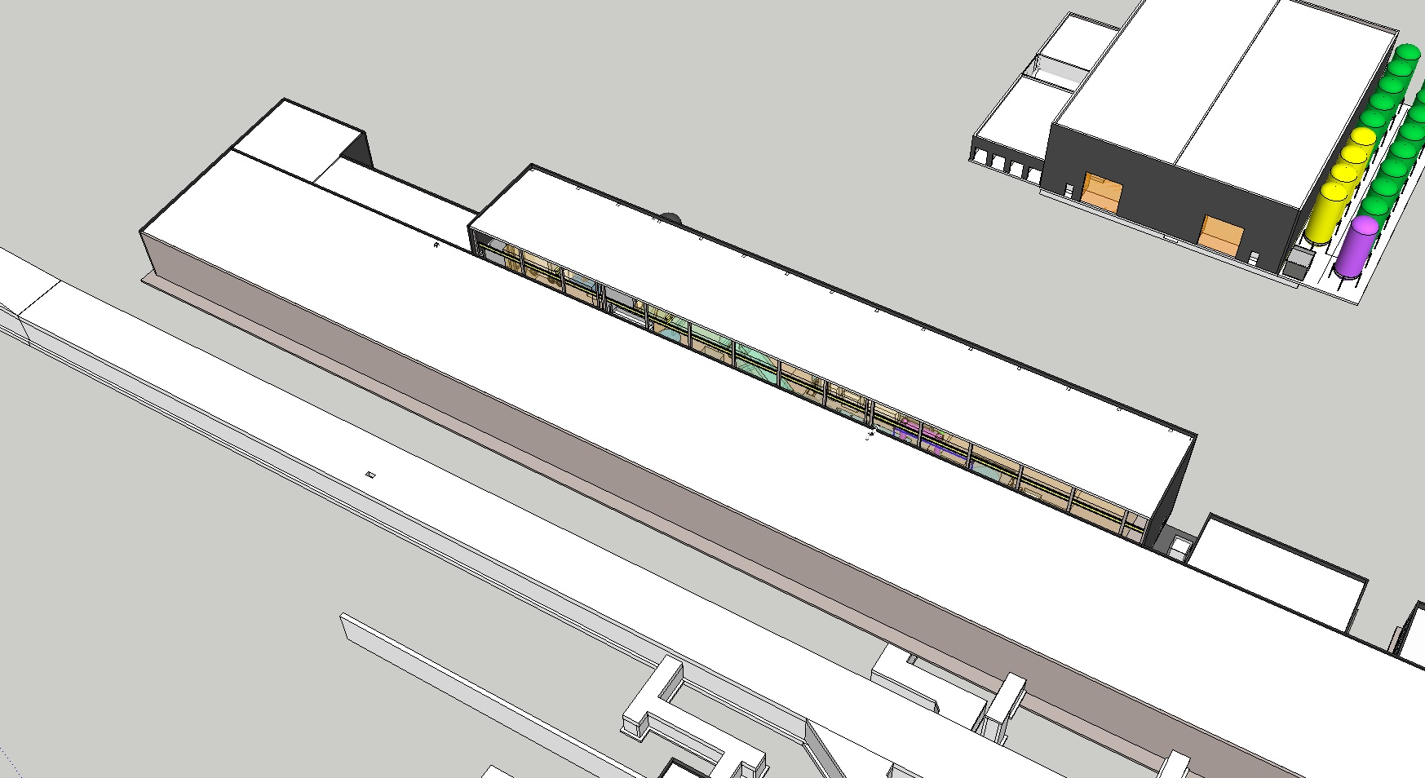
Test Stand 2
Test Stand 2 will occupy 45 m in the high energy end of the klystron gallery, in the Gallery Technical Area (cont. space).
W. Hees

Slide 6
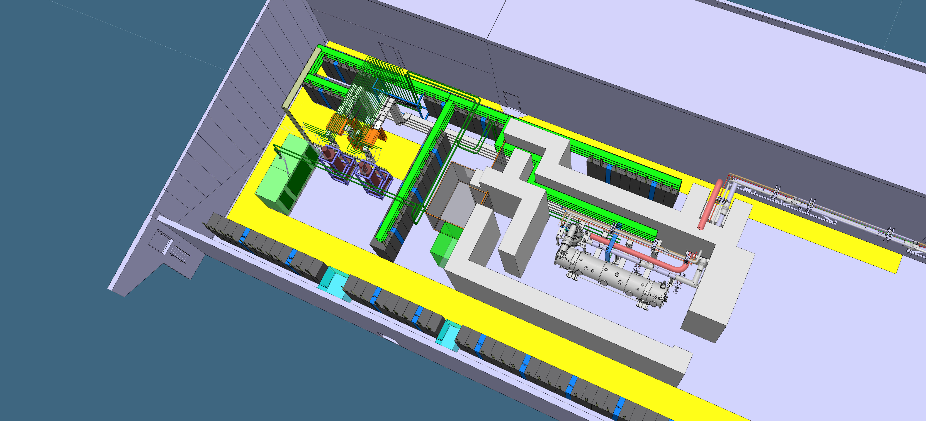
Test Stand 2
Cryogenics and
Test Stand Control room
High power RF
equipment
Cryo Transfer Line
Test bunker
Preparation
Area

Slide 7
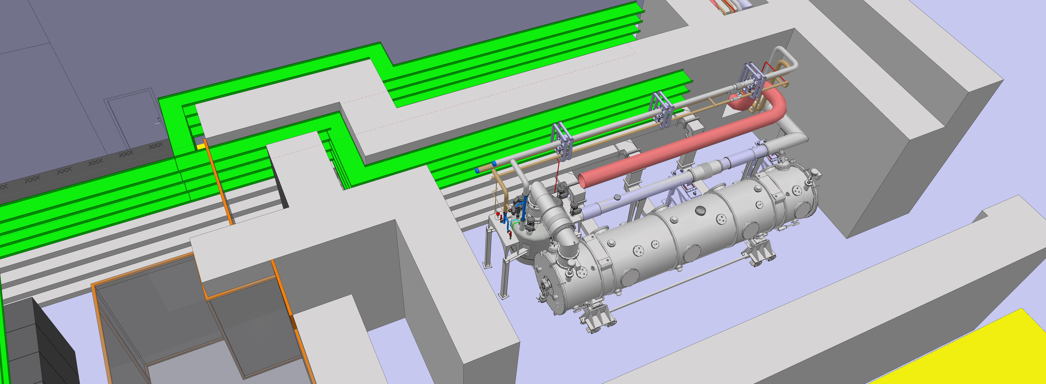

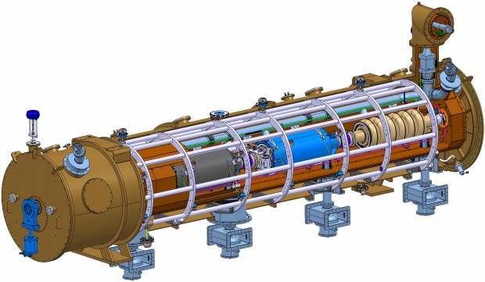
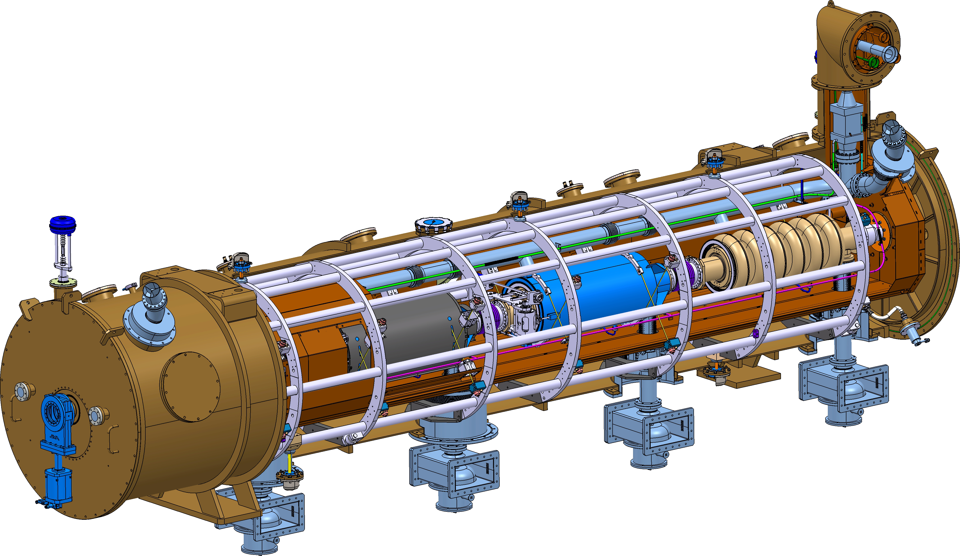



Cryomodule workflow
Saclay
Lund

Slide 8
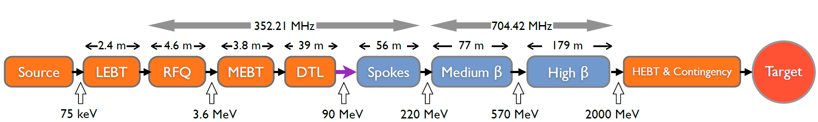
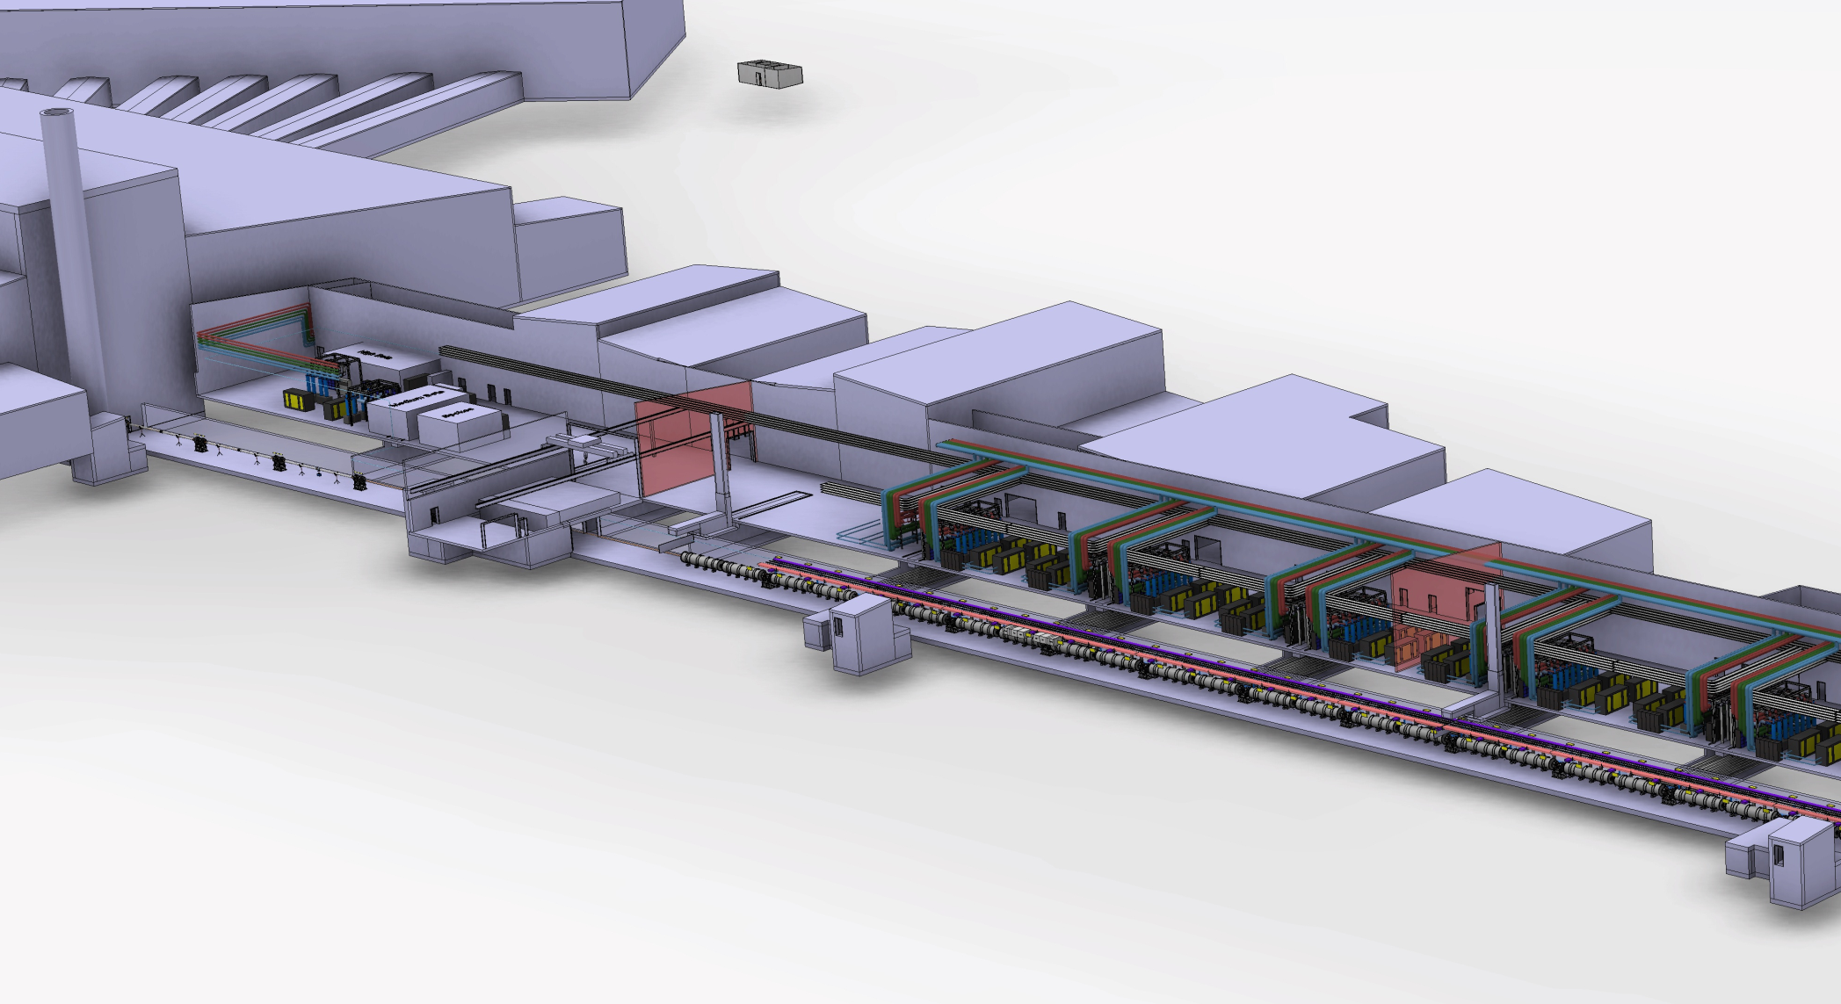

Cryomodule workflow
Klystron gallery
 | MEDIUM-β | HIGH-β
β | 0.67 | 0.86
# CM | 9 | 21
Cav. /CM | 4 | 4
# Cav. | 36 | 84
CM L [m] | 6.584 | 6.584
Sector L [m] | 77 | 179
Proton Beam
Elliptical cavities Cryomodules
Medium-β and high-β
P.Bosland, C.Darve

Slide 9
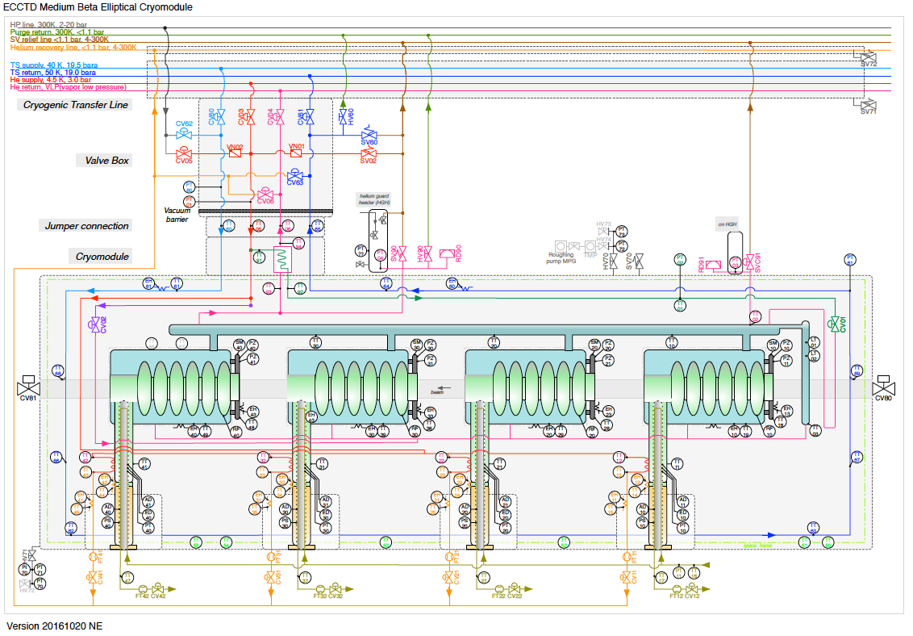
Elliptical Cryomodule P&ID

Slide 10
Interfaces

Slide 11
Operation

Slide 12
Procedure
 | Cavity Test in Test Stand | Estimated Average Time per module/hours | Implementaion Hardwre/software
Incoming Inspection | Safety Check | 4 | Manual
 | Risk Check
 | Check shock loggers
 | Visual inspection of flanges, connectors, waveguides
Component Check | Cavity piezo and temperature sensor check | 1 | VNA &Motor controller/Labview, or LLRF/EPICS
 | cavity motor tuner check | 1 | VNA&Piezo controller/Labview, or LLRF/EPICS
 | RF cable connection check | 1 | VNA/Labview
System Check | Interlock/Sensors check | 1 | Interlock/EPICS
 | RF source/waveguide check | 2 | Manual
 | LLRF check | 1 | LLRF/EPICS
Warm RF Measurement /Calibration | Cavity spectrum measurement | 2 | VNA/Labview
 | RF cable calibration | 1 | VNA/Labview
 | Cavity Gradient calibration | 1 | VNA/Labview
Warm RF Conditioning | Input RF coupler and Cavity Conditioning in room temperature | 36 | SG(Signal Generator)/Labview, or LLRF/EPICS
Cooldown to 2K | Temperature/helium level monitoring | 24 | EPICS
 | Vacuum monitoring |  | EPICS
 | Cool down to 2K |  | EPICS
RF Measurement /Calibration in 2K | Cavity spectrum measurement | 1 | VNA/Labview
 | RF Cables Calibration | 1 | VNA/Labview
 | Waveguide/directional coupler calibration | 1 | VNA/Labview
Cavity on Resonance | Coarse tuning the cavity | 2 | VNA &Motor controller/Labview, or LLRF/EPICS
 | Fine tuning Cavities on Resonance | 1 | VNA&Piezo controller/Labview, or LLRF/EPICS
Cold RF Conditioning | Input RF coupler and Cavity Conditioning in 2K | 8 | SG/Labview, or LLRF/EPICS
Heat Load Measurement | Measuring heat load at different cavity gradient | 36 | SG/Labview, or LLRF/EPICS
 | Static heat load
 |  |  | SG/Labview, or LLRF/EPICS
Performance Validate | Cavity Gradient Ramp up | 1 | SG/Labview, or LLRF/EPICS
 | Cavity Quench Threshold Identification, Emax establish | 3 | Interlock/Labview or EPICS
 | Cross talk between Cavities | 2 | SG/Labview, or LLRF/EPICS
"Long" run test at Emax | Adequeate time run test at maximum operation gradient | 5 | SG/Labview, or LLRF/EPICS
Determine FE onset | Increase cavity gradient and record readiation readings at different location of cryomodule | 1 | SG/Labview, or LLRF/EPICS
  Reception & Preparation
  Coupler conditioning
  Cool down
  RF tests up to full power
  Heat load tests
  Warm up & Prepping for installation
Detailed testing procedures to be written by IK partners from IFJ PAN, WP10, WP08 and linac group SRF specialists.
R.Zeng, F.Schlander, E.Asensi

Slide 13
Schedule
 | 2017 |  |  |  |  |  |  |  |  |  |  |  | 2018
 | 1 | 2 | 3 | 4 | 5 | 6 | 7 | 8 | 9 | 10 | 11 | 12 | 1 | 2 | 3 | 4 | 5 | 6 | 7 | 8 | 9 | 10 | 11 | 12
Partial access
Full access
Utilities available
RF inst. and comm.
Cabling inst.
Controls comm.
Bunker inst.
TL and Cryo inst.
PSS inst. and comm.
MB-ECCTD CM
MB-Series CM
Installation in 2017 with first tests of medium beta cryomodules in 2018,
high beta cryomodules to be tested starting middle 2019.

Slide 14
Summary
TS2 in Lund performs the SAT of the elliptical cavity cryomodules.
High-level requirements come from WP05.
  Collaborative work is a must.

