Slide 1
How to build an Accelerator envelope
Kieran Deasy
Section Manager
G01
www.europeanspallationsource.se
2016-11-23

Slide 2
Agenda
Introduction
Building a tunnel
Looking forward
Lessons learned/Recommendations
Feel free to ask questions during the presentation

Slide 3
Kieran Deasy
Section Manager
Concrete Works
G01 Accelerator Tunnel
Target Building
Notes:
Kieran Deasy 45yrs old, orginally from Ireland but now live in Helsingborg with my wife Åse and 2 daughters Erin 8yrs and Mika 4yrs. It is my family thats important to me and gives me the drive in my daily work to think safe and also for the safety of my colleagues and their familys also. We all shall come home safe everyday. That should be the mindset of everybody that works on ESS.

Slide 4
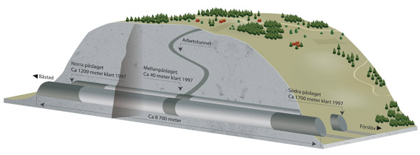
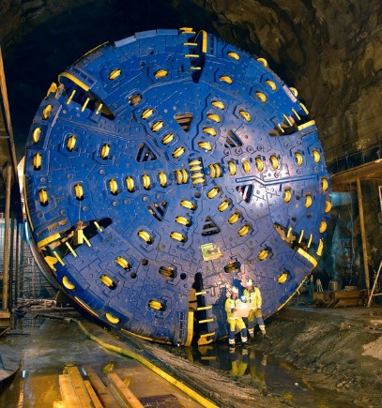
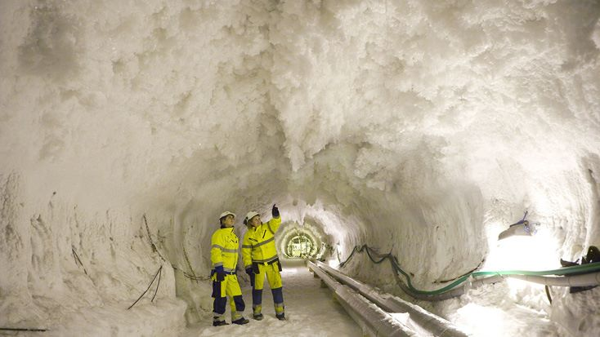
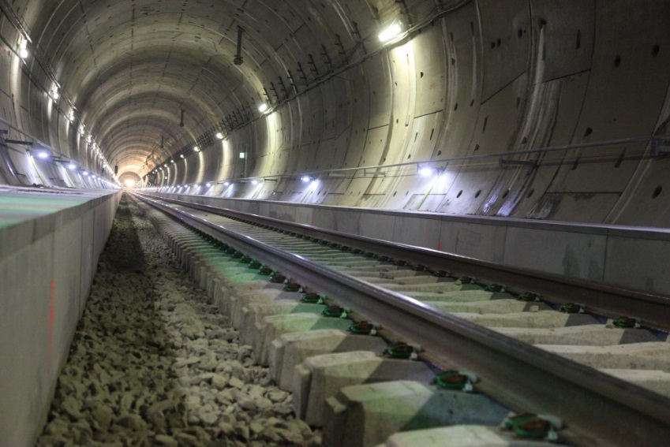
Previous tunnel experience -Hallandsås project
Notes:
Over 10 year on Hallandsås , section manager to the cross tunnel both rock excvation and concrete.
Long project with a lot of challanges, especially due to the water conditions.
When asked to come to ESS, my first question was is there water there, I was tried of water issues.

Slide 5
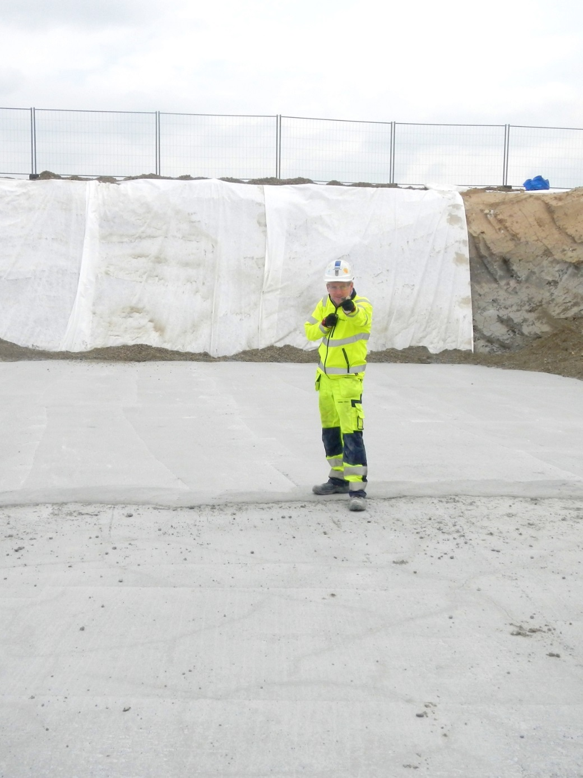
From Ion Source to Target -Where did we start ?

Slide 6
Notes:
To begin with we neeeded Guiding Principles set together by ESS and Skanska.
Role model for Collaborative Working
Driving force in fullfilling the ESS mission – so if we seem a bit pushy at times and require fast decisions or design…it not that we are being difficult….It our mission
Deliver with Schedule, described quality and Breeam rating.
Open Honest and respectful. We take responsibility and help each other.

Slide 7
Planning & Buildability
Scope of works
Time Planning
Buildability/feasibility
Organization
define clear roles
what do we do ourselves and what is sub-contracted?
Routines, follow up on works, performance/production rates.
CONSTANT CIRCLE OF IMPROVEMENTS & RE-PLANNING.
Notes:
Started on ESS full time in June 2014.
First try to determine what we had to build and define the scope of works.
Once had defined scope, how long time did I have to build…how fast yea wanted it :
How many people was need to build it in that time
How large organisation was need to control the construction.
Subcontractor or own people, taking into consideration Union requirement.

Slide 8
Central support
Steering Group
Project Management
Finance
HR
Detailed Design Team
Admin
Project Support
Quality
Health & Safety
Risk
Sustainability
Communications
Construction
Section Managers
MEP
Pre-Construction
Procurement
Planning
Change Mgmt
Estimation/Target Cost
Installation Coordinators
Surveyor Team
Site Facilities
Notes:
Our core business is to build an organisation in a short time to perform on a high level.
Different people in different roles, and support groups to help and keep the production teams in lines with laws and requirement.

Slide 9
Planning an organisation
November 2014
November 2015
Section Manager Concrete Works
Kieran Deasy
Section Manager Concrete Works
Kieran Deasy
Production Manager G01 Niclas Silfverberg
Production Engineer Joanna Soltysiak
Production Engineer Michael Svensson
Production Engineer Joanna Soltysiak
Production Engineer Michael Svensson
Installations Coordinator Jan Lundgren
Installations Coordinator Jan Lundgren
Supervisor G01 Tunnel Niclas Silfverberg Johan Berglund
Supervisor Aux Building + G02 tbd
Supervisor CTL/HEBT
Johan Berglund
Supervisor Stubbs/Retaining Wall
Rocco de Beer
Supervisor FEB
Lennart Andersson
Supervisor Linac/Emergency Exists
Jonas Ljungberg
Supervisor Dog Leg
Josef Bäck
2 Supervisors
5 Supervisors
Notes:
Section Manager role, overall responsible for the production works, priorities: H&S safety first, Bas-U Map, quality, production
Start off with a small group in Dec 2014, but after short time we had built up our organistation to have a responsibe supervior for the different areas so that we could cope with the demands and reauirements of the works, H&S , Quality, Logistics, procurement, follow up, etc

Slide 10
Time plan G01 works
2014 2015 2016
Oct Nov Dec Jan Feb Mar Apr May Jun Jul Aug Sep Oct Nov Dec Jan Feb Mar Apr
G01 BLINDING
G01 BASE SLABS
G01 WALLS
G01 VAULTS
CTL
HEBT
FEB
DOG LEG
RETAINING WALL
EMERGENCY EXITS
STUBS
Notes:
We defined a time scheule that fitted with ESS needs.

Slide 11
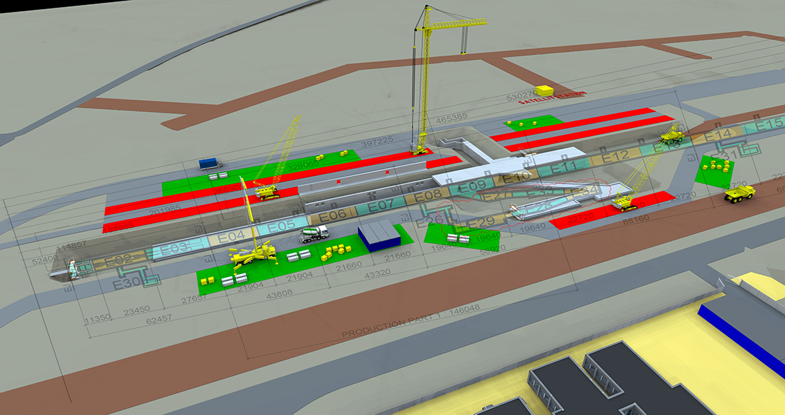
Linac sequence E10 - E04 E11 - E25
Notes:
Site Layout plan to help with the planning of the works and logistic,

Slide 12
G01 first walls Why did we start in the middle? (E10)

Slide 13
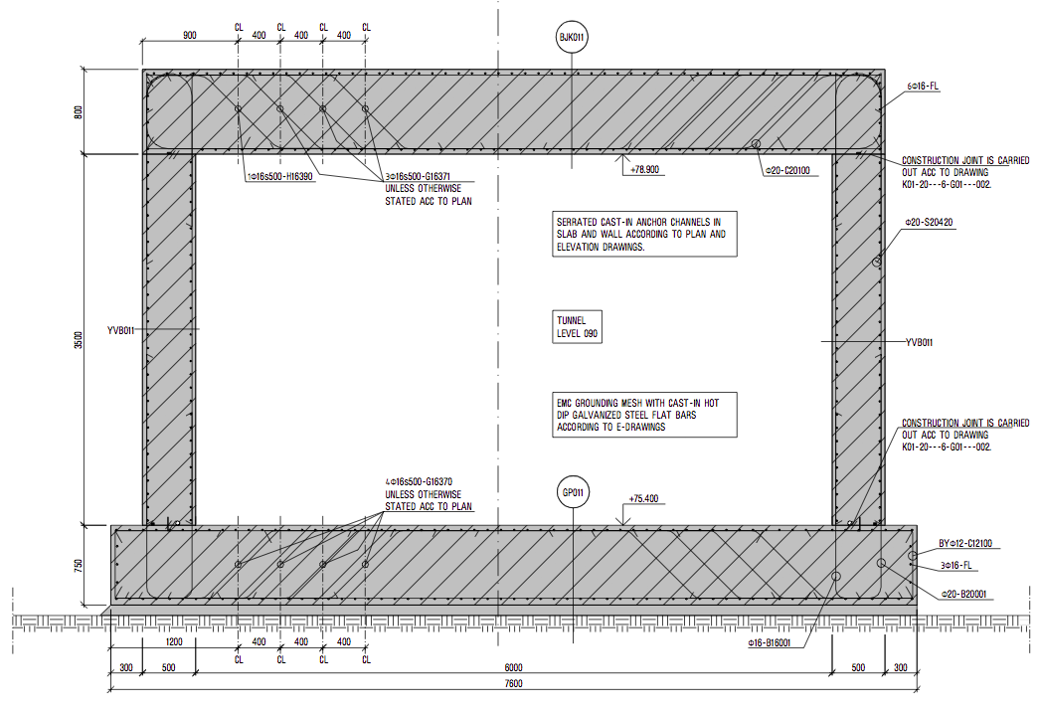
G01 drawing, cross-section
Notes:
Base slab 7600 x 750mm thick
Walls 3,5m x 500mm
Vault 7m x 800mm thick

Slide 14
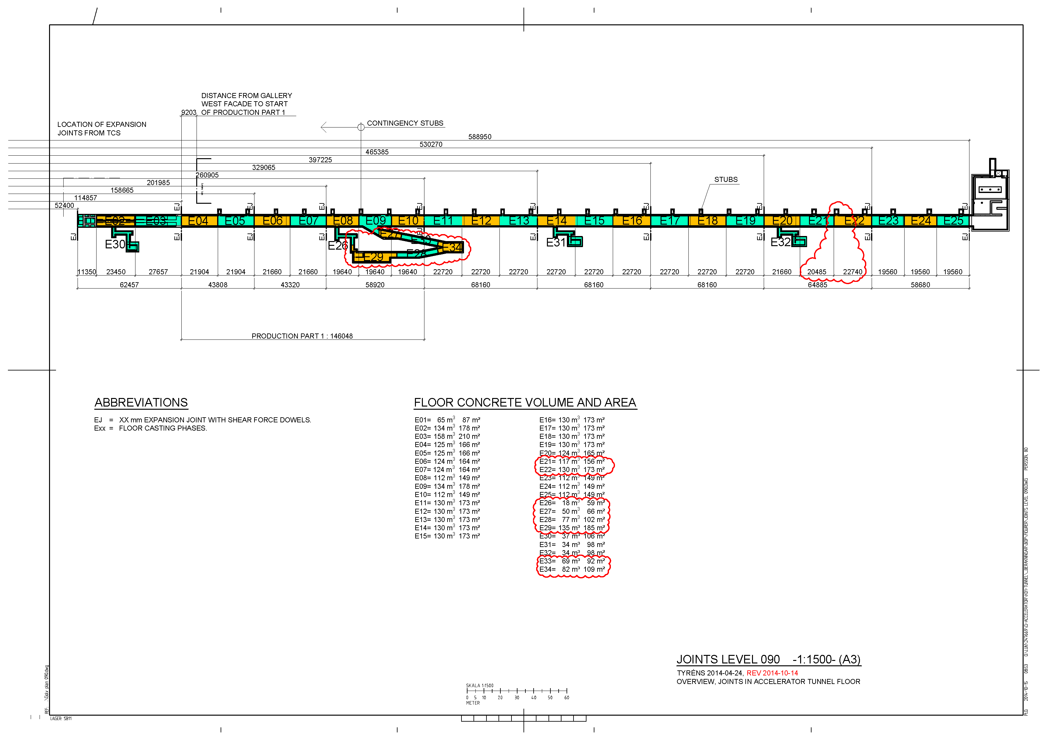
Notes:
Where do we start,
Started and E10 and worked towards E04 - this was the intial test area required for early handover to Accelerator.
Also starting at E10 opened up area for the HEBT and CTL gallery where we had defined in the planning stage that require a lot of manhours.
After we remobilised to E11 and constructed towards the FEB.
Casting sequence BS 20m long, wall 10m and vault 10m. Limited the wall and vault length due to rsik for thermal cracking in the concrete structure.
When we got into our swing of things we were cast and BS, Wall section and vault section each week.
Facts
Tunnel incl dogleg 9129 m3
Stubbs & ret wall 2110m3
FEB 1878m3
EE 900m3
HEBT 1380m3
Total approx 16000m3 , enough concrete to fill 8 olympic swimming pools
Total reinf 2000 tons
Time
Tunnel Oct 14 – march 2016
Stubbs & ret wall - july 2015-july 2016
FEB may 2015-dec 2015
EE 900m3
HEBT june 2015-march 2016

Slide 15
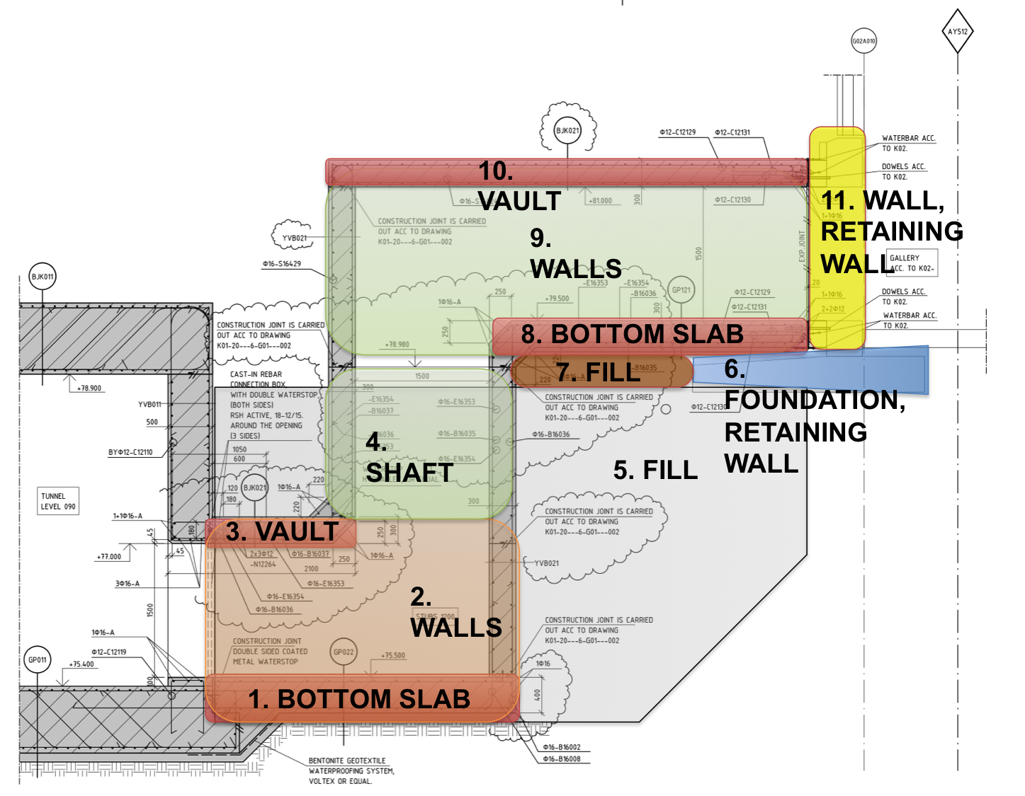
Stub sequences – A challenge
Notes:
Looked into a lot of different options in planning stages, steel pipes, prefab ( to heavy for crane safey use heavy works) , at the end came up with this casting sequence , which reauire backfill to complete top section.
35m3 divided in 9 seaprate castings x 27 = 300 different casting, all casting require same preparation documentation wise and a larger casting..VSI , Self Inspections
Required detailed planning.

Slide 16
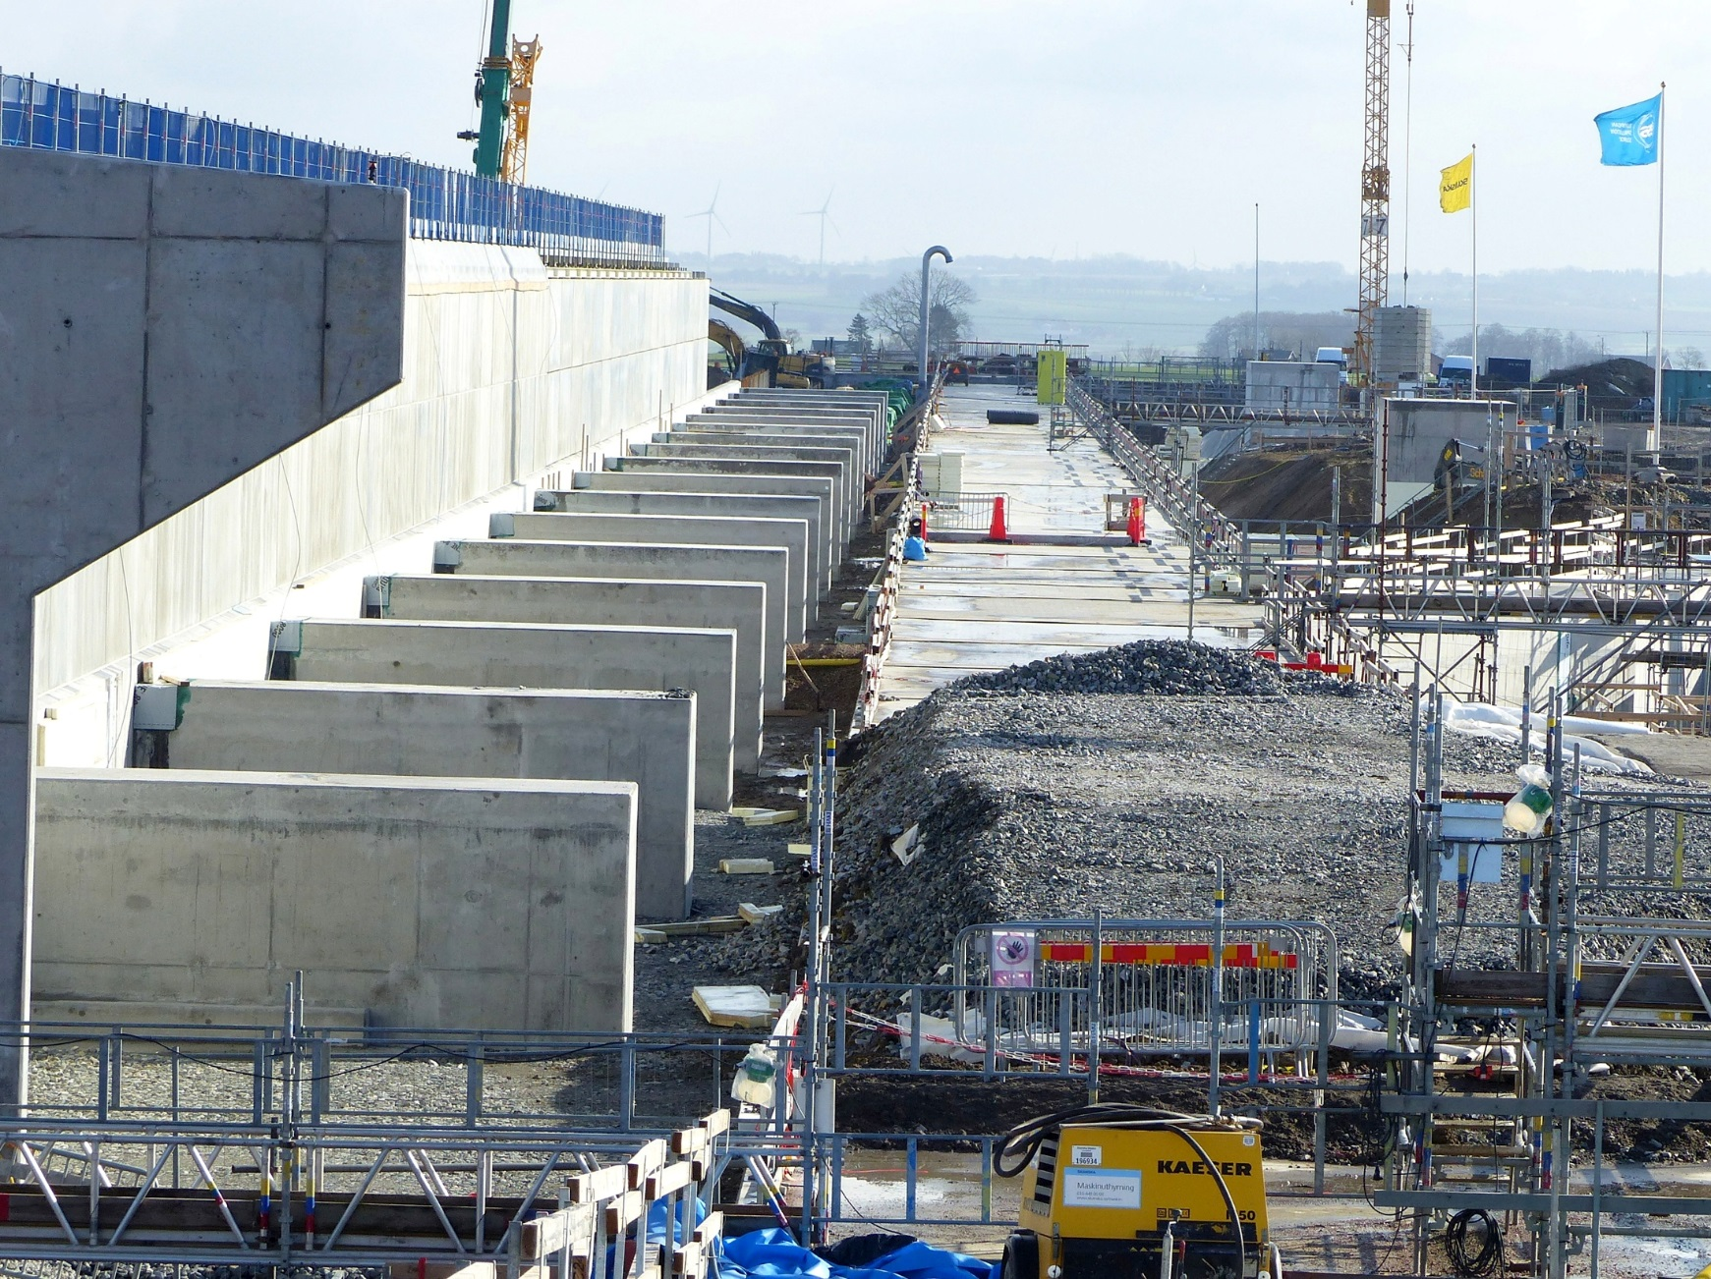
27 stubs
Notes:
Here how they looked when they were finished,

Slide 17
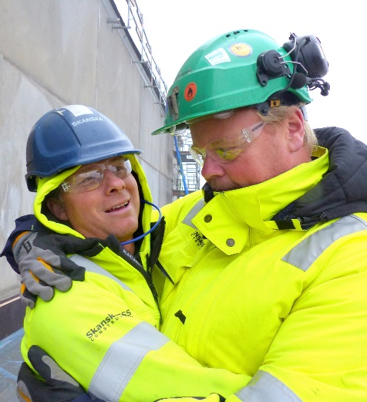
Risks & Safety
We plan together and communicate before any work is started.
- Risk inventory
Risks are assessed and addressed
Work Instructions Detailed planning before all work activities
”We work Safely – or not at all!”
Skanska Sweden’s Health and Safety Policy
Notes:
We have a slogan with Skanska from our top management, ”WORK SAFE OR NOT AT ALL.”. Its short easy to remember, but behind this goal / vision require a lot of backoffice works, risk assessment, detailed planning, so that the day the work starts the job goes safely and smoothly. But in the end if you see your planning is not suffient then you have to stop the works and rethink. Nobody should be exposed to unsafe working conditions.
Work Instruction- describe how the works shall be carried out,

Slide 18
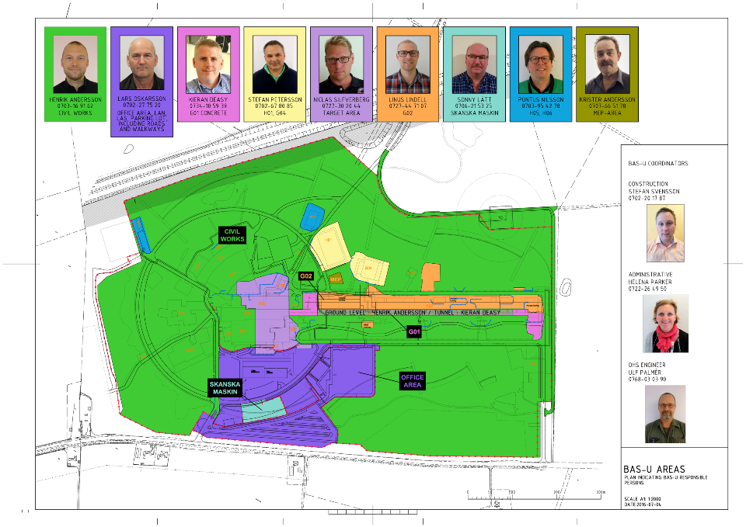
Bas-U Areas
Notes:
To ensure a safe work site the site was divided into differnet works area where each area has a BAS U ( safety coordinator ) it is a Swedish safety law requirement. The BAS U is responsible to coordinated the works in his area from a H&S point of view, to ensure works between different groups are coordinated that one group does not cause a risk to the other,

Slide 19
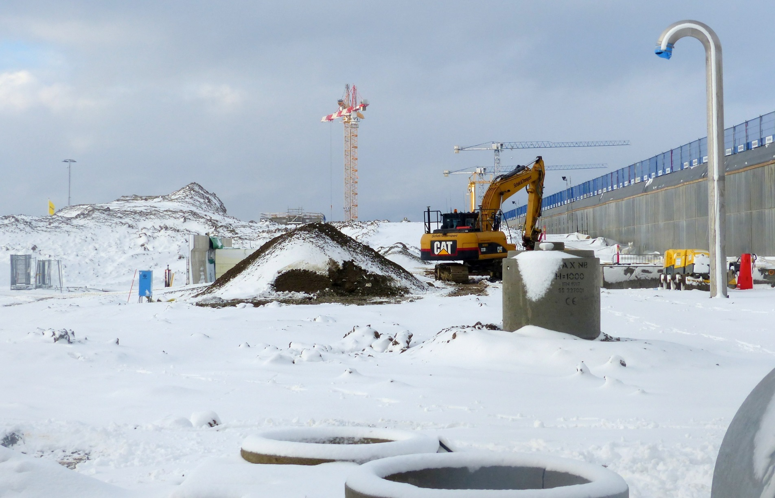
First ESS Installation Cryo exhaust pipe
Notes:
March 2016…

Slide 20
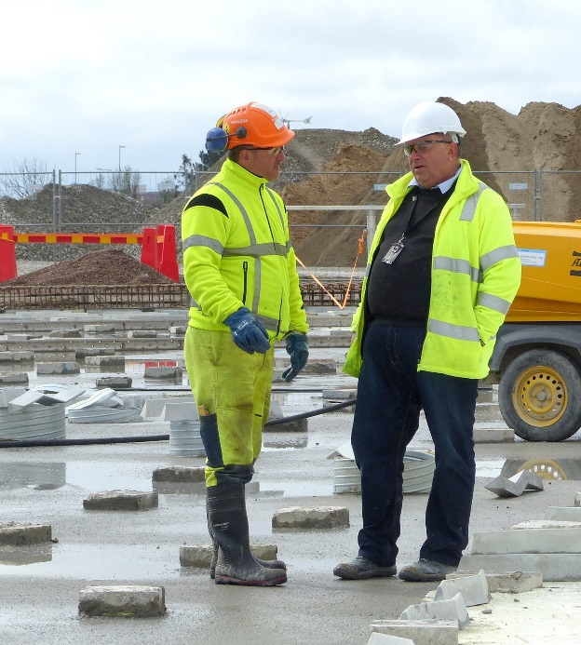
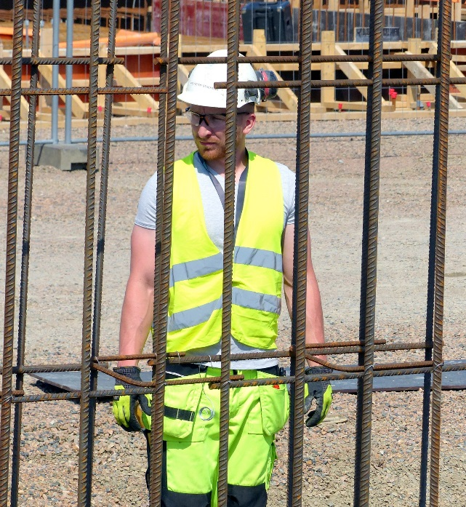
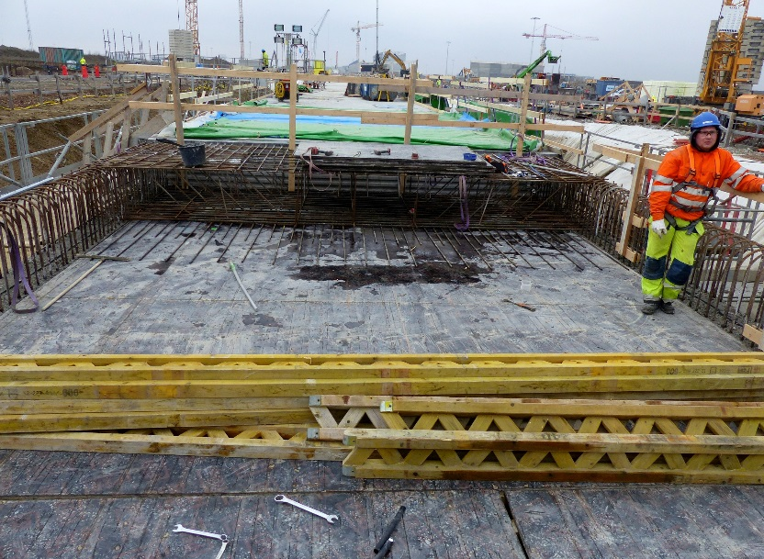
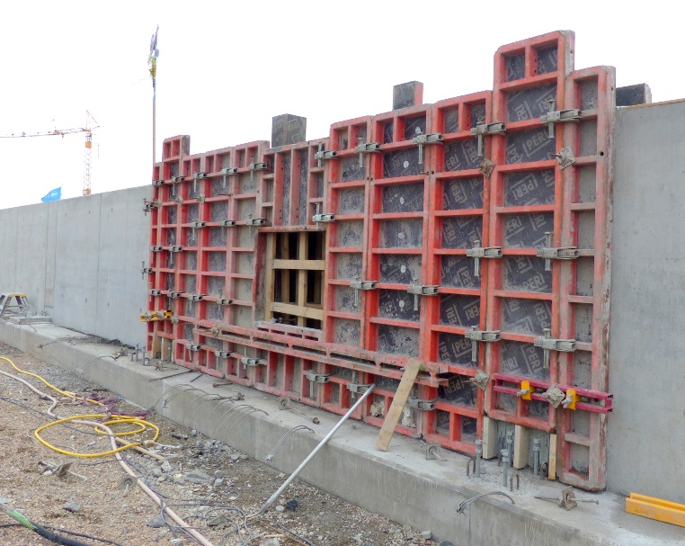
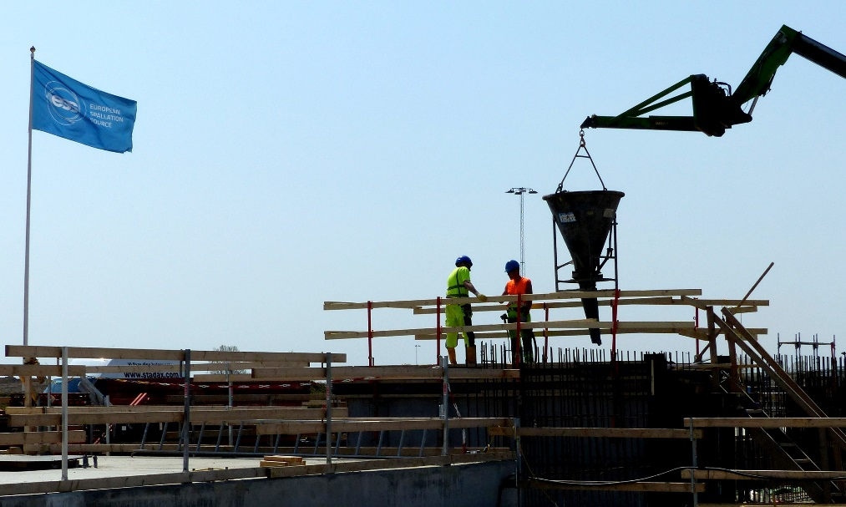
Journey of a sub-contractor
Notes:
A subcontractor requires works, not just an issue of a procucment package and let work and control them with contractural clauses, need to work close with them and see they do what they promised in the tender stage. Guide them help them and you will reap the benifits.
Difficults in the begining
Langauge
Differnt safety culture
Not used of quaility of Skanka ESS
Helped them organise, keep on top of them all the time in the being,
After 6 months – year they became a self running groups and the are a big part of our success on the the tunnel.

Slide 21
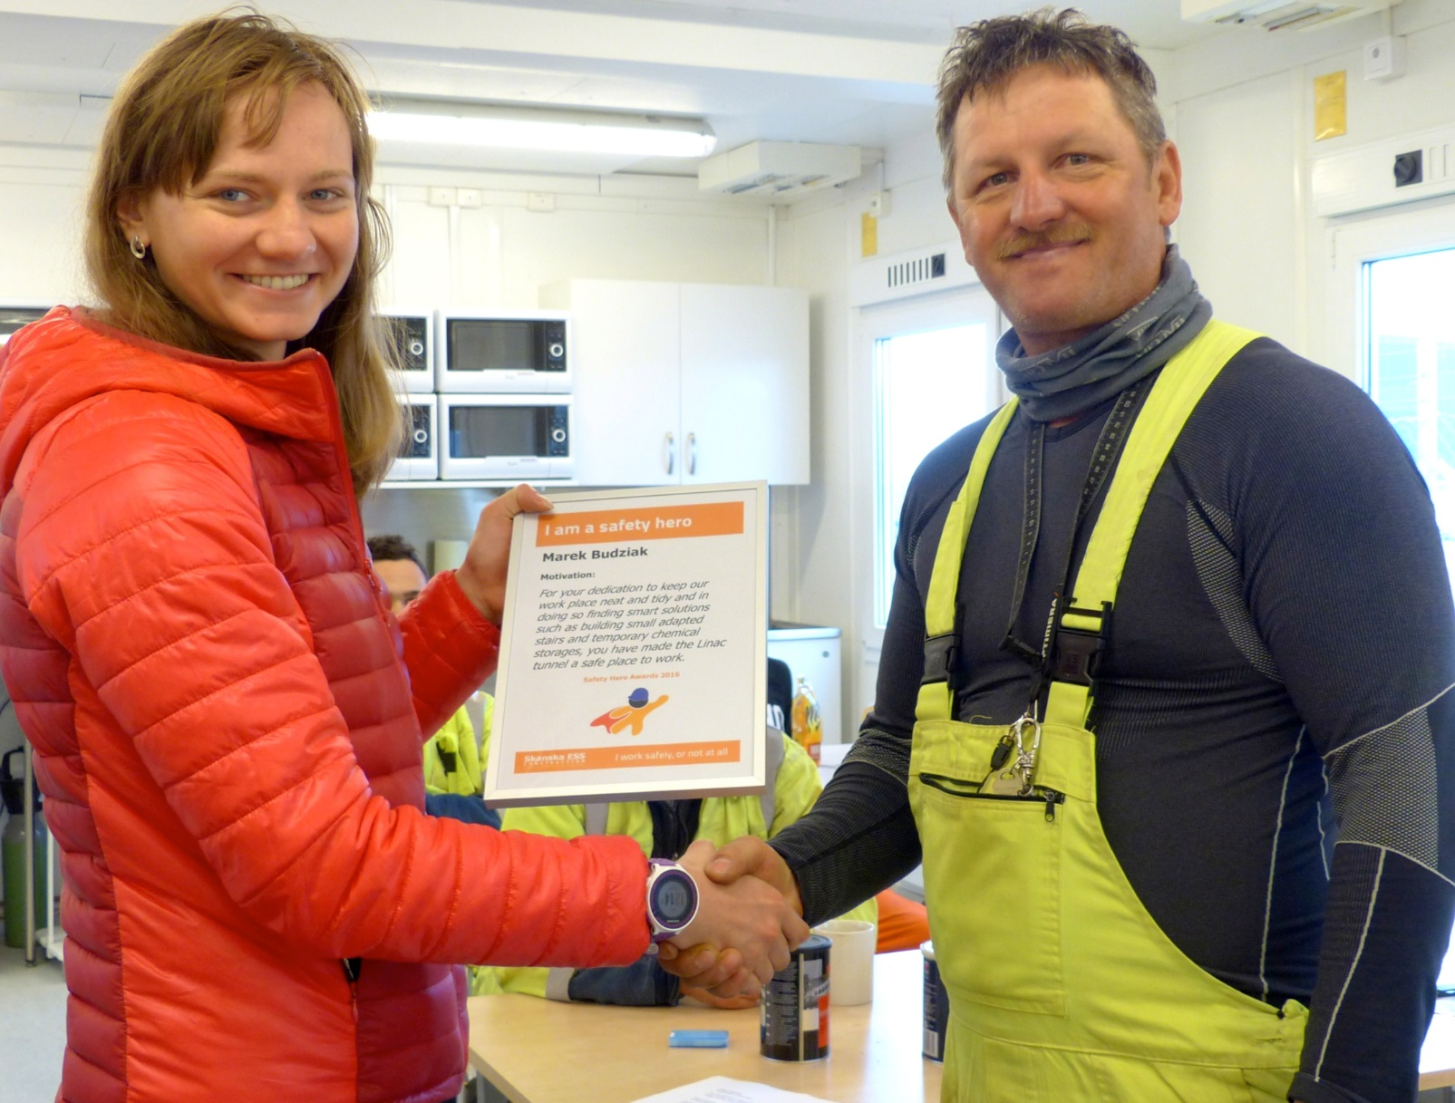
Safety Hero!
Notes:
See what working together and helping each our can achieve.

Slide 22
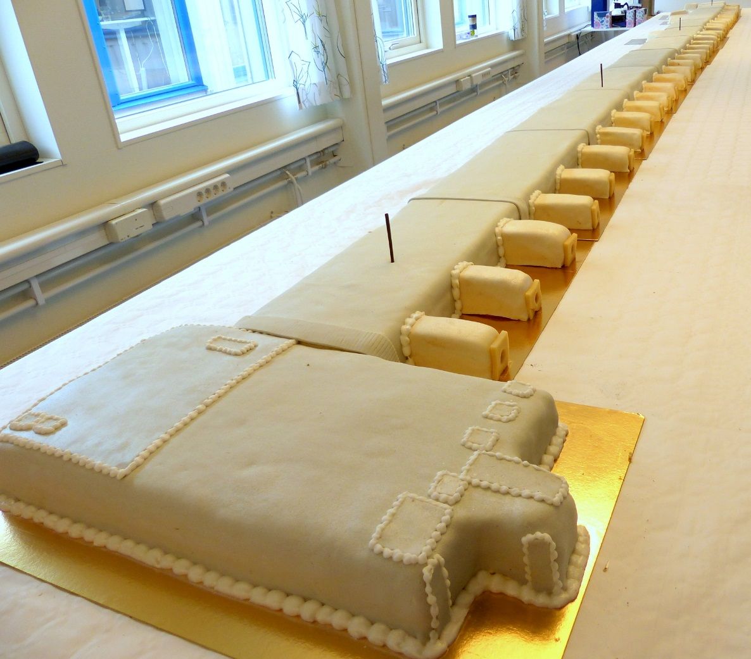
G01 Topping out ceremony 8 April 2016
G01 – a success story.
Within schedule
and within budget!

Slide 23
Looking Forward
www.europeanspallationsource.se

Slide 24
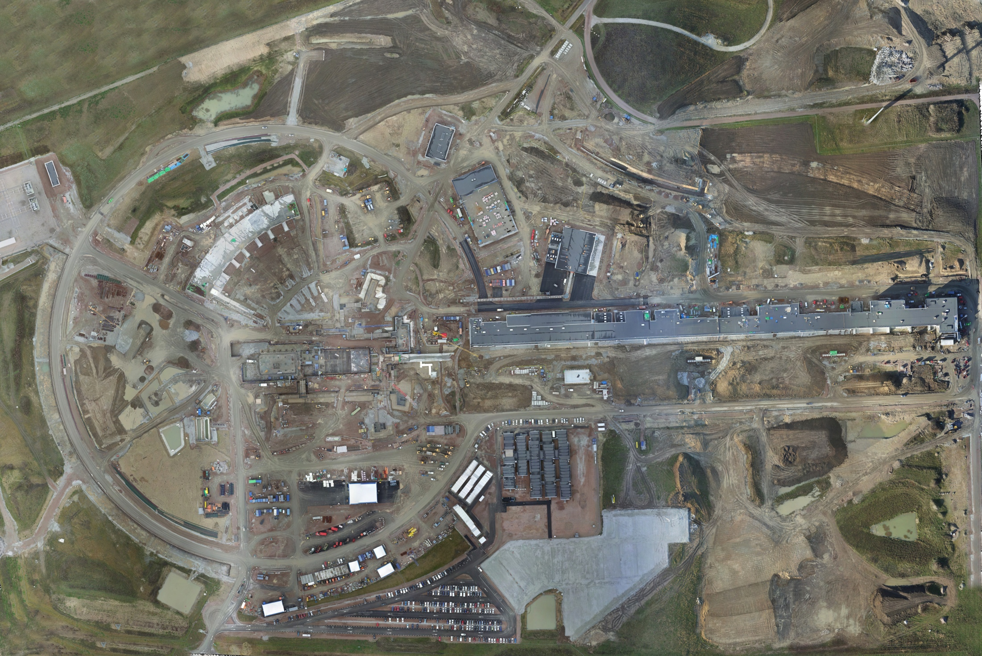
Aerial view 1 November 2016

Slide 25
Welcome on board!
Access Milestone | Date
Partial Access Gas Storage G04 | 07-Nov-16
Partial Access G04 | 04-Jan-17
Partial Access Cold Box G02 | 04-Jan-17
Milestone | Date
Sectional Handover H05 | 02-May-17
Sectional Handover H06 | 02-May-17
Sectional Handover G04 | 02-May-17
Sectional Handover G01 | 02-May-17
Sectional Handover G02 | 31-May-18
CHALLENGE: Parallel works

Slide 26
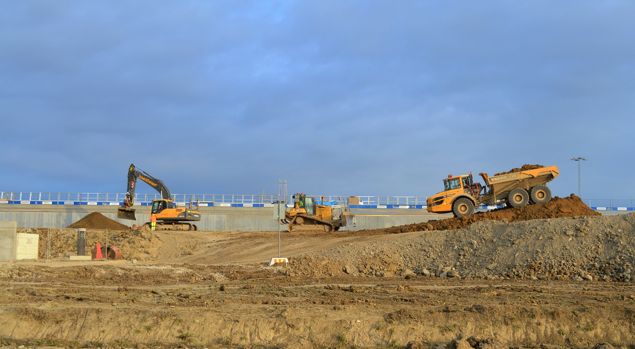
G01, Accelerator tunnel, topfill

Slide 27
Reinforced slope & backfill
Notes:
Planning to filled over tunnel by christmas
Waterproof membrane in place by summer 17

Slide 28
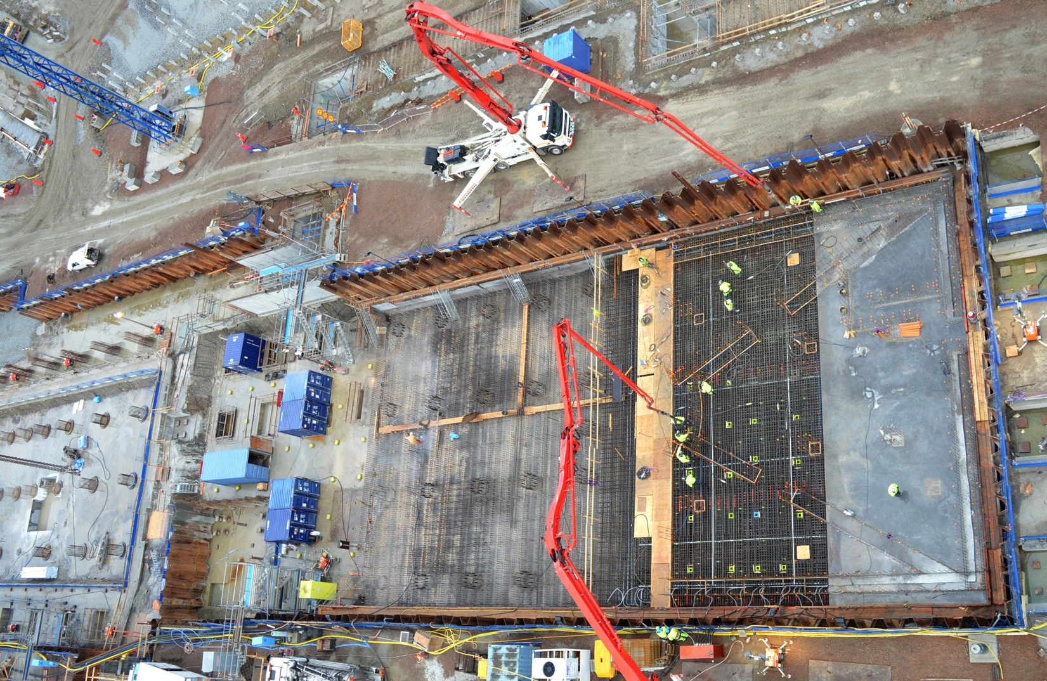
Target – Monolith
Notes:
Describe where we are with the target

Slide 29
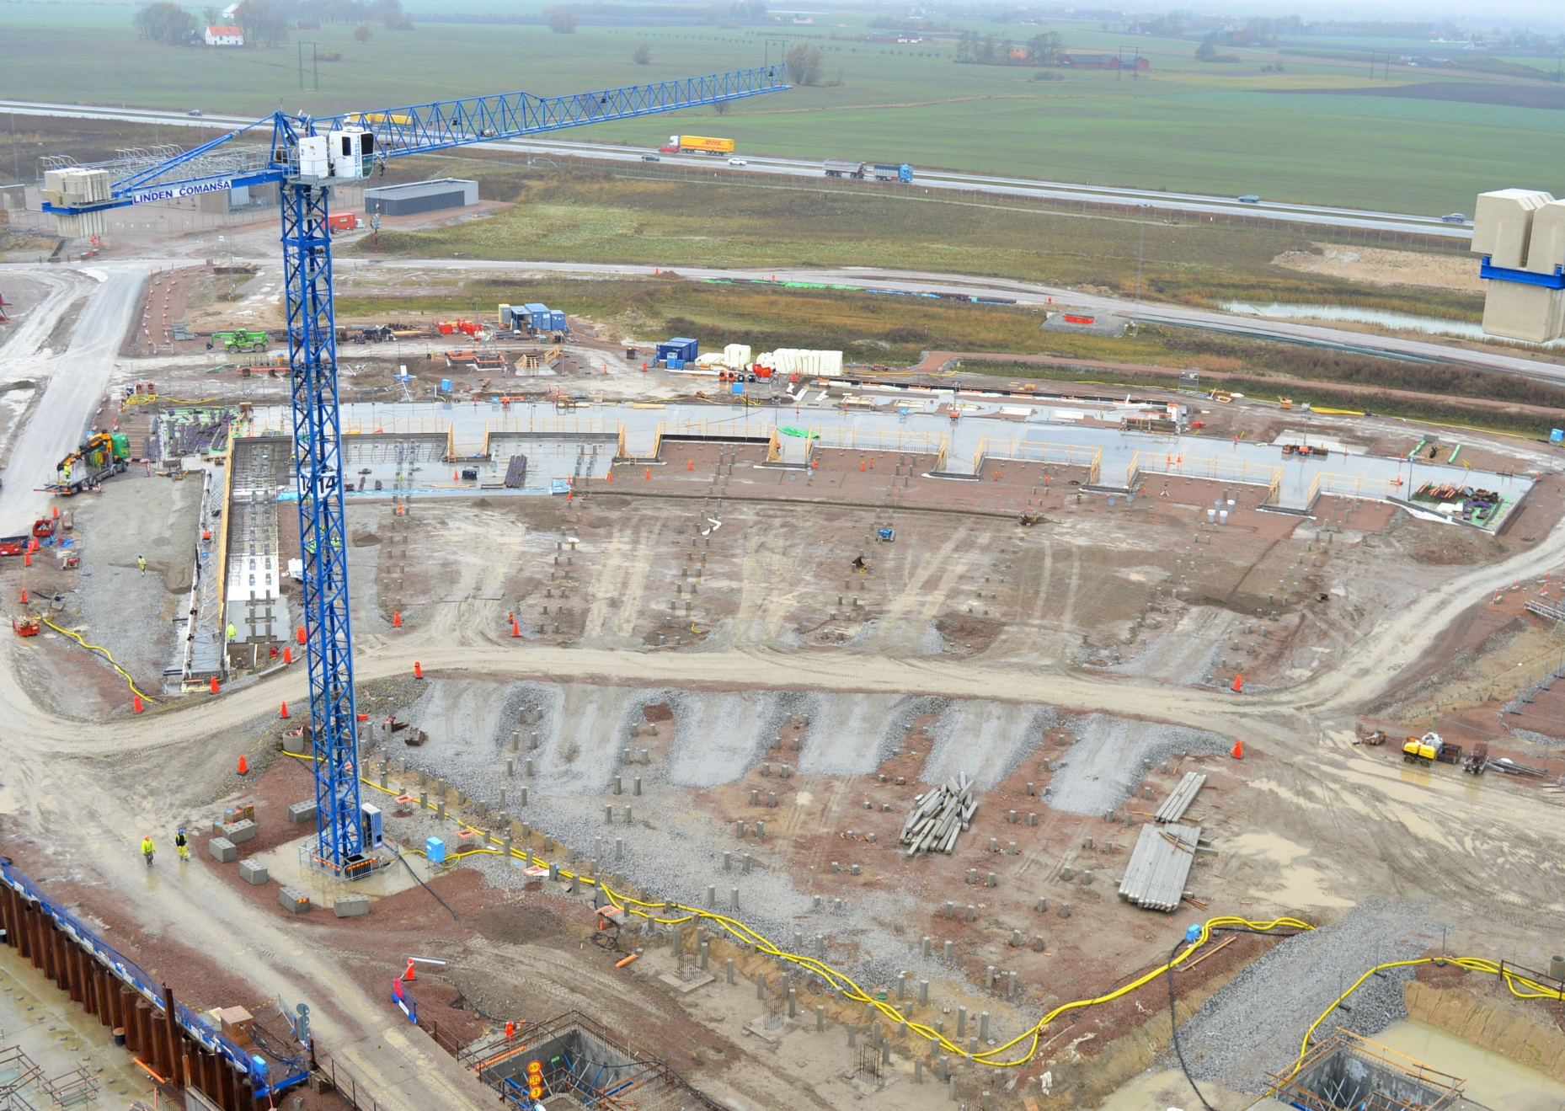
E01 Experimental Halls E02 Beam Line Gallery
Notes:
E building
Concrete complete march 2107
Superstructure April 2017

Slide 30
Lessons learned/ Recommendations
www.europeanspallationsource.se

Slide 31
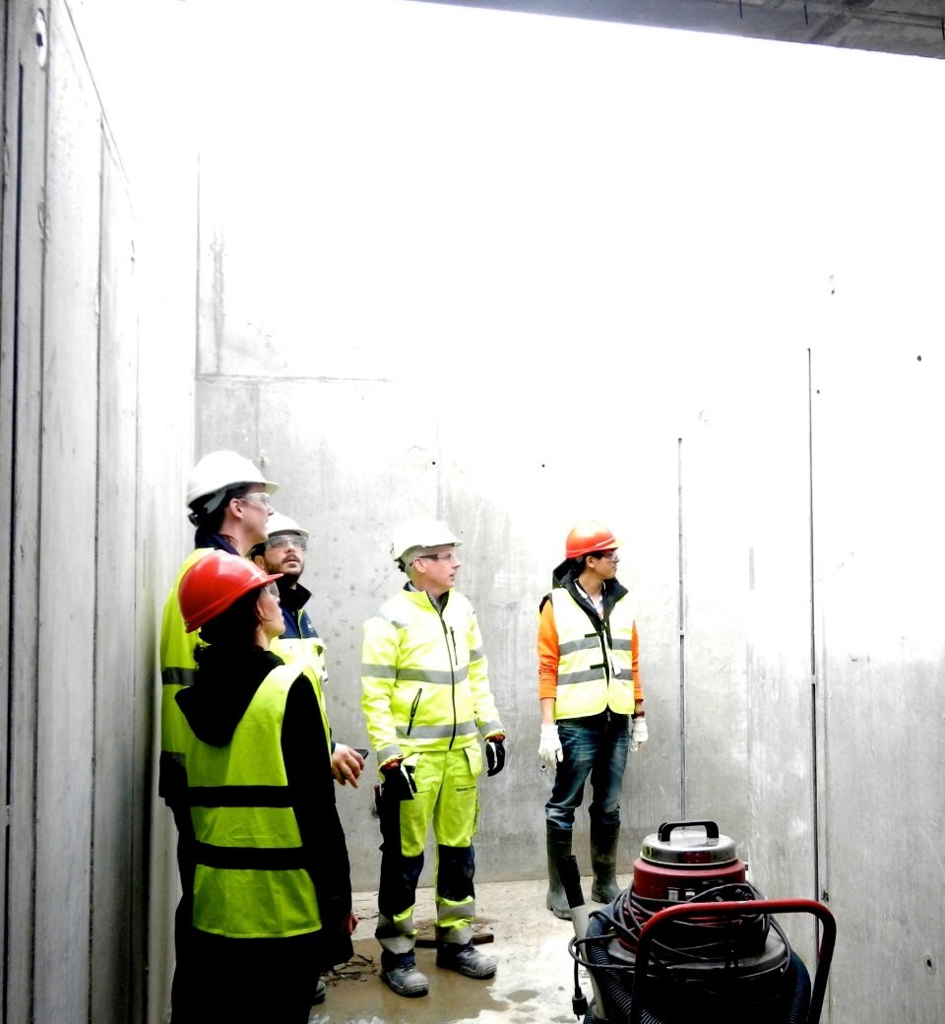
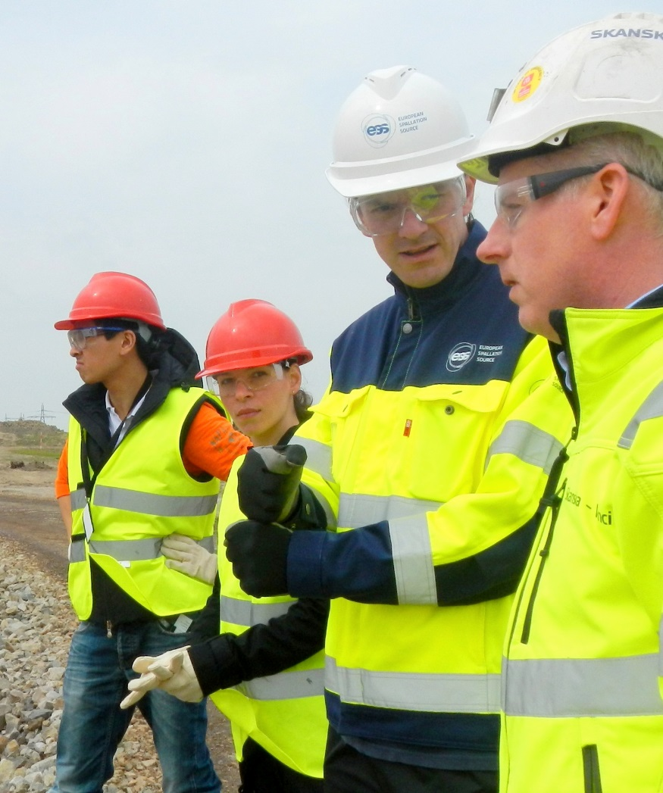
Early involvement – Sharing Knowledge
Notes:
Good to know what we are building and the customers needs.

Slide 32
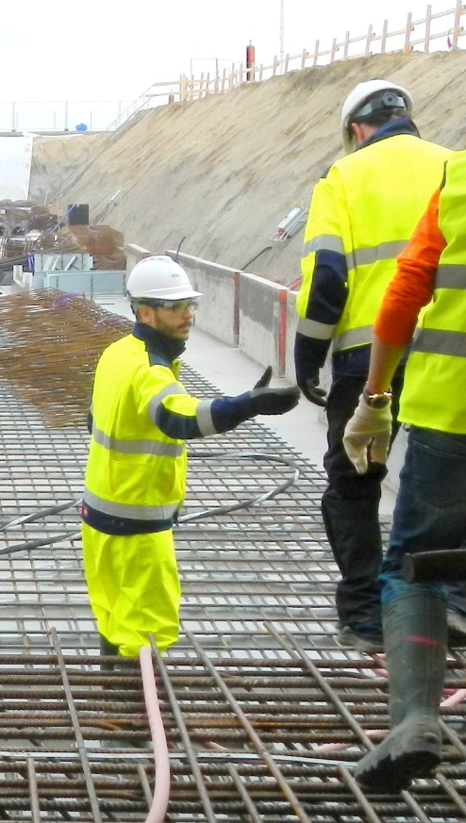
Recommendations
Plan, plan and plan
– make sure you are ready when you start works, otherwise go back and plan more!
Define clear roles
Each man to his profession
Don’t underestimate the complexity of the project and the need for routines & administration (Q etc)
Feel responsible
Routines H&S, Quality etc
Divide Bas-U areas
Early Design
Help each other. Collaboration is key.
Use our experience and expertise – a winning concept.

Slide 33
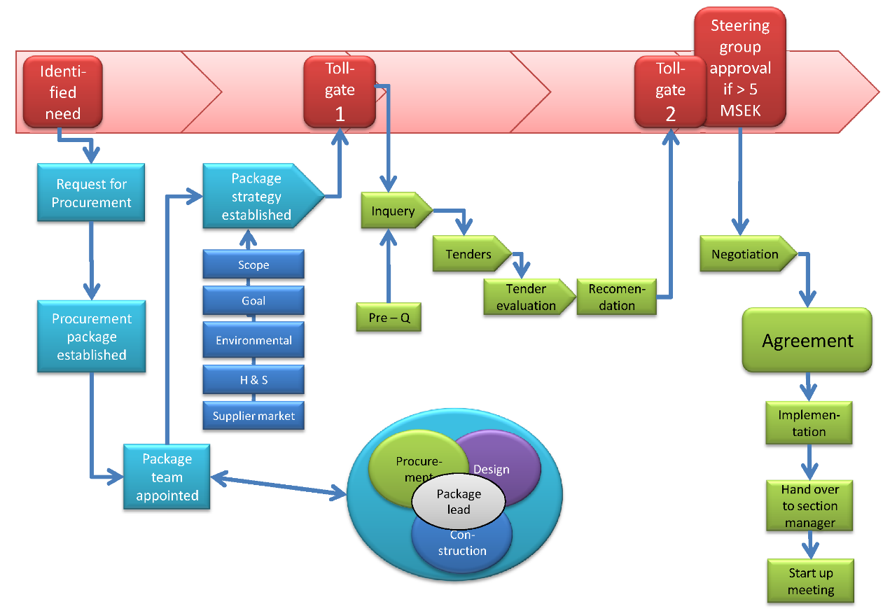
Procurement process To meet our standards in regards to Quality, H&S, values
TAKES TIMES – BE OUT IN GOOD TIME !
Notes:
This a flow chart for our procurement process, and we have many more like this, for Health and Safey and Quality, I am not intended for you to memories it, but such routines take time…..be out early.

Slide 34
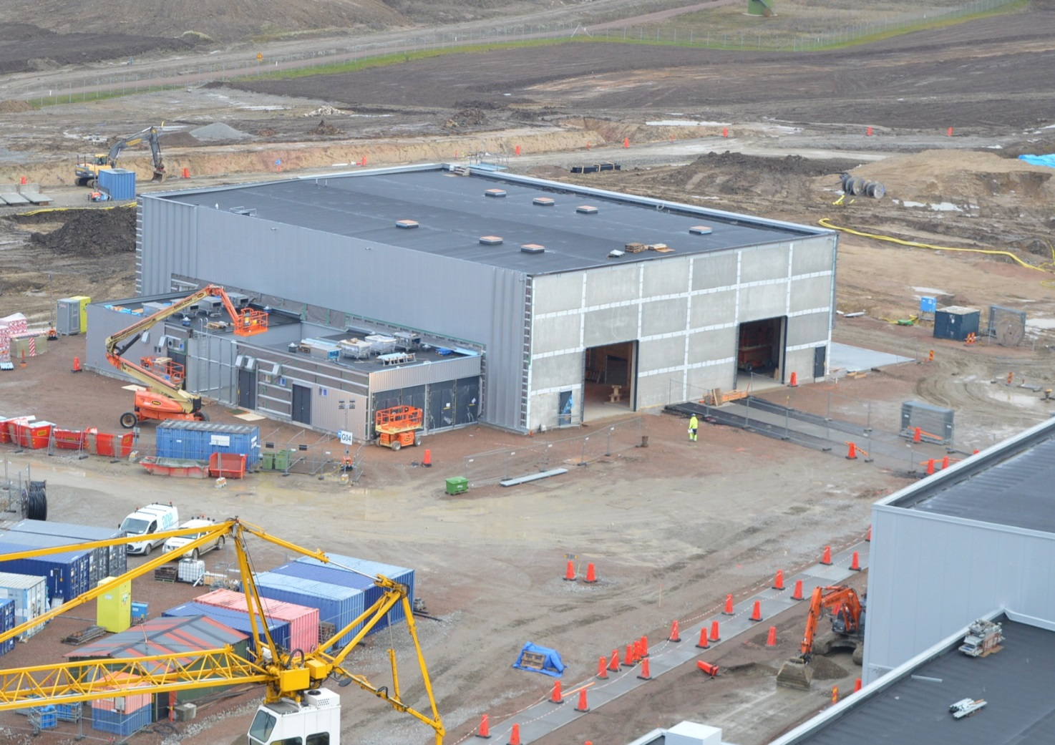
Framework agreements We have prepared the site for you!
Site-wide services established
Scaffolding
Lifts
Cranes
Concrete
Rebar
Site cabins
Containers
Equipment
Safety barriers
Etc
Groundwork already done!
Notes:
Take help form the routines at that are in place at the present, through the Stakeholder Guidlines and minor work agreement.

Slide 35
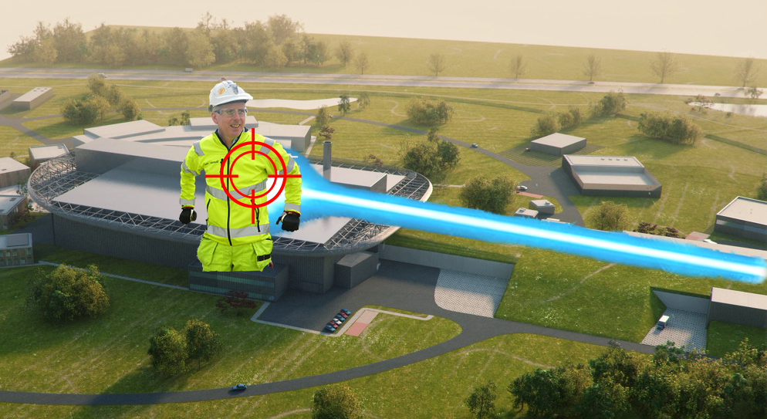
Together we will achieve: Beam on target!
Notes:
In the end, I hope you will be shooting at the target and not looking for someone else to shoot.

