Slide 1
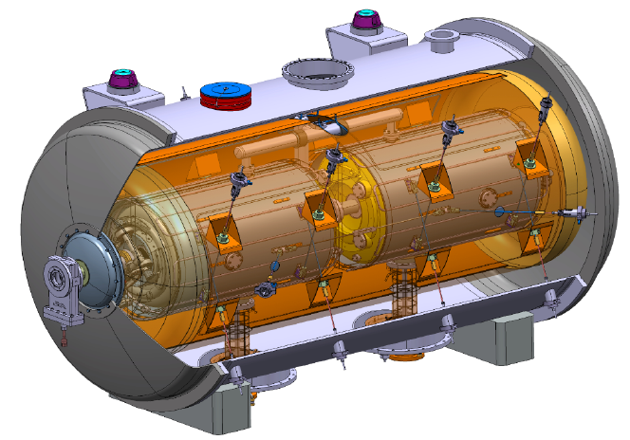
SAFETY DURING ACCELERATOR INSTALLATION ACTIVITIES ON THE ESS SITE
AD Retreat Nov. 24th, 2016

Slide 2
Recurrent Questions
What are the Personal Protective Equipment required to be on site?
What documentation do I need to fill-in before starting installation activities?
Which kind of training do I need to follow before going on the site?
Who should I contact in case of an incident?
Who is responsible for the safety aspects during installation activities?
Etc…
WP representative
Main objective of this presentation: provide you with a better understanding of the pre-requisites and instructions before and during installation activities

Slide 3
Installation Path
Preparation of the
safety documentation

Slide 4
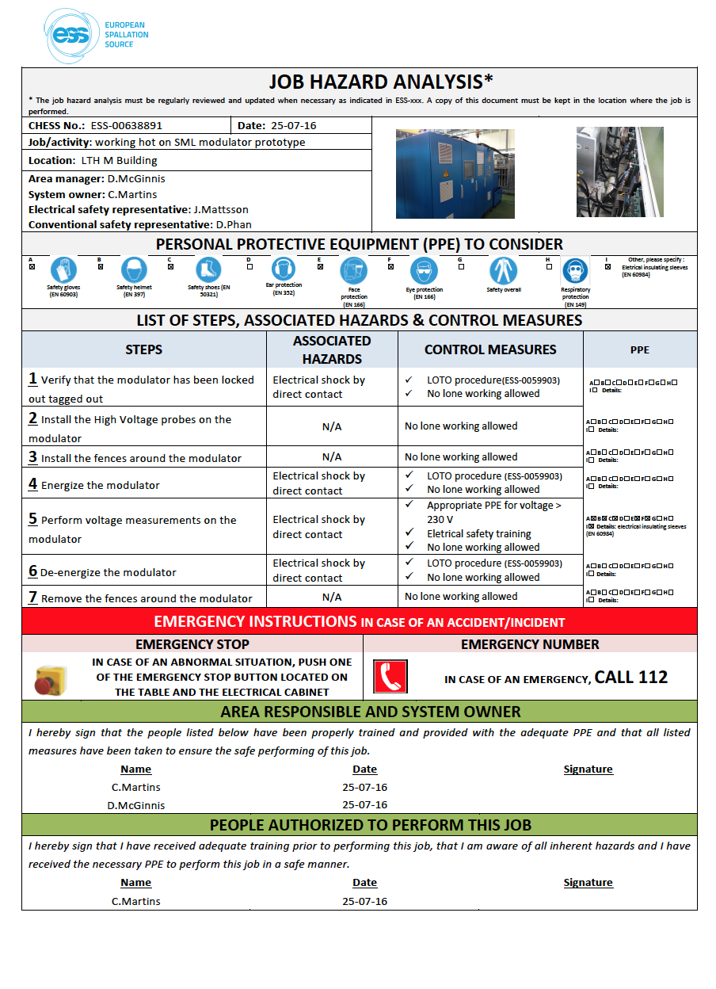
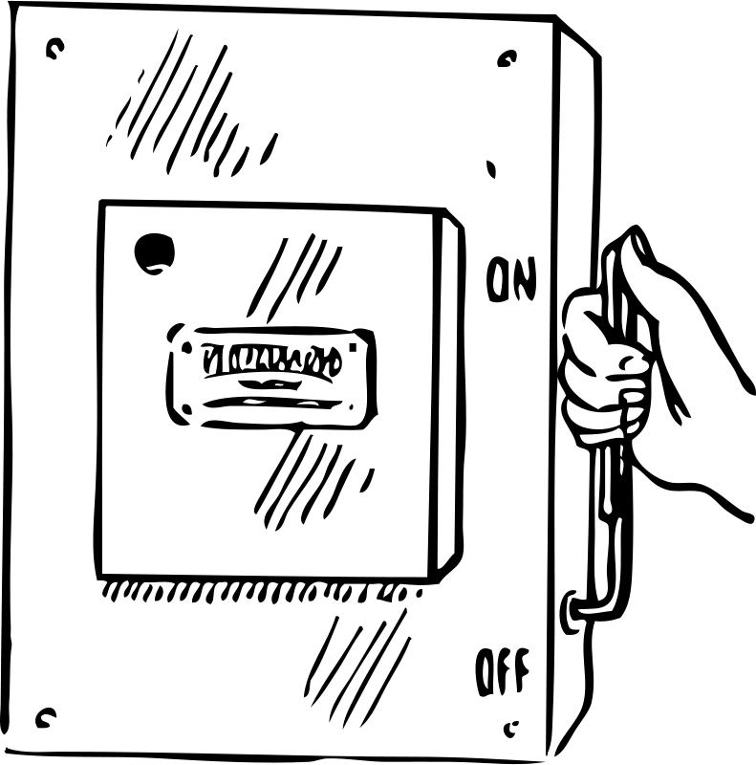
Job Hazard Analysis (JHA)
Description of the tasks to be performed
ESS system leader
Contractor
ESS-0064035

Slide 5
Job Hazard Analysis (JHA)
List of associated hazards
ESS system leader
Contractor
ESS-0064035

Slide 6
Job Hazard Analysis (JHA)
List of control measures and PPE
ESS system leader
Contractor
Safety procedures
Safety at ESS
ESS-0064035

Slide 7
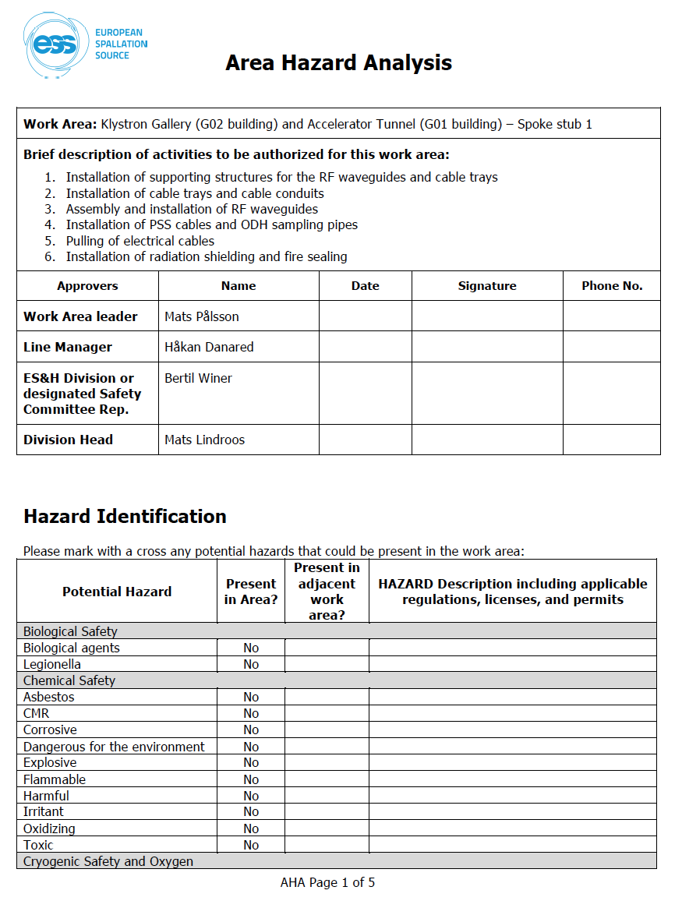
Area Hazard Analysis (AHA)
List of hazards and control measures
ESS
Area supervisor
21%
Safety procedures
RADIATION
O2 monitor
DIS-1
Controlled area
Radiation at ESS
ESS-0064035

Slide 8
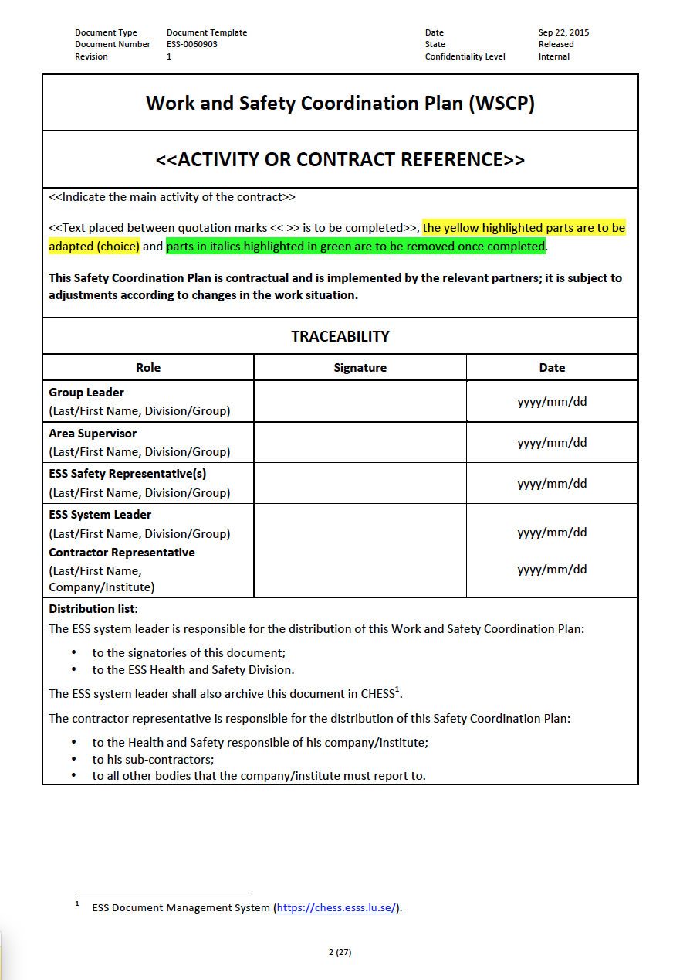
Work and Safety Coordination Plan (WSCP)
ESS system leader
Contractor
ESS area supervisor
Part 1: Work Coordination Plan
GENERAL INFORMATION
Working hours
Duration of the activity
Contact persons
Regulatory framework & applicable documentation
PREPATORY MEASURES
Pre-work visits
Organizational measures (e.g. storage, waste management, equipment/machines, etc.)
Participation of ESS to the work (e.g. electricity, water, staff, maintenance, safety measures, etc.)
Provisions for personnel rooms and hygiene (e.g. toilets, changing rooms, etc.)
Description of the work to be done
ESS-0085649

Slide 9
Work and Safety Coordination Plan (WSCP)
ESS system leader
Contractor
ESS area supervisor
Part 2: Safety Coordination Plan
HAZARD IDENTIFICATION AND CONTROL MEASURES
Area Hazard Analysis (AHA)
Job Hazard Analysis (JHA)
Co-activities
Control documents (e.g. fire permit, work authorization, lock-out/tag-out permit, etc.)
INFORMATION AND TRAINING
List of mandatory safety training and awareness
Minimum number of first aiders required
Site map
Reporting in case of an incident
ESS-0085649

Slide 10
Installation Path
Contractor
ESS
OK
OK
Area supervisor
Group leader
Day-14
OK
OK
System leader
Safety team
Preparation of the
safety documentation
Submission of the
safety documentation
Approval of the
safety documentation

Slide 11
Approval of the safety documentation
Accelerator Division
ES&H Division
Skanska
Area supervisor
OK
Group leader
OK
Safety
representative
OK
Safety
representative
OK
Safety
representative
OK
System leader
OK

Slide 12
Installation Path
Contractor
ESS
OK
OK
Area supervisor
Group leader
Day-14
OK
OK
Albert Einstein
System leader
Safety team
Preparation of the
safety documentation
Submission of the
safety documentation
Approval of the
safety documentation
Pre-registration for the ID06

Slide 13
Pre-registration
https://c101portal.esss.lu.se/forregistrering-ny-personal
https://c101portal.esss.lu.se/pre-registration-new-personnel

Slide 14
Installation Path
Contractor
ESS
OK
OK
Area supervisor
Group leader
Day-14
OK
OK
Albert Einstein
System leader
Safety team
Preparation of the
safety documentation
Submission of the
safety documentation
Approval of the
safety documentation
Pre-registration for the ID06
Self-learning Regulations

Slide 15
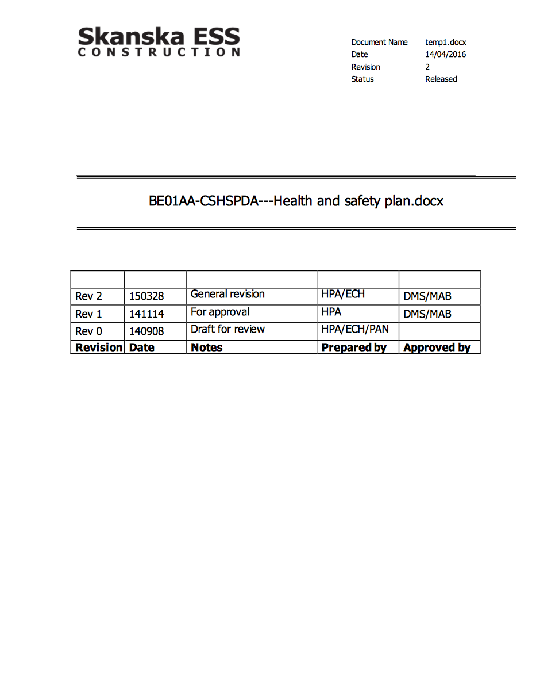
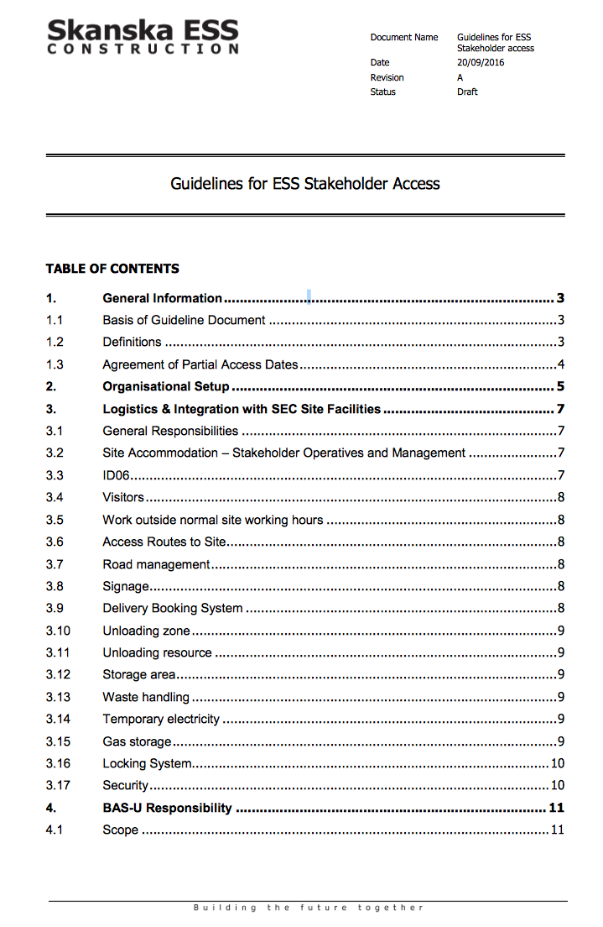
ESS-SKANSKA site rules
ESS-0063375
ESS-0020522
ESS-0062090

Slide 16
Installation Path
Contractor
ESS
OK
OK
Area supervisor
Group leader
Day-14
OK
OK
Albert Einstein
System leader
Safety team
Preparation of the
safety documentation
Submission of the
safety documentation
Approval of the
safety documentation
Pre-registration for the ID06
Safety at ESS site
Safety Induction
(1 hour)
Self-learning Regulations

Slide 17
Safety induction
Mondays, Tuesdays and Thursdays at 07:00 (ESS site).
Svenska
No fixed days. Held upon request (ESS site).
English
Contact: site.reception@esss.se

Slide 18
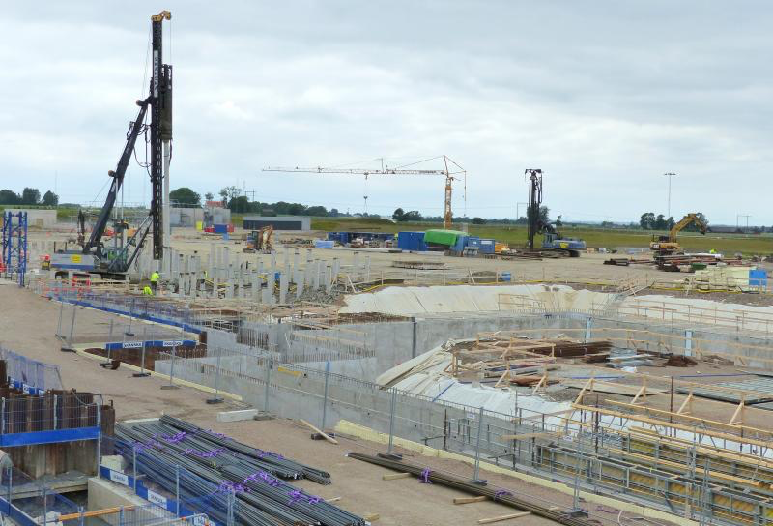
Installation Path
Contractor
ESS
OK
OK
Area supervisor
Group leader
Day-14
OK
OK
Albert Einstein
System leader
Safety team
Preparation of the
safety documentation
Submission of the
safety documentation
Approval of the
safety documentation
Pre-registration for the ID06
Online course
Installation specific not defined yet
ESS
Skanska
Pre-work visit
Safety at ESS site
ESS
Submission of the
Work permit work in progress
Contractor
Safety Induction
(1 hour)
Self-learning Regulations
Waste handling
Companies and IK-partners
ESS
D-Day
Arrival on site
Contractor
Awareness session
(30 min)
Classroom course Risk specific not defined yet
Personal Protective Equipment

Slide 19
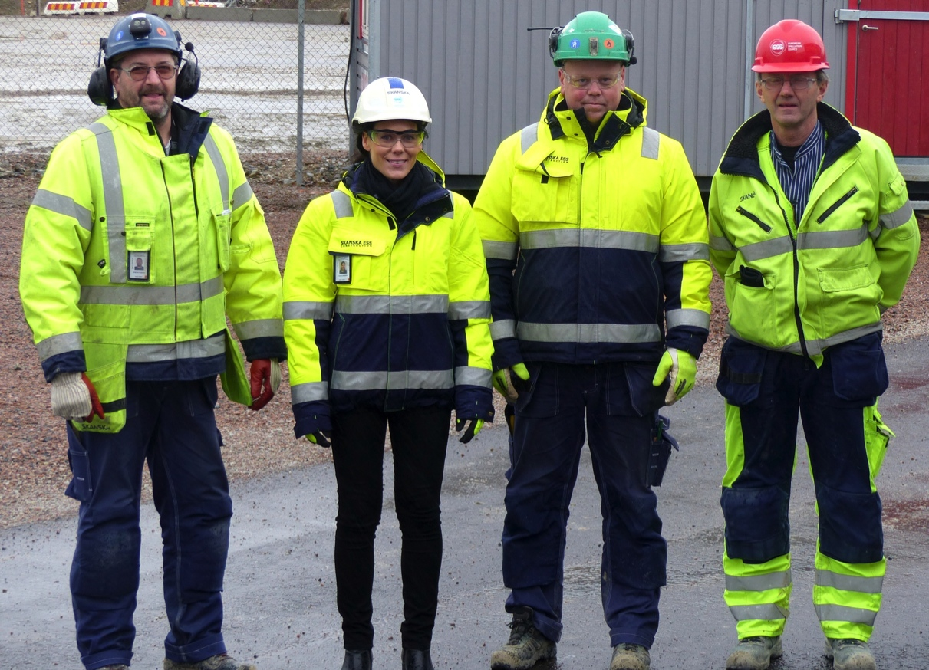
Personal Protective Equipment (PPE)
Albert Einstein

Slide 20
Installation Path
Contractor
ESS
OK
OK
Area supervisor
Group leader
Day-14
OK
OK
Albert Einstein
System leader
Safety team
Preparation of the
safety documentation
Submission of the
safety documentation
Approval of the
safety documentation
Pre-registration for the ID06
Pre-work visit
Safety at ESS site
ESS
Online course
Installation specific not defined yet
Contractor
Safety Induction
(1 hour)
Self-learning Regulations
Waste handling
Companies and IK-partners
ESS
D-Day
Arrival on site
Contractor
Awareness session
(30 min)
Classroom course Risk specific not defined yet
Personal Protective Equipment
Morning briefings
To be continued…

