Slide 1
ESS Medium Beta Cavity Design and Construction in LASA
Saeid Pirani

Slide 2
OUTLINE
ESS medium-beta section
Recent update and status at LASA
Design parameters of medium-beta prototypes
Fabrication – Subcomponents frequency control
Fabrication – Assembly and cavity welding
Fabrication and Pre-Tuning
Fine grain 6 cell cavity vertical test result

Slide 3
ESS medium-beta section
INFN-LASA activities:
Series
In-kind contribution of 36 medium-beta (MB) cavities, including Niobium procurement, Cavity fabrication in the industry, Documentation, Certification activities, Cold test in a qualified infrastructure, Transportation and Man power for the above activities.
Prototypes
Two MB cavity prototypes (same geometry different materials) have been designed, fabricated and will be cold tested at INFN-LASA.
MB cavity technical requirements
Frequency (MHz) | 704.42
Number of cells | 6
Geometric beta | 0.67
Nominal Acc. Gradient (MV/m) | 16.7
E_{peak} (MV/m) | < 45
RF peak power (kW) | 1100
Q external | 5.9-8×10⁵
Q₀ at nominal gradient | > 5×10⁹

Slide 4
Recent update and status at LASA
PDR, held in LASA on 19 May 2016, of INFN-designed MB cavity : Approved
Suggestions from PDR review committee
Study on Multipacting: Complete
Qext vs Field Flatness: Complete
Study on HOM shifting with mechanical tolerances: Complete
Prototypes
Fabrication (Fine Grain (FG) & Large Grain (LG)): Done
FG cavity vertical test: Done
LG cavity vertical test : soon

Slide 5
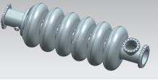
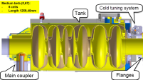
Design parameters of prototypes
Design goal
Plug-compatible
Larger cell-to-cell coupling factor, k>1.5%
Allowing for a slight modest sacrifice on E_{peak} and R/Q
Plug-compatible
RF Parameters | INFN design | ESS spec.
R_{iris} (mm) | 50 | ≥47
Geometrical beta | 0.67 | 0.67
Frequency (MHz) | 704.42 | 704.42
Acc. length (m) | 0.855 | 0.855
Cell to cell coupling k | 1.55%↗(+26%)
π-5π/6 mode sep.(MHz) | 0.70↗(+30%) | >0.45
G (Ω) | 198.8
Optimum beta, β_{opt} | 0.705 | 0.705
Max R/Q at β_{opt} (Ω) | 374
E_{acc} at β_{opt} (MV/m) | 16.7 | 16.7
E_{peak}/E_{acc} | 2.55 ↗ (+7%)
E_{peak} (MV/m) | 42.6 ↘ (-6%) | < 45
B_{peak}/E_{acc}(mT/MV/m) | 4.95 ↗ (+3%)
Q₀ at nominal gradient | >5×10⁹ | >5×10⁹
Q_{ext} | 7.8×10⁵ | 5.9~8×10⁵
Mechanical parameter | INFN Design
Cavity wall thickness (mm) | 4.5
Stiffening ring radius (mm) | 70
Cavity Internal volume (l) | 69
Cavity internal surface (m²) | 1.8
Stiffness (kN/mm) | 1.7
Tuning sensitivity K_{T} (kHz/mm) | -210
Vacuum sensitivity K_{V} for K_{ext} ~ 21 kN/mm (Hz/mbar) | 31
LFD coefficient K_{L} for K_{ext} ~ 21 kN/mm (Hz/(MV/m)²) | -1.7

Slide 6
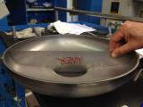
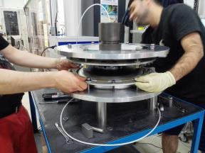
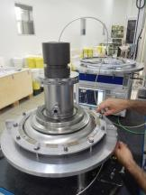
Fabrication - Subcomponents frequency control and trimming
Dumbbells (DBs) and End groups (EGs) are frequency-controlled before and after trimming
HC
DB trimmed

Slide 7
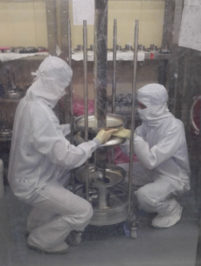
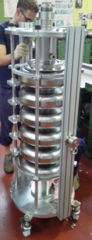
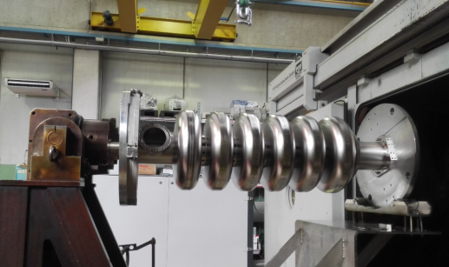
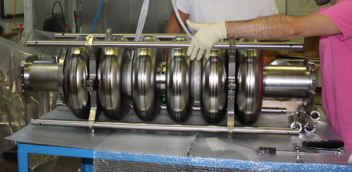
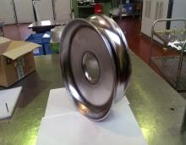
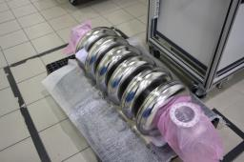
Fabrication – Assembly, cavity welding
Fine Grain Cavity
Large grain cavity
LG DB

Slide 8
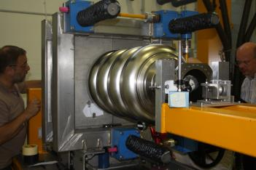
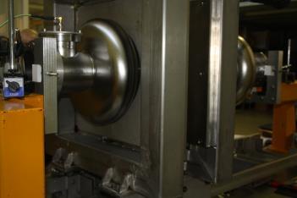
Pre-tuning (in air, room temperature, before BCP)
Cavity just fabricated: f=703.51 , FF=70%
Cavity after final tuning: f=703.11MHz, FF=97%
FF=70%
Tuning an inner cell
FF=97%

Slide 9
Fine Grain 6 Cell Cavity
Vertical Test Measurement Results

Slide 10
Cavity properties
Frequency @ 2K
704.213 MHz (as expected)
Length @ room temperature
1257.6 mm
Qext for power coupler antenna @ 2K
6E9
Qext for pickUp antenna @ 2K
1.5E11

Slide 11
Power Rise @ 2K
100 W CW cryo power, i.e. 16,7 MV/m @ Q₀ 5e9

Slide 12
Radiation

Slide 13
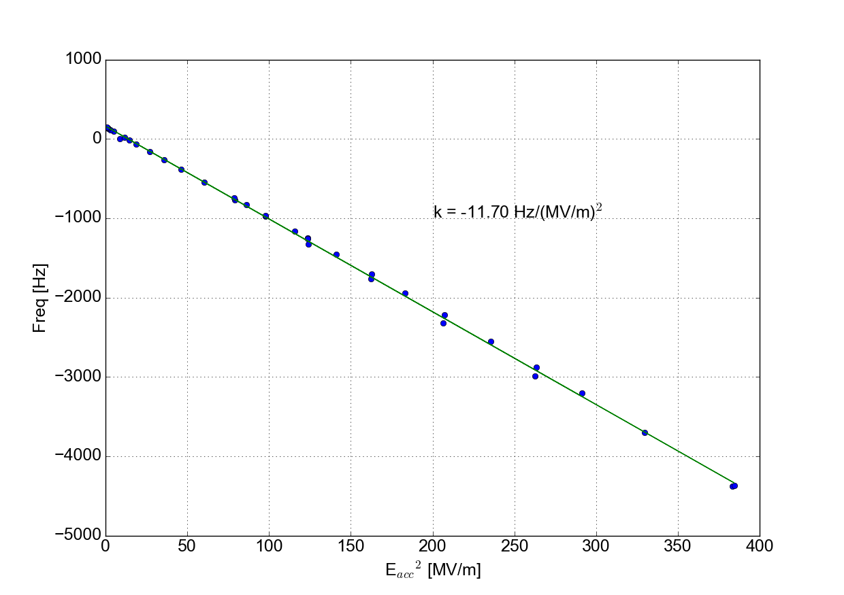
Static Lorentz Force Detuning Free cavity

Slide 14
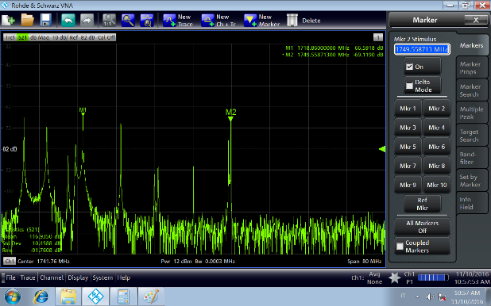
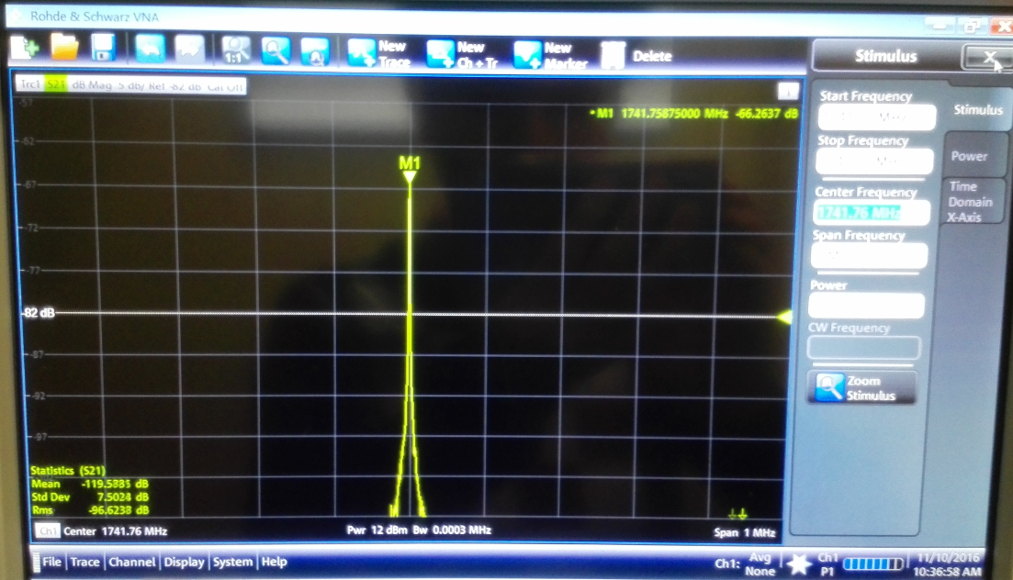
HOM
The monopole mode close to 5th machine line
Directly measured at 2K, F = 1741.8 MHz (>19 MHz from machine line at 1761.05 MHz)
Close to expected value, <1 MHz to simulation at 1742.4 MHz.

Slide 15
Special thanks to my colleages in LASA-INFN for their frindly and colaborative attitude
Thanks for your attention

Slide 17
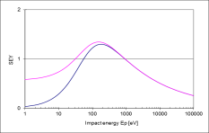
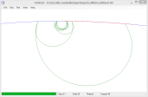
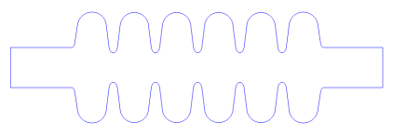
Study on Multipacting
Used FishPact code
For INFN MB cavity, the two-point multipactings are found in small regions near equator (<<1 mm)
First order MP occurs in the E_{acc} range of 7 MV/m to 14 MV/m, with maximum final impact energies around Eacc = 11 MV/m, 30.2 eV and 33.3 eV for inner cell and end cell, respectively.
Typical SEY
Pen HC/End HC
# The impact energy for the 1st order two-point MP is in the range of 30 - 50 eV, irrespective of RF frequency.
Although two-point MP’s are ubiquitous, they are not expected to limit the cavity performance owing to the fact that the impact energy is very close to the first cross-over of the secondary emission yield (SEY) curve, which shifts up after the surface is “cleaned up” by processing.
----- R.L. Geng
# Geng, R. L." Proc. of the PAC’2003 (2003): 264-268.

Slide 18
Study on Q_{ext} vs Field Flatness
Four common types of field distribution acchieved by stretching or squeezing cells
With field flatness, FF≥90% the Q_{ext} is expected in range 7 to 9 × 10⁵

Slide 19
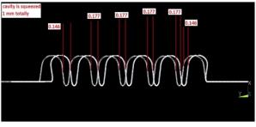
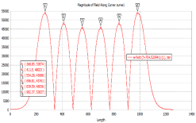
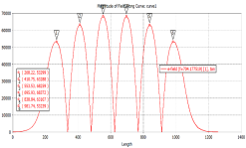
Study on Q_{ext} with tuning
Since the end cells are not the same as inner ones, stretching or squeezing whole cavity will lead shorter length change on end cells, thereby affecting the frequency and field flatness.
Stretching cavity leads decreasing Q_{ext}, while squeezing leads increasing Q_{ext}. The sensitivity is about 0.18E+5/mm
1 mm squeezed cavity by Freq. tuner
Length changes on each cell by squeezing the cavity 1 mm
Cavity tuner effect on frequency and Qext
FF trend during squeezing
FF trend during stretching

Slide 20
Tuning after Bulk BCP
Cavity just fabricated: f=703.51 , FF=70%
Cavity after tuning: f=703.11MHz, FF > 97%

