Slide 1
Tunnel – ISRC¹ & LEBT² (with focus on installation)
Øystein Midttun
WP3³ – ion source guy (in-kind)
¹ISRC = ion source
²LEBT = low energy beam transport
³WP3 = normal conducting front end = first 50 m of the accelerator
www.europeanspallationsource.se
24 November, 2016

Slide 2
For an accelerator physicist an ion source is something far far away, …
CERN is an extreme case

Slide 3
For an accelerator physicist an ion source is something far far away, …
ESS is a little easier

Slide 4
... sometimes referred to as a black box, ...
Ions

Slide 5
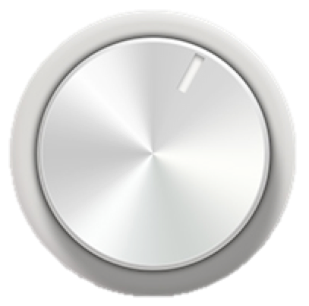
... and should ideally have three buttons.
On/off
Particle
type
Ions
Intensity

Slide 6
(in the ESS case: two buttons)
On/off
Protons
Intensity

Slide 7
An ion source generally consists of a plasma generator and an extraction system
Plasma chamber
Extraction electrode
E
Material input
Ions
Plasma
(ion + electrons)
Power to heat
the plasma
Hole to let ions out

Slide 8
The ESS proton source uses microwaves to heat the hydrogen plasma
High voltage insulator
Extraction eletrodes
Plasma chamber
Waveguide
Pumping ports
Gas injection
Solenoid magnets
50 cm

Slide 9
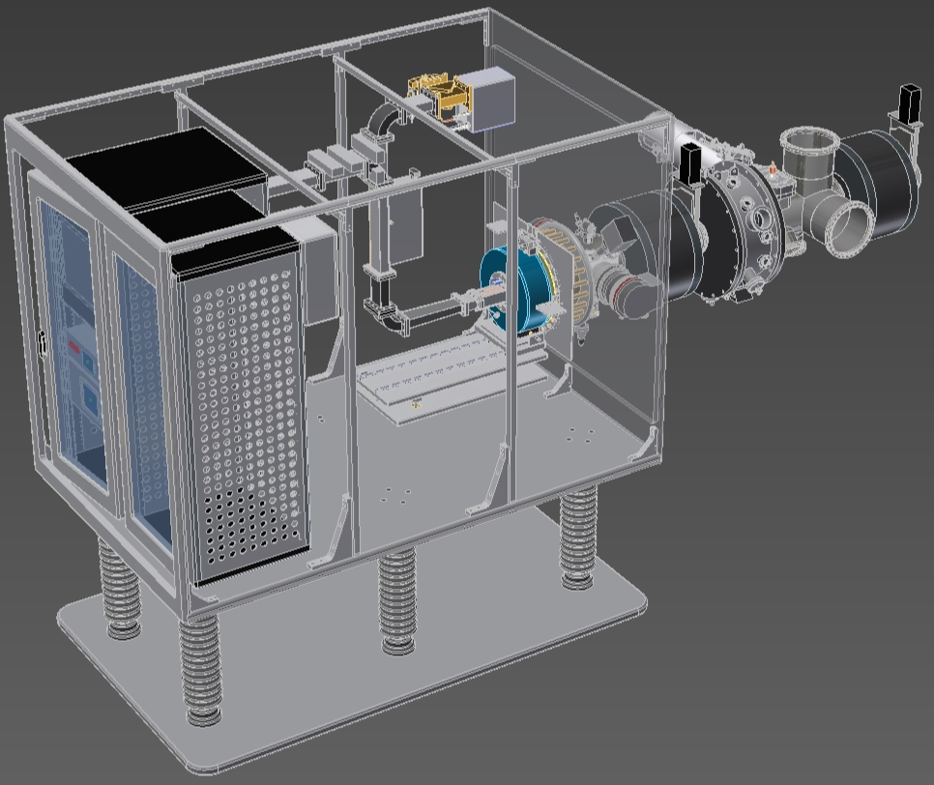
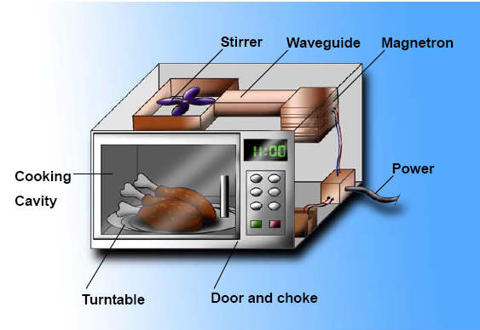
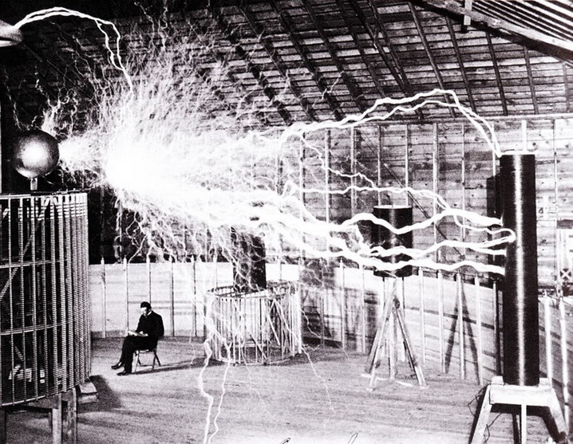
The magnetron injects the microwaves, and the high voltage platform provides the electric extraction field
Magnetron
Power -> microwave oven
High voltage -> Tesla coil
Plasma chamber
High voltage isolators

Slide 10
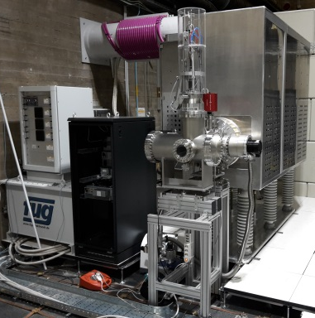
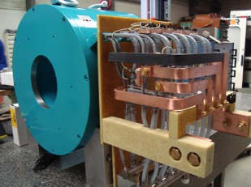
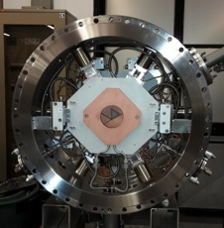
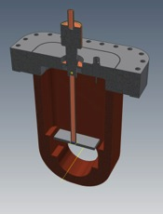
The low energy beam transport (LEBT) matches the beam to the RFQ input
Proton source
– creates the beam
Solenoid
– focuses the beam
Iris
– controls the current
Chopper and collimator
– controls the pulse length

Slide 11
With computer models, we can simulate and “look at” the beam in the LEBT
H⁺
H₂⁺

Slide 12
The ion source and LEBT are the first elements of the accelerator
Proton source
LEBT

Slide 13
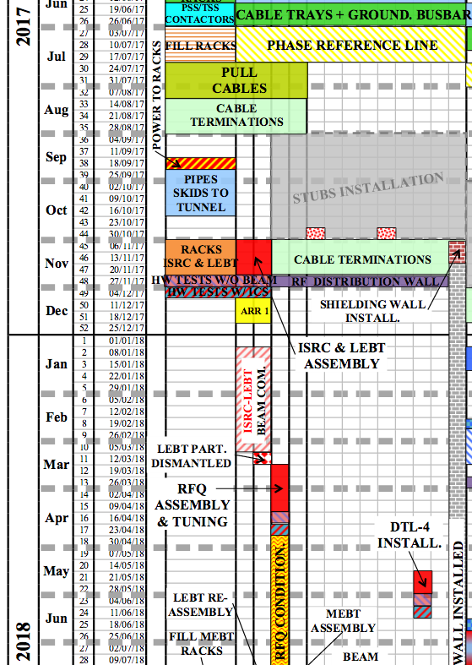
Logically they are installed (and commissioned) first
Installation
3 weeks
for installation, and
9 weeks
for commissioning
is (very) short
Commissioning

Slide 14
Installing the ion source is a collection of small tasks (not exhaustive list)
Cooling water
Fiber optics
HV power
Controls power
Proton source
HV platform
Diagnostics
LEBT
Control system
HV cage
H₂ gas delivery
Ground connections

Slide 15
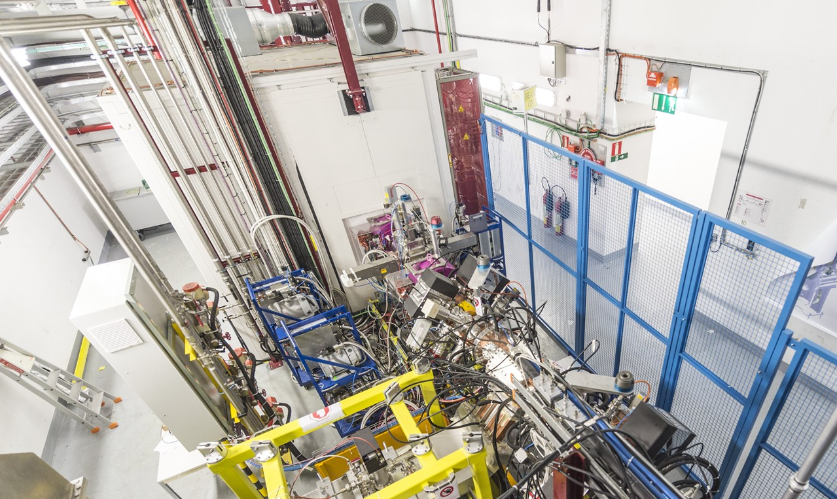
The final installation will be something similar to the Linac4 installation at CERN
Ion source
LEBT
H⁻ ion source and LEBT at Linac4, CERN

Slide 16
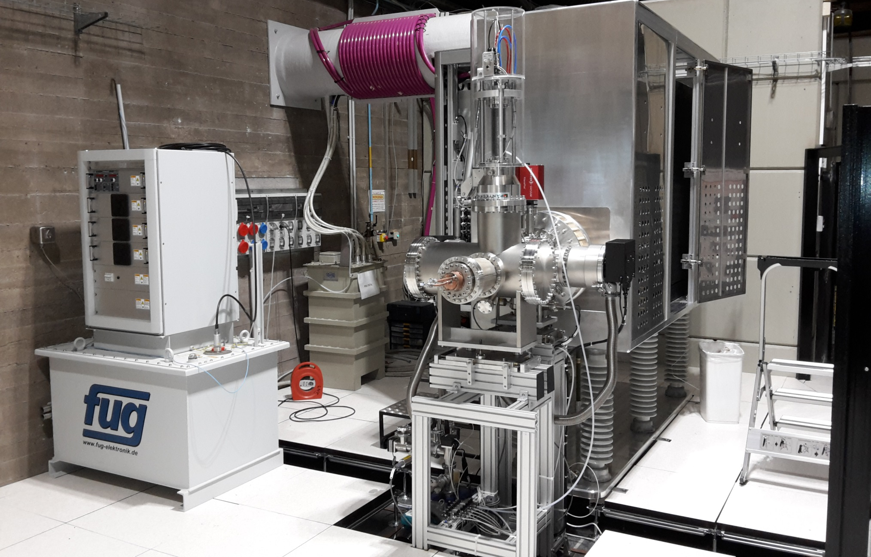
I hope that you will not consider the ion source as a black box (it can also be white or grey …)
I hope that you will not consider the ion source as a black box
Proton source for ESS – Catania, Italy

