Slide 1
Accelerator Division Site Installation
Dr. Eng. Nick Gazis, Accelerator Installation Manager
Edgar Sargsyan, Deputy Accelerator Installation Manager
on behalf of the AD installation team
www.europeanspallationsource.se
AD/CF retreat - 24 November 2016

Slide 2
ESS Project
DG
J. Womersly , DG
J. Haines ESS Project leader
ESS-wide Centralized Resources
ESS-wide shared resources
Technical Directorate
R. Garoby, Director
A. Vargara, Dep. Director
Science Directorate
A. Schryer ,Director
S. Kennedy, Dep. Director
Resources arranged centrally by Sub-Projects
Target Sub-Project Office
E. Pitcher HoD
R. Linander dHoD
Accelerator Sub-Project Office
M. Lindros HoD
H.Danared dHoD
J.Weisend dHoD
ICS Sub-Project Office
H.Carling HoD
NSS Sub-Project Office
S. Kennedy HoD
CF Sub-Project Office
K. Hedin HoD
Work Package Managers
WP2-7
Target Systems
Work Package Managers
WPX-X
AD Systems
Work Package Managers
WPX-X
ICS Systems
Work Package Managers
WPX-X
NSS Systems
Work Package Manager
WPX-X
CF Systems
Resources arranged by individual work unit participants
IKC Resources (some already secured)
Contracted Resources (dedicated people and/or equipment)

Slide 3
ESS Installation roles and titles
SITE MANAGEMENT
COST
ESS-wide Centralized Resources
Administration
Technical
SWOCOR
SAFETY
SCHEDULE
ESS Installation coordinator
ESS Installation coordinator
Installation Coordinator
Installation coordinator
Installation Area Supervisor
Installation area supervisor
Installation package leader
Installation package
leader
Resources arranged by individual work unit participants
IKC Resources (some already secured)
Contracted Resources (dedicated people and equipment)

Slide 4
Acc Sub-Project Installation Organization
Blue = Already in-place
Green = remains to be secured
SWOCOR
(Shared Workplace Coordination Responsible)
Skanska/C101
ESS-wide Centralized Resources
ESS-wide shared resources (except C101)
Technical Directorate
R. Garoby, Director
A. Vargara, Dep. Director
Accelerator Sub-Project Office
M. Lindros, Sub-Project leader
J. Weisend, Deputy Sub-Project Leader
N. Gazis, Installation Coordinator
X, X, X, Installation Areas Supervisors
XXX, Project Planner/Controller
Resources arranged centrally by Target Sub-Project
Work Package Manager
WP2
Work Package Manager
WP3
Work Package Manager
WP4
Work Package Manager
WP5
Work Package Manager
WP6
Work Package Manager
WP7
Resources arranged by individual work unit participants
IKC Resources (some already secured)
Contracted Resources (dedicated people and equipment)

Slide 5
Accelerator Division (AD) – Site Organization
BAS-U
ESS installation manager
Accelerator installation Coordinator
Nick Gazis
Deputy: Edgar Sargsyan
Area Supervisor Gallery (G02) Interim - E. Sargsyan
AD and ESS central installation services
RATS and logistics
(Central function)
Planning coordination Edgar Sargsyan
Quality – Matthew Conlon
Mechanical
Mechanical
Mechanical
Mechanical
Safety Team– Duy Phan, Skanska safety and ES&H
Electrical
Area Supervisor Tunnel (G01) and & FEB (levels 090 & 100) Interim - N. Gazis
Utilities
Area Supervisor Cryobuildings (G04) I. Sjoholm
Electrical
Utilities
Electrical
Utilities
Area Supervisor Test stand (in G02) W.Hees
Electrical
Utilities
RF
other..
el
System Leader 1
util
other..
mech
System Leader 2
AREAS
Other..
other
Task masters (Installation Support Team)
System Leader 3, 4..

Slide 6
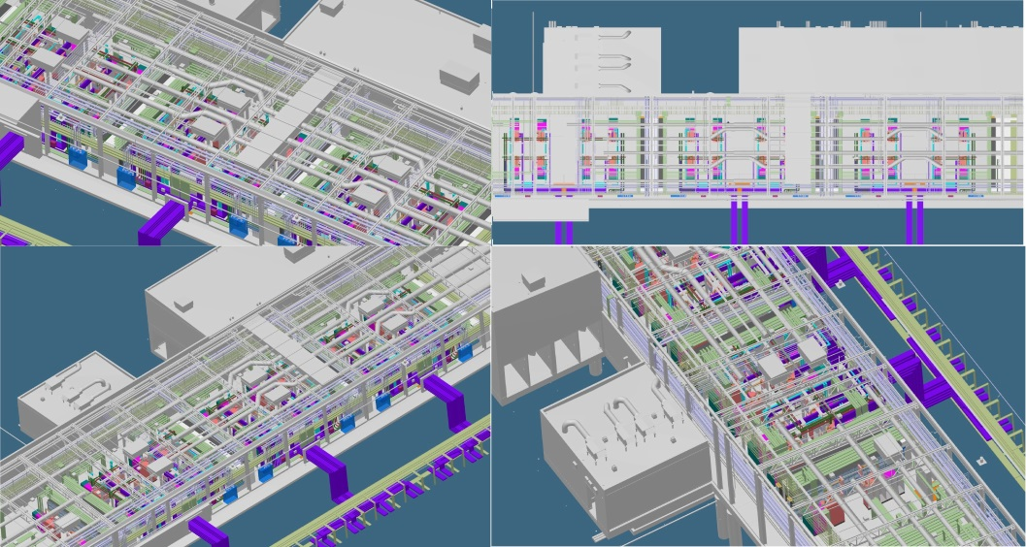
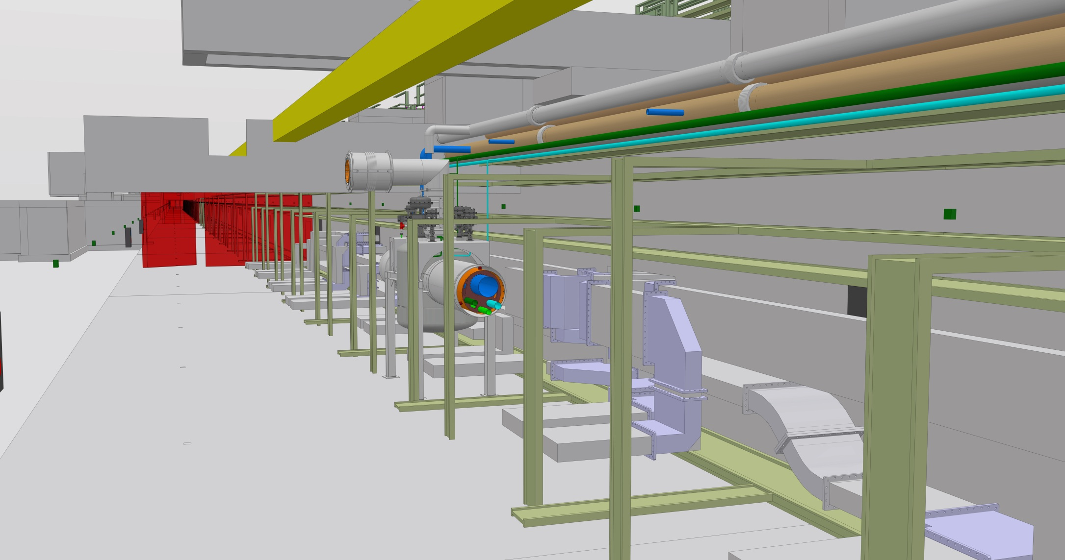
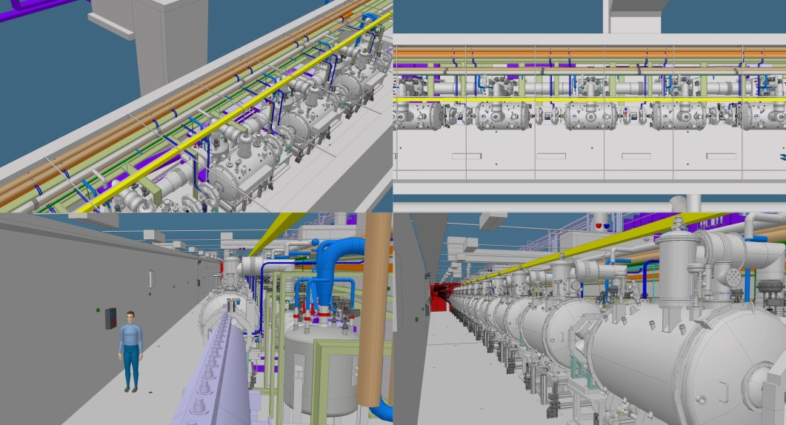
AD installation sequence
Current tunnel installation sequence:
Marking
Hole Drilling
Water-cooling pipes installation (inclduing dedicated supports)
Cable trays and grounding bus bar installation (inclduing dedicated supports)
Phase Reference Line (PRL) installation
Stubs (trays, waveguides, cables) installation
NCL and CDS
CryoModules (CMs) and LWUs.
High level of complexity is evident so efficient coordination is explicit!

