Slide 1
Cryomodules: Spokes
Nuno Elias
Accelerator and CF retreat meeting
24th of November 2016

Slide 2

Thanks
CNRS/IPNO partners

Slide 3
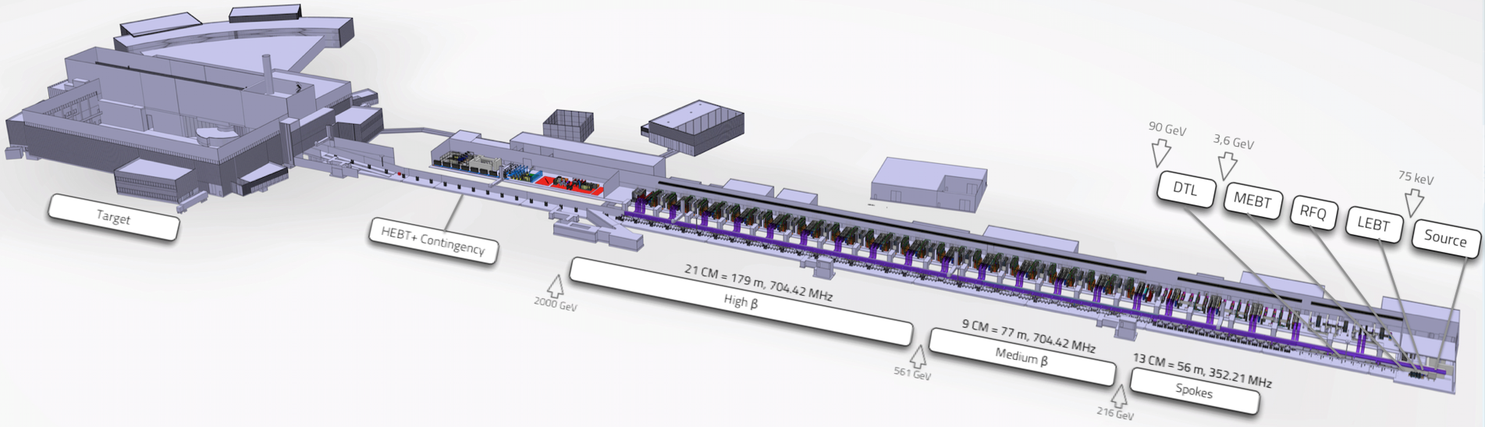
Accelerator
Number of CM’s
179
SPOKES
MEDIUM-BETA
HIGH-BETA
4
Cavities per CM
Sector Length [m]
56
13
2
77
9
4
21
Notes:
The ESS particle accelerator. Probably all of you have seen various versions of this slide.
While the previous speakers have focused on what is included in the first 30 meter of the accelerator, me and my colleague will give a hint of what is in the next 300 meter
IT is mainly composed of 3 sections, if one excludes the contingency space.
Those are the spokes section composed of 13 cryomodules and spanning about 56 meters.
The medium beta section composed of 9 medium beta cryomodules and spanning 77 meters
And finally the high beta section of the linac composed of 21 cryomodules and ranging 179 meters
Each of the spokes cryomodules houses 2 cavities, while each of the medium beta cryomodules houses 4 cavities
The superconducting cavities are the main responsible for providing energy to the beam.
As you can see the beam leaves the dtl with an energy of 90 GEV and has a steep ramp up in energy, achieving up to up to 2000GeV

Slide 4
Our In-Kind Collaborators
CAVITIES
CEA
#3
SPOKES
MEDIUM-BETA
HIGH-BETA
CEA
CRYOMODULES
TESTS
IPNO
Proto
IPNO
IPNO
CEA
#3
INFN
CEA
STFC
UU
Series
TS2
#6
TS2
#18

Slide 5
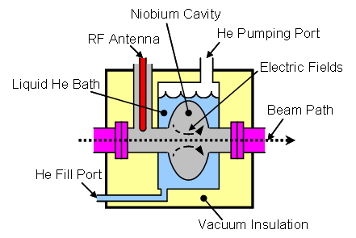
What is a Cryomodule?
Housing for the Superconducting accelerating cavities:
  Transmit power to beam.
  Maintain the cavity at the right frequency
  Keep cavities cold (superconducting)
  Support + alignment
    RF power,
    Power coupler
    Beam vacuum + vacuum interface
    Magnetic shield
    Instrumentation
Frequency tuning: cold tuning system (step motor, piezo)
Need cryogenics plant
Cryogenics system
Thermal shielding + MLI
Insulation vacuum,
Safety features

Slide 6
Cryomodule Disciplines
BEAM
VACUUM
INSULATION
VACUUM
RF
CRYOGENICS
SRF CAVITY
TUNING SYSTEM
CONTROL
SYSTEMS
ALIGNMENT SYSTEM

Slide 7
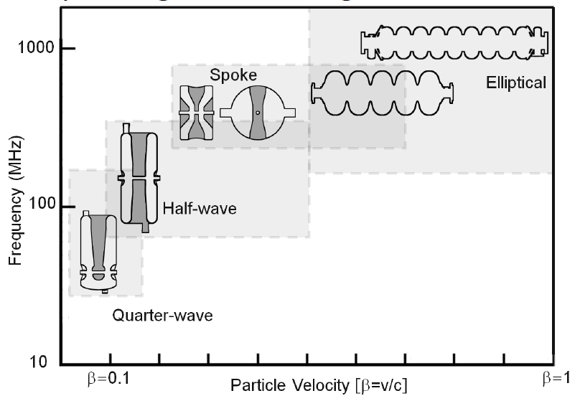
How do cavities look like?

Slide 8
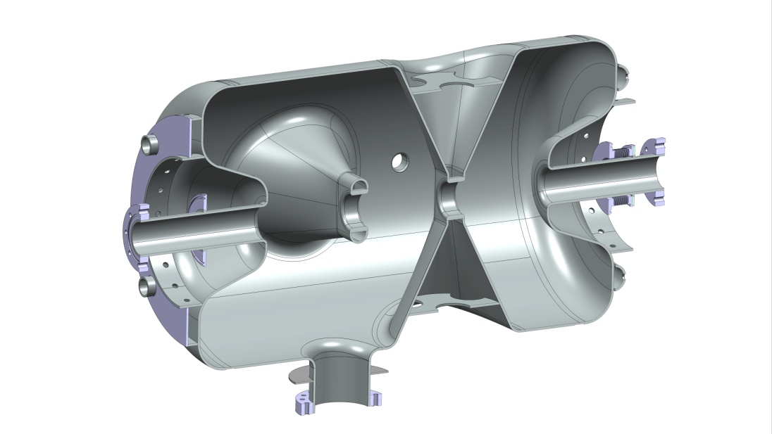
The Spokes cavity

Slide 9
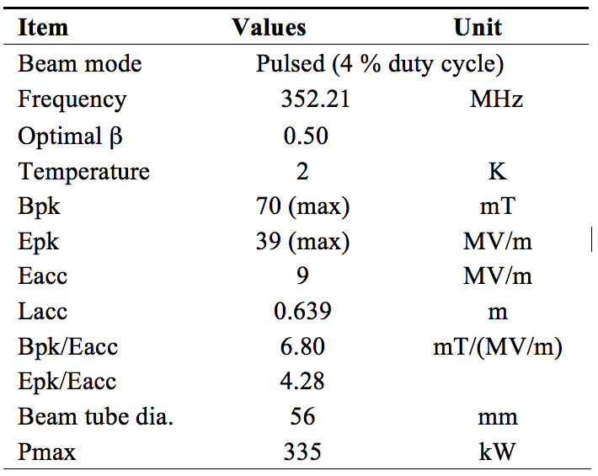
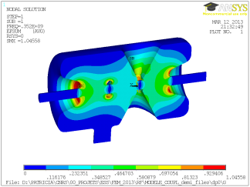
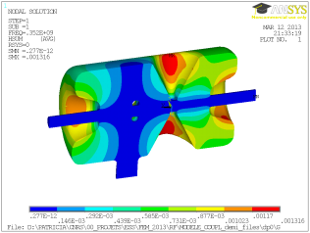
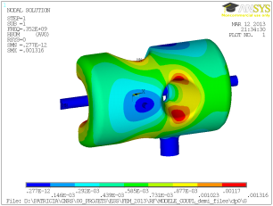
Double spoke cavity design parameters
E_{pk}
B_{pk}
B_{pk}

Slide 10
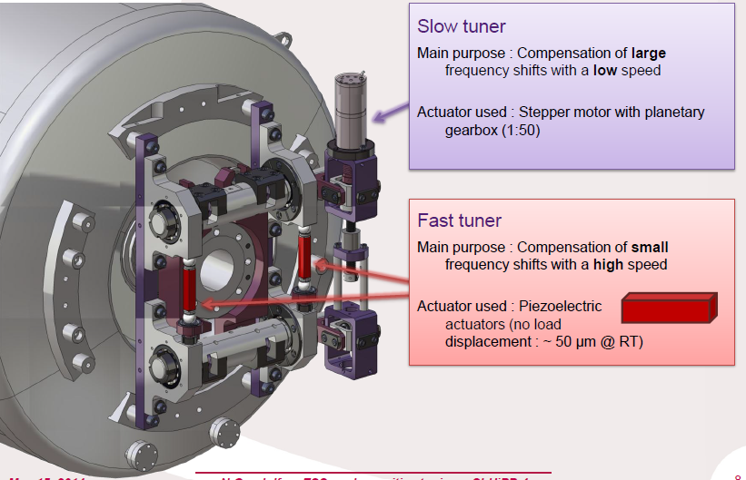
Cold tuning system

Slide 11
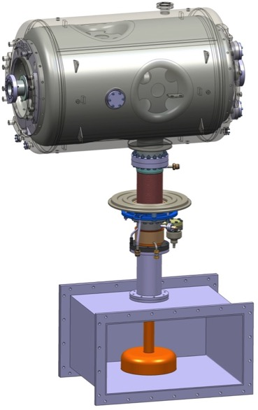
Spoke cavity package

Slide 12
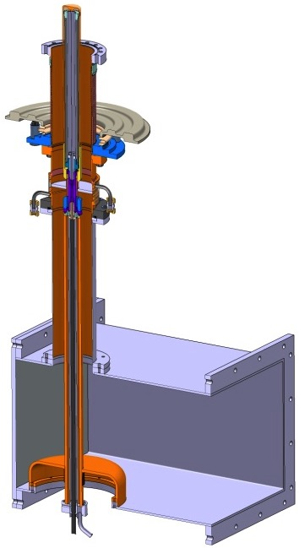
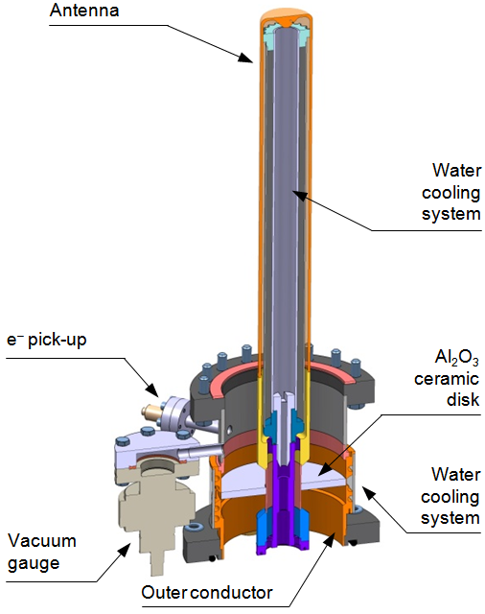
Power Coupler
Antenna
Spoke: 335 kW
Beam vacuum
Outer conductor
double-wall helium cooling circuit
Inner conductor
(water-cooled)
Al₂O₃
ceramic disc
WR2300
Doorknob transition
RF input
Doorknob

Slide 13
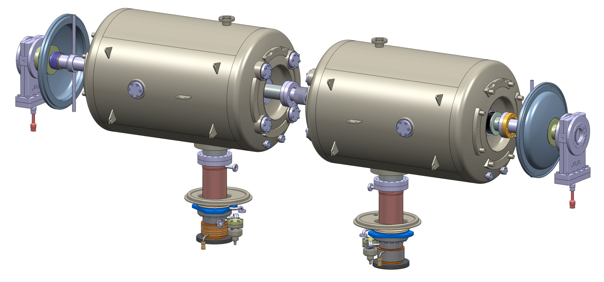
Spokes cryomodule assembly
Cavity string assembly in clean room
  Small dish ends + warm valves

Slide 14
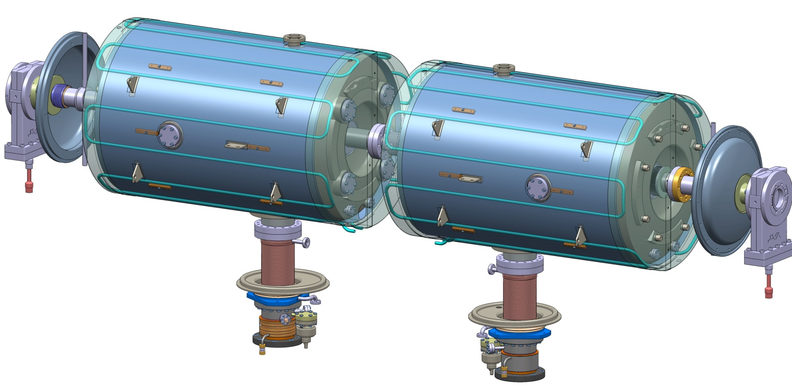
Spokes
Magnetic shielding
  Actively cooled

Slide 15
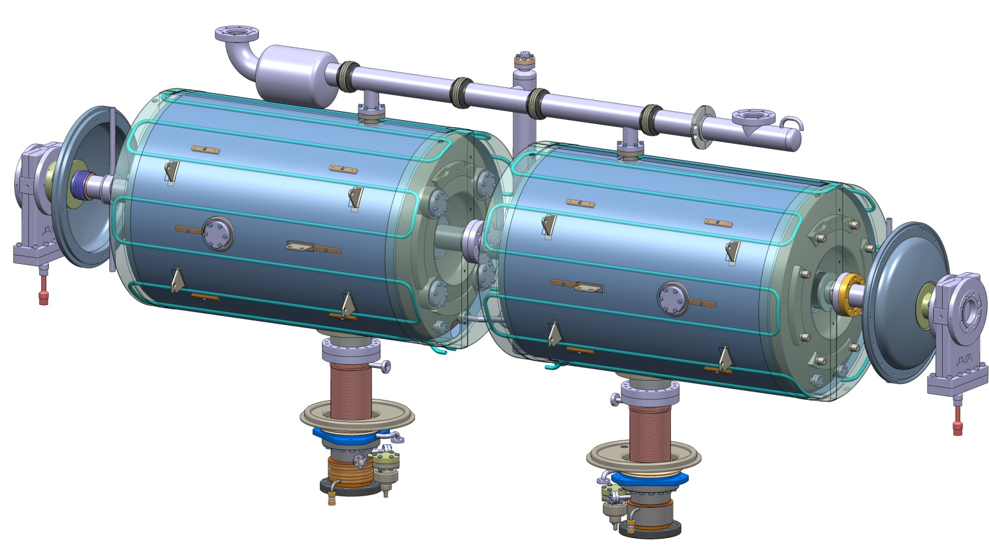
Spokes
Cryogenic distribution
  3 circuits
    2 K: C
    5 K: PC
    50 K: TS

Slide 16
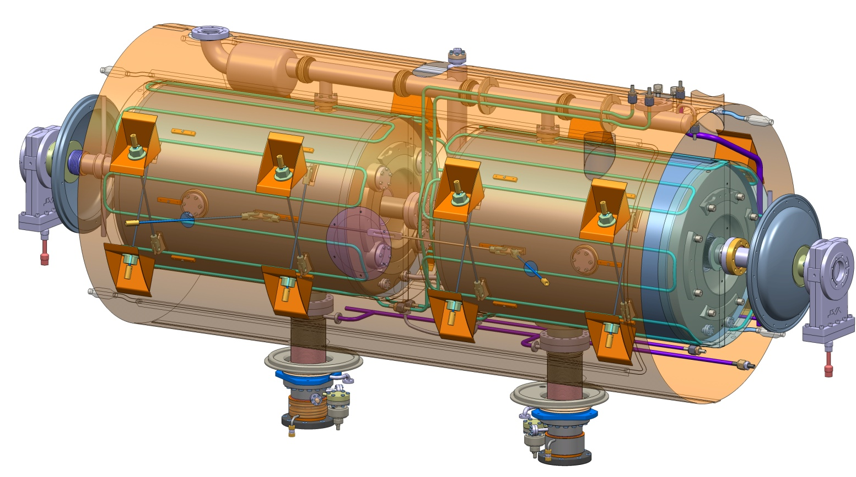
Spokes
Supporting rods
  TA6V alloy
Thermal shield
  Al

Slide 17
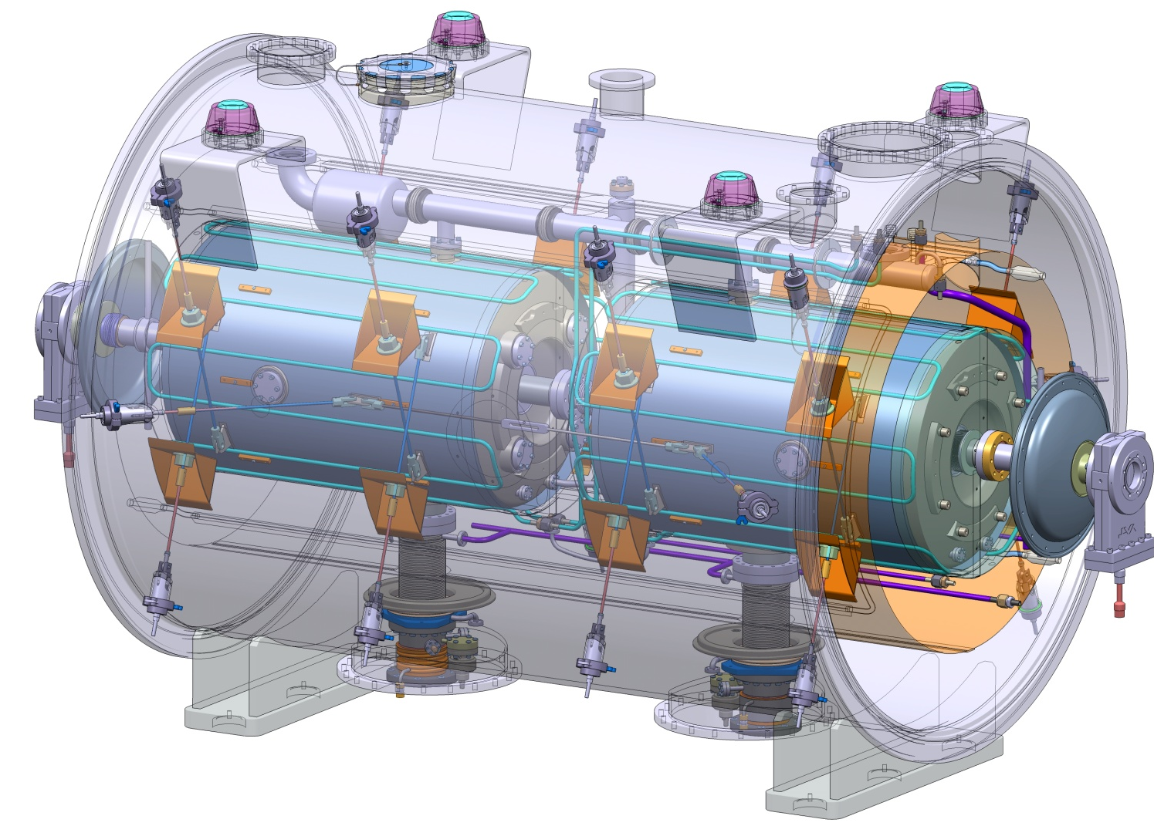
Spokes
Cryostating
External rods

Slide 18
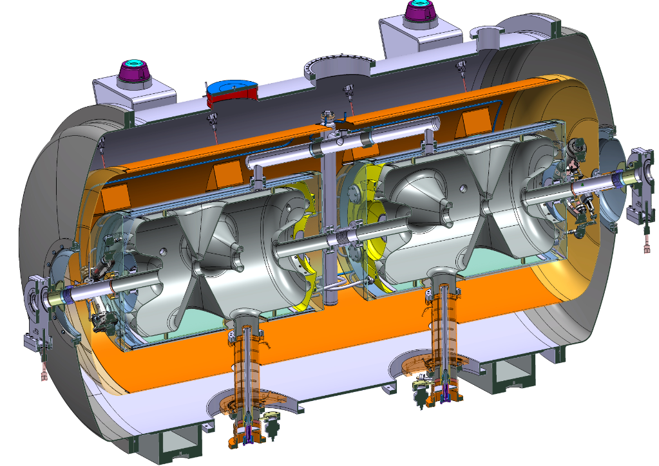
The Spokes Cryomodule
Final Cryogenic circuits
Cold tuning system
Thermal screen ends
Cryostat ends
Alignment tie rods
2-phase manifold
Cold Tuning System
C-W transition
Power coupler double wall cooling
Power coupler antenna cooling

Slide 19
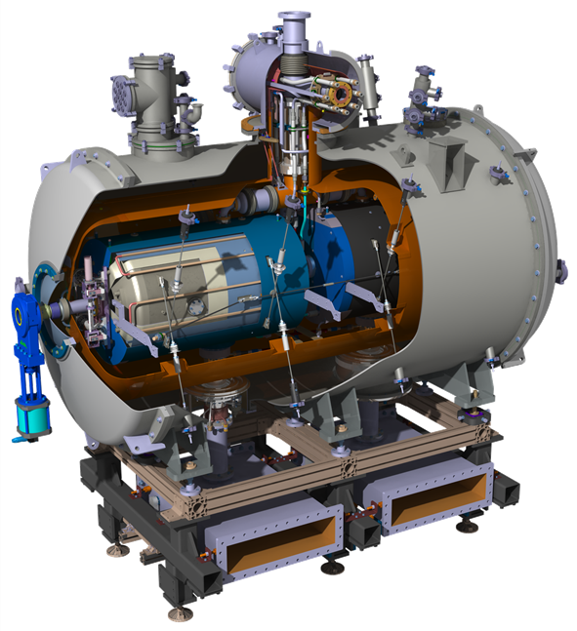
The Spokes Cryomodule
Length : 2.88 m
Diameter: 1.304m

Slide 20
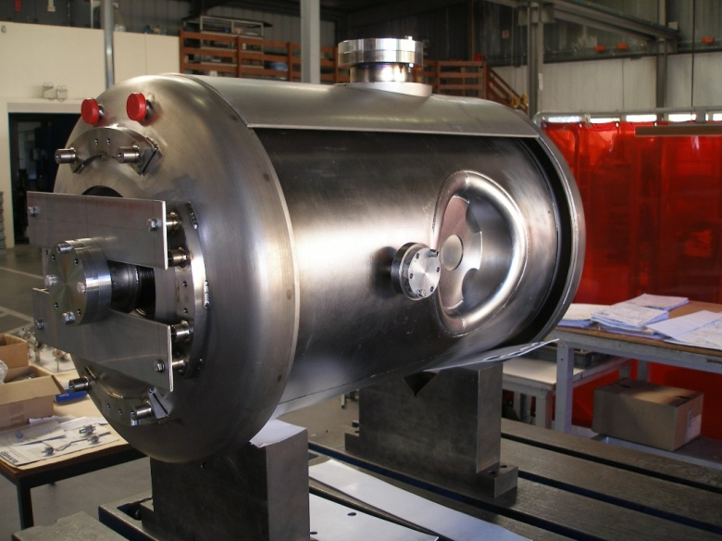
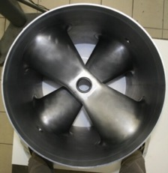
Spoke cavities prototypes
Cavity and Helium tank
View of the spoke cavity bars

Slide 21
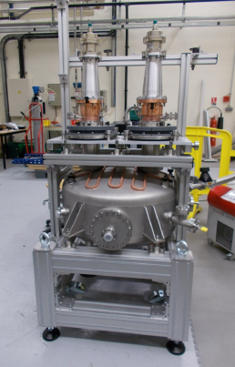
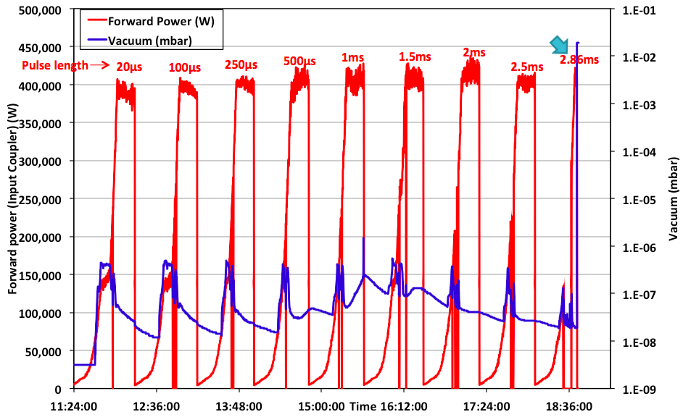
Spoke power-coupler performances
@IPNO
➔ One spoke power coupler reached ESS requirements (sept. 2016)
Power coupler conditioning bench: all parts realized, dry assembly done.

Slide 22
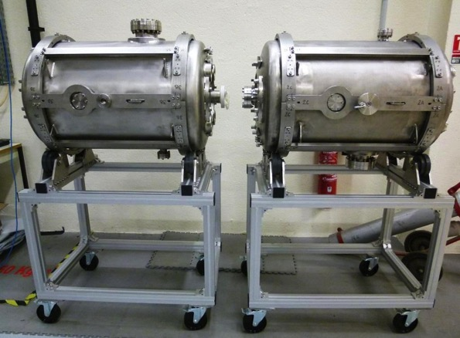
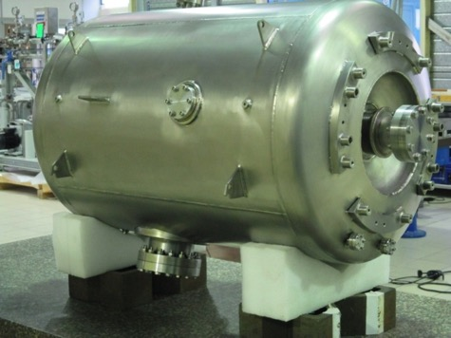
Prototype Spoke cavities
Romea
Giulietta
Germaine

Slide 23
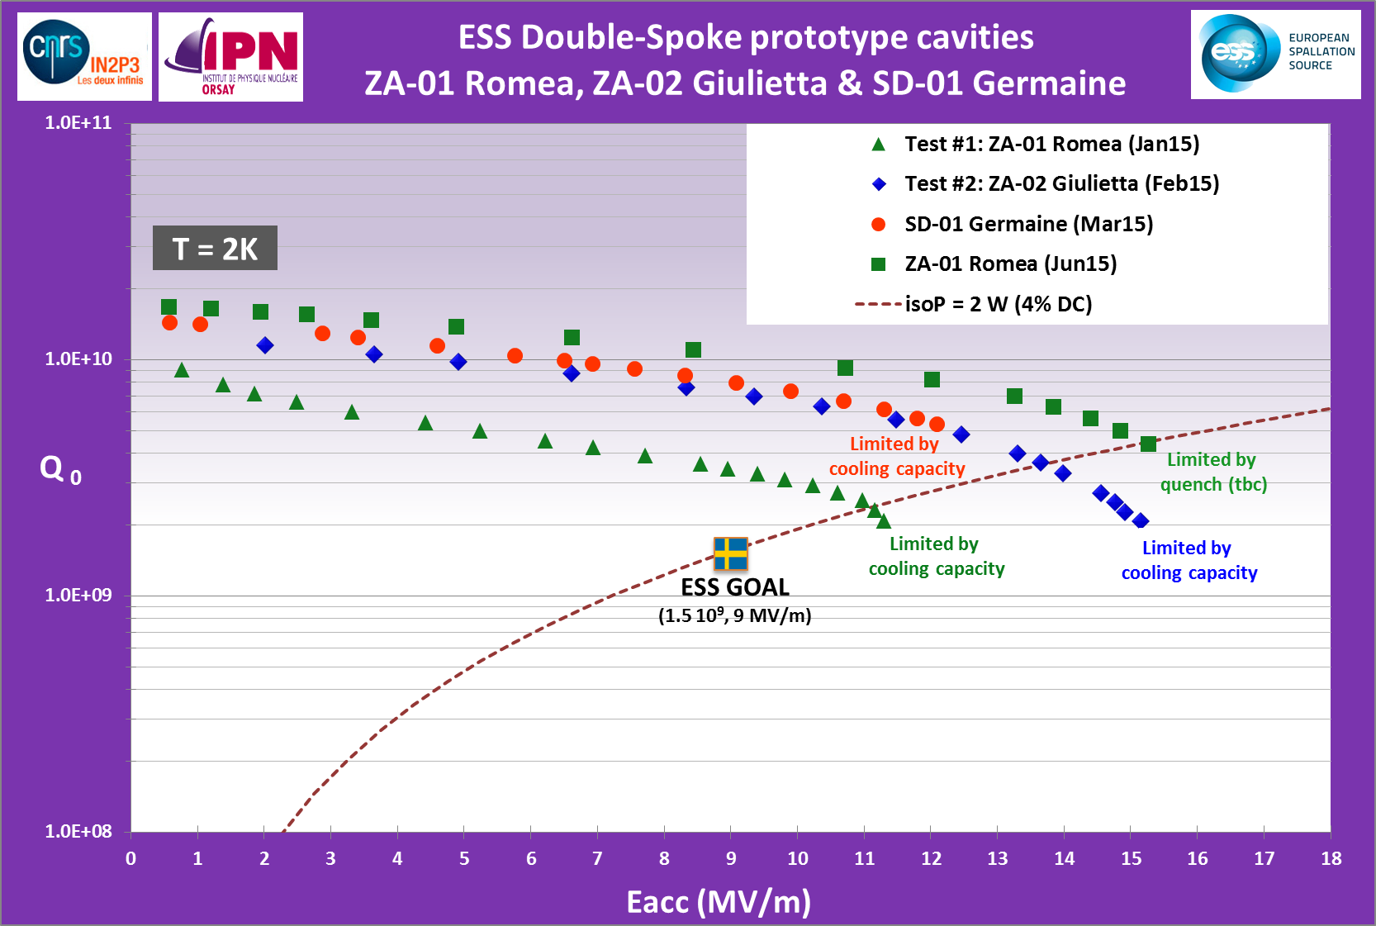
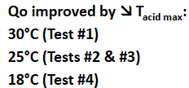
Spoke cavity performances
@ IPNO
➔ Spoke cavity exceeding ESS requirements in vertical test on both Eacc and Qo
Eacc_max=15.3 MV/m achieved with “Romea”
Several MP barriers but easily processed.
Qo > 1.6 10¹⁰
Strong FE at max gradient
Limitation is the cooling capacity (unstable conditions, cavity in vertical position)
No Baking
No heat treatment
Hpk=105 mT
Epk=66 MV/m

Slide 24
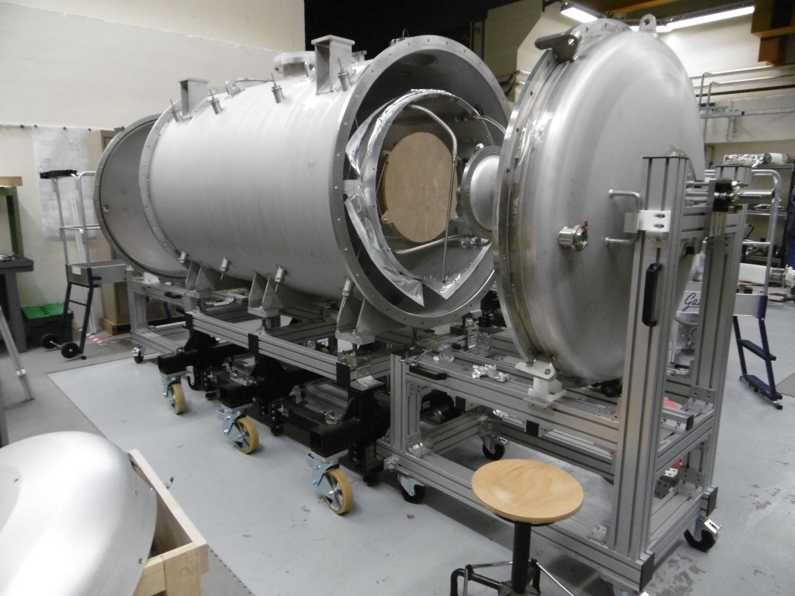
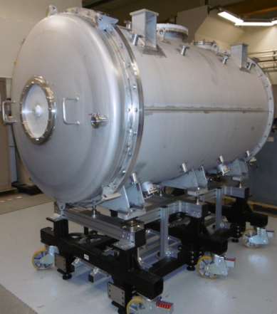
The Spokes CM

Slide 25
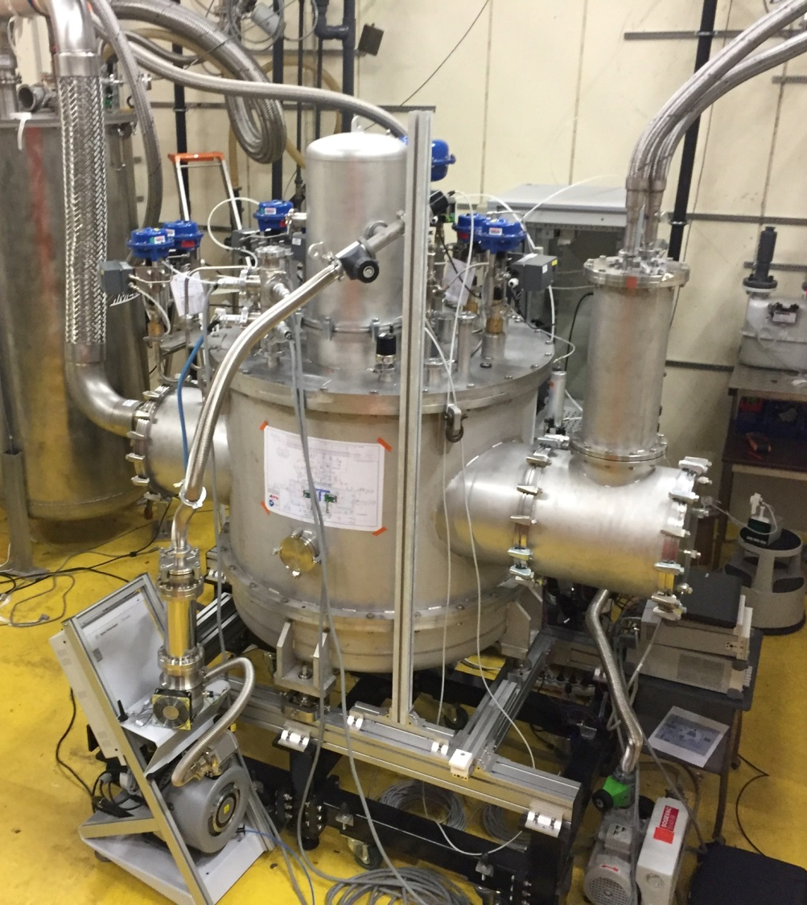
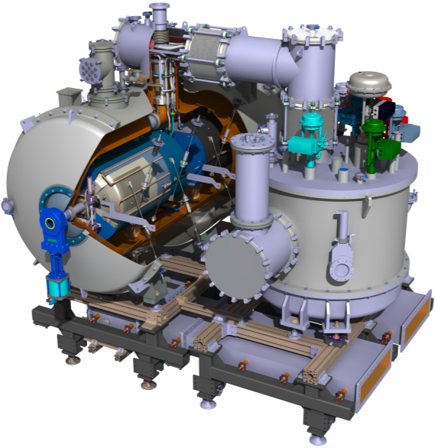
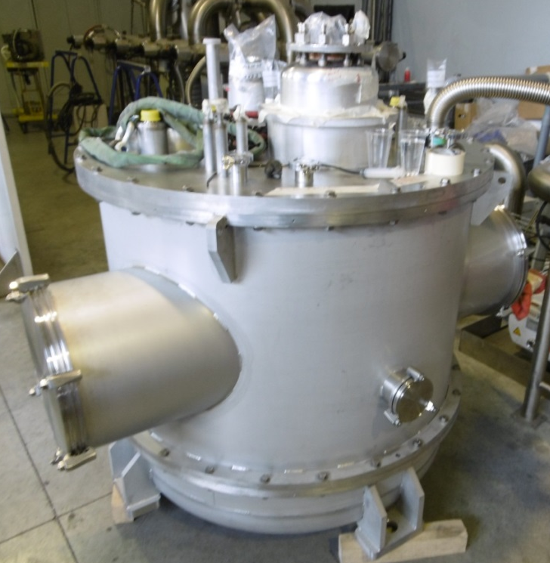
Spokes Valve box
SPOKE CRYOMODULE
VALVE BOX

Slide 26
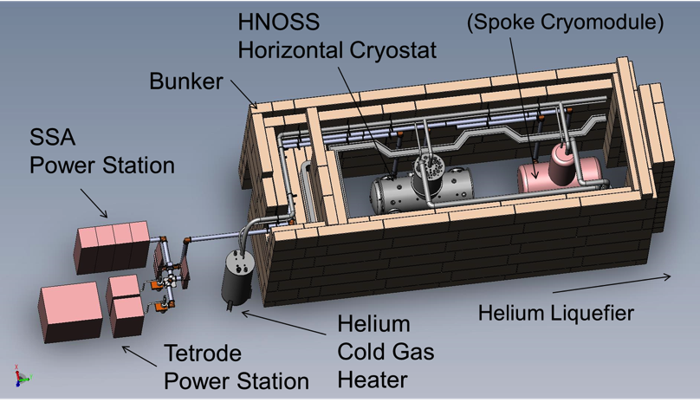
SRF Test Stand @ Uppsala University
RF Power Source + LLRF
Control System
Cryogenics + valve box

Slide 27
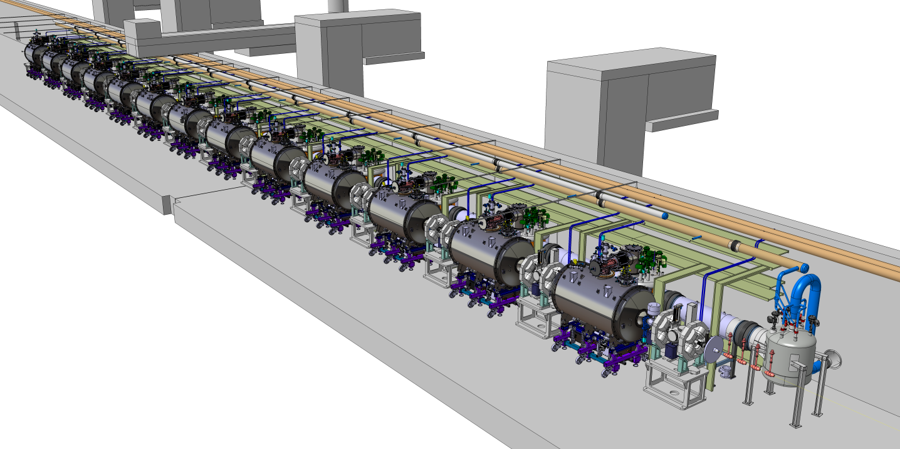
Spokes Section in tunnel
Auxiliary process lines
Vent line
Beam direction
(to target)

Slide 28
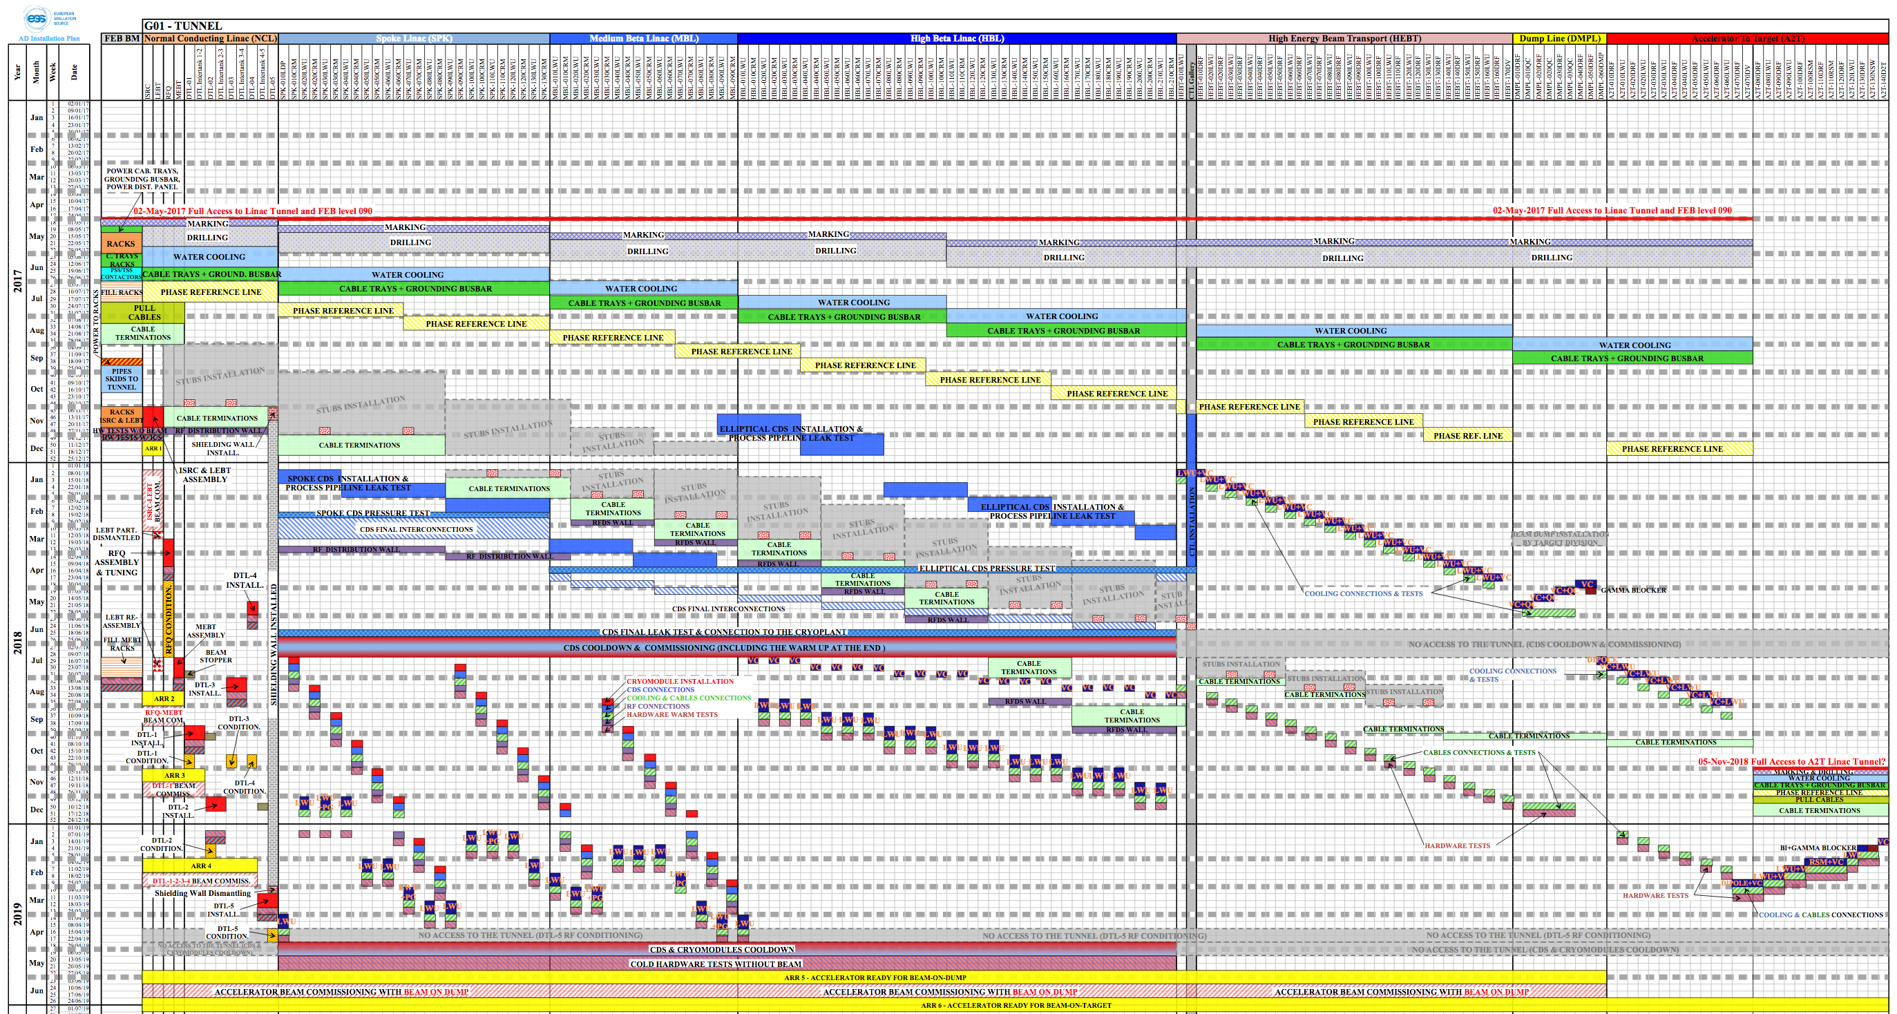
Master Installation and Commissioning Schedule:Tunnel
CRYOMODULE INSTALLATION
CDS CONNECTIONS
COOLING & CABLES CONNECTIONS
RF CONNECTIONS
HARDWARE WARM TESTS

Slide 29
Cryomodule Installation
Transportation to approximate location in the tunnel
Positioning CM in correct location
Alignment of CM to beam axis
Add door knob connection
Physical connection of RF waveguides
Physical connection of CM and CDL
Physical connection of CM cryogenic auxiliary pipes
Physical connection of CM isolation pumping sys.
Physical connection of CM beam vacuum
Physical connection of CM power coupler antenna water cooling
Cabling connections
  Welding of pipes
  Leak testing of welded pipes
  Closure of vacuum jacket
  Leak testing of vacuum jacket connection
  Physical Welding/Flanged connection of pipes
  Leak testing of connected pipes
  Physical Welding/Flanged connection of pipes
  Leak testing of connected pipes
Setup of mobile clean room
Wait for Correct laminar conditions
Physical connection of gate valves
Leak testing of connected gate valves
  Physical Welding/Flanged connection of pipes
  Leak testing of connected pipes
Cabling connection of control valves cryo
Cabling connection of control valves water
Cabling connection of manual valves cryo
Cabling connection of manual valves vac
Cabling connection of manual valves water
Cabling connection of flow meters
Cabling connection of CM feedthroughs
Cabling connection of vacuum gauges and pressure gauges
Cabling connection of gate valves
Cabling connection of Arc detectors
Cabling connection of RF antenna
Cabling connection of Bias excitation source
Cabling connection of E charge detector

Slide 30
Cryomodule Testing and Commissioning
  Signal testing of electrical connections up to PLC switchboard
  Signal calibration/zeroing up to conditioner level (through cable)
  Visual inspection of subsystems
Local Testing (without beam; without ICS)
Local Testing with ICS (without beam)
Integrated Testing with ICS (without beam)
Integrated Testing with ICS, with beam
  Read-out instruments states from control room (T’, P’ s, F’s, L’s, Position indicators of valves Individual Control of equipment and read-back states from control room Heaters Cryo Valve open/ close / 50% Tuner operation? Piezo operation? Gate valve operation?
  Purging of Helium Systems
  Validation of absence of Helium Leaks (at warm to isolation vacuum, beam vacuum)
  Cooling of Cryomodules to 4K , 2K
  Measurement of heat loads at 4K , 2K
  Test all operating modes
  Low Power measurements/ cavity (Tuner operation, Cavity frequencies, HOM Heater control)
  High Power measurements/cavity (Conditioning, E max, Q0, Heat loads, Lorentz force detuning)
  High Power measurements/cavity (Conditioning, E max, Q0, Heat loads, Lorentz force detuning)

Slide 31
Acknowledgments
IPNO/CNRS partners
More information: https://ess-ics.atlassian.net/wiki/display/CRYOM/Cryomodules+Collaboration+Space

Slide 32
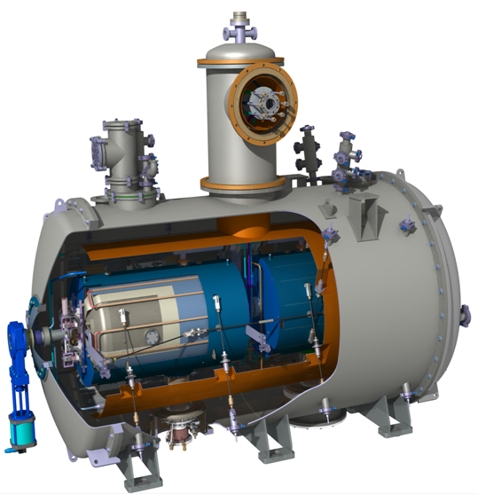
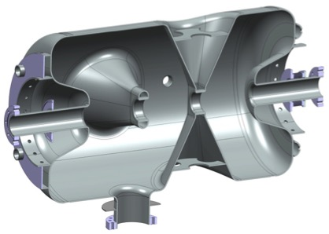
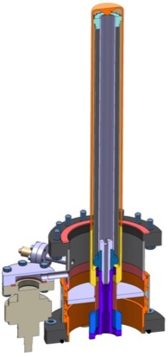
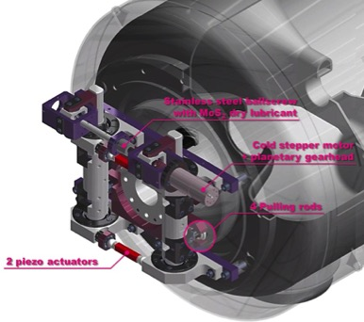
Spoke cryomodule design
Double Spoke
SRF Cavities
Double spoke cavity
(3-gaps), 352.2 MHz, β=0.50
Goal: Eacc = 9 MV/m [Bp= 72 mT ; Ep = 39 MV/m]
4 mm (nominal) Niobium thickness
Titanium Helium tank, Ti stiffeners
Lorentz detuning coeff. : -4.4 Hz/(MV/m)²
Tuning sentivity Δf/Δz = 128 kHz/mm
Cold Tuning System
Power Coupler
Slow tuner (stepper motor):
Max tuner stroke: 1.28 mm
Max tuning range: ~ 170 kHz
Tuning resolution: 1.1 Hz
Fast tuning by 2 piezo-actuators
Noliac 50x10x10 or PI 36x10x10 mm
Applied voltage up to +/- 120 V
Estimated tuning range at 2K: 800 Hz
Ceramic disk, 100 mm diameter
400 kW peak power (330 kW nominal)
Antenna & window water cooling
Outer conductor cooled with LHe
Doorknob transition from coaxial
to ½ height WR2300 waveguide

Slide 33
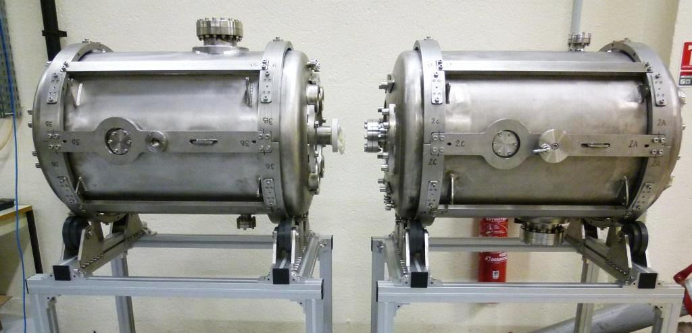
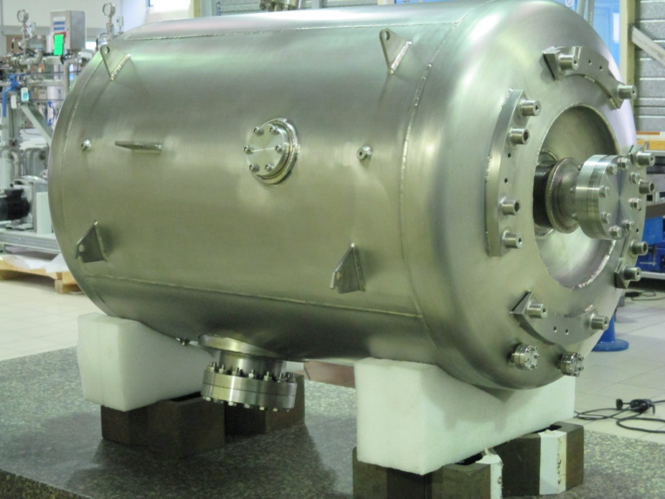
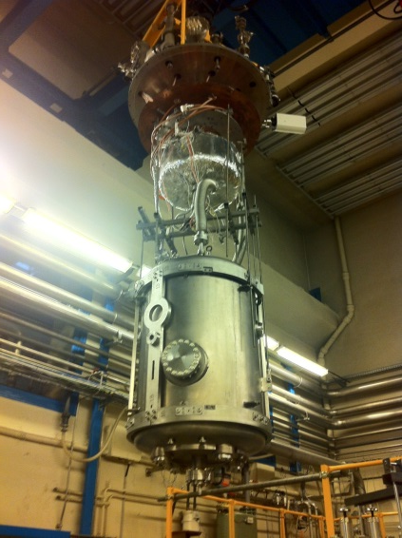
Spoke Cavities design & prototype performances 1/2
DOUBLE-SPOKE CAVITY
Frequency [MHz] | 352.21
Beta_optimum | 0.50
Operating gradient [MV/m] | 9.0
Temperature (K) | 2
Bpk [mT] | 61
Epk [MV/m] | 38
G [Ohm] | 133
r/Q [Ohm] | 427
Lacc (=beta optimal x nb of gaps x λ /2) [m] | 0.639
Bpk/Eacc [mT/MV/m] | 6.8
Epk/Eacc | 4.3
P max [kW] | 335
ZA 01
Romea
ZA 02
Giulietta
3 spoke cavity prototypes have been fabricated and tested in vertical cryostat:
#1 fabricated by SDMS (Fr), #2 and #3 fabricated by ZANON (It)
Niobium is from Tokyo Denkai (Japan)
SD 01
Germaine
33

Slide 34
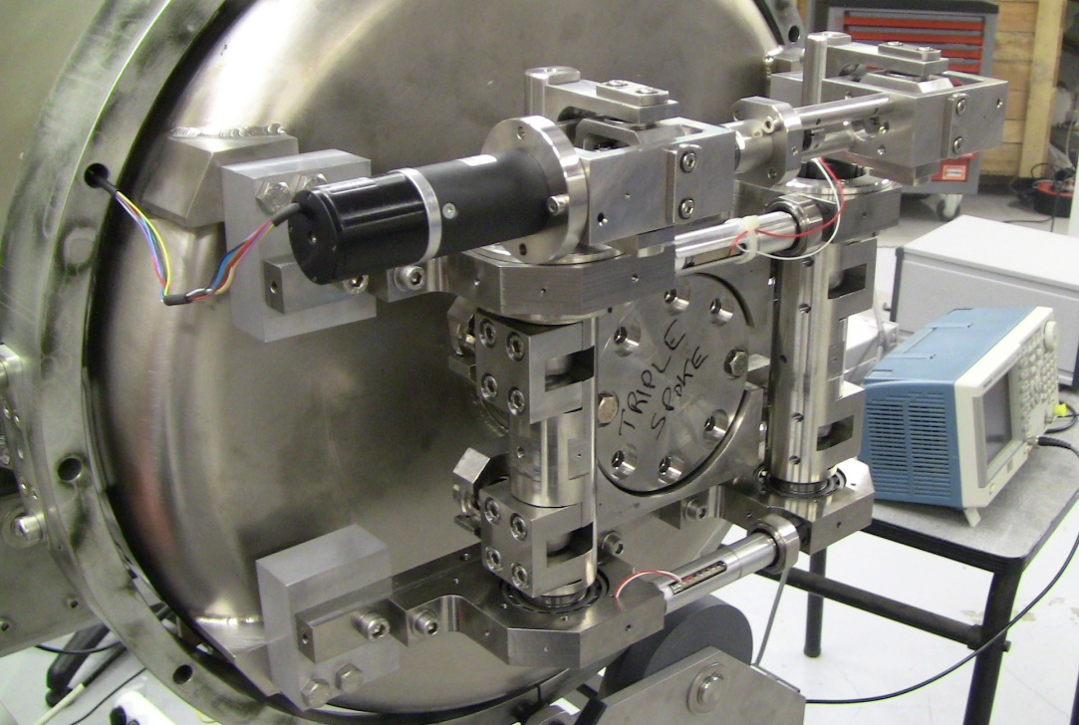
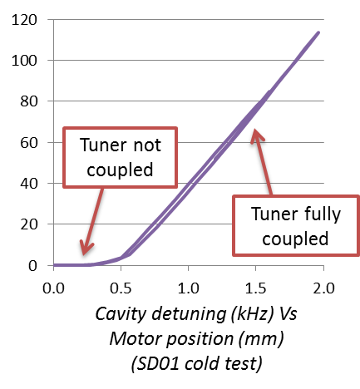
Cold tuning system design & prototype performances 2/2
4 prototypes tuners fabricated by ESIM (Fr) and tested (Cryo, VT)
With 50 mm piezos length → All specifications reached
With 90 mm piezos length (purpose: extra margin → Bad performances. Analysis in progress: pre-load? high stress (differential thermal shrink)?...
Coarse tuning range

Slide 35
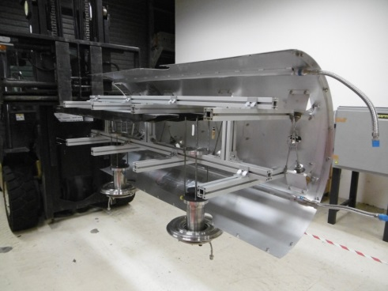
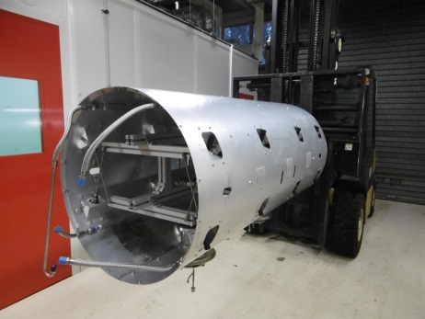
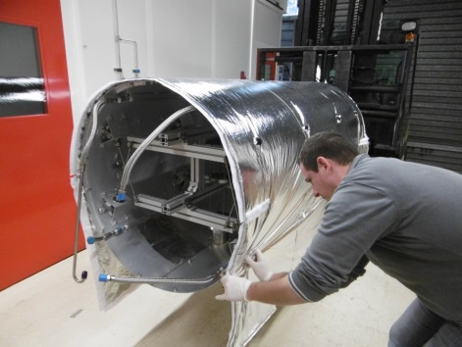
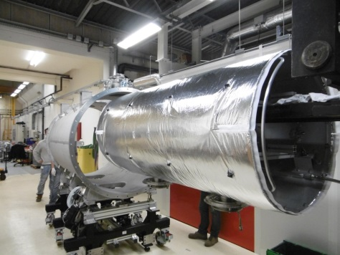
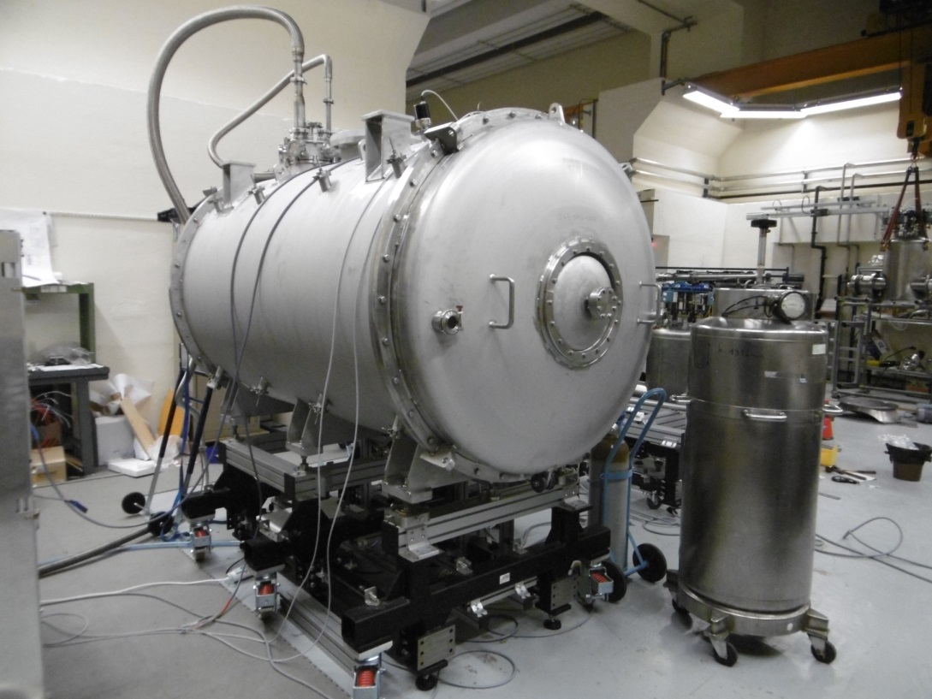
Cryomodule design & prototyping 1/2
First test at 80 K in the cryomodule (without the cavity package) in February 2016

Slide 36
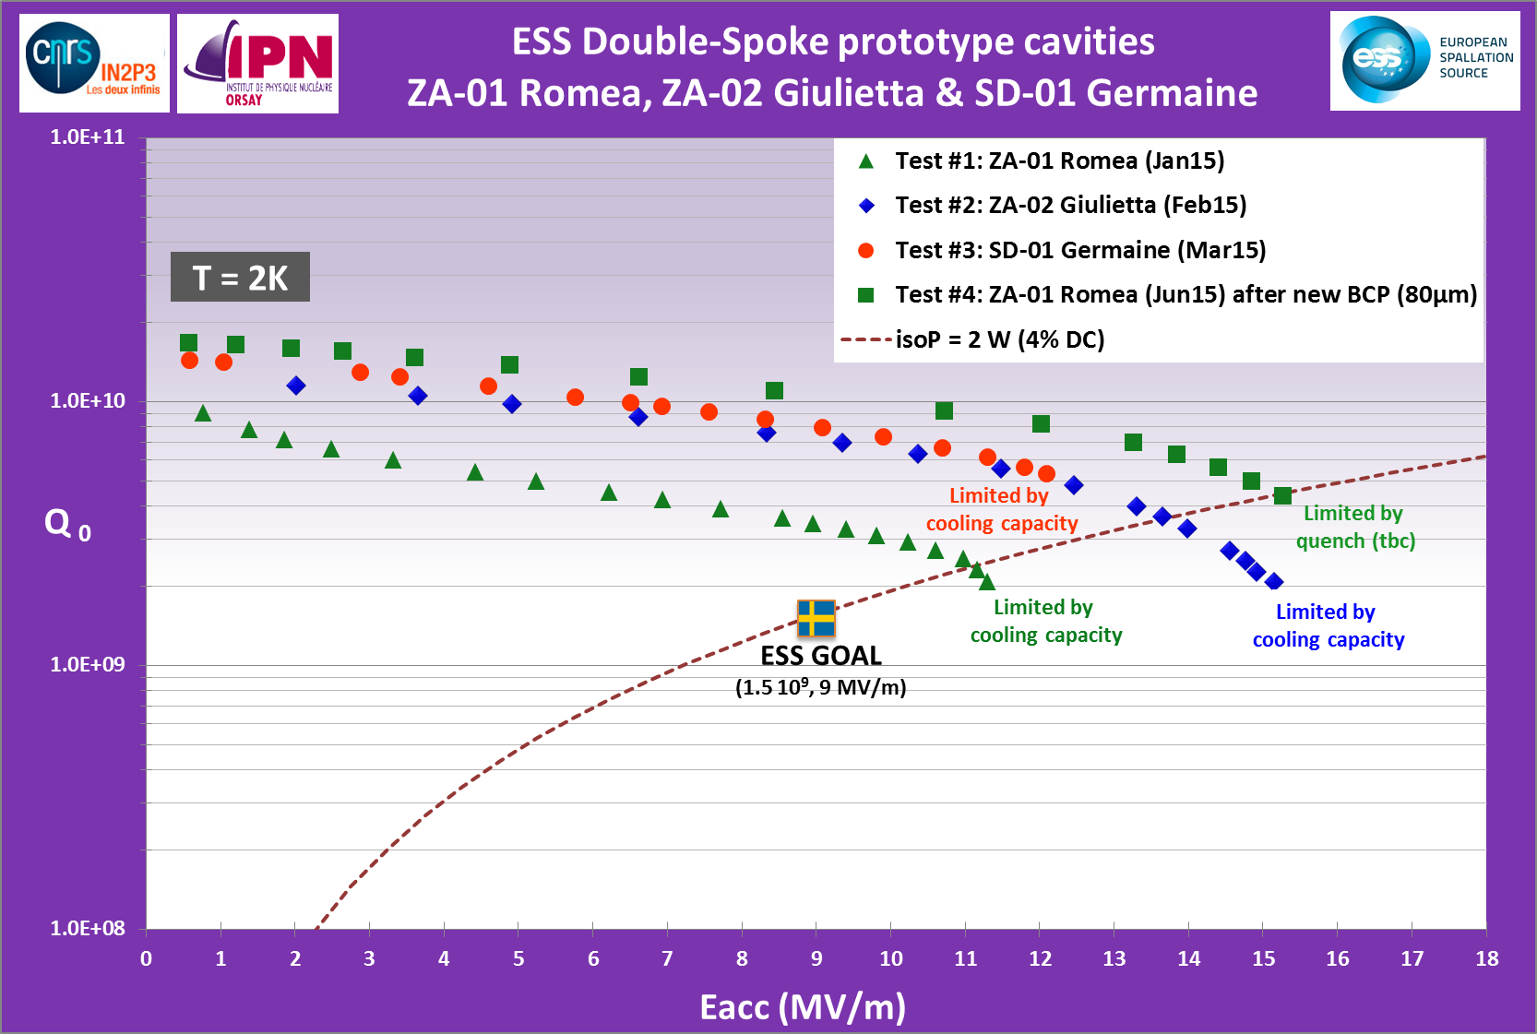
Tests in 2015
15.4 MV/m

Slide 37


Best results
Pcav<0.5W
ZA 01
Romea
ZA 02
Giulietta
SD 01
Germaine

Slide 38


Cryogenics Distribution System layout

Slide 39
PID – Spokes cryomodule

Slide 40
Operating modes

Slide 41

Spoke cryomodule
General PID

Slide 42





Spoke section: contents
Cryomodule components
Valve box
Tooling and test of components

