Slide 1
Cryomodules: Ellipticals
Felix Schlander
Accelerator and CF retreat
23 November, 2016

Slide 2
Outline
Introduction
Cavity fabrication
Transport of cryomodules
Interfaces in the tunnel

Slide 3
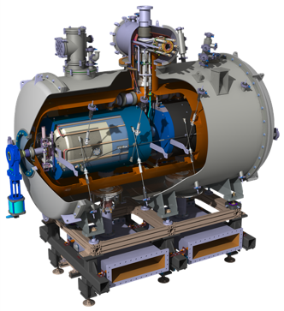
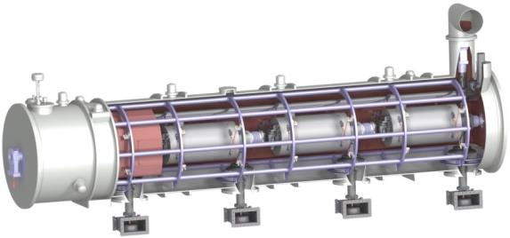
ESS cold linac
352.21 MHz
704.42 MHz
2.4 m
4.6 m
3.8 m
39 m
56 m
77 m
179 m
Target
Source
LEBT
RFQ
MEBT
DTL
Spokes
Medium β
High β
HEBT & Contingency
75 keV
3.6 MeV
90 MeV
216 MeV
571 MeV
2000 MeV

Slide 4
Elliptical cryomodule
30 modules (9 medium, 21 high beta, exterior will be identical) – 256m in tunnel (with LWU)
Ø 1.35 m
6.7 m

Slide 5
Introduction
Cavity fabrication
Transport of cryomodules
Interfaces in the tunnel

Slide 6
Cavities in cryomodule
Cavity design was chosen with the following aspects:
2 cavity types (optimised for different proton velocities)
Dimensions of cavities must fit in same type of cryomodule
Medium beta cavity (6 cells) High beta cavity (5 cells)
P. Michelato, 4th SRF Collab. Meeting 2016 M. Ellis, 4th SRF Collab. Meeting 2016

Slide 7
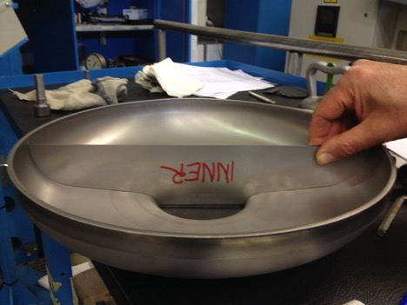
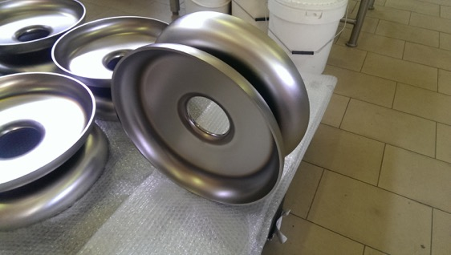
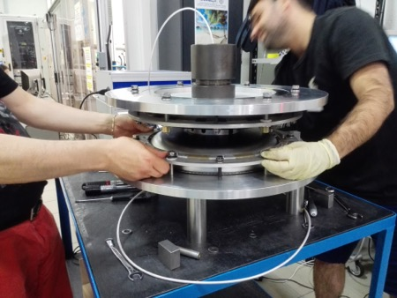
Cavity fabrication
P. Michelato, 4th SRF Collab. Meeting 2016

Slide 8
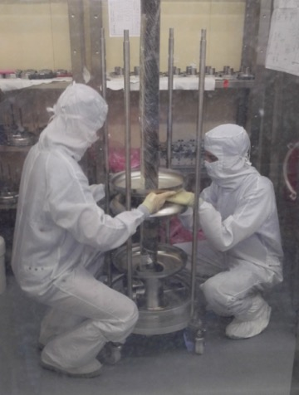
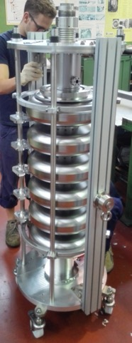
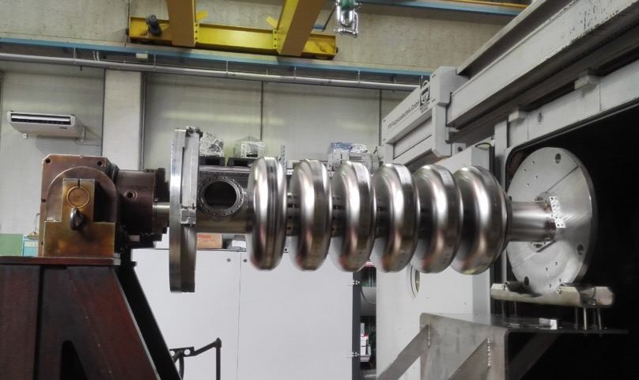
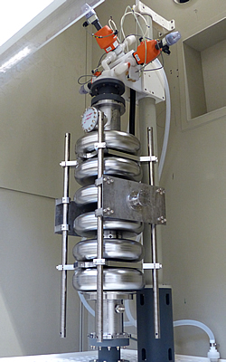
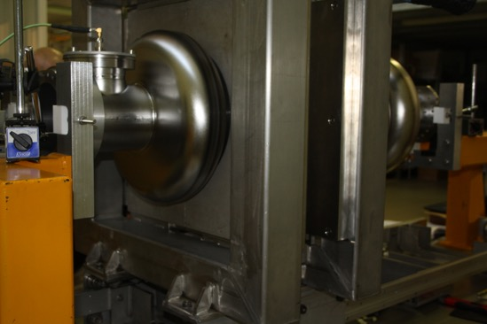
P. Michelato, 4th SRF Collab. Meeting 2016
Courtesy of CEA IRFU

Slide 9
Introduction
Cavity fabrication
Transport of cryomodules
Interfaces in the tunnel

Slide 10
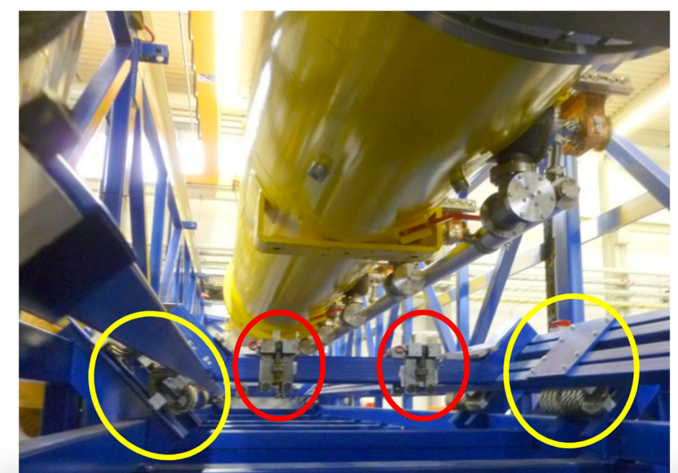
Transportation of module (XFEL example)
S. Barbanotti, MOPP021, IPAC 2014

Slide 11
Module in the tunnel
Moving and positioning of cryomodules in tunnel is currently under investigation – commercial solutions preferred …

Slide 12
Introduction
Cavity fabrication
Transport of cryomodules
Interfaces in the tunnel

Slide 13
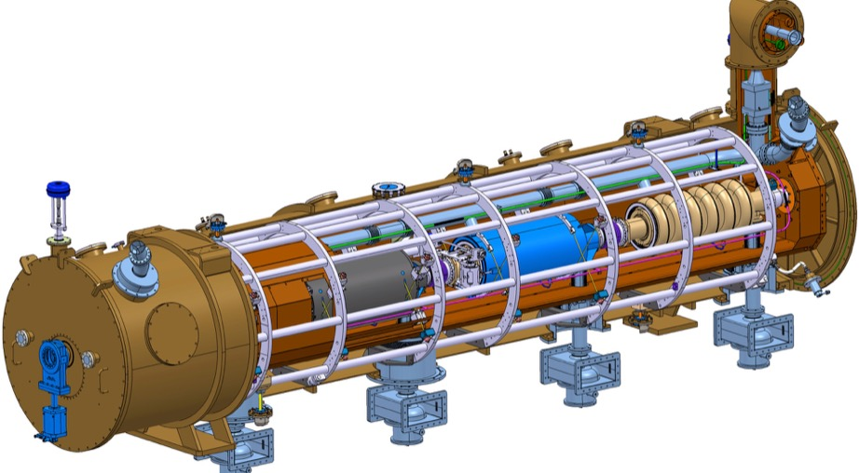
These interfaces have to be considered
Cabling
HV, Power supplies
Cryogenics
ICS
Survey & Alignment
Magnets
RF
Water Cooling
Vacuum
Cavities

Slide 14
Thank you!

