Slide 1
RFQ & MEBT
Georg Hulla
WP3 liaison officer (=“messenger”) for RFQ & MEBT
www.europeanspallationsource.se
23 November, 2016

Slide 2
If you are interested in details…
https://dl.dropboxusercontent.com/u/2477230/Accelerators%20without%20equations-W-TGT%2020131024.pdf

Slide 3
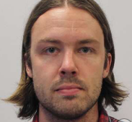
First of all!
Many thanks to Daniel Lundgren for working with me on RFQ and MEBT and providing me input for this presentation!
Unfortunately Daniel had to leave on a short notice for the bunker project… ☹

Slide 4
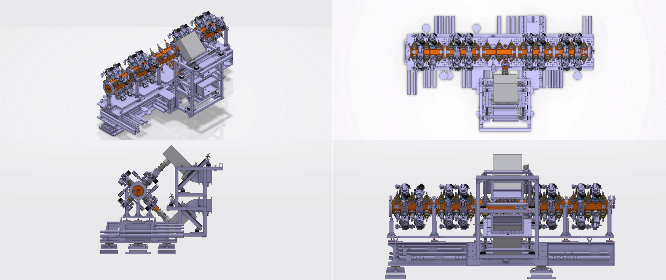
Some info about the RFQ
˜4.7m
1.5m
˜8000kg
˜2.6m
˜1.8m

Slide 5
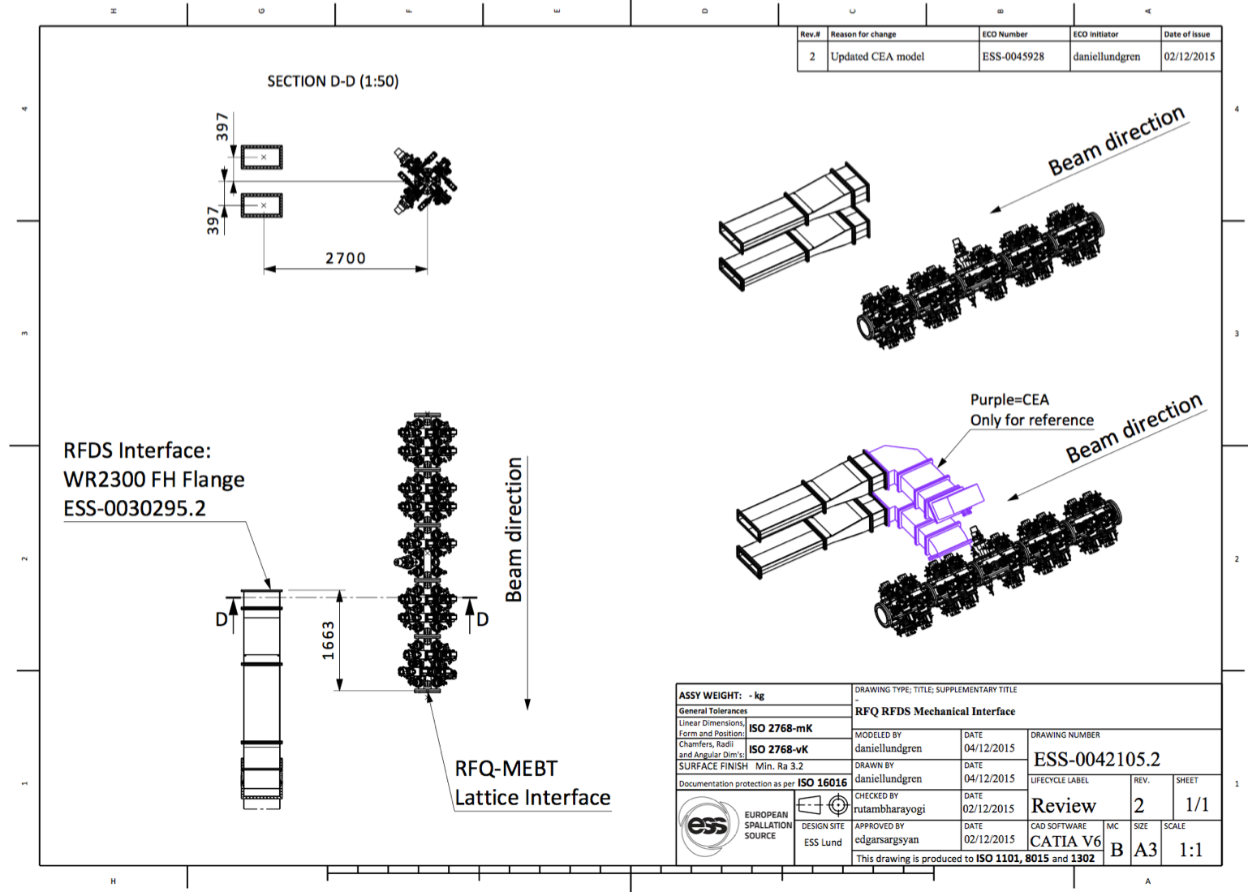
Scope and interface definitions

Slide 6
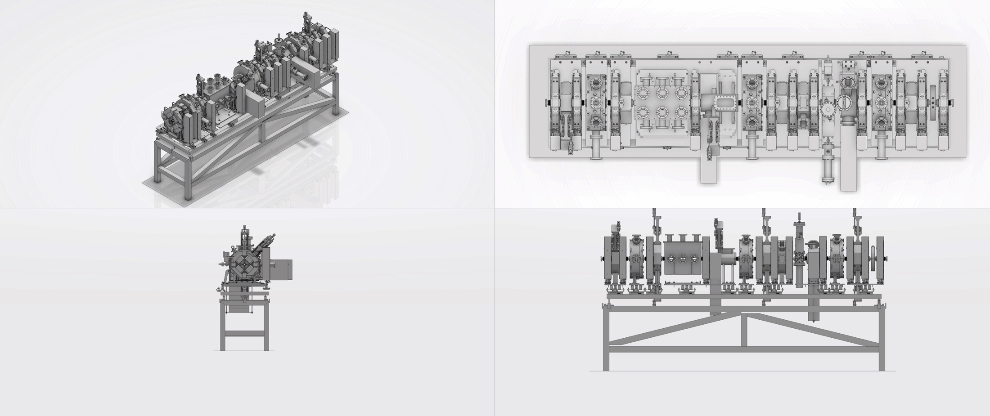
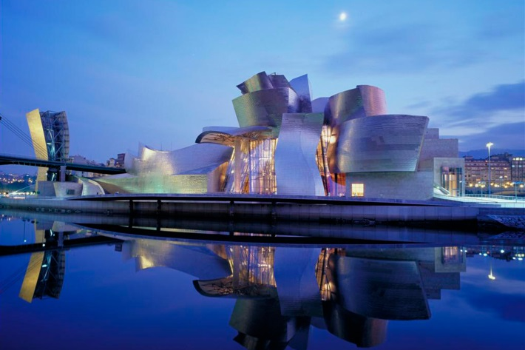
Some info about the MEBT
˜3.8m
˜4000kg
1.5m

Slide 7
Difficult assembly & alignment procedure

Slide 8
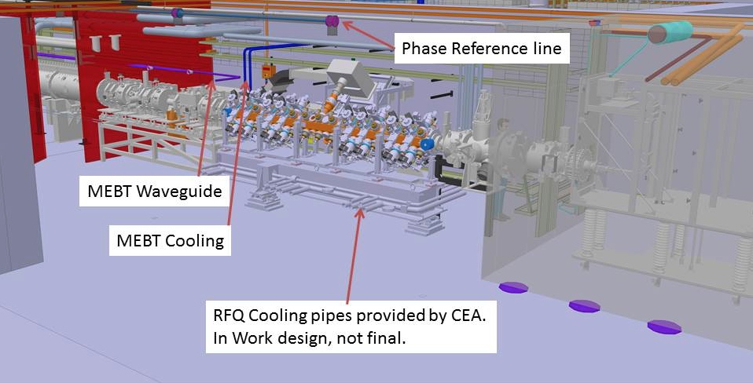
Warm Linac Tunnel

Slide 9
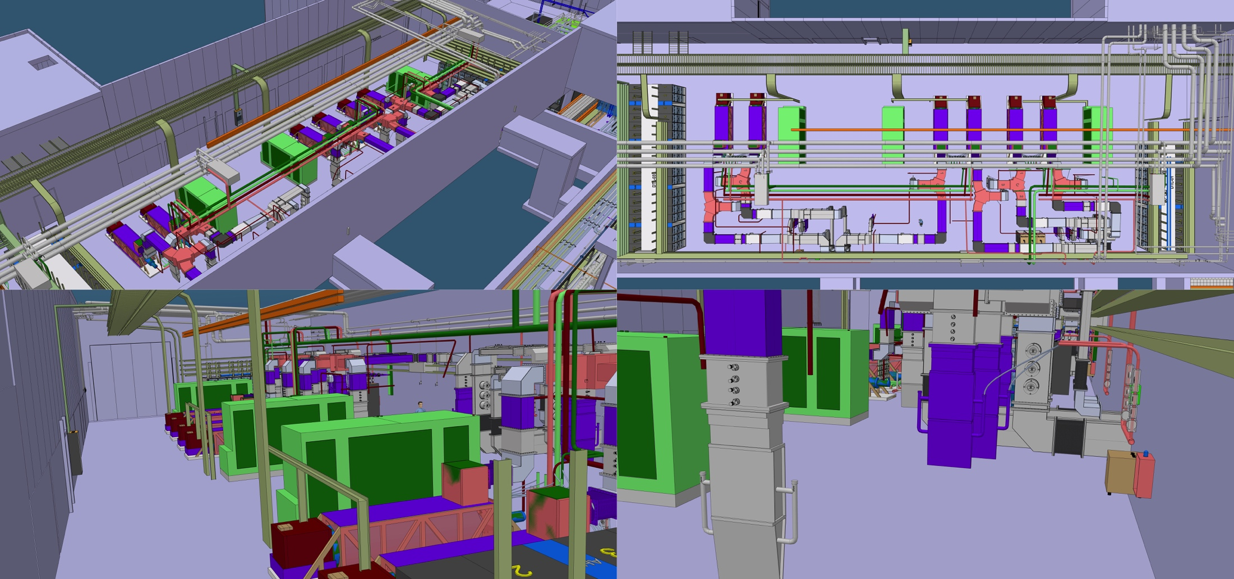
Gallery

Slide 10
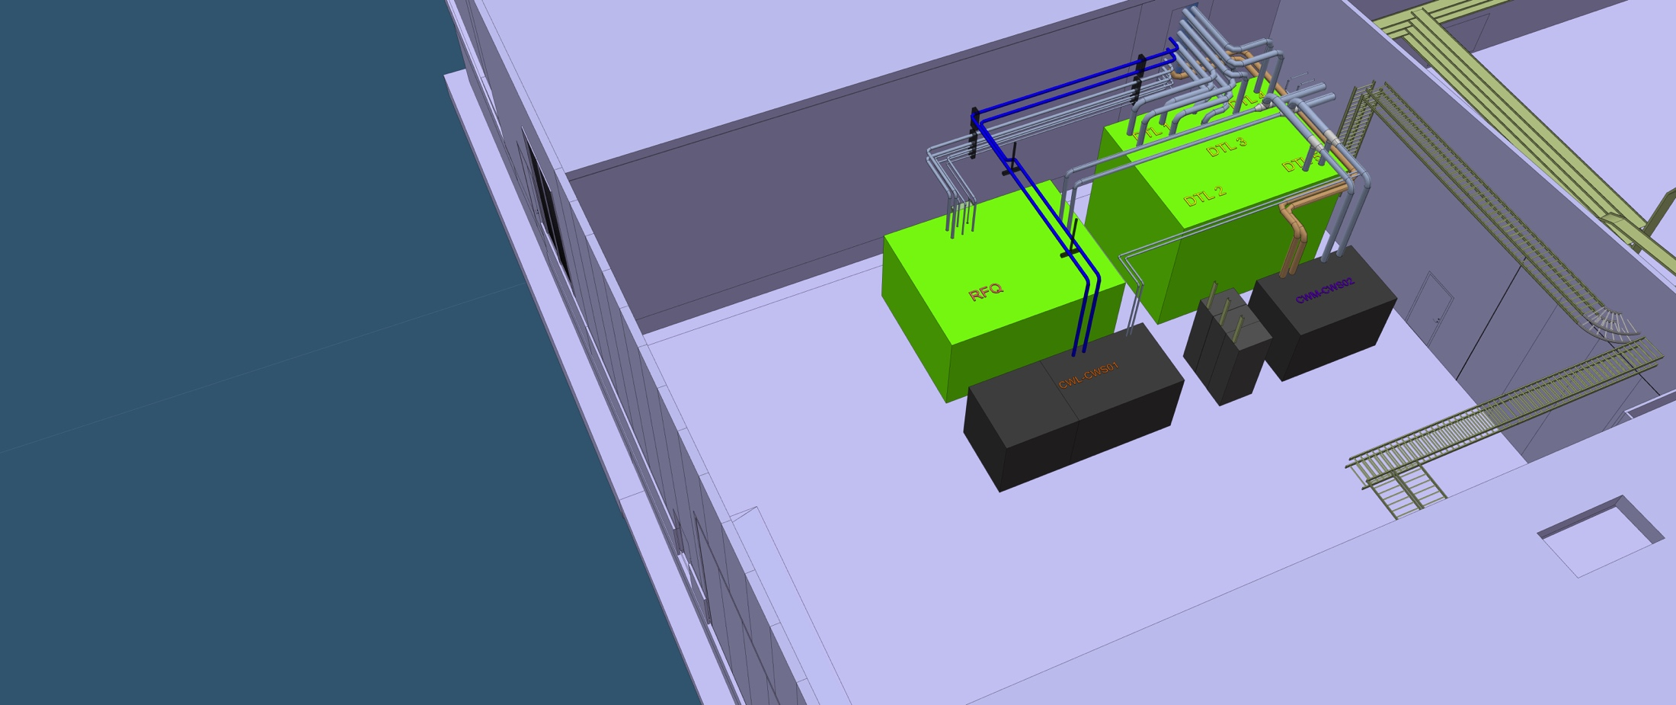
FEB100 - Cooling Skids
4m
5m
2.5m

Slide 11
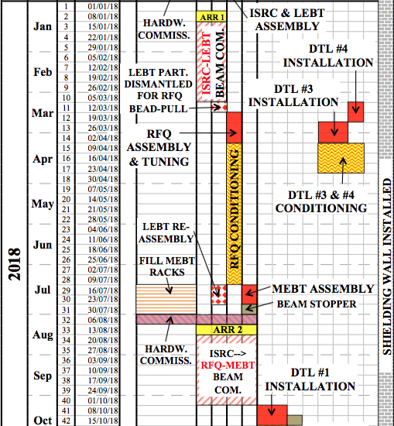
RFQ & MEBT installation planning

Slide 12
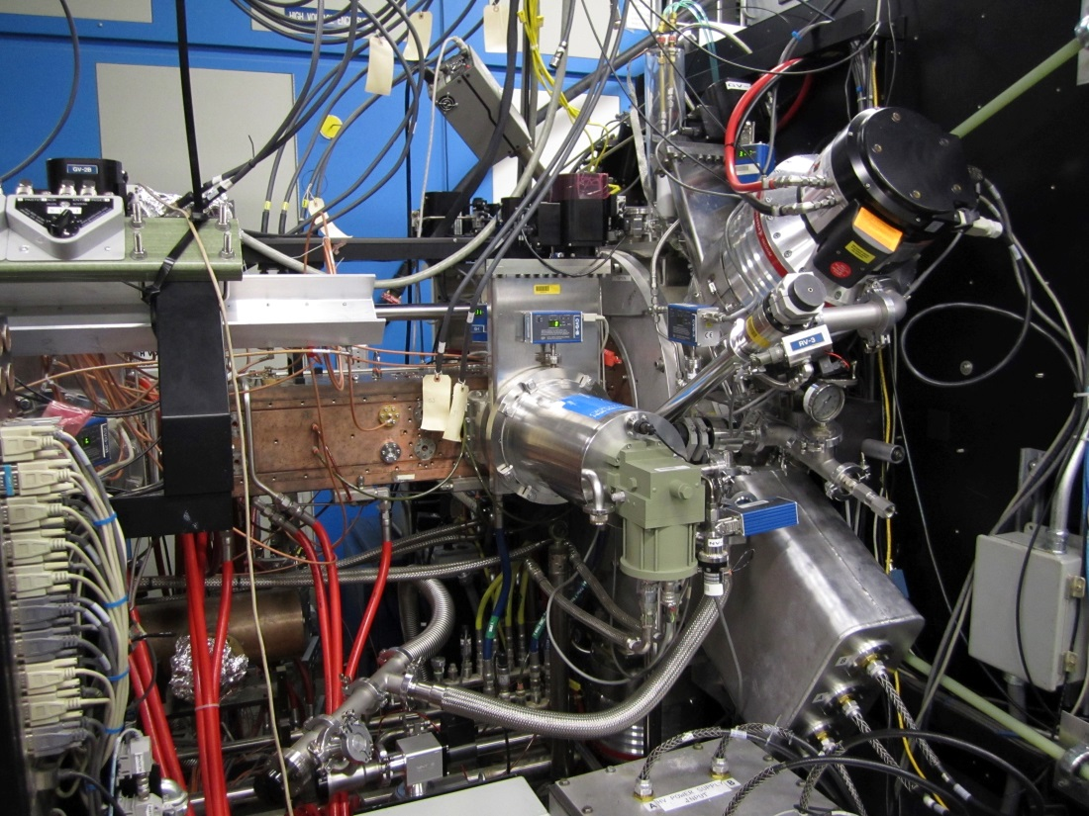
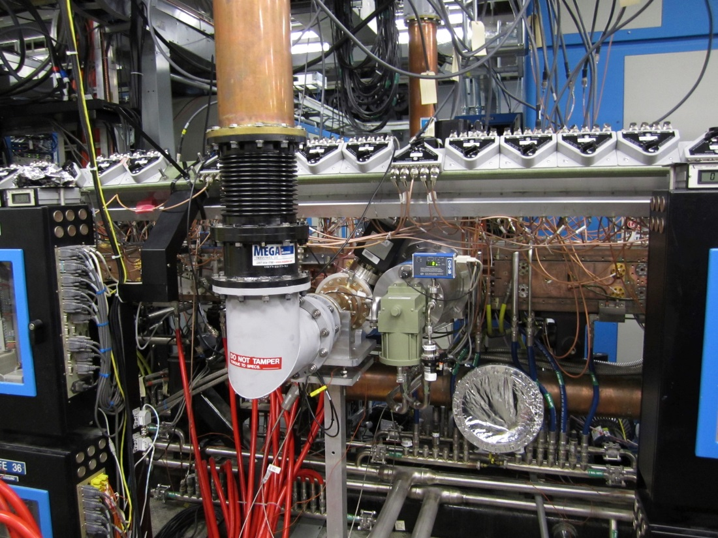
RFQ at SNS

Slide 13
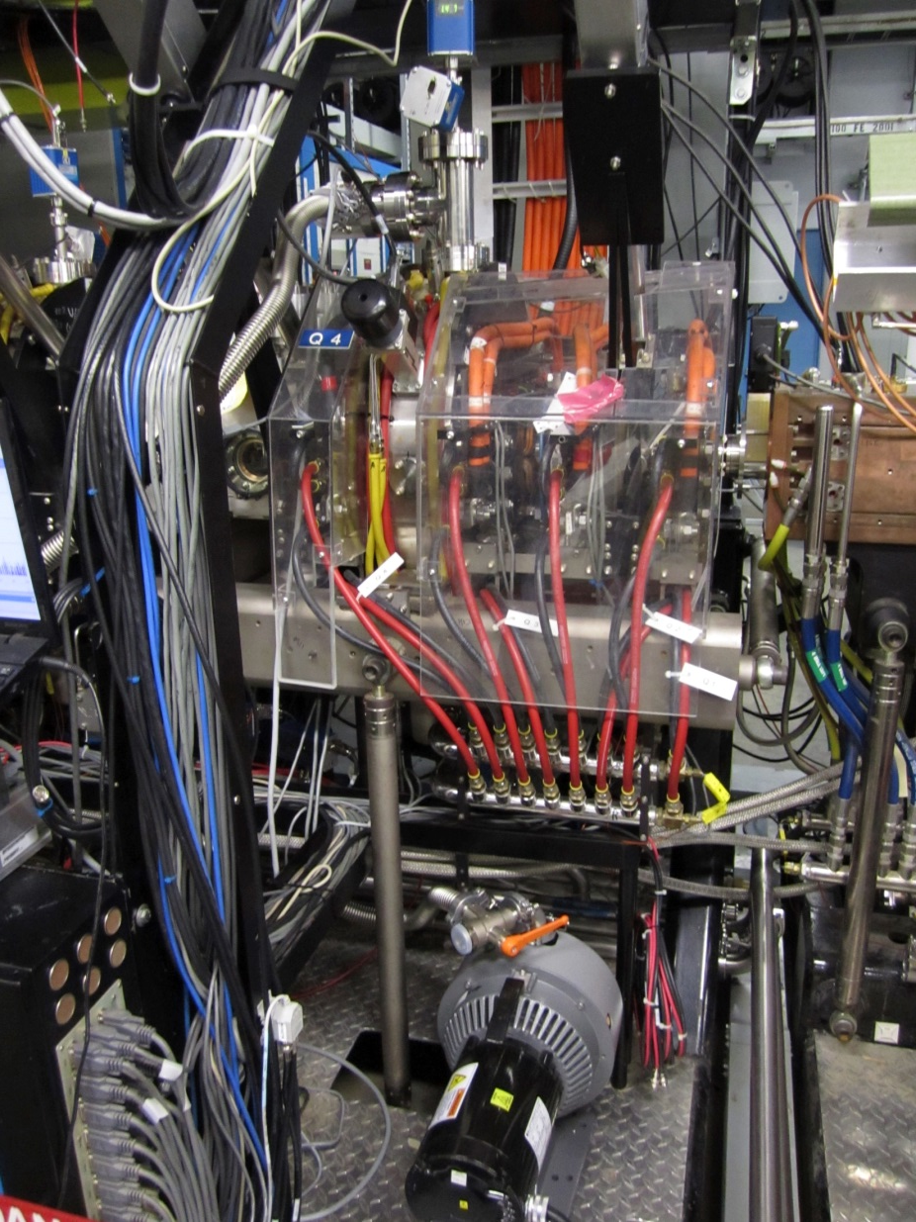
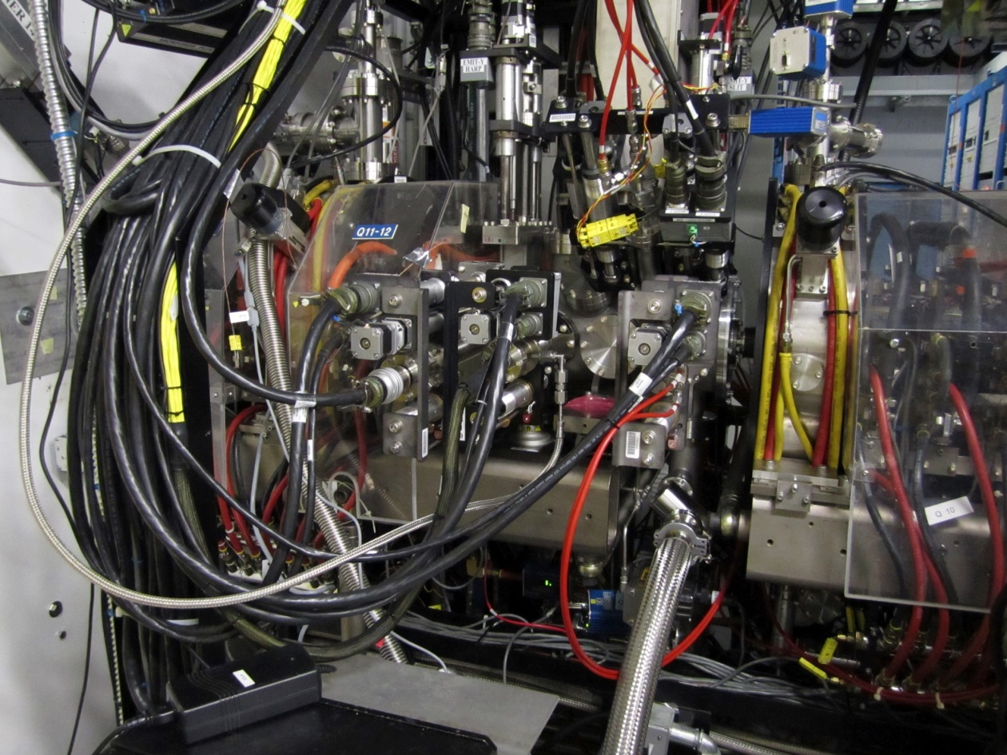
MEBT at SNS

Slide 14
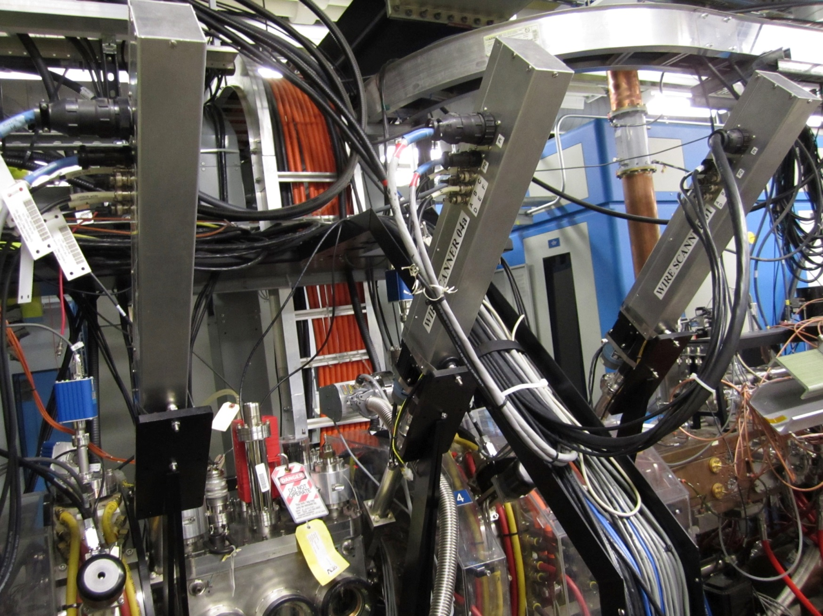
MEBT at SNS

Slide 15
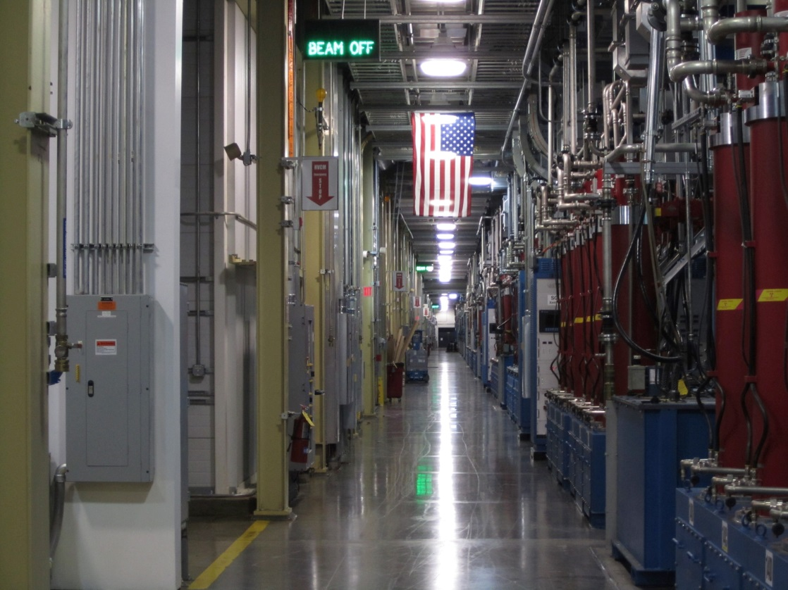
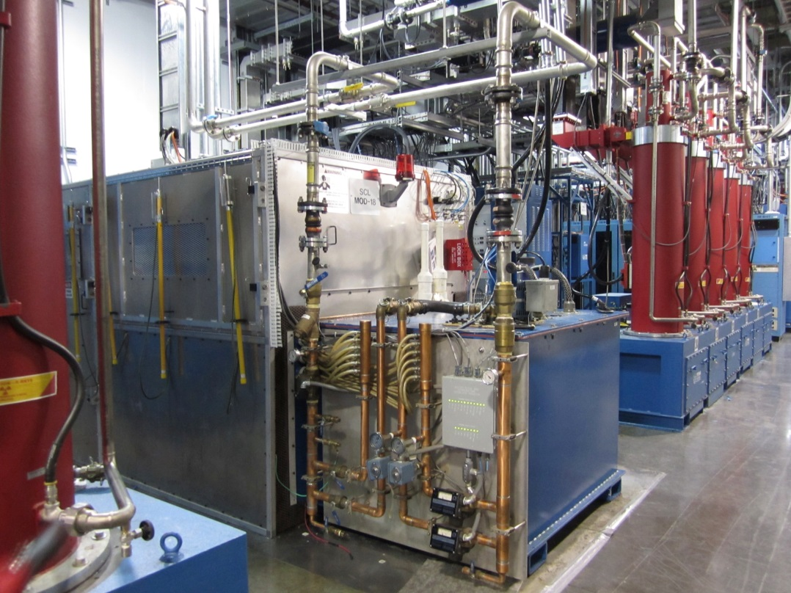
Gallery at SNS

Slide 16
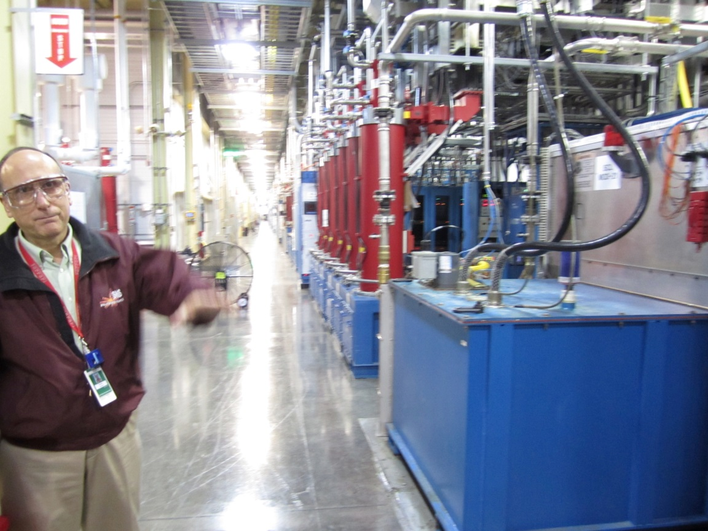
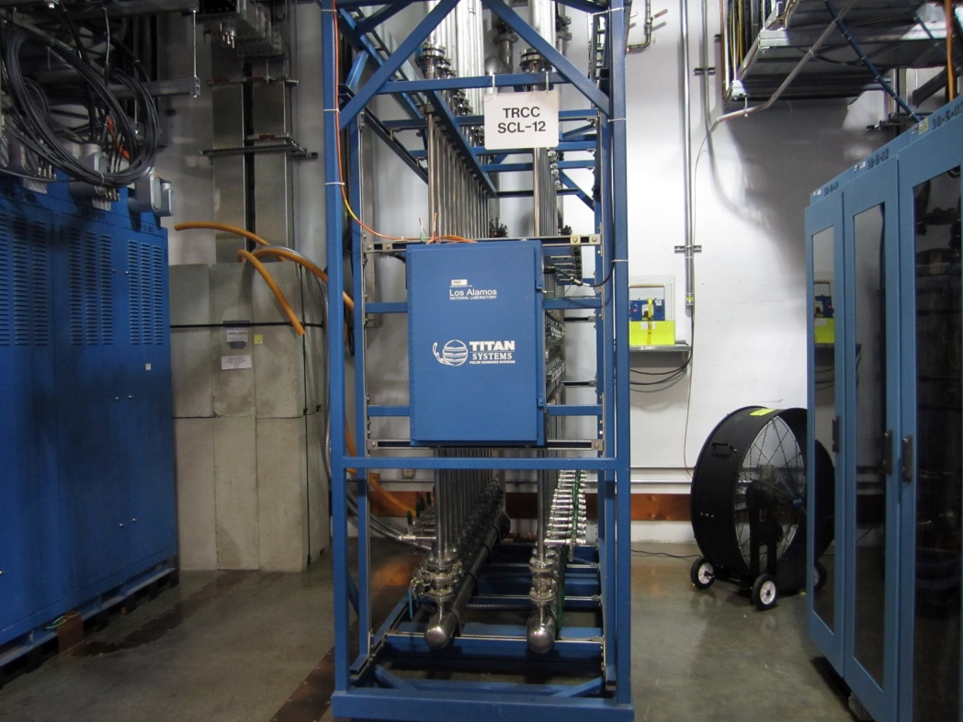
Gallery at SNS

Slide 17
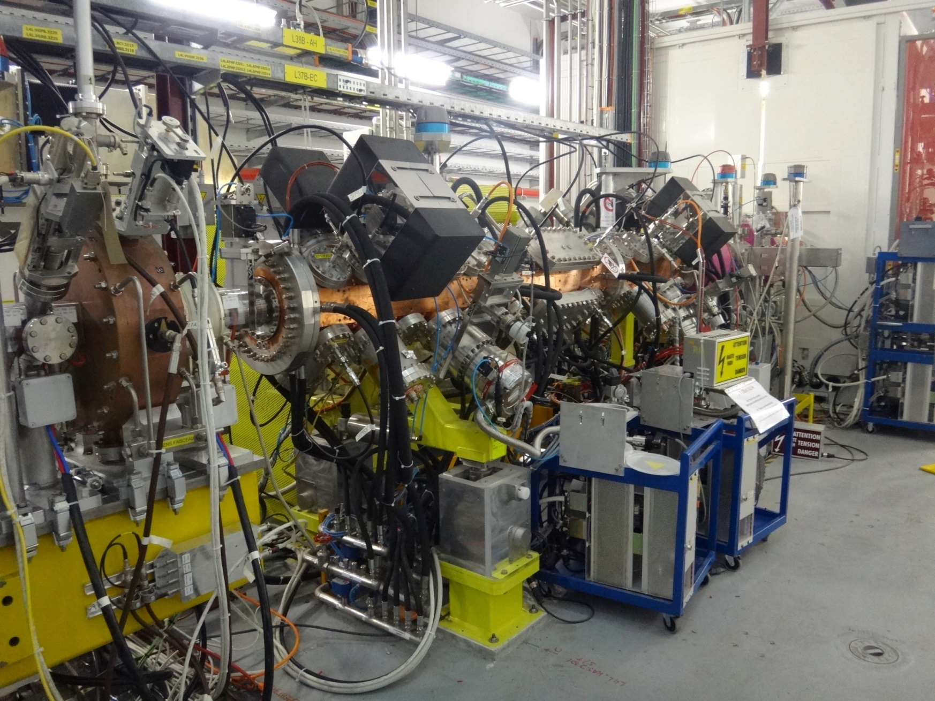
RFQ at Linac4 (CERN)

Slide 18
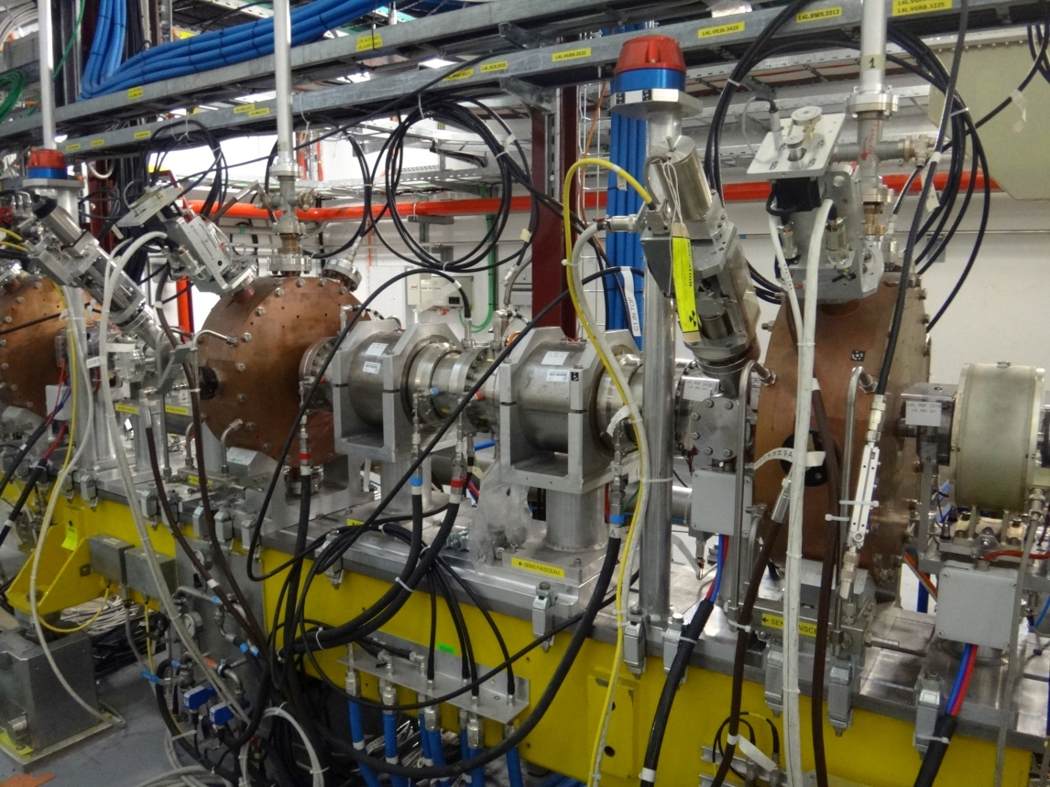
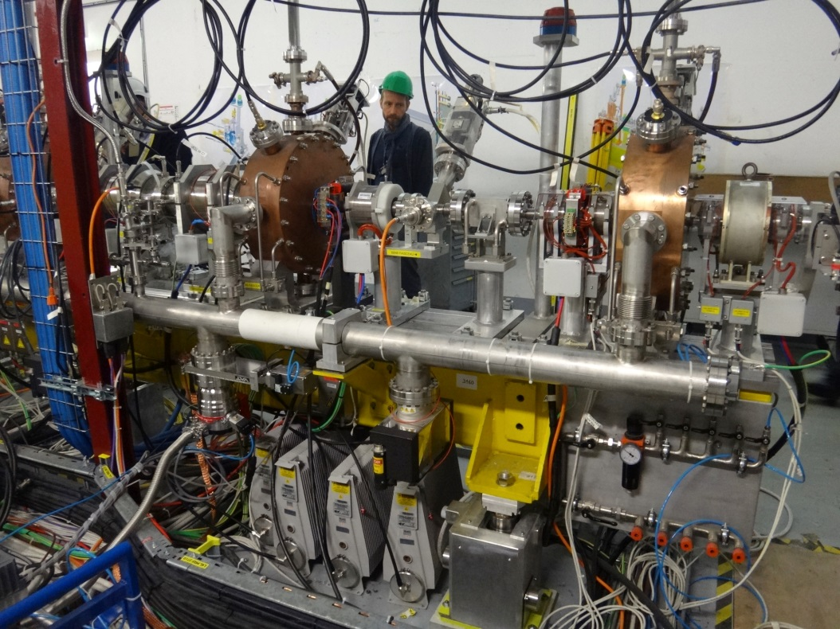
MEBT at Linac4 (CERN)

Slide 19
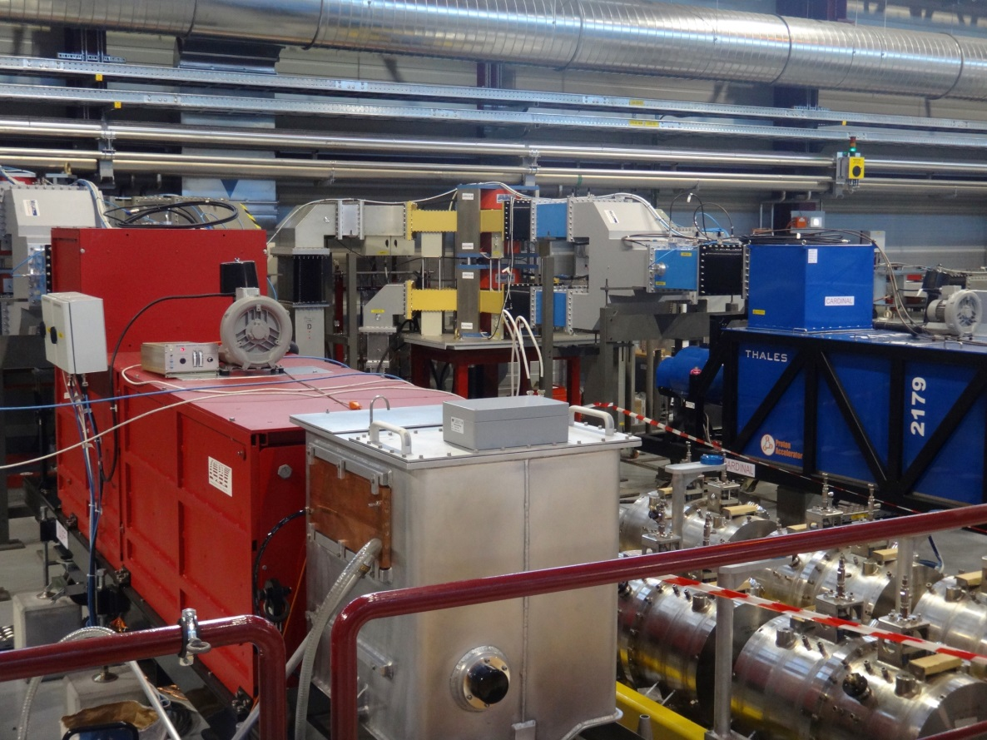
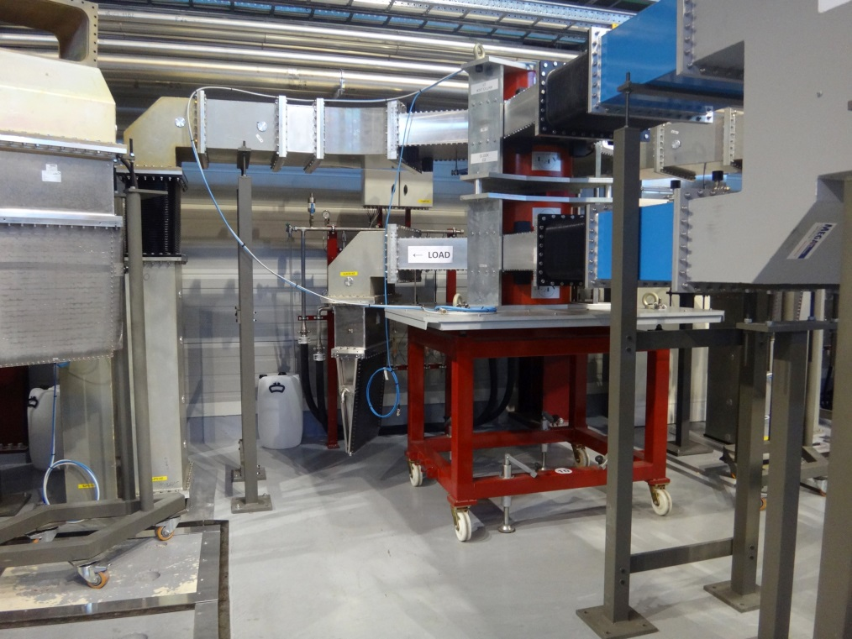
Gallery at Linac4 (CERN)

