Slide 1
LWU Description & Installation
Fabio Ravelli
Vacuum System Engineer
Specialized Technical Service – ESS ERIC
www.europeanspallationsource.se
24 November, 2016

Slide 2
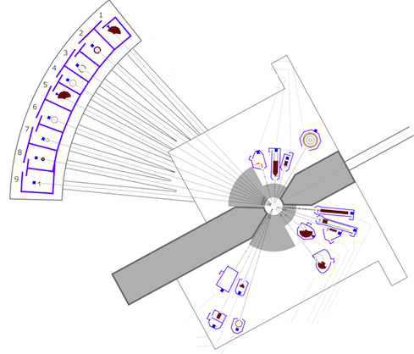
ESS Vacuum Group Mission
Target
Warm LINAC
Cold LINAC
The ESS Vacuum Group has the responsibility of “all ESS technical vacuum” of the Accelerator, Target and Neutron Instruments and associated laboratories.
During the construction phase our main task is to support the in-kind-contributors (IKC’s) in the design of the required vacuum systems.
The Primary goal is to have a homogeneous vacuum design throughout the ESS complex.
Neutron
Instruments

Slide 3
Vacuum Standardization
Our primary goal is to promote the use of common vacuum equipment selection and common design and fabrication standards by a close collaboration with our partners. In 2014 a Vacuum Standardization meeting took place and a list of equipment suitable for Standardization was selected (ref. ESS Vacuum Handbook)
An important element of Standardization is the Procurement Policy by which we ask the IKC’s to participate to a single Framework Agreement for all of their vacuum component requirement
The ESS Vacuum documents (handbooks, rules or interface documents) are the most important documents and cover the requirements for the accelerator, target and instruments
http://europeanspallationsource.se/accelerator-documents

Slide 4
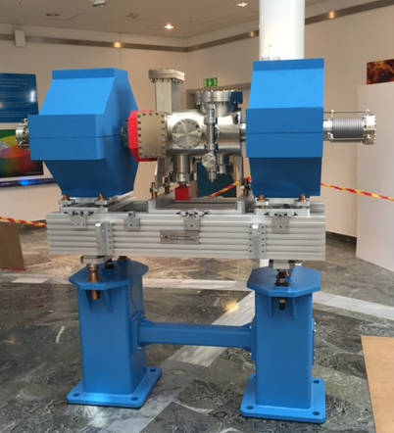
The Meaning of “LWU”….
….Linac Warm Unit
These are Components (Units) of the Linear accelerator (Linac) installed between two adjacent cryo-modules that operate at RT (thus Warm)
IKC of ESS Vacuum from UK
75 LWU’s are going to be built by our IKC, Science & Technology Facilities Council, Daresbury UK, to be delivered to ESS in the time frame 2017 – 2019 (1 prototype already delivered, an additional one will be delivered beginning 2017)
The unit weighs approximately 400 kg without magnets

Slide 5
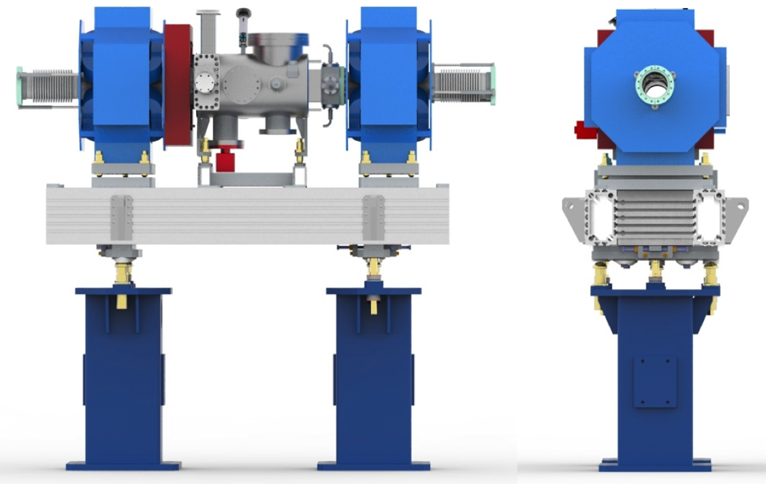
LWU Overview
Aperture for sand or flange for the transportation rolls and the interconnecting transport beam.
Pedestal: 170 kg, support the unit, dump vibrations, they have hollow design and they can be filled with sand to improve damping

Slide 6
LWU Overview
Electromagnets: they steer and “shape” the proton beam, mounted on high precision alignment fixtures
Girder: Aluminum profile structure, allow coarse adjustment in beam direction. It is connected to the pedestals though high precision adjustment fixtures and it carries on top the active LWU components. Can be used to support cables, patch panels and water cooling pipes.

Slide 7
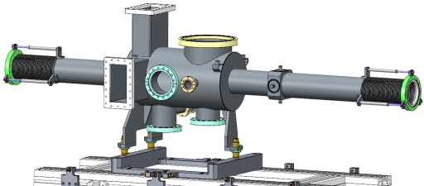
LWU Overview
Hydro-formed bellows: low particle generation, when compressed they allow the LWU insertion between two cryo-modules. They also provide an alignment of the chamber independently from the magnets
UHV chamber capable of 10⁻¹⁰ mbar vacuum or better
Vacuum Chamber: stainless steel vessel, particle free cleaning, UHV fabrication standards, offers vacuum continuity between cryo-modules, it hosts vacuum pump, gauges and beam instruments to measure beam parameters. Mounted on high precision aligning fixture.

Slide 8
LWU Overview
Wire scanner: can tell how the protons are distributed in the beam
Vacuum gauges from atmosphere to 1 x 10⁻¹⁰ mbar
BPM (Beam Position Monitor): detect the location of the center of the beam
UHV Vacuum Pump (NEG and SIP combination)

Slide 9
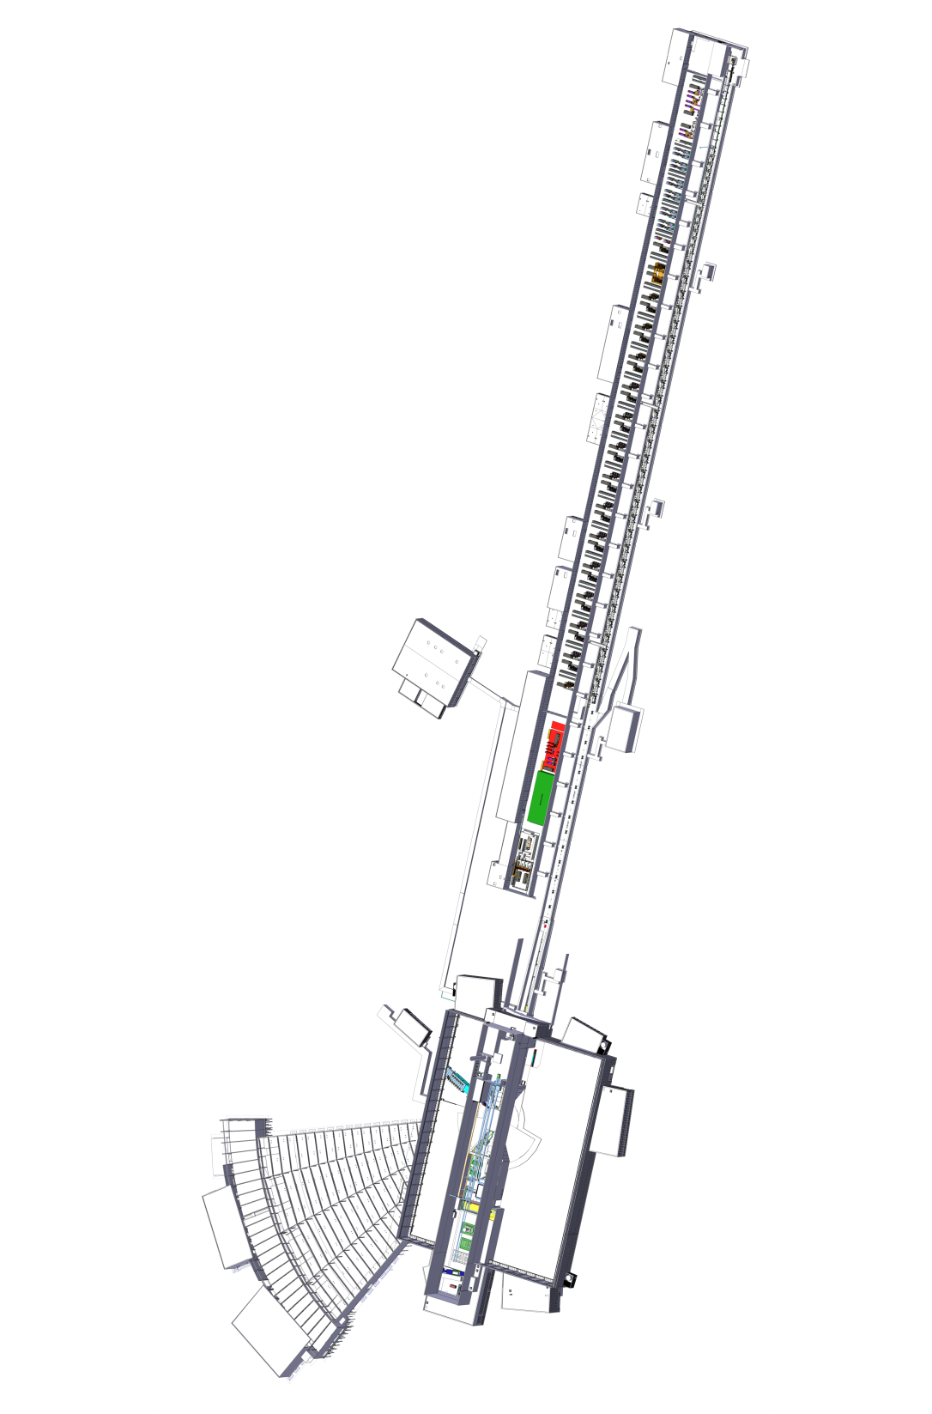
Installation Lay-out
Some of the LWU’s are located between 2 superconducting radio frequency cryo-modules
13 in Spokes
9 in Medium β
21 in High β
And 32 in HEBT/A2T/DPL

Slide 10
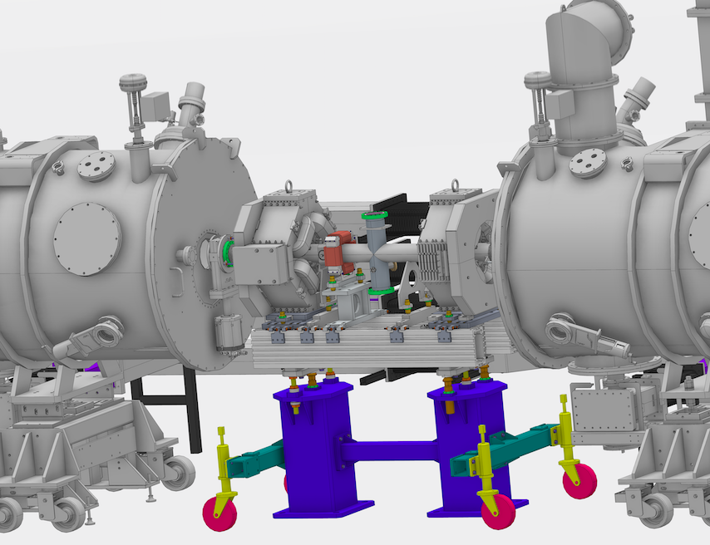
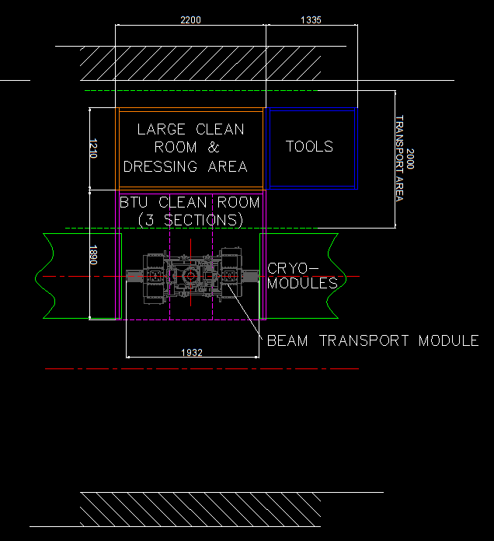
LWU Particle Free Installation
The connection to the cryo-modules must be performed in a particle free environment, as any particle entering will decrease the efficiency of the superconducting cavities
Portable clean rooms are used in the tunnel for installation

Slide 11
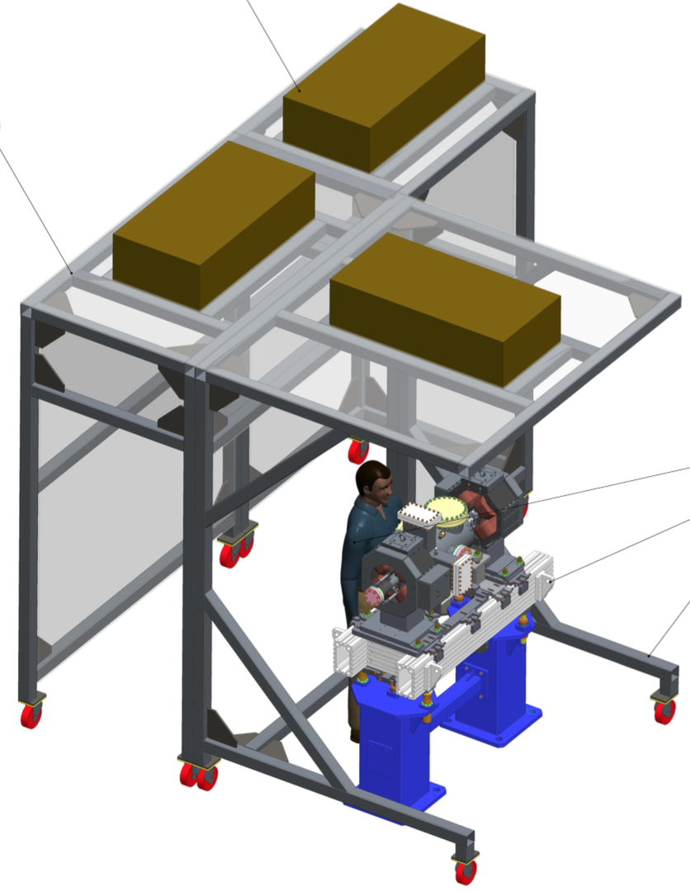
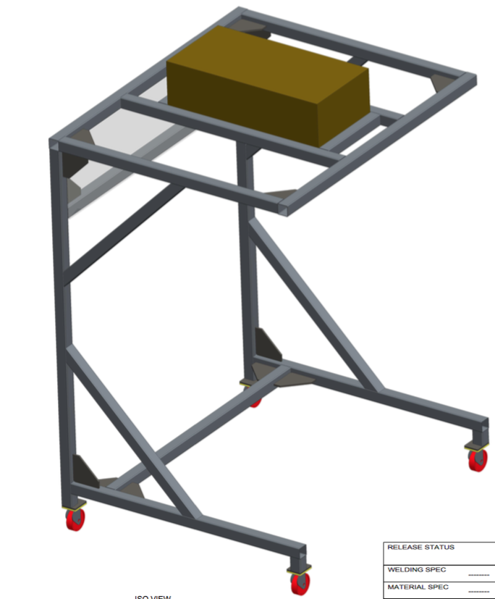
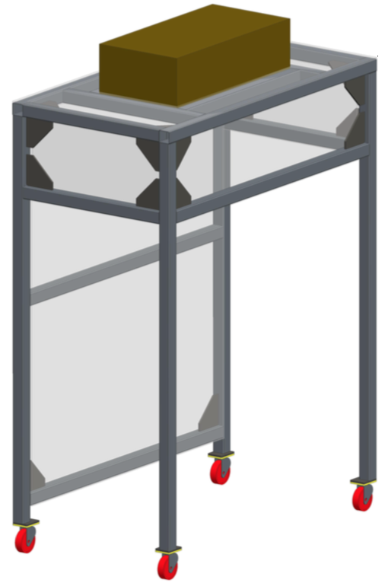
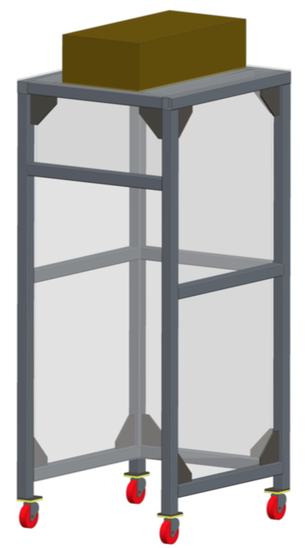
Portable Clean Room Basics
HEPA Filters
Three separate units with different cleanness level: a gowning/dressing room, a stock room for tools and components and the LWU room (ISO 5 condition) LWU CR has a cantilever design to allow the insertion across the beam pipe
Equipped with ceiling mounted HEPA filters
With rigid walls and soft-wall
Equipped with particle counter and cleaning station
Stock Room
Soft-walls not showed
LWU Room
Gowning Room

Slide 12
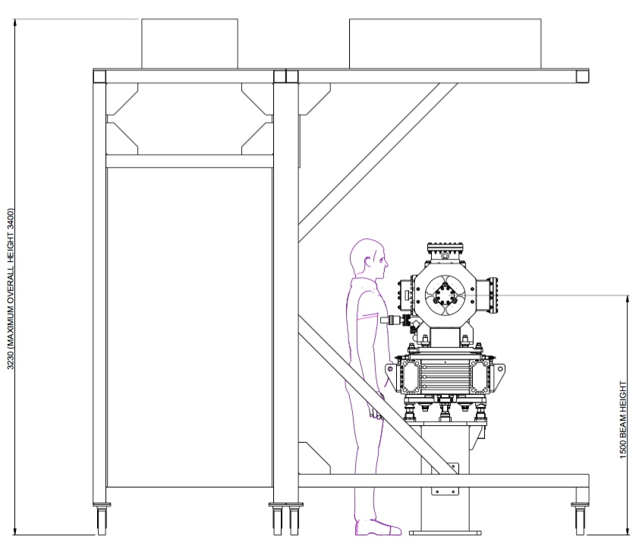
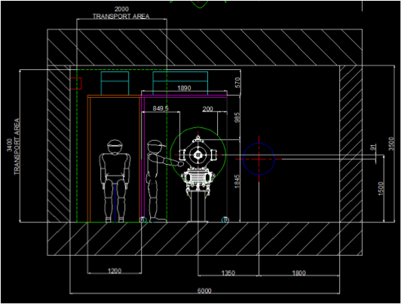
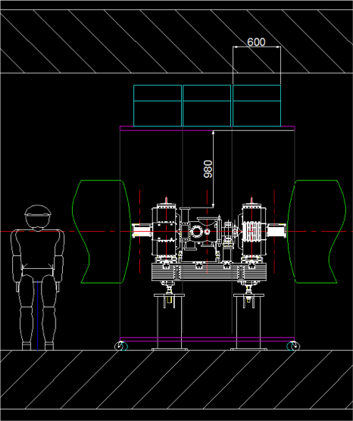
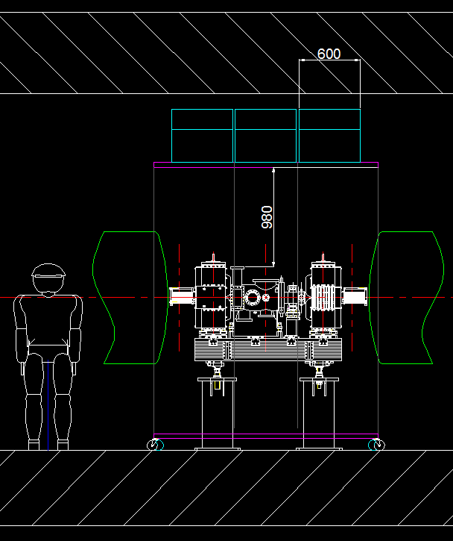
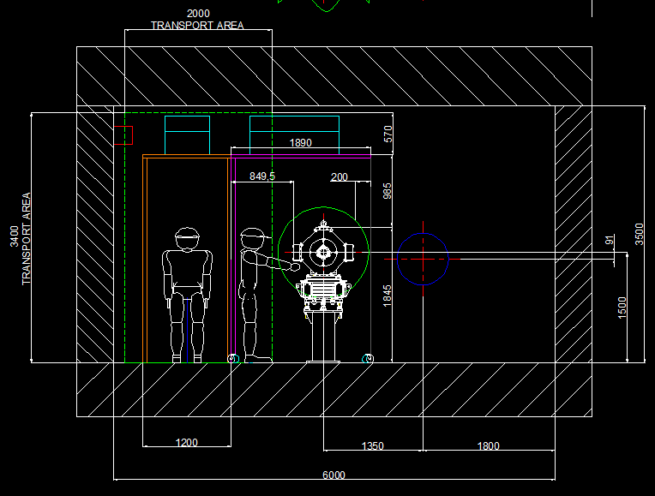
Portable Clean Room Basics
Once moved in position, the clean room will be put in operation and the actual work can only start when the clean room reaches the ISO 5 specification. It will take up to two weeks to complete an instrument installation in the tunnel.

Slide 13
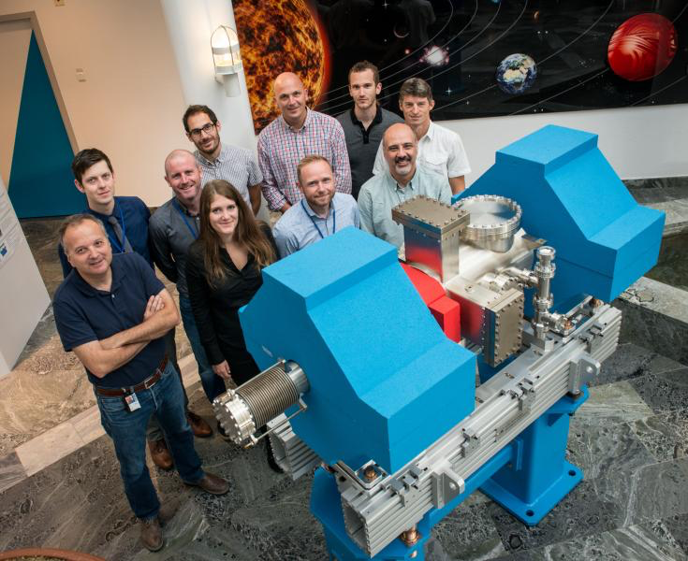
The ESS – STFC LWU Team!
Thank you for your attention!

