Slide 1
Installation Consideration for Phase Reference Distribution System at ESS
Rihua Zeng
RF Group, Accelerator Division
2016-Nov-24

Slide 2
Outline
What is Phase Reference Distribution System(PRDS) at ESS?
What is Challenges of RFDS and Solutions?
Installation Challenges

Slide 3
Similar to SNS

Slide 4
Where Is It at ESS Tunnel?

Slide 5
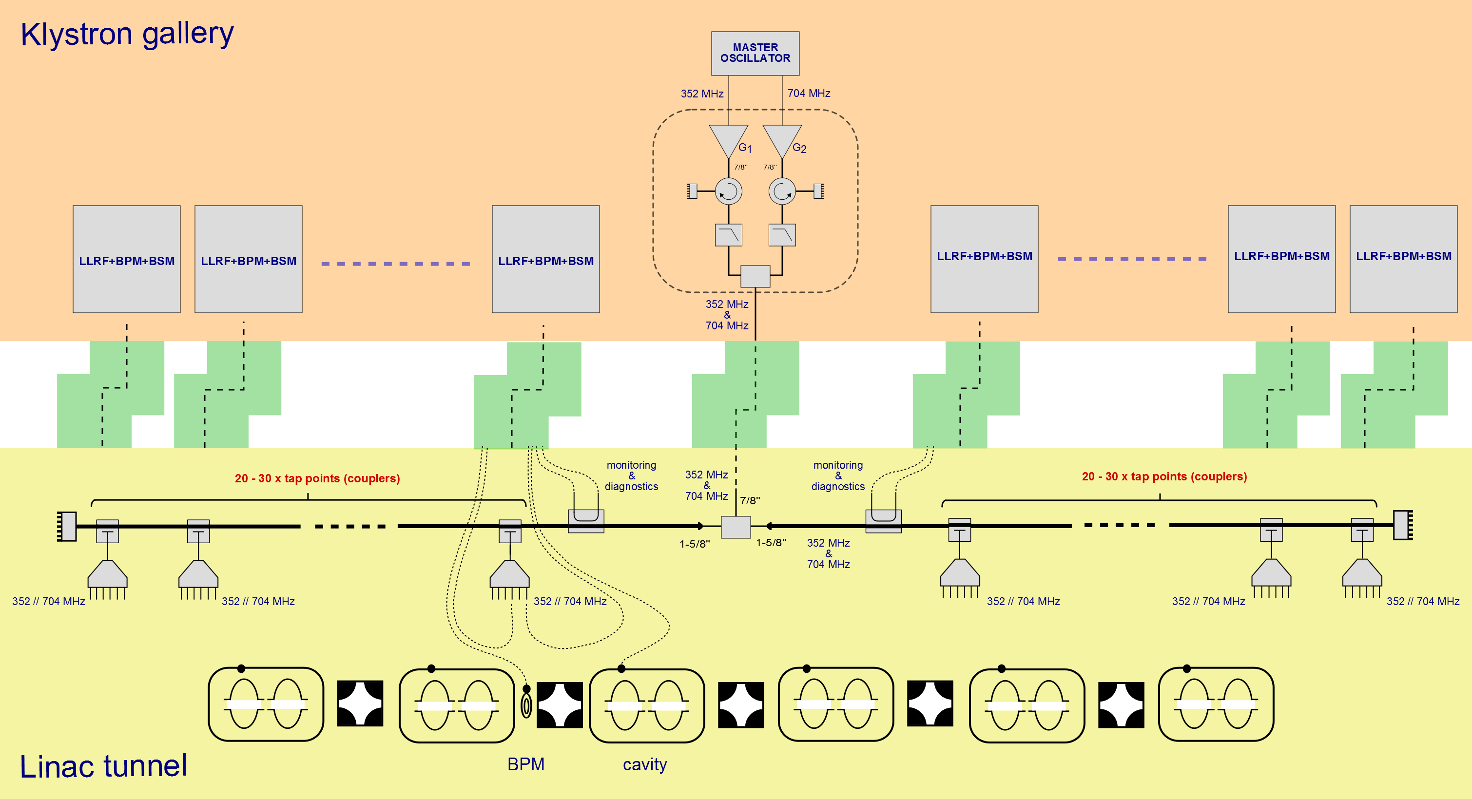
System Overview

Slide 6
Challenge of Phase Reference Line
No two points in the linac further than ±2° of phase (at 704.42MHz)
Length change of the whole line (600 meters) should be:
ΔL(T, P) < ±2 mm

Slide 7
Factors Affecting Length
Thermal Expansion
Humidity/Air Pressure Change inside Pipe

Slide 8
Solutions
Temperature control for the whole line within ±0.1°C
Pressurized dry air or nitrogen gas filling to the line

Slide 9
Temperature Control for 600m Line
Divide 600 meters into around 70 zones(8.52 meter, half STUB length)
Each zone is individually controlled with PID control for heating cables
Each zone is insulated by insulation pipes

Slide 10
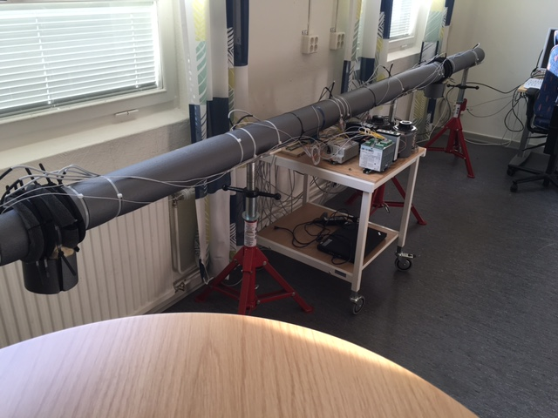
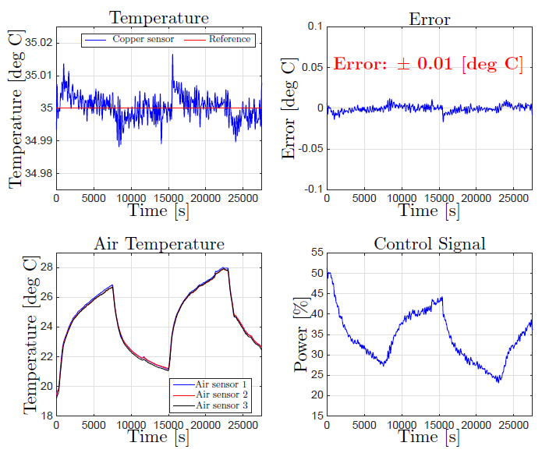
Temperature Control Prototype
±0.01°C achieved in 1.5 meter line with one directional coupler
±0.05°C achieved in 5 meter line with two directional couplers

Slide 11
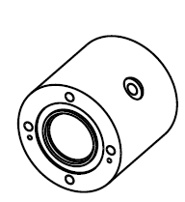
Pressure and Humidity stabilization
Compressed air or nitrogen gas in discussion
Two step pressure reduction
Silica gel filters to stabilize humidity
Electronic barometric sensors
Electronic flow meter

Slide 12
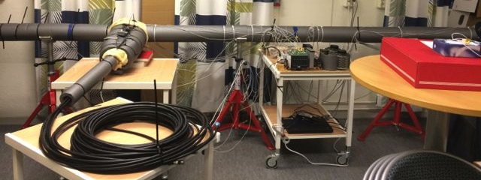
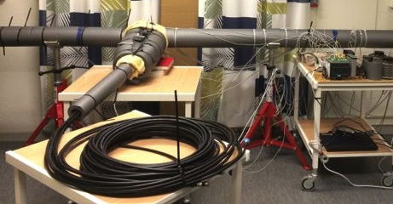
Installation Challenges
Not only the pipe itself
✕70
…..
…..

Slide 13
Installation Challenge(In-Kind from Poland)

Slide 14
Installation Challenge
Thanks!

