Slide 1
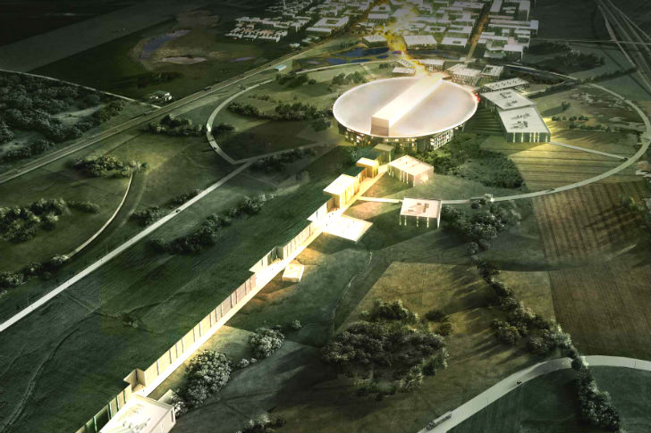
Gallery - Modulators
Paulo J Torri
ESS – Accelerator Division - RF
Power Converters Section
www.europeanspallationsource.se

Slide 2
ESS Linac Project and Modulator requirements
target
tunnel
RF gallery

Slide 3
ESS Linac Project and Modulator requirements
ESS Linac layout
Pulsed Linac:
Beam pulse length = 2.86 ms
Pulse repetition rate = 14Hz
Beam pulse power = 125 MW
Beam average power = 5 MW

Slide 4
Modulators for High Power RF sources
RF Power
CAVITY
BEAM

Slide 5
Modulators for High Power RF sources
RF AMPLIF.
(KLYSTRON)
RF Power
CAVITY
Control
RF
BEAM

Slide 6
Modulators for High Power RF sources
RF AMPLIF.
(KLYSTRON)
RF Power
CAVITY
115 kV
100 A
3,5 mS
14 Hz
Control
RF
BEAM

Slide 7
Modulators for High Power RF sources
MODULATOR
RF AMPLIF.
(KLYSTRON)
RF Power
CAVITY
115 kV
100 A
3,5 mS
14 Hz
Control
RF
BEAM

Slide 8
Modulators for High Power RF sources
AC Electrical Network
MODULATOR
RF AMPLIF.
(KLYSTRON)
RF Power
CAVITY
115 kV
100 A
3,5 mS
14 Hz
Control
RF
BEAM

Slide 9
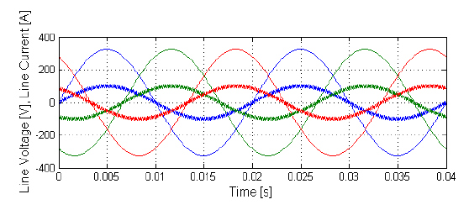
Modulators for High Power RF sources
AC Electrical Network
MODULATOR
RF AMPLIF.
(KLYSTRON)
RF Power
CAVITY
115 kV
100 A
3,5 mS
14 Hz
Control
RF
BEAM

Slide 10
Modulators for High Power RF sources
AC Electrical Network
MODULATOR
RF AMPLIF.
(KLYSTRON)
RF Power
CAVITY
115 kV
100 A
3,5 mS
14 Hz
Control
RF
BEAM

Slide 11
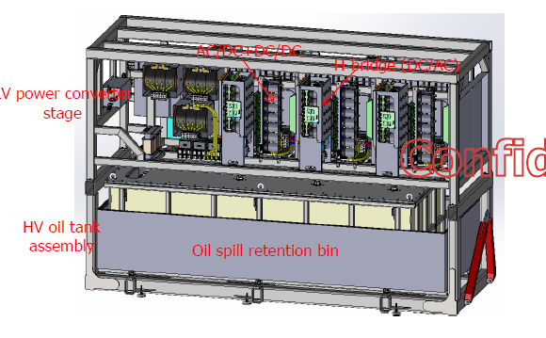
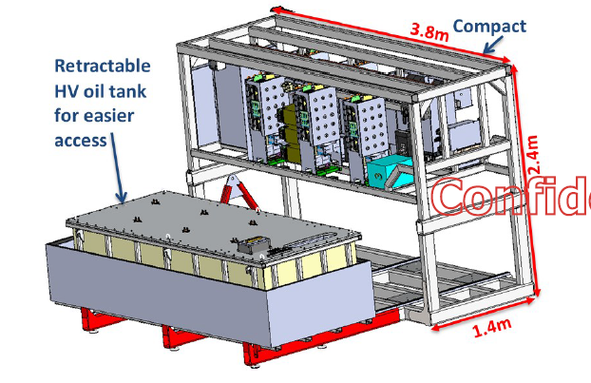
Modulators for High Power RF sources
What we have inside a modulator?
Sophisticated Power Electronic System
Pictures of the final product (open doors)
Total weight: 8000 kg

Slide 12
ESS Linac Project and Modulator requirements
ESS Linac layout
3 Modulators 660kVA

Slide 13
ESS Linac Project and Modulator requirements
ESS Linac layout
3 Modulators 660kVA
9 Modulators 660kVA

Slide 14
ESS Linac Project and Modulator requirements
ESS Linac layout
3 Modulators 660kVA
9 Modulators 660kVA
21 Modulators (klystrons or IOT’s) 660kVA

Slide 15
ESS Linac Project and Modulator requirements
ESS Linac layout
3 Modulators 660kVA
9 Modulators 660kVA
21 Modulators (klystrons or IOT’s) 660kVA

Slide 16
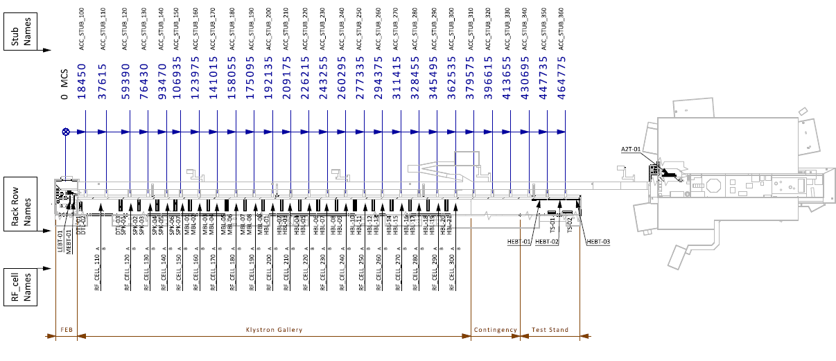
ESS Modulator Installation
ESS Linac layout
ACCSYS Name: ESS-0025905.1

Slide 17
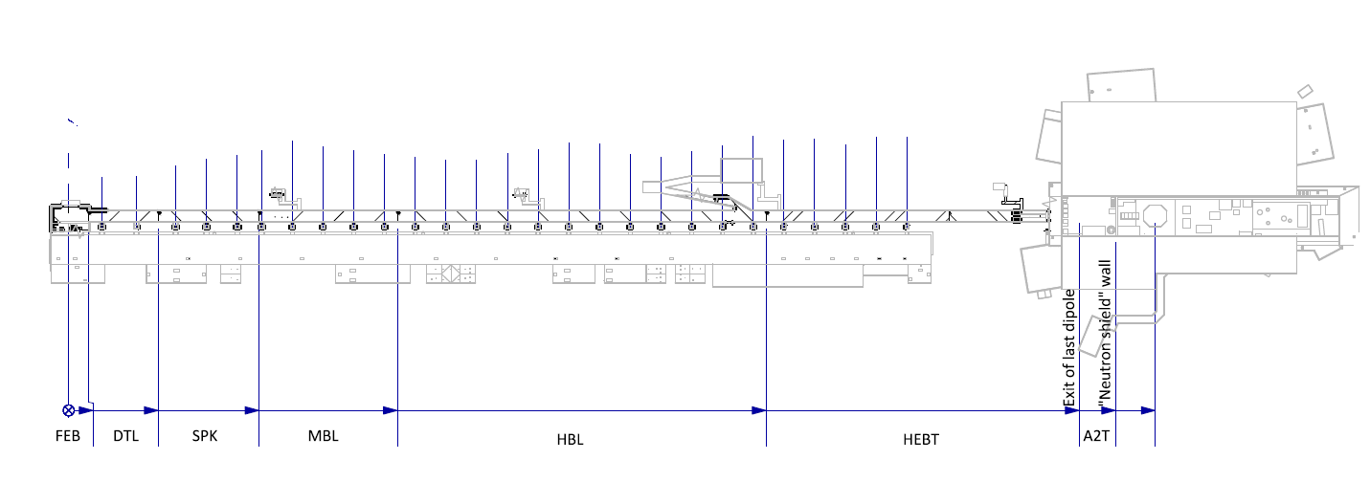
ESS Linac Project and Modulator requirements
ESS Linac layout

Slide 18
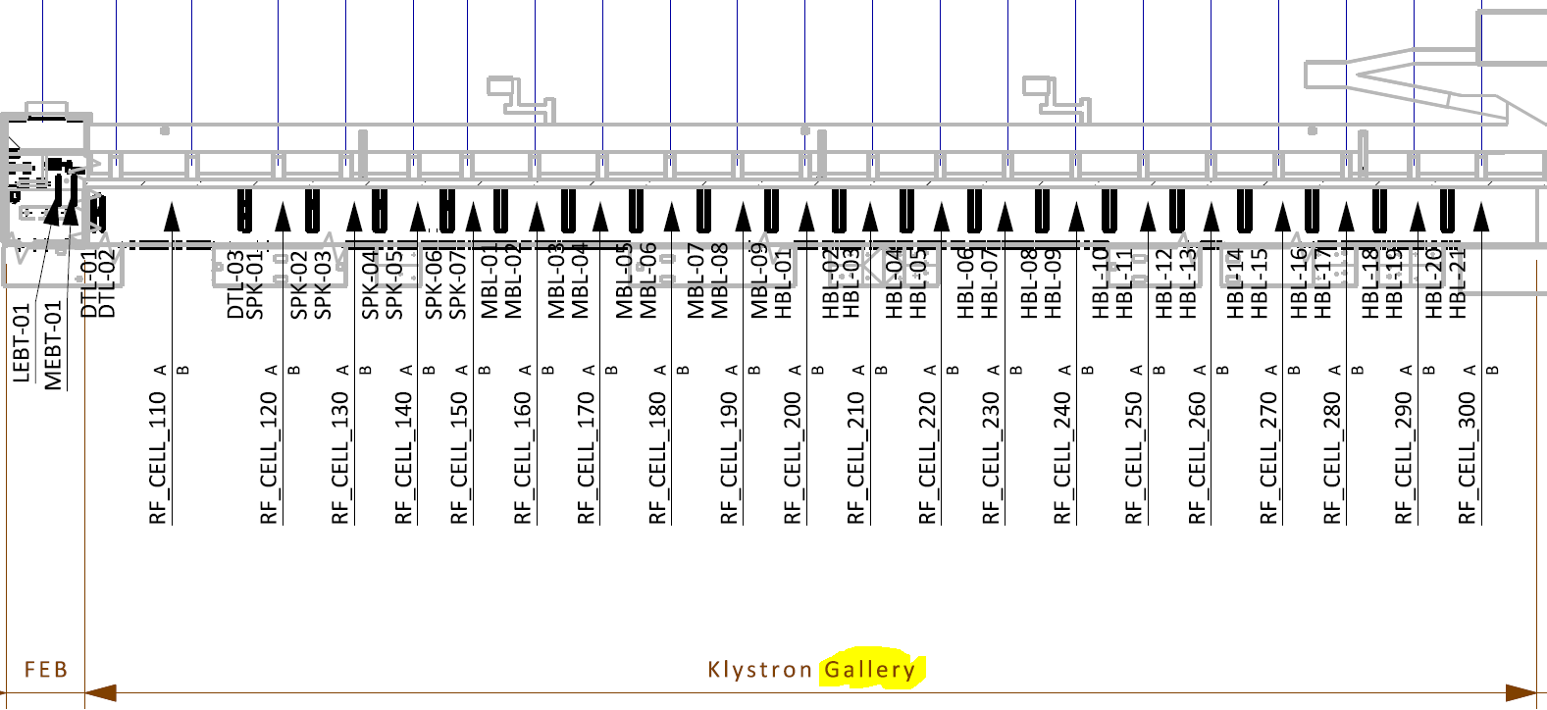
ESS Linac Project and Modulator requirements
ESS Linac layout

Slide 19
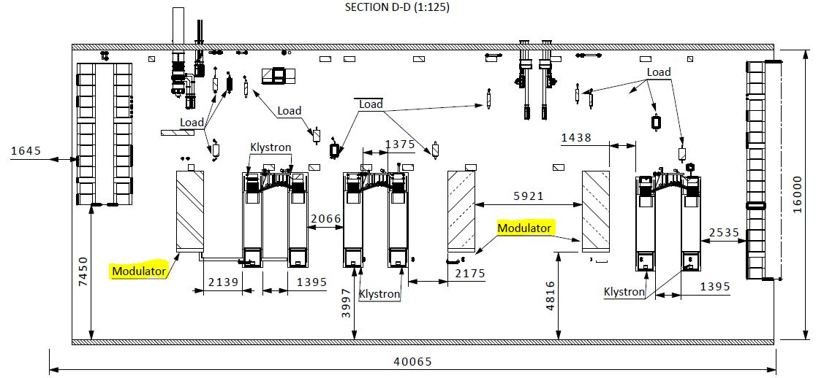
ESS Modulator Installation
PLACEMENT IN THE GALLERY: RF_CELL_110 – DTL RFQ
ESS-0038136.2

Slide 20
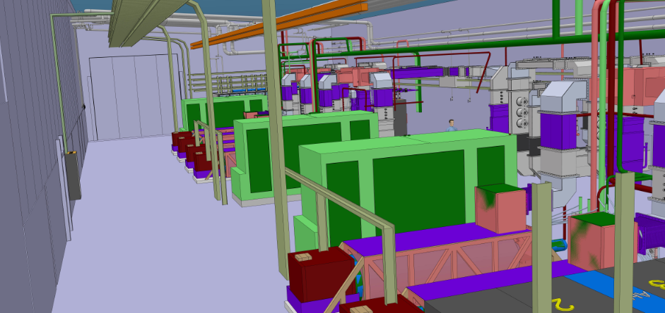
ESS Modulator Installation
PLACEMENT IN THE GALLERY: RF_CELL_110 – DTL RFQ

Slide 21
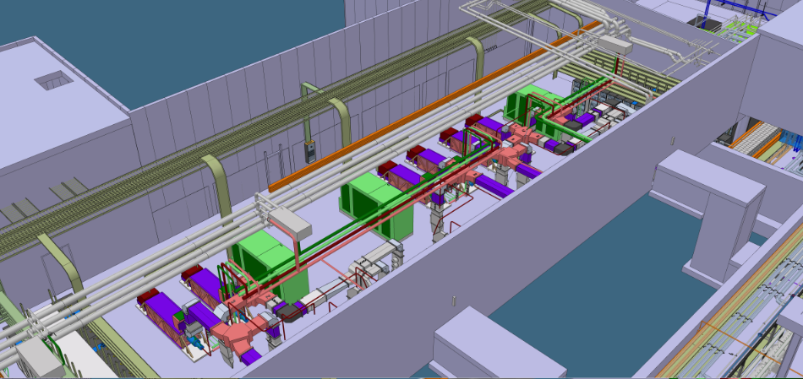
ESS Modulator Installation
PLACEMENT IN THE GALLERY: RF_CELL_110 – DTL RFQ

Slide 22
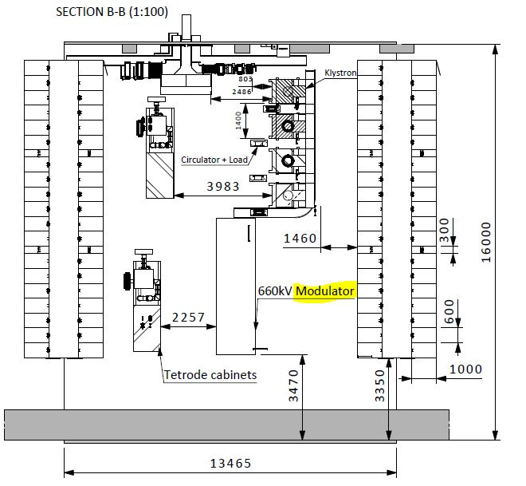
ESS Modulator Installation
PLACEMENT IN THE GALLERY: RF_CELL_150 - MB
ESS-0006436.7

Slide 23
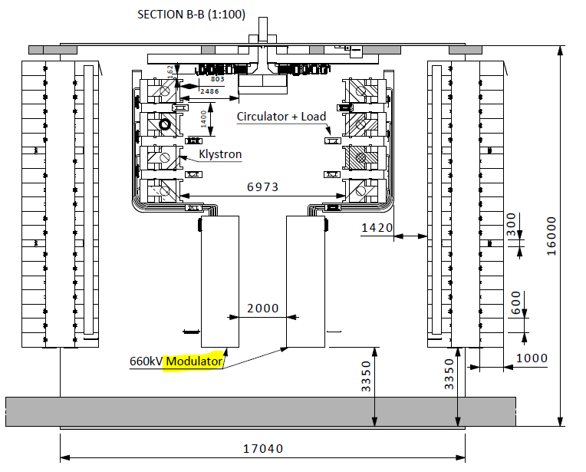
ESS Modulator Installation
PLACEMENT IN THE GALLERY: RF_CELL_160 – 190 MB
ESS-0006436.7

Slide 24
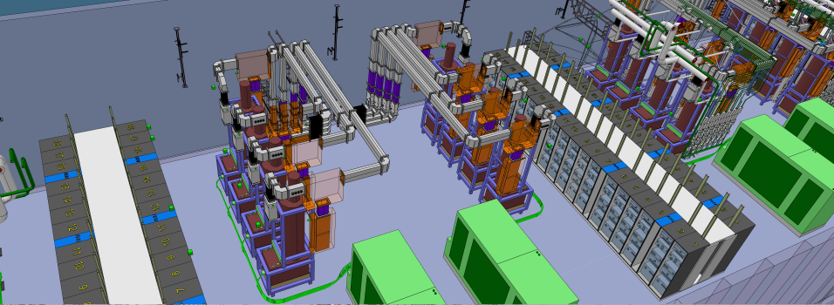
ESS Modulator Installation
PLACEMENT IN THE GALLERY: RF_CELL_160 … - MB (HB)

Slide 25
ESS Modulator Installation
Installation Plan (ESS-0055889 2)
Assumptions (https://ess-ics.atlassian.net/wiki/display/AI/Installation+plan+assumptions )
Modulators & magnet power converters (WP17)
- Cable trays and power cables as well as cooling hoses should preferably be installed before the modulator installation in order to not delay the operation of the modulator.
- Unloading of modulators at the building entrance shall be done by ESS.
- IFJ PAN will move the modulators inside the RF Gallery, install in the marked area, connect power, cooling and controls. Then feel up the oil, let it rest one day. Planned manpower: 2 technicians + 1 engineer from IFJ PAN + 1 engineer from WP17.
- Clarify where the oil storage is located in the Gallery?

Slide 26
ESS Modulator Installation
Installation Plan (ESS-0055889 2)
Assumptions (https://ess-ics.atlassian.net/wiki/display/AI/Installation+plan+assumptions )
Modulators & magnet power converters (WP17)
- The equipment for moving the modulators inside the Gallery is in the scope of the WP17.
- Testing is done first on a dummy load (1 day).
- Soak test on the first unit of the 660 kVA modulator shall be done for 2-3 weeks in a dedicated test area.
- Total one week from unloading to start of modulator operation, including the tests.
- Tetrodes (high power amplifier + high voltage power converter) installation 2 weeks.
- Tetrode test on a dummy RF load 1 week.
- Tetrode installation and test are planned to be done by the manufacturer (Italian company?).

Slide 27
ESS Modulator Installation
Installation details:
Moving and positioning in the gallery (small tractor to pull)
Mechanical installation: fixings, cable trays
Water cooling connections: plug-in flexible hoses
- Fill in with isolating oil
Electrical connections:
- Grounding: floor grounding mesh/electrical system network
- Output cables to the Klystrons (HV): cable already assembled
- Input power cables: 3 phase x 600V, 660 kVA, 2 x 240 mm2 cables
- Control power supply cables: 3 phase x 400 V from UPS, 1 kVA
- Signal interfaces: safety interlocks (PSS, MPS) and control (ICS)

Slide 28
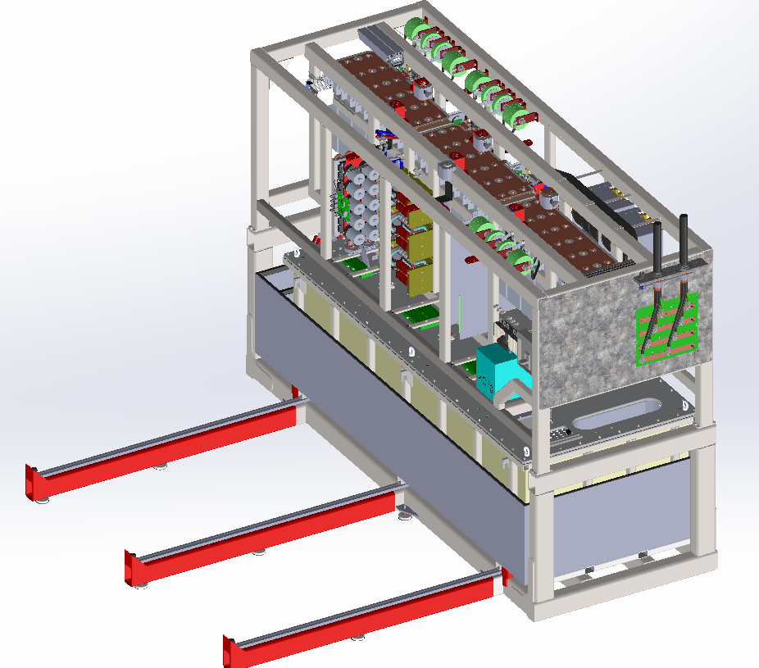
ESS Modulator Installation
Input power cables: 3 phase x 600V, 660 kVA, 2 x 240 mm2 cables
Output cables to the Klystrons (HV)
Water cooling connections

Slide 29
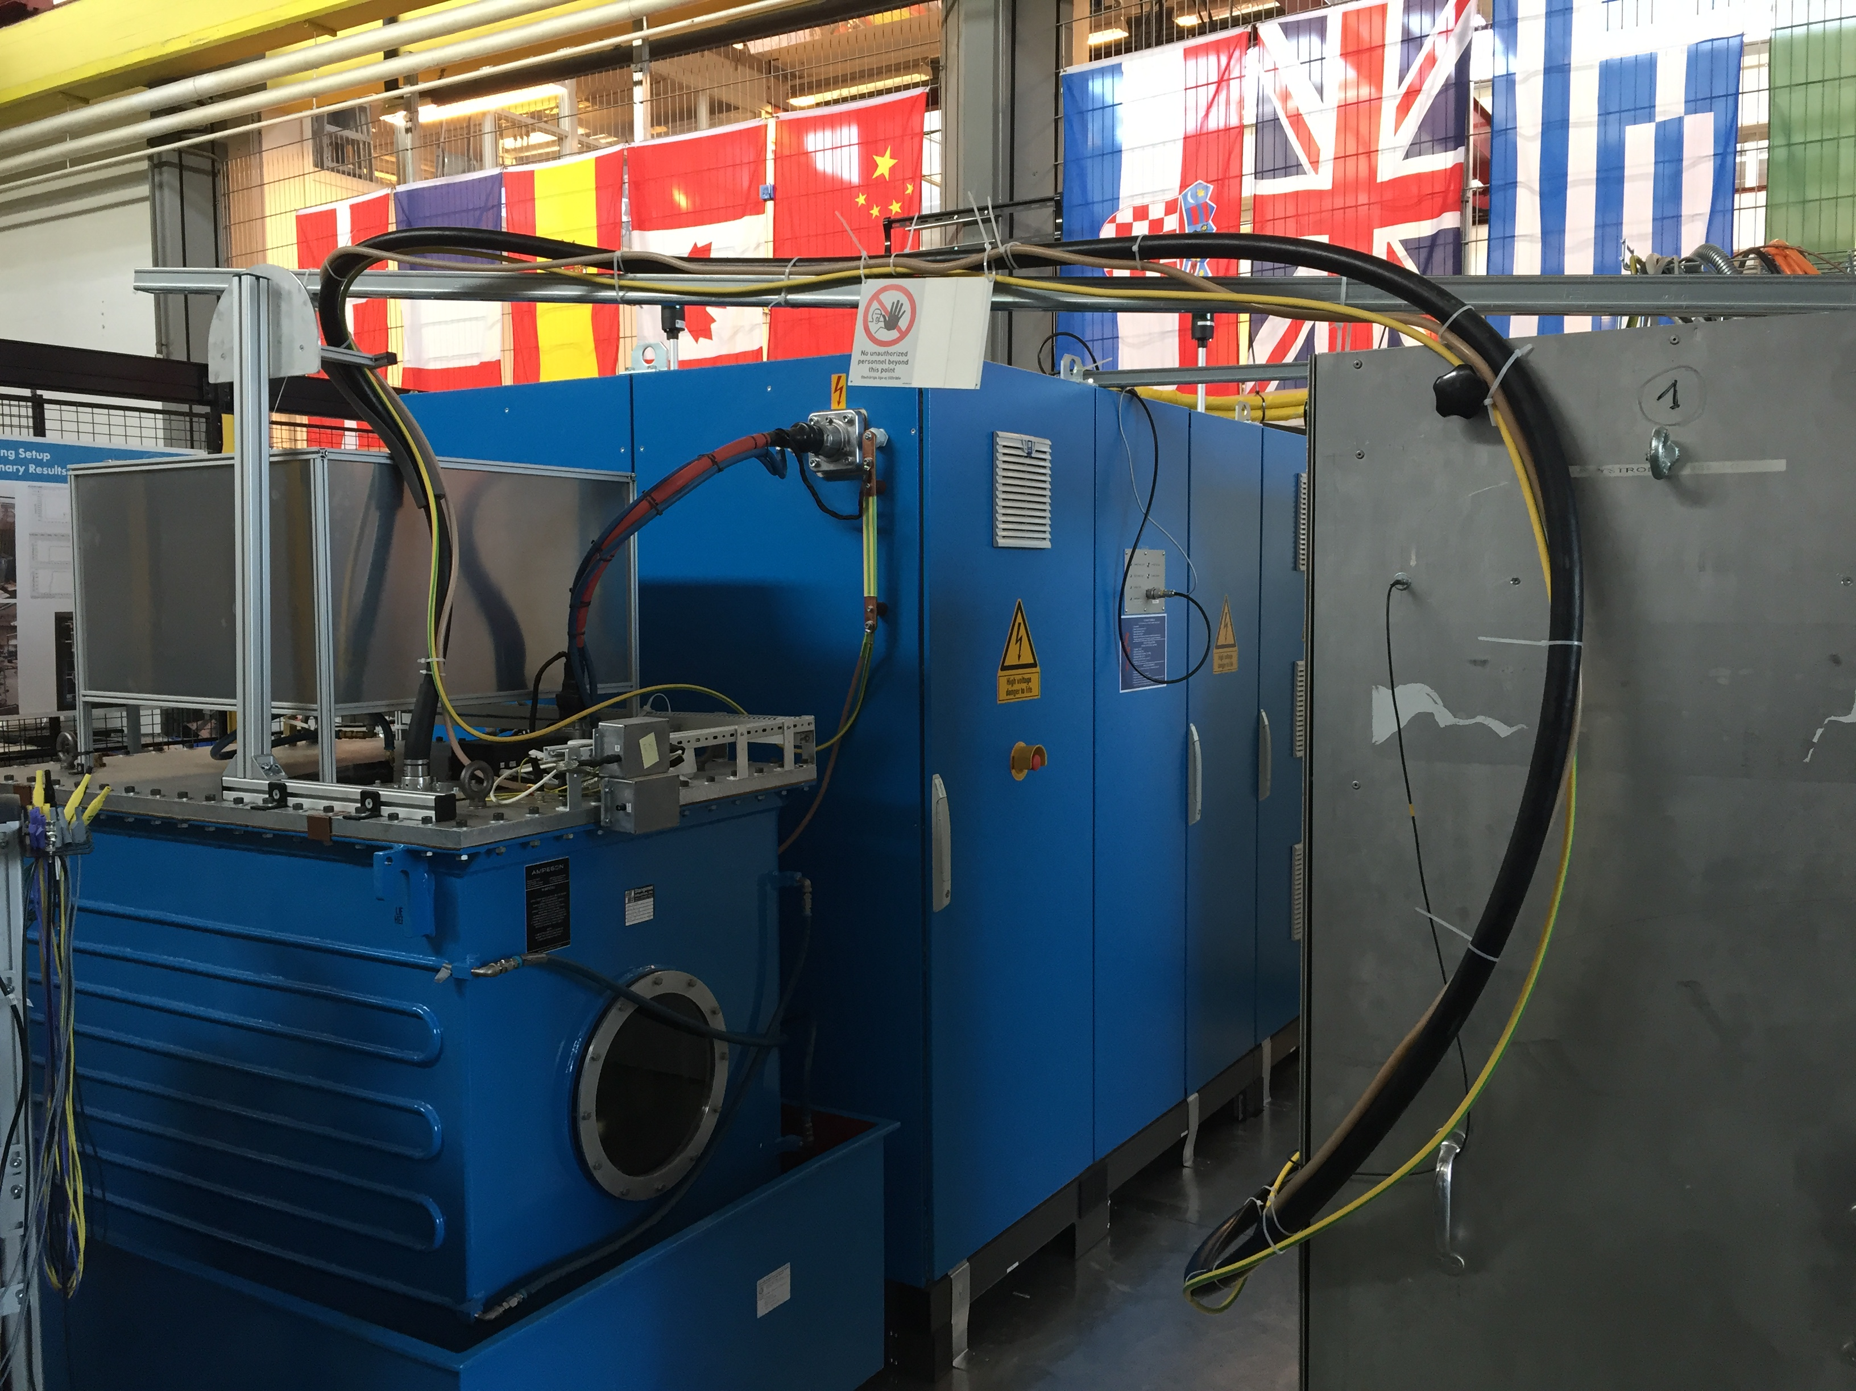
ESS Modulator Installation
Output cables to the Klystrons (HV)

Slide 30
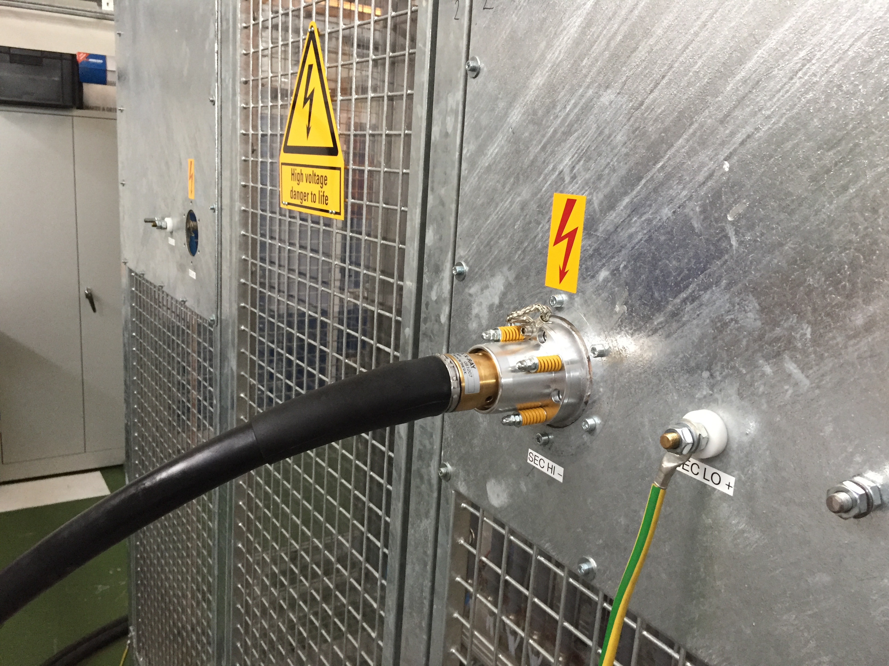
ESS Modulator Installation
Output cables to the Klystrons (HV)

Slide 31
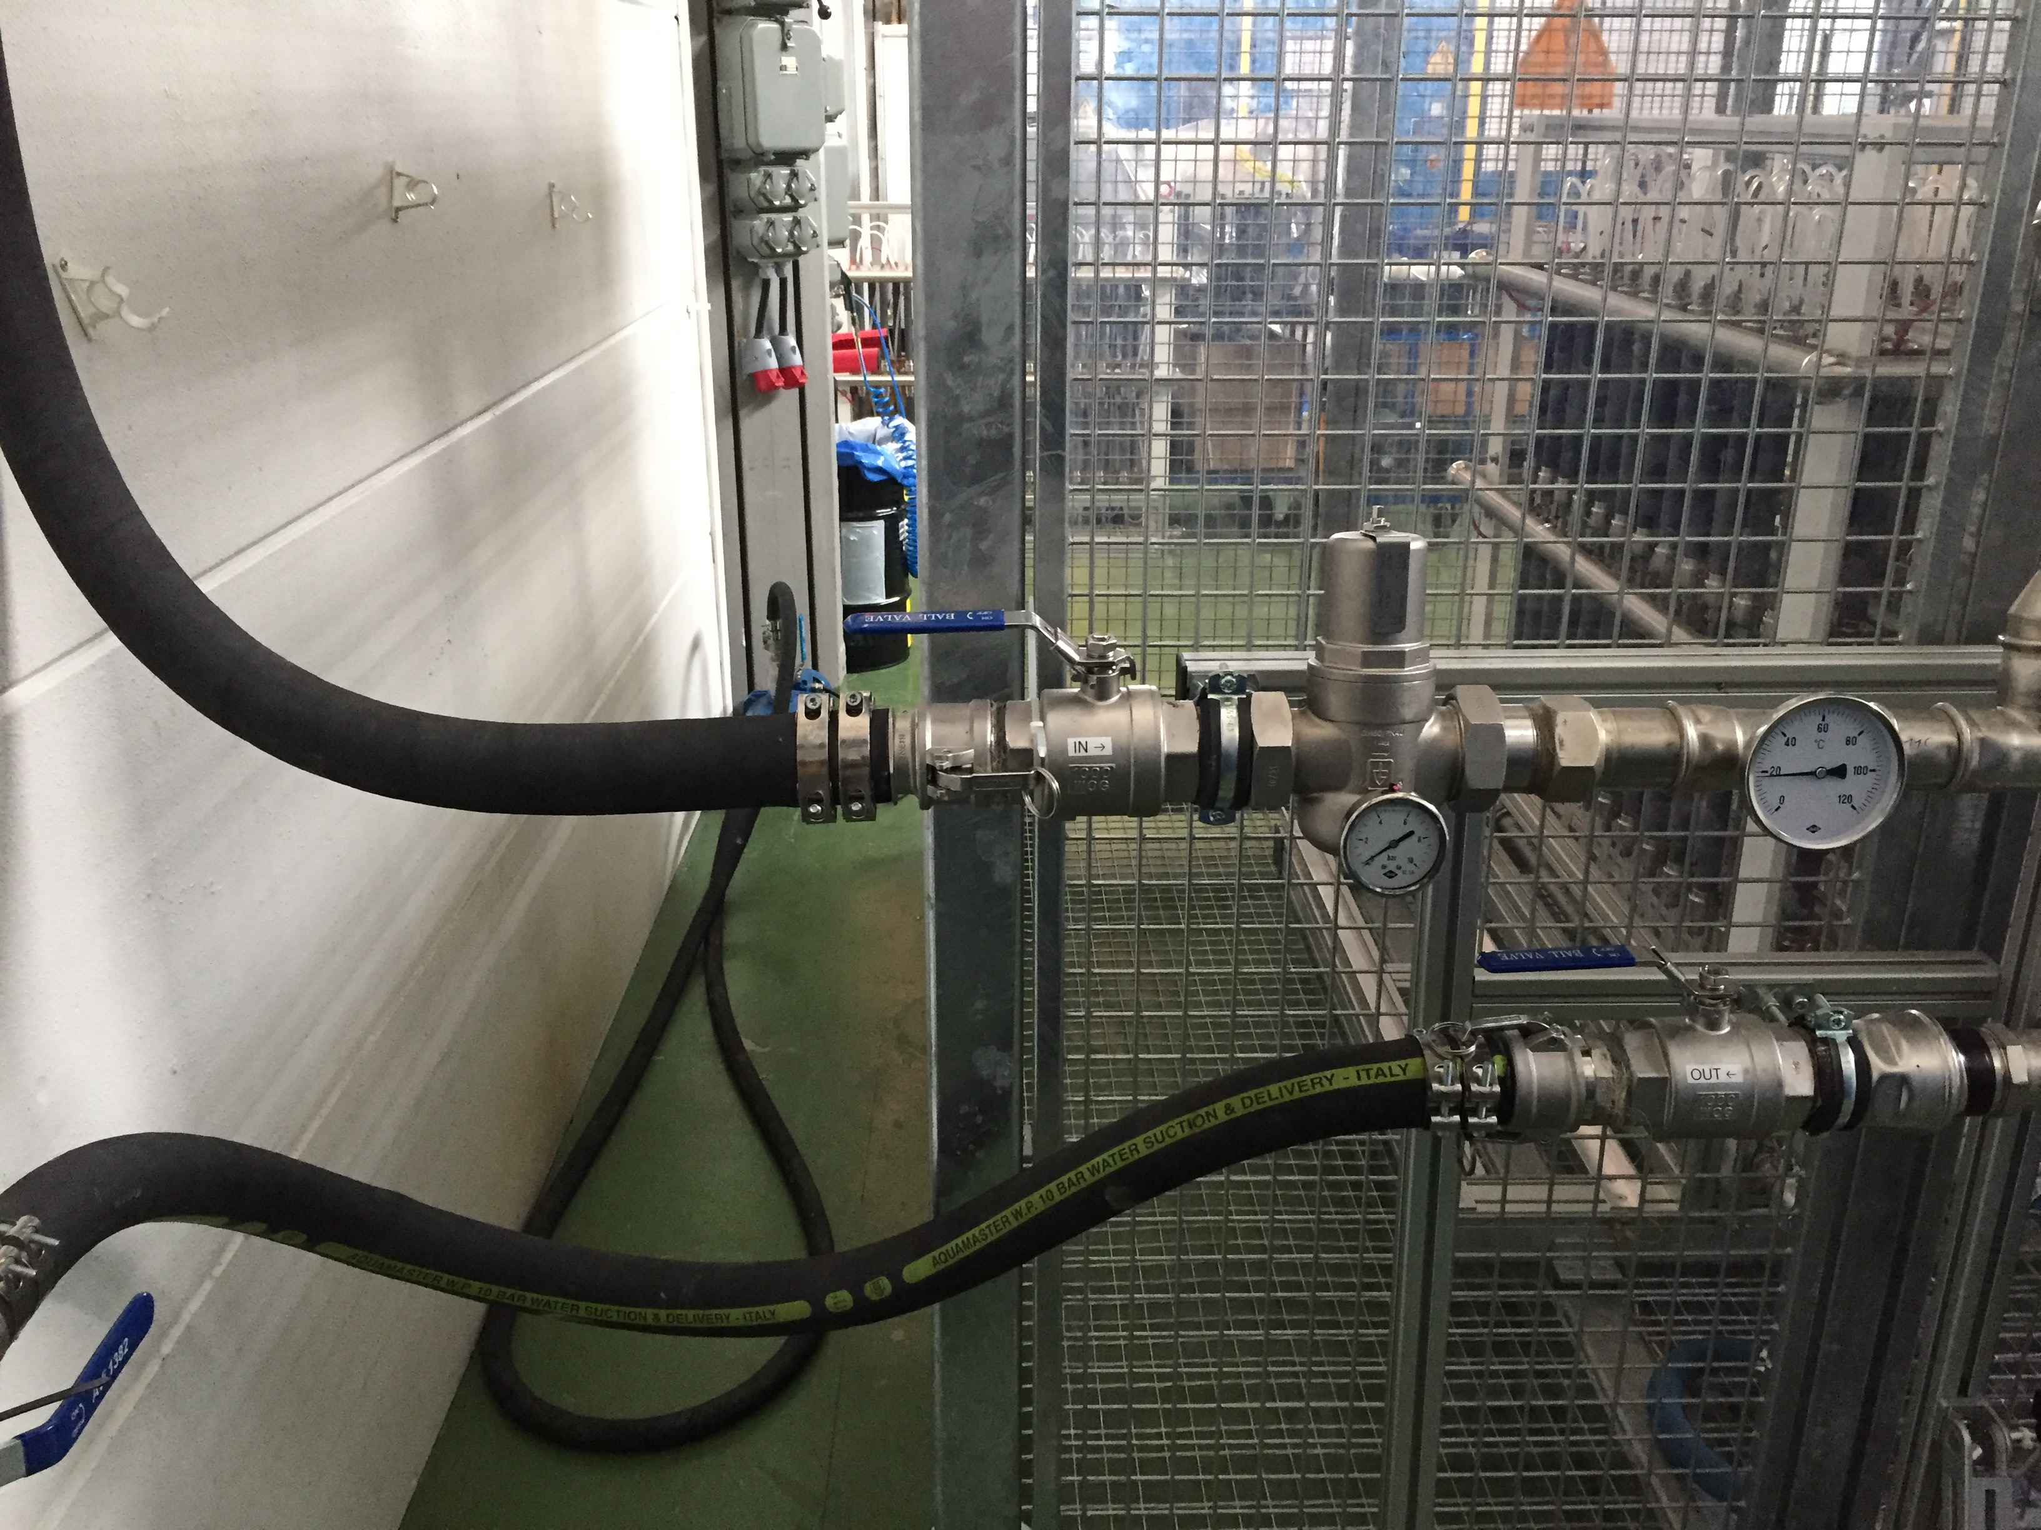
ESS Modulator Installation
Water cooling connections

Slide 32
ESS Modulator Installation
Conclusions:
Relatively easy installation
Compact equipament
Modular design
Plug-in connections
Pre-tested

Slide 33
ESS Linac Project and Modulator requirements
Target
Tunnel
RF gallery

