Slide 1
HEIMDAL scope-setting
Mogens Christensen (AU/DK), Kåre Iversen (AU/DK), Jürg Schefer (PSI/CH), Bjørn Hauback (IFE/N), Isabel Llamas (IFE/N), Rodion Kolevatov (IFE/N) Paul Henry (ESS/S),
Kim Lefmann (KU/DK), Sonja Holm (KU/DK), Martin Olsen (KU/DK)
www.europeanspallationsource.se
16-10-31

Slide 2
Overview
Project summary
Consortium details
High level science case
Instrument layout
Timeline
HEIMDAL Overview
  01 Shielding
  02 Neutron optics
  03 Choppers
  04 Sample Environment
  05 Detectors
  08 Instrument Specific Technical Equipment & 09 Instrument infrastructure
  06 DMSC, 07 MCA, 10 Vacuum, 11 PSS

Slide 3
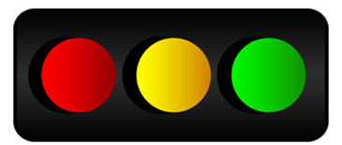
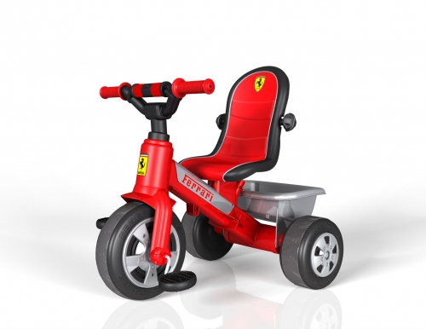
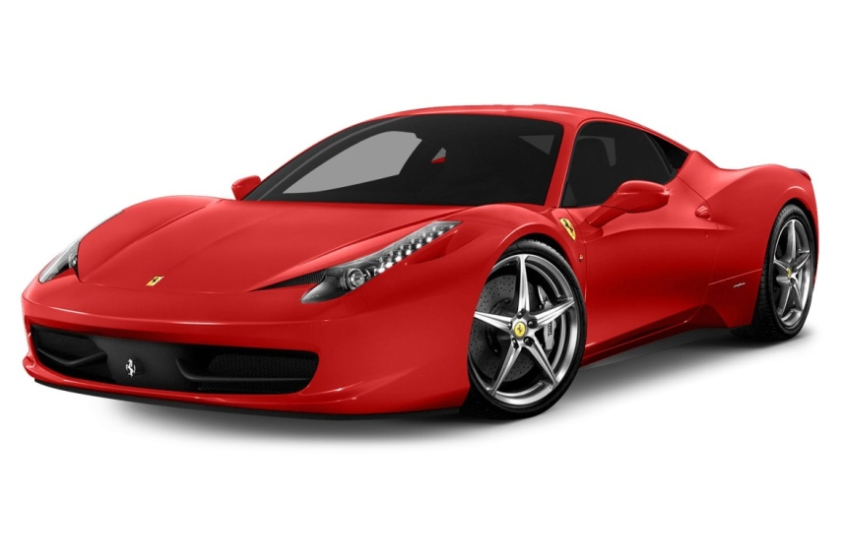
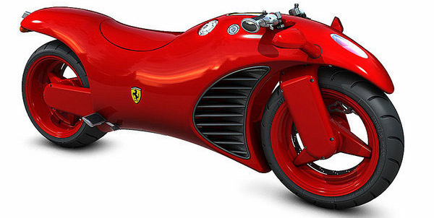
Project summary
Submission 2013 proposal round, STC approval July 2014
Phase I started May (in reality September) 2016 (budget 327.4 k€)
Scope setting 31st October, TG2 expected primo Q2 2017
Proposal cost estimates (12 M€, 15 M€, 19 M€)
Cost target: category B (12 M€)
Cost category
World leading
instrument
Full scope

Slide 4
Consortium
70/30 model: 70% in-kind, 30% cash
Lead: Aarhus University (DK), Mogens Christensen
Partners: PSI (CH), IFE (N)
Consortium financial contributions: 30%/35%/35% (DK/CH/N)
Interim lead instrument scientist: Paul Henry / Mogens Christensen
Lead instrument engineer: Kåre Iversen (AU)
Guide design: Kim Lefmann / Sonja Holm (KU)
Shielding calculations: Bjørn Hauback / Isabel Llamas, Rodion Kolevatov (IFE/N)

Slide 5
High level scientific requirements (Diffraction)
Q resolution to ~21 Å⁻¹:
  - Crystallographic studies
  - Anharmonic thermal vibration
  - Total scattering (PDF Δr_{min}~ π/Q_{max} ~ 0.15 Å) bond distances C=N 1.48 Å, C=O 1.23 Å
Peak resolution Δd/d ~ 4·10⁻⁴:
  Investigation of large unit cell structures e.g. metal organic frameworks
  Crystallite size determination to up to about 600 nm.
  Comparison with X-rays – Lab: 2·10⁻³, Synchrotron: analyser: 2·10⁻⁵, Flat panel: 5·10⁻⁴
  Size broadening: D_{v} = λ/(βcosθ), Strain broadening: ε_{ave} = β/(4tanθ)

Slide 6
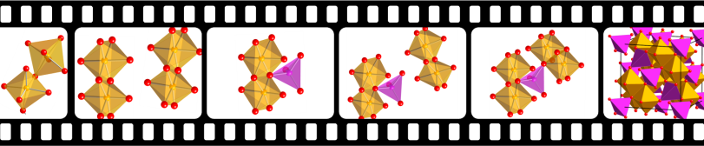

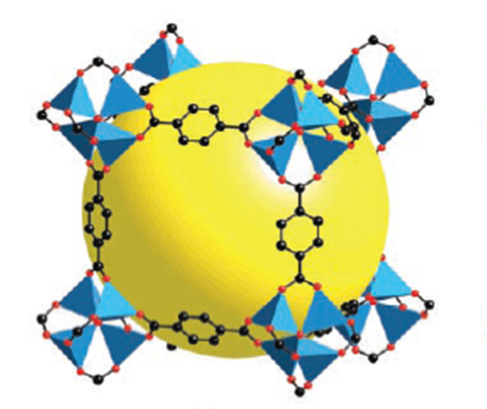
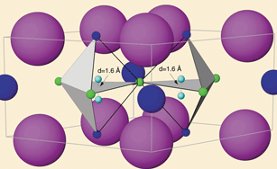
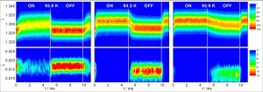
High level scientific requirements (Diffraction)
3. High flux mode with time resolutions below 10 s for kinetic measurements.
Crystal growth – nucleation and growth.
Catalytic reactions.
Charge discharge of battery cells / hydrogen storage devices.
Heating and cooling ramps (typically 1-10 K/min).
Continuous applied pressure.
Gas adsorption in Metal Organic Frameworks (MOFs).
Electrochemical potential.
Mechanical induced strain – plastic deformation.
  Steels, alloys, bones and teeth
4. Quasi-stroboscopic mode time resolution 10 µs.
The 10 µs is the detector limited readout time.
Application of cyclic electric field – Piezoelectric.
Application of cyclic mechanical pressure – elastic deformation.

Slide 7
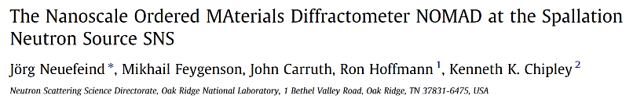
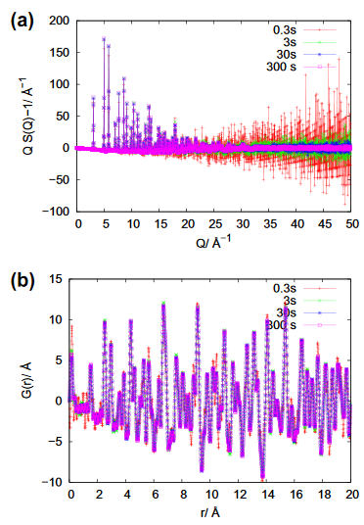
High level scientific requirements (Diffraction)
5. Diffraction tomographic measurements within 1 day:
With reduced beam size to 1 x 3 mm²
Data set collection dataset 30 min, 40 projections, each 9°
6. In situ total scattering experiments with high time resolution of 60 s:
Flux and detector efficiency is lower at short wavelength to compensate compared to conventional TNPD 10 s is a time scale of 60 s expected.

Slide 8
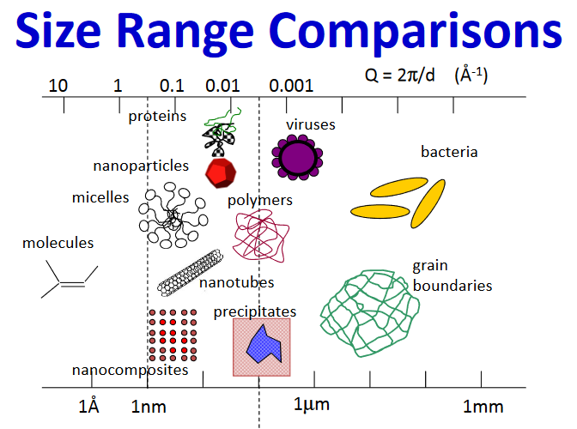
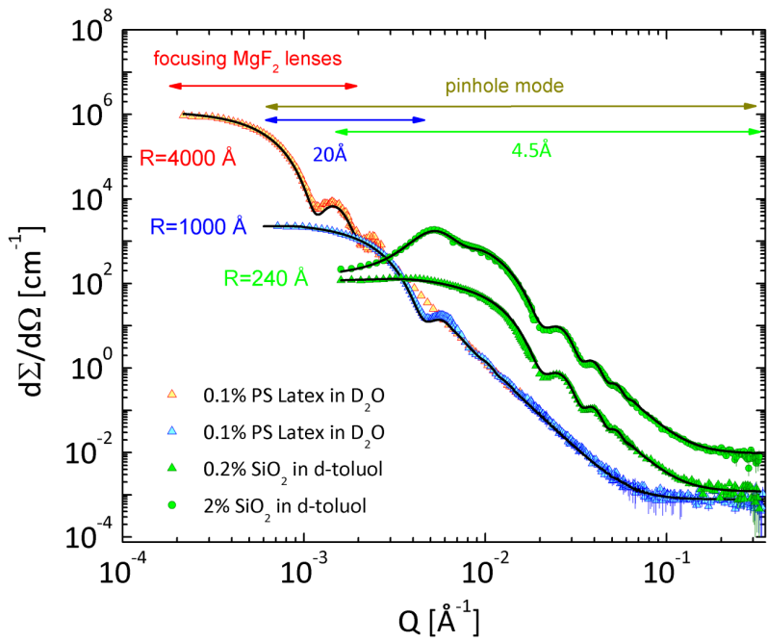
High level scientific requirements (SANS)
7. Quasi simultaneously collect small angle scattering data with a q-resolution covering 3 orders of magnitude from 10⁻³ to 10⁰ Å⁻¹.
Size limits 100-400 nm
Core-shell particles
Pore dimension
MOF, Zeolites
Aggregates
Amorphous materials
Polymers

Slide 9
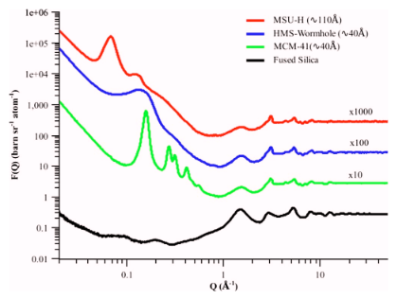
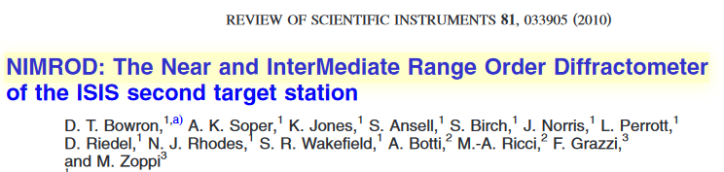
High level scientific requirements (SANS)
8. Quasi simultaneous data collection of NPD and SANS i.e. time resolution of 10 s.
- SANS typical 3 orders of magnitude more intense than WANS.
- SANS uses full pulse, but narrow collimation => similar flux.
- SANS will be much faster than WANS => Quasi simultaneous data collection - doable

Slide 10
High level scientific requirements (Imaging)
9. Measurement of samples with areas of up to 5x5cm.
This limit is fixed by field of view and detector size.
Sufficient space for most in situ cells relevant for:
  Battery cells
  Hydrogen storage devices
  Thermoelectric modules
  Fuel cell stack
  Catalysis
  Crystal growth
  Heating and cooling stages
Currently avaliable ‘Timepix’ detector 2.8 x 2.8 cm².
10. Pixel resolution of 50x50 µm.
This resolution is given by the L/D and the pixel size of the detector

Slide 11
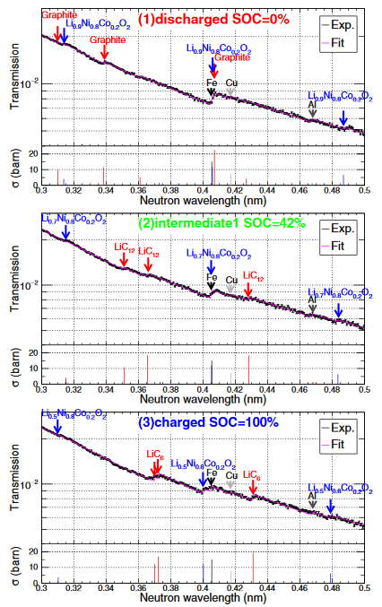
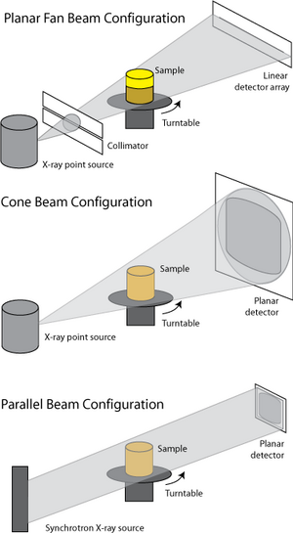
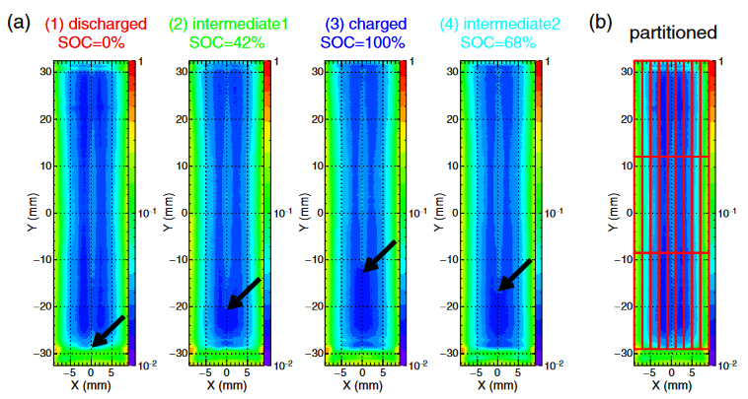
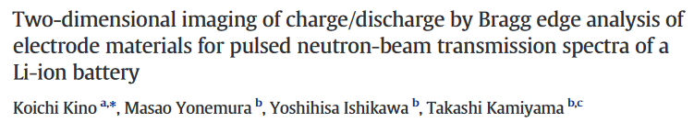
High level scientific requirements (Imaging)
11. Perform Bragg-edge imaging with potential of doing 3D phase reconstruction:
The Δd/d for cold beam is ~1% allowing:
  Phase identification
  Strain mapping
Combined with tomographic measurements 3D mapping can be made.

Slide 12
High level scientific requirements
Requirement | Cost category | World leading instrument | Full scope
01 powder diffraction with Q _{max} >21 Å⁻¹
02 high peak resolution with Δd/d ~ 4·10⁻⁴
03 high flux mode with time resolutions <10 s
04 quasi-stroboscopic data collection with 10 µs resolution
05 diffraction tomographic capabilities
06 in situ total scattering experiments with 60 s time resolution
07 quasi-simultaneous SANS covering 10⁻³ to 10⁰ Å⁻¹
08 SANS and NPD quasi simultaneous with time resolution ~10 s
09 Imaging up to 5x5cm with cold beam
10 Imaging pixel resolution of ~50x50 µm
11 Bragg-Edge imaging with potential 3D reconstruction

Slide 13
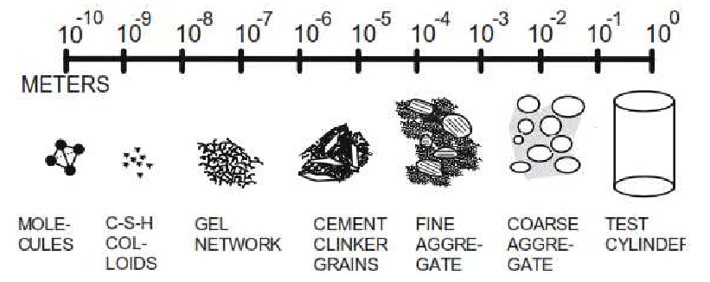
Science example 0 - Cement
Portland cement is aggregate in a matrix of hydrated calcium silicates and aluminates.
US uses roughly 500 million metric tons of concrete.
8% of world CO₂ emission is related to cement
CO₂ is consumed in the curing process: CaO + CO₂ → CaCO₃
The atomic, nano- and microscale are important for the properties of the concrete.

Slide 14
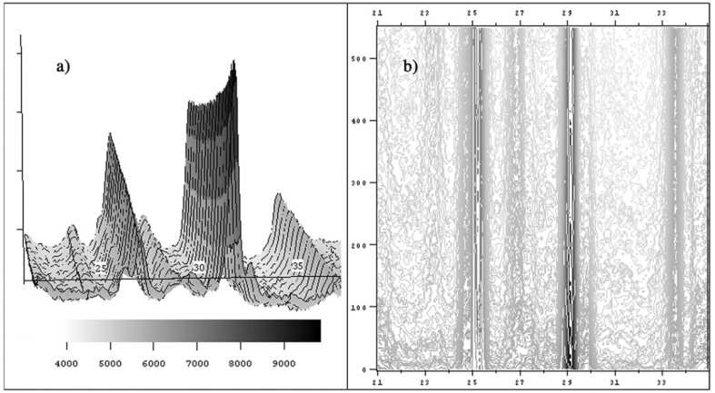
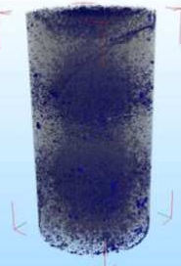
Science example 0 - Cement
Mercury Intrusion Porosimetry used to determine pore structure before neutron diffraction experiment – pore size range 10-100 nm.
Time
Neutron diffraction patterns of the accelerated carbonation.
SANS – Powder diffraction would allow both pore size and structural investigations.
Imaging allows evaloution of curing on macroscopic scale.
Castellote, M., Andrade, C., Turrillas, X., Campo, J. & Cuello, G. J. Accelerated carbonation of
cement pastes in situ monitored by neutron diffraction. Cement and Concrete Research 38, 13651373, 2008.

Slide 15
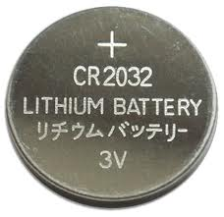
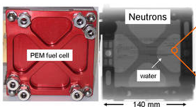

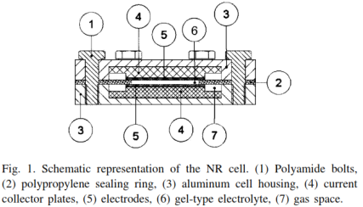
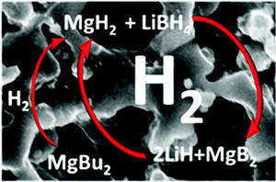
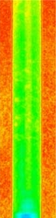
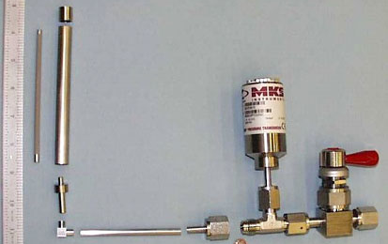
Science example 1: Energy storage
Lithium ion batteries
Fuel cells
Advantages of using neutrons
  Good contrast for light elements: H, Li, O
  Study real size objects
  Investigations under working conditions
Hydrogen storage

Slide 16
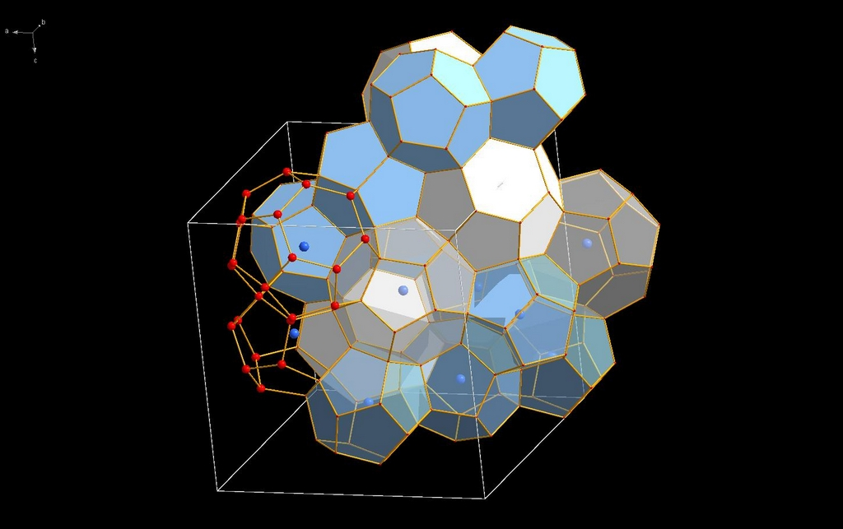
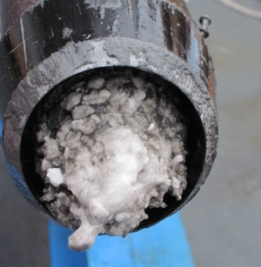
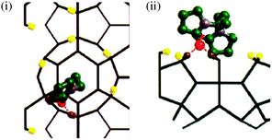
Science example 2 – Crystallization and growth
Clathrate hydrates are solids made from small gas molecules and water.
Gas hydrates forms in gas and oil subsea pipelines
=> often results in blockage and shutdown of pipelines.
Small molecules are added to the oil to prevent crystallization
HEIMDAL: Follow crystallization before nucleation (SANS)
Crystal growth (Powder diffraction)
Distribution within tube (imaging)
Total scattering (PDF) – give information about the role of inhibitors

Slide 17
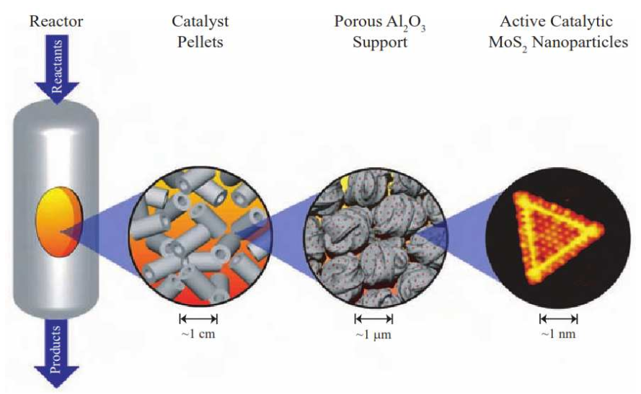
Science example 3: Heterogeneous catalysis
Imaging
SANS
Diffraction

Slide 18
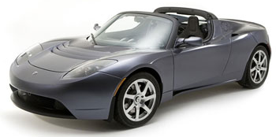
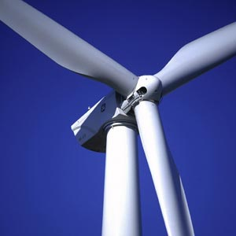
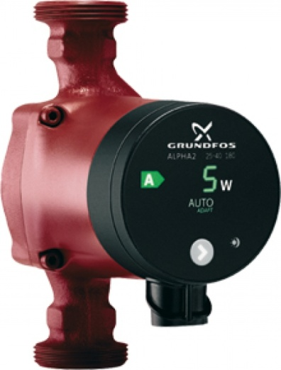
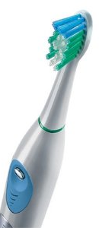
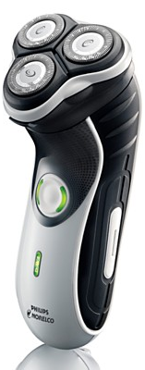
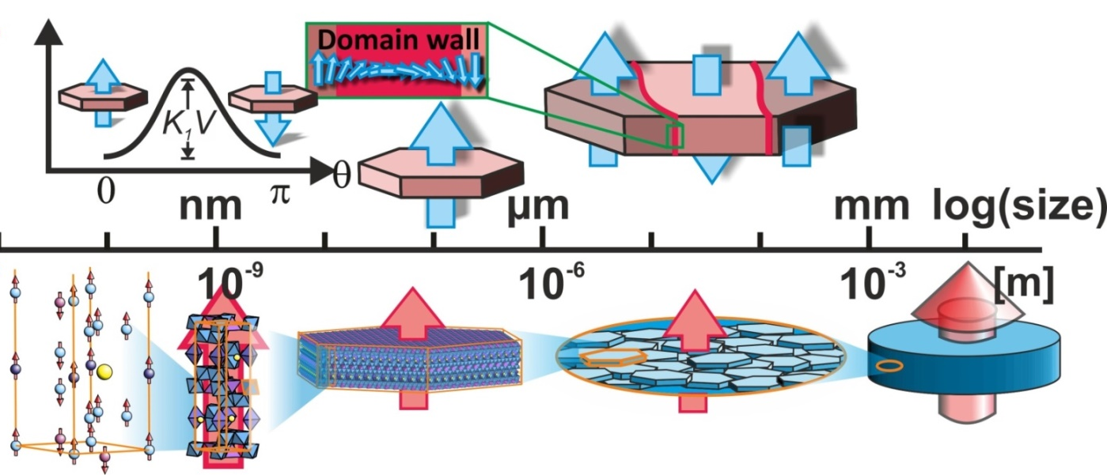
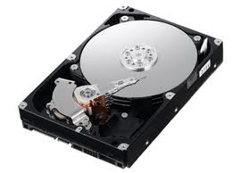
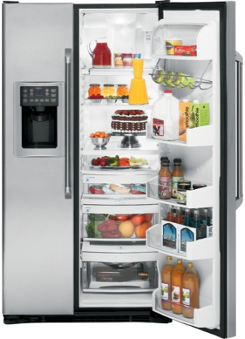
Science example 4 – Nanocomposite magnets
Magnetic materials are everywhere!
Magnetic nanocomposites made of soft/hard :
  improve magnetic strength
exchange-coupling.

Slide 19
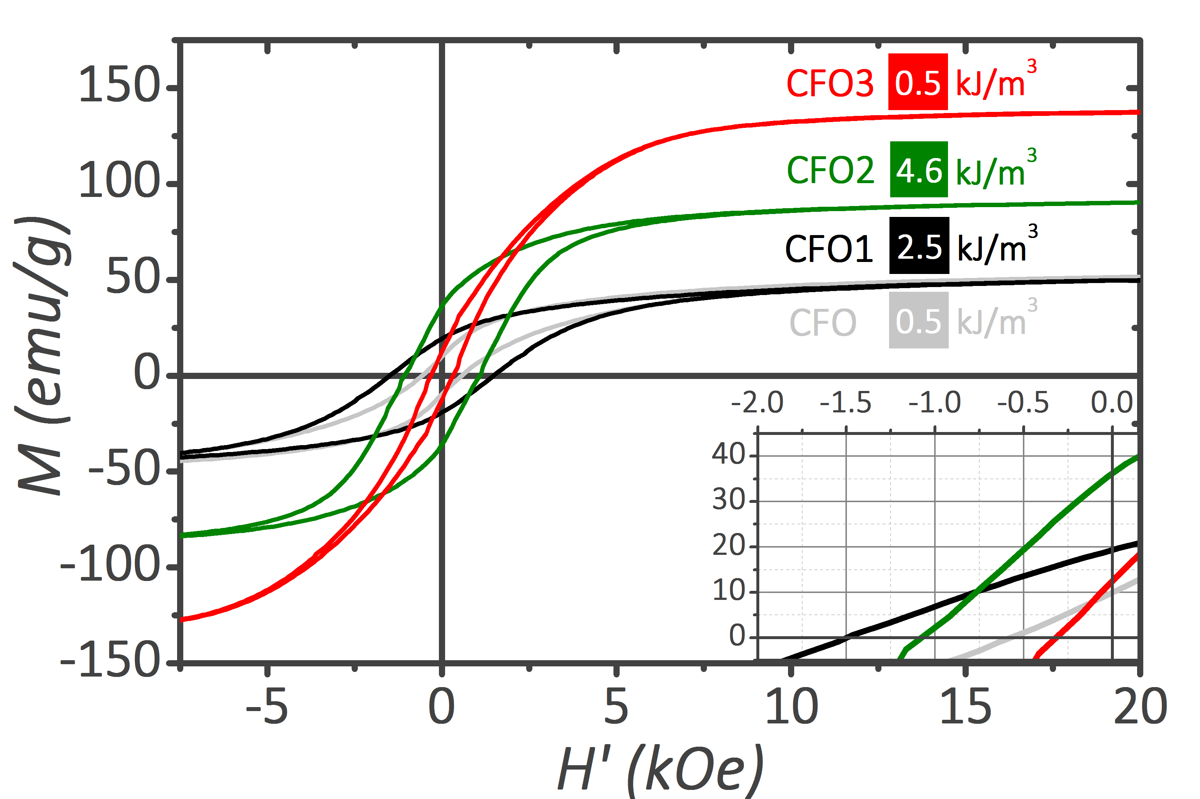

Exchange spring magnets
M
M
M
HARD
SOFT
↑ H_{C}
↑ M_{S}
H
H
H
EXCHANGE-SPRING
MAGNETS
CoFe₂O₄
CoFe₂O₄
PARTIAL
Reduction
CoFe₂
A. Quesada, C. Granados et al,. Adv. Electron. Mater., 2, 1500365 (2016)

Slide 20
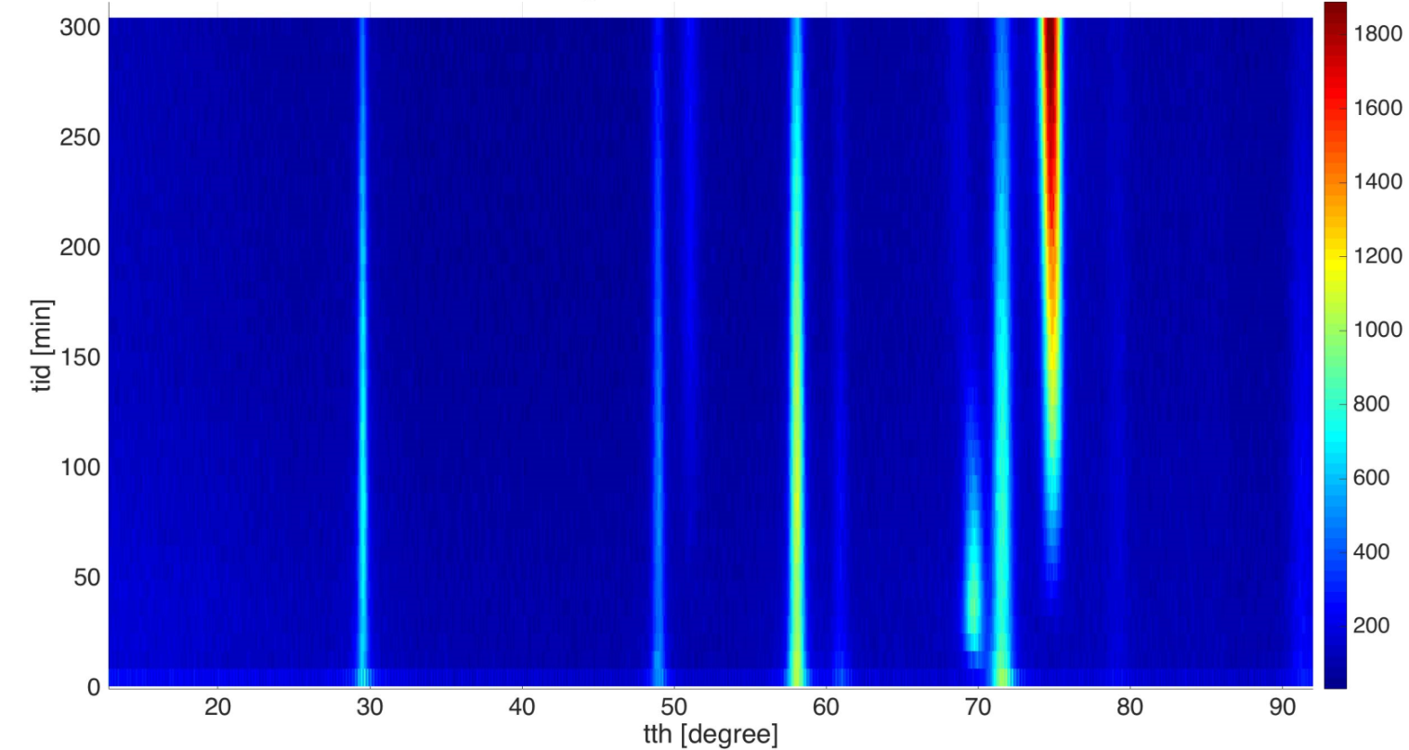
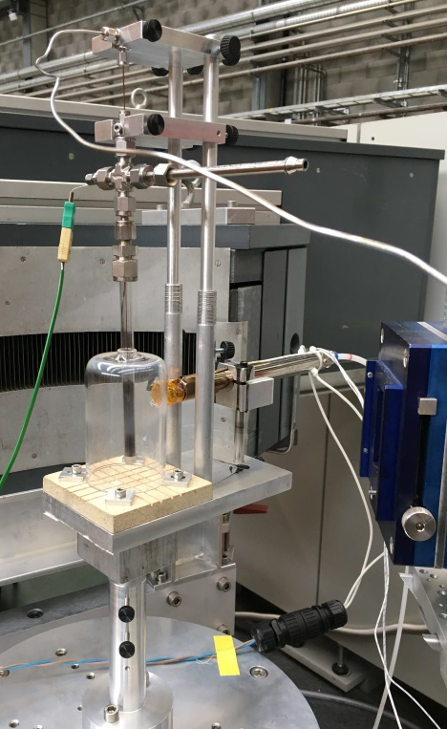
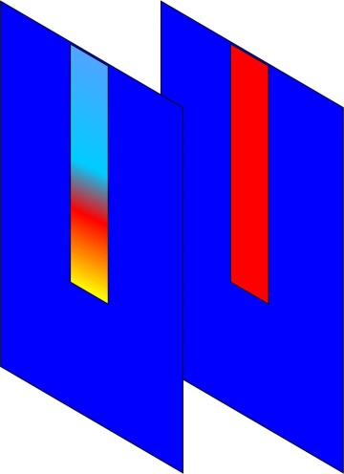
In situ reduction at DMC@PSI
SANS
Bragg–edge
Imaging
Jakob Ahlburg, Cecilia Granados, Henrik Lyder Andersen, Pelle Garbus, Emmanuel, Lukas Keller

Slide 21
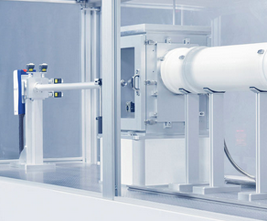
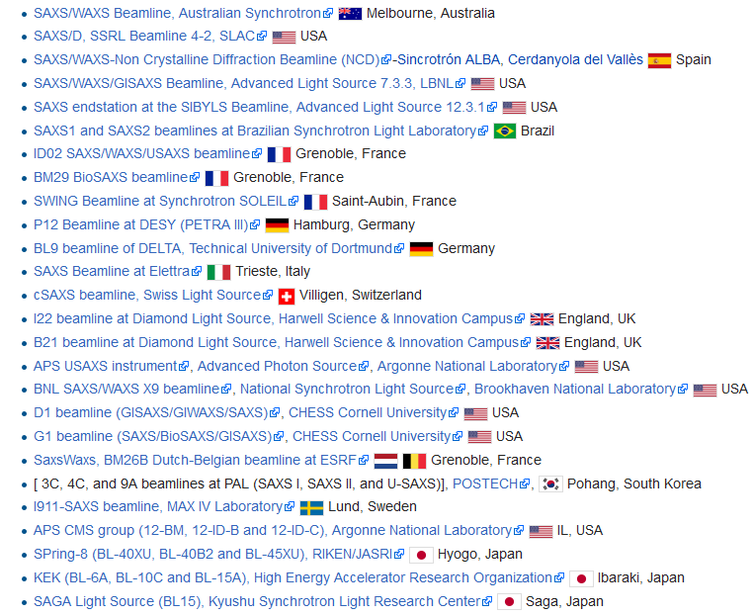
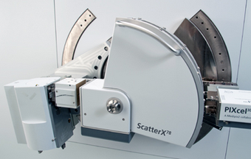
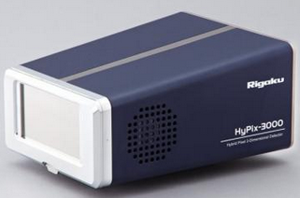
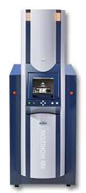
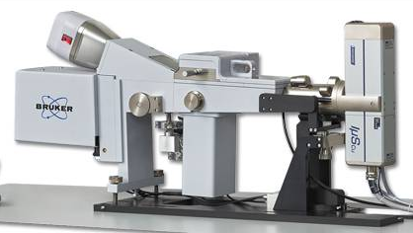
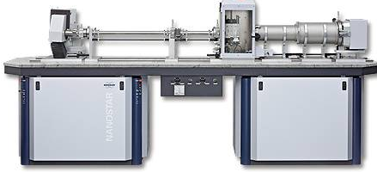
SAXS/WAXS vs SANS/WANS
At synchrotrons there are >20 beamlines combining SAXS/WAXS:
Companies offering SAXS/WAXS for laboratory:
PANalytical offers laboratory setup for SAXS/WAXS (2014)
Xenocs offers laboratory SAXS/WAXS (2015)
Bruker offers 3 different SAXS/WAXS setups (2015)
Rigaku offers laboratory SAXS/WAXS (2016)
For neutrons there is currently no user community
… but ESS is for the future 2023…

Slide 22



Instrument layout
Experimental hall E01
Beam port W8
Neighbour: T-Rex
HEIMDAL

Slide 23


Instrument layout
Original layout:
- Mirroring setup due to moderator setup.
- Problems with W8 due to guide hall wall.

Slide 24

Instrument layout
Original layout:
- Mirroring setup due to moderator setup.
- Problems with W8 due to guide hall wall.
- Using straight parallel guides with bender at the end.

Slide 25


Instrument layout
Original layout:
- Mirroring setup due to moderator setup.
- Problems with W8 due to guide hall wall.
- Using straight parallel guides with bender at the end.
- High cost of double vacuum and shielding.

Slide 26



Timeline

Slide 27
High level scientific requirements
Requirement | Cost category | World leading instrument | Full scope
01 powder diffraction with Q _{max} >21 Å⁻¹
02 high peak resolution with Δd/d ~ 4·10⁻⁴
03 high flux mode with time resolutions <10 s
04 quasi-stroboscopic data collection with 10 µs resolution
05 diffraction tomographic capabilities
06 in situ total scattering experiments with 60 s time resolution
07 quasi-simultaneous SANS covering 10⁻³ to 10⁰ Å⁻¹
08 SANS and NPD quasi simultaneous with time resolution ~10 s
09 Imaging up to 5x5cm with cold beam
10 Imaging pixel resolution of ~50x50 µm
11 Bragg-Edge imaging with potential 3D reconstruction

Slide 28
HEIMDAL options
HEIMDAL Overview
  01 Shielding
  02 Neutron optics
  03 Choppers
  04 Sample Environment
  05 Detectors
  08 Instrument Specific Technical Equipment & 09 Instrument infrastructure
  06 DMSC, 07 MCA, 10 Vacuum, 11 PSS

Slide 29




01 Shielding
Extra shielding
- limited space
Extra shielding
- limited space

Slide 30

01 Shielding - Instrument
Roof access:
-Via movable trap door.
- Steel and boralcan used as linner.

Slide 31
01 Shielding
01 Shielding | Cost category | World leading instrument | Full scope
Guide shielding | 2.07 M€ | 2.07 M€ | 2.07 M€
Diffraction cave shielding | 0.35 M€ | 0.35 M€ | 0.35 M€
SANS cave shielding | 0 M€ | 0.30 M€ | 0.28 M€

Slide 32



02 Guides - Monolith
Monolith
Entry
Exit

Slide 33

02 Guide - Thermal
Change guide configuration:
Original guide: Kinked
Advantage:
Avoid line of sight
Disadvantage:
High cost
Changed to straight guide.
Advantage:
Reduced cost
More short wavelengths
Disadvantage:
Need for T0 choppers

Slide 34

02 Guide optimization
Sample size:
  Horizontal 5 mm
  Vertical size 20 mm
Pinhole collimation in bunker:
  6 m – size H 30 mm V 50 mm
  24 m – size H 30 mm V 50 mm
Sample divergence:
  Horizontal ±0.35°
  Vertical ±0.50°

Slide 35
02 Guide - Cold
Original proposal:
  Two completely independent guides
Advantage: Complete freedom in optimization – separation of signal at sample
Disadvantage: Cost 1.50 M€ + shielding
  Partly independent guides:
Advantage: Cost reduction both on guides and choppers
Disadvantage: beams cannot be conditioned independently

Slide 36

02 Guide - Cold
Possible to take
out the cold beam
The cold guide is feed into the thermal guide before exiting the bunker
02 Guides | Cost category | World leading instrument | Full scope
Thermal guide | 2.43 M€ | 2.43 M€ | 2.43 M€
Cold guide in bunker | 0 M€ | 0.26 M€ | 0.26 M€

Slide 37






03 Choppers – thermal
TC1 Pulse shaping chopper 6.5 m
Selects triangular pulse
TC2 Pulse selection chopper
ESS-0041170_Guideline CHIM.pdf

Slide 38


03 Choppers - Thermal
TC3 – 78 m Frame overlap
Approx. ½ length of instrument

Slide 39

03 Choppers - Thermal
Removal of prompt pulse from
The guide is straight
  => Prompt pulse suppression becomes very important

Slide 40
03 Choppers - Cold
CC1 Band definition - 6.8 m
CC2 Frame overlap - 14 m
TC3 Frame overlap - 78 m
This price does not include additional labor cost
Extended shutdown will be required
03 Choppers | Cost category | World leading instrument | Full scope
Thermal choppers | 1.17 M€ | 1.17 M€ | 1.17 M€
Cold choppers | 0 M€ | +0.33 M€ | 0.33 M€

Slide 41


04 Sample environment
- Temperatures between 10 mK and 2000 K
- Automatic sample changer in the temperature range 1.8 – 800 K
- Vertical magnetic fields up to 15 Tesla at temperatures 1.8-300 K, special cases 50 mK
- Uniaxial pressure up to 20 GPa at temperatures down to 3 K
- Electric fields up to 10 kV/mm at temperatures down to 1.8 K
- Temperatures between 10 mK and 2000 K
- Automatic sample changer in the temperature range 1.8 – 800 K
- Vertical magnetic fields up to 15 Tesla at temperatures 1.8-300 K, special cases 50 mK
- Uniaxial pressure up to 20 GPa at temperatures down to 3 K
- Electric fields up to 10 kV/mm at temperatures down to 1.8 K
04 Sample environment | Cost category | World leading instrument | Full scope
Robotic sample changer | 0 M€ | 0.05 M€ | 0.05 M€
Multi temperature changer 2-800 K | 0 M€ | 0.25 M€ | 0.25 M€

Slide 42




05 Detectors - Diffraction
Original proposal:
  Area: 6.2 m²
  Coverage: 2.75 sr
  Cost: 7.07 M€
Cost category:
  Area: 0.5 m²
  Coverage: 0.36 sr
  Cost: 0.57 M€
Top-view
Side-view

Slide 43


05 Detectors - Diffraction
Original proposal:
  Area: 6.2 m²
  Coverage: 2.75 sr
  Cost: 7.07 M€
Cost category:
  Area: 0.5 m²
  Coverage: 0.36 sr
  Cost: 0.57 M€
World leading instrument:
  Area: 2.1 m²
  Coverage: 1.34 sr
  Cost: 2.26 M€
Top-view
Side-view

Slide 44


05 Detectors - Diffraction
Original proposal:
  Area: 6.2 m²
  Coverage: 2.75 sr
  Cost: 7.07 M€
Cost category:
  Area: 0.5 m²
  Coverage: 0.36 sr
  Cost: 0.57 M€
World leading instrument:
  Area: 2.1 m²
  Coverage: 1.34 sr
  Cost: 2.26 M€
Full scope:
  Area: 3.2 m²
  Coverage: 2.02 sr
  Cost: 3.34 M€
Top-view
Side-view

Slide 45




05 Detectors - Diffraction
Offer from CDT:
Segments covers 0.6° in 2θ, covered by two VOXELs
=> discretization in 2θ is 0.3°.
The φ will have 64 channels, giving a resolution of ~10 mm FWHM.

Slide 46

05 Detectors - diffraction
Cost category:
  Area: 0.5 m²
  Coverage: 0.36 sr
  Cost: 0.57 M€
World leading instrument:
  Area: 2.1 m²
  Coverage: 1.34 sr
  Cost: 2.26 M€
Full scope:
  Area: 3.2 m²
  Coverage: 2.02 sr
  Cost: 3.34 M€
05 Detectors - diffraction | Cost category | World leading instrument | Full scope
Angular coverage 10-150° | +1.69 M€ | 1.69 M€ | 1.69 M€
Backscattering 150-170° | 0.57 M€ | 0.57 M€ | 0.57 M€
Backscattering 170-190° | +0.57 M€ | +0.57 M€ | 0.57 M€
Backscattering 190-210° | +0.57 M€ | +0.57 M€ | 0.57 M€
Angular coverage 210-305° | +1.15 M€ | +1.15 M€ | +1.15 M€

Slide 47
05 Detectors – High level requirements
05 Detectors - diffraction | Cost category | World leading instrument | Full scope
Angular coverage 10-150° | +1.69 M€
Backscattering 150-170°
Backscattering 170-190° | +0.57 M€ | +0.57 M€
Backscattering 190-210° | +0.57 M€ | +0.57 M€
Angular coverage 210-305° | +1.15 M€ | +1.15 M€ | +1.15 M€
Day-1 capabilities | Cost category | World leading instrument | Full scope
01 powder diffraction with Q _{max} >21 Å⁻¹
02 high peak resolution with Δd/d ~ 4·10⁻⁴
03 high flux mode with time resolutions <10 s
04 quasi-stroboscopic data collection with 10 µs resolution
05 diffraction tomographic capabilities
06 in situ total scattering experiments with 60 s time resolution

Slide 48


05 Detectors - SANS
Original proposal
Almost full SANS coverage
 | 3Å | 11.75 Å
Q_{min} (Å⁻¹) | 0.01 | 0.003
Q_{max} (Å⁻¹) | 4.1 | 1.1

Slide 49

05 Detectors - SANS
Cost category: Not upgradable to SANS
World leading: Upgradable to SANS – no detectors included
Full scope: 10 m detector included
05 Detectors - SANS | Cost category | World leading instrument | Full scope
SANS - 10m
SANS - 4.5 m

Slide 50

05 Detectors - SANS
05 Detectors - SANS | Cost category | World leading instrument | Full scope
SANS - 10m
SANS - 4.5 m
Day-1 capabilities | Cost category | World leading instrument | Full scope
07 quasi-simultaneous SANS covering 10⁻³ to 10⁰ Å⁻¹
08 SANS and NPD quasi simultaneous with time resolution ~10 s

Slide 51


05 Detectors - Imaging
The cold beam is ideally suited cold imaging
Including Bragg-edge imaging (Δλ/λ) = 0.1%
Detector could eventually be shared with ODIN.
Upgradable for imaging
Choppers | 0.31 M€
Detector (Timepix) | 0.15 M€
Manpower | 0.05 M€
Contingency | 0.06 M€
Total cost | 0.57 M€
Could be shared
Day-1 capabilities | Cost category | World leading instrument | Full scope
09 Imaging up to 5x5cm with cold beam
10 Imaging pixel resolution of ~50x50 µm
11 Bragg-Edge imaging with potential 3D reconstruction
Requirement | Cost category | World leading instrument | Full scope
09 Imaging up to 5x5cm with cold beam |  | +0.57 M€
10 Imaging pixel resolution of ~50x50 µm |  | +0.57 M€
11 Bragg-Edge imaging with potential 3D reconstruction |  | +0.57 M€

Slide 52
05 Detectors - Imaging
Day-1 capabilities | Cost category | World leading instrument | Full scope
09 Imaging up to 5x5cm with cold beam
10 Imaging pixel resolution of ~50x50 µm
11 Bragg-Edge imaging with potential 3D reconstruction
Requirement | Cost category | World leading instrument | Full scope
09 Imaging up to 5x5cm with cold beam
10 Imaging pixel resolution of ~50x50 µm |  | +0.57 M€
11 Bragg-Edge imaging with potential 3D reconstruction

Slide 53
08 Instrument specific technical equipment
09 Instrument Infrastructure
 | Cost category | World leading instrument | Full scope
Manpower (Lead engineer/scientist, technicians, partners): | 2.98 M€ | 3.15 M€ | 3.39 M€
Travel | 0.14 M€ | 0.14 M€ | 0.14 M€
Man-years | 27.3 | 29.1 | 31.8
Instrument infrastructure (Main items) | Cost category | World leading instrument | Full scope
False floor diffraction | 0.08 M€
Diffraction tank | 0.28 M€
False floor SANS |  | +0.09 M€
SANS tank |  | +0.80 M€
Beamstop | 0.05 M€
Crane | 0.06 M€
Hutch (sample preparation area, sample containers, etc) | 0.15 M€

Slide 54
  06 DMSC, 07 MCA, 10 Vacuum, 11 PSS
 | Cost category | World leading instrument | Full scope
06 DMSC | - | - | -
07 MCA | 0.19 M€ | 0.19 M€ | 0.19 M€
10 Vacuum | - | - | -
11 PSS | 0.13 M€ | 0.13 M€ | 0.18 M€

Slide 55
Conclusion
Requirement | Cost category | World leading instrument | Full scope
01 powder diffraction with Q _{max} >21 Å⁻¹
02 high peak resolution with Δd/d ~ 4·10⁻⁴
03 high flux mode with time resolutions <10 s
04 quasi-stroboscopic data collection with 10 µs resolution
05 diffraction tomographic capabilities
06 in situ total scattering experiments with 60 s time resolution
07 quasi-simultaneous SANS covering 10⁻³ to 10⁰ Å⁻¹
08 SANS and NPD quasi simultaneous with time resolution ~10 s
09 Imaging up to 5x5cm with cold beam
10 Imaging pixel resolution of ~50x50 µm
11 Bragg-Edge imaging with potential 3D reconstruction

Slide 56
The day-1 instrument
Day-1 capabilities | Cost category | World leading instrument | Full scope
01 powder diffraction with Q _{max} >21 Å⁻¹
02 high peak resolution with Δd/d ~ 4·10⁻⁴
03 high flux mode with time resolutions <10 s
04 quasi-stroboscopic data collection with 10 µs resolution
05 diffraction tomographic capabilities
06 in situ total scattering experiments with 60 s time resolution
07 quasi-simultaneous SANS covering 10⁻³ to 10⁰ Å⁻¹
08 SANS and NPD quasi simultaneous with time resolution ~10 s
09 Imaging up to 5x5cm with cold beam
10 Imaging pixel resolution of ~50x50 µm
11 Bragg-Edge imaging with potential 3D reconstruction

Slide 57
Upgrades
Day-1 capabilities | Cost category | World leading instrument | Full scope
01 powder diffraction with Q _{max} >21 Å⁻¹
02 high peak resolution with Δd/d ~ 4·10⁻⁴
03 high flux mode with time resolutions <10 s
04 quasi-stroboscopic data collection with 10 µs resolution
05 diffraction tomographic capabilities
06 in situ total scattering experiments with 60 s time resolution
07 quasi-simultaneous SANS covering 10⁻³ to 10⁰ Å⁻¹
08 SANS and NPD quasi simultaneous with time resolution ~10 s
09 Imaging up to 5x5cm with cold beam
10 Imaging pixel resolution of ~50x50 µm
11 Bragg-Edge imaging with potential 3D reconstruction

Slide 58
Comments from STAP
Summary of STAP recommendations:
Provision of 1 sr on Day-1 is the absolute minimum to provide a working instrument
Science case is strongly endorsed with emphasis on simultaneous NPD + SANS (+ imaging).
HEIMDAL reflects ESS desire for adventurous novel instruments, driven by user community.
NPD with realistic SANS upgrade path is a minimum requirement
NPD programme will complement DREAM.
Short term support and growth of instrument team is critical
Explore the possibility of ‘borrowing’ an imaging camera from elsewhere (e.g. ODIN)

Slide 59
Comparison with other instruments
Instrument | Type | Δd/d@90° | Δλ (Å) | Λ_{mean} (Å) | q_{range} (Å) | Detector Type | D_{area} (sr) | Flux (n/s/cm2) | Geff
GEM @ ISIS | TOF | 0.5% | 3.5 | 1.8 | 0.04-100 | Sc | 3.9 | 2.0·10⁶ | 1
New Polaris @ ISIS | TOF | 0.5% | 5.5 | 2.9 | 0.7-125 | Sc | 5.67 | 1.0·10⁷ | 7
Nomad @ SNS | TOF | 0.6% | 3 | 1.6 | 0.5-125 | ³He | 4 | 1.0·10⁸ | 71
Powgen @ SNS | TOF | 0.5% | 2 | 1.1 | 3-120 | Sc | 4.4 | 2.5·10⁷ | 14
I-materia@JPARC | TOF | 0.5% | 6 | 3.3 | 0.007-70 | ³He | 4 | 1.0·10⁸ | 85
Nova@JPARC | TOF | 0.5% | 7 | 3.6 | 0.4-100 | ³He | 5 | 4.0·10⁸ | 427
D20@ILL | CW | 1.6% | - | 1.3 | 0.2-8 | ³He | 0.27 | 1.0·10⁸ | 2
Powtex@FRM2 | TOF | 0.6% | 1.4 | 1.6 | 0.4-13 | ¹⁰B | 6.2 | 1.0·10⁷ | 7
Wombat@OPAL | CW | 1.0% | - | 2.4 | 0.4-4 | ³He | 0.59 | 1.3·10⁸ | 8
HEIMDAL (H.R.) | TOF | 0.2% | 1.7 | 1.5 | 0.6-21 | ¹⁰B | 2.75 | 3.8·10⁶ | 4
HEIMDAL (M.R.) | TOF | 0.6% | 1.7 | 1.5 | 0.6-21 | ¹⁰B | 2.75 | 6.2·10⁸ | 182
HEIMDAL (H.F.) | TOF | 1.0% | 1.7 | 1.5 | 0.6-21 | ¹⁰B | 2.75 | 2.0·10⁹ | 353
HEIMDAL (H.R.) | TOF | 0.2% | 1.7 | 1.5 | 0.6-21 | ¹⁰B | 1.36 | 3.8·10⁶ | 2
HEIMDAL (M.R.) | TOF | 0.6% | 1.7 | 1.5 | 0.6-21 | ¹⁰B | 1.36 | 6.2·10⁸ | 90
HEIMDAL (H.F.) | TOF | 1.0% | 1.7 | 1.5 | 0.6-21 | ¹⁰B | 1.36 | 2.0·10⁹ | 174
HEIMDAL (H.R.) | TOF | 0.2% | 1.7 | 1.5 | 0.6-21 | ¹⁰B | 1.36 | 1.5·10⁶ | 1
HEIMDAL (M.R.) | TOF | 0.6% | 1.7 | 1.5 | 0.6-21 | ¹⁰B | 1.36 | 2.5·10⁸ | 36
HEIMDAL (H.F) | TOF | 1.0% | 1.7 | 1.5 | 0.6-21 | ¹⁰B | 1.36 | 8.0·10⁸ | 70
5MW
2MW

Slide 60
HEIMDAL – long instrument
Advantage of long instrument at ESS:
Very low background
=> small samples
=> short counting time – ideal for kinetic studies
Narrow wavelength band
=> single wavelength band – easier data treatment
=> better statistics at high q-values
- anharmonic vibration, nuclear density
Horizontal detector geometry + radial collimator:
Complex sample environment

Slide 61
HEIMDAL – long instrument
Narrow wavelength band (0.6-2.3 Å):
- ideal for structures up to 10000 Å³ (unit cell dimensions 21.5 x 21.5 x 21.5 Å³)
=> corresponding to 98.6% of all structures reported since 2006.

Slide 62

Insertion extraction of beam

