Slide 1
ESHAC #5
ESS HQ, Lund
2016-10-03—10-04
www.europeanspallationsource.se
3 October 2016

Slide 2
ESS 2016 priorities – DG Slide
Continue emphasis on schedule performance – key to success
Transition In-kind partners into execution phase (instruments!)
3rd Annual Project Review and Response – now
Submit application to regulatory authority for license to commission first stages of accelerator systems – May
Establish a “cash facility” for liquidity gap/hold schedule – June
ESS start installation machine (accelerator) equipment – Sep
Establish operations plans consistent with requirements – Dec
Engage new members – ongoing

Slide 3
Cost baseline status
* Indexation at at 1.5%/year applied.
26%
15%
12%
16%
41%
9%
42%
% Complete

Slide 4
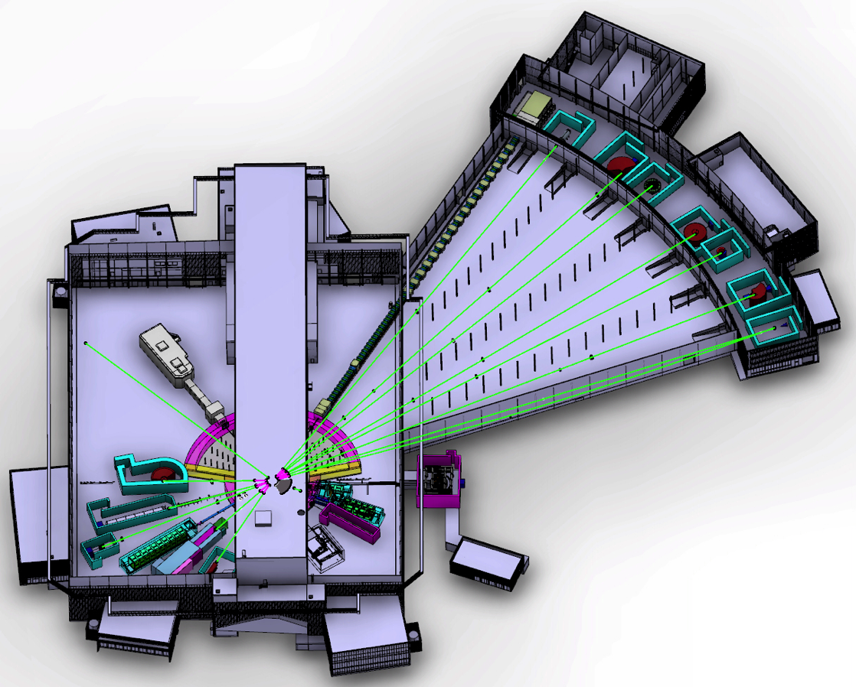
The ESS Neutron Instruments
NMX
Instruments 1-16 to be delivered by NSS project
Instruments 17-22 to be delivered during initial operations (up to 2028)
BEER
C-SPEC
BIFROST
MIRACLES
MAGIC
T-REX
ODIN
HEIMDAL
DREAM
VOR
15 (+1) Neutron Instruments (2025)
SKADI
LoKI
FREIA
VESPA
ESTIA
HR-NSE
Proton beam
50 m
100 m
150 m
Instrument Layout (Jan 2016)

Slide 5
Major In Kind Contributions to NSS:
The Neutron Beam Instruments
Instrument class | Neutron Instrument | Lead Partner(s) | cost (M€) | % IK
Large scale structures | LOKI broadband SANS | ISIS (UK) | 12.2 | 94%
 | SKADI general-purpose SANS (note 1) | FZJ (DE) | 12 | 100%
 | ESTIA focusing reflectometer | PSI (CH) | 9 | 100%
 | FREIA liquids reflectometer | ISIS (UK) | 9 | 100%
Diffraction | NMX macromolecular crystallography | ESS | 11.7 | 70%
 | DREAM powder diffractometer (bispectral) | FZJ (DE) | 12 | 100%
 | HEIMDAL hybrid diffractometer | AU (DK) | 12 | 70%
 | MAGIC magnetism single-crystal diffractometer | LLB (FR) | 12 | 100%
Engineering | BEER engineering diffractometer | HZG (DE) + NPI (CZ) | 12 | 100%
 | ODIN multi-purpose imaging | TUM (DE) + PSI (CH) | 9 | 90%
Spectroscopy | C-SPEC cold chopper spectrometer | TUM (DE) | 15 | 100%
 | BIFROST extreme-environments spectrometer | DTU (DK) | 12 | 71%
 | T-REX bispectral chopper spectrometer | FZJ (DE) | 15 | 100%
 | VESPA vibrational spectroscopy | CNR (IT) | 12 | 100%
 | MIRACLES backscattering spectrometer | ESS-Bilbao (ES) | 12 | 95%
 | 16th Instrument (VOR or NSE) | TBD | 12 | 90%
 | 16 instruments (cost) |  | 188.9 | 92.5%
Provisional total budget =
188.9 M€
In-Kind Target
92.5 %
Estimated ESS commitment to instruments 43 M€ (including guide bunker)
¹Includes SONDE funded detector development, worth ~ 1.5 - 2 M€
4 April 2016

Slide 6
ESH & Q Highlights– 2016
Application #2 to SSM – May
Permit for test stand – May
Contract with SKB – Aug
EFQM workshop – Aug, Oct
New ESH & Q Ass Director – Oct
EMT – Q Review
Complementary information SSM – Dec

Slide 7
Day 1 – October 3
Time | Item | Presenter
09.00 – 09.15 | Welcome
09.15 – 10.15 | Follow-up of ESHAC #3 | Peter Jacobsson
10.15 – 10.30 | COFFEE
10.30 – 11.20 | Status and follow-up the SSM application #2 | Thomas Hansson
11.20 – 11.50 | SSM Licensing work | Peter Frisk/SSM
11. 50 – 13.00 | LUNCH (Medicon Village)
13.00 – 13.30 | Installation Phase - Safety | Bertil Winér/Peter J
13.30 – 14.00 | Commissioning Phase – Safety | Peter Jacobsson
14.00 – 14.30 | Quality | Mattias Skafar
14.30 – 14.50 | COFFEE
14.50 – 15.20 | ODH | Duy Phan
15.20 – 15.50 | Sustainability – Energy | Peter Jacobsson
16.15 | Site Visit
19.00 | Dinner

Slide 8
Day 2 – October 4
Time | Item | Presenter
08.45 – 09.30 | Cost estimate – ESH & Q , “Steady State Operation” | Peter Jacobsson
09.30 | COFFEE
10.00 – 11.45 | Internal ESHAC meeting
11.45 – 12.30 | Lunch (in-house)
12.30 | Continued internal ESHAC discussions
13.00/13.30 | Close-out
14.30 | Ending of meeting

Slide 9
Charge
How do you look upon the organisation of ESH and Q and the included cost estimate for the future operational phase
What is your opinion about the status of our SSM application work and the associated time schedule
How do you look upon the work done for sustainability
How do you look upon the work done for ODH
Your comments regarding the schedule and needed work for the commissioning, especially the first part of the accelerator

