Slide 1
European Spallation Source ERIC
Vacuum System Section
Specialized Technical Service
(ESS.30.1.4)
Marcelo Juni Ferreira
Vacuum System Section Leader
Specialized Technical Service
www.europeanspallationsource.se
14 October 2016

Slide 2
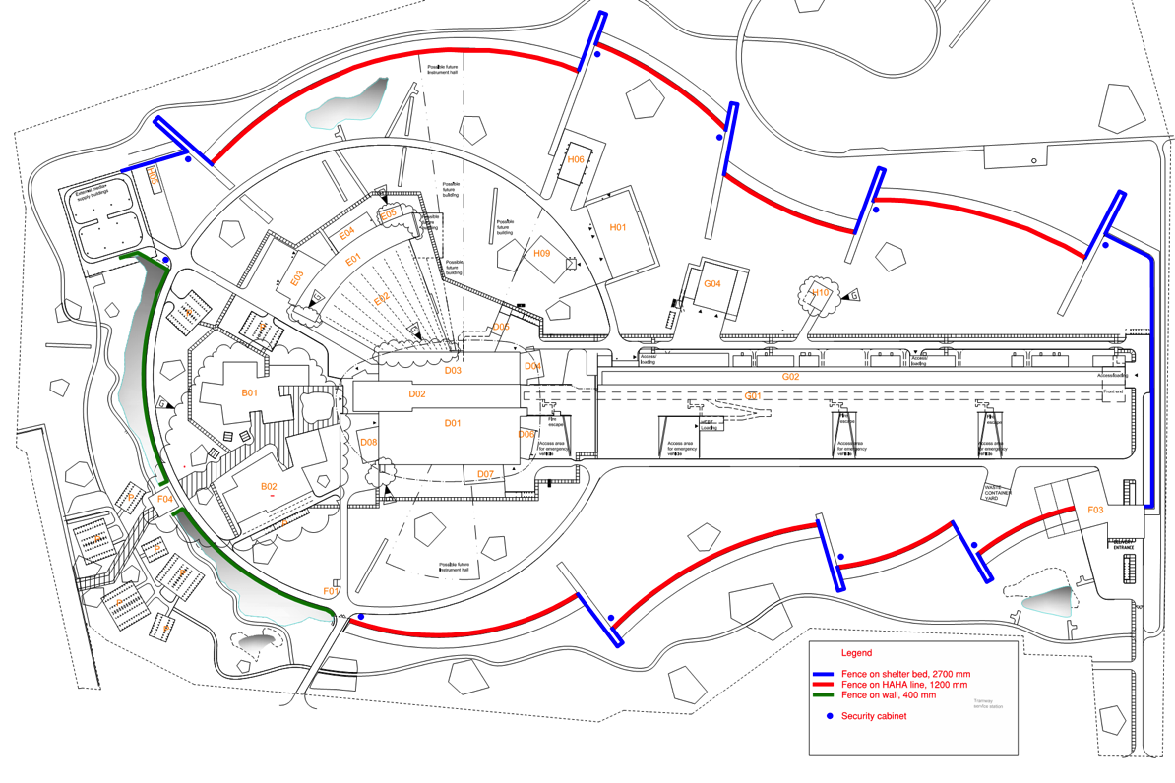
Vacuum System Section - Specialized Technical Service – location distribution
Vacuum room on Neutron Instruments hall:
Bunker (NG, choppers),
Neutron guides (MH),
Instruments (LV, MV,HV)
Sample environment.
Vacuum room on G02 (klystron gallery) Accelerator:
Warm LINAC (HV),
Cold LINAC (HV, UHV, vacuum insulation, Cryo/ particle free),
A2T + Dump+ DogLeg (HV).
Vacuum system on Target building:
Monolith Vessel (HV),
PBW (He).
Vacuum Laboratory site wide support for all:
- Accelerator/Target/Instruments
-stand-alone vacuum systems,

Slide 3
Subject Matter Experience in Operating Vacuum systems to Support Approach and Estimate
Experience of the Vacuum System team
  Marcelo Juni Ferreira – section leader
  2.5 years ESS Vacuum system
  3 years SLAC Vacuum Science and Eng. Department
  4 years NSLS-II/BNL Vacuum Group
  18 years LNLS/ABTLuS
  Peter Ladd former section leader (ESS and SNS)
  4 years ESS Vacuum Group
  10 years SNS Vacuum Group
  30 years ITER, Cornell, private business....
Consulted with SNS to compare estimates:
Peter Ladd and J. Prince

Slide 4
Vacuum system Experience to Support Approach and Estimate for Operation
ESS Vacuum System approach:
If the subsystem is already define (Ex: Accelerator), the maintenance in spare/supplies is estimated by average over 3 years period,
If the subsystem is unknown (Ex: Instruments) the vacuum system cost/budge is used as a figure with 3% as maintenance in spare/supplies,
Peak work during shut-down is expected to have support from other groups or external contractors,
Minimum trained/skilled ESS personnel to keep critical activities necessary for ESS operation (Ex: particle-free instrumentation on cryo modules min number to exchange a BI = 3+1 ),
Take advantage of standardization policy from early stage (Framework Agreement + ESS Vacuum Handbooks),
Centralized management with a minimum core team to keep state-of-art technology and engineering.
Consulted with SNS to compare estimates:
Detail budge for vacuum from 2006-2008,
Totals for vacuum spare/supplies 2009-2011,

Slide 5
Vacuum System Scope, Requirements and Function
Vacuum System Scope
Vacuum System section has the responsibility for all ESS “technical” vacuum systems of the Accelerator, Target and Neutron Instruments including neutron guides and choppers.
The main task is to support the in-kind-contributions (IKC) of the ESS vacuum systems provided by our Partners to ensure an integrated vacuum system design and operation.
Vacuum System Requirements
Operate the ESS facility on the most effective way to ensure:
  Reliability of the operation (by design and/or maintenance),
  Cost effective and safe design and operation,
  Standardization of vacuum equipment and procedures,
  Training non-vacuum personnel on the operation of the vacuum system,
Function of the Vacuum System team:
  Specify the vacuum system (pressure range, pumps, instruments, costing for fabrication and operation),
  Design and fabrication process specifications (including vacuum control system, safety and vacuum standardization policy),
  In house critical mass to have “state-of-art” application of vacuum technology for the ESS science,
  Vacuum Testing: materials, designs (gas dynamics), instruments and pumps for all applications (EX: test vacuum compatibility of cables to be used on the neutron instruments),
  Maintenance of all vacuum related equipment,
  Installation of all vacuum systems including interface with ESS/ICS,
  Operation of the ESS vacuum system complex and/or training of non-vacuum personnel on the vacuum system,

Slide 6
Labor Resources to Support Vacuum System Operations
Expertise requirements
Vacuum System Eng. (Physicist/Engineer Phd), material science for vacuum, instrumentation/pumps, particle accelerator vacuum system design, gas dynamics/vacuum simulation specialist, management ,
Vacuum System Eng. (physicist/engineer), vacuum, contamination, instrumentation/pumps, system design and particle free specialist ,
Vacuum System Eng. (Materials Engineer), material science for vacuum, contamination and gas dynamics/vacuum simulations specialist,
Vacuum System Eng. (Electronics Engineer), control systems (hard+soft), High voltage/electronics, vacuum instrumentation/pumps/gauges/valves controllers, and cabling,
Vacuum System Technicians: mechanics, vacuum instrumentation/pumps, particle-free work, cryogenics, vacuum instrumentation maintenance and particle accelerator operation.
Staffing plan (normal working hours)
  1 FTE Engineering management
  3 FTE Engineering Accelerator
  1 FTE Engineering Instruments
  4 FTE Technicians Accelerator
  3 FTE Technicians Instruments
  1 FTE Technicians Target
  Internship undergraduate students (physicist/engineer),
  apprenticeship training (technical students),

Slide 7
Operations Costs for ESS Vacuum System
Includes:
-Vacuum spares include: pumps, gauges, RGA, valves, clean rooms, leak detectors, control system, controllers, gas injection and venting systems.
-Vacuum supplies include: detergents, chemicals, laboratory tools, hardware, Al foils, wipes, paper, gaskets, o-rings, bolts, shop supplies, oil, grease, external services, etc.
-Contractors for peak workloads during shutdown or special maintenances.

Slide 8
Comparison ESS ⬄SNS Facilities Operation
ESS Vacuum Team
Scope:
Responsible for all ESS “technical” vacuum systems of the Accelerator, Target and Neutron Instruments,
Target in high-vacuum connected directly to accelerator,
Responsible for the Vacuum control system,
Early discussions with choppers and Instruments (x22),
Early implementation of vacuum policy on standardization, Vacuum FA,
Resources: staff of 13
5 engineers;
8 technicians;
Budget: 1.1M€ (including all support for Accelerator/Target/Instruments)
SNS Vacuum Team
Scope:
originally responsible only for accelerator. Later became responsible for Instruments.
Target run in He.
No responsibilities on control system,
No standardization, high cost/effort on maintenance,
Late implementation on vacuum rules for instruments (x17).
Resources: staff of 12
4 engineers;
8 technicians (support from Union on mechanical and electrical),
Support from Beam Instrumentation staff,
Budget: $1M (no Instrument budge from 2006 to 2011).

Slide 9
Summary
Operation cost (FTE and budge) was estimated using ESS personal experience against SNS as benchmark,
Use the best available information on ESS vacuum system to create a reasonable scenario for maintenance and operation,
Use of standardization of equipment and procedures to simplify maintenance and operation (scale),
Use of the best knowledge on the field to make cost effective options for the vacuum system,
FTE prepared on inputs from each division Accelerator/Target/Instruments,
Steady State Budget: 1 M€
Steady State FTE’s: 13 (1.3 M€)

Slide 10
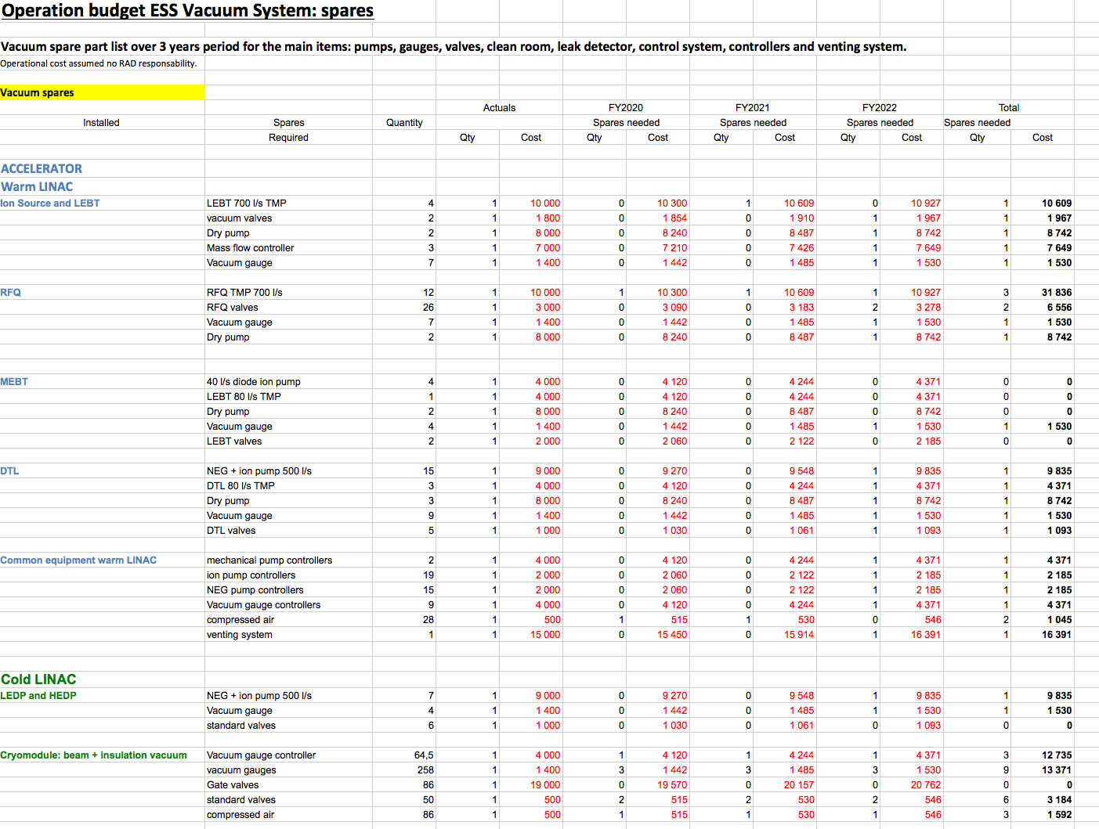
Budged for Vacuum
14/10/16
Vacuum System Section MJ Ferreira, November 2016 ESS Operations Cost Review
10

Slide 11
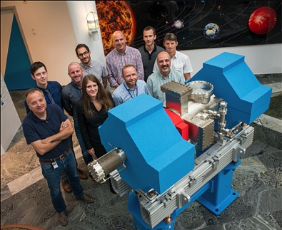
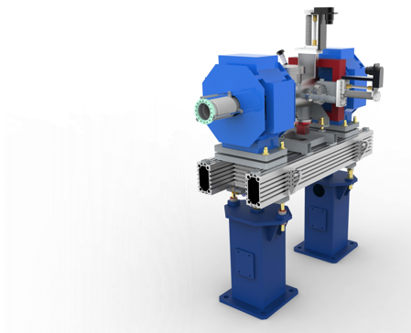
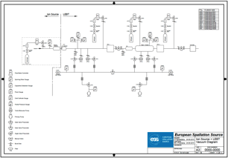
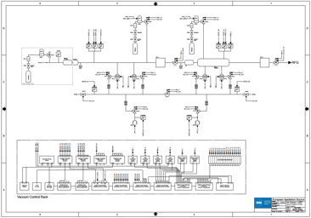
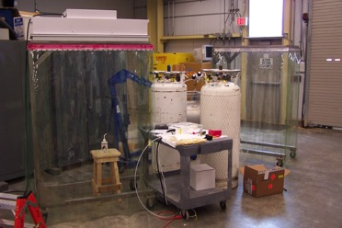


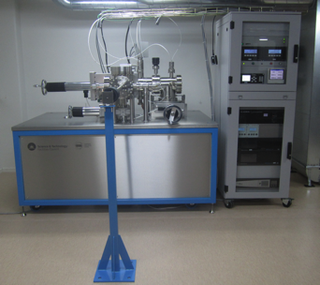

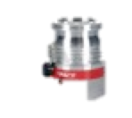

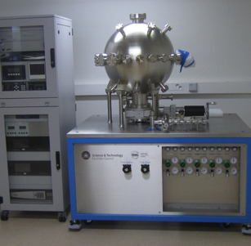

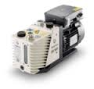
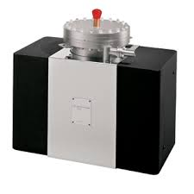
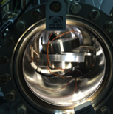
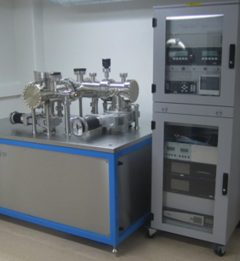
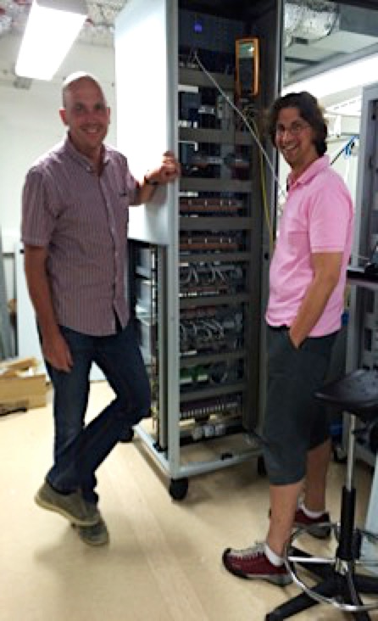
WBS ESS.30.1.4:
Vacuum System
Portable clean room for particle free installation Cold LINAC
Vacuum diagram.
Standardization and integrated approach through Framework Agreement including in kind.
Vacuum control: important to know early stage since vacuum device control differs functionalities.
Vacuum Lab. Supporting design and operation for Acc/Target/Instruments and Control System.

