Slide 1
BrightnESS WP5
First Integrated Design Review
January/February 2017
DMSC, Copenhagen

Slide 2
Welcome
What do we want this meeting/workshop to be?
BrightnESS is funded by the European Union’s Horizon 2020 research and innovation programme under grant agreement No. 676548
Notes:
Who is who? Who does what?
There will be food, coffee, fruit, and cake. (I hope.)
Hands on
Integration
Stuff for operations

Slide 3
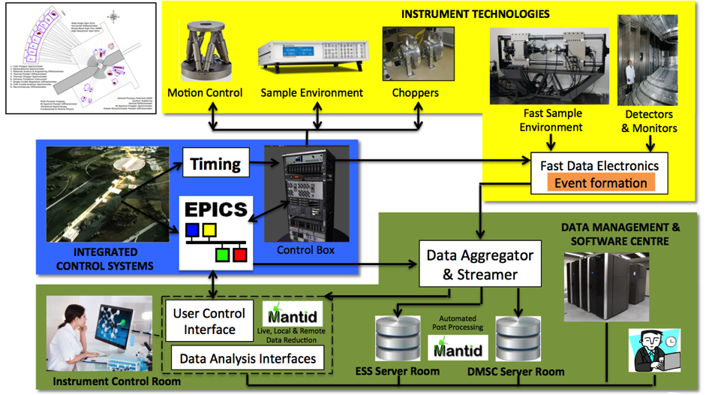
Overview of ESS Data Pipelines
BrightnESS is funded by the European Union’s Horizon 2020 research and innovation programme under grant agreement No. 676548

Slide 4
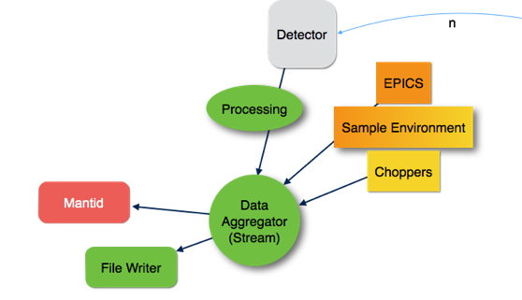

Architecture
Design Model
BrightnESS is funded by the European Union’s Horizon 2020 research and innovation programme under grant agreement No. 676548

Slide 5
Interfaces and Responsibilities
DST
Beamline
facility services
DB
Detector
DM
Lund
Detector
SE
(fast) SE
Motion et al
IDG
Copenhagen
DAM
Both/Redundant
External
unknown
Event Formation
Event Formation
ICAT
ISPyB
+Glue
UO
Config Engine
Auth
AGG
“BDI”
fast SE
EPICS
Download
Web
Reduction
Analysis
Service
ECP
Live Mantid
Live Analysis
Analysis
Reduction
per beamline
PFS
Service
FW

Slide 6
Data flow from Detectors, SE, choppers and motion control to disk, Mantid & analysis
Detector
signal
Detector data
interface
Detector
signal
processing
Pixel positioning
Frames of Events &
Aggregation of meta data
Detectors
Apache Kafka
ERC
Neutron data and meta data Aggregator
Kafka
Kafka
Mantid subscriber
Fast SE readout
Data reduction
automated reduction
data correction
visualisation of reduced data
Fast SE & motion
i.e With a latency
that is outside of spec for EPICS
High speed
environment
data interface
File Nexus Processed
API config
ERC
Accelerator data
Fast SE data
PSS Status
Analysis interface
PLC layer
Instrument PV
access gateway
Sample environment
Time stamped
signals
Data analysis codes
visualisation of analysed data
Control Box
API config
Analysis file in
Motion axis
ERC
IOC(s)
Python based experiment control system & visualisation of detector data.DAQ control & configuration
ChiC
Control Box
Time stamped
signals
Choppers
ERC
IOC(s)
ERC
WEB
File writing service
DM group
ID group
ICS
ICS software, CCDB ,IOC factory naming, SCR
DOI
Reduction
/ Analysis
API
catalogue
PFS
ERC
Event receiver card
DB access
DAM
group
DST
group
Chopper & motion & SE
Detector group
User Office DB

Slide 7

Detectors
Science NT Groups
Agg.
Mantid
AAS
Epics
Devices
Mantid
AAS
DMSC DM
PV gate
FileWriter
ICS
CA comm
Agg Comm
File Writer Comm
MAAS Comm
Abstraction layer
Script Engine
Logging
Alarms
ECP config
Configuration service
Vis service
Server
Access control layer
Client
Client
Client
Client

Slide 8

Overview of WP5
Task 5.1 | Creating a standard neutron event data stream for different detector types | ESS, KU
Task 5.2 | Creating a standard method for streaming meta-data for fast applied fields | ESS, PSI
Task 5.3 | Software to aggregate and make available neutron event data and sample meta-data | ESS, PSI, Elettra
BrightnESS is funded by the European Union’s Horizon 2020 research and innovation programme under grant agreement No. 676548

Slide 9
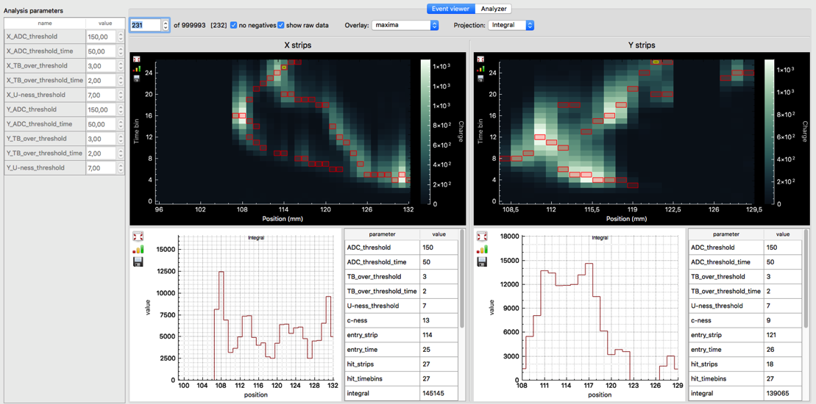
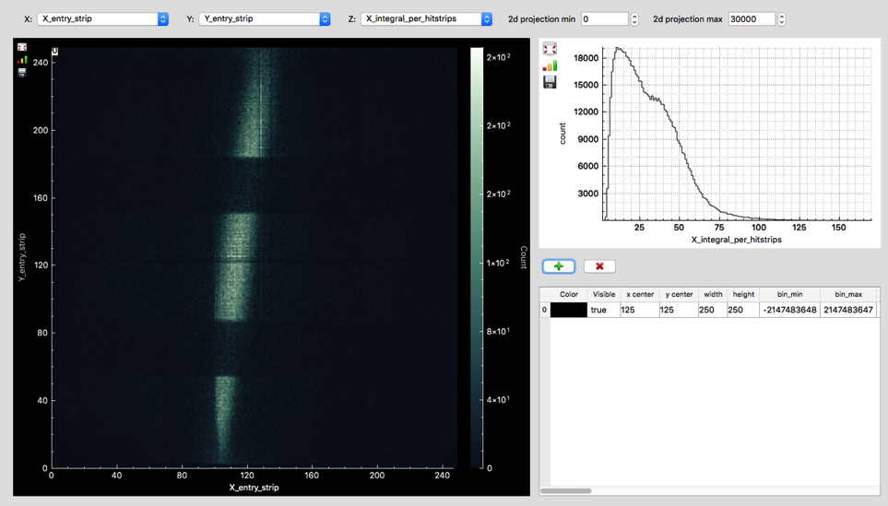
Task 5.1 -- Event Formation/Classification
BrightnESS is funded by the European Union’s Horizon 2020 research and innovation programme under grant agreement No. 676548

Slide 10
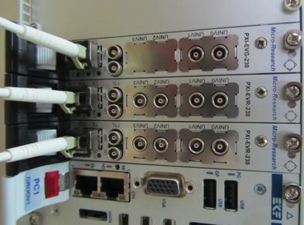
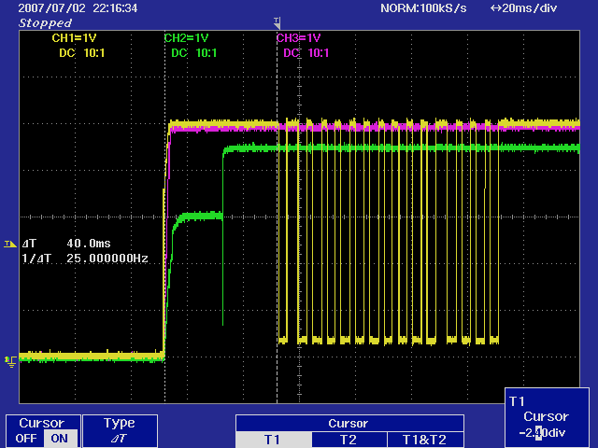
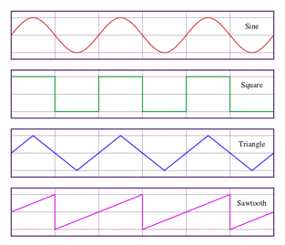
Task 5.2 – Fast Field Data
Joint Task with PSI.
Collecting Metadata from fast Sample Environments
High Speed – up to MHz
Lots of data, close to neutron events
No turn key solution available
that includes accurate timing
Evaluating partial technical
solutions that can be combined
Integration into data stream
BrightnESS is funded by the European Union’s Horizon 2020 research and innovation programme under grant agreement No. 676548

Slide 11



Task 5.3 – Data Aggregation
Technology Choice:
Client
Server
Client
V4
Server
Facility Control System
Client
EPICS interaction model
General Purpose Communication Library
“Big Data” Data Broker
Design Model
BrightnESS is funded by the European Union’s Horizon 2020 research and innovation programme under grant agreement No. 676548

Slide 12
Milestones and Deliverables
BrightnESS is funded by the European Union’s Horizon 2020 research and innovation programme under grant agreement No. 676548

Slide 13
Agenda
BrightnESS is funded by the European Union’s Horizon 2020 research and innovation programme under grant agreement No. 676548
Notes:
Session conveners’ role

Slide 14
Workshop
Ask questions. We’re not running a tight programme, there is time.
Have a positive attitude but do find and point out problems:
If you think something will not work, be unreliable, slow or you just don't understand it, say so!
Be concrete in your suggestions.
BrightnESS is funded by the European Union’s Horizon 2020 research and innovation programme under grant agreement No. 676548

