Slide 1
Introduction, PSS Strategy, Strålsäkerhetsmyndigheten (SSM) & Standards.
Stuart Birch
Personnel Safety Systems
ESS/ICS/PS
Date: 2016-11-29

Slide 2
Stuart Birch
Part of the ESS Instrument Control Systems Division, Protection Systems Group, Senior Engineer for Personnel Safety systems.
10+ years as Electrical Design Engineer at ISIS (Rutherford Appleton Laboratory) UK.
Tasks included:-
  All Electrical Design, installation and commissioning of Extracted Proton Beam line
  All Electrical Design for 7 Day one Neutron Instruments including the Design, Development, Installation, Commissioning and Validation of the Instrument Personnel Protection Systems.
  2 years as ISIS Design Division Electrical Group leader.
20+ years Electrical Design Engineer for a small Power Supply/Transformer manufacturing Company in the UK (Director)

Slide 3
Contents
Introduction
ESS Personnel Safety System Scope
Strategy of the ESS Personnel Safety Systems
PSS Quality Management Plan
PSS Software Configuration Management.
PSS1 Overview

Slide 4
Introduction
The primary role of the Personnel safety systems is to protect ESS Workers/Personnel from hazards that have been identified during the development of the systems.
Assessments and analysis will decide which hazards will be mitigated with the PSS.
Typically the hazards will be, but not limited to the following:
Ionising radiation produced by the accelerator Proton beam in accelerator controlled areas
X-Rays produced from high power RF systems in the accelerator controlled areas
Conventional hazards in the accelerator controlled areas which include:
  High voltage
  Oxygen Deficiency hazard
  Magnetic fields
  Lasers class 4
Note the PSS is not designed to mitigate radiation from activated components.

Slide 5
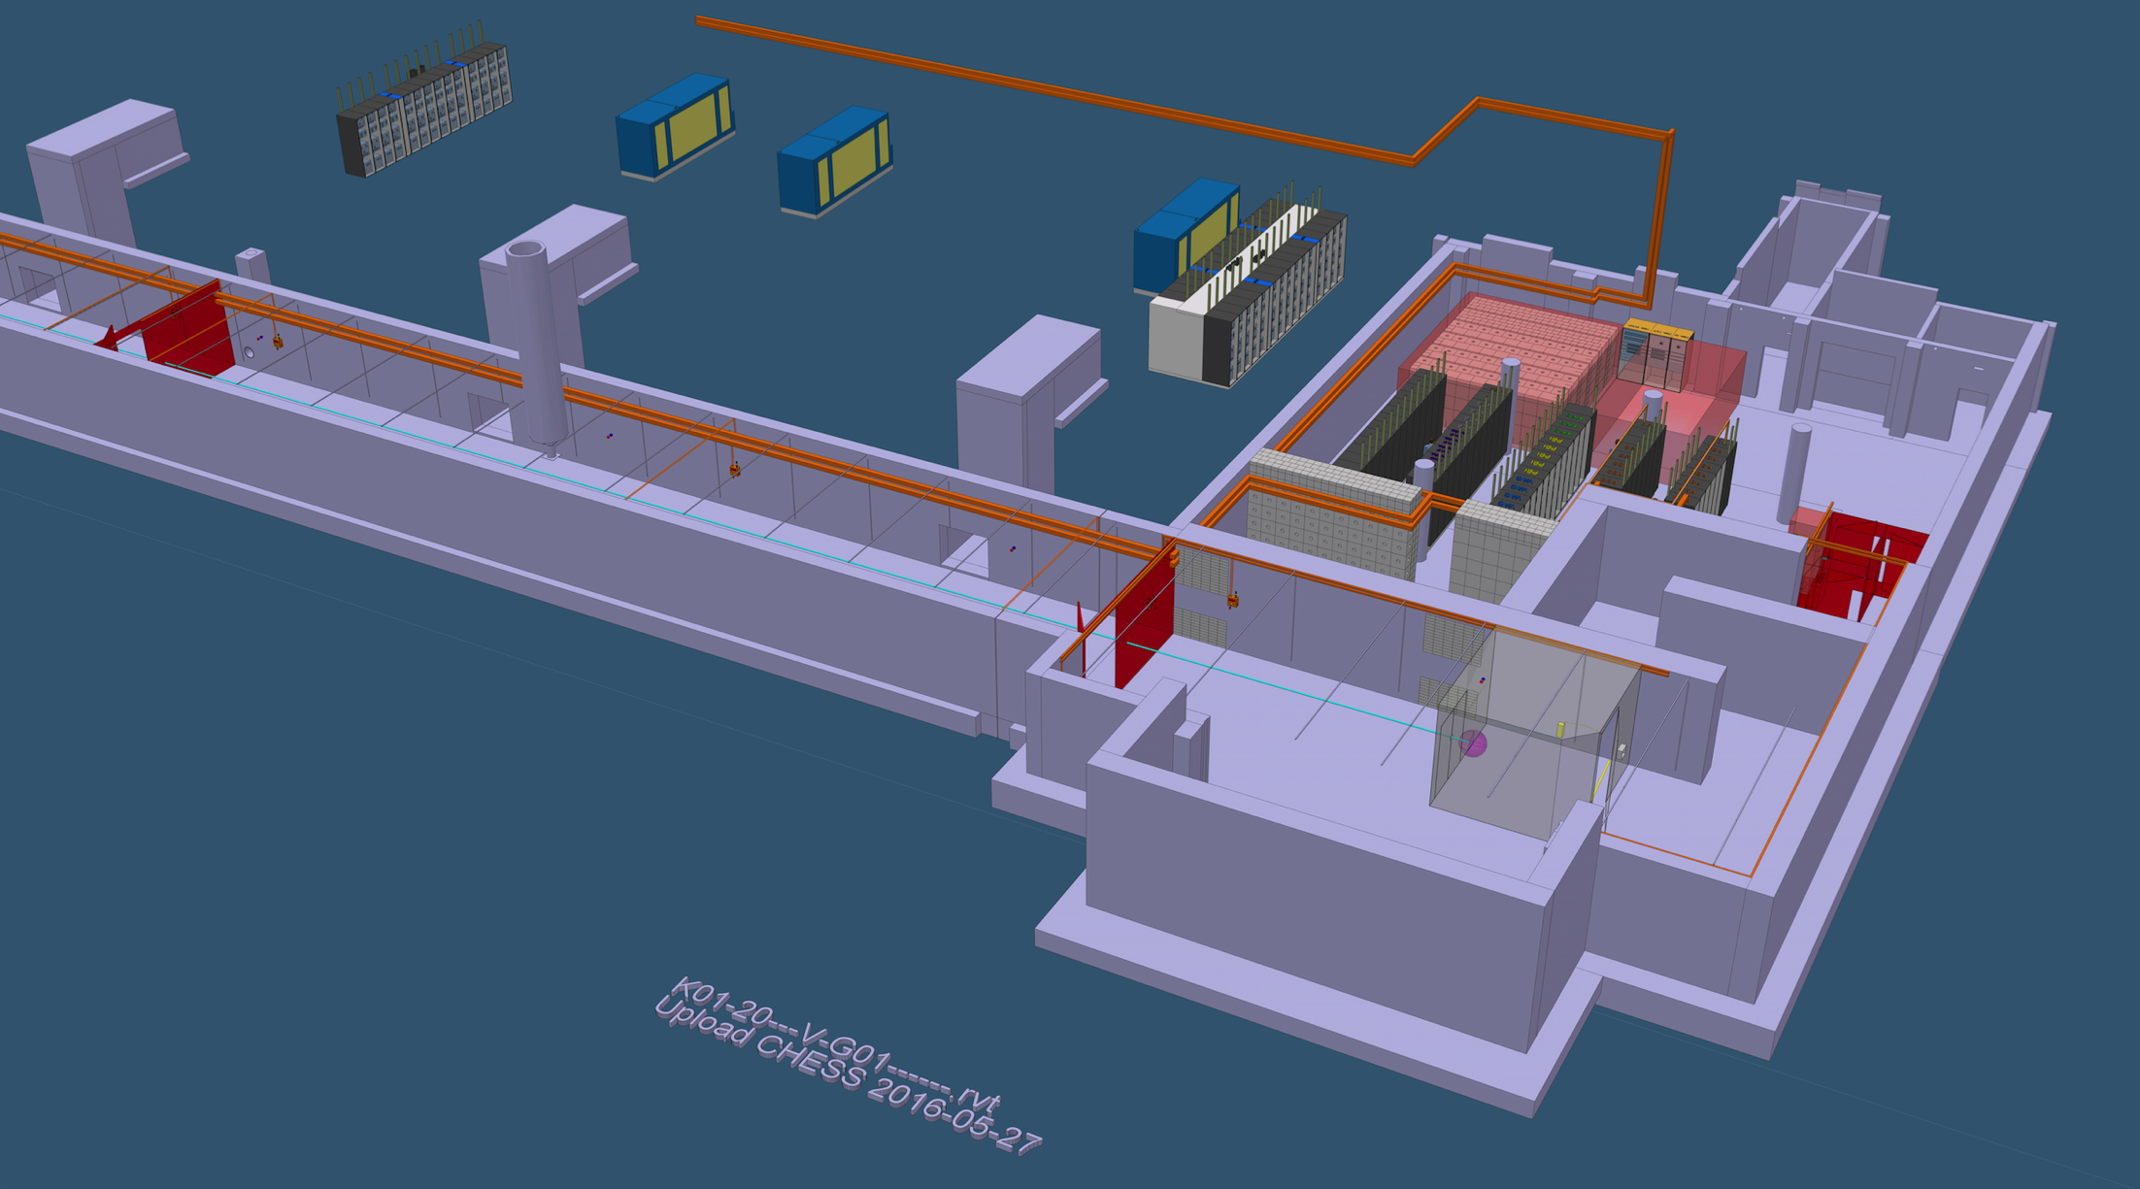
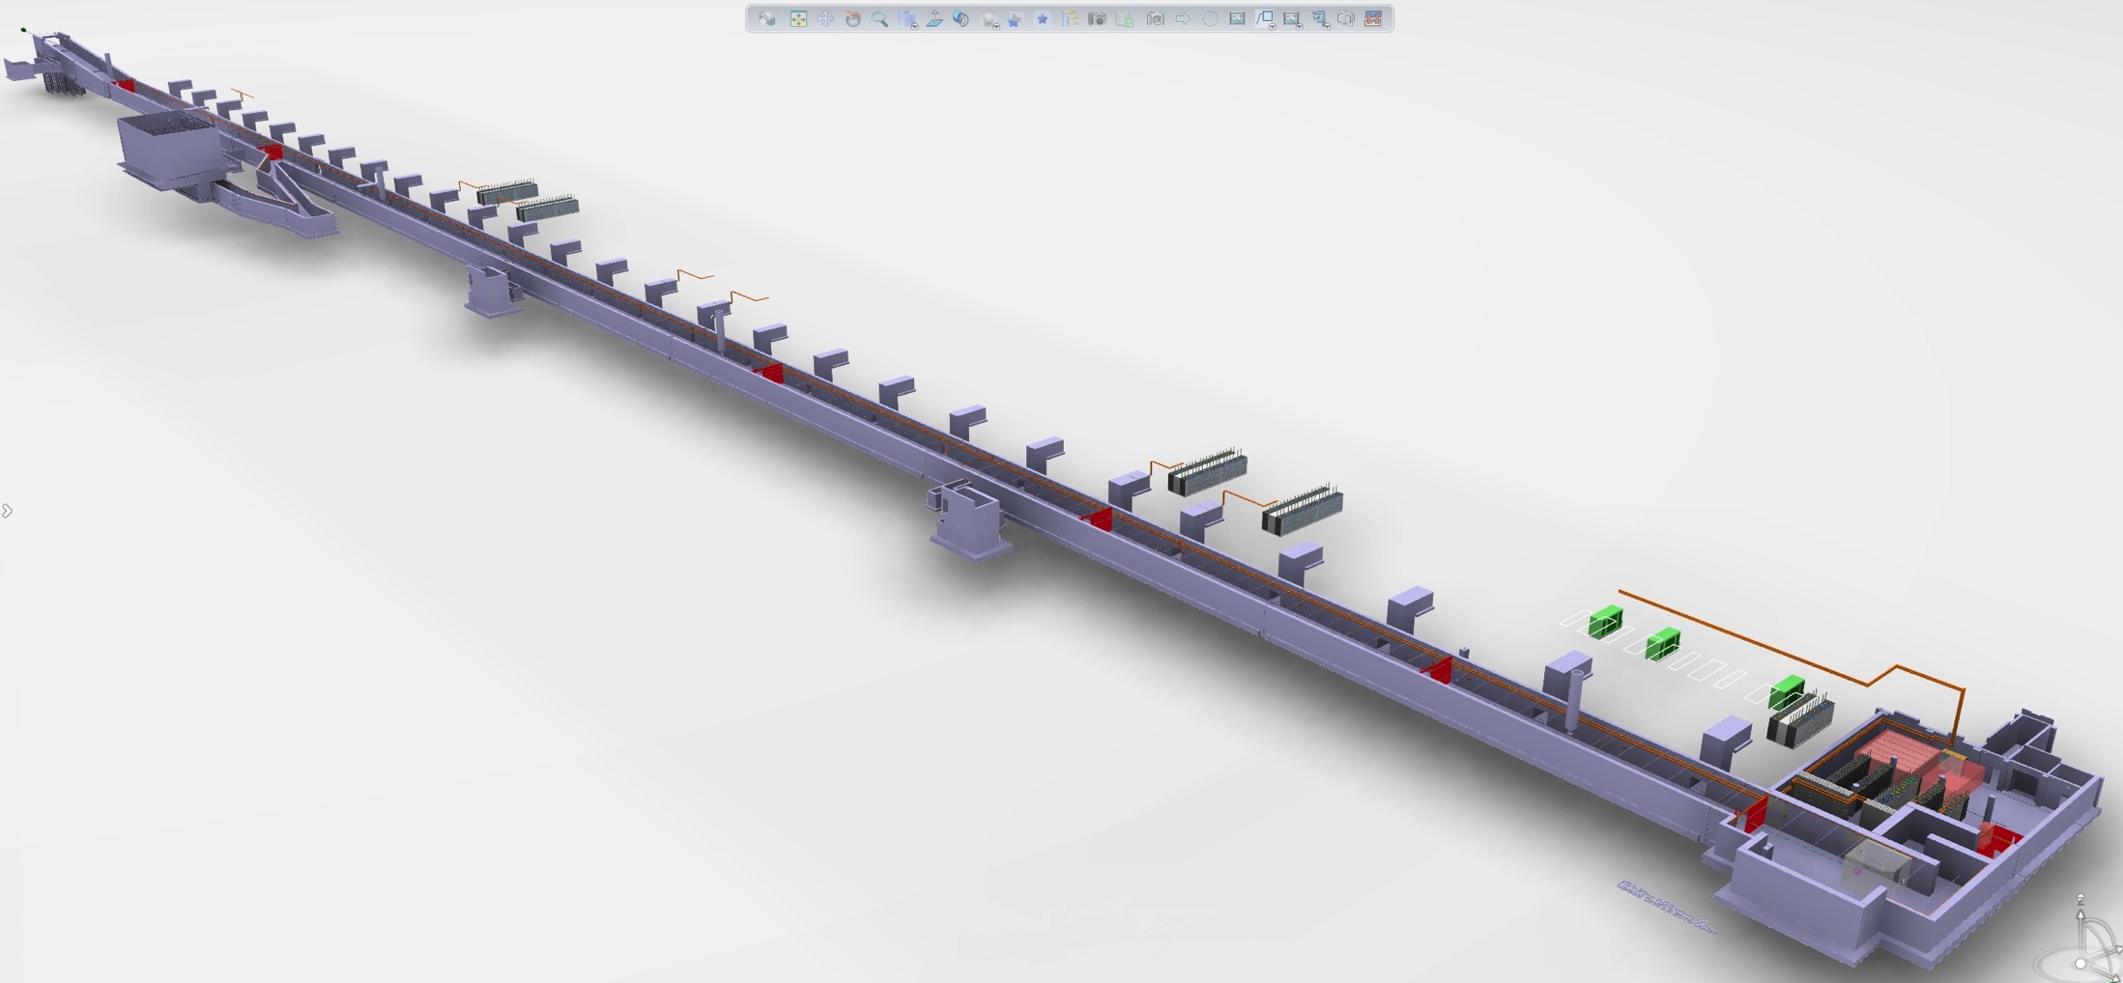
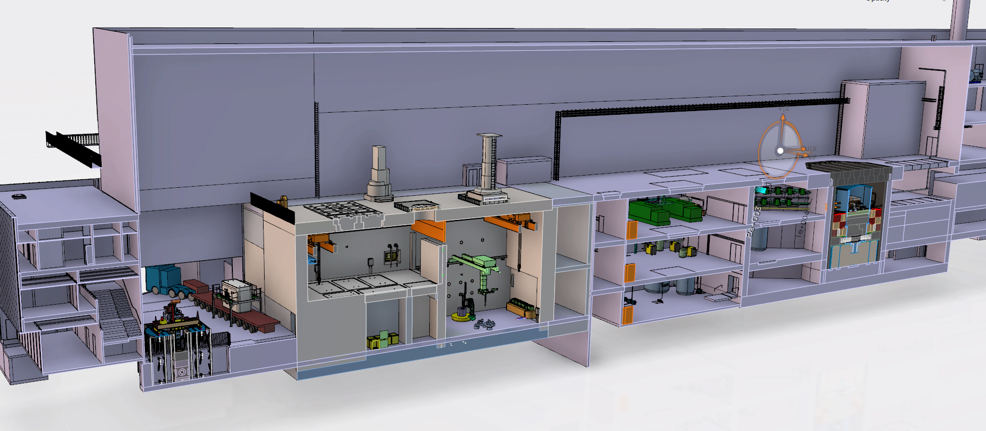
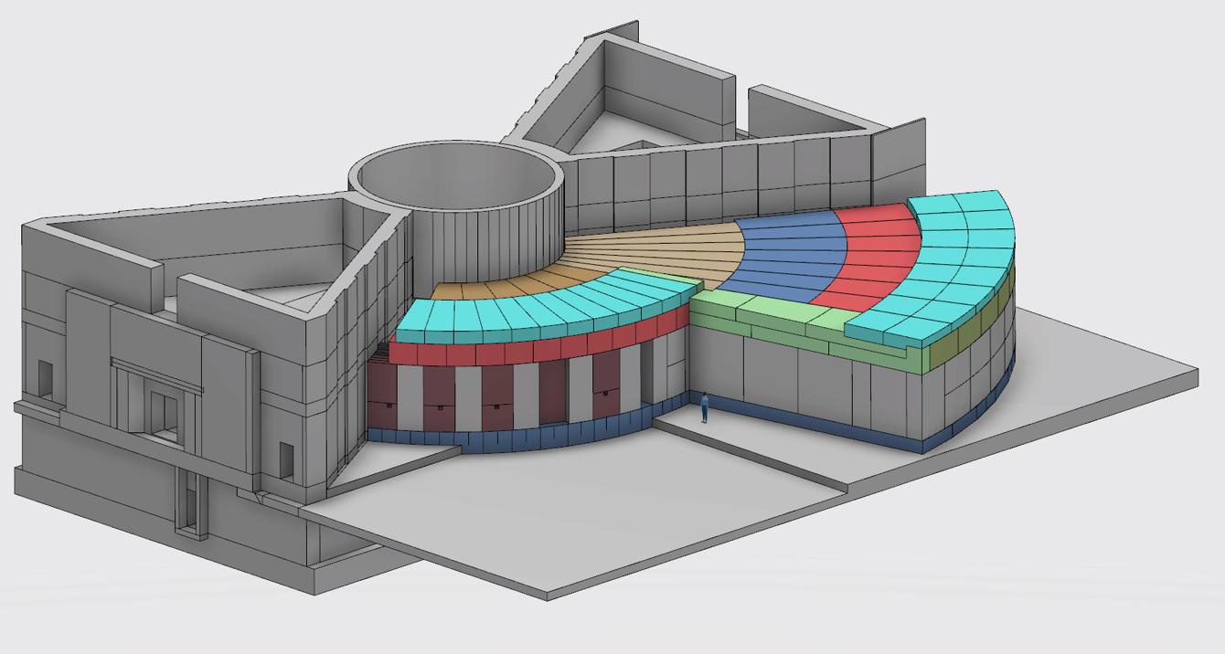
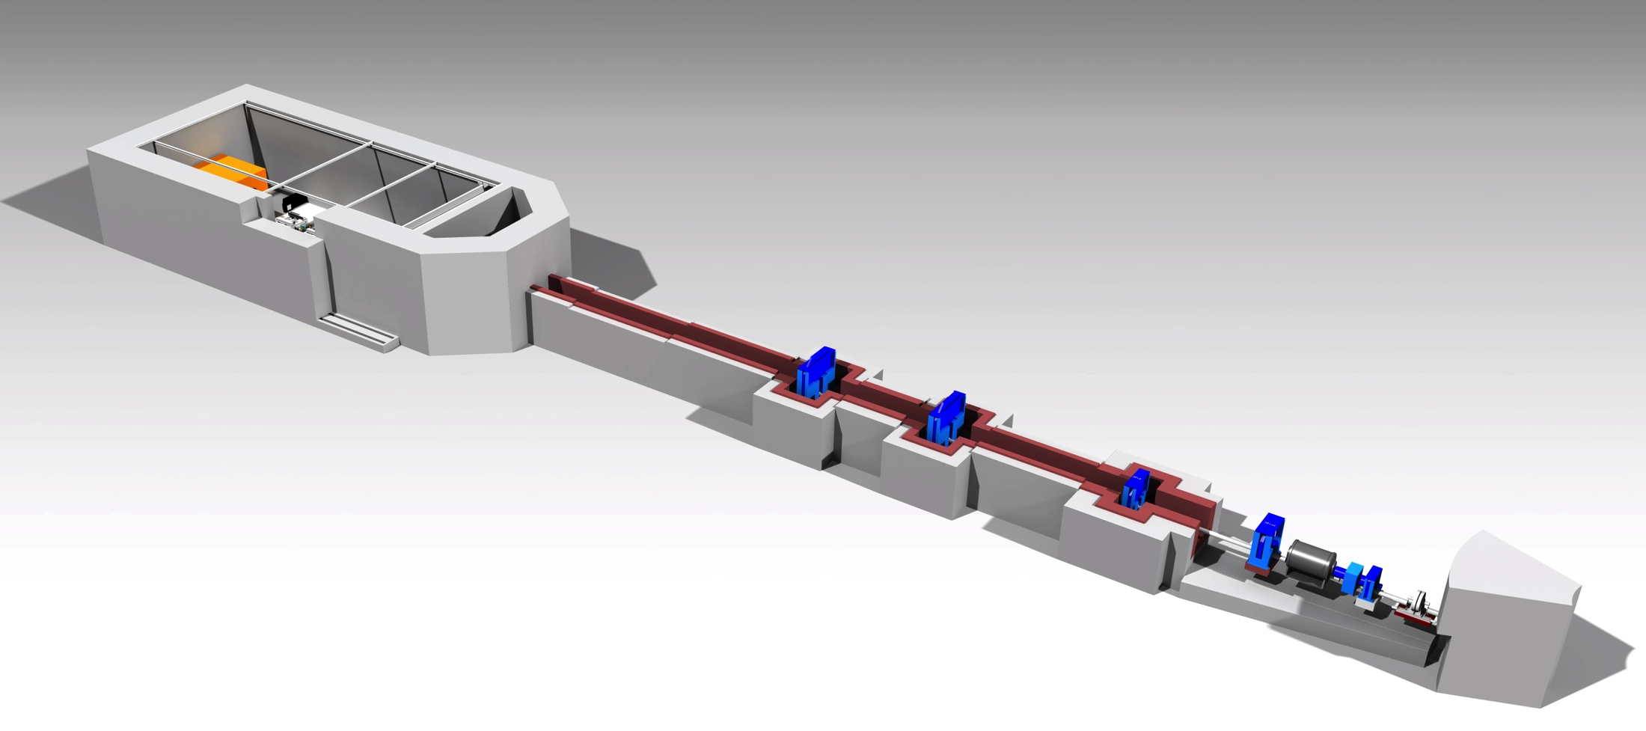
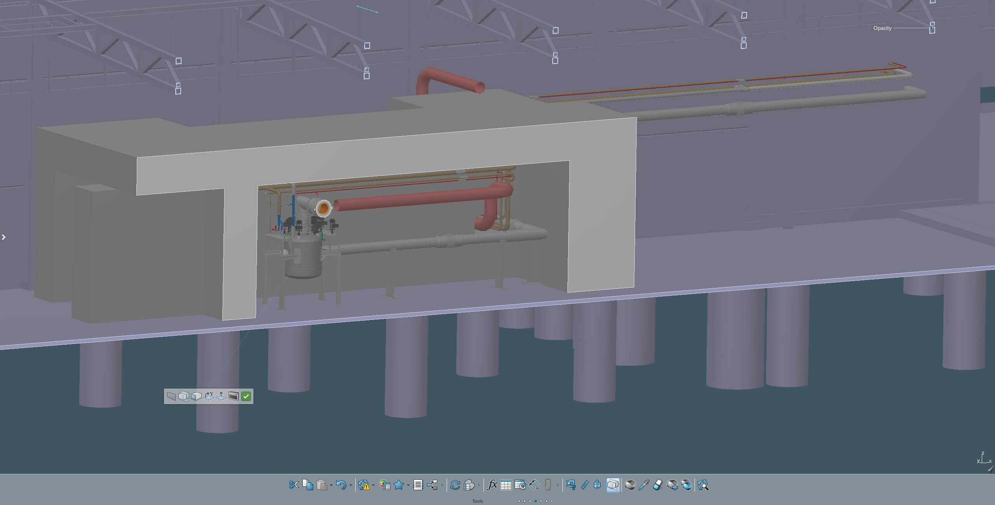
ESS PSS Scope
Personnel Safety System 1. for the ESS Accelerator warm section:
Personnel Safety System for the ESS accelerator which includes:
Personnel Safety System for the ESS Target
Personnel Safety System for the Bunker
Personnel Safety System for the first three Neutron Instruments
Personnel Safety System for the Cryogenic test stand (TS2)
Notes:
Bunker is in a new re-defining process

Slide 6
PSS Strategy
ESS CHESS Document ESS-018828 English version of the SSM Conditions
SSMFS 2008-27: The Swedish Radiation Safety Authority’s “regulations concerning operations at accelerators and with sealed radiation sources”.
Strålsäkerhetsmyndigheten
(SSM) Conditions
ESS PSS Strategy to meet all requirements
IEC 61508
IEC 61508:2010 Parts 0 to 7

Slide 7
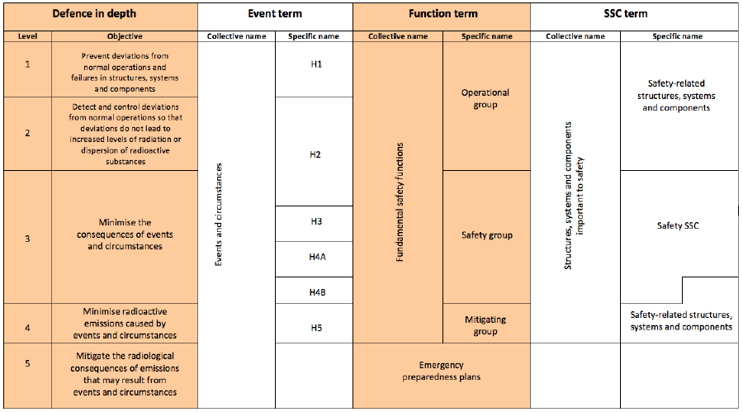
PSS Strategy (SSM conditions ESS-0018828)
Defence in depth Level 1. To prevent deviations from normal operations and faults in structures, systems and components.
Defence in depth level 2. To detect and control deviations from normal operations and verify that the discrepancies do not lead to increased radiation levels or dispersion of radioactive substances within the facility.
Defence in depth level 3. To minimise the impact of events and circumstances that lead to increased radiation levels and limit the dispersion of radioactive substances within the facility and surrounding areas, as well as counteract extensive damage to the radiation sources
Defence in depth level 4. To ensure that radioactive emissions to the environment resulting from events and circumstances with extensive damage to radiation sources are as low as is practicable and reasonable.
Key terms used in SSM conditions

Slide 8
PSS Strategy (SSM conditions ESS-0018828)
The ESS PSS Strategy will be to develop all PSS systems using SAFETY RELATED structures systems and components important to safety.
Key terms used in SSM conditions
Notes:
In our opinion

Slide 9
PSS Strategy (SSMFS 2008-27)
SSMFS 2008-27: The Swedish Radiation Authority’s “regulations concerning operations at accelerators and with sealed radiation sources”.
Section 10. An analysis of the conditions in the facility with respect to the risk of potential exposure to radiation is to be carried out before a facility is taken into use.
Section 11. Based on the analysis carried out as specified in Section 10, administrative and technical procedures are to be designed with the purpose of preventing predictable causes of unintentional exposure of persons.
Section 12. Before primary radiation or similar radiation is delivered into an area, the area is to be inspected in such a manner that ensures that no person is present in the area. Access to such an area is to be blocked when the radiation is being delivered. At least two independent technical systems are to be used to prevent radiation of personnel in the event that the block is overridden.
Hazard Analysis
(IEC61508 HAZID, SIL Determination, SIL Verification)
Formalised Search.
Access System.
Two Train System.
Notes:
SSM requirements ess-0018828
Section 10-12 shall be used when designing controll systems
These are mentioned in the requirements as well

Slide 10
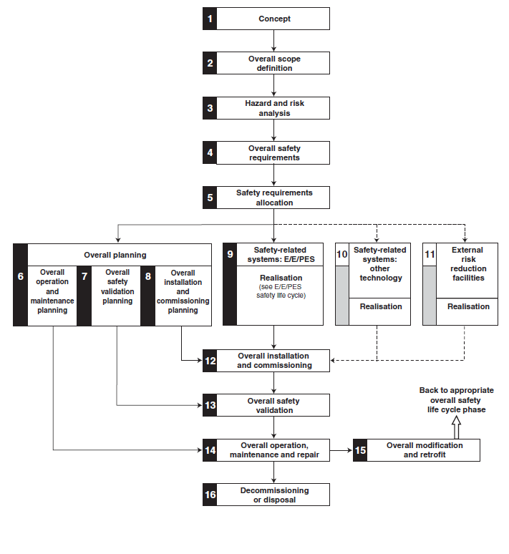
PSS Strategy (IEC61508)
In line with many similar accelerator based facilities around the world,
Is was decided in 2012 the the ESS personnel safety systems should
be designed in accordance with IEC61508:2010.
The IEC61508 safety life cycle has 16 phases
which roughly can be divided into three groups as follows:
Phases 1-5 address analysis
Phases 6-13 address realisation
Phases 14-16 address operation.
IEC61508 lifecycle
Notes:
SSM requirements ess-0018828
Section 10-12 shall be used when designing controll systems
These are mentioned in the requirements as well

Slide 11
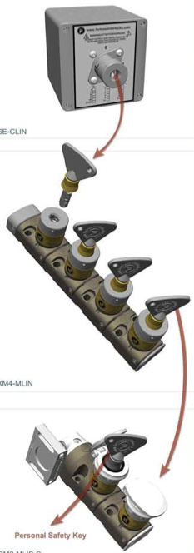
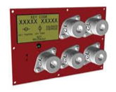
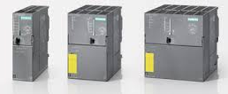
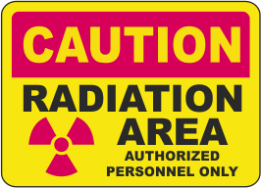
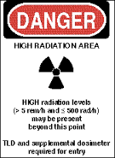
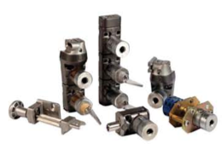
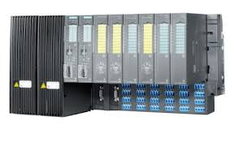
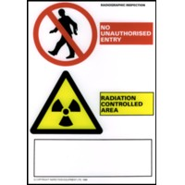
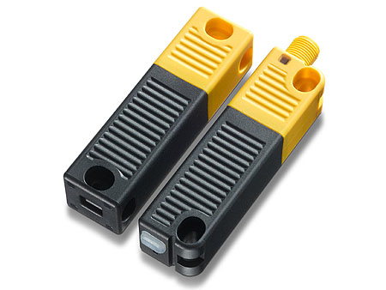
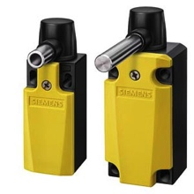
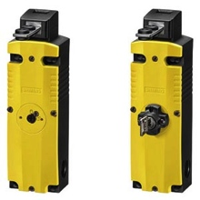
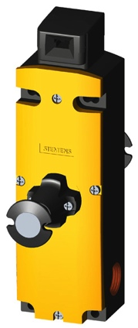
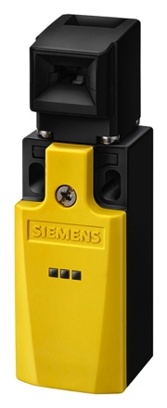
PSS Strategy (IEC61508) Risk
Residual Risk
Tolerable Risk
Tolerable Risk
Risk which is accepted in a given context
based on the current values of society.
EUC
RISK
EUC Risk
Risk arising from the equipment
under control (EUC) or its
interaction with the EUC.
Residual Risk
Risk remaining after protective measures have been taken.
Increasing
Risk
External Risk reduction
Authorisation
Personal Training
Signage
Electrical/Electronic/Programmable Electronic System.
Safety PLC Systems
Hard wired Relay systems
Other technologies.
Mechanical Key exchange System(s).
Necessary Risk Reduction
Actual Risk Reduction
Partial risk covered by other technology Safety-related systems
Partial risk covered by E/E/PE Safety-related systems
Partial risk covered by external risk reduction facilities
Risk reduction achieved by all safety-related systems
and external risk reduction facilities
Notes:
The purpose of determining the tolerable risk for a specific hazardous event is to state what is deemed reasonable with respect to both the frequency of the hazardous event and its specific consequences.
The tolerable risk will depend on many factors. For example, the severity of the consequences or injury, the number of people exposed to danger, the frequency and the duration of the exposure. Important factors will be the perception and views of those exposed to the hazardous event.
Risk reduction is achieved by a combination of all the safety protective features, including any associated SIF. The necessary risk reduction to achieve the specified tolerable risk, from a starting point of the risk presented by the Equipment Under Control (EUC), is shown in Figure 4.

Slide 12
PSS Strategy Summary
The ESS Personnel Safety System design.
Designed in accordance with SSM requirements for a Safety Related Systems.
Designed, manufactured, commissioned and validated to IEC61508, using proven technology.
Designed as a two train system
Designed as fail safe system
Will include the following, in its design philosophy:
  Single failure
  Common Cause Failure
  Redundancy
  Diversity
  Separation
Notes:
Common Cause Failure: The result of one or more events, causing concurrent failures of two or more separate channels in a multiple channel system, leading to a system failure.
Diversity: Different means and/or technologies used to perform a required function.
Redundancy: The existence of more than one means for performing a required function or for representing information.
Separation: Physical separation of independent systems to reduce the possibility of the personnel safe-ty systems being affected by the same external event.
Single failure: An occurrence, which results in the loss of capability of a component to perform its in-tended safety functions.
External event: An external event such as earth-quake, flooding, fire and power failure which can directly affect the facility and cause the degradation of the ESS personnel safety systems.

Slide 13
ZHAW (Zurich University of Applied Sciences)
ESS have signed an in-kind agreement with ZHAW (Zurich University of applied Sciences in Winterthur).
ZHAW will provide fully independent audit to ensure compliance for the ESS PSS.
This will be carried out in three stages:
Analysis
ZHAW to review analysis documentation
and produce an IEC61508 compliance report.
Design/Realisation
ZHAW to review design/realisation documentation
and produce an IEC61508 compliance report.
Commissioning
ZHAW to attend and witness the commissioning and
validation. Produce an IEC61508 compliance report for the
commissioning and validation documentation.
NOTE There is no formal approval or certification!

Slide 14
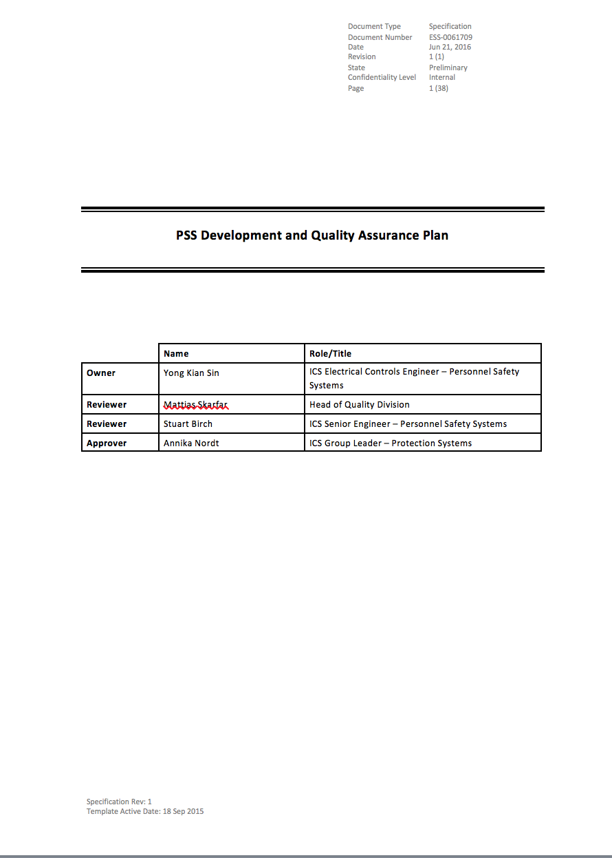
PSS Quality Management and Quality Assurance Plan
The objective of this Development Plan is to outline the methodology and approach that will be used to create and maintain the safety relevant functionality of PSS.
The document defines the steps, necessary to design, create, verify and validate the whole PSS system architecture.
Key aims of this document are:
Definition of management activities which are necessary in the different phases of the system lifecycle of PSS
Definition of the technical activities in the different phases of the safety lifecycle which are necessary to achieve the required functionality
Definition of the responsibilities and activities of people, departments and organisations in each phase of the system lifecycle

Slide 15
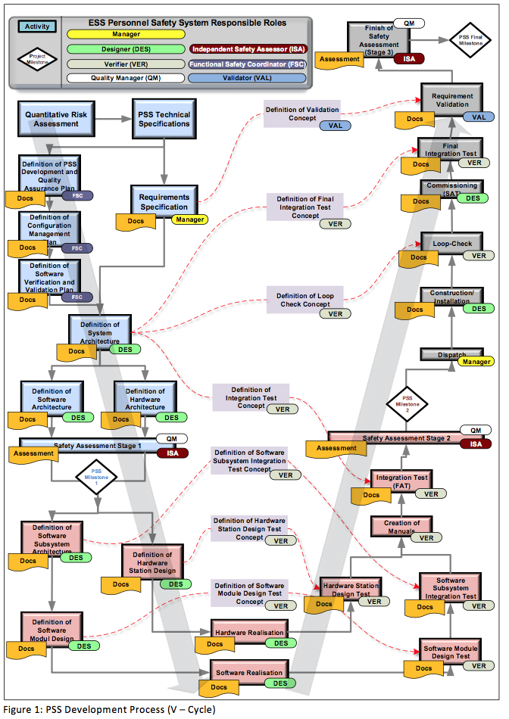

Slide 16
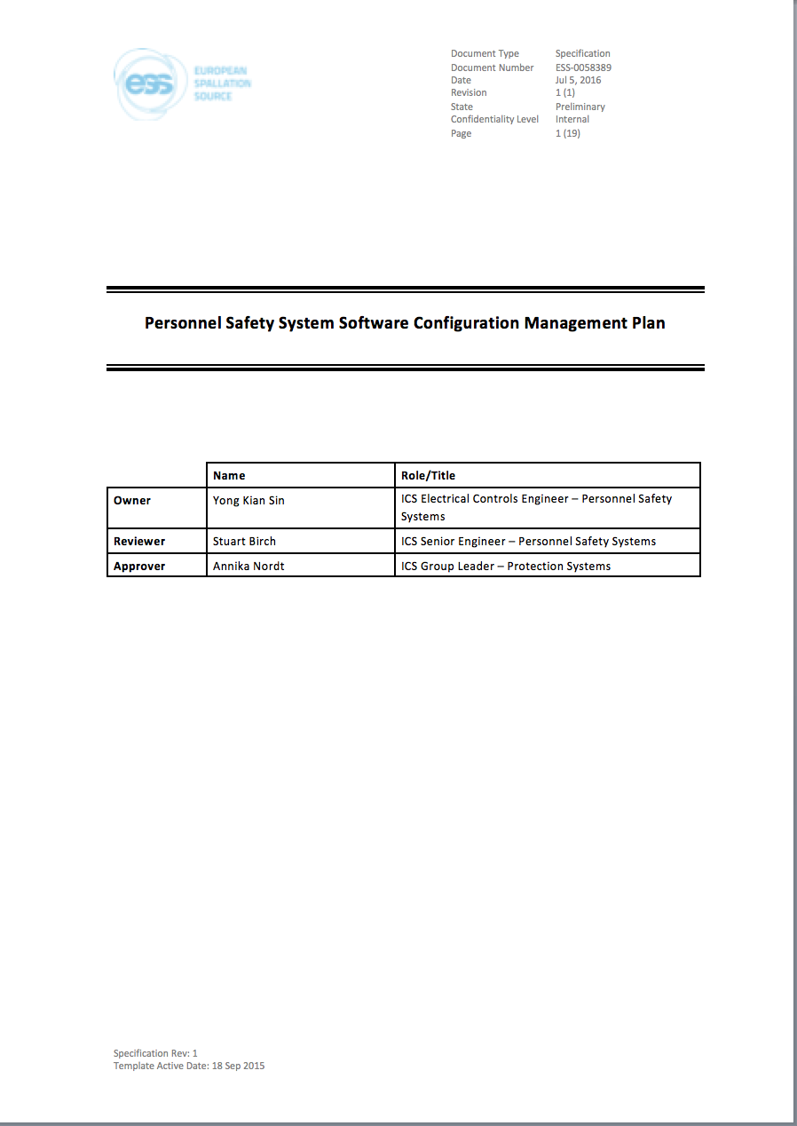
PSS Software Configuration Management
The Software configuration management plan will apply administrative and technical controls throughout the lifecycle of the PSS software, in order to manage changes and thus ensure that the specified requirements for safety continue to be satisfied. It will guarantee that all necessary operations have been carried out to demonstrate that the required safety integrity has been achieved.
Planning of the process, including defining activities, responsibilities and the tools;
Identifying uniquely the name and versions of each configuration item and when they are to be brought under configuration control (configuration identification);
Identifying the versions of each software item which together constitute a specific version of a complete product (baseline), including re-used software, libraries, and purchased and customer supplied software;
Identifying the versions of relevant hardware modules, including the hardware release and firmware version;
Identifying, tracking and reporting of the status of items, including all actions and changes resulting from a change request or problem, from initiation through to release (configuration status accounting)
Providing release management and delivery.

Slide 17
PSS1 Overview.

Slide 18
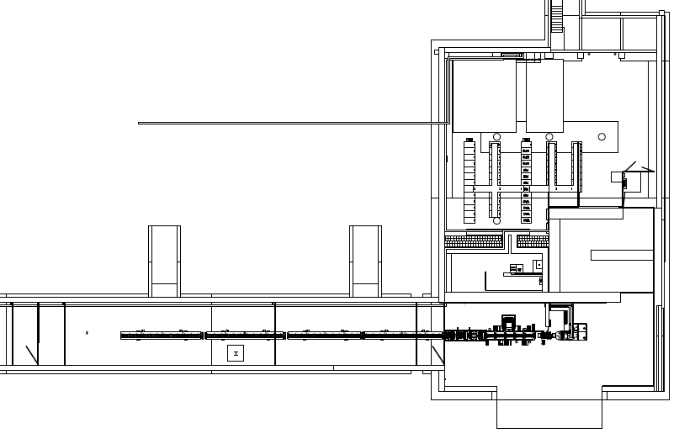
PSS1 Overview.
G01 Front End Building Level 90.
PSS Controlled Area
Front End Double Gated Entrance
and Emergency Exit 1.
DTL 4
DTL 3
DTL 2
DTL 1
PSS Emergency Exit 2
Temporary Shield Walls
Temporary Beam Dump
MEBT
Proton Source
RFQ
LEBT

Slide 19
PSS1 Rack Position.
G01 Front End Building Level 90.
PSS1 Rack Positions

Slide 20

Questions

