Slide 1
Introduction to
Integrated Control Systems
Henrik Carling
ESS/ICS
Date: 2016-11

Slide 2
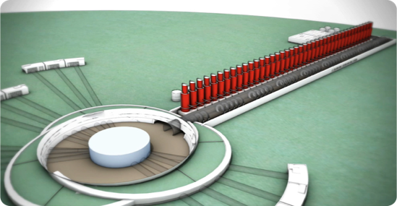
What is ICS about?
The ESS facility is a large and complex machine with very much equipment that needs to work in synchronization - and with well-known configurations
For this purpose almost all equipment at the ESS facility is connected to the Integrated Control System
The control system is the ”central nervous system of ESS”
Examples:
  Voltage supplies for magnets
  Vacuum systems
  Cryogenic equipment
  RF equipment
  Air conditioning in the tunnel
An estimated 1.5 million
control points will be needed

Slide 3





ICS Project scope
Work package 01 Management and administration
Work package 02 Software Applications
Work package 03 Software core
Work package 04 Hardware core
Work package 05 Machine protection
Work package 06 Equipment
Work package 07 Control system infrastructure
Work package 08 Physics
Work package 09 Personnel safety systems
Work package 10 Integration - Accelerator
Work package 11 Integration - Target
Work package 12 Integration - Instruments
Work package 13 Integration - Conventional facilities
Work package 14 Test Stands
Work package 20 Installation
Software
Electronics
Infrastructure
Safety & protection

Slide 4
Technology scope for ICS
The span of technical scope and the competencies needed in ICS is enormous
From analog signals to Java-based high-end, big-data GUI:s in high performance, high availability
PLC systems
Safety and protection systems
Infrastructure: networking, data centre, control room
Systems integration, Installation
Project management and administration
Databases
Availability, performance
Applicatoins (GUI, Web, Services)
EPICS
Industrialization, maintenance
Development environments
Kernel drivers
Operating systems (RT)
CSS/Eclipse
Digital communication
Test and validation
PCB, packaging
Test and validation
Analog electronics
Digital electronics
FPGA firmware
Electronics hardware
Software
Safety and protection
PLC
Infrastructure

Slide 5
ESS ERIC
BOARD OF DIRECTORS
DIRECTOR GENERAL
MACHINES DIRECTORATE
SCIENCE DIRECTORATE
PROJECT SUPPORT & ADMINISTRATION DIRECTORATE
CONVENTIONAL FACILITIES
ACCELERATOR
NEUTRON INSTRUMENTS
GENERAL SERVICES
ES &H and Q
TARGET
NEUTRON TECHNOLOGIES
HUMAN RESOURCES
COMMUNICATIONS & EXTERNAL RELATIONS
SYSTEMS ENGINEERING
SCIENTIFIC ACTIVITIES
FINANCE
INTEGRATED CONTROL SYSTEM
SCIENTIFIC PROJECTS
INFORMATION TECHNOLOGY
ENGINEERING & INTEGRATION SUPPORT
DATA MANAGEMENT SOFTWARE CENTRE
LEGAL
SUPPLY, PROCUREMENT & LOGISTICS

Slide 6
ICS Organization
2016-11-07
Henrik Carling
Division head
Wojtek Fabianowski in-kind manager
IT/Infrastructure
Anna Gillberg
Team assistant
Annika Nordt
Safety and protection
Daniel Piso
Hardware and integration
Hector Novella
Deputy project manager
Susanne Regnell
Control Software
Timo Korhonen
Chief engineer
Ben Folsom
PhD student
Start 2017-02-01
Angel Monera
FPGA Engineer
David Brodrick
Integrator
Benedetto Gallese
Integrator
Alessio Curri
ICS administrator
Start 2017-02-01
Denis Paulic
PLC Engineer
Javier Cerejo
PhD Student
François Bellorini
Integrator
Emanuele Laface
Accelerator physicist
Benjamin Bertrand
Software engineer
Manuel Zaera-Sanz
PLC Engineer
Start TBD
Start TBD
Claudio Rosati
Software engineer
Joao Martins
Integrator
Jeong Han Lee
Integrator
Jan-Åke Persson
Senior software engineer
Morteza Mansouri
Safety Engineer
Julen Etxeberria
Intern
Nick Levchenko
Integrator
Karin Rathsman
Senior scientist
Start 2017-02-01
Juan Esteban Müller
Software scientist
Riccard Andersson
PhD student
Simone Farina
Embedded systems egineer
Alexander Söderqvist
Integrator
Ricardo Fernandes
Senior software engineer
End 2016-12-31
Leandro Fernandez
Senior software engineer
Stuart Birch
Senior safety engineer
Niklas Claesson
Integrator
Krisztián Löki
Integrator
Thilo Friedrich
PhD student
Remy Mudingay
Infrastructure engineer
Yong Kian Sin
IEC61508 engineer
Open positions (2)
Fredrik Luthander
Software engineer
Viktor Fred
Electrical engineer
Szandra Kövecses
Technical coordinator
Open positions (2)
Consultants
Open positions (2)
Employee
Consultant
Temporary employee
Consultant
off-site
Position under consideration

Slide 7
ICS In-kind partners
Partner Institutes
Atomki, Hungary
CEA, France
CNRS/IPNO, France
Elettra, Italy
ESS Bilbao, Spain
IFE, Norway
INFN Catania, Italy
INFN Legnaro, Italy
PSI, Switzerland
Tallinn Technical University, Estonia
ÚJV Řež, Czech Republic
University of Łódź , Poland
Uppsala University, Sweden
ZHAW, Switzerland
Agreement signed
Agreement waiting for signature
Early discussions
Collaboration agreement

Slide 8
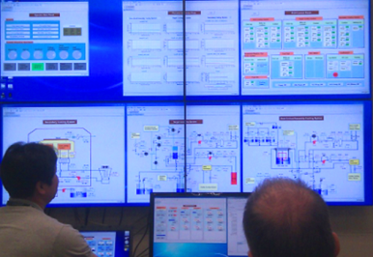
ICS SOFTWARE ACTIVITIES

Slide 9
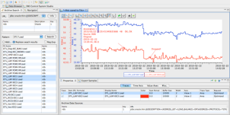
Software team scope description
Controls configuration tools
  Controls Configuration Database (CCDB)
  Naming Server for naming convention
  Cable Database (CDB)
  IOC Factory
  CS Entry
  Role Based Access Control (RBAC)
Clients
  Alarm Handling
  E-logbook
  Archiving System
  Save, Compare & Restore
  Scenario management
  GUI/HMI (Control System Studio)
Core controls software
  Development/contributions to core EPICS
  Timing applications
  Post-mortem diagnostics
Physics modelling
  Open XAL
  ESS Linac Simulator
  Beam Physics Applications
Operation tools – Scripting frameworks
  iPython
  Scripting Execution Environment
  Macroserver
Software development environment
  Vagrant for virtualization
  Ansible for automation of deployment and configuration of our software infrastructure
  Jenkins for continuous integration support

Slide 10
ICS Hardware platforms

Slide 11


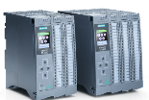
Three layer strategy - control systems at ESS
Signal speed
A custom made microTCA board with a powerful FPGA and a CPU. A FPGA framework constitutes the development environment. The CPU runs EPICS
ICS has adopted a three layer strategy for implementing the control system based on signal speed
  A custom made platform based on microTCA for applications with data acquisition exceeding 100 kHz
  The CPU will run EPICS and the FPGA will have a complete application development environment
  For slower signals, EtherCAT will be used as a real-time fieldbus with good price/performance ratio
  Synchronization and event information are key for applications where a full custom platform solution would be too costly
  Low speed signals are handled with commercially available PLC systems from Siemens
  This is a cost-effective solution that addresses ESS reliability and maintainability requirements
  The PLC:s will be connected to EPICS for further integration into the control system
10 MHz
1 MHz
100 kHz
Digital controls platform
10 kHz
1 kHz
EtherCAT I/O modules that are connected to commercial or open-source EtherCAT master controllers which are in turn connected to the EPICS based control system
100 Hz
EtherCAT
10 Hz
Slower signals are handled by industrial automation (PLC) for reliability and cost reasons. The standardized platform for ESS applications comes from Siemens
1 Hz
0.1 Hz
Industrial automation (PLC)

Slide 12
“Other” I/O
ICS is trying to standardize control solutions wherever possible
  Serial devices
    Use MOXA – almost de-facto standard
  Ethernet-based devices
    Ethernet as a fieldbus connected to EPICS
  Detectors
    EPICS AreaDetector supports a large device base
  Motion control
    Working together with our NSS colleagues

Slide 13
SAFETY AND PROTECTION

Slide 14
Personnel safety system
Scope overview statements
  The primary role of the Personnel safety systems is to protect ESS Workers/Personnel from hazards that have been identified during the development of the systems.
  Assessments and analysis will decide which hazards will be mitigated with the PSS.
  This will be achieved by controlling the access of personnel to controlled areas when a potential hazard is present.
  Note the PSS is not designed to mitigate radiation from activated components
  The ESS Accelerator PSS will also be used to control other hazards present within the accelerator tunnel as deemed appropriate
Budget and organization
  Total PSS construction budget 5.9 M €
  In-kind potential: Low (<= 20%)
  Staffing ~6 FTE PSS core team in the construction phase
  Predicted staffing 5.5 FTE in operations phase

Slide 15
Control SYSTEM
INFRASTRUCTURE

Slide 16
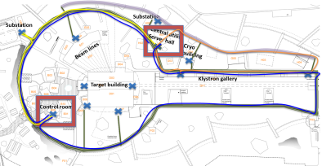
Control system infrastructure
The scope in this work package infrastructure required for the Control System to operate
A centralized ESS Control Room, which allows the entire facility to be controlled from the same location
Operations consoles, servers and file storage required for operation
Networks between Control boxes, Timing system units, Control Room, Data Centre and other control equipment
Efforts and material required for connecting devices to the ICS

Slide 17

Integrated Control Systems
Thank you for your attention

