Slide 1
PSS Architecture and Software
SSM visit for PSS
Denis Paulic
PLC Engineer, Personnel Safety Systems
ESS/ICS/PS
Date: 2016-11-29

Slide 2
My Background
M.Sc. in Electrical Engineering and Information Technology
Experience:
Equipment qualification specialist @ PLIVA Croatia (7 months)
Testing and validation of computerized systems following the 21 CFR Part 11 FDA requirements and GAMP.
Fellow @ CERN (2,5 years)
Development of the inspection monorail train (TIM)
Development, analysis, testing, commissioning and operation of TIM’s control system
Machinery Directive, IEC 62061 and ISO 13849
Safety critical PLC interlock systems for MEDICIS and ISOLDE experiments
IEC 61508, IEC 61511
Visual odometry system and image processing for loop closure detection
PLC engineer @ ESS (1,5 years)
Concept, design, development, commissioning, operation and maintenance of the safety critical PSS systems, following the IEC 61508 and IEC 61511 standards.

Slide 3
Contents
PSS Software Decisions
PLC network architecture
Cyber security study and measures
PLC software architecture
Requirements for operator interface
Software realisation requirements

Slide 4
Personnel Safety System
Safety interlock system
If the Beam is ON → No Access
If Access is allowed → No Beam permit
If Emergency → Hard switch-off hazardous equipment
Access control system
Authorisation and authentication (databases, counters...)
Access point systems (message display, card readers...)
ODH monitoring system
If oxygen level low → No Access, activate lights and sounders
Radiation monitoring system
If radiation level high → Emergency

Slide 5
PSS Software Decisions
Latest version of Siemens SIMATIC STEP 7
V13 SP1 → V14;
TIA Portal including:
Safety Advanced:
Safety checks are automatically performed in the software;
Fail-safe blocks for error detection and error reaction are inserted automatically when the safety program is compiled;
WinCC Comfort for HMI programming.
2-train fail-safe PLC system
Siemens fail-safe CPUs allow the processing of standard and safety programs on a single CPU.
Certified to satisfy the Safety Integrity Level SIL3 in accordance with IEC 61508:2010.
Notes:
Siemens fail-safe CPUs allow the processing of standard and safety programs on a single CPU. This allows fail-safe data to be evaluated in the standard user program and thus, this integration provides the system advantages and the extensive functionality of SIMATIC also for fail-safe applications. Besides this, Siemens fail-safe CPUs (and SIMATIC Safety F-systems in general) are certified to satisfy the Safety Integrity Level SIL3 in accordance with IEC 61508:2010, which means it is suitable for the SIL required by each SIF it services in PSS accelerator system
Verification tests that the system was built right (according to the requirements). Validation checks that the right system was built (truly meets the needs and intent of the customer). V&V primarily involve testing of the software system, though it encompasses analyses, inspections, and reviews as well. The amount of testing can be tailored, with safety critical units and subsystems receiving the majority of the test effort. Traceability from the requirements, through design and coding, and into test is an important part of V&V.

Slide 6
General PLC Network Architecture

Slide 7
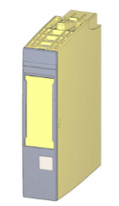
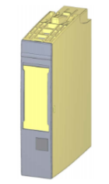
Devices for Fail-safe Applications
Fail-safe CPU (1518F-4 PN/DP)
Network separation: Integrated PROFINET interface with 2 ports for line structure and 2 additional interfaces for Ethernet and PROFINET basic services
Integrated system diagnostics;
4-level security concept.
Fail-safe digital input module (8x24VDC HF)
8 inputs (SIL3/Cat.4/PLe);
Diagnostics: short circuit, wire break → channel-specific;
load voltage missing → module-specific;
Fail-safe digital output module (4x24VDC/2A PM HF)
4 outputs, PM-switching (SIL3/Cat.4/PLe)
Diagnostics: short circuit, wire break, load voltage missing

Slide 8
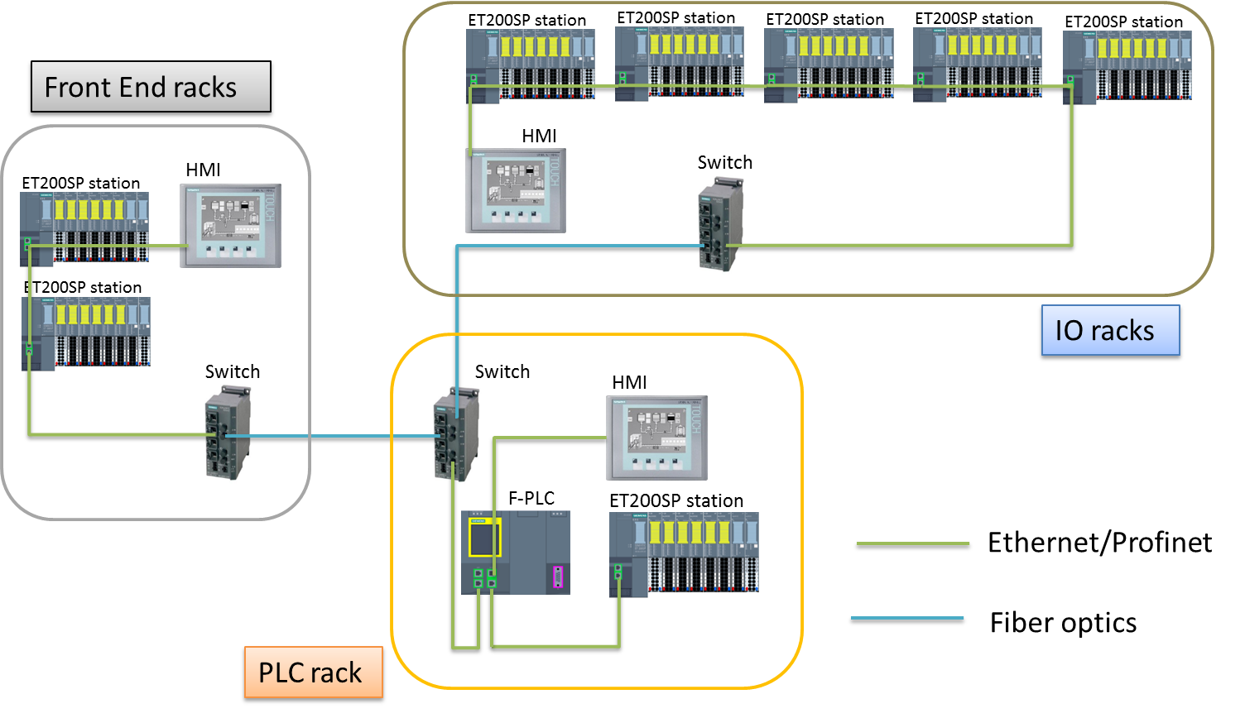
Accelerator PLC Architecture – Single Train

Slide 9
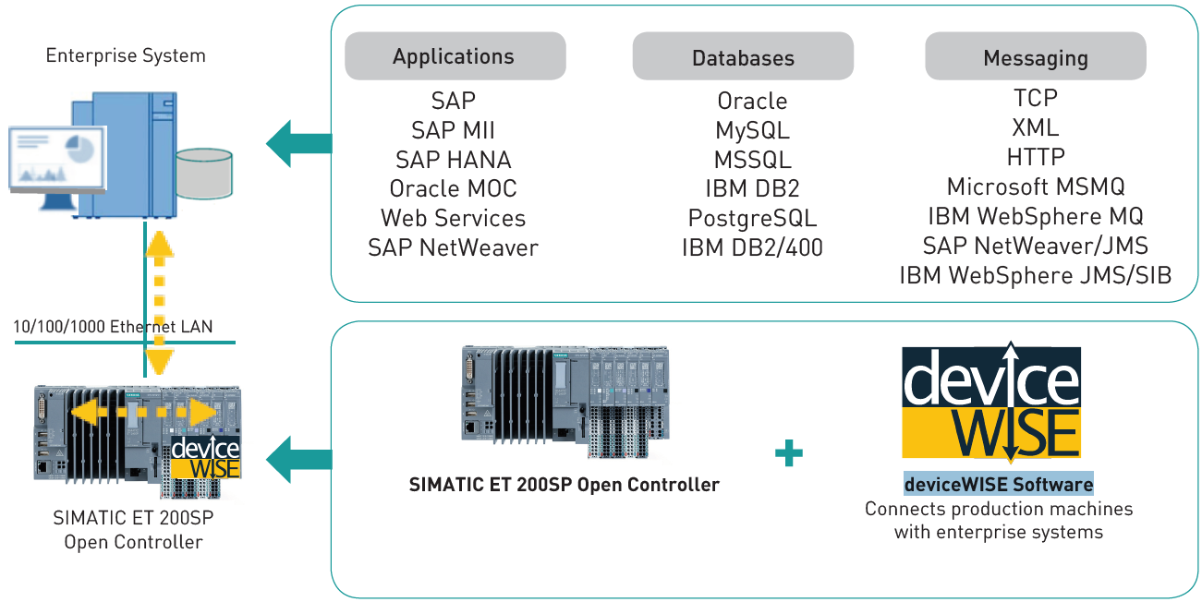
Open Controller – Connection to Databases
Siemens ET200SP Open Controller – Embedded Windows 7
Combines the functions of a PC-based software controller with visualization, enterprise IT connectivity and central I/O-s in a compact device.
deviceWISE - enterprise software for Siemens SIMATIC ET 200SP Open Controller.
Recommended by F. Havart, CERN

Slide 10
Cyber Security Study
Defence-in-Depth – applying multiple countermeasures in a layered manner.
Plant security
Network security layer: In-kind partner from Estonia: Cyber security risk assessment and mitigation plan for the ICS, based on IEC 62443.
Initial meeting: 2016-10-17
PSS - stand-alone system using its own network.
NIST framework (NIST SP 800-82)
IEC 62443
Network security
System integrity
NIST = National Institute of Standards and Technology
SP = Special Publication

Slide 11
System Integrity Layer
System Integrity
Application Level
- Authentication and use administration
- Detection of attacks
- Integrated access protection
- Passwords management
- System hardening
- Recovery procedures
Database Level
- Database authentication and permissions
- Data management (logging, storing, retrieving…)
- Data encryption and encryption keys management
Update Management Level
- Patch management – software and firmware updating
Hardware Replacement Level

Slide 12
Integrated Access Protection Mechanisms
Components with integrated security features
S7-1500 controller with activated ”Protection level”
The access to PSS safety software will be protected by two password prompts: one for the safety program and another for the safety CPU.
Checking the collective signature of the safety program (Checksum test):
In case of the software misuse, the system goes to Alarm mode;
PSS system administrator must be informed immediately;
Checksum will change after any error-free safety software re-generation.
HMI panels in ”Secure mode”
Automatically enabled in Siemens HMIs.
Managed network switches
Additionally have the ability to configure, manage, and monitor your local network,
Help to monitor and decide who should have the access to local netrwork.
Firewalls
Firewall change control, alert users prior to changes, ”Deny All” fisrt and then add exceptions...
Central user administration
User accounts and policies.
Enforcing of security guidelines
Password validity, incorrect logging-on monitoring, etc.
Example

Slide 13
Patch Management and Firmware Updates
Siemens supports with compatibility tests of Microsoft security patches
Recommendation from Siemens:
Patch distribution via central patch server in DMZ
Set up the update groups and processes for online updates to simplify patch distribution.
Firmware updates might be needed to fix security related vulnerabilities
Firmware database (configuration management).
As soon as information on a vulnerability becomes available, the weak point will be evaluated for relevance to the application concerned.
DMZ = Demilitarized zone, contains and exposes an organization's external-facing services to a usually larger and untrusted network

Slide 14
System Hardening and Antivirus Software
Locked cabinets.
Physical protection of the engineering workstation.
If updating using the USBs - new USB stick every time!
Engineering workstation (off-line machine)
Disable: Internet/Intranet connection, WLAN and Bluetooth.
2 x Anti-virus software: Siemens supports compatibility checks with McAfee VirusScan Enterprise
Application Control for whitelisting software.
In case of detecting the malicious software must not:
Remove files or block access thereto;
Place files in quarantine;
Block communication;
Shut systems down.
Remove: Flash, Java, Webserver, FTP, Remote Desktop, Adobe, Internet Explorer, etc.
Deactivate or mechanically block unused interfaces:
Ethernet and USB ports
Booting and auto-start of external media.
Reduce configured user accounts to necessary minimum.
Check regularly.
FTP = File Transfer Protocol

Slide 15
General PLC Software Architecture
HAL = Hardware Abstraction Layer
I/O = Input/Output

Slide 16
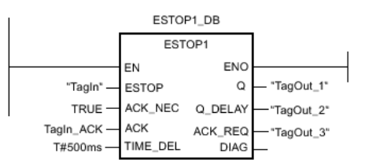
Ready-To-Use Siemens Functions
ESTOP1:Emergency STOP up to stop category 1
Discrepancy monitoring of the two NC contacts (when two channels are involved) is performed with suitable configuration (type of sensor interconnection: 2-channel equivalent) directly through the F-I/O with inputs.
Stop category 0: Enable signal Q is reset to 0, as soon as input E-STOP takes a signal state of 0.
Stop category 1: Enable signal Q_Delay is reset to 0 after the time delay set at input TIME_DEL
NC = Normally Closed
Q = Output

Slide 17
Ready-To-Use Siemens Functions
EV1oo2DI: 1oo2 evaluation with discrepancy analysis
Output Q is set to 1, if the signal states of inputs IN1 and IN2 both equal 1 and no discrepancy error DISC_FLT is stored. If the signal state of one or both inputs is 0, output Q is set to 0.
As soon as the signal states of inputs IN1 and IN2 are different, the discrepancy time DISCTIME is started. If the signal states of the two inputs are still different once the discrepancy time expires, a discrepancy error is detected and DISC_FLT is set to 1 (restart inhibit).
IN = Input

Slide 18
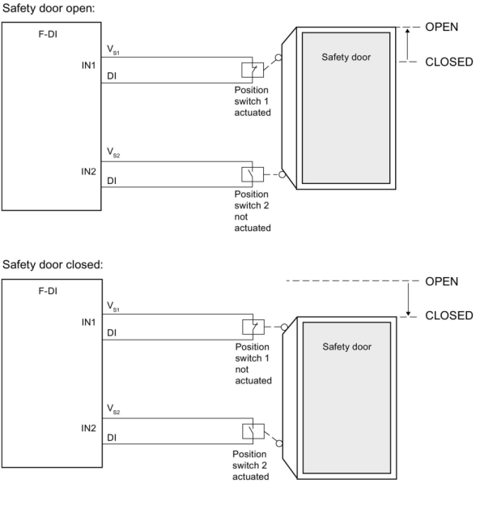
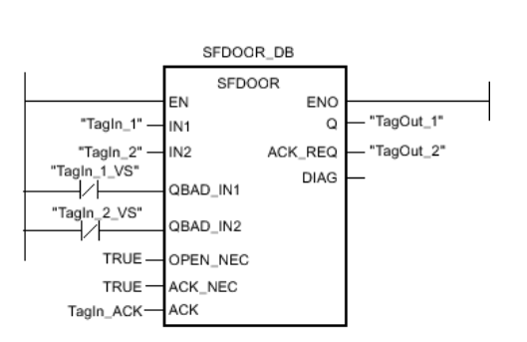
Ready-To-Use Siemens Functions
SFDOOR: Safety door monitoring
Enable signal Q is reset to 0 as soon as one of the inputs IN1 or IN2 take a signal state of 0 (safety door is opened). The enable signal can be reset to 1, only if:
Inputs IN1 and IN2 both take a signal state of 0 prior to opening the door (safety door has been completely opened)
Inputs IN1 and IN2 then both take a signal state of 1 (safety door is closed)

Slide 19
Requirements For Operator Interface
System status information critical to maintaining the SIL shall be available as part of the operator interface:
where the process is in its sequence
indication that system’s protective action has occurred
indication that a protective function is bypassed
information about automatic actions from PSS system
status of sensors and final elements
the loss of energy where that energy loss impacts safety
the results of diagnostics
System operator interface shall prevent changes to SIS software.
Any writing from standard to safety part of the software shall be documented and tested to make sure it cannot lead the system to an unsafe state.
Notes:
It is essential to provide access protection in operation mode for the access to the safety part of the software. The access to PSS safety software shall be protected by two password prompts: one for the safety program and another for the safety CPU. To optimise the access protection, the passwords for safety CPU and safety program shall be different. More information about password protection of safety related software can be found in ESS-0058389.
Initially, no access protection is necessary for test purposes, commissioning, etc. That is, it is allowed to execute all offline and online actions without access protection, but the safety of the system shall be guaranteed through other organizational measures, for example, restricted access to certain areas.
To prevent the misuse, the system shall automatically check the collective signature of the safety program (Checksum test) and in case of the software misuse; the system shall go to Alarm mode and PSS system administrator must be informed immediately. Note that checksum will change after any error-free safety software re-generation.
In Siemens S7-1500 series, the F-runtime group information DB is used for that purpose, where data about F-signature of the safety program, safety program’s compilation date and F-runtime group collective signature can be found and used for checking. Note that these are standard program data and should not be part of the safety program.

Slide 20
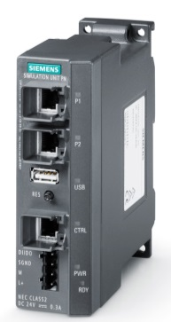
PSS Test Stand - PSS Software Virtual Commissioning
Software (system) development and testing
Preparing and testing the software updates before being downloaded to PLC
Facilitating preparation for operation, maintenance and periodical testing
As similar as possible to real system
Easier to detect software logic errors
Siemens Simulation Unit PN
Verification → Virtual Commissioning
Functionality and software verification tests:
Control/automation loops
Switching functions
Pre-allocation, reading-out and changing digital and analog I/O-s
Functionality test for alarms and messages
PN = Profinet
Notes:
A Test Platform is necessary through the lifecycle of a safety system to:
develop the system and test it before production deployment
prepare upgrades
help during the operation & maintenance phase
The closer to production system the platform, the easier it is to detect all kind of errors, not only in the software logic.
In the LHC0 Test Platform, the introduction of SIMBA and SIMIT makes it possible to rapidly change the configuration of the test platform and to conduct the necessary tests or error reproduction on demand.

Slide 21
Software Realisation Requirements
During realisation records shall be created, including:
decisions and their rationale;
problems and their solutions;
testing performed on each module.
Software manuals will be generated at a later stages of development process, and shall include:
drawings, diagrams, descriptions and explanations necessary for the use, maintenance and repair of the system and procedures for checking functionalities;
warnings concerning ways in which the system shall not be used;
instructions for the training of operators;
the description of the adjustment and maintenance operations (including preventive measures);
instructions for safe adjustment and maintenance actions;
the specifications of the spare parts and tools to be used and provided;
instructions for commissioning.
Documentation shall enable the Operator to create maintenance records.

Slide 22
Questions

Slide 23
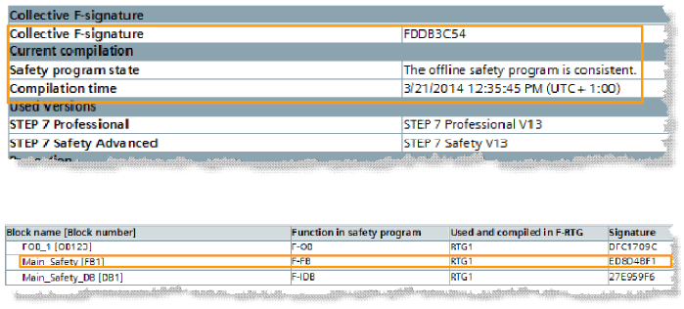
Checksum Test - F-runtime Group Information DB
X Close

Slide 24
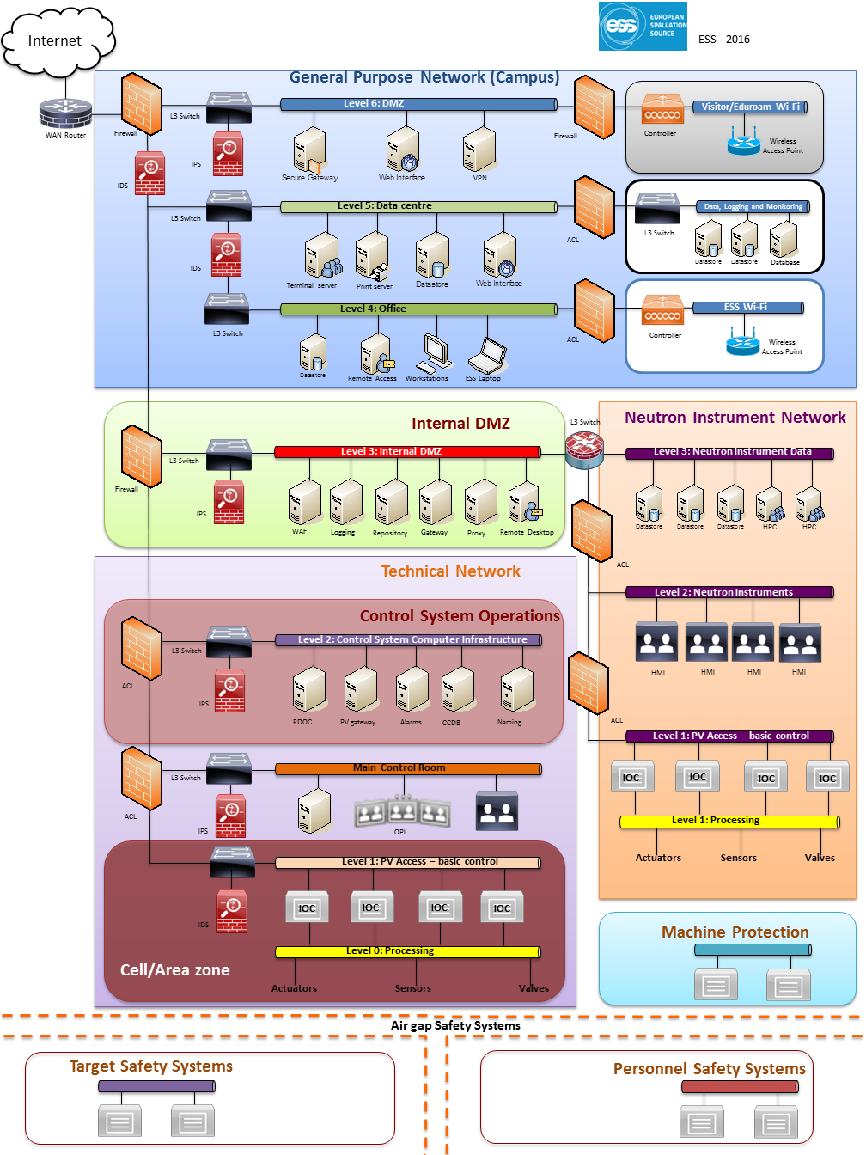
Notes:
An air gap, air wall^{[1]} or air gapping^{[2]} is a network security measure employed on one or more computers to ensure that a secure computer network is physically isolated from unsecured networks, such as the public Internet or an unsecured local area network.^{[3]} The name arises from the technique of creating a network that is physically separated (with a conceptual air gap) from all other networks. The air gap may not be completely literal, as networks employing the use of dedicated cryptographic devices that can tunnel packets over untrusted networks while avoiding packet rate or size variation can be considered air gapped, as there is no ability for computers on opposite sides of the gap to communicate.
The concept represents nearly the maximum protection one network can have from another (save turning the device off). It is not possible for packets or datagrams to "leap" across the air gap from one network to another, but computer viruses such as Stuxnet^{[4]} and agent.btz have been known to bridge the gap by exploiting security holes related to the handling of removable media. The possibility of using acoustic communication has also been demonstrated by researchers.^{[5]} Researchers have also demonstrated the feasibility of data exfiltration using FM frequency signals.^{[6][7]}
The upside to this is that such a network can generally be regarded as a closed system (in terms of information, signals, and emissions security) unable to be accessed from the outside world. The downside is that transferring information (from the outside world) to be analyzed by computers on the secure network is extraordinarily labor-intensive, often involving human security analysis of prospective programs or data to be entered onto air-gapped networks and possibly even human manual re-entry of the data following security analysis.^{[8]}

