Slide 1
High Level Overview of PSS Hazard Analysis
Stuart Birch
Personnel Safety Systems
ESS/ICS/PS
Date: 2016-11-29

Slide 2
Contents
HAZID Process
Risk Matrix
Safety Integrity Level (SIL) Determination
Safety Integrity Level (SIL) Verification
Reliability Block Diagram
Simplified Example.

Slide 3
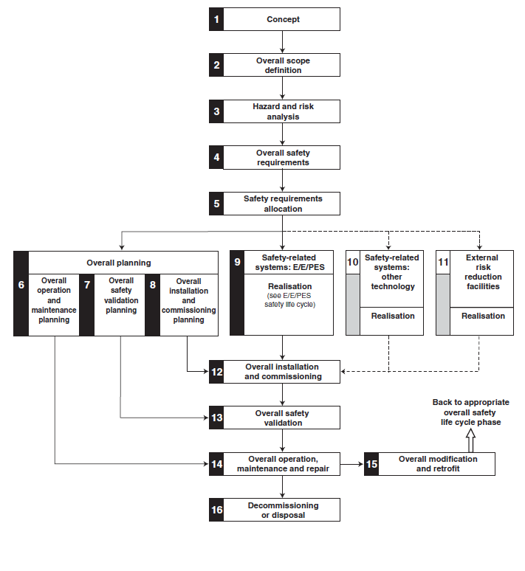
Hazard Identification
The HAZID took the form of a set of meetings in December 2015.
The following personnel attended the meetings:
Stuart Birch
Denis Paulic
Morteza Mansouri
Aurelien Ponton
Edgar Sargsyan
The following hazards were considered:
Prompt radiation
High voltage
Motion control (moving mechanical equipment)
Asphyxiation
High magnetic field
For each zone in the accelerator, the following were considered:
The hazards
The degree of potential harm to people
Who could be harmed
The frequency of opportunity for harm
The non‐PSS based safety measures
The PSS safety function

Slide 4
Hazard Identification Meetings
Meeting1 Discussed the Following:
Proton Source and LEBT equipment.
Proton source
Solenoid coils
Vacuum
Repeller electrodes
Iris
Faraday cup
Chopper
Meeting 2 Discussed the Following:
RFQ and MEBT Equipment
RFQ
Buncher Cavities
Quadrupole magnets
Chopper
Faraday cup
Meeting 3 Discussed the Following:
DTL’s and Spokes
DTL’s
Spokes
Quadrupole magnets
Meeting 4 Discussed the Following:
Medium and High beta cavities.
Medium Beta cavities
High beta cavities
Meeting 5 Discussed the Following:
HEBT and A2T Equipment
Dipole magnets
Quadrupole magnets
Beam diagnostic equipment

Slide 5
PSS1 Radiation Hazards
PSS 1 Radiation Hazards. | Mitigation
Radiation from Proton Beam up to 75MeV. For 1Hz, 62mAmp, 5uSec pulse, 4.5 Sv/h. 1 metre from the beam (calculated figures Accelerator Division). | Actuators on three systems to remove beam. Proton Source Plasma system (incoming mains power) Proton Source Extraction system (incoming mains power) Radio Frequency Quadrupole (RFQ) Radio frequency (RF) systems (incoming mains power to modulator, Low level RF failsafe RF switch)
X-Ray radiation on RFQ from high power Radio frequency. No calculated levels are available at this time although it is expected to be in the mSv range. | Actuators on three RFQ RF system devices to remove beam. Incoming modulator power sub-station circuit breaker under voltage coil. Incoming modulator power modulator circuit breaker under voltage coil. Low level RF failsafe RF switch. For some modes of operation we also remove waveguide
X-Ray radiation on Buncher cavities 1, 2, & 3 (MEBT) from high power Radio frequency. No calculated levels are available at this time although it is expected to be in the uSv range | Actuators on three Buncher cavity RF system devices to remove beam. Incoming modulator power sub-station circuit breaker under voltage coil. Incoming modulator power modulator circuit breaker under voltage coil. Low level RF failsafe RF switch. For some modes of operation we also remove waveguide
X-Ray radiation on Drift Tube Linac (DTL) DTL 1, 2, 3 & 4 from high power Radio frequency. No calculated levels are available at this time although other facilities have measured > 200mSv. | Actuators on three DTL RF system devices to remove beam. Incoming modulator power sub-station circuit breaker under voltage coil. Incoming modulator power modulator circuit breaker under voltage coil. Low level RF failsafe RF switch. For some modes of operation we also remove waveguide

Slide 6
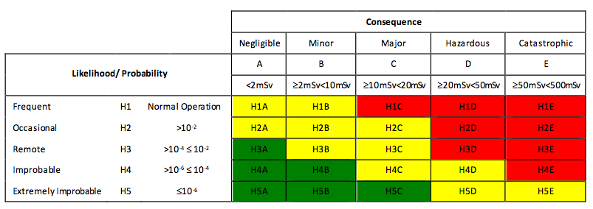
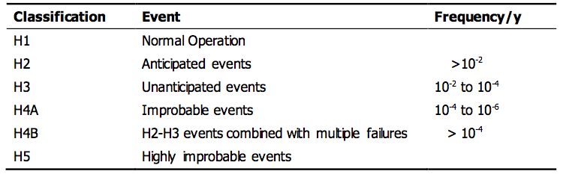
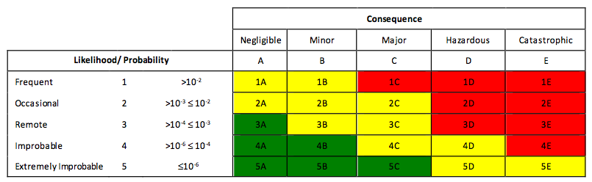
Hazard Identification (Risk Assessments)
SSM requirements for the Radiation safety functions will be identified and categorised in accordance with ESS-0000004 and ESS-0016468 documents.
  IEC 61508 methodologies will then follow
PSS Radiation Risk Matrix
Definition of event classes for radiation hazards
PSS Conventional Risk Matrix

Slide 7
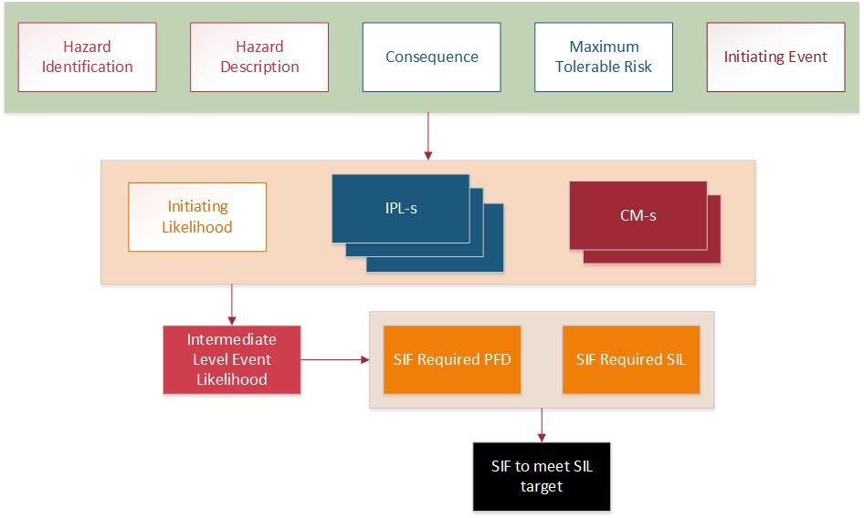
SIL Determination - LOPA
Determination of the potential frequency and consequence of agreed hazards.
Determination of the risk reduction provided by other measures and the resulting risk gap if any.
Assignment of SIL requirements for SIF-s to any resulting risk gaps in accordance with IEC 61508.
Notes:
The LOPA considered the specified hazards and documented the initiating causes and the independent protection layers (IPL’s) that prevent the hazard or reduce the risk.
The severity of the consequences and the likelihood of occurrence were then compared to the maximum tolerable risk and the required SIL determined.
Header:
Hazard ID and Hazard
Consequence - Provides a description of the deviation/hazardous event
Maximum Tolerable Risk - The numerical severity of the hazard consequence as applied to worker safety, the environment, asset damage and reputation. These figures come from the radiation classification of each safety function.
Initiating Event
Initiating Likelihood (/yr) - Quantifies the expected rate of the occurrence of the initiating event. This rate is based on the experience of the LOPA team and any historical information
Independent Protection Layers (IPL) - IPLs can be claimed for procedures and interlocks not going through the safety PLCs (ie mechanical key exchanges etc.)
Conditional Modifiers - The conditional modifier (between 0 and 1) represents the probability of avoiding the hazard once it has been initiated. Credit can also be taken where hazards can only apply during specific modes of operation.
Risk reduction layers can include occupancy ie exposure time to a hazard, distance from a hazard and restricted access to specific hazardous areas.
Intermediate Level Event likelihood (/yr) - The intermediate event likelihood is calculated by multiplying the initiating likelihood by the PFD’s of all the protection layers and mitigating layers. The calculated value is in units of events per year.
SIF Required PFD - Calculated by comparing the maximum tolerable risk with the intermediate level event likelihood.
SIF Required SIL - Obtained from table 3 above, corresponding to the PFD target
SIF to Meet PFD/SIL Target - Description of the SIF that will fulfil the requirements of the SIL target

Slide 8
SIL Verification – Bow-Tie Technique
Complimentary FTAs and ETAs are used for SIL verification.
Multiple Causes (Basic Events) – leading to undesired event
Multiple Consequences after event
Preventive measures
Mitigation measures
Initial undesired event
The focus of FTA
The focus of ETA
Notes:
FTA - deductive method for identifying the numerous ways in which equipment failures, software failures, human error, environmental factors, and external events can lead to accidents or other undesirable conditions.
Basic events, which represent a simple failure or fault, are the building blocks of the model. It may be a hardware failure, a human error, or an adverse condition.
Basic events are always assumed to be independent of each other. This means that the occurrence of one basic event does not influence the probability of occurrence of any other basic event.
Bow-tie: when complimentary FTAs and ETAs are used
FTA is concerned with analysing faults which might lead to an event, whereas ETA is interested in stopping it escalating
A dangerous failure (IEC 61508-4) is defined as a failure, which has the potential to put the safety-related system in a hazardous or fail-to-function state.
A detected failure (IEC 61508-4) is defined as a failure detected by diagnostic tests, operator intervention (for example physical inspection and manual tests), or through normal operation.
Undetected failures are only revealed by proof tests.
$$PFD=λMDT$$
$MDT$ is the mean time taken to repair ($MTTR$ , or Mean Time to Repair) a fault, plus the time taken to detect it. It is assumed that, on average, a fault will occur at the mid-point of the test interval, and, thus, the time taken to detect a fault is equal to half the test interval, $T/2$ , and therefore:
$$MDT=MTTR+T/2$$
$${PFD}_{\left(Detected\right)}=λ_{DD}.MTTR$$
$${PFD}_{\left(Undetected\right)}=λ_{DU}.{T_{p}}/2$$

Slide 9
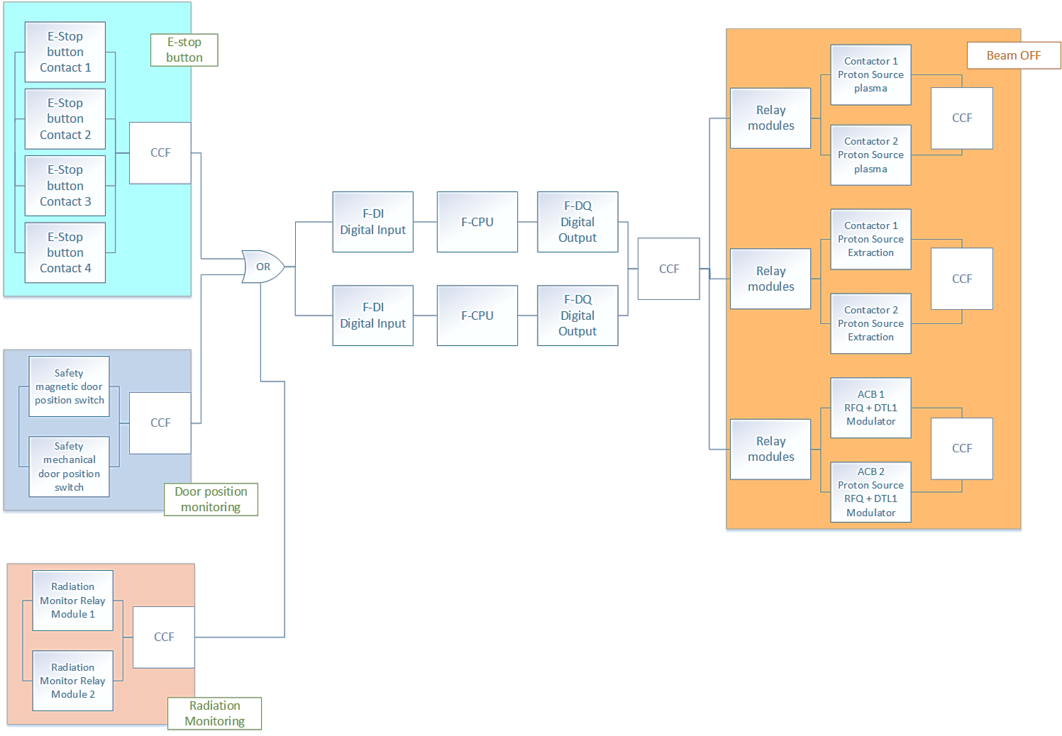
Basic Beam-OFF RBD Model
Diagrammatic method for showing how component reliability contributes to the success or failure of a complex system.
Notes:
A reliability block diagram (RBD) is a diagrammatic method for showing how component reliability contributes to the success or failure of a complex system.

Slide 10
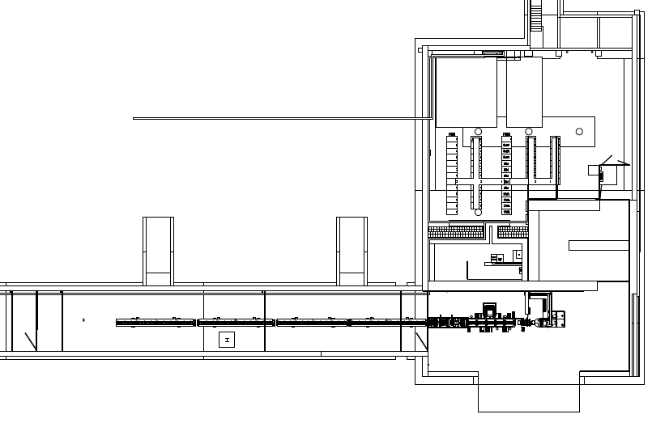
Example.
PSS1 Level 90 Emergency Exit 2.
PSS Controlled Area
Emergency Exit 2.
DTL 3
DTL 2
DTL 1

Slide 11
Example.
Emergency Exit 2
Intrusion Into PSS1 controlled area through tunnel level 90 Emergency Exit 2. The PSS controlled area is closed and the proton commissioning beam is “on”.
LOPA worksheet
RBD
FTA/ETA

Slide 12
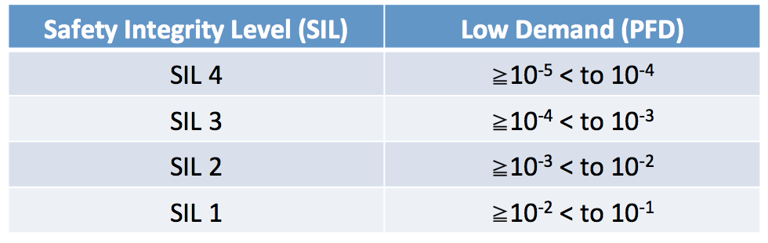
LOPA Worksheet.
HAZARD ID. | Hazard | Consequence | Initiating Event | Basic Events | Maximum Tolerable Risk (based on Risk assessment and safety classification) | Initiating Likelihood | Independent Protection Layer | Independent Protection Layer | Independent Protection Layer | Conditional Modifier | Intermediate Level Event Likelihood | Safety Instrumented Function (SIF) Required for Probability of failure on Demand | Safety Instrumented Function (SIF) Required Safety Integrity Level (SIL) | Safety Instrumented Function (to meet PFD/SIL target)
PSS1001 | Ionising radiation. For 1Hz, 62mA, 5us pulse, 4.5 Sv/h. 1 metre from the beam (calculated figures Accelerator Division). | Fatality or shortened life. | Intrusion into PSS1 controlled area through tunnel level 90 Emergency Exit 2. The PSS1 controlled area is closed and the Proton commissioning beam is "on". |  | 1.00E-06 | 1 | IPL 001 | IPL 002 | IPL 003 | CM001 | 0.00009 |  | SIL2 | door position and lock monitoring
 |  |  |  | Emergency Exit Gate lock broken, followed by person entering PSS1 controlled area whilst beam is on. |  |  | Emergency Exit Mechanical door lock. Door cannot be opened from the outside (No handle on Non hazardous side) | Training & Signage | Message display and Lights (BIW) | Occupancy of the Accelerator Tunnel Zone 3
 |  |  |  |  |  |  | 0.01 | 0.1 | 0.1 | 0.9
 |  |  |  |  |  |  |  |  |  |  | 0.00099 | 1.01E-03
 |  |  |  | Emergency Exit Gate left open during the formalised search, followed by person entering PSS1 controlled area whilst beam is on.
 |  |  |  |  |  |  | IPL 004 | IPL 002 | IPL 003 | CM001 | 0.0009
 |  |  |  |  |  |  | Formalised Search procedure | Training & Signage | Message display and Lights (BIW) | Occupancy of the Accelerator Tunnel Zone 3
 |  |  |  |  |  |  | 0.1 | 0.1 | 0.1 | 0.9

Slide 13
Example RBD Safety Instrumented Function (SIF)
Upon detecting input from the Door switches (1 magnetic and 1 mechanical) (via contacts, 1oo2), the safety PLC (1oo2) sends signal to stop Proton source plasma system, Proton source extraction system, and Radio Frequency Quadrupole (RFQ) (1oo3).
F-DI
F-CPU
F-DO
PSrc Plasma
Emergency Door 2 Switches
S1
S1
PSrc Extraction
S2
F-DI
F-CPU
F-DO
S2
RFQ
Detection
Evaluation
Reaction

Slide 14
Example. RBD
Upon detecting abnormal door access (via 2 switches on the door, 1oo2), the safety PLC (1oo2) sends signal to stop Proton source plasma system (pair of contactors 1, 1oo2), Proton source extraction system (pair of contactors 2, 1oo2), and RFQ (pair of UV coils on the modulator circuit breakers, 1oo2). Stopping either proton source plasma or proton source extraction system would stop ionising source., whilst stopping the RFQ is not 100% effective as a person in the close range would be exposed to a hazard of 75KeV.
 |  |  |  |  |  |  |  |  |  |  |  |  |  |  |  |  |  | Safety Relay 1 |  |  |  |  |  | Contactor 1 PS Plasma
 |  |  |  |  |  |  |  |  |  |  |  |  |  |  |  |  |  |  |  |  | CCF |  |  |  |  |  | CCF
 |  |  |  |  |  |  |  |  |  |  |  |  |  |  |  |  |  | Safety Relay 2 |  |  |  |  |  | Contactor 2 PS Plasma |  |  |  |  |  |  |  |  | Safety Relay 1 |  |  |  |  |  | Contactor 1 PS Plasma
 |  |  |  |  |  |  |  |  |  |  |  |  |  |  |  |  |  |  |  |  |  |  |  |  |  |  |  |  |  |  |  |  |  |  |  | CCF |  |  |  |  |  | CCF
 |  | Magnetic Safety Switch |  |  |  |  |  | F-DI |  | CPU |  | F-DQ |  |  |  |  |  | Safety Relay 1 |  |  |  |  |  | Contactor 1 PS Extract |  |  |  |  |  |  |  |  | Safety Relay 2 |  |  |  |  |  | Contactor 2 PS Plasma
 |  |  |  |  | CCF |  |  |  |  |  |  |  |  |  | CCF |  |  |  |  |  | CCF |  |  |  |  |  | CCF |  |  | CCF |  |  |  |  |  |  |  |  |  |  |  |  |  |  | CCF
 |  | Mechanical Safety Switch |  |  |  |  |  | F-DI |  | CPU |  | F-DQ |  |  |  |  |  | Safety Relay 2 |  |  |  |  |  | Contactor 2 PS Extract |  |  |  |  |  |  |  |  | Safety Relay 1 |  |  |  |  |  | Contactor 1 PS Extract
 |  |  |  |  |  |  |  |  |  |  |  |  |  |  |  |  |  |  |  |  |  |  |  |  |  |  |  |  |  |  |  |  |  |  |  | CCF |  |  |  |  |  | CCF
 |  |  |  |  |  |  |  |  |  |  |  |  |  |  |  |  |  | Safety Relay 1 |  |  |  |  |  | Circuit Breaker 1 UV coil |  |  |  |  |  |  |  |  | Safety Relay 2 |  |  |  |  |  | Contactor 2 PS Extract
 |  |  |  |  |  |  |  |  |  |  |  |  |  |  |  |  |  |  |  |  | CCF |  |  |  |  |  | CCF
 |  |  |  |  |  |  |  |  |  |  |  |  |  |  |  |  |  | Safety Relay 2 |  |  |  |  |  | Circuit Breaker 2 UV coil
SENSORS
LOGIC SOLVER
1oo3 (95%)
1oo2 (5%)
NOTE: of the 3 channels, stopping RFQ is not 100% effective as person at close range will still be exposed to radiation (75Kev from source) (assumed 95% effective), the each of the other 2 channel is 100% effective;
this can be modelled as the 2 RBD blocks: one 1oo3 with 95% effective, one 1oo2 with 5% effective; together 100% achieved for the first 2 channels, the last channel (RFQ) is only 95% effective.
Notes:
NOTE: there are 3 sets of final elements in 1oo3, each set of final element is 1oo2; to calculate the final PFD, one should calculate the dangerous failure rates of each set of final element, and use that for final PFD calc in 1oo3.
NOTE: of the 3 channels, stopping RFQ is not 100% effective as person at close range will still be exposed to radiation (assumed 95% effective), the each of the other 2 channel is 100% effective;
this can be modelled as the 2 RBD blocks: one 1oo3 with 95% effective, one 1oo2 with 5% effective; together 100% achieved for the first 2 channels, the last channel (RFQ) is only 95% effective.

Slide 15
RBD Model SIF 1.0
Stopping RFQ is not 100% effective as person at close range will still be exposed to radiation (assumed 95% effective), the each of the other 2 channel is 100% effective.

Slide 16
Example RBD.
 |  | SENSORS |  |  | CCF |  |  | F-DI |  | CPU |  | F-DQ |  |  | CCF |  |  | SAFETY RELAYS |  |  | CCF |  |  | ACTUATOR |  |  | CCF |  |  | CCF |  |  | SAFETY RELAYS |  |  | CCF |  |  | ACTUATOR |  |  | CCF |  |  | CCF
Configuration |  | 1oo2 |  |  | 1oo1 |  |  | 1oo2 |  | 1oo2 |  | 1oo2 |  |  | 1oo1 |  |  | 1oo2 |  |  | 1oo1 |  |  | 1oo2 |  |  | 1oo1 |  |  | 1oo1 |  |  | 1oo2 |  |  | 1oo1 |  |  | 1oo2 |  |  | 1oo1 |  |  | 1oo1
CCF Contribution |  |  |  |  | 10% |  |  |  |  |  |  |  |  |  | 5% |  |  |  |  |  | 10% |  |  |  |  |  | 10% |  |  | 10% |  |  |  |  |  | 10% |  |  |  |  |  | 10% |  |  | 10%
Qty |  | 1 |  |  | 1 |  |  | 1 |  | 1 |  | 1 |  |  | 1 |  |  | 1 |  |  | 1 |  |  | 1 |  |  | 1 |  |  | 1 |  |  | 1 |  |  | 1 |  |  | 1 |  |  | 1 |  |  | 1
λDD (autotest)
λDD (autotest) x Qty
MTTR (hrs)
λDD (sys)
PFD (d) in ta
λDD(PST)
λDD (PST) x Qty
Tp(PST) (hrs)
λDD(PST) (sys)
PFD(PST) in ta
λDU (proof test) |  | 1.00E-08 |  |  | 1.00E-09 |  |  | 1.00E-09 |  | 1.00E-09 |  | 1.00E-09 |  |  | 1.50E-10 |  |  | 1.7E-09 |  |  | 1.7E-10 |  |  | 4.00E-08 |  |  | 4.00E-09 |  |  |  |  |  | 1.7E-09 |  |  | 1.7E-10 |  |  | 4.00E-08 |  |  | 4.00E-09
λDU (proof test) x Qty |  | 1.00E-08 |  |  | 1.00E-09 |  |  | 3.00E-09 |  |  |  |  |  |  | 1.50E-10 |  |  | 5.06328E-13 |  |  | 1.7E-10 |  |  | 2.80E-10 |  |  | 4.00E-09 |  |  |  |  |  | 5.06328E-13 |  |  | 1.7E-10 |  |  | 2.80E-10 |  |  | 4.00E-09
Tp (hrs) |  | 175200 |  |  | 175200 |  |  | 175200 |  |  |  |  |  |  | 175200 |  |  | 175200 |  |  |  |  |  | 175200 |  |  | 175200 |  |  | 175200 |  |  | 175200 |  |  | 175200 |  |  | 175200 |  |  | 175200 |  |  | 175200
IDU (channel) |  |  |  |  |  |  |  |  |  |  |  |  |  |  |  |  |  | 4.23E-09 |  |  |  |  |  |  |  |  |  |  |  | 4.23E-10 |  |  | 2.23E-10 |  |  |  |  |  |  |  |  |  |  |  | 2.23E-11
λDU (sys) |  | 1.75E-11 |  |  | 1.00E-09 |  |  | 1.58E-12 |  |  |  |  |  |  | 1.50E-10 |  |  | 2.32E-15 |  |  |  |  |  |  |  |  |  |  |  | 4.23E-10 |  |  | 8.68E-15 |  |  |  |  |  |  |  |  |  |  |  | 2.23E-11
PFD (u) in Tp |  | 1.02E-06 |  |  | 8.8E-05 |  |  | 9.21E-08 |  |  |  |  |  |  | 1.31E-05 |  |  | 1.02E-10 |  |  |  |  |  |  |  |  |  |  |  | 3.70E-05 |  |  | 5.07E-10 |  |  |  |  |  |  |  |  |  |  |  | 1.95E-06
Total λDD (sys)
Total λDU (sys)
λD (sys)
PFD Achieved (total) |  | 1.41E-04
SIL Achieved (PFD) |  | 3
Notes:
10% for CCF sensors and actuators
5% for logic solvers

Slide 17
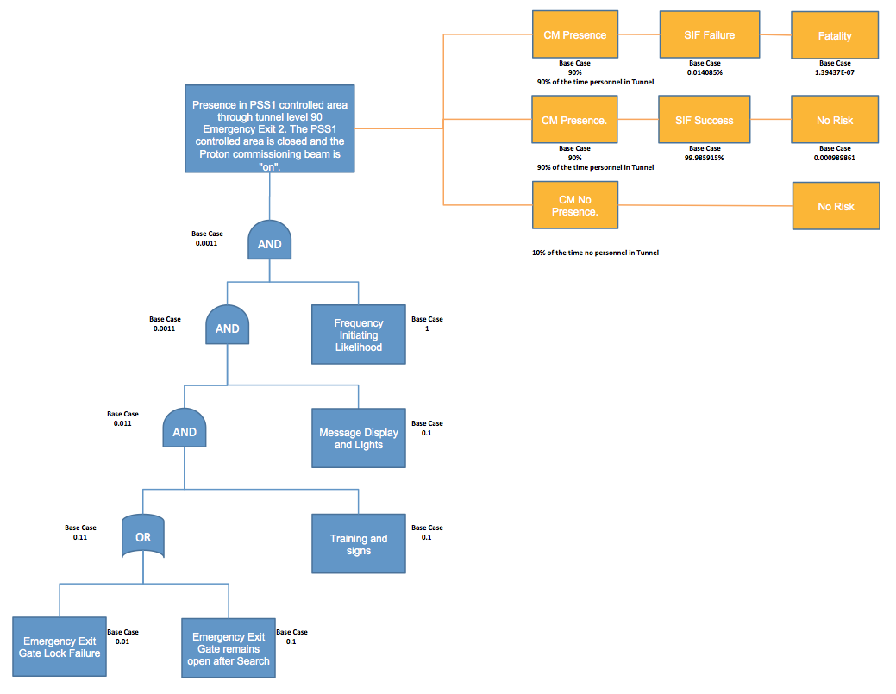
Example Simplified FTA/ETA Bow-Tie.
Mitigating measures
Consequences
Output frequencies

Slide 18

Questions

