Slide 1
PSS Test Stand
SSM Visit to ESS/ICS (2016-11-29)
Morteza Mansouri
Engineer for Safety Critical Systems
www.europeanspallationsource.se
28 November 2016

Slide 2
Contents
PSS Test Stand Objective
PSS Test Stand Layout
PSS Test Stand Devices/Equipment
PSS Test Stand Device Distribution Layout
PSS Test Stand Functions
Summary

Slide 3
PSS Test Stand Objective
The PSS test stand is being developed in the PS lab. The PSS test stand will be used for simulation and evaluation purposes of any systems/equipment to be developed by PSS team.
All PSS related procedures (search patrol, open access, restricted access, etc.) will tested in this prototype.

Slide 4
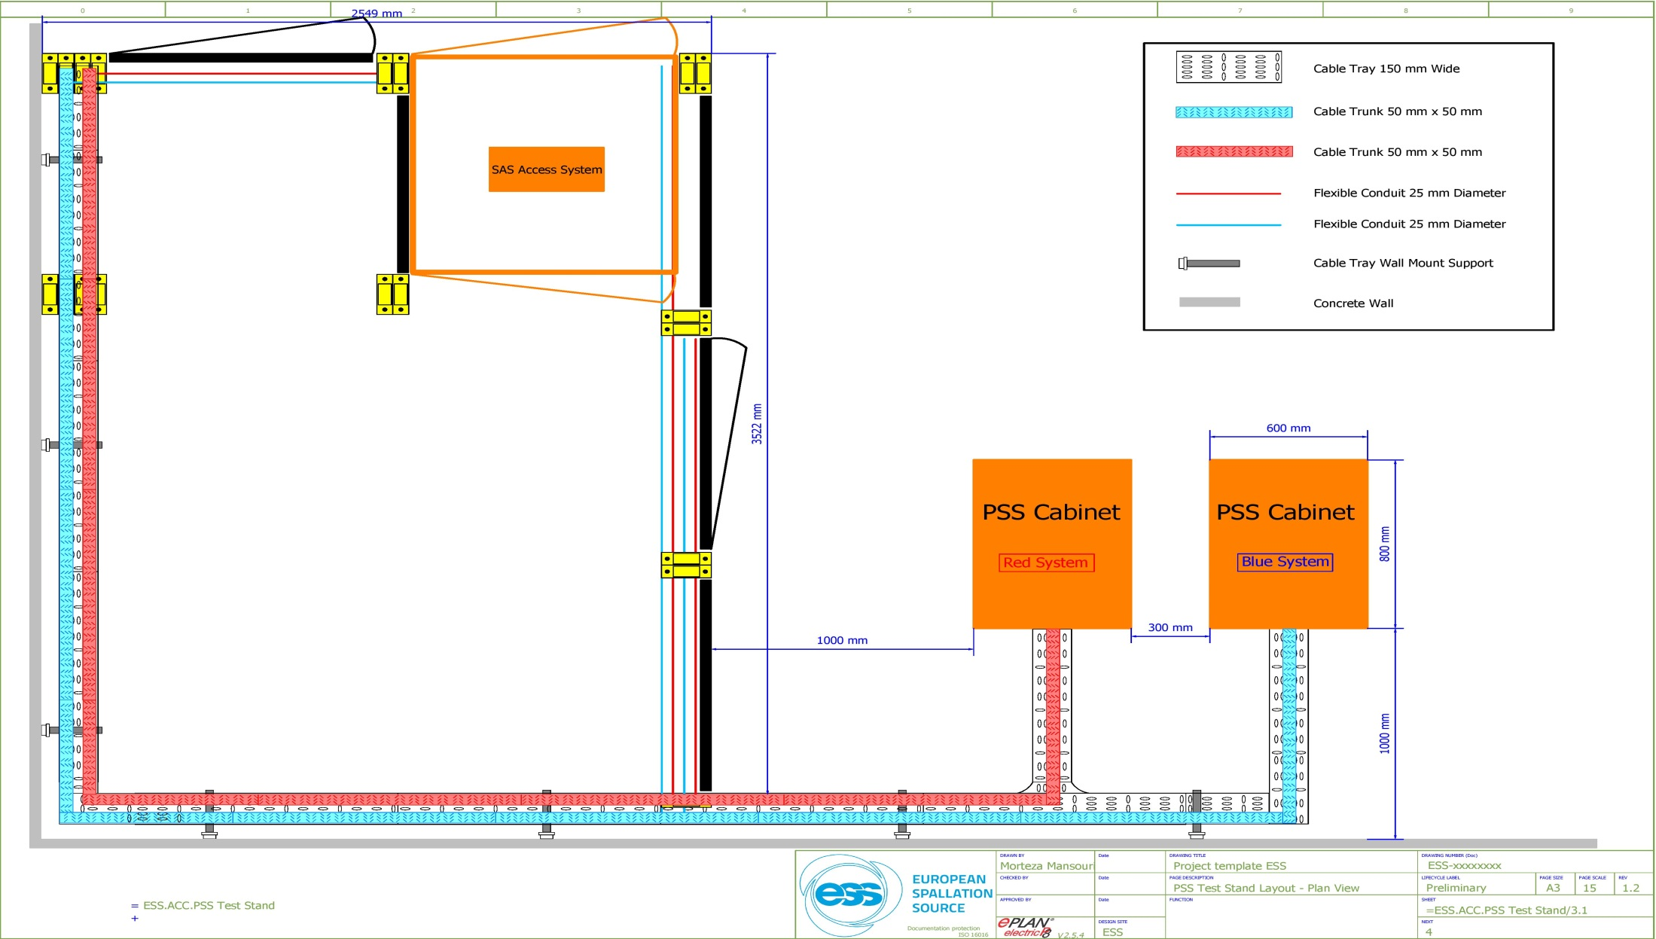
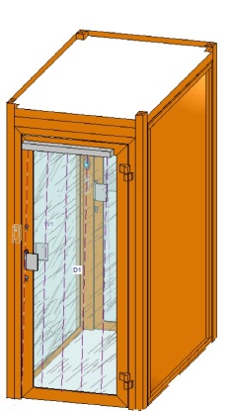
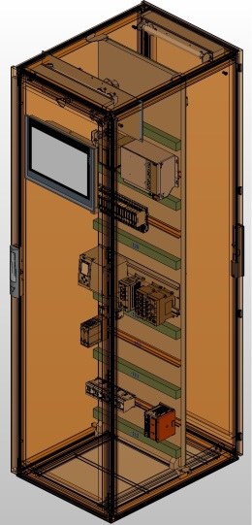
PSS Test Stand Layout
PSS controlled area
Double-door access system
Emergency escape route
Zone gate

Slide 5
PSS Test Stand Devices/Equipment
Following systems/equipment are currently installed in the PSS test stand:
Two racks designed for PSS and painted in RAL 2000 as PSS specific color (in-house design)
Two-train safety PLC systems (Siemens S7-1500 safety PLC)
Double-door access system (Gunnebo)
Swipe card system (SALTO)
Public address system (ASL)
Message display system (Red Lion Controls)
HMI for PSS supervision system (Siemens)
Beam-off stations (in-house design)
PSS blue/red lights (Thorlux)
PSS Contactors to interface the following equipment(Siemens):
Ion source plasma generator
Ion source extraction system
RFQ modulator
RFQ LLRF
RF system modulator
RF system LLRF
These equipment are simulated by lights.

Slide 6
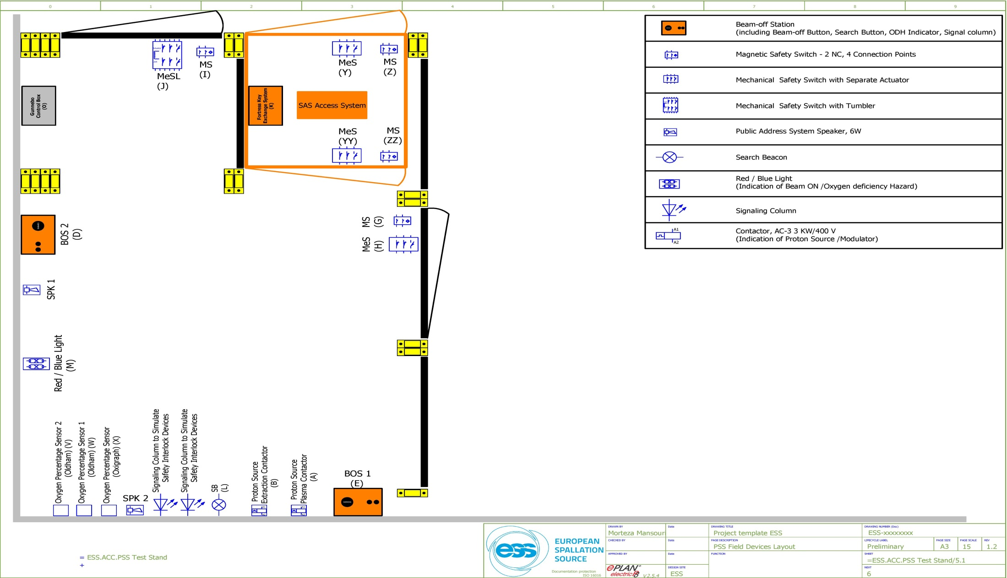
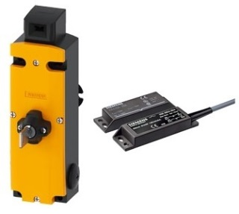
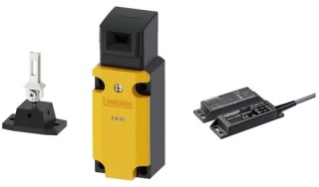
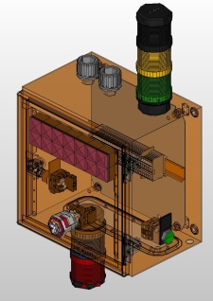
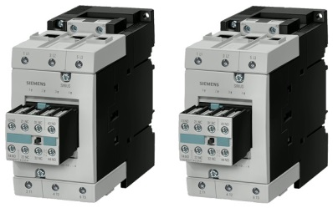
PSS Test Stand Device Distribution Layout

Slide 7
PSS Test Stand Functions
The following modes/functions are ready to be presented during our visit to PSS test stand:
Open Access: in this mode, personnel may get access to the PSS controlled areas through PSS access system. The swipe card system allows personnel access to PSS controlled areas upon identification.
Restricted Access: in this mode up to 2 people can have access to PSS controlled areas while carrying safety tokens with themselves (assuring that accelerator will never come back to operation unless the safety tokens are parked in their place again). The PSS controlled areas searched state is not broken during restricted access.
Search procedure: The formalized search patrol of PSS controlled area.
Normal enabling/disabling of the PSS actuators (by open access and BeamON modes).
Emergency disabling of the PSS actuators while intrusion to PSS controlled area happens or a beam-off button is pressed.

Slide 8
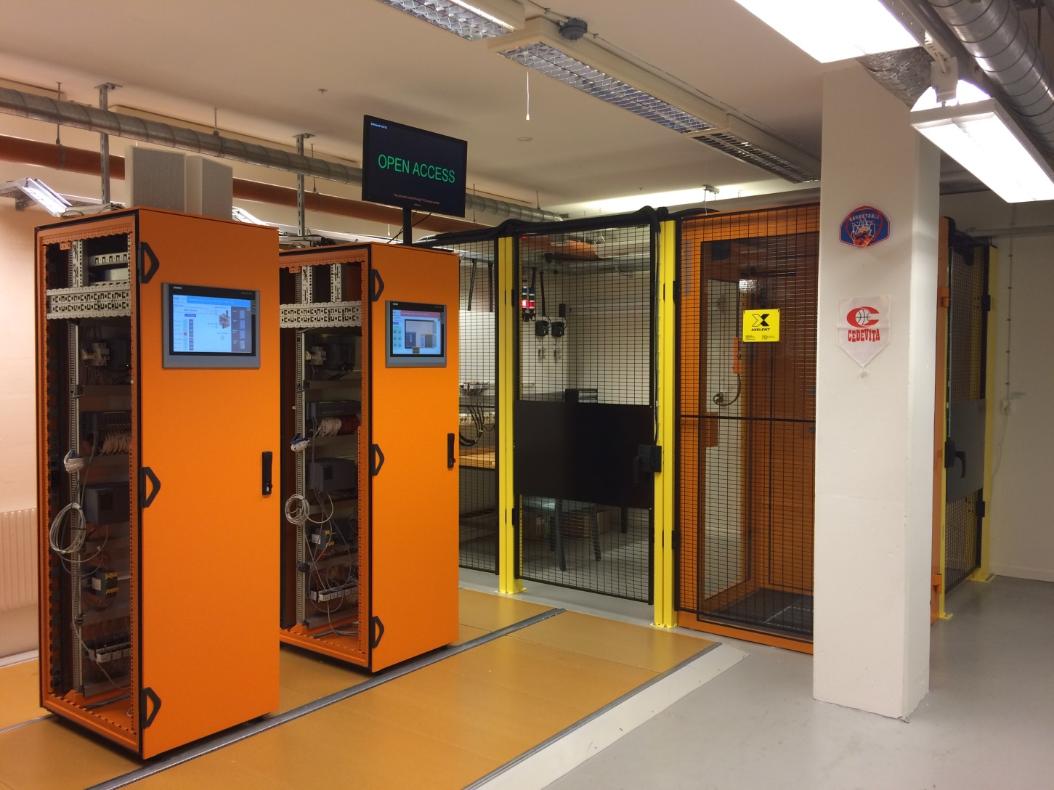
Summary
The functions/equipment/procedures to be presented at PSS test stand visit do not show the final design of accelerator PSS.

Slide 9
Thank you for your attention!

