Slide 1
PSS Hardware
SSM Visit to ESS/ICS (2016-11-29)
Morteza Mansouri
Engineer for Safety Critical Systems
www.europeanspallationsource.se
16-11-29

Slide 2
Contents
Accelerator PSS Block Diagram
Accelerator PSS Overview
Access Points to Accelerator Tunnel
PSS 1 Hardware
PSS Powering Method and Cables
PSS Cable Containments
PSS Interfaces
Summary

Slide 3
About Myself
I work as engineer for Safety Critical Systems (Personnel Safety Systems) at ESS/ICS.
6 years of experience as electrical controls engineer in industry.
3+ years experience as Personnel Safety Systems engineer at SESAME synchrotron light source facility in Jordan.
  Design, installation and commissioning of Booster Personnel Safety Systems.
  Design of Personnel Safety System for Storage Ring and first beamline.

Slide 4
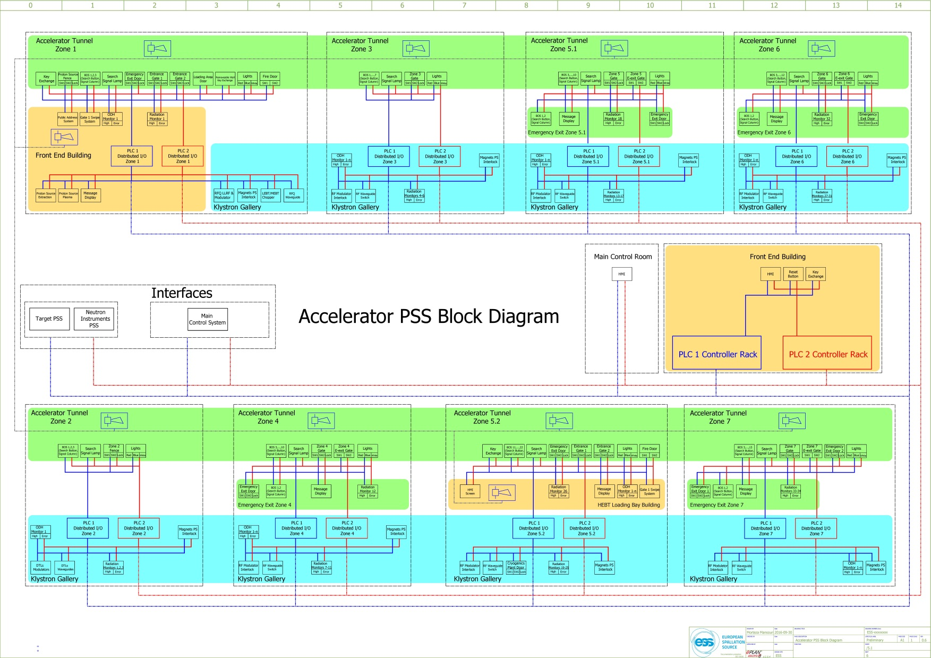
Accelerator PSS Block Diagram

Slide 5
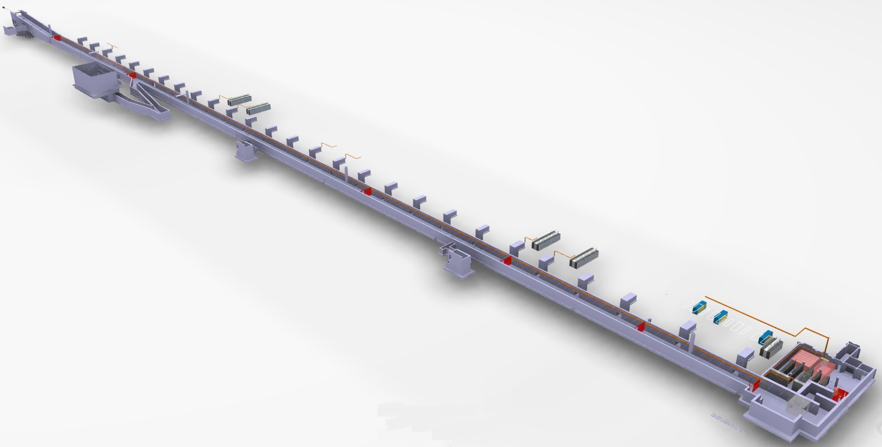
Accelerator PSS Overview
Zone 6
Phase 2: Accelerator PSS
All accelerator tunnel area and emergency exit ways are considered as PSS controlled areas.
To facilitate the search procedure in accelerator tunnel, PSS has considered 7 zones in this area. The zones are
separated from each other by 6 fences. The position of these fences will be continuously monitored by PSS safety switches
Zone 5
Zone 4
Zone 7
Phase 1:
PSS 1; Linac warm section
Zone 3
Zone 2
Zone 1 includes: Proton Source, LEBT, RFQ, MEBT
Zone 1
Zone 2 includes: Drift Tube Linacs (DTLs)
Zone 3 includes: Spoke cavities
Zone 4 includes: Medium Beta Elliptical cavities
Zone 5 includes: High Beta Elliptical cavities
Zone 6 includes: High Energy Beam Transport (HEBT)
Zone 7: A2T

Slide 6
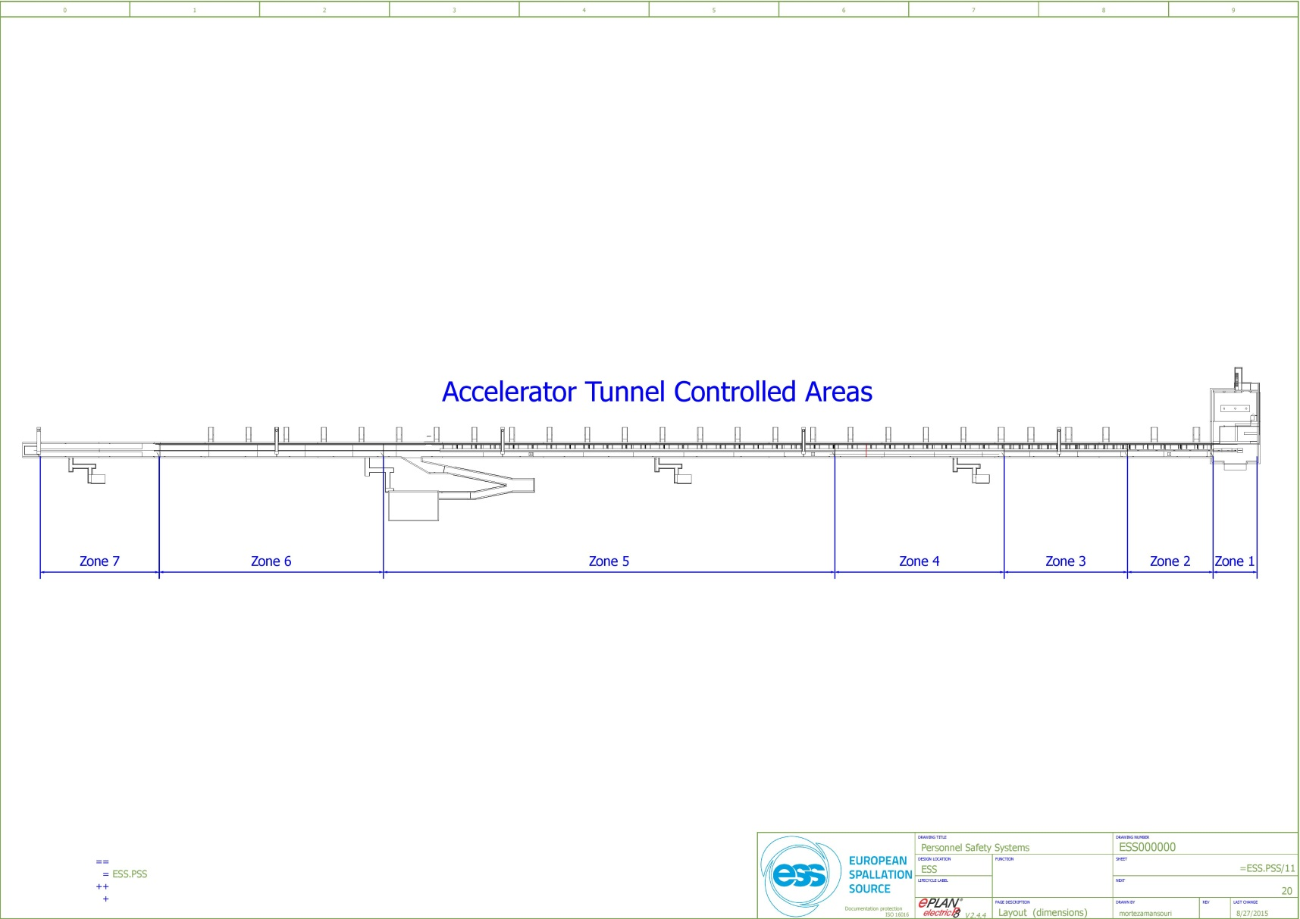
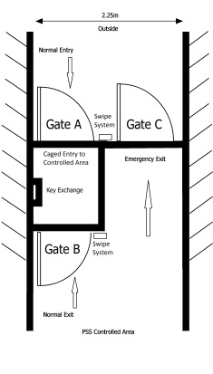
Access Points to Accelerator Tunnel
In order to control and monitor the personnel access to PSS controlled areas at any time, there will be two access points to PSS accelerator tunnel.
Front end building (G01 level 90)
HEBT loading bay (G01 Level 100)
Double-door access system to ensure single person entry/exit.
Entry of personnel upon identification.
PSS key exchange system.
Communication between the access system booth and Main Control Room (MCR) by intercom.
Video surveillance (CCTV) inside the access system booth to be used in MCR.
Notes:
Double-door access system to ensure single person entry/exit.
Entry of personnel upon identification thorough swipe system (password protected) and ESS databases.
Monitoring of access system doors by safety switches as part of PSS safety instrumented functions.
Interface between access system control box and PSS PLC to allow personnel in/out of PSS controlled areas.
Accommodate PSS key exchange system inside the access system booth to be used for personnel access.
Accommodate HMI inside the access system booth to be used for personnel access.
Communication between the access system booth and Main Control System (MCR) by intercom.
Video surveillance (CCTV) inside the access system booth to be used in MCR.

Slide 7
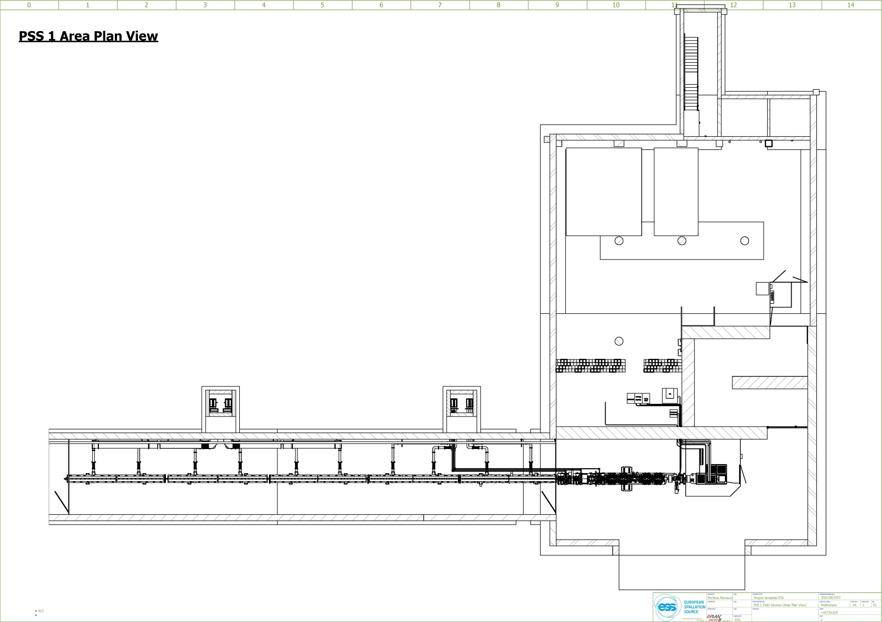
PSS 1 Hardware: Beam-off Stations
PSS 1 Area Plan View
Beam-off Stations
Zone 1
BOS 3
Zone 1
BOS 1
Zone 1
BOS 2
Zone 2
BOS 1
Zone 2
BOS 2
Zone 2
BOS 3

Slide 8

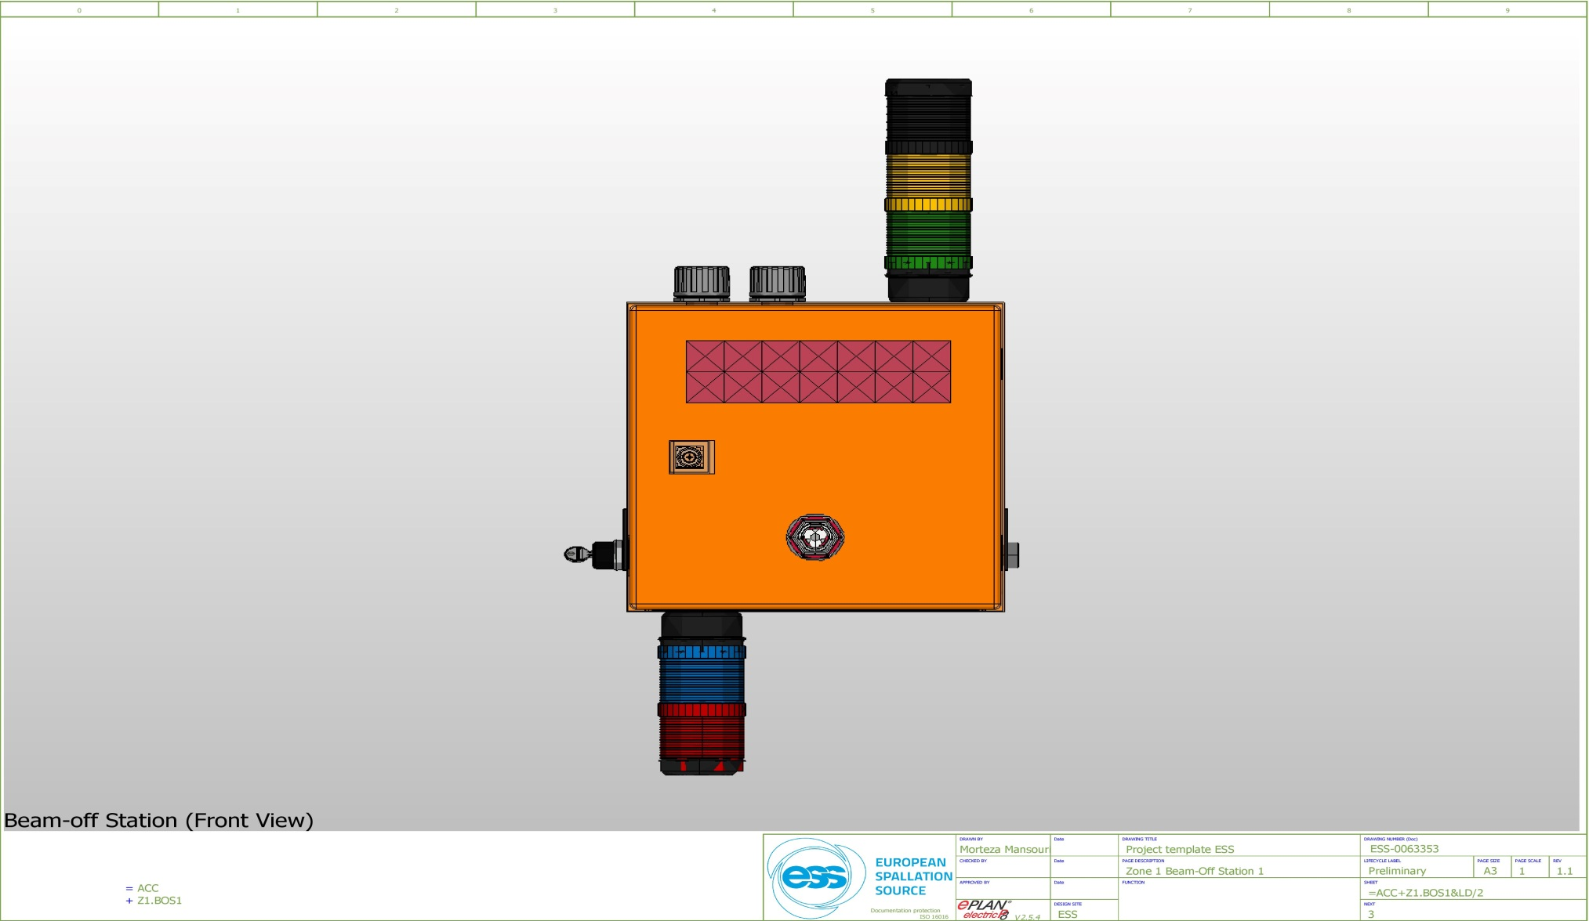
Beam-off Station Design
Search Buzzer
Beam-off button pressed
Search
Zone 3
PSS Zones ODH Indicator
Zone 2
Zone 7
Zone 1
Zone 4
Zone 5
Zone 6
Beam-off button
Test Lights Key Switch
Search button
Beam is ON
ODH in current zone

Slide 9
PSS 1 Hardware: Radiation Monitors
PSS 1 Area Plan View
Radiation Monitors
Beam-off Station
Zone 1
RM 2
BOS
Zone 2
RM 2
Zone 2
RM 3
Zone 1
RM 1
Zone 2
RM 1
BOS
BOS
BOS
BOS
BOS
Notes:
Radiation monitors installed at strategic locations of Accelerator, Target and Neutron instruments buildings measure continuously dose levels and trigger a beam stop if pre-defined thresholds are being exceeded within a few milliseconds. If a critical radiation level (according to the thresholds set in the radiation monitor control units) is detected, two relays (for High Level Alarm) inside the radiation monitor’s safety box will be triggered.
Similarly, two relays are being triggered in case of errors in the radiation monitors detectors. The safety interlock system is interfacing these relays (High level alarm and Error) activating the SIF for radiation monitoring and removing beam permit if needed.
The High level alarm and Error relays in each radiation monitor shall provide the trigger(s) to PSS PLC(s) through dry contact(s).

Slide 10
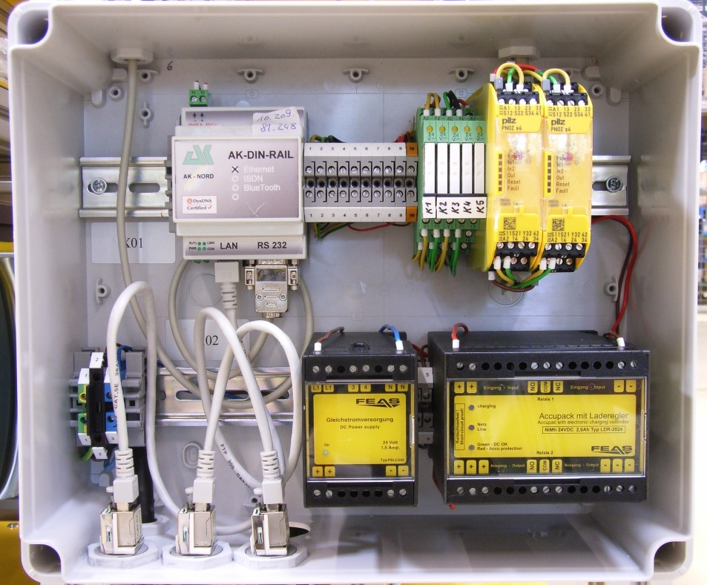
PSS Requirements on Radiation Monitors
Hazard: failure of shieldings in various areas,
Mitigation: radiation monitors installed at strategic locations in the klystron gallery (next to stubs) and at the accelerator tunnel entry/exit points measure continuously dose levels and trigger a beam stop if pre-defined thresholds are being exceeded within xx ms.
Working principle: If a critical radiation level
(accoring to the thresholds set in the
radiation monitor control units) is detected,
two relays (for High Level Alarm) inside the
radiation monitor’s safety box is being triggered.
Similarly, two relays are being triggered
in case of errors in the radiation monitors detectors.
The safety interlock system is interfacing these
relays (High level alarm and Error)
activating the SIF for radiation monitoring and
removing beam permit if needed.

Slide 11
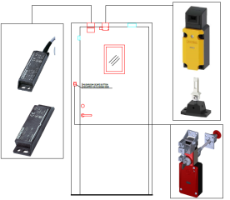
PSS 1 Hardware: Access & E-exit Doors
PSS 1 Area Plan View
Access/E-exit Doors
Beam-off Station
Radiation Monitor
+
RM
E-Exit
Door
E-Exit Door
Access System
FEB
BOS
RM
RM
RM
RM
BOS
BOS
BOS
BOS
BOS
Notes:
Positive opening operation:
The contacts with normally closed function are opened reliably by means of a positively-driven
actuating plunger mechanism. This is referred to as a positive opening operation.
IEC 60947-5-1 and DIN EN 60947-5-1 require positive opening of normally closed contacts
for operator protection and stipulate use of the marking.

Slide 12
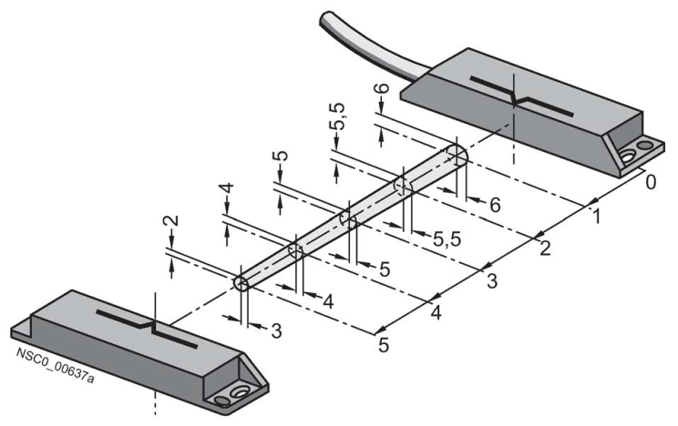
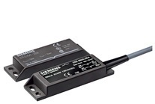
Non-contact magnetically operated safety switch
A magnetically operated switch comprises a coded switching magnet and a contact block (sensor unit).
Features:
  Tamper-proof protective door monitoring
  SIL 3 acc. to IEC 61508, achievable with single switch pair

Slide 13
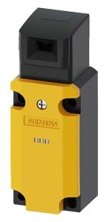
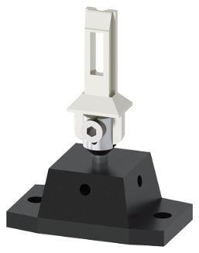
Mechanical Safety Switches with Separate Actuator
Positive opening →
The NC contacts of the switch are forced open mechanically, positively-driven and reliably by the plunger.
(an internal mechanism forcibly separates normally closed contacts and prevents them from welding together - allowing the safety circuit to open. Requirements in IEC 60947-5-1, Annex K prevent the reliance on spring action alone to separate the contacts.)

Slide 14
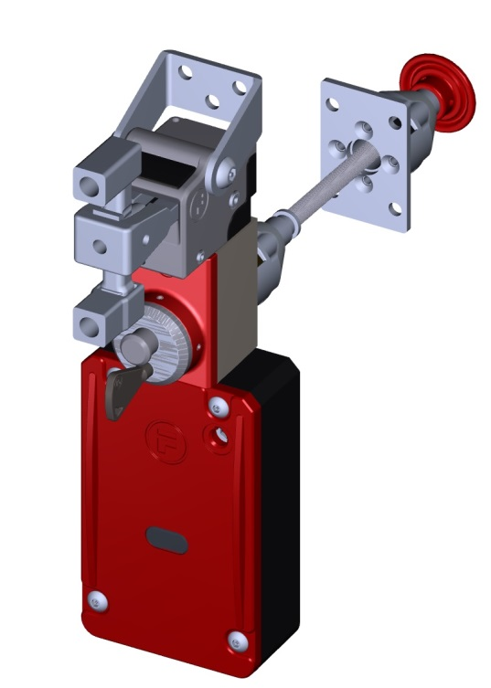
proLok (Solenoid Locking Safety Switches )
Features:
  Spring locked (power to unlock)
  Escape release from inside (mechanical push button to release door)
  A special key to unlock the unit from outside (to be used by authorized personnel in case of emergency)

Slide 15
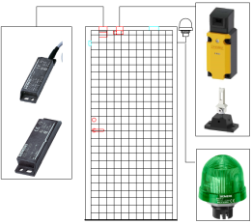
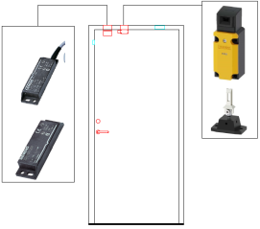
PSS 1 Hardware: Fire Door & Zone Fences
PSS 1 Area Plan View
Fire Door/Zone Fence
Beam-off Station
+
Radiation Monitor
E-exit Door
Access Doors
RM
E-Exit
Door
PSS Zone Fences
Fire Door
BOS
RM
RM
RM
Fire
Door
RM
Zone 2
Fence
Zone 3
Fence
BOS
BOS
BOS
BOS
BOS
In PSS 1, Zone 3 fence will be used as an emergency exit.

Slide 16
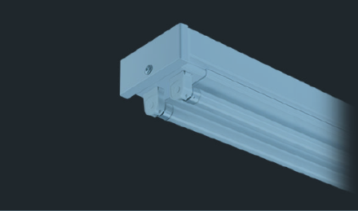
PSS 1 Hardware: PSS Blue & Red Lights
PSS 1 Area Plan View
PSS Blue/Red Lights
+
Beam-off Station
Radiation Monitor
E-exit/Fire Door
Access Doors
To be used as a layer of protection, PSS will install blue and red lights in PSS controlled areas. The blue lights will turn on when the proton beam is on and the red lights will turn on when there is Oxygen Deficiency Hazard (ODH).
Zone Fence
RM
Kanby 2 batten luminaries
Separately switched, 2x58W
E-Exit
Door
PSS B/R Light
BOS
RM
RM
RM
PSS B/R Light
Fire
Door
RM
PSS B/R Light
PSS B/R Light
PSS B/R Light
PSS B/R Light
Fence
PSS B/R Light
Fence
PSS B/R Light
PSS B/R Light
PSS B/R Light
PSS B/R Light
BOS
BOS
BOS
BOS
BOS
Notes:
To be used as a layer of protection, PSS will install blue and red lights in PSS controlled areas. Each light fitting will have two luminaries (2x58W) which are separately switched.
The blue lights will turn on when the proton beam is on and the red lights will turn on when there is Oxygen Deficiency Hazard (ODH).

Slide 17

PSS 1 Hardware: Message Display
+
PSS 1 Area Plan View
Message Display
Beam-off Station
Radiation Monitor
E-exit/Fire Door
Access Doors
Message Display
Zone Fence
RM
B/R Light
Message Displays will be installed at the entry and E-exit points to tunnel as a pre-warning for radiation hazards, ODH, access status, etc.
E-Exit
Door
PSS B/R Light
BOS
RM
RM
RM
PSS B/R Light
Fire
Door
RM
PSS B/R Light
PSS B/R Light
PSS B/R Light
PSS B/R Light
Fence
PSS B/R Light
Fence
PSS B/R Light
PSS B/R Light
PSS B/R Light
PSS B/R Light
BOS
BOS
BOS
BOS
BOS
Notes:
Message displays will be installed at the access and emergency exit points to PSS controlled areas as a pre-warning for radiation hazards, ODH, access status, etc.
The displays will be controlled by PSS PLCs.

Slide 18
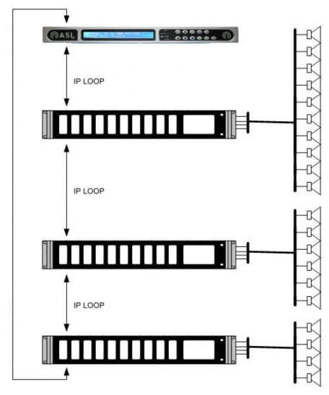
PSS 1 Hardware: Public Address System
PSS 1 Area Plan View
Public Address System
Beam-off Station
Radiation Monitor
+
E-exit/Fire Door
PSS PA system will be installed to broadcast messages during ODH, search patrol, etc.
PA system will be triggered by PSS PLC(s).
Access Doors
Zone Fence
RM
B/R Light
E-Exit
Door
Message Display
PA System
PSS B/R Light
BOS
RM
RM
RM
PSS B/R Light
Fire
Door
RM
PSS B/R Light
PSS B/R Light
PSS B/R Light
PSS B/R Light
Fence
PSS B/R Light
Fence
PSS B/R Light
PSS B/R Light
PSS B/R Light
PSS B/R Light
BOS
BOS
BOS
BOS
BOS
Notes:
PSS public address system will be installed in all PSS controlled areas to broadcast messages during search patrol, or any other message needed to be broadcasted by PSS.
Public address system will be triggered by PSS PLC(s).

Slide 19
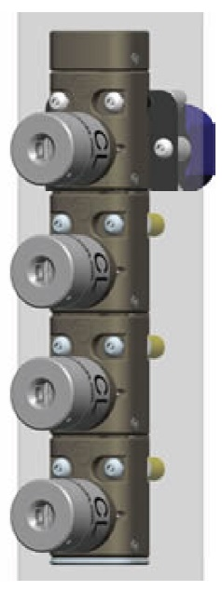
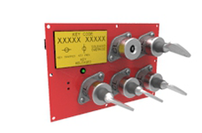
PSS 1 Hardware: Key Exchange System
  The PSS key exchange system (Trapped Key Interlock Switches) will be used to ensure that a predetermined sequence of events takes place or that hazards have been removed before personnel become exposed to them. This system ensures that the access process to PSS controlled areas is followed and cannot be circumvented or short cut.
  PSS will use modular key exchange units which are used to exchange one or more keys for a number of other keys. The unit will contain stainless steel mechanical lock modules with uniquely coded keys.

Slide 20
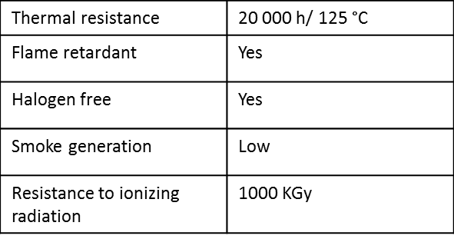
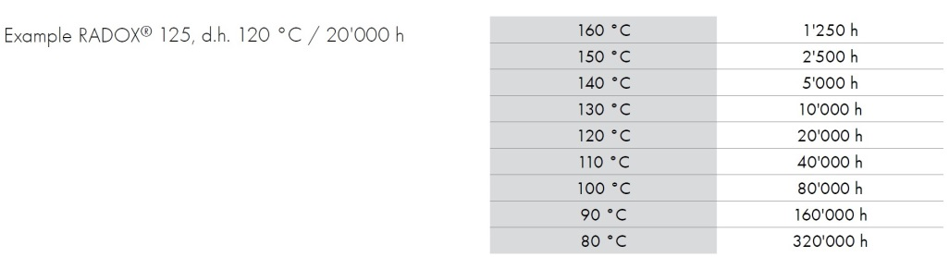
PSS Powering Method and Cables
The PSS racks are equipped with UPS and battery and the PSS access systems are always powered by emergency power. This is to acquire the following benefits:
  Not losing the searched state of the 600-meter long tunnel in case of AC power failure.
  The PSS access systems will remain functional during facility electricity outage.
  PSS keeps monitoring the status of all the sensors (door switches, etc. ) and actuators during facility electricity outage.
  Considering the requirements such as temperature, ionizing radiation, EMI and RFI at various levels in Accelerator, Target and Neutron instruments buildings, for signal and fiber optic cables, PSS will use radiation resistant (up to 1000 kGy), high temperature (up to 125 °C), low frequency industrial cables in all PSS installations.
Life time expectation:
RADOX 125 has a life span of 20 000 h at a conductor temperature of 120 °C,
which is approx. 2,5 years. If it is used at another temperature, lifetime
expectations are as shown in the table above.
The typical characteristics of insulation and jacket of Radox 125 cable

Slide 21
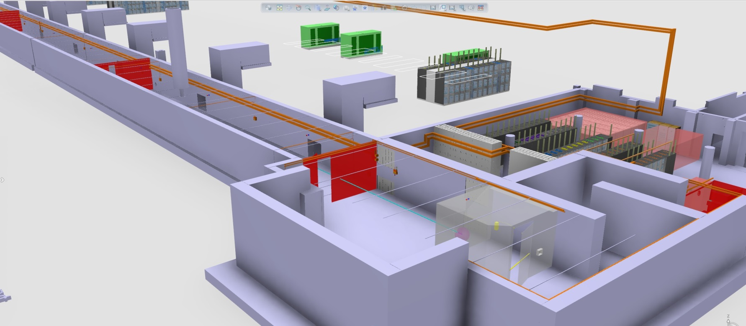
PSS Cable Containments
As part of PSS safety requirements specifications in accordance with IEC 61508:2010, the two independent PSS trains should be physically separated to reduce the possibility of the PSS being affected by the same external events. Therefore, in any two train personnel safety system, the cables of each train (from sensor to logic solver to actuator) will run through two separated enclosed, sealed and marked containments/conduits.

Slide 22
PSS Interfaces
PSS will stop the accelerator proton beam by removing mains electrical power from following systems:
  The Ion source plasma generator system
  The Ion source extraction system
  The RFQ modulator system
PSS will remove mains electrical power from the following systems to mitigate against X-ray hazards when there is access to tunnel:
  MEBT bunchers (3 units)
  Drift Tube Linacs (5 units)
  Spoke cavities (26 units)
  Elliptical medium beta cavities (9 units)
  Elliptical high beta cavities (21 units)
PSS will interface with two bending magnets which send the beam towards Target.

Slide 23
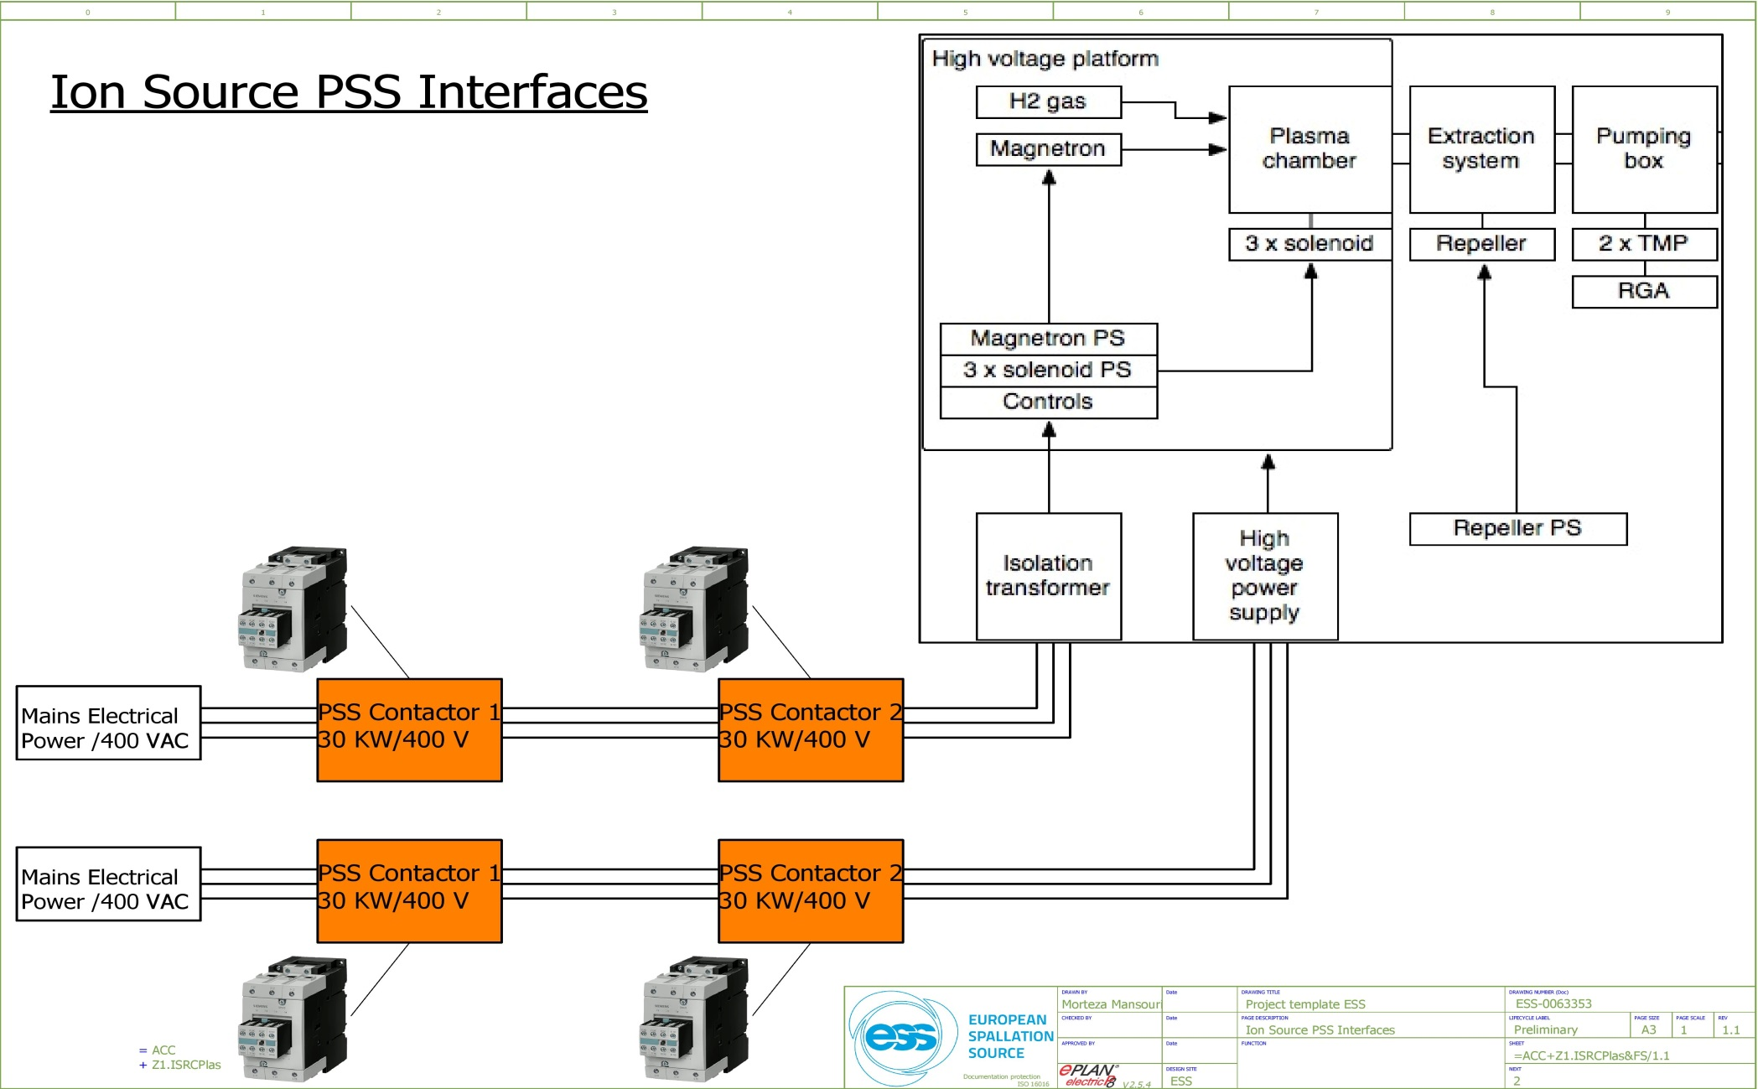
PSS Interfaces: Ion Source
Siemens Contactors for “Safety” applications:
The contactors are provided with positively driven (mirror) contacts which meet or exceed the criteria for "Safety Contactors” according to IEC 60947-4 Annex F. When applying Safety Contactors in safety circuits, the NC auxiliary contacts must be wired in series or parallel and must be used as monitoring contacts with feedback to the safety evaluation device (i.e. safety relay or failsafe logic controller).
PSS Blue Train
PSS Blue Train
PSS Red Train
PSS Red Train
PSS Blue Train
PSS Blue Train
PSS Red Train
PSS Red Train
Notes:
PSS interfaces with Ion Source (ISRC).
Accelerator PSS will interface two subsystems of ISRC.
Ion Source isolating transformer in G01 building.
PSS will have the opening order function of the 3-phase supply power to the ISRC isolating transformer. As a PSS Safety Instrumented Function (SIF), in order to de-energize ISRC plasma generator, the 3-phase supply voltage of the ISRC isolating transformer must pass through the two PSS contactors (in series) which are installed in a PSS sealed box.
2. Ion Source high voltage transformer in G01 building.
PSS will have the opening order function of the 3-phase supply power to the ISRC High Voltage transformer. As a PSS Safety Instrumented Function (SIF), in order to de-energize ISRC extraction system, the 3-phase supply voltage of the ISRC High Voltage transformer must pass through the two PSS contactors (in series) which are installed in a PSS sealed box.

Slide 24
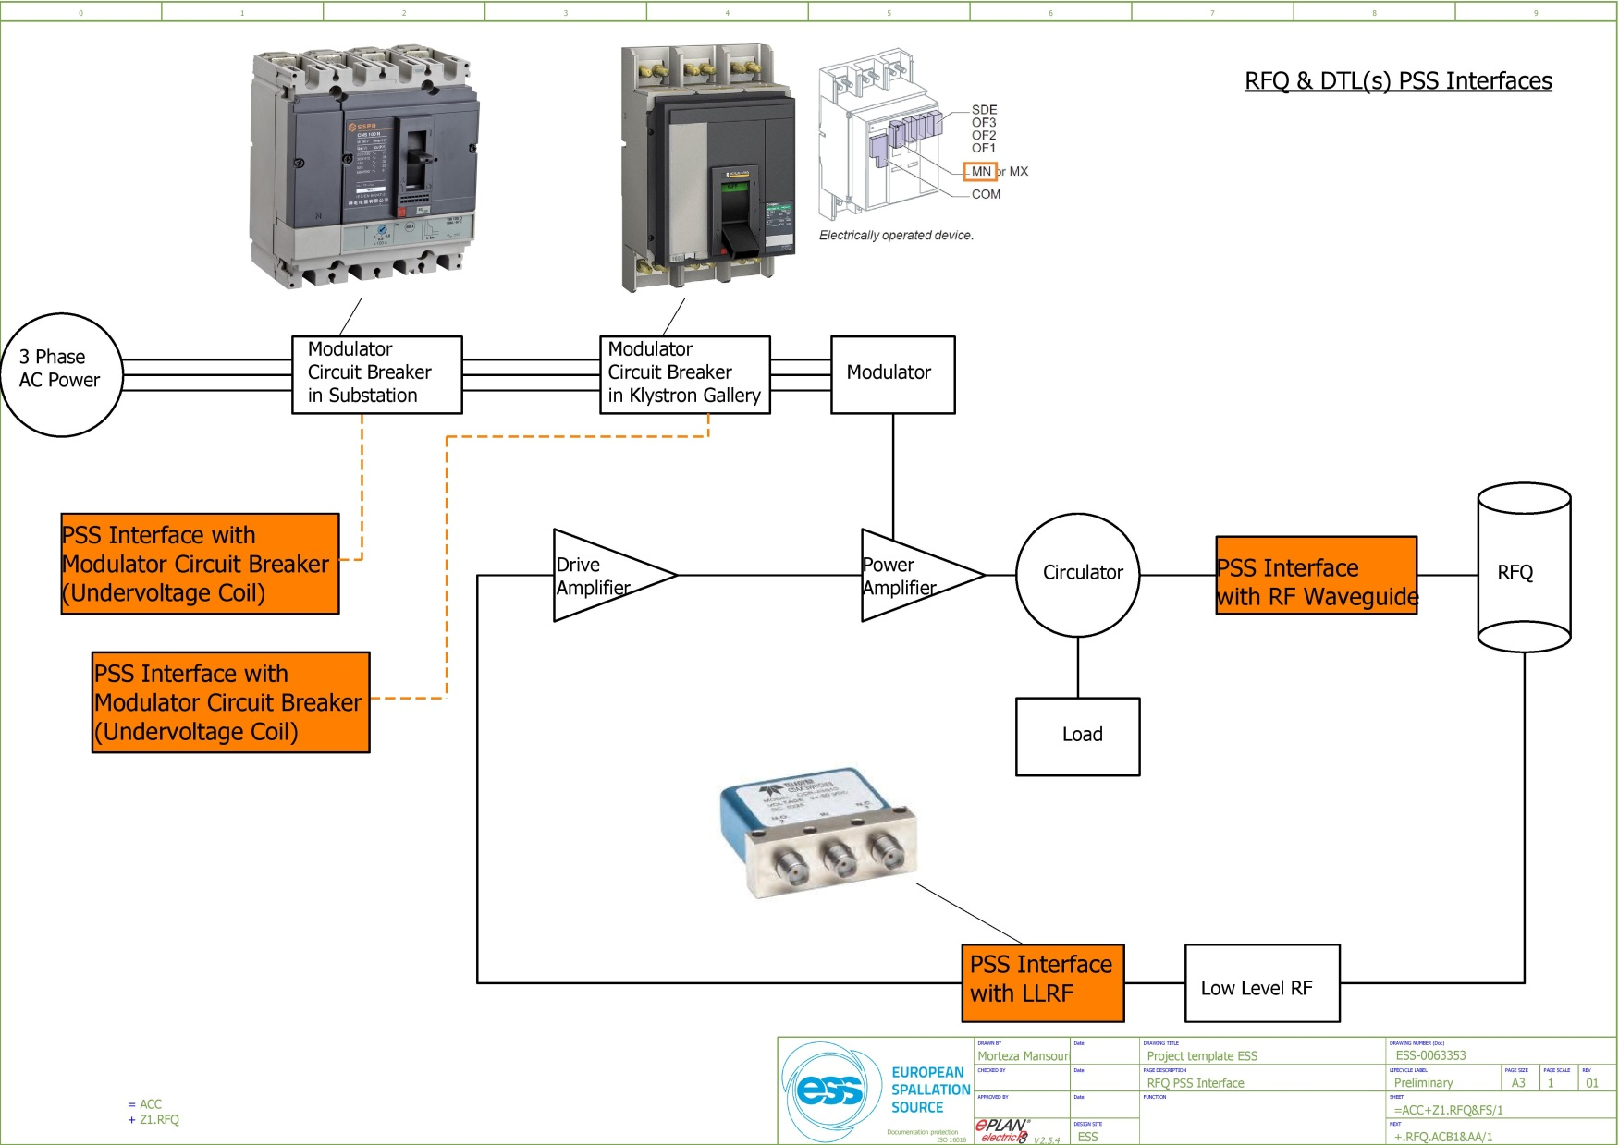
PSS Interfaces: RFQ & DTL(s)
In case of access to tunnel by personnel, the RF modules test can only be performed after a piece of waveguide has been removed and sealed properly in the Klystron Gallery.
PSS will use failsafe, 24 VDC RF switches with indicator mirror contacts to interface with Low level Radio Frequency systems (LLRF) in RF cells such as MEBT bunchers, RFQ, DTL(s), spoke cavities, etc.
Instantaneous under voltage release coil in Molded case circuit breakers (MCCB). As an example, to be used in case of PSS interface with RF modulators in accelerator.
The under voltage release coil instantaneously opens the circuit breaker when its supply voltage drops to a value between 35 % and 70 % of its rated voltage. If there is no supply on the release, it is impossible to close the circuit breaker, either manually or electrically. Any attempt to close the circuit breaker has no effect on the main contacts. Circuit breaker closing is enabled again when the supply voltage of the release returns to 85 % of its rated value.
The control signal for the under voltage coil passes through the two PSS contactor relays.
Notes:
Accelerator PSS will interface four subsystems of RFQ.
RFQ Modulator air circuit breaker (ACB) in substation.
RFQ Modulator air circuit breaker (ACB) in klystron gallery.
RFQ LLRF.
RFQ Waveguide.

Slide 25
Summary
The hardware for Accelerator PSS (sensors, PLCs, actuators, etc.) are being tested at PSS test stand.
The access control systems procedures are being developed based on the double-door access system in the lab.
The key exchange philosophy is being developed.

Slide 26
Thank you for your attention!

Slide 27
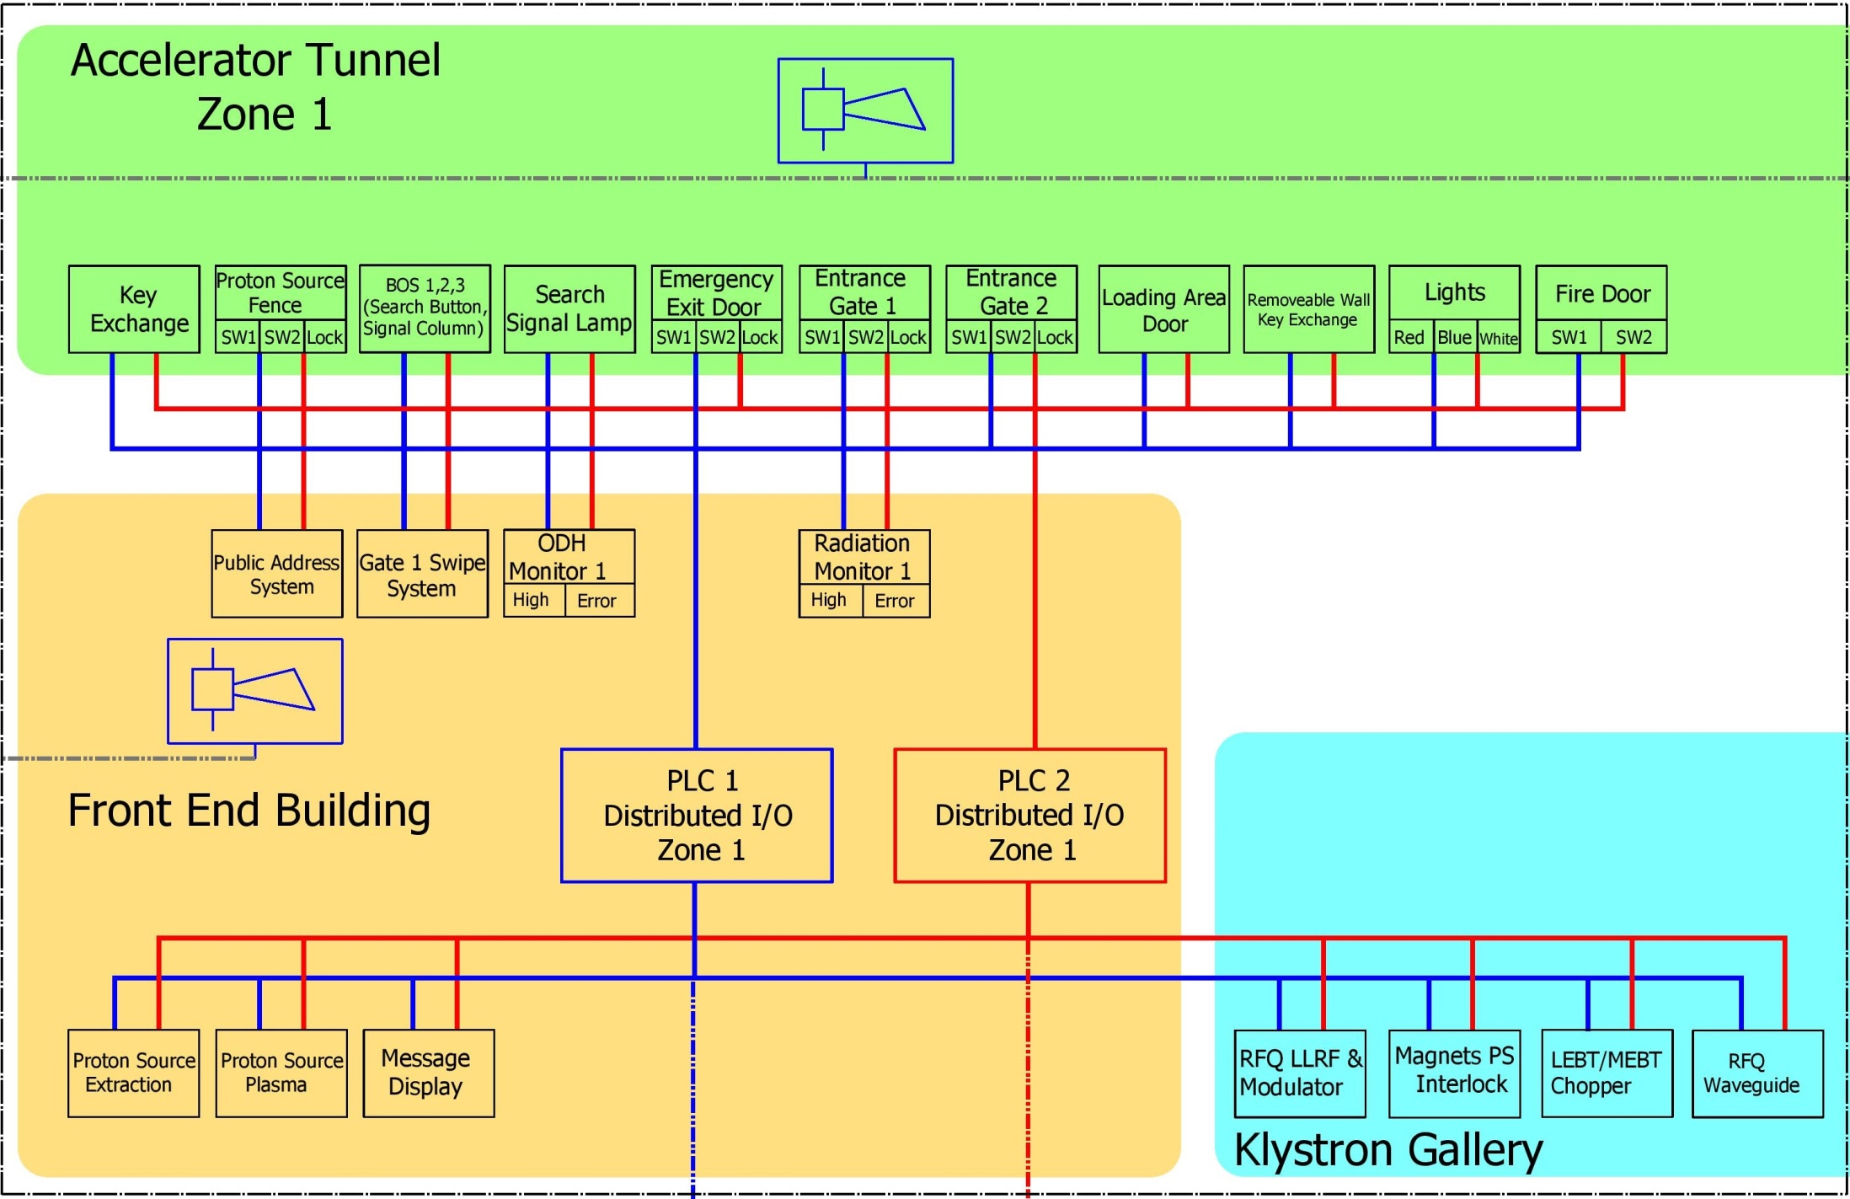

Slide 28
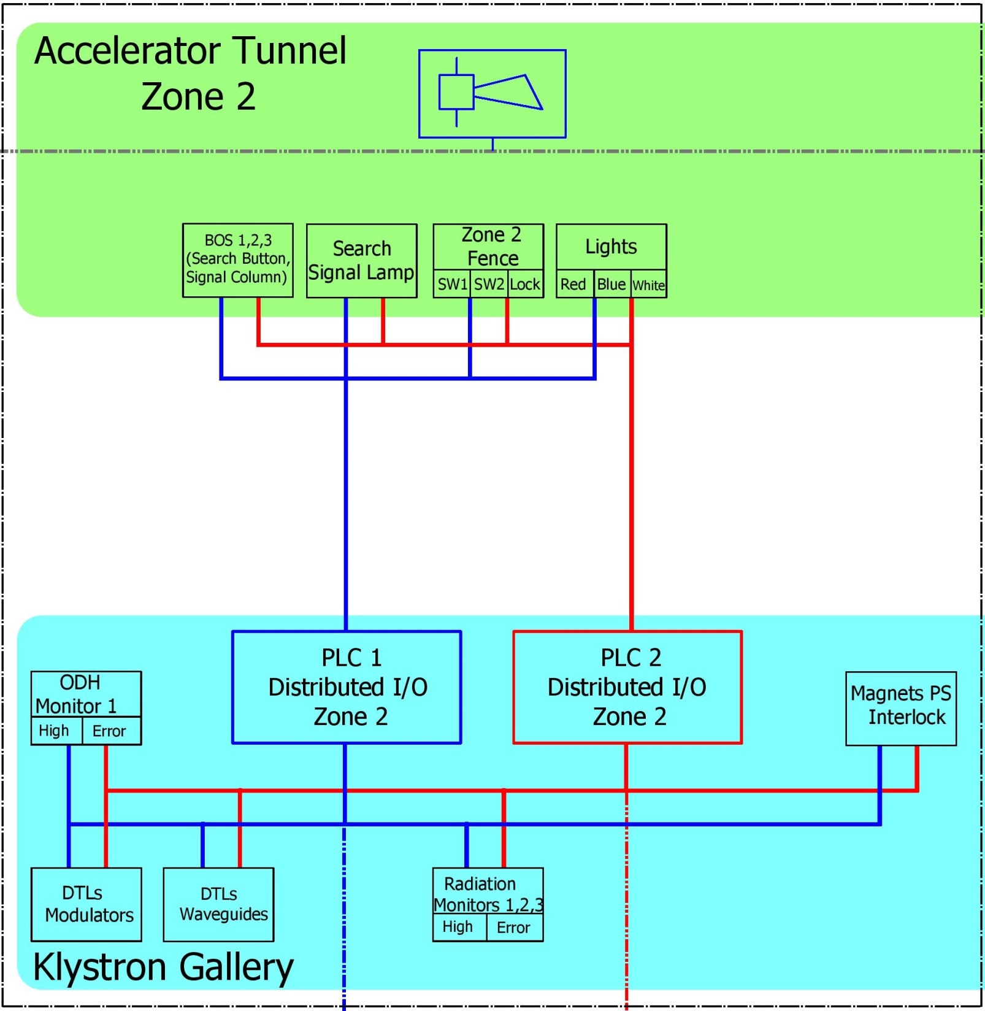

Slide 29
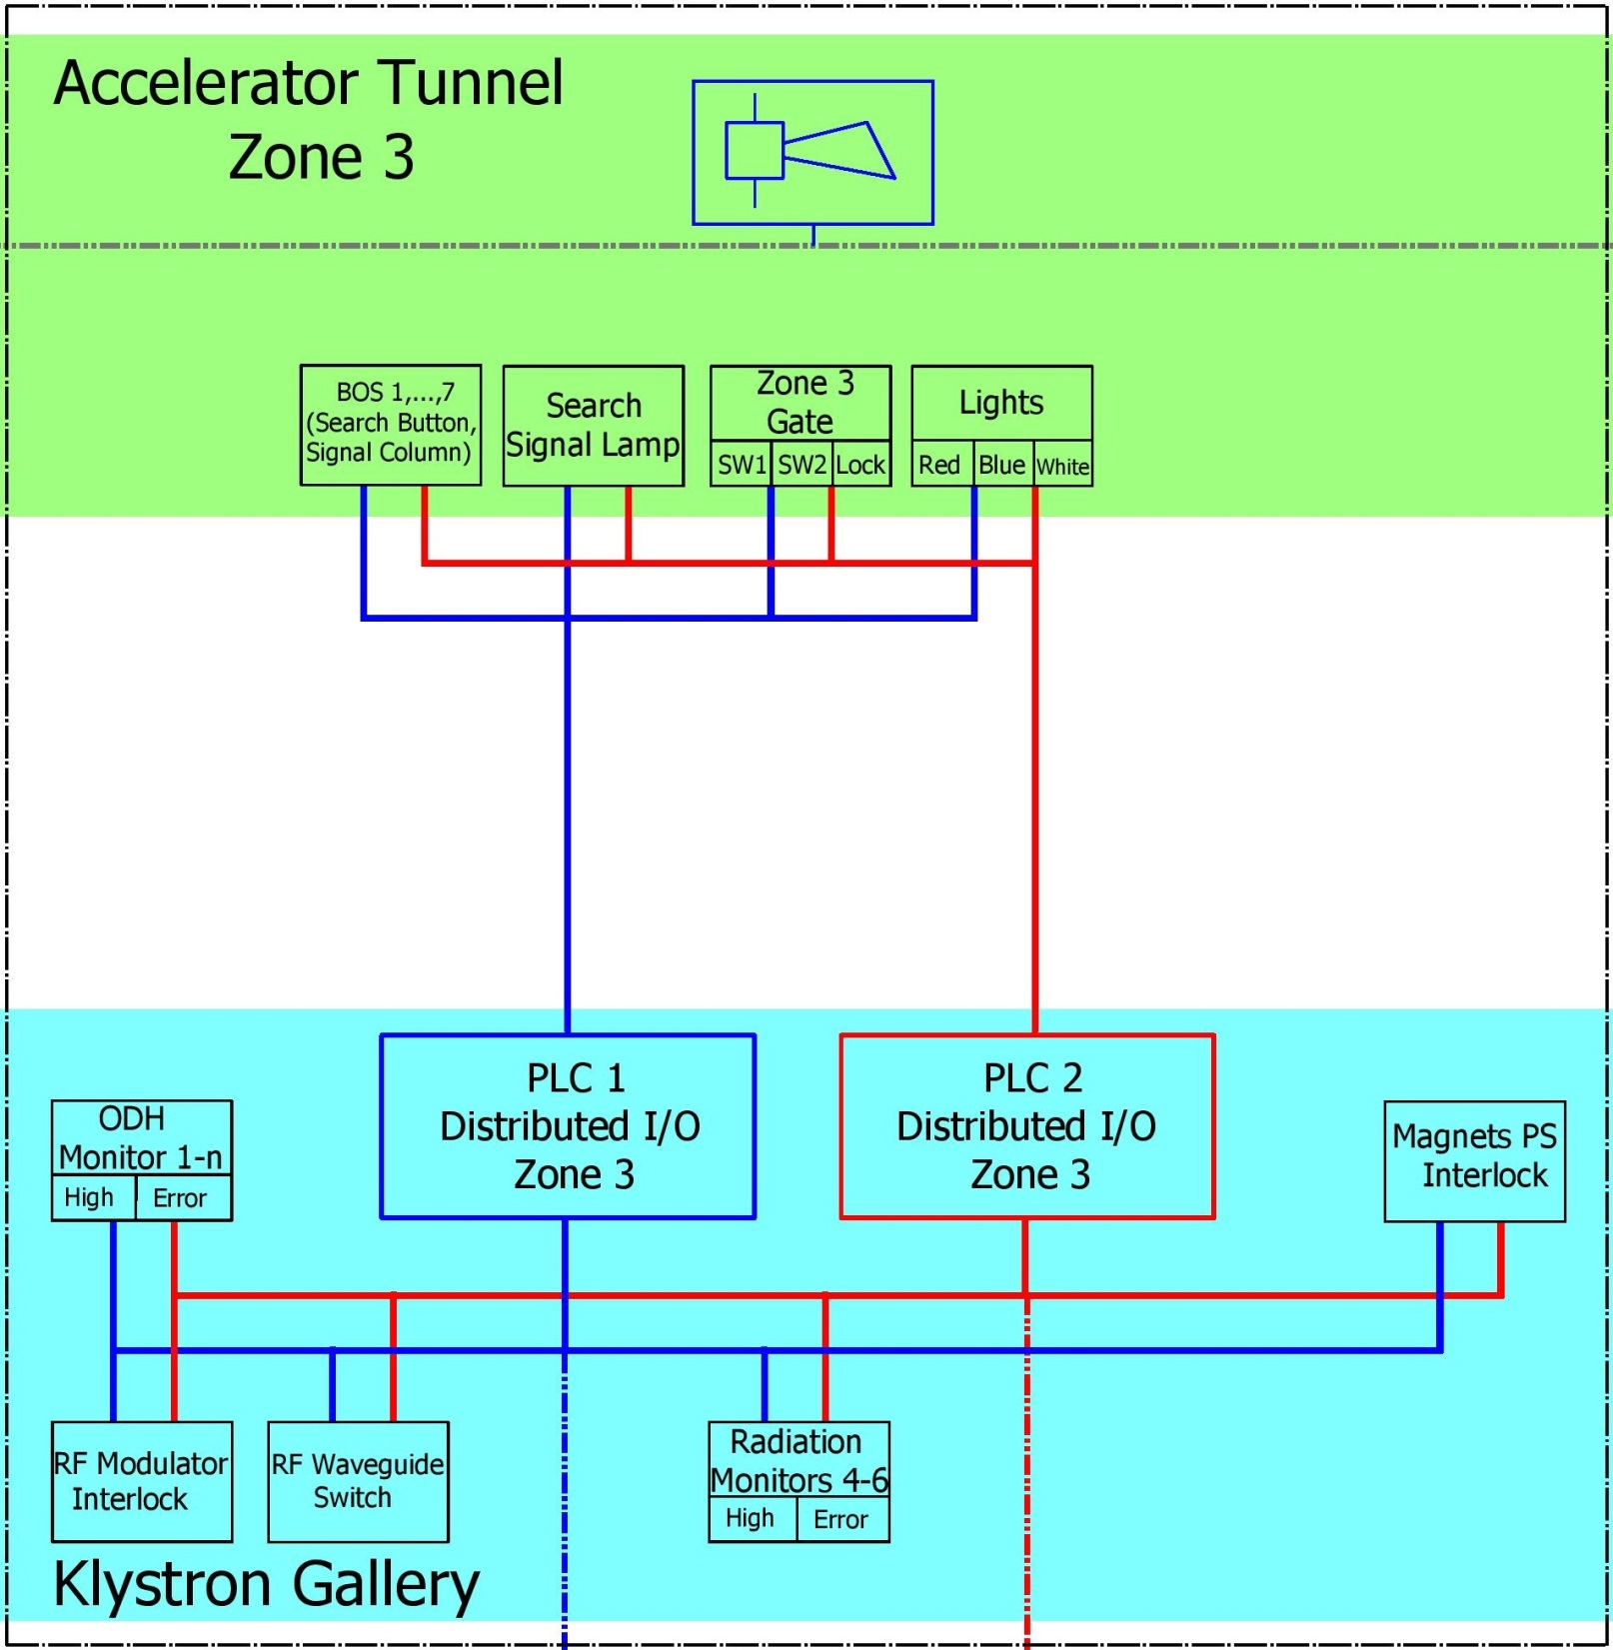

Slide 30
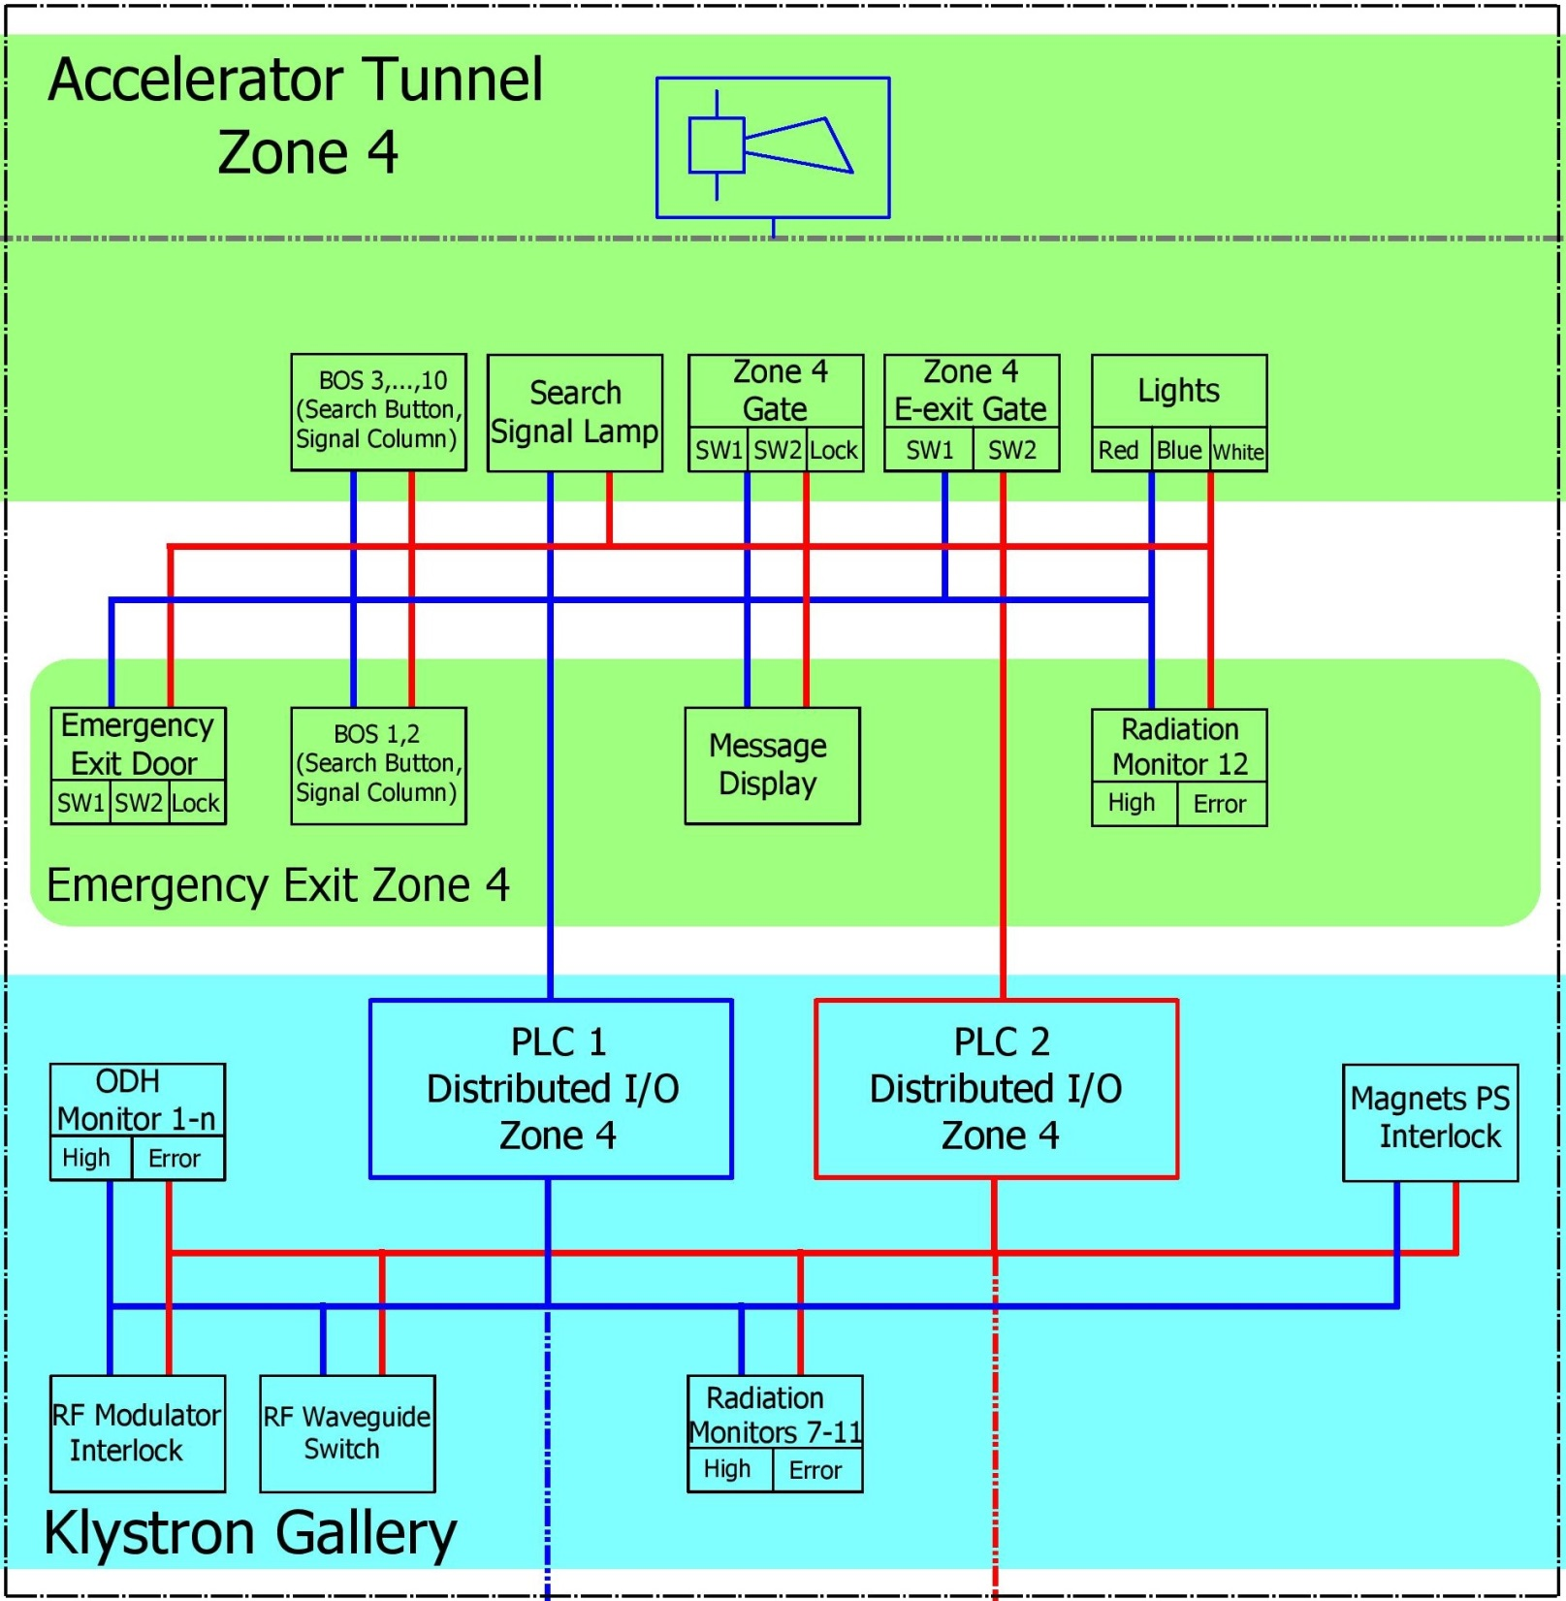

Slide 31
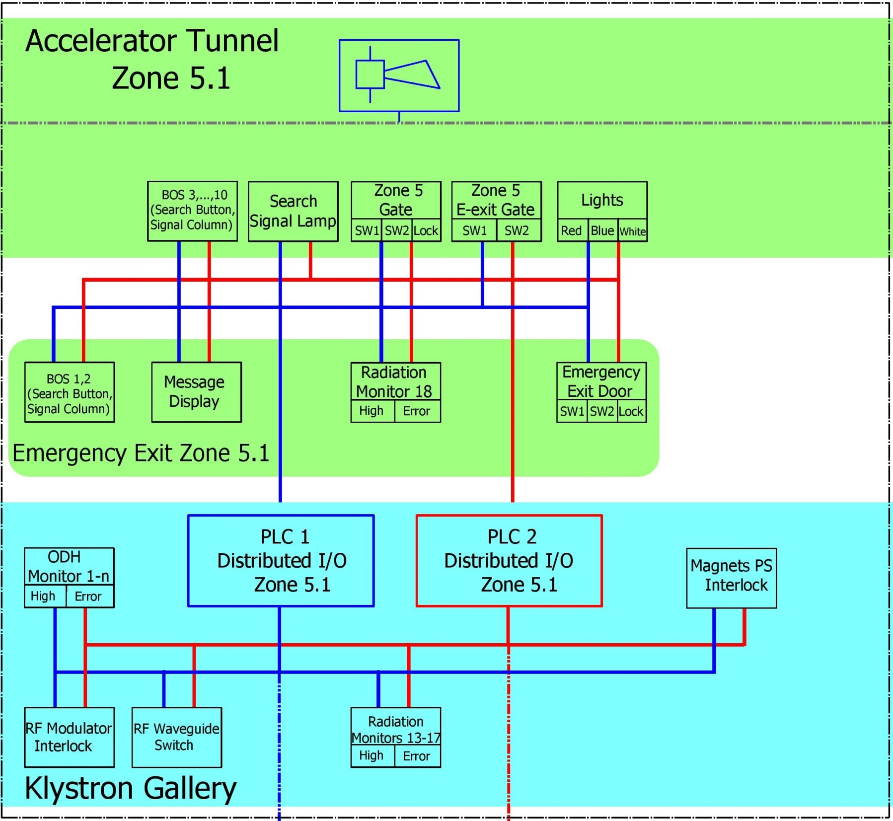

Slide 32
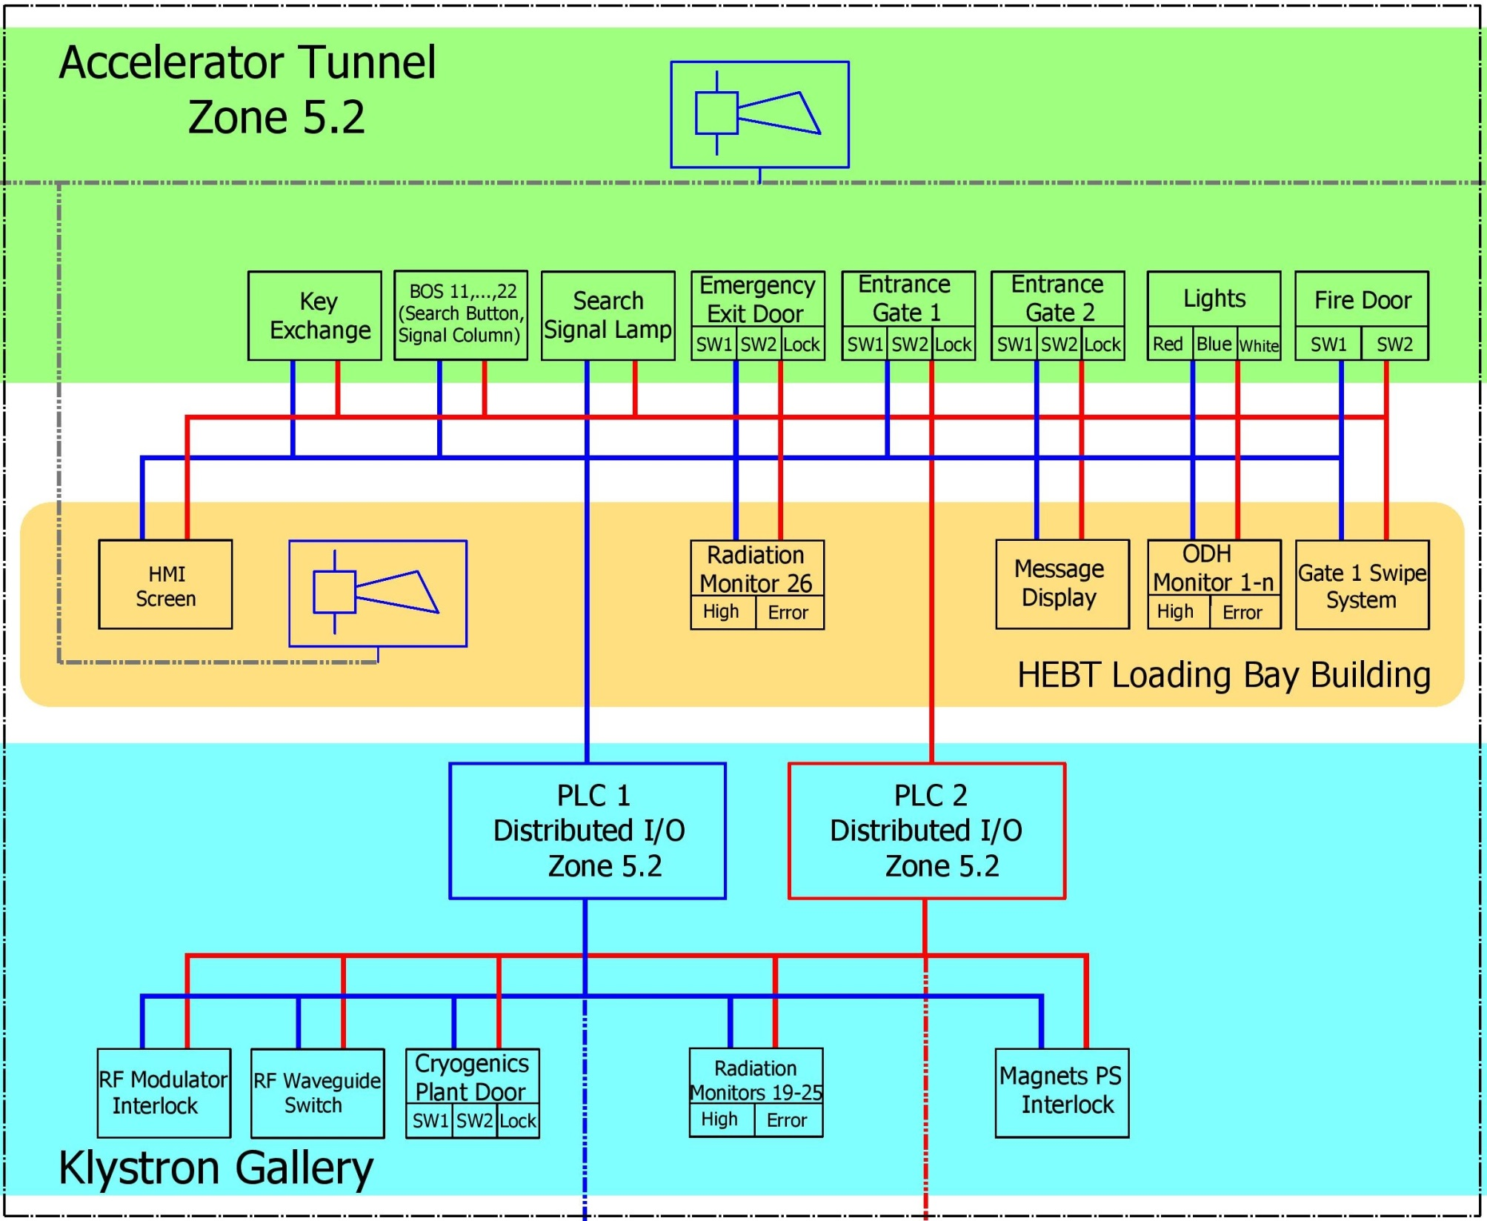

Slide 33
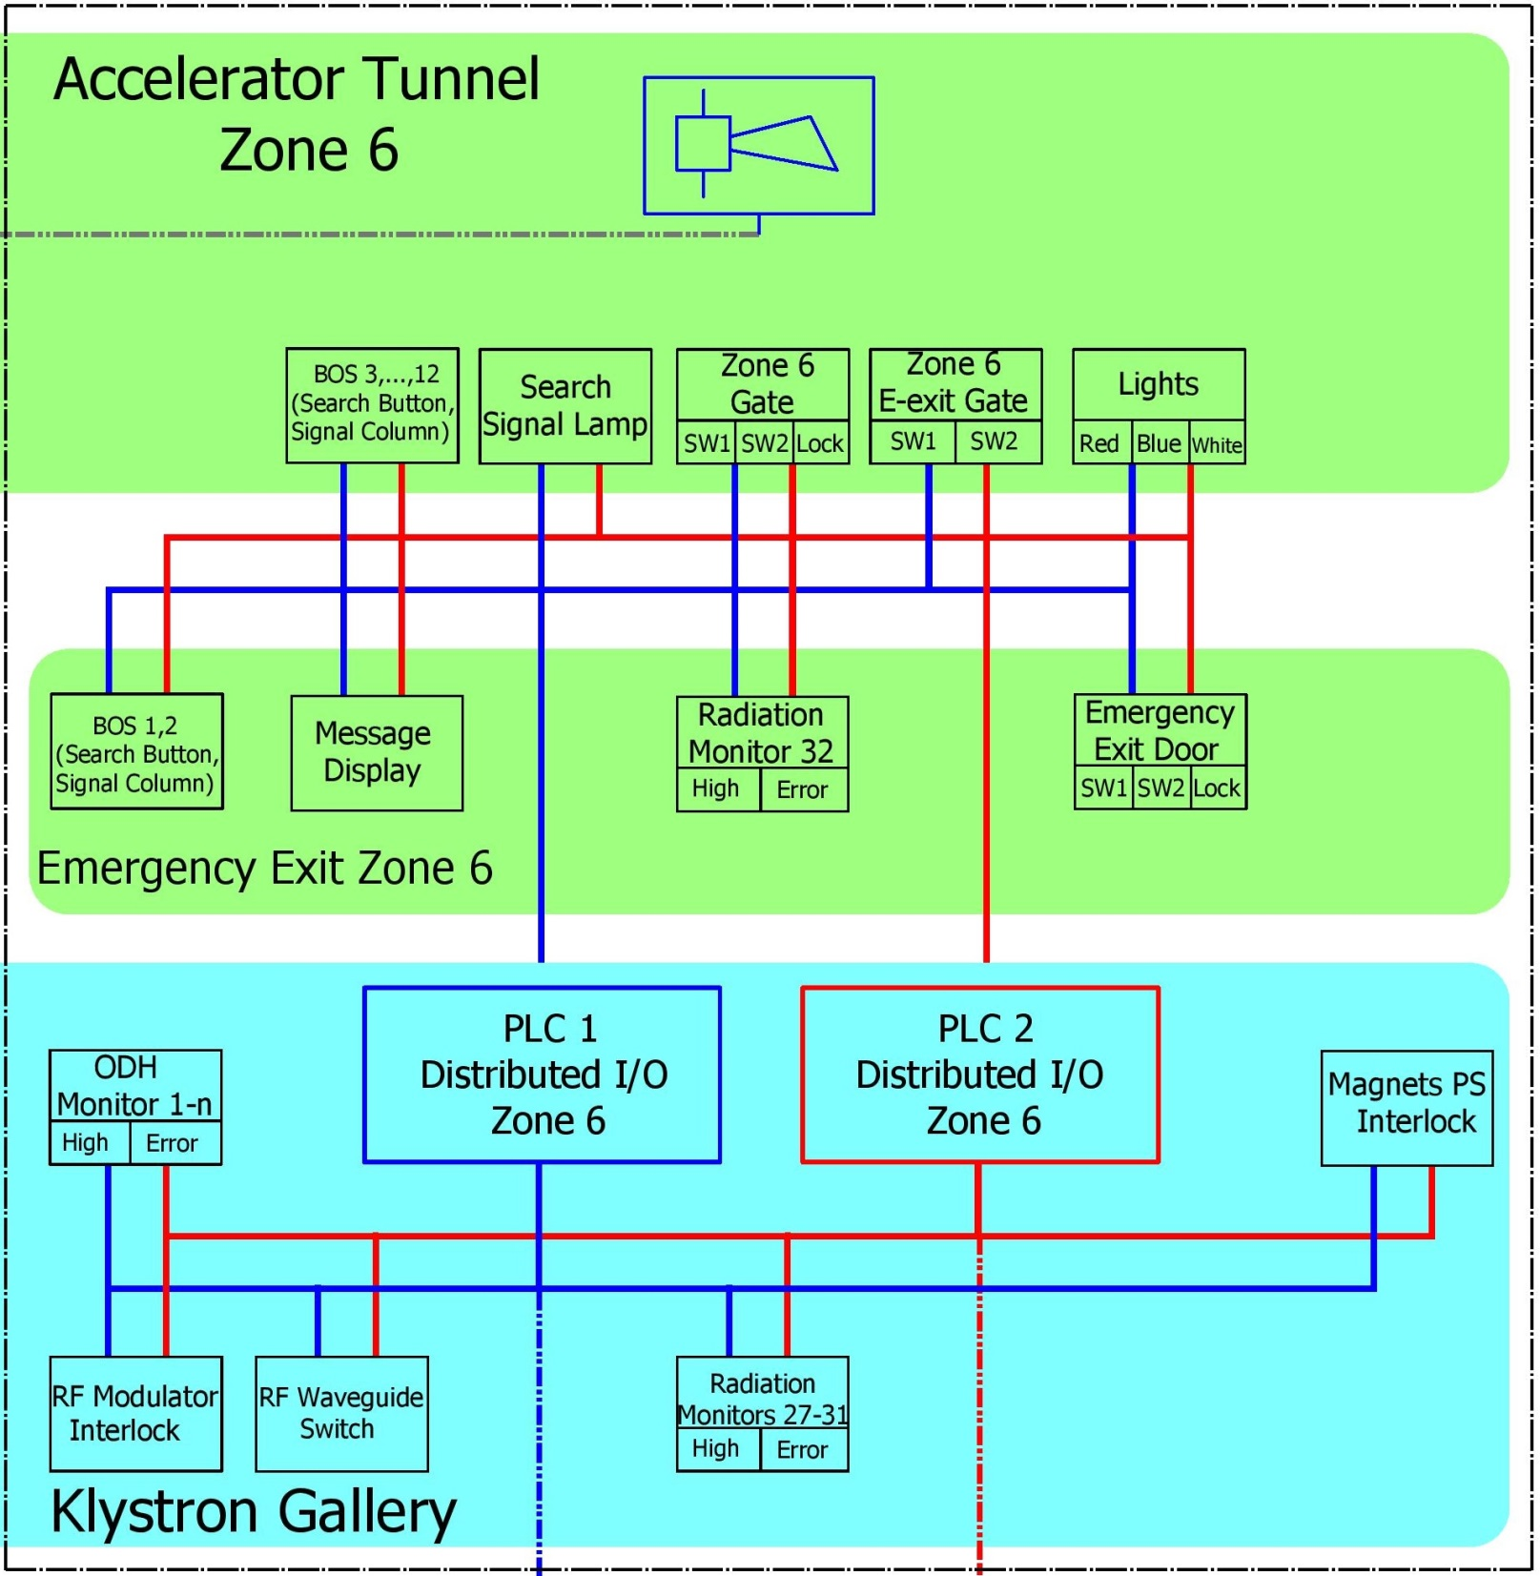

Slide 34
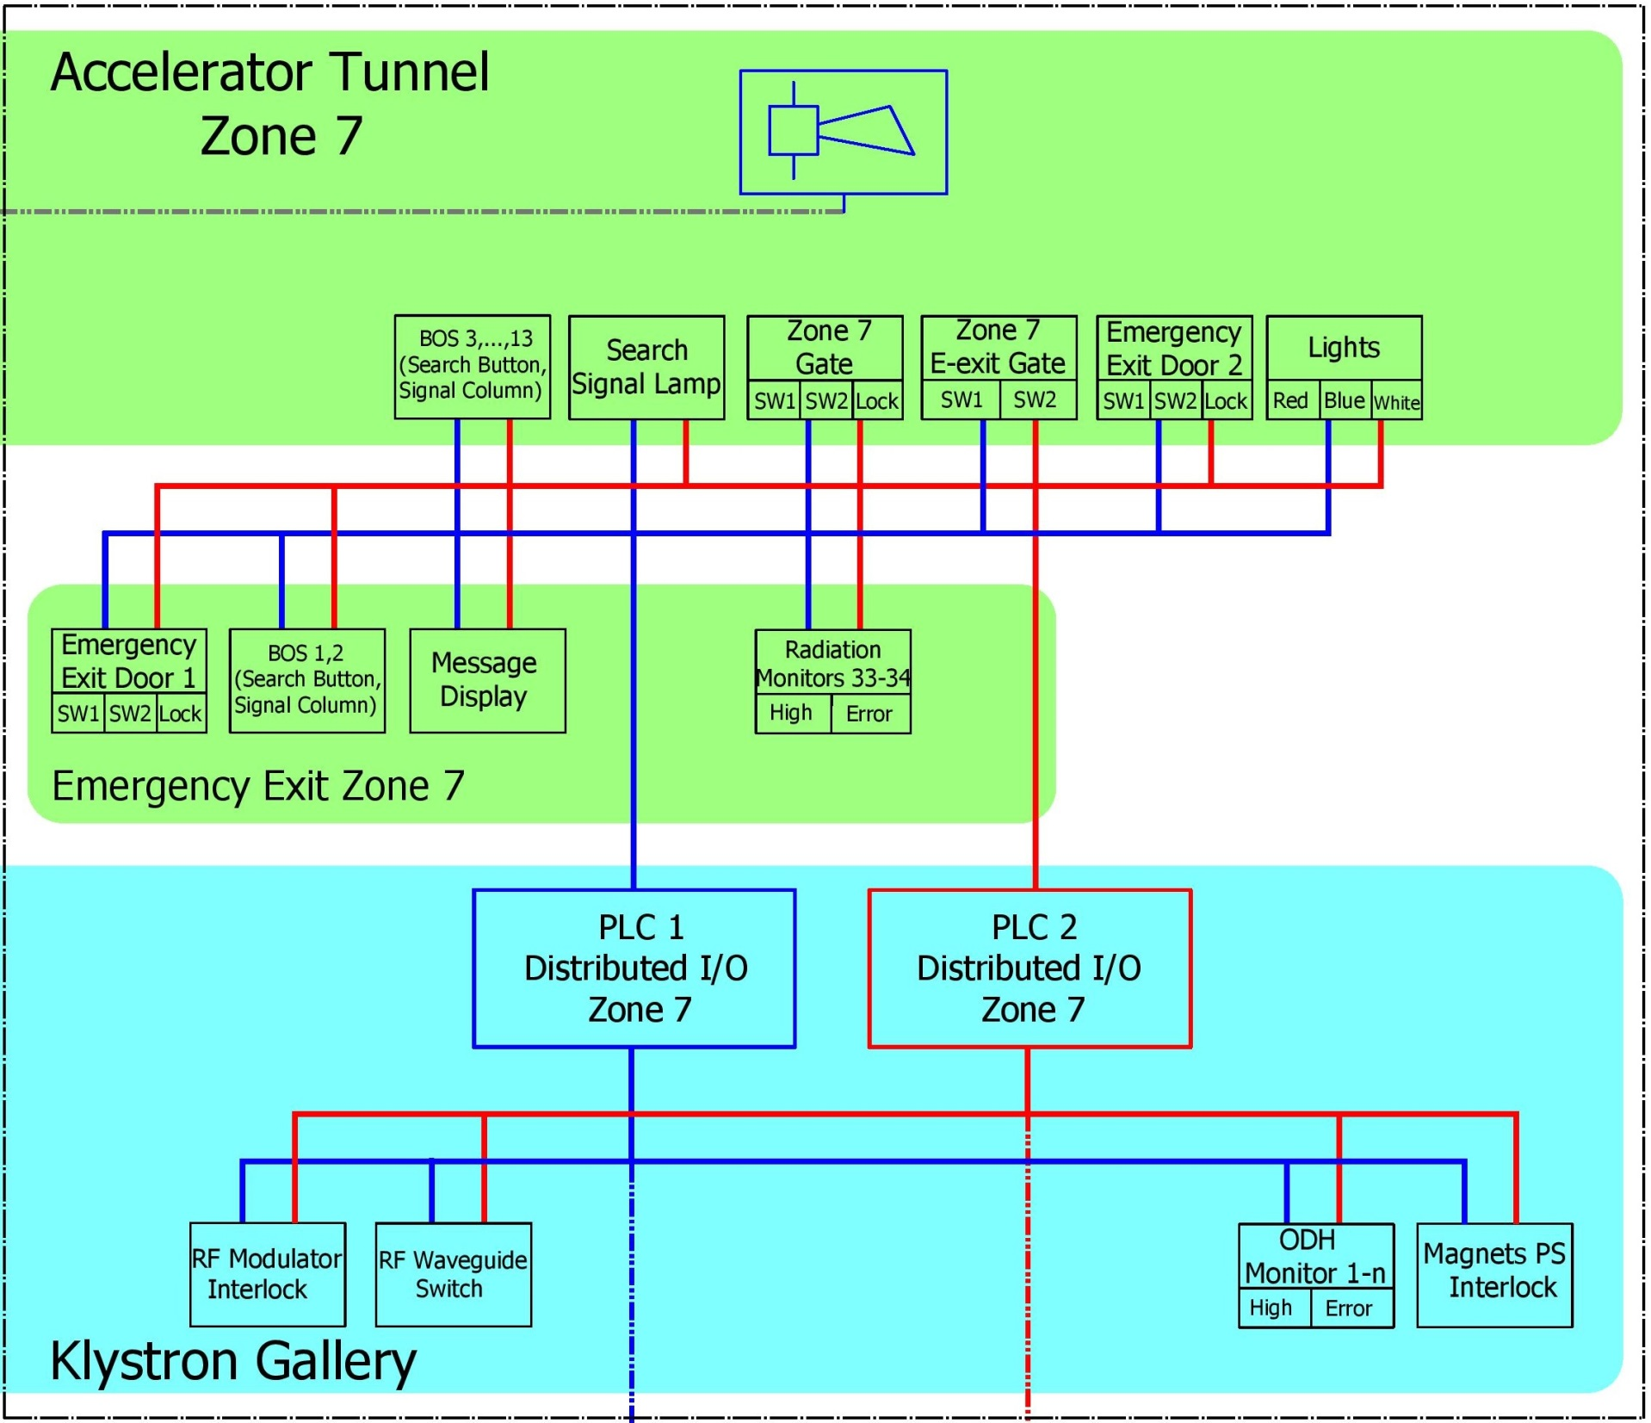

Slide 35
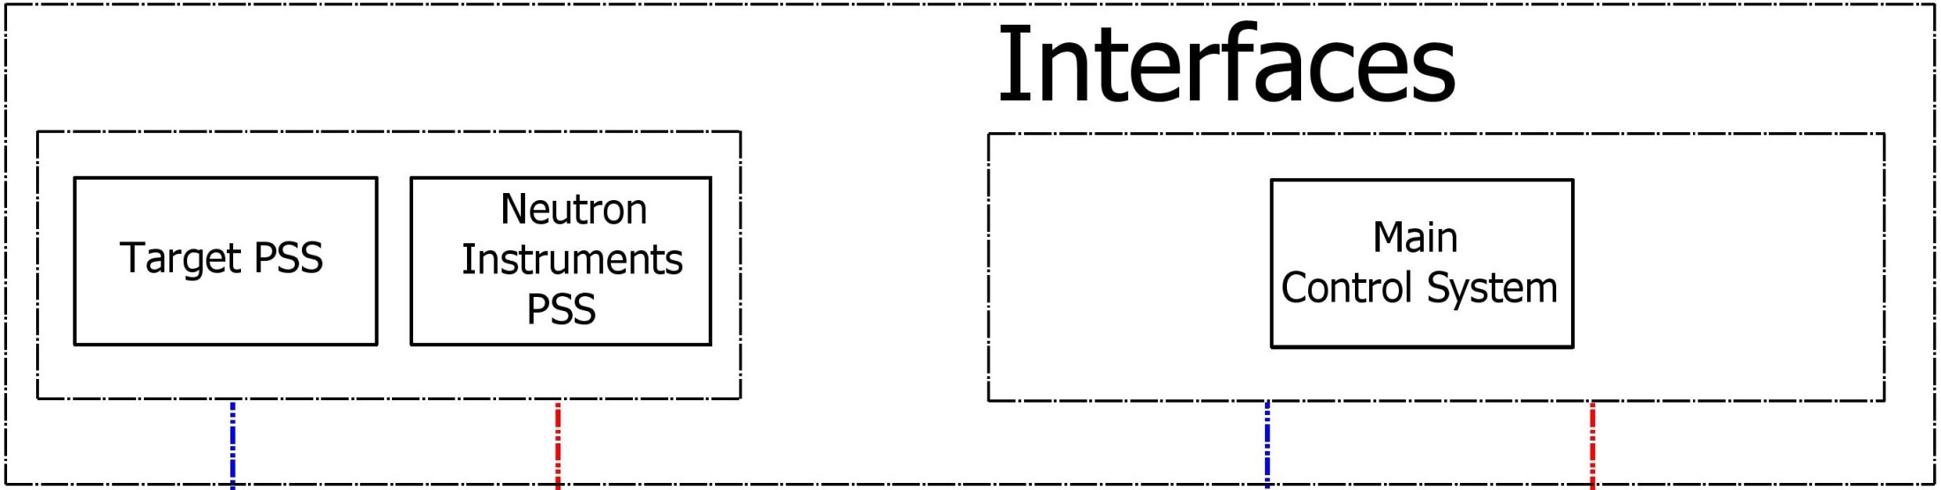

Slide 36
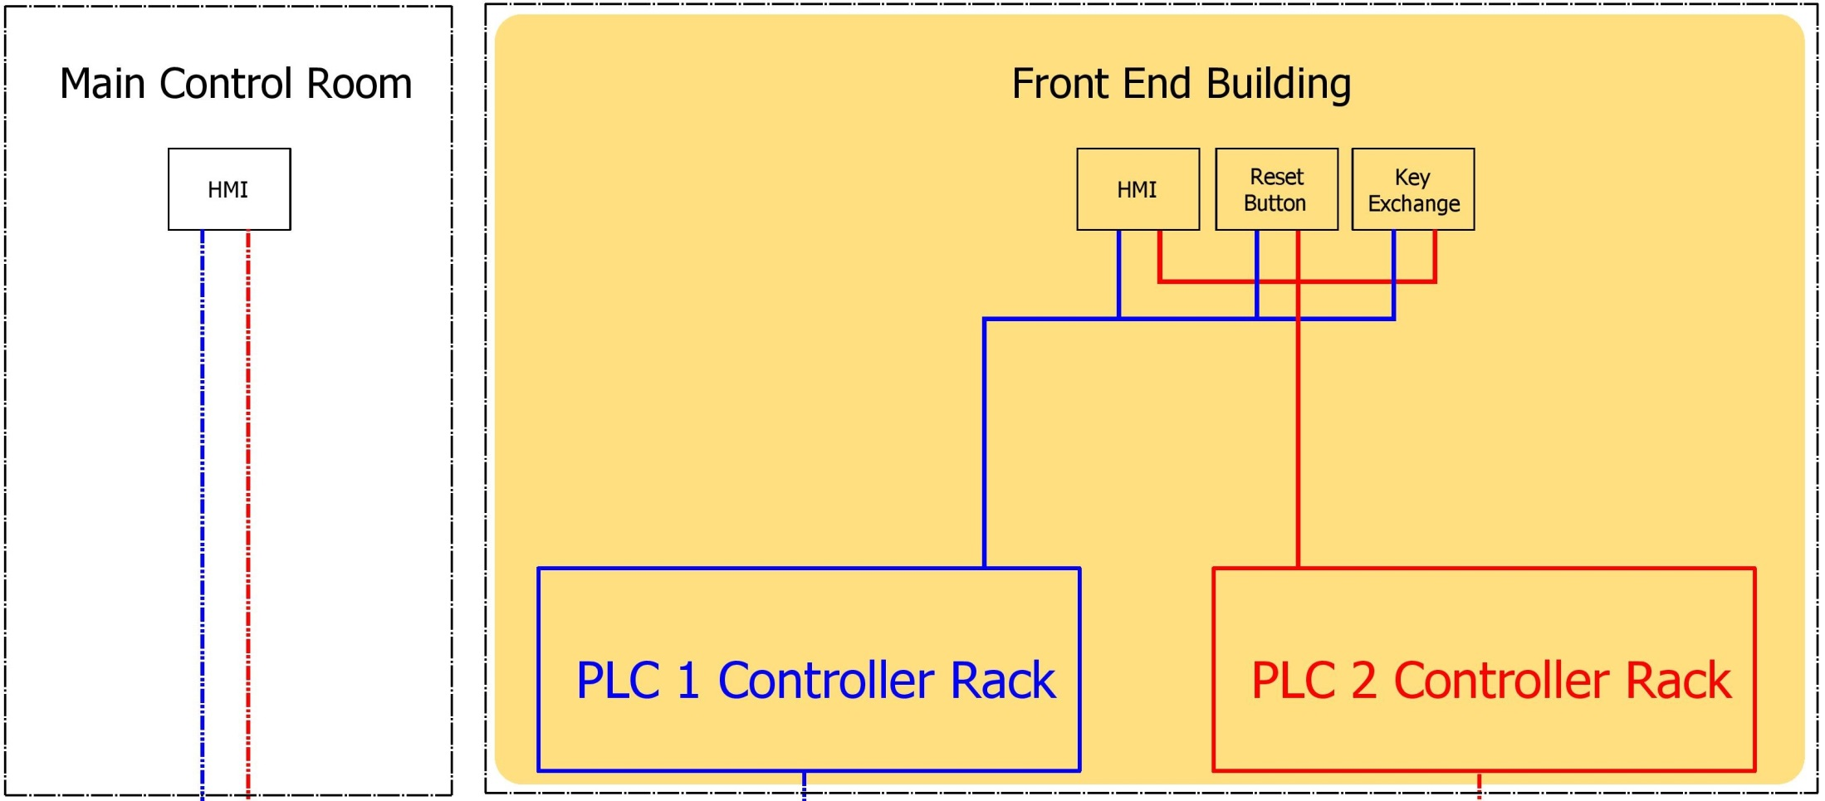

Slide 37
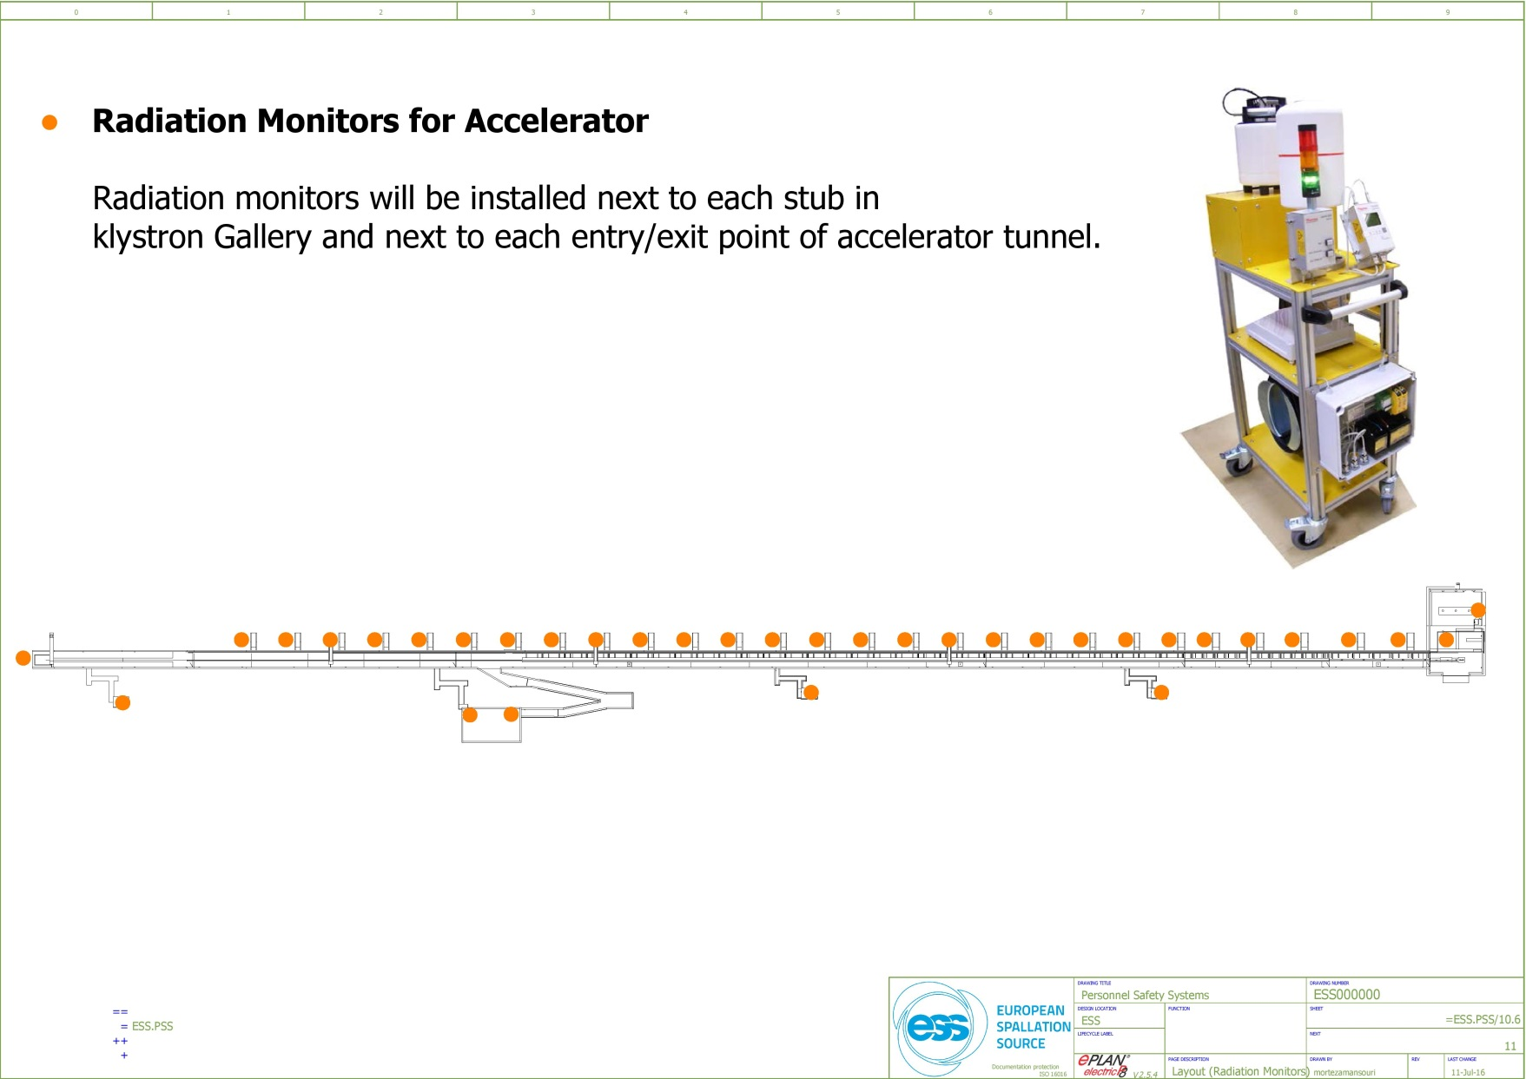
Distribution of Radiation Monitors
27 radiation monitors in klystron gallery.
5 radiation monitors at the end of emergency exit routes.
2 radiation monitors at the access points.
1 radiation monitor in Target building utility room(level 90).
1 radiation monitor in Target building gallery support area (level 100).
1 radiation monitor at the end of cryogenic transfer line.

