Slide 1
ESS Cryogenic Moderator System (CMS)
TAC 05.04.2017
Y. Beßler | y.bessler@fz-juelich.de
Central Institute for Engineering, Electronics and Analytics (ZEA)
Engineering and Technology (ZEA-1)

Slide 2
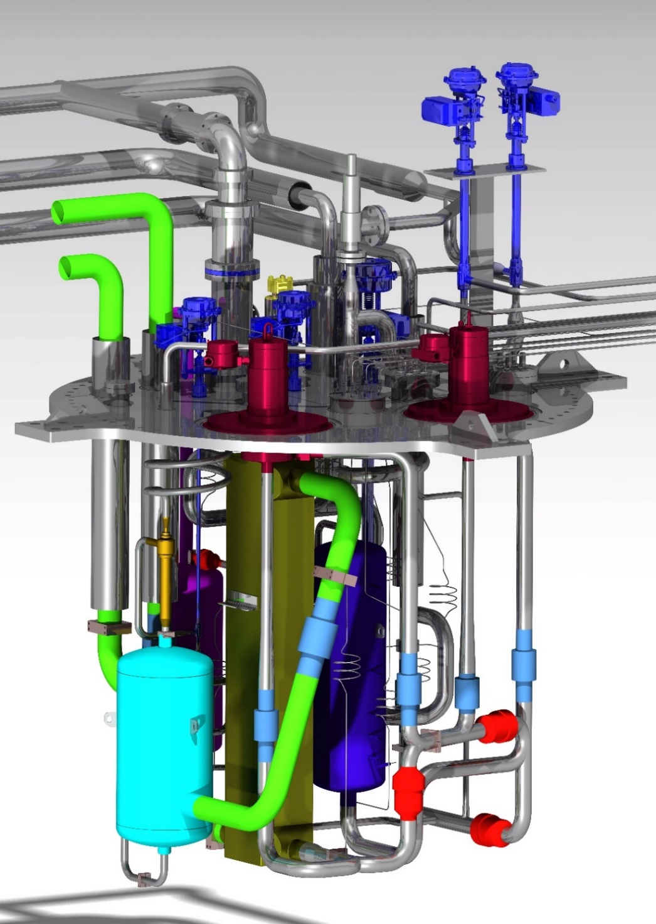
Outline
  CMS overview
  M&R System overview
  Cryostat design
  Cryostat calculations
  FAT in Jülich
  Transportation
  Installation on side
  Response to TAC 14
  recommendation
  3D X-Ray of cold Moderator
  1st and 2nd burst test
  Summery

Slide 3
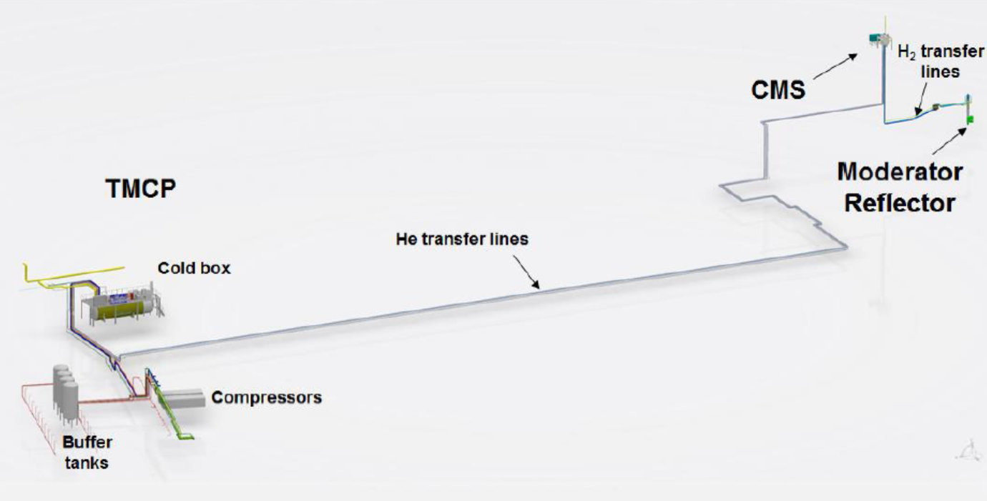
Cryogenic infrastructure overview
scope of supply FZJ
TIK3.2
45 m
TIK3.1
335 m
TIK3.3

Slide 4
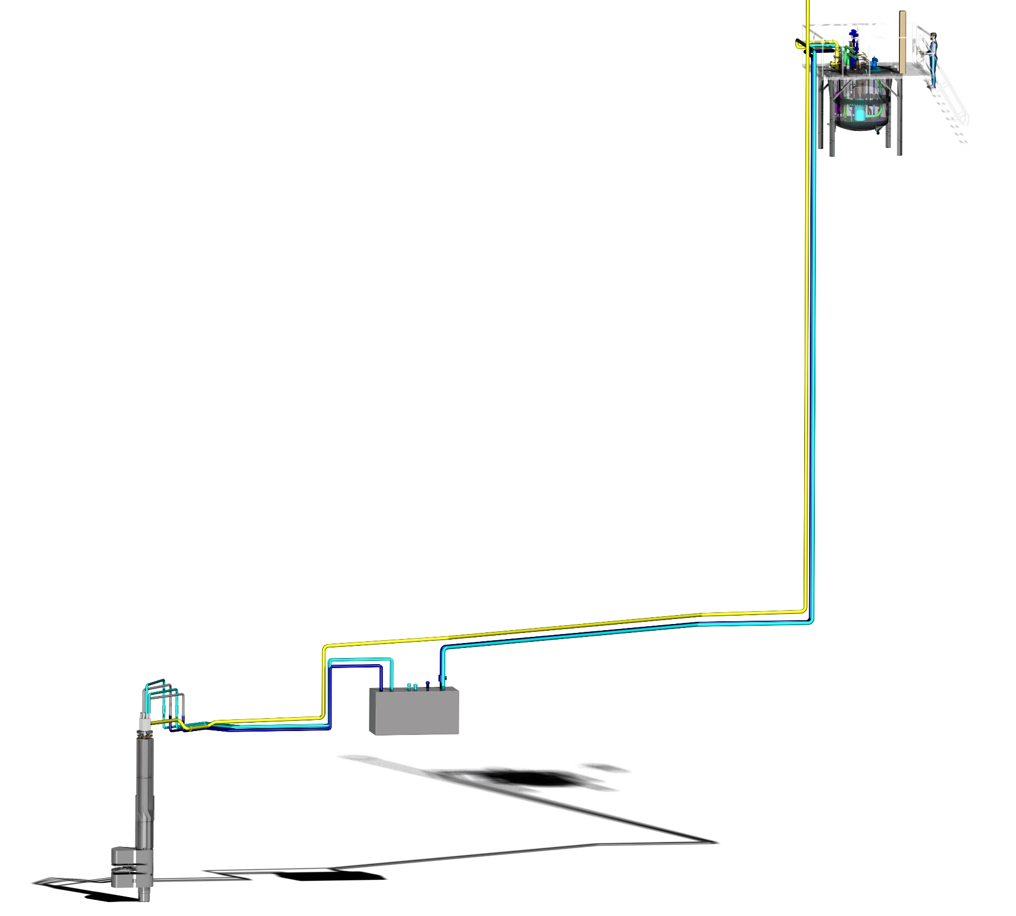
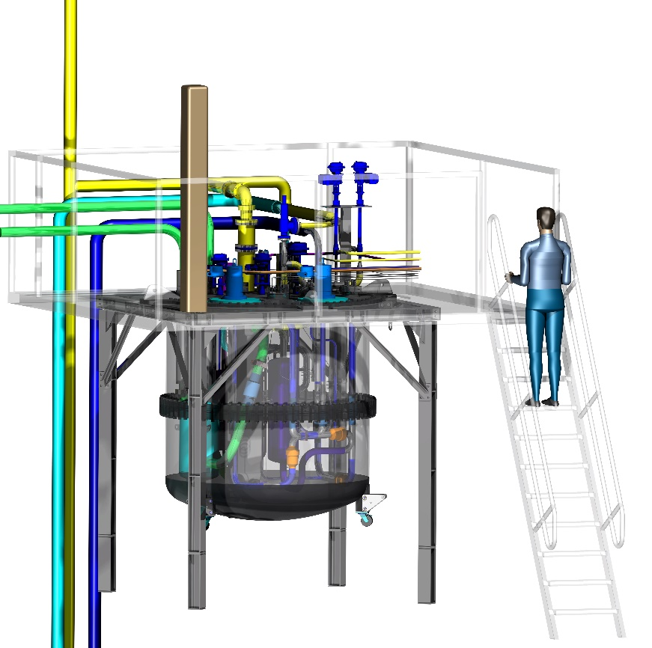
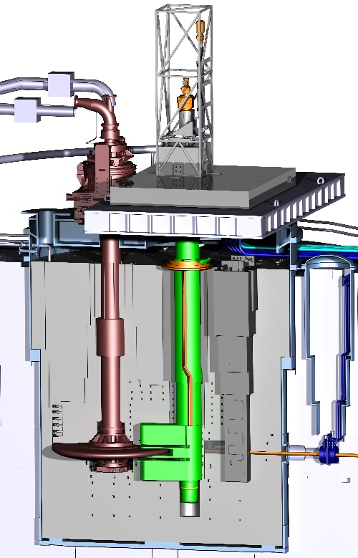
Cryostat TIK 3.2
(CDR Feb. 2017)
M&R System
overview
Rotation Unit TIK3.1
(CDR May 2016)
Twister TIK 3.1
(CDR Aug. 2017)
LH2 Pumps TIK3.2
(CDR May 2016)
Transfer lines TIK3.2
(CDR May 2016)
Cold, Moderators,
thermal Moderators,
Reflectors TIK3.1
(CDR Oct. 2016)
Be raw material TIK3.1
(CDR May 2016)

Slide 5
CMS flow chart
scope of supply FZJ

Slide 6
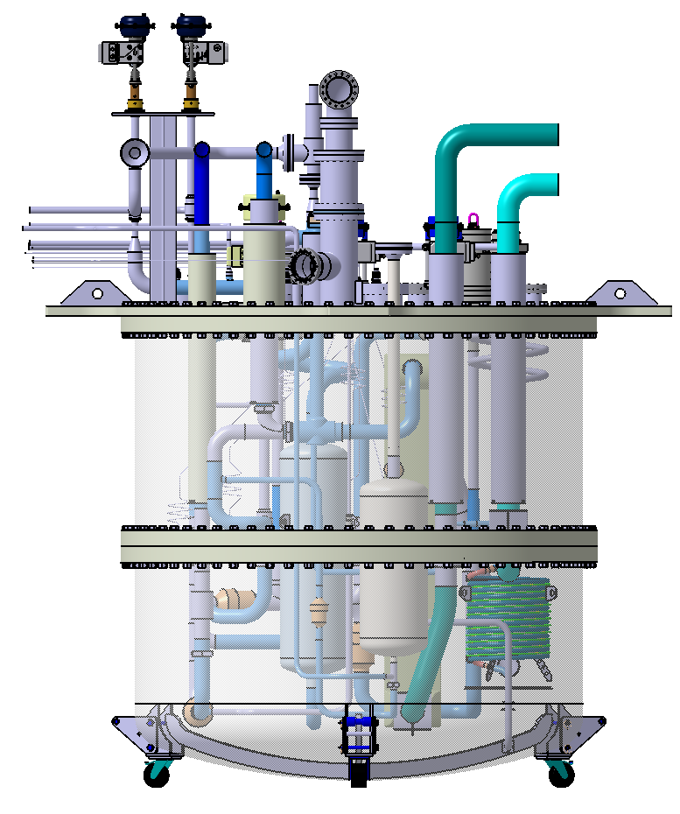
Cryostat Design Overview
Ø 2.5 m
Weight 2.87 t (total)
Height 3.1 m (bottom wheels to upper control valves)
Volume ~ 4500 l
Components:
- Vessel (consisting of three parts:
top plate, upper cylindrical part,
bottom part)
- Hydrogen cycle with Ortho/Para-Converter,
Pressure Control Buffer, pumps and filter
- Helium cycle with heat exchangers
- Control valves and check valves
- Instrumentation (pressure and temperature
sensors)
3.1 m
Vessel
(transparent
view)

Slide 7
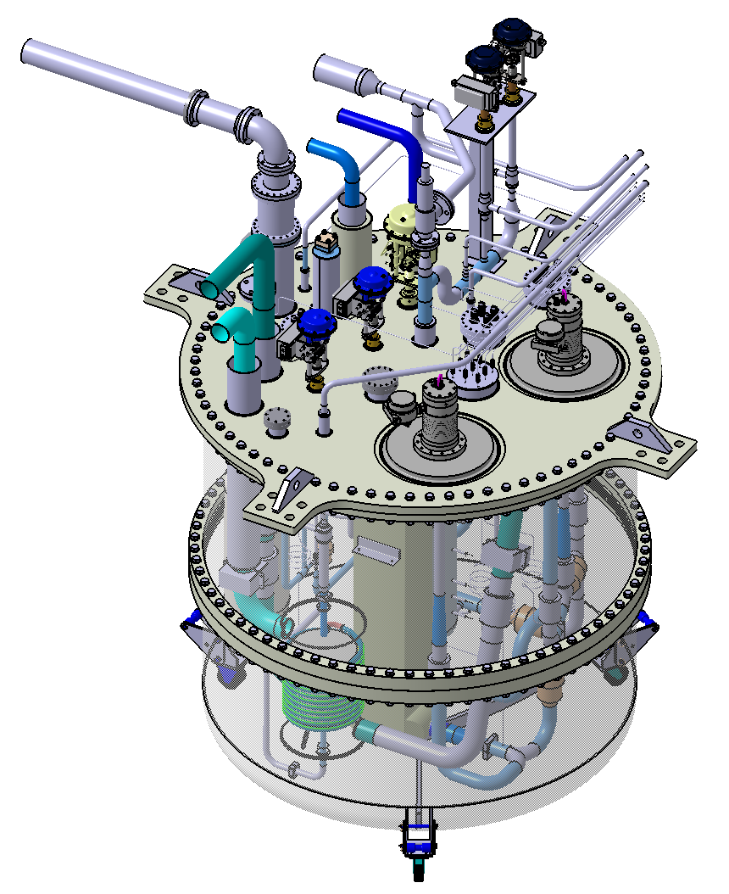
Cryostat Design Overview
Connections to gas
management panel
Connections to vent line
Cryo valves
Hydrogen supply line
LH₂ pumps
Helium supply line
Main connection plate
Vessel

Slide 8
Cryostat Design Overview

Slide 9
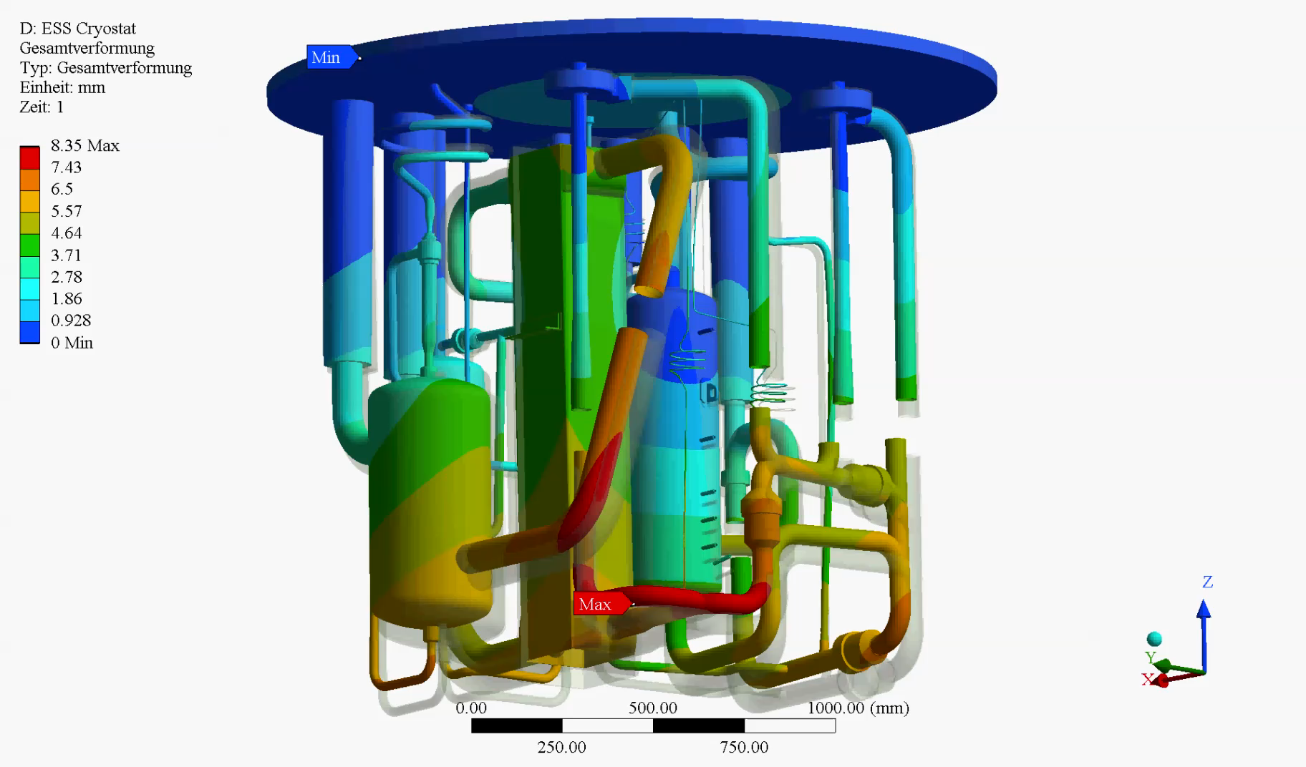
CMS FE calculations
-Simulation results (total deformation)
Deformation 24x

Slide 10
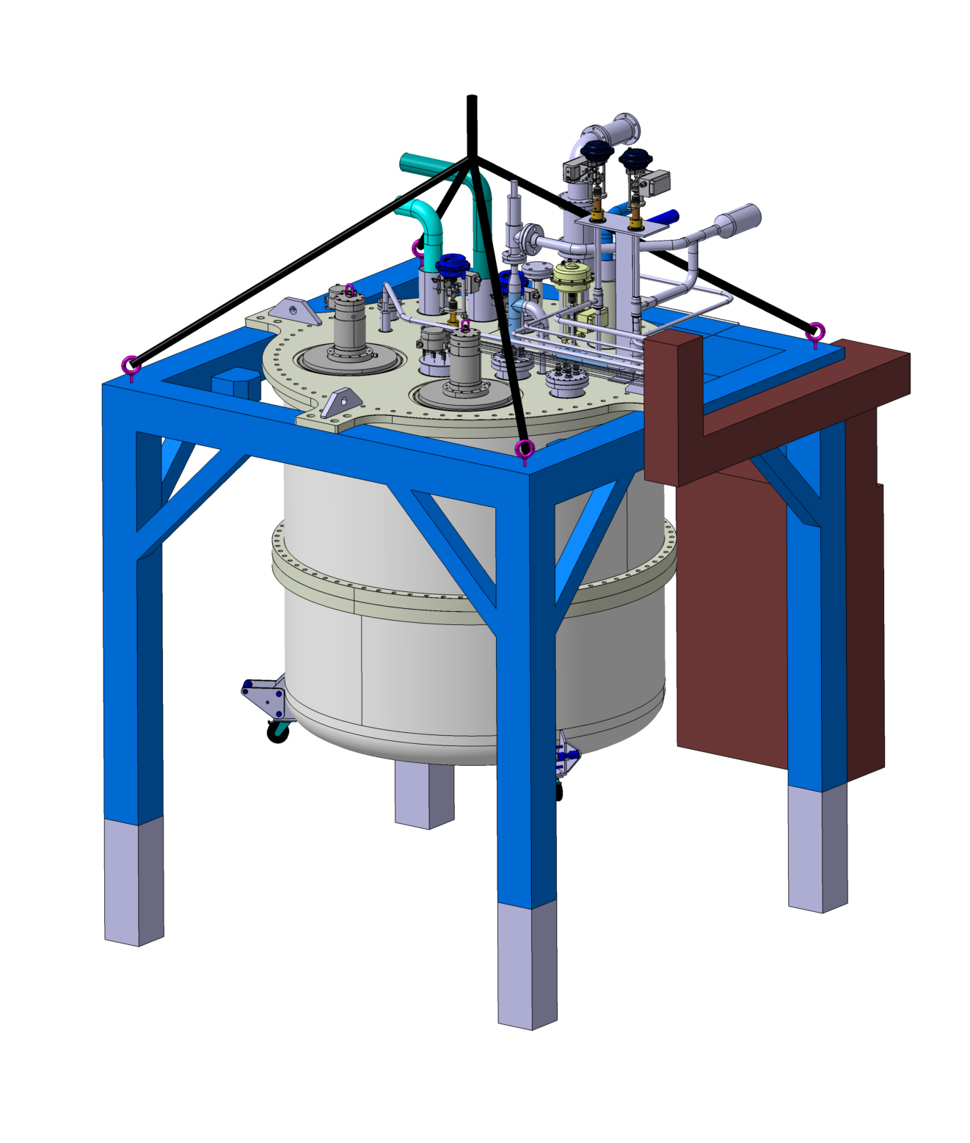
FAT set up @ FZJ
Gas management panel
Four lifting eyes
60°
Appr. 3.8m
2.15m
2.75m
0.6m
Support Frame
2.815m
2.515m
Removable feets (grey)

Slide 11
Additional Equipment needed for the FAT
Special testing equipment
  Cooling unit: To make tests at liquid nitrogen temperature a special LN2 cooling unit is needed, which allows the cooldown and the steady state cooling of the loop for a certain time. Since maximum temperature differences on the plate-fin heat exchanger the cooling unit must be able to provide in the beginning gaseous nitrogen at any desired temperature between 300 and 80 K.
  Nitrogen refrigerant feed: A source of gaseous nitrogen with a pressure higher than 15 bar.
  Nitrogen venting system to outside the building: For the venting of the refrigeration nitrogen and for the exhaust of the active and passive safety valves and the box vacuum safety relief.

Slide 12
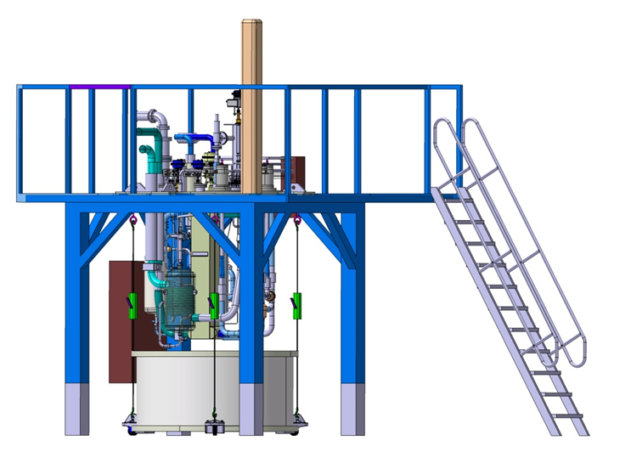
Test 1: Warm cryostat with removed shell
Inspection of piping and instruments
Inspection of piping for compliance with PFD and PID
Inspection of instrument location and tests of wiring to transmitters
Photographs of all internals
Valve functioning control
All valves shall be actuated along their full stroke repeatedly. The valves shall move softly within the whole range of mechanical operation, without any visible, audible or otherwise noticeable signs of jerks.
First leak test of internal piping
Filling of the circuit with helium of about 2 bar. Looking for leaks by sniffing and by overnight pressure stability.
After these tests the cryostat shell will be mounted and the cryostat will be evacuated.

Slide 13
Test 2: Warm cryostat with mounted shell
Leak test of vacuum jacket
The vessel shall be evacuated to a sufficiently low pressure and then submitted to helium leak tests (ESS Vacuum Handbook Part 4 – Vacuum test manual). During these tests all the welding seams, flanges, feed-throughs, etc. shall be sprayed from outside with helium. The leak detector shall be connected to one of the provisional flanges on the vacuum vessel. Any detected leaks shall comply to the specified values.
Integral process piping pressure and leak test
The pressure test shall be carried out in accordance with the PED and with EN 13480-4 requirements. The test pressure shall be not less than 1.43 times the maximum allowable pressure (17 bar.a). During the pressure test, the pressure in the assembled parts shall be gradually increased to a value of 50 % of the required test pressure. Thereafter the pressure shall be increased in steps of approximately 10 % of the required test pressure until the test pressure is reached. The pressure shall be then reduced after 10 min to the maximum allowable pressure and held during the inspection of the assembled parts. The helium content in the exhaust of the vacuum pump will be monitored. The vacuum level in the cryostat will be monitored. Outside connections to the process loop will be sniffed with a helium leak detector.

Slide 14
Test 3: First cooldown of cryostat
Installation of superinsulation
First cooldown
The process pipes will be evacuated and filled with small amounts of nitrogen gas repeatedly. Then the process will be filled with 10 bar nitrogen and the pressure control system will be operated.
The pumps will be started and will circulate the nitrogen via the bypass valve.
The cooldown will start with cooling gas from the cooling unit. The initial cooling gas temperature will be about 260 K and will be lowered in accordance with the loop temperature.
The cooldown will go down to about 150 K. The system will be held at this temperature level for the following tests.
The performance of the temperature sensors will be monitored.
Check of superinsulation
Wall sections, which have not been internally insulated sufficiently, will become wet on the outside. The insulation will be improved after the next warm-up.
First inspection of pump operation
The operation of the pumps will be monitored qualitatively concerning stable running, temperatures on the outside, functioning speed control etc.

Slide 15
Test 4: First warmup of the cryostat
First warmup
The warmup will be performed with “warming” gas from the cooling unit. The initial warming gas temperature will be about 180 K and will be increased in accordance with the loop temperature.
The operation of the pumps will assist in the warmup to 300 K.
The nitrogen pressure in the loop will be lowered to atmospheric pressure.
Opening of the shell
After the warming up to 300 K the two shells of the cryostat will be removed.
Repair of superinsulation and instrumentation
All deficiencies detected during the first cooldown will be repaired.
All components and pipes of the process – with the exception of the pressure control buffer and holding points for transportation- will be covered with superinsulation.

Slide 16
Test 5: Second cooldown
Second cooldown
The process pipes will be evacuated and filled with small amounts of nitrogen gas repeatedly. Then the process will be filled with 10 bar nitrogen and the pressure control system will be operated.
The pumps will be started and will circulate the nitrogen via the bypass valve CV-6203. The cooldown will start with cooling gas from the cooling unit. The initial cooling gas temperature will be about 260 K and will be lowered in accordance with the loop temperature.
The cooldown will go down to about 120 K. The pumps will be shut down before the condensation of nitrogen starts.
From now on the final cooldown and filling with liquid nitrogen will be performed without rotation of the pumps. After the whole loop (except the upper section of the pressure control buffer) is filled with subcooled liquid nitrogen, the pumps will be started again.

Slide 17
Test 6: Buffer performance test
Pressure control buffer cryogenic performance test
As soon as the loop is fully filled with liquid nitrogen and the pumps have been started, the functioning of the pressure control system is tested by simply changing the set value of the pressure controller: For an increase of the pressure the vapor release valve at the top will be closed and the electric heating at the bottom will be increased. For a lowering of the pressure the release valve will be opened and the heating at the bottom will be reduced.

Slide 18
Test 7: Pump performance test with subcooled LN2
Turbo pump performance test
The performance curves of the pumps with liquid nitrogen on a pressure level of e.g. 10 bar will be established by variation of the speed and the bypass valve setting. The subcooled liquid nitrogen is cooled by liquid nitrogen evaporating in HX 1 at e.g. 78 K. Cold operation with impact on the pump geometry and thermal behavior can be verified. Furthermore, the predicted performance of the pump contractor at rated conditions shall be matched with experimental values.
After this test, the system will be warmed up. It is now ready for packing and shipping to ESS.

Slide 19
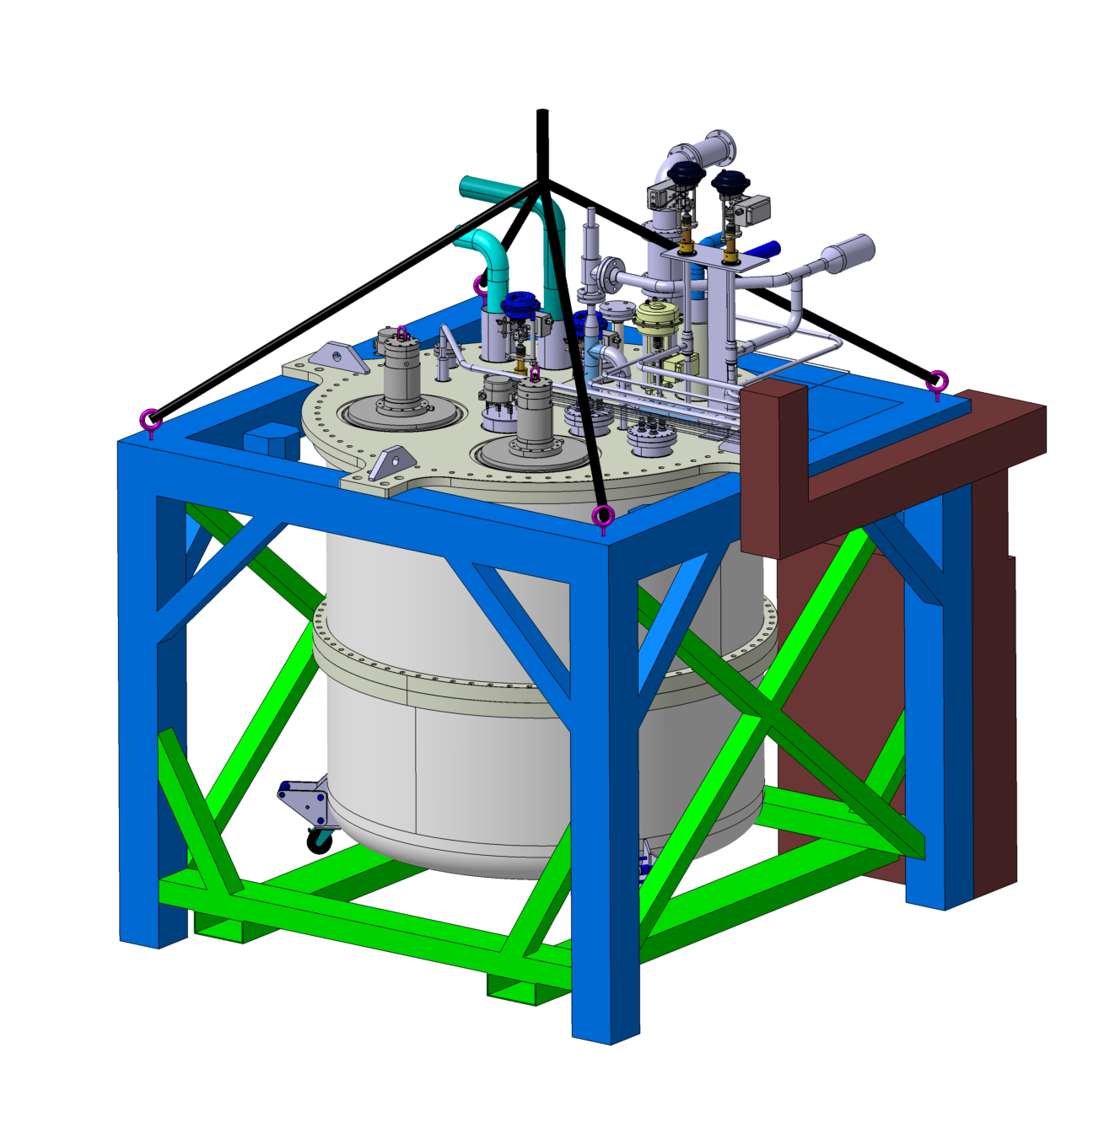
Transportation
60°
-Removing the removable feet and installing an additional transport safety device (green) with forklift attachment.
Appr. 3.2m
2.15m
-MLI is on some parts not installed to have space for fixing structure for transportation
2.815m
2.515m

Slide 20

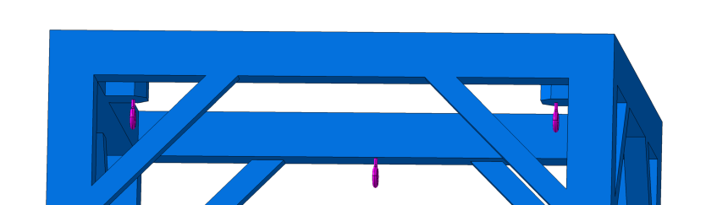
Installation on side
Re mounting of the removable feet, to ensure the
necessary clearance to disassemble the vessel.
The lowest Point of the cryostat inner components is a meter above ground, the two vessel parts are 970mm.
Three of the lifting eyes will move to the lower attachment points for later use and one in storage Position.
2.75m

Slide 21
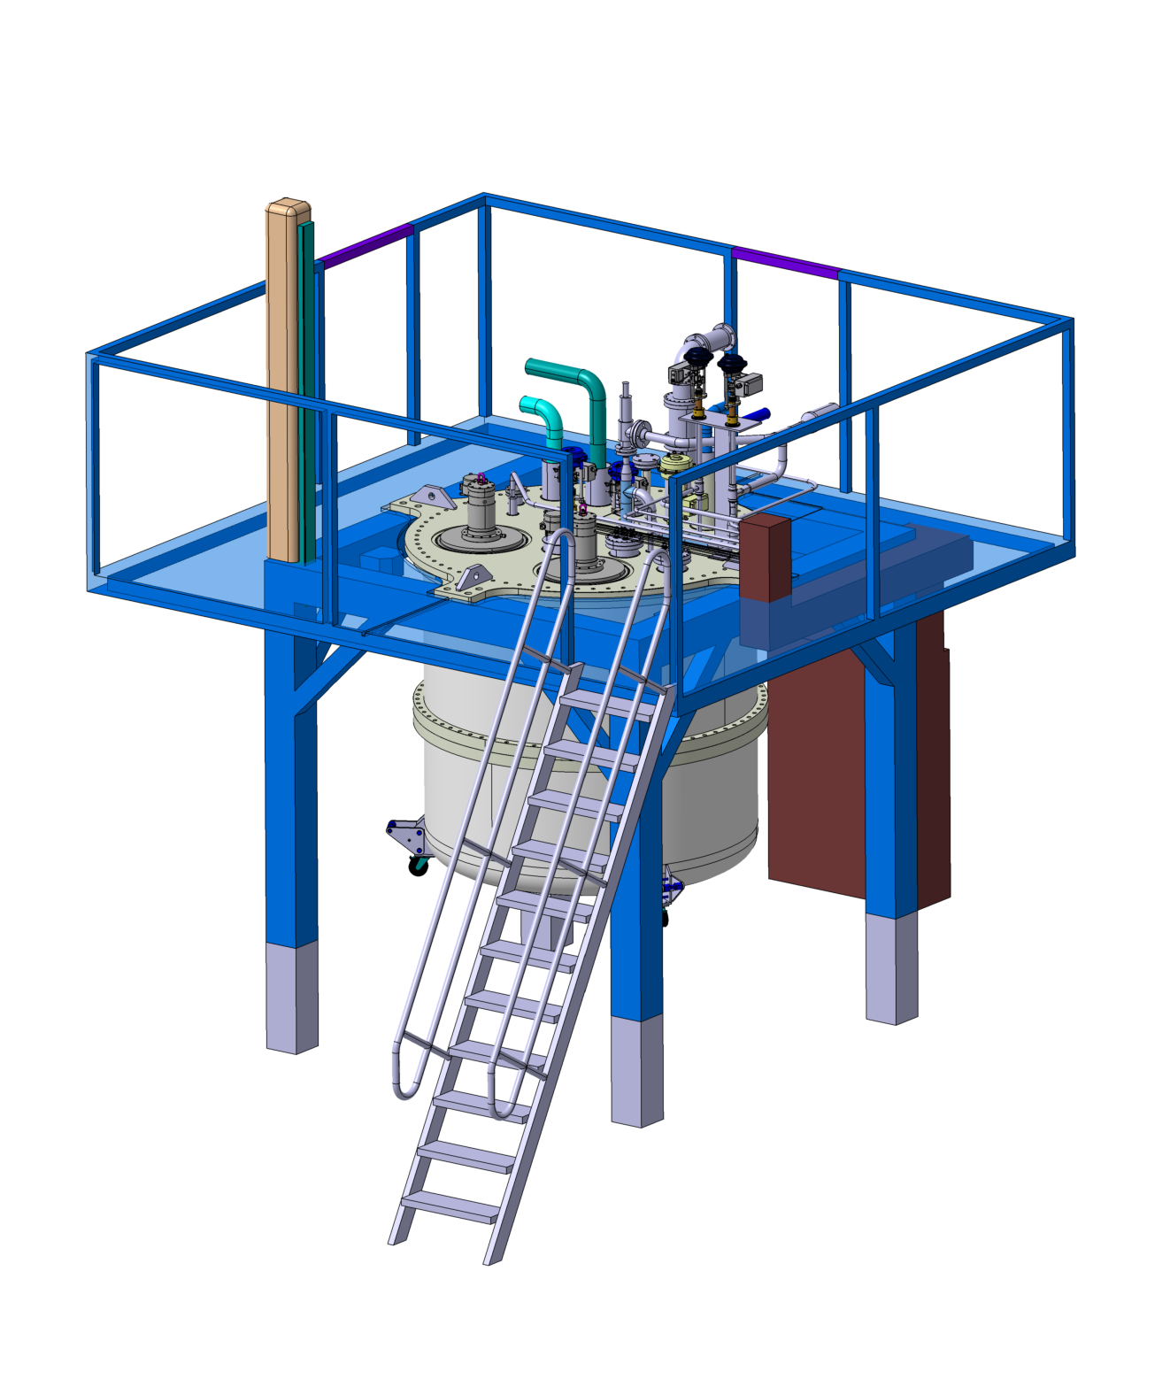
Installation on side
4m
3.6m
1.25m
Plattform
4m
Foldable crane
Installation of the platform and crane
Ladder
60°

Slide 22
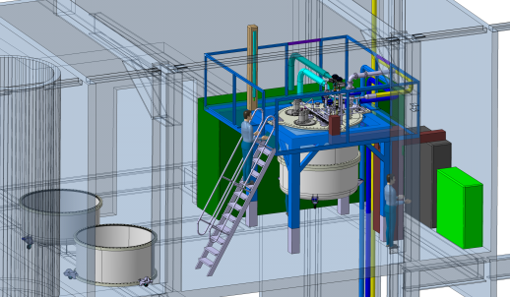
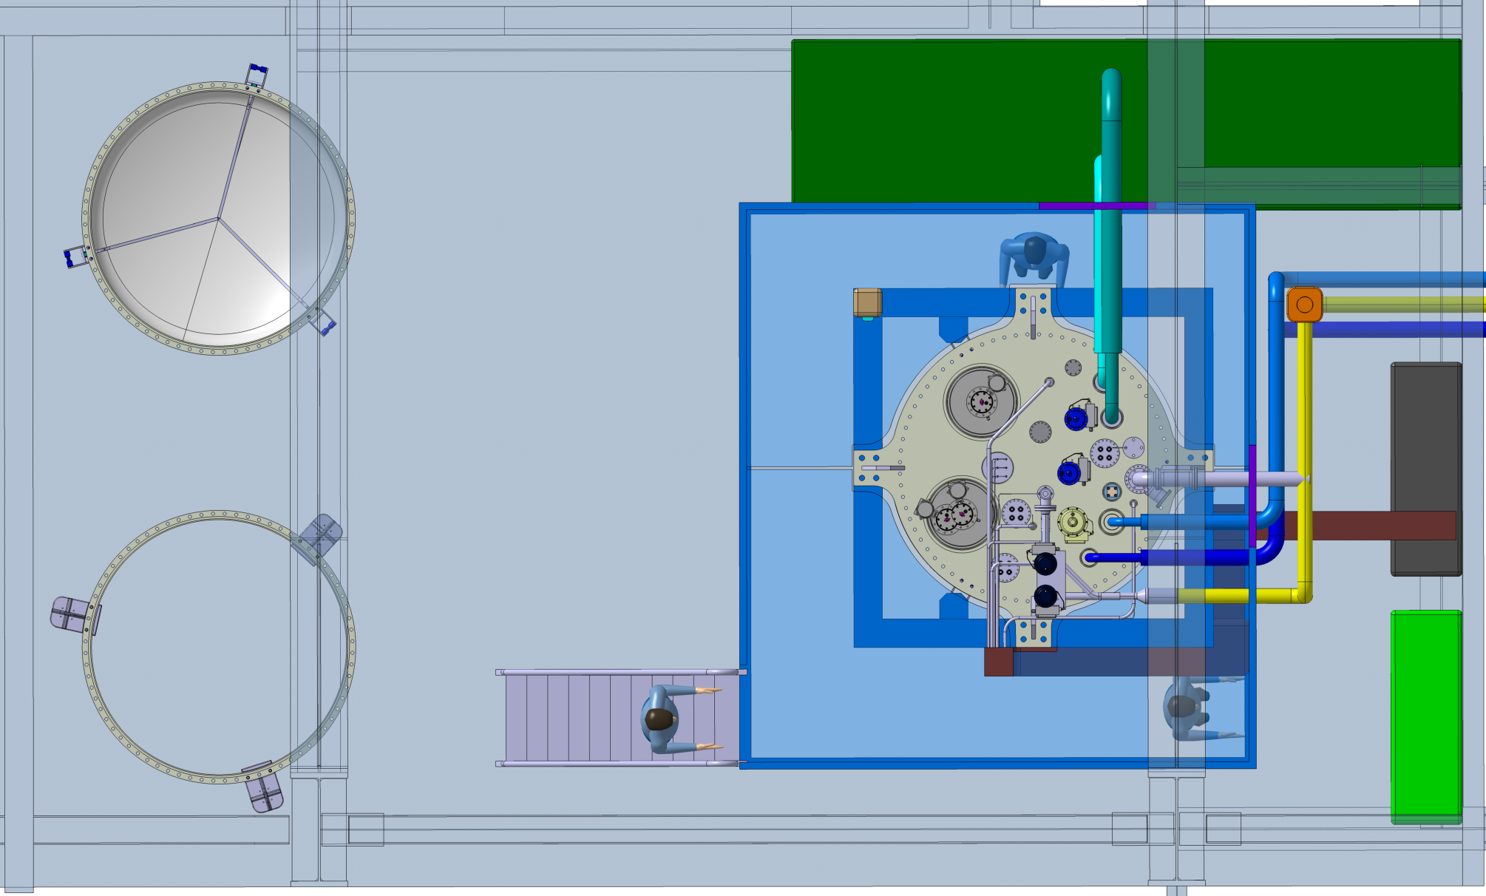
Room Layout
Jumper Spool Box
1.232m
4.69m
HyTl - FZJ
Vessel storage positions
CF
1.5m
1.5m
Vacuum Pumps
0.5m

Slide 23
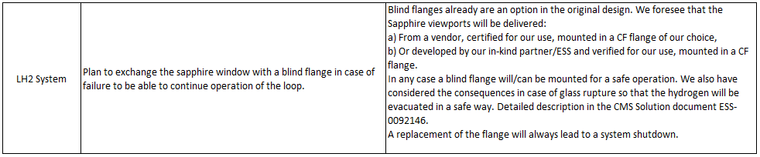
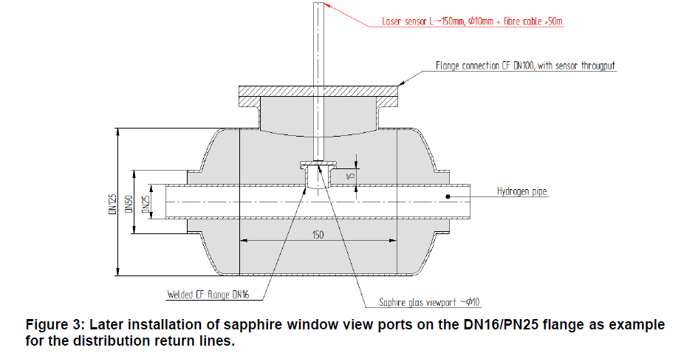
Response to TAC 14 recommendation
o-p-H2 measurement system -Raman Spectroscopy-

Slide 24
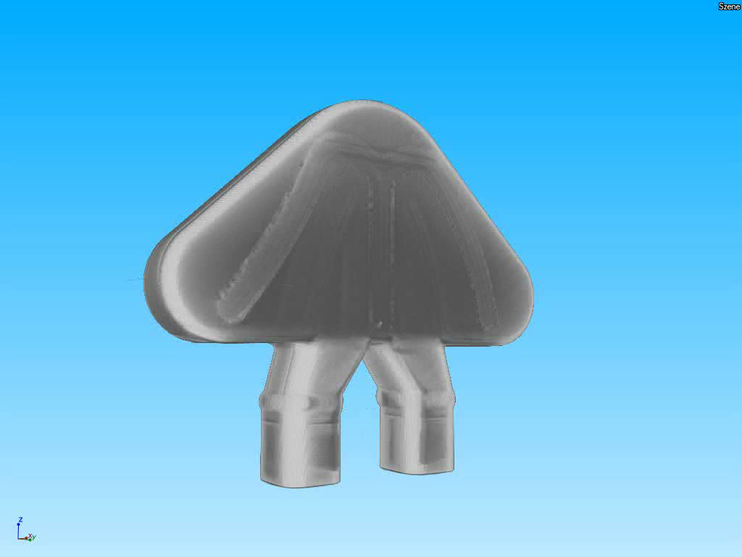
3D X-RAY of cold Moderator test vessel

Slide 25

1st Burst test cold Moderator (water)

Slide 26
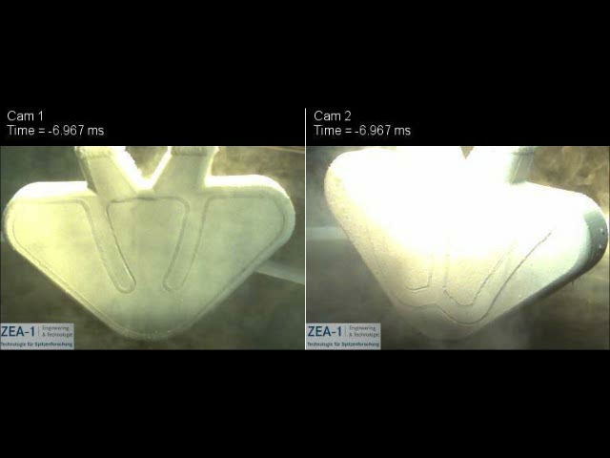
2nd Burst test cold Moderator (LN2)
≈10 m/s

Slide 27
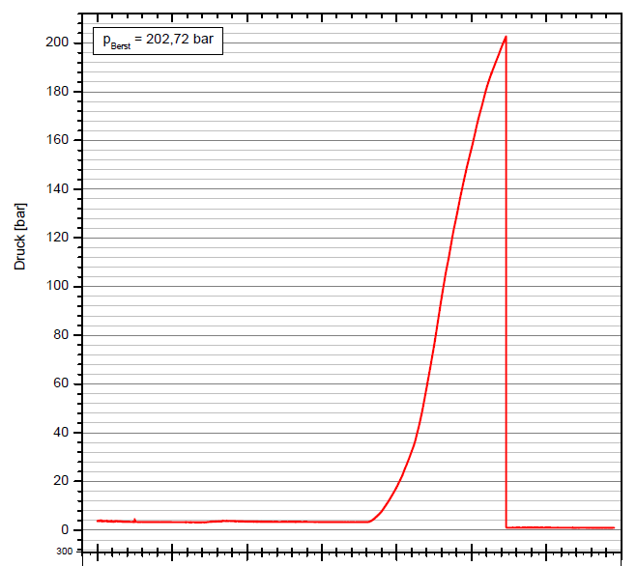
Burst test summery
LN2
H2O
Design pressure
17 bar
Operation pressure
10 bar

Slide 28
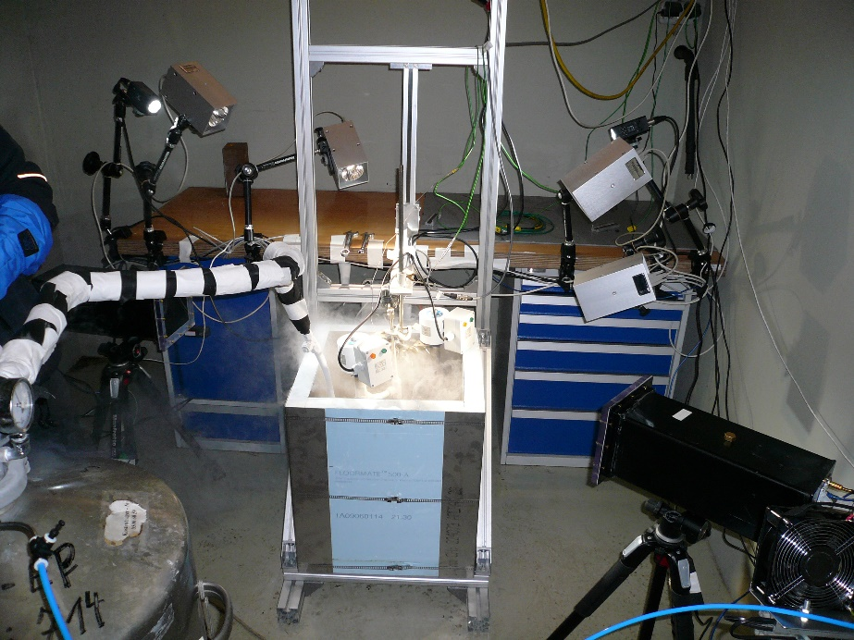
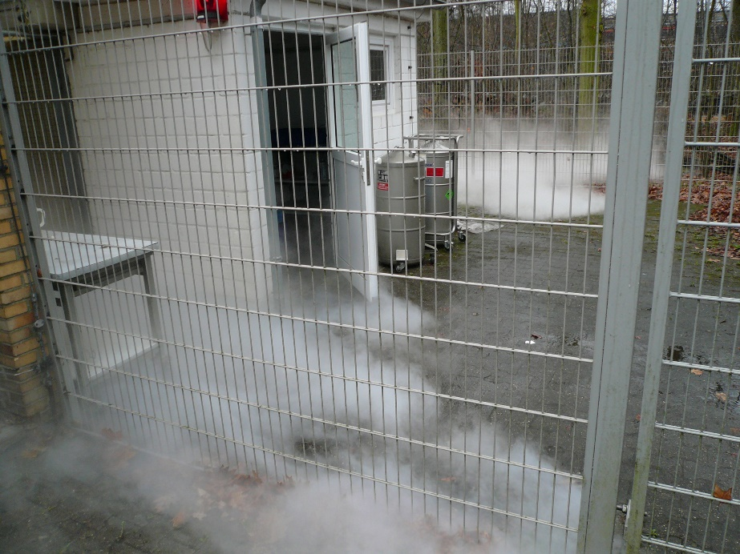
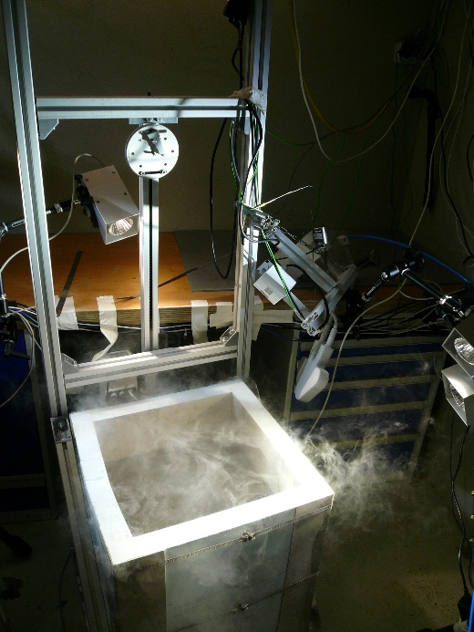
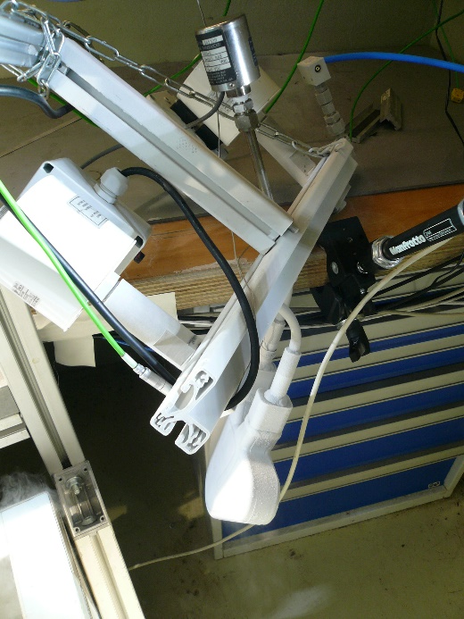
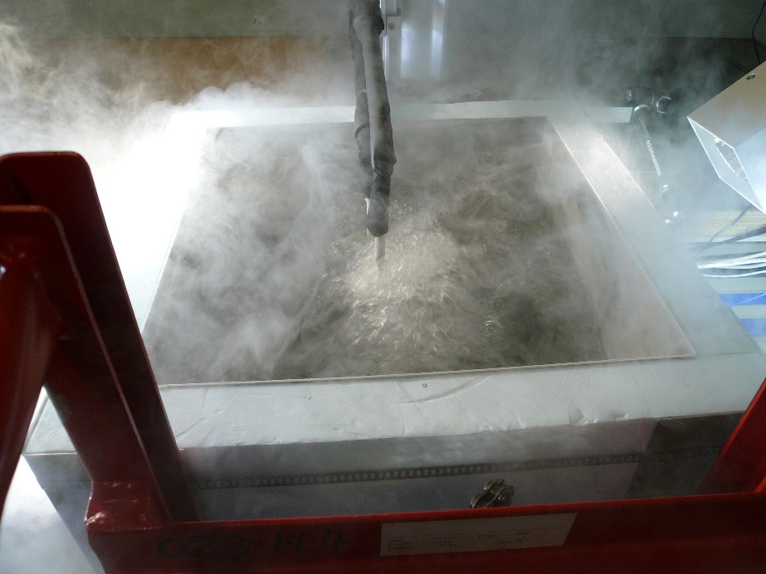
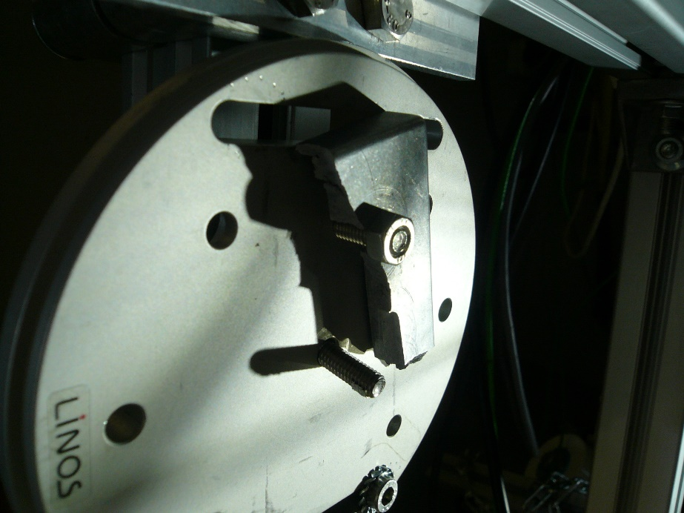

Slide 29
Summary
The final design phase has been successfully completed with a delay of ≈2 months
Procurement phase is ongoing
Manufacturing will start soon
Contract with TÜV is in place (welding inspection according PED)
We currently prepare our laboratory for the FAT test
Subsystem test will start in summer 2017
System shall be ready for transportation in May 2018…

Slide 30
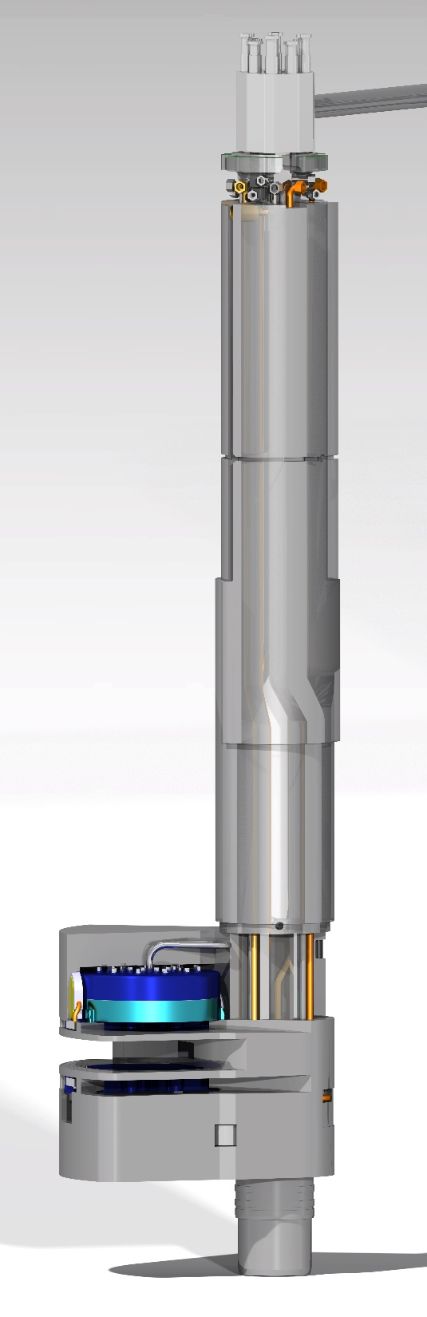
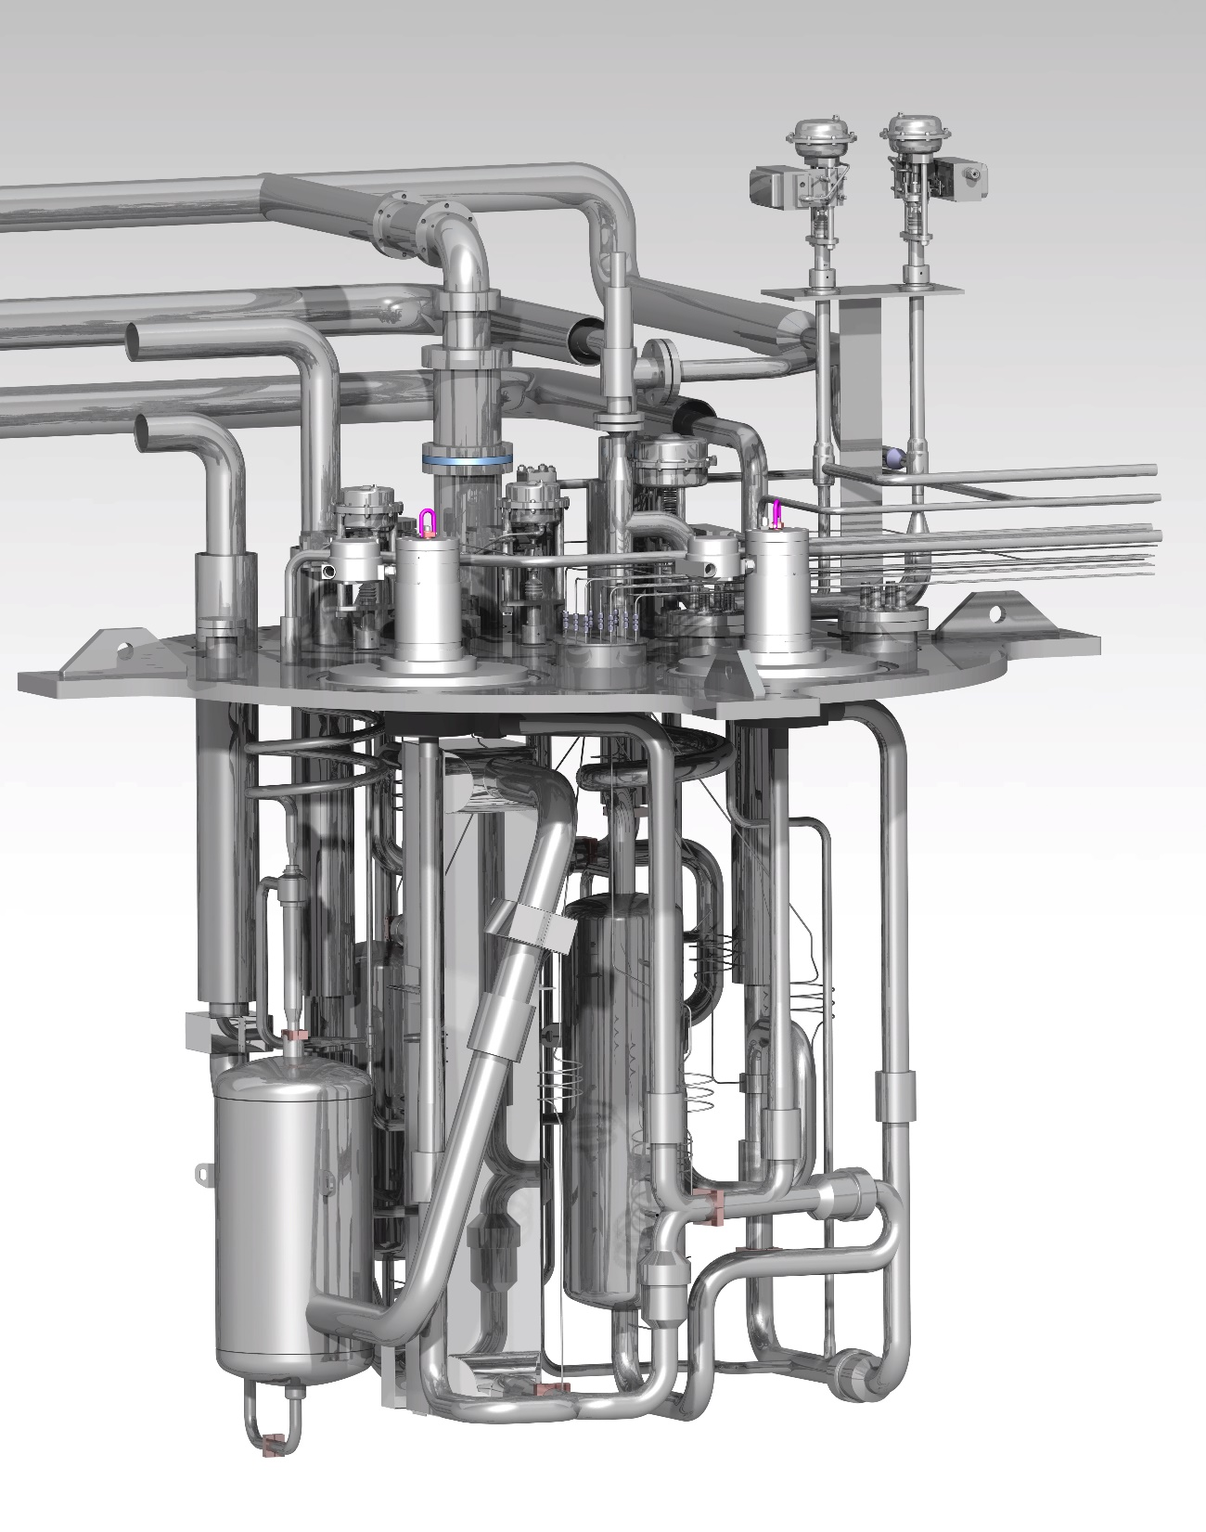
T
H
A
N
K
S
!

