Slide 1
Target ‘Ready for Beam’ Signal Definition
Linda R. Coney, Jens Harborn, Kristoffer Sjögreen
European Spallation Source (ESS)
www.europeanspallationsource.se

Slide 2
Outline
Defining ‘Ready for Beam’
State Machines
System classification & loads
Ready for Beam

Slide 3
RBOT vs Ready for Beam
RBOT – planning milestone
All Target systems are designed, manufactured, delivered, installed and tested without beam
System function has been verified to meet requirements set out during design for operations & interfaces
Not necessarily when beam actually arrives on target
BOT – later milestone when beam arrives
Licensing permission to take beam from SSM approved
Practice with remote handling of monolith systems done
Instruments ready
Requires target systems signal ‘Ready for beam’

Slide 4
Defining Ready for Beam parameters
Quick answer
Everything is running as designed to meet system performance and interface requirements as verified during previous testing
Of course… it is more complex..
Systems defined as ok – what folds into that definition?
Does it depend on the beam conditions – power, (un)rastered, rep rate?
Does it depend on the state of other systems?
Does it change during commissioning?
How are the safety systems related to beam-to-Target?
PSS, TSS, WES (Worker Evacuation System), ACF-mode control
Fire, ODH

Slide 5
Different answers depending on the system during ESS startup
System | Depend on beam parameters? | On other systems? | Change with commissioning? | Is it a required safety system?
Primary water systems | No | Yes (connected cooling systems) | No | No
HVAC | No | Unlikely | No | No
He cooling system | Probably (flow) | Yes (1046) | Possibly | No (not the cooling function)
Wheel | Yes (limited p+ beam power is allowed on not rotating wheel.. otherwise NO) | Yes | Possibly | No
LH2 system | Maybe? | Maybe? | Maybe? | No
MP (Target) | Yes | Yes | Possibly | No

Slide 6
Different answers depending on the system during ESS startup – I&C systems
System | Depend on beam parameters? | On other systems? | Change with commissioning? | Is it a required safety system?
TSS | No | No | No | Yes
PSS | Yes (ON/OFF) | Maybe | Maybe | Yes
WES | No | No | No | Yes
MP (Target) | Yes | Yes | Possibly | No
ACF mode control | No | No | No | Decoupled/No

Slide 7
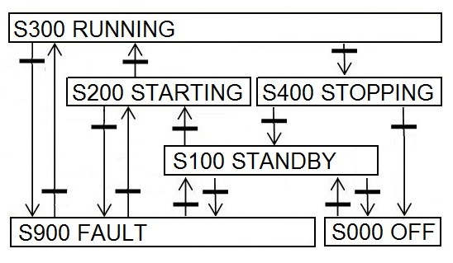
Defining Ready for Beam parameters
Need a systematic method for identifying when each system is ok for beam
Define state machines for each system from overall ESS down to subsystems
All state machines have 6 basic modes in common
Running, Starting, Stopping, Standby, Fault, Off
Each of the five main ESS system groups is represented by its own state machine
Depending on system functionality, sub modes are added to one of the basic modes
Ex. Target wheel has sub-mode ‘Parked’ under ‘OFF’

Slide 8
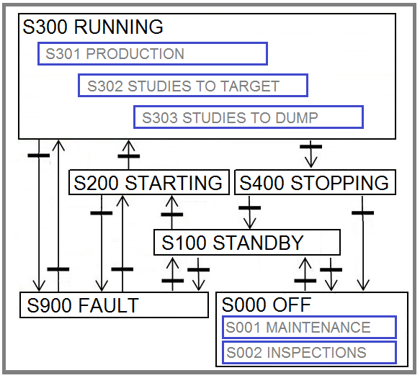
State Machines
Five main ESS system groups defined
ESS
Accelerator
Target Station
Neutron Scattering Instruments
PSS
Each is represented by its own state machine
Top level state machine has the five basic modes with additional sub-modes within RUNNING and OFF

Slide 9
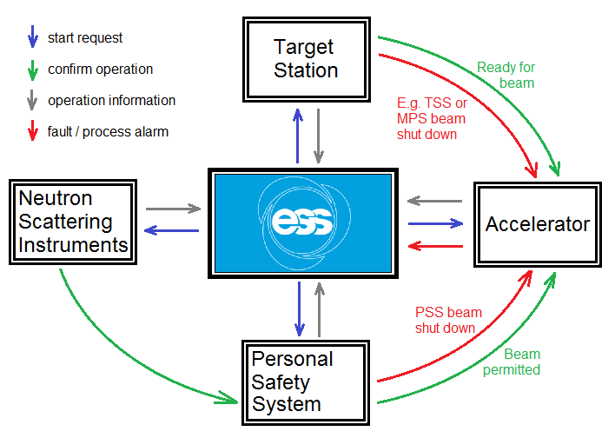
State Machines – Signal Exchange
State machines for the main system groups exchange signals
Start requests propagate within the main systems and down to lower levels – Chain principle
Conceptual example based on early Startup discussions

Slide 10
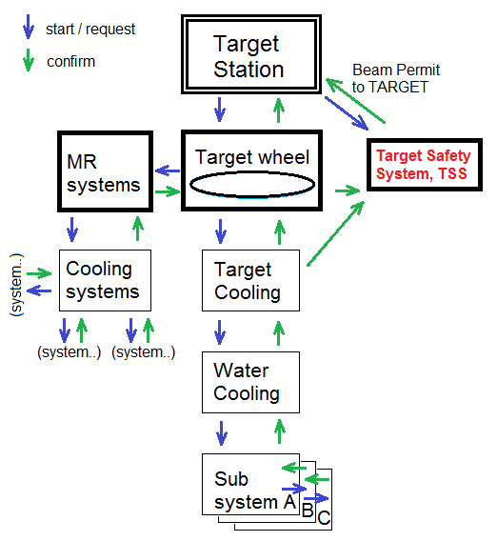
State Machines – Chain Principle
Start request propagates from Target Station down to lowest sub-systems
Confirm operational propagates back up to Target Station
Only systems with direct dependencies perform synchronized information exchange

Slide 11
Define Modes for Each System
What is ‘Running’ for the different systems?
What are ‘Fault’ conditions for the different systems?
What are limits for process values?
MP limits, TSS limits where applicable
Identify role in radiation safety case as defined by the accident analyses
g Determines classification of system and quality class
Identify operational and accidental loads
gDetermine load cases for which the systems must be qualified
Example for mechanical system – wheel

Slide 12
Classification of systems
ESS rule for identification & classification of safety important components (ESS-0016468)
g safety or safety-related (Category 1-5)
ESS rule for quality regulation – mechanical equipment (ESS-0047989)
g Quality class & corresponding RCC-MRx code class
Wheel – Category 4 (MQC4) g but we apply RCC MRx Section III Subsection C because it is exposed to radiation (formal EN-13445 according to PED)
RCC MRx defines 4 Operating Conditions with criteria levels
Component replaced if reach Level D stress, exposed to Level C < 10 times
Operating Conditions | Occurrence | Criteria Level
SF1 | Normal operation | Level A criteria
SF2 | Normal operating incidents | Level A criteria
SF3 | Emergency conditions | Level A or Level C criteria
SF4 | Highly improbable | Level A, C or D criteria

Slide 13
Design basis (KFM) – System 1000 (wheel, shaft, drive)
System description, classification, level of exposure to radiation
Load cases – Derived from legislation, similar operational experience, accident analysis reports
Includes connections/interfaces with Safety SSCs
Normal operations loads
Design conditions (ex. Pressure, temperature, mass)
Operating conditions (ex. steady beam, beam trips,
Transient loads
Operating conditions (ex. beam trips with helium cooling operational, unsynchronized rotation)
Accidents – Stopped wheel (AA1), non-rastered & focused beam (AA2), loss of cooling (AA3, AA4, AA7, AA8), local blockage (AA5), EQ (AA14)
Identify loads applied to each part of the system and bin into RCC-MRx categories: SF1 – SF4

Slide 14
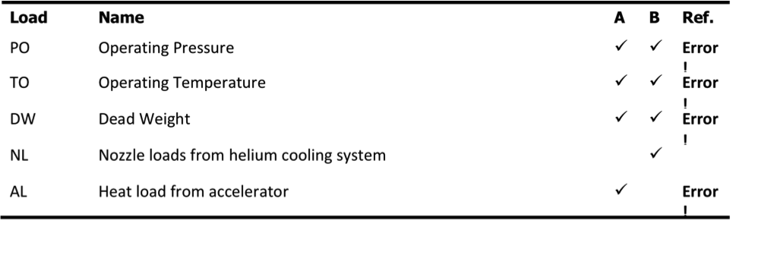
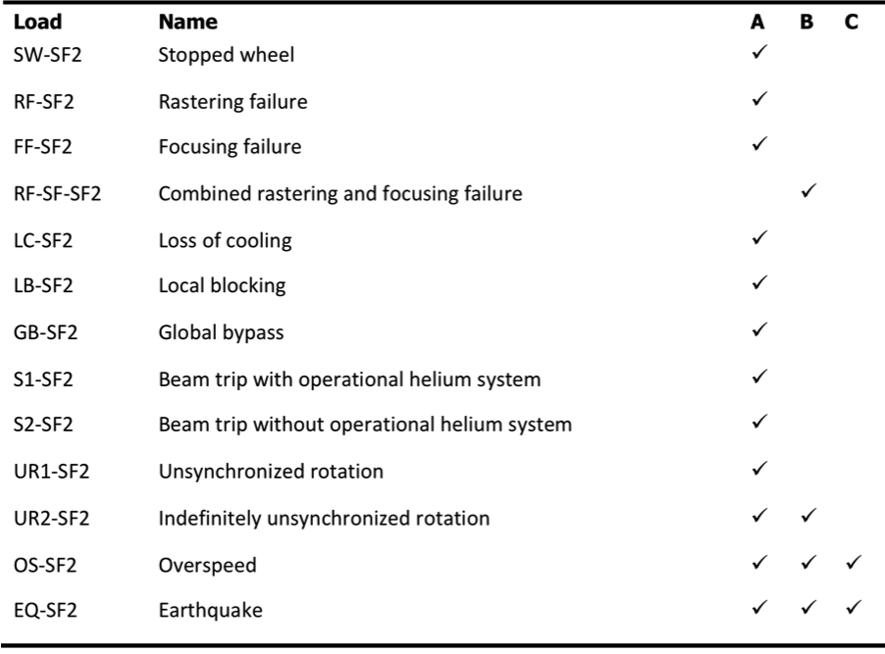
Summary of loads – System 1000
SF1 loads are normal operating conditions
Wheel
Shaft
Drive
SF2 – normal operating incidents
Identify loads mitigated by MP or TSS
Determines which criteria can be used to define limits
MP – level A
TSS – level A, C or D

Slide 15
Summary of loads – System 1000
SF3 – emergency operating conditions
SF4 – highly improbable operating conditions

Slide 16
Required for ‘Ready for Beam’ – Safety Systems
PSS – in mode ‘Running’
All enclosures searched and secured
TSS – in mode ‘Running’ and sub-mode ‘Beam to Target’
Helium temperature below TSS trip level
Helium flow above TSS trip level
Helium pressure above TSS trip level
Wheel rotation above TSS trip level
Monolith pressure below TSS trip level
WES (Worker Evacuation System) – in mode ‘Running’ & ok
Fire detection/alarm system

Slide 17
Required for ‘Ready for Beam’ – Systems
Machine protection – in mode ‘Running’ and ok
All parameters monitored by MP are within the MP trip levels
Target station systems in mode ‘Running’ and within normal operating parameters as defined by the load cases
Wheel drive – synchronized rotation
Helium cooling system
Primary water systems, intermediate water systems
Cold moderator cryo system
Monolith vessel atmosphere system, shutters
Target building HVAC
Target monitoring plug systems

Slide 18
Conclusions
Development of the process is underway
Need to further define operating parameters and limits for all of the systems in order to arrive at quantitative parameter values
Further investigation of the relationship between target station systems and beam configurations (current, power, rep rate, etc) needed

Slide 19
Conceptual Sample Start Sequence
User activates Start Request
Propagates to Target Station (TS) and is read by many systems within TS
ex. TSS, target wheel, MR-system
Propagates to Accelerator (ACC) with all sub-systems and to Target Machine Protection
TS response:
The target wheel enters READY FOR BEAM when the cooling is RUNNING and synchrinized run.
TSS reads a set of target station process values, ex. Helium cooling flow and target wheel rotation and enters mode BEAM TO TARGET and indicates ‘ready for beam’. TSS continuously reads the process values while in mode BEAM TO TARGET.
Acc reads:
‘Ready for beam’ from TSS and
‘Ok’ from all PSS signals, and
Maximum allowed proton power from NSS and
Enters start sequence for beam to target.
ACC main State Machine indicates different modes
ex. ION SOURCE ON to STARTUP RAMPING and finally to PRODUCTION
ESS main state machine
Reads modes from TS, ACC, and NSS and indicates current overall mode

