Slide 1
Specialized Technical Services Overview, Accomplishments and Challenges
J.G. Weisend II
www.europeanspallationsource.se
April 2016

Slide 2
Specialized Technical Services (STS) is Responsible For
All Vacuum Systems at ESS
Almost all Cryogenic systems at ESS
Cryogenic Moderator System (CMS) provided by TD. Operations will later be provided by STS
Sample environment cryogenics provided by experiments. Helium supply & recovery by STS
Elliptical Cavity Cryomodule Testing
Technical Water Cooling Systems for Accelerator project with some additional support to instruments
Technical Electrical Systems for Accelerator

Slide 3
Some Features of STS Work
Contributions to Accelerator, Target and Neutron Science projects
A large amount of scope provided by industrial vendors: Air Liquide, Linde, PowerHeat, TBD Racks and Cabling vendors
A large amount of scope provided by In-Kind-Partners: STFC, WUST, IPN, IPNJ
Involvement of many stakeholders: e.g. Cryomodule Testing involves: CEA/IPO, RF, ICS; Water systems involves links to CF, linac components (DTL RFQ, CM etc.) and ICS
Long lead times for equipment resulted in an aggressive schedule.

Slide 4
Accelerator Division - Specialized Technical Services
Specialized Technical Services
John Weisend II – GL
Wolfgang Hees
Anton Lundmark
Evangelia Vaena
Frithiof Jensen
Emilio Asensi
Gunilla Jacobsson
Akif Coku (C)
Björn Henriksson (C)
Jörgen Jönsson (C)
Fredrik Persson (C)
Mats Lindroos – Head of Division
Håkan Danared – Deputy Head of Division
John Weisend II – Deputy (sub-)Project Leader
Vacuum
Marcelo Juni Ferreira – SL
Hilko Spoelstra
Simone Scolari
Christophe Jarrige
Fabio Ravelli
Kristell Barthélemy
Richard Bebb
Ralf Huber (2017-07-03)
Peter Ladd (C 50%)
Cryogenics
Philipp Arnold – SL
Jaroslaw Fydrych
John Jurns
Xilong Wang
Xiaotao Su
Johnny Råström (2017-05-08)
Mattias Olsson (2017-09-04)
Ila Sjöholm (C)
Piotr Tereszkowski (C)
Notes:
§

Slide 5
HIgh Level Accomplishments
A strong team has been established
All engineers and some technicians in place – additional technician/operator hiring underway
Sufficient depth for succession planning
Majority of major contracts placed and majority of IK components in series production
Start of work on site: Piping, Test Stand preparation
STS buildings near completion, some turned over to us
Deliveries of cryoplant components start in Q2/Q3 2017
Work started in Vacuum lab and clean room
Vacuum handbook published & blanket order organized
Rack systems out for tender and cable data base populated
Water systems entering detailed design, with some components under installation
Test stand bunker designed and utilities under development
Discussions with MAX IV re; Helium recovery
11 PDRs, 8 CDRs and 2 IRRs held to date on STS activites

Slide 6
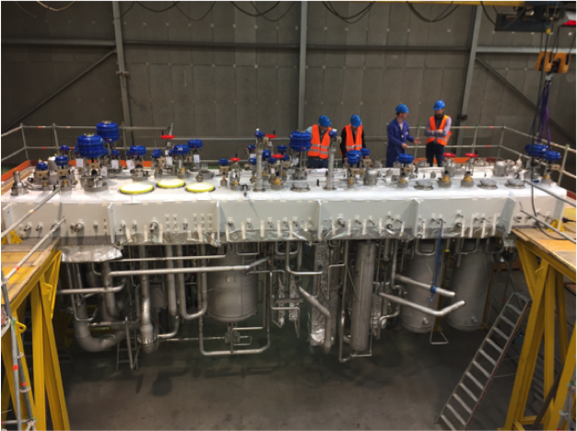
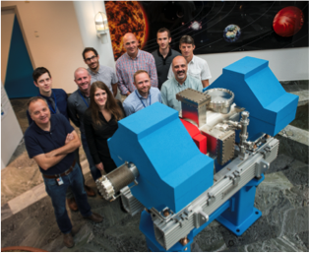
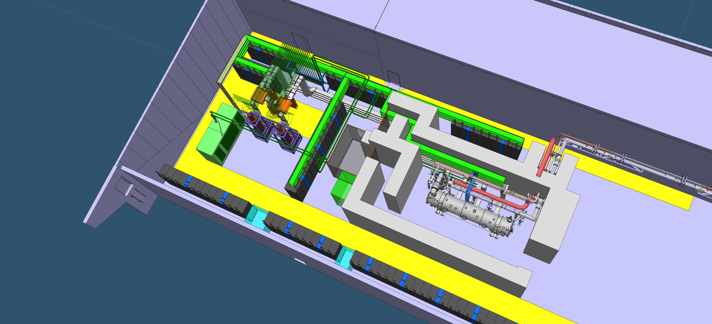
Examples of work – more in subsequent talks

Slide 7
Challenges
Technical: Majority of systems reflect conservative well understood design choices with significant review and appropriate margin
Technical issues will arise during installation and commissioning. Solutions include: staff competency, engineering margin and ramp up of operations
Issue with Cold Compressor bearing lifetime has been identified and is being watched closely. Communication with DESY & Linde has been invaluable

Slide 8
Challenges
Non –Technical
Staff retention and avoidance of burn out – particularly during installation work ( shift, on-call, scope creep)
Role of STS in full operations
Location within organization
Possible new roles
We are discussing this but no significant changes are envisioned prior to ~ 2020 – We need to concentrate on completing the project first
There are positions for all current and planned staff in the operations budget

Slide 9
Backup Slides

Slide 10
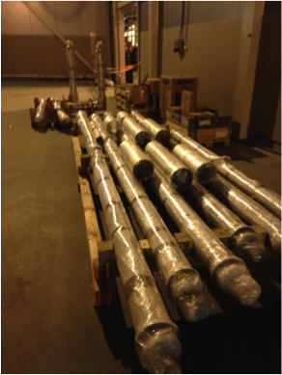
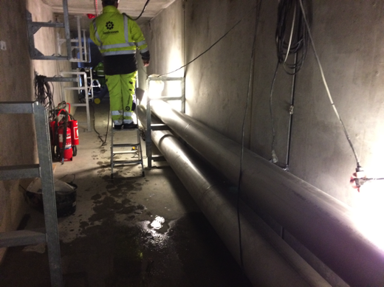
Cryogenics

Slide 11
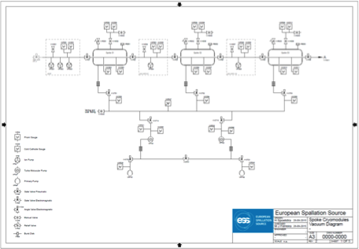
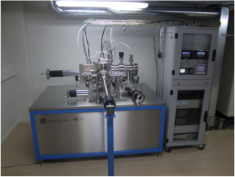
Vacuum

Slide 12
Utilities

Slide 13
Test Stand

