Slide 1
Accelerator Cryoplant (ACCP) at the European Spallation Source
Work Unit 11.11.3
Xilong Wang
ACCP project engineer
www.europeanspallationsource.se
06 April 2017

Slide 2
Outline
System Overview
Project Status
Conclusion
Upcoming Activities

Slide 3
(1.1) System overview – Block Diagram
Pure Helium
Gas Storage
Standalone Helium Purifier
Helium Recovery System
Target Moderator
Cryoplant
Accelerator
Cryoplant
20 m³ LHe Tank
5 m³
LHe Tank
Test & Instrument Cryoplant
Target Cryodistribution System
LHe Mobile Dewars
Test Stand Cryodistribution System
Cryodistribution System for Elliptical Linac
Cryodistribution System for
Spoke Linac
LN2 Storage Tanks
Hydrogen Circulation Box
Elliptical
Cryomodules
Spoke
Cryomodules
LN2 Mobile Dewars
Instruments & Experiments
Test Stand Lund 2
Hydrogen Moderator

Slide 4
(1.2) System overview – Performances
Heat loads (installed capacity)
  3050 W @ 2 K
  9 g/s liquefaction rate @ 4.5 K
  11380 W @ 40-50 K
  ~9 kW @ 4.5 K equivalent
Continuous operation of the ACCP
24 h per day / 7 days per week
2 years without schedule shut-down
Availability > 99%
Not count utilities and process control
Notes:
Several facts can be read out of this figure for 2K load which is representative for other ACCP loads as well
1) load depends strongly on number of installed CMs, not so much on beam power!
2) substantial load contribution from static load, i.e. also when beam off
3) quite big operation range also due to uncertainties
Part load operation to be evaluated in bids

Slide 5
(1.3) System overview – Features
Three warm compressors, six turbines, three cold compressors and several bunches of plate fin heat exchangers
Mixed compression cycle at 2 K
Capacity control
  Floating pressure cycle for HP compressor
  VFD for SP, LP compressors and CCs
  Exchange of CCs flow parts
All built-in acceptance test equipment
Notes:
Six turbines and without LN2 precooling
One bed dryer and without external purifier

Slide 6
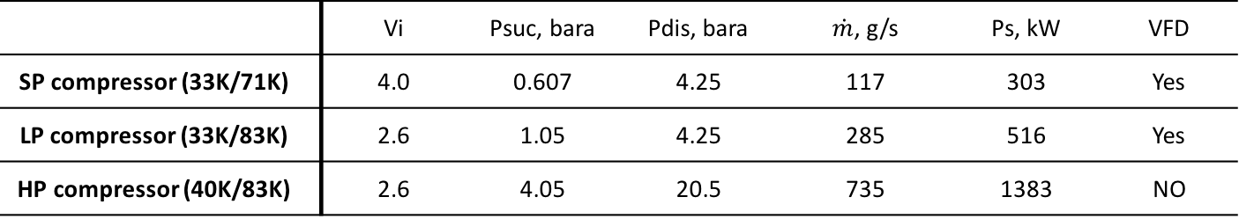
(1.4) System overview – Parameters
Main electrical power | 2.37 MW
Power at 4.5 K equivalent | ~9 kW with exergy efficiency 25.9%
 | Vi | Psuc, bara | Pdis, bara | $\dot{m}$, g/s | Ps, kW | VFD
SP compressor (33K/71K) | 4.0 | 0.607 | 4.25 | 117 | 303 | Yes
LP compressor (33K/83K) | 2.6 | 1.05 | 4.25 | 285 | 516 | Yes
HP compressor (40K/83K) | 2.6 | 4.05 | 20.5 | 735 | 1383 | NO
Impurity removal (ORS/dryer/cryogenic adsorbers) | Oil | BOR (1000 ppm) - Coalscer in skid (10 ppm) - FOR (0.5 ppm Aerosols and 10 ppb Vapour)
 | Water | One bed on line dryer (0.1 ppmv)
 | Air | Two 80 K Adsorbers (73 K, 20 bar) and one 20 K adsorber (24 K, 20 bar)
Cold compressors | Ceramic ball motor bearing; Exact same as DESY 1-3 Stages, HS270(CC1), HS220(CC2 and CC3); Nominal mass flow rate:116.6 g/s
Plate Fin Heat Exchanger | NTU<35 per block, Calculations conducted for all modes, Two horizontally installed
Liquid He storage | 20’000 Dewar (2.2 tons) + Subcooler in cold box (1500 liter)
Warm He storage tank | 14 X 70 m³ at 20 bar (2.7 tons) (CMs + CDS + ACCP in total)
Notes:
Heat exchanges, turbines, cold compressors datasheet could be found in the back-ups.

Slide 7
(1.5) System overview – Partners
Contractor: Linde Kryotechnik AG (LKT)
Contract signed on 17 March 2015
Warm compressors (VMY 536H): | Aerzen | Germany
Compressor Motors and VFDs: | ABB | Finland
Oil adsorber and coalscers | KASAG | Switzerland
Dryer | Aquagas | Sweden
Plate fin heat exchanger | Linde Schalchen | Germany
Cold compressors | PBS | Czech Republic
Transfer lines Between Cold box and Dewar | Demaco | Netherlands
On site piping, Cabling and installation (Option 1) | Jobsab | Sweden
20’000 l Dewar (Option 2) | Statebourne | UK

Slide 8
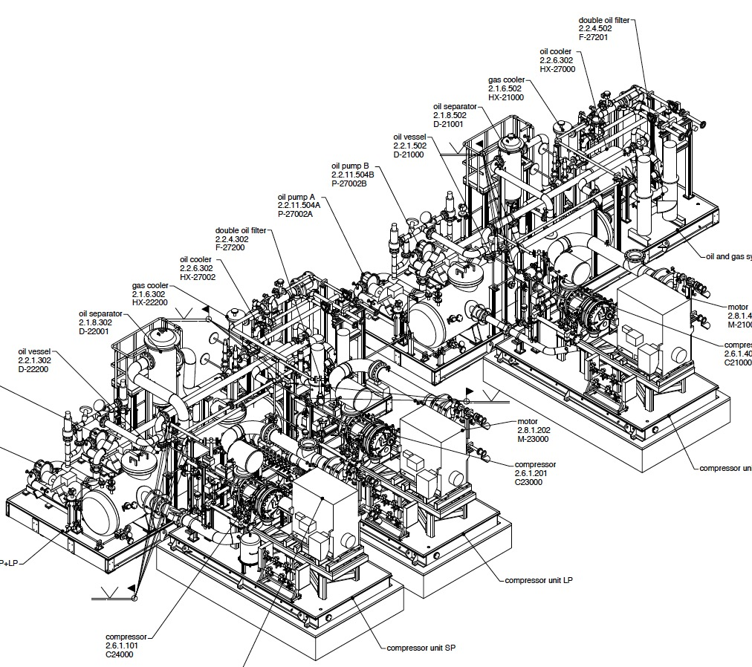
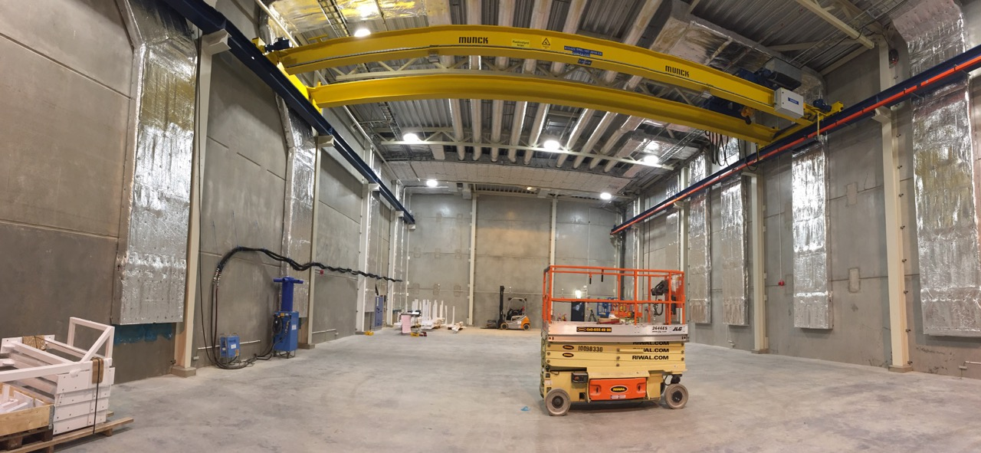
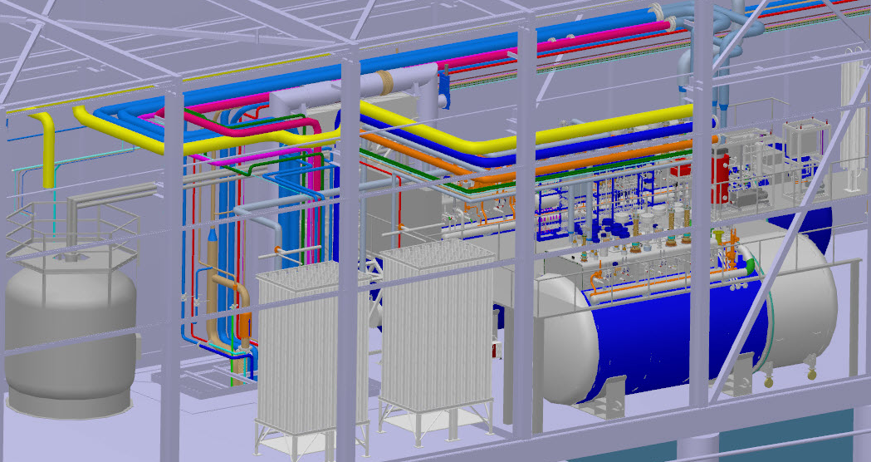
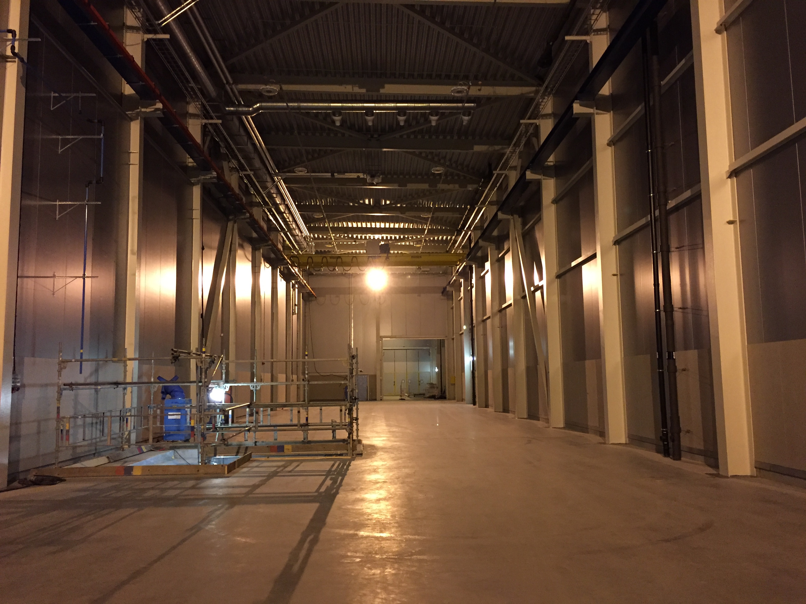
(1.6) System overview – Physical Location
Full Access
2nd May 2017

Slide 9
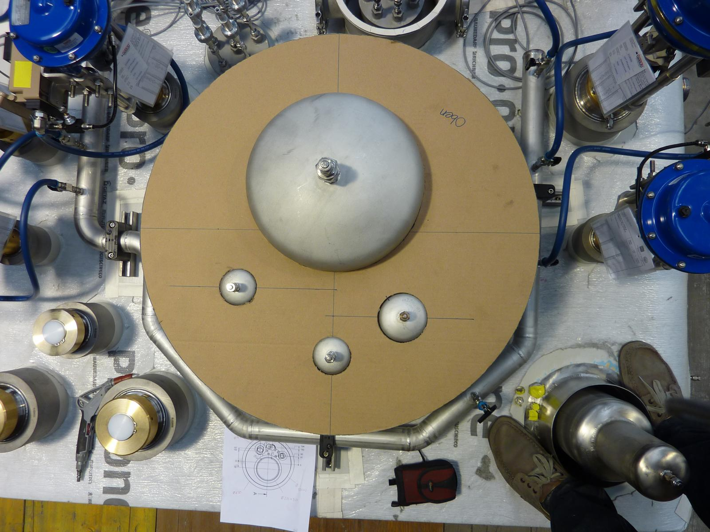
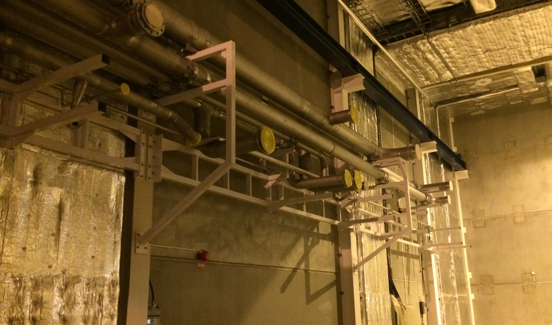
(1.7) System overview – Interfaces
Physical/process interfaces:
  ACCP to CDS
  ACCP to Interconnecting piping
  ACCP to Utilities
    Electricals, cooling water, instrument air, ventilation, CF
Project interfaces:
  ACCP to CDS
  ACCP to Interconnecting piping / PHS
  ACCP to TICP/Recovery
  ACCP to ICS
  ACCP to LKT
Interfaces managed through:
  Interface Control Documents (ICD) for internal interfaces
  Confluence wiki pages for cryogenic systems interfaces
  Project reviews and meetings with LKT
  CHESS

Slide 10
Outline
System Overview
Project Status
Conclusion
Upcoming Activities

Slide 11
(2.1) Project status – Reviews & Inspections
Project meetings and reviews
KOM
FMEA
CDR-1
PDR-2
LDR
PDR-1
HAZOP
CDR-2
IRR
IDR
May-15
Aug-15
Oct-15
Nov-15
Jan-16
Mar-16
Jun-16
Aug-16
Sep-16
Mar-17
Intermediate inspection
(Fabrication Check)
PFHE
Compressor
Motor
CB internal
Compressor skid functional
Compressor skid leak test
Control loop check
GMP & ORS & Dryer
Dewar
Apr-16
Jun-16
Jul-16
Feb-17
Mar-17
Mar-17
May-17
May-17
May-17
Notes:
Intensive review and it takes two or three days normally
PDRs for key component procurement approval
CDR for detail design approval and start to fabrication
HAZOP and FMEA for risk and mitigation

Slide 12
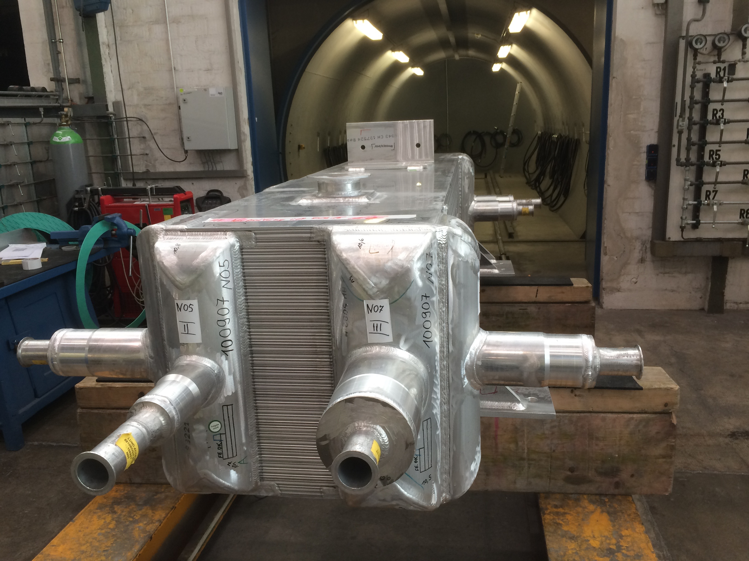
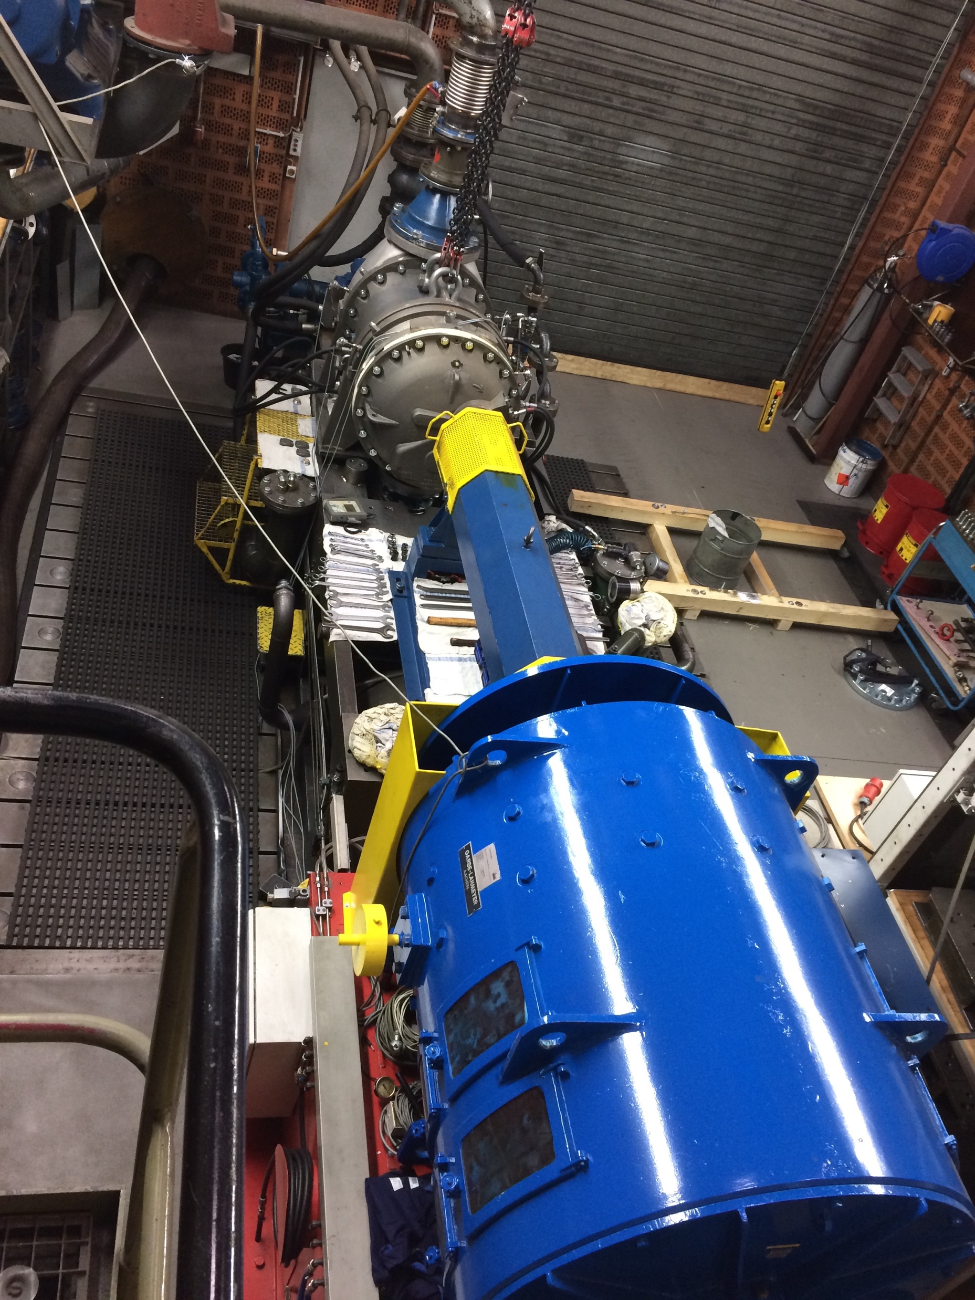
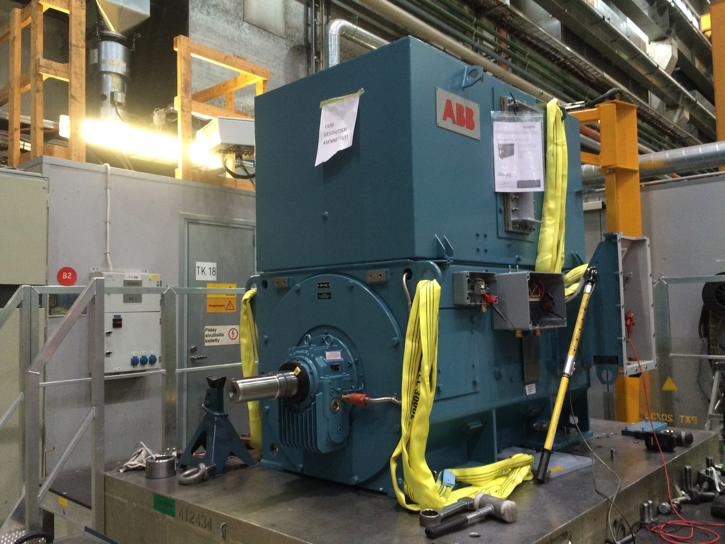
(2.2) Project status-Pictures
PFHX Pressure test
Motor factory acceptance test
Compressor factory acceptance test
Notes:
PFHX pressure test
Motor factory acceptance test
LP compressor factory acceptance test

Slide 13
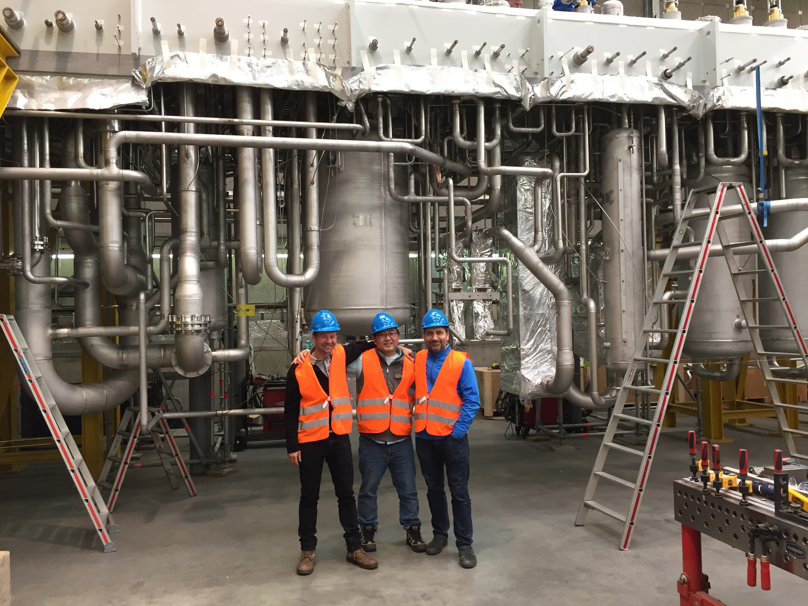
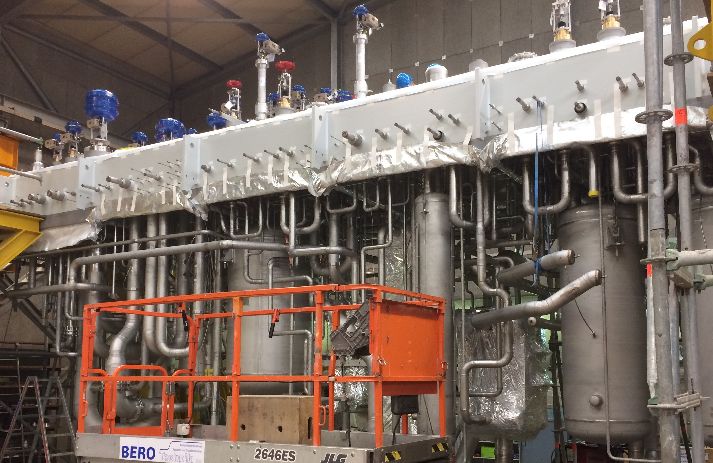
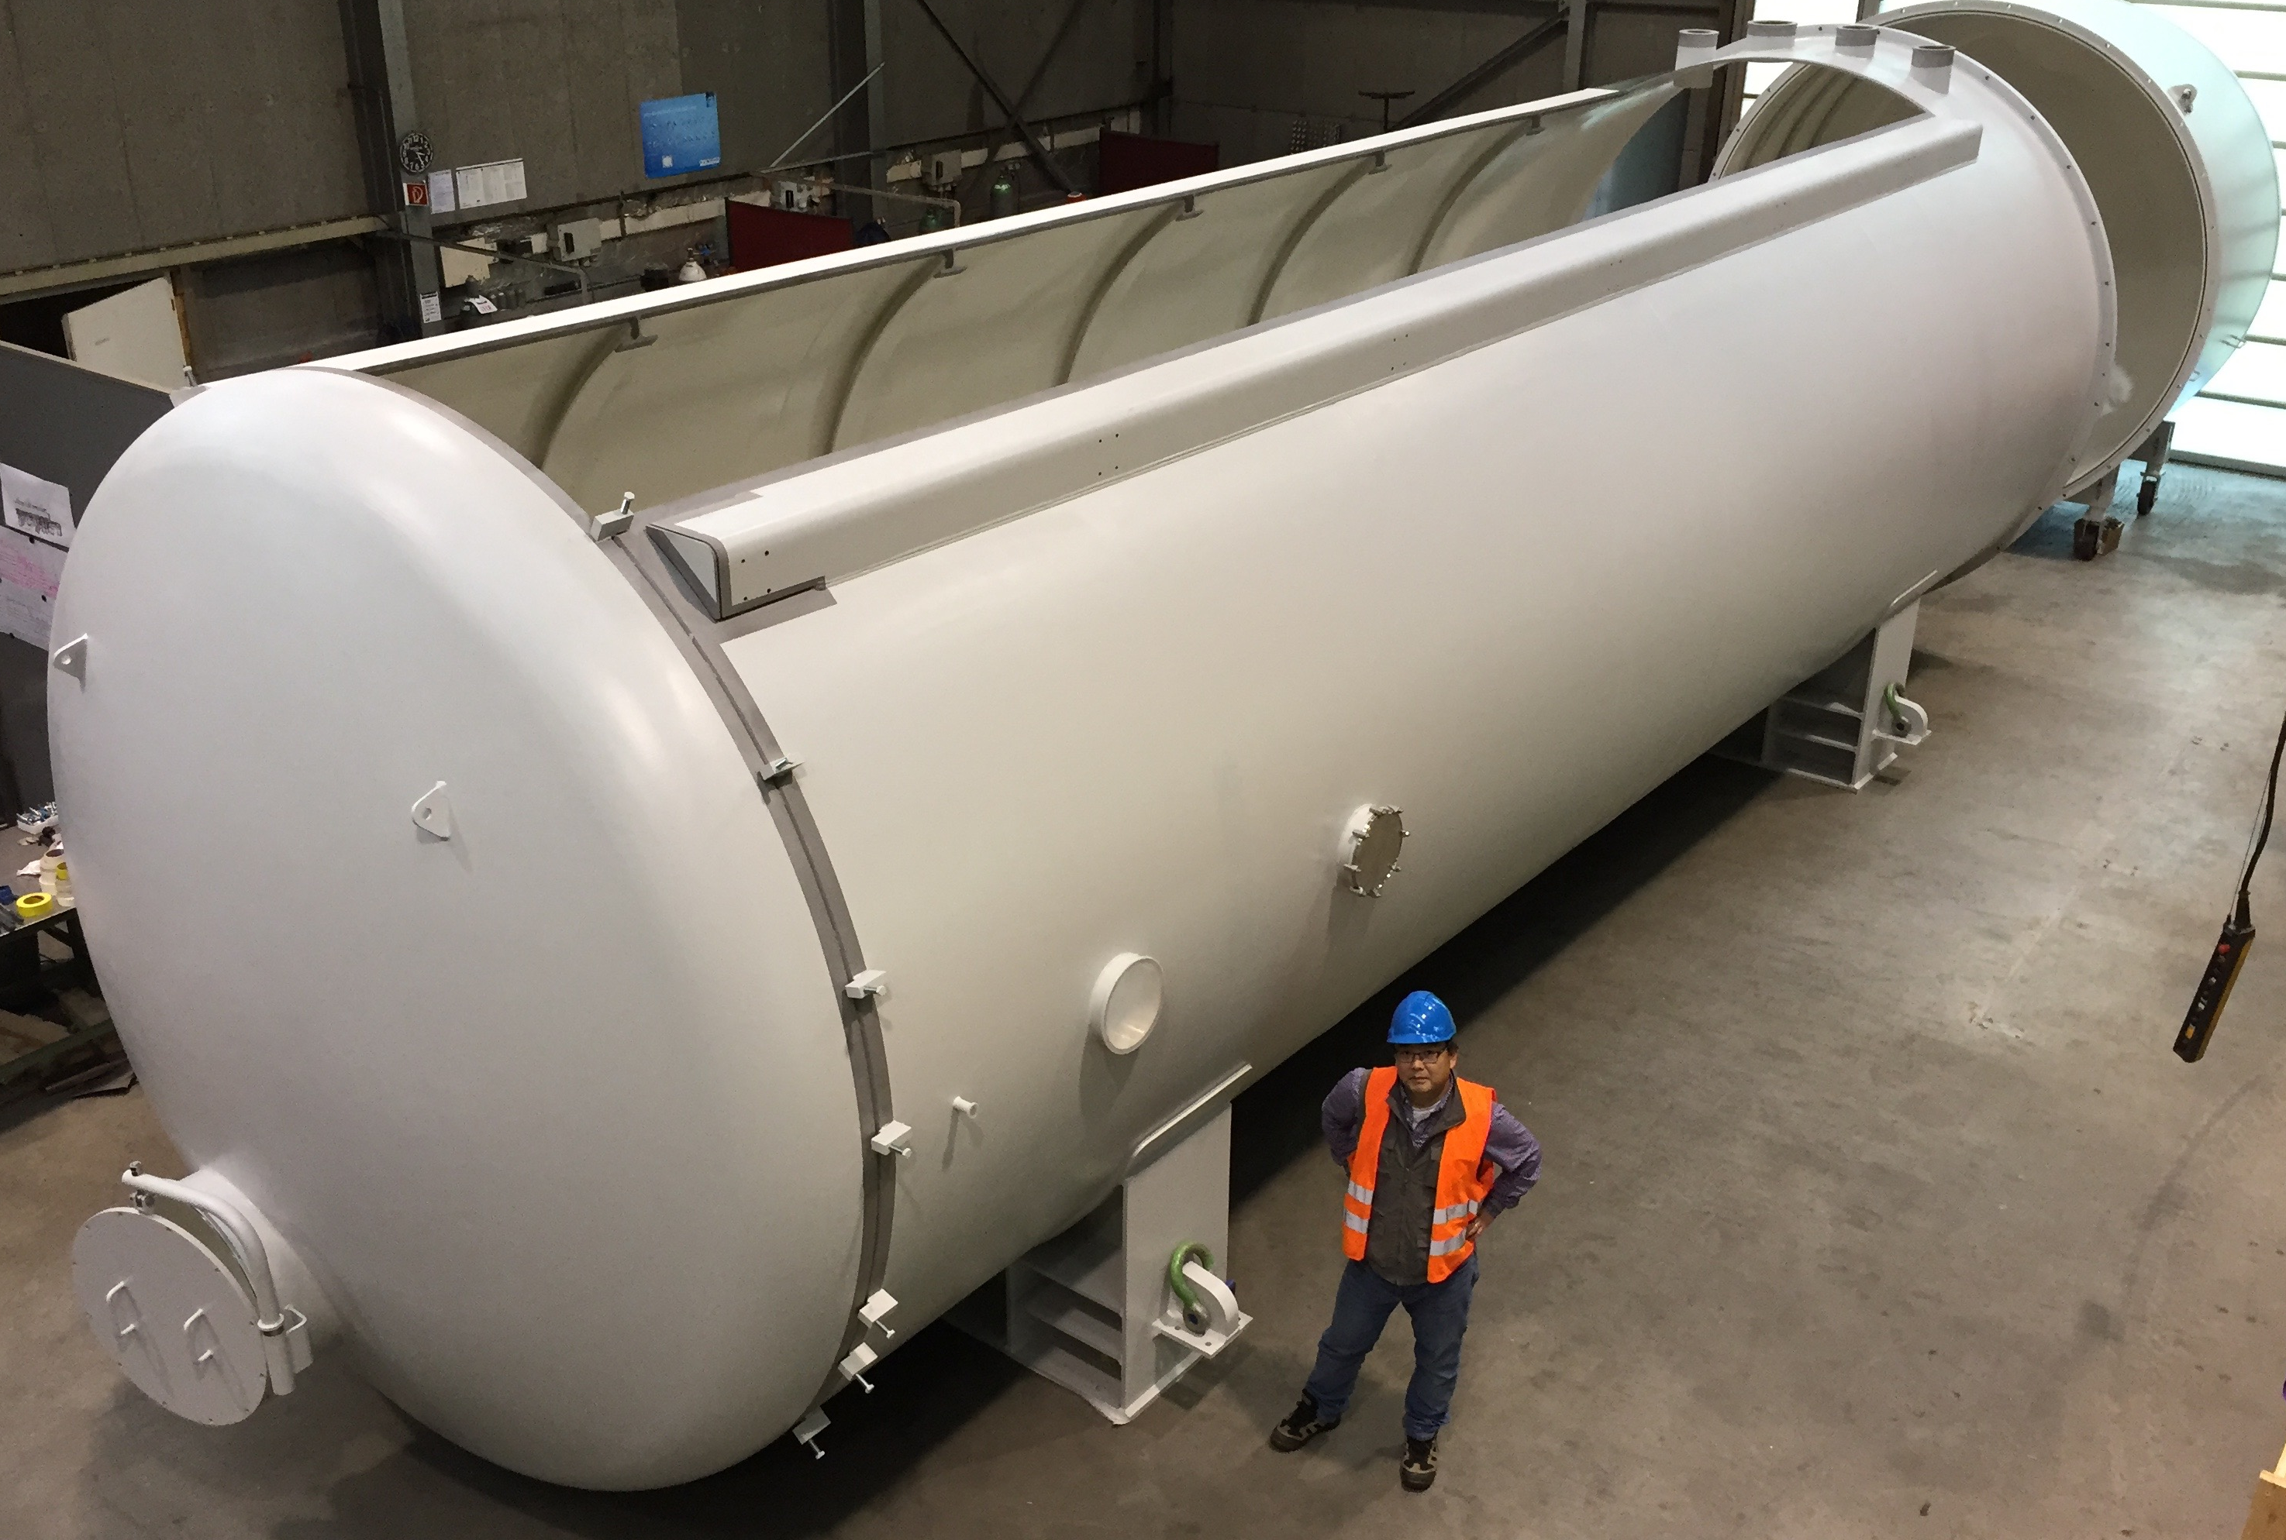
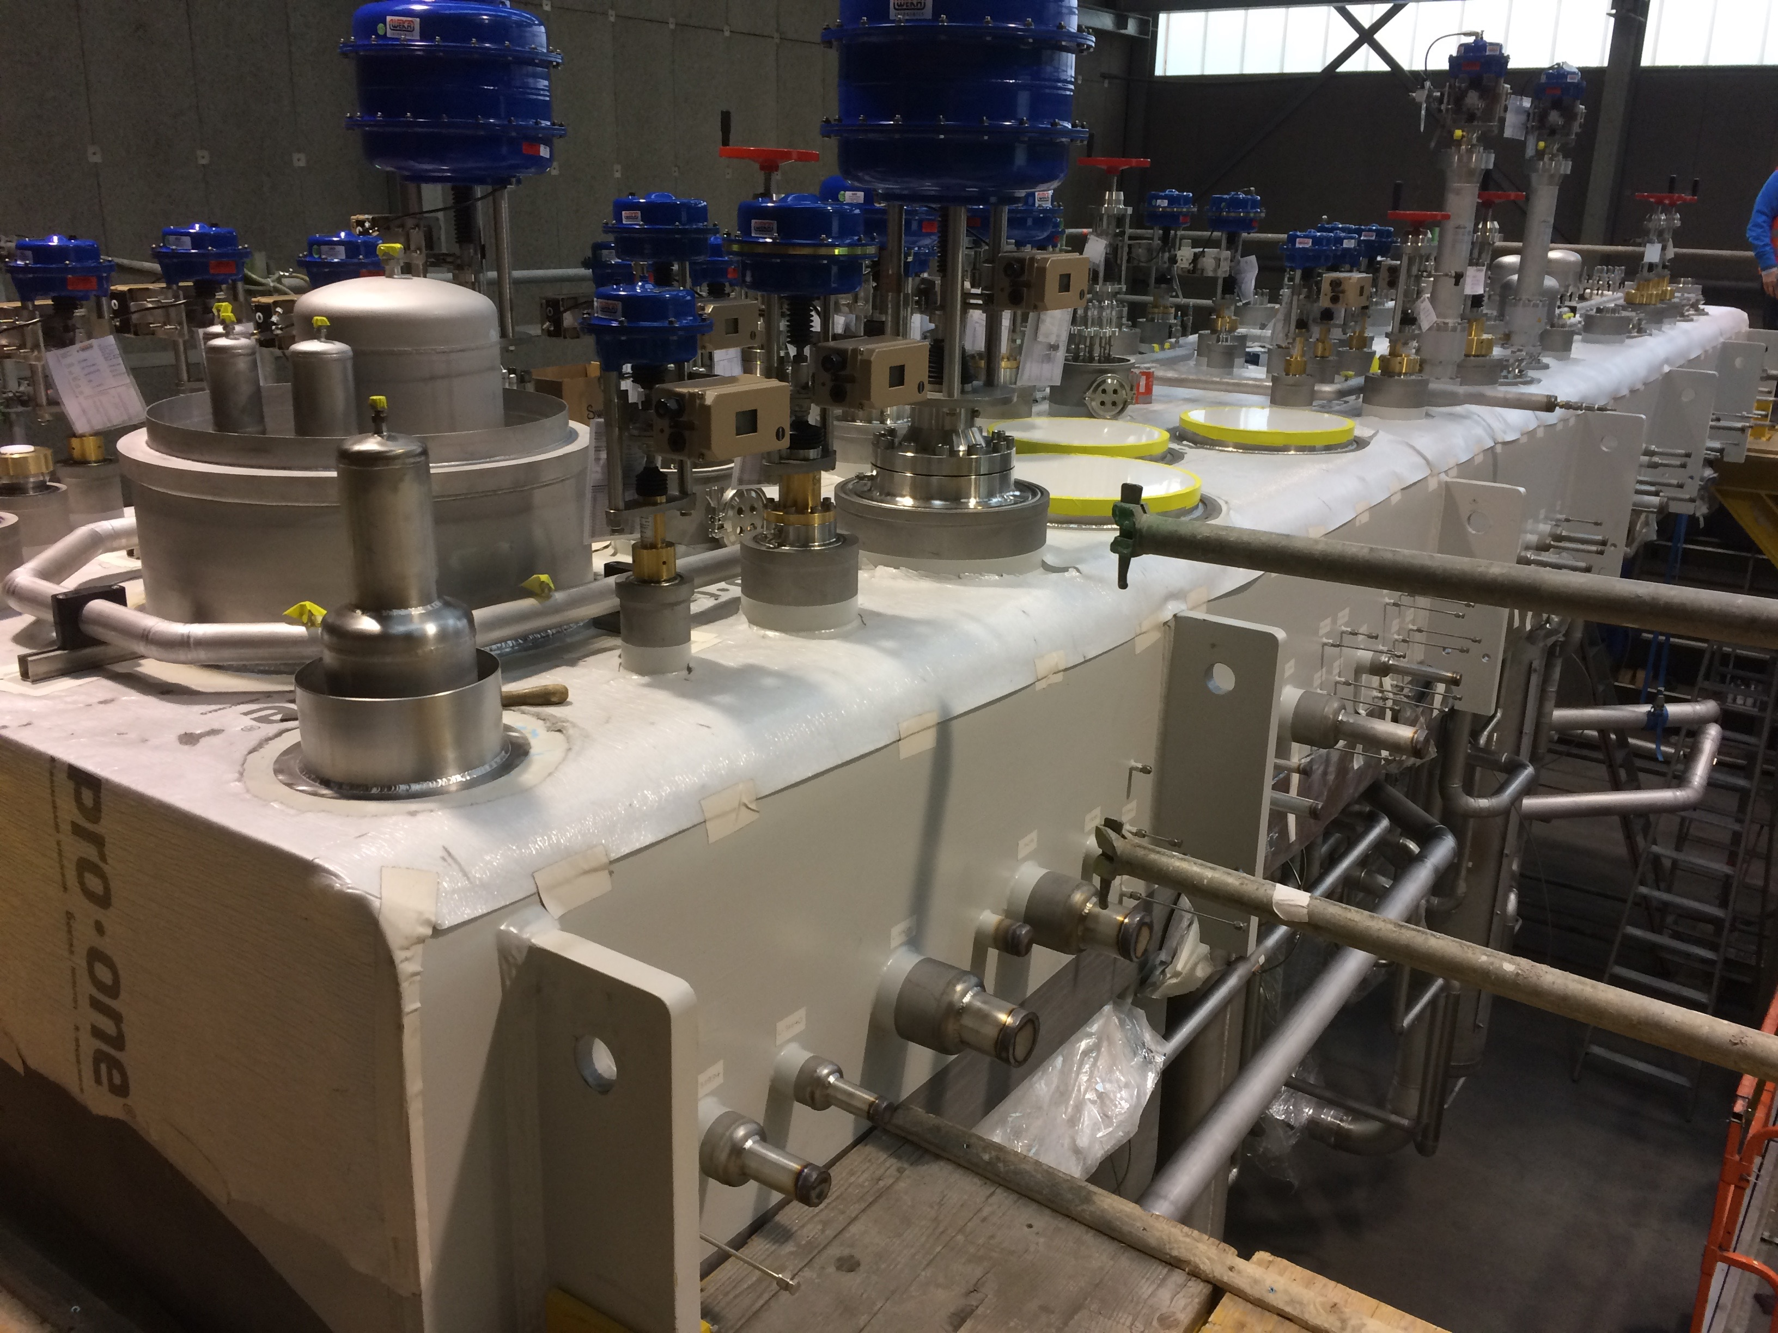
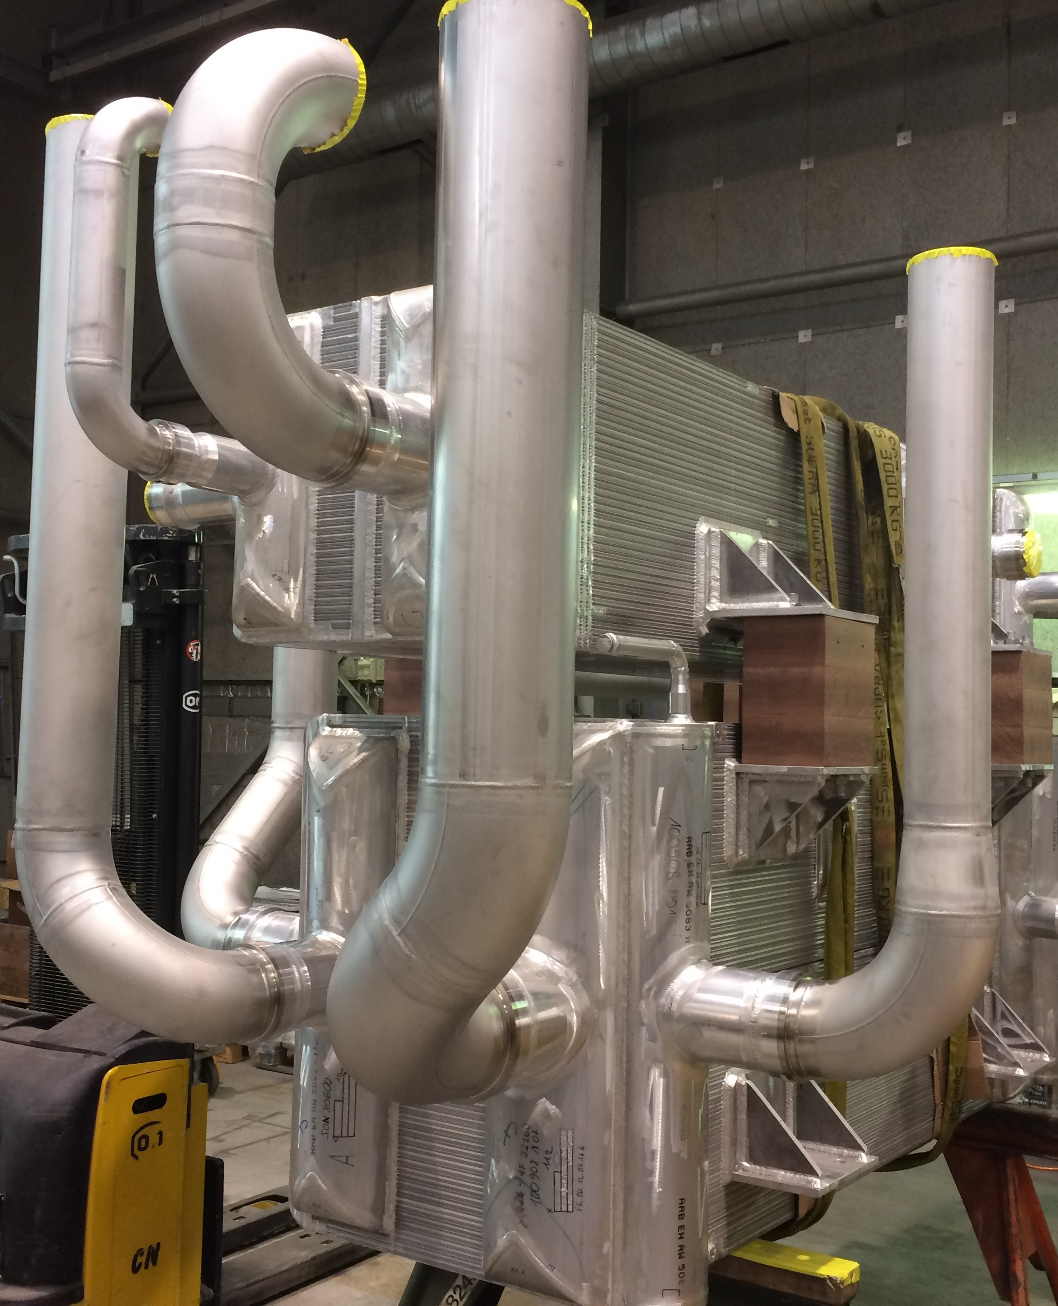
(2.2) Project status-Pictures
Cold box internal piping inspection

Slide 14
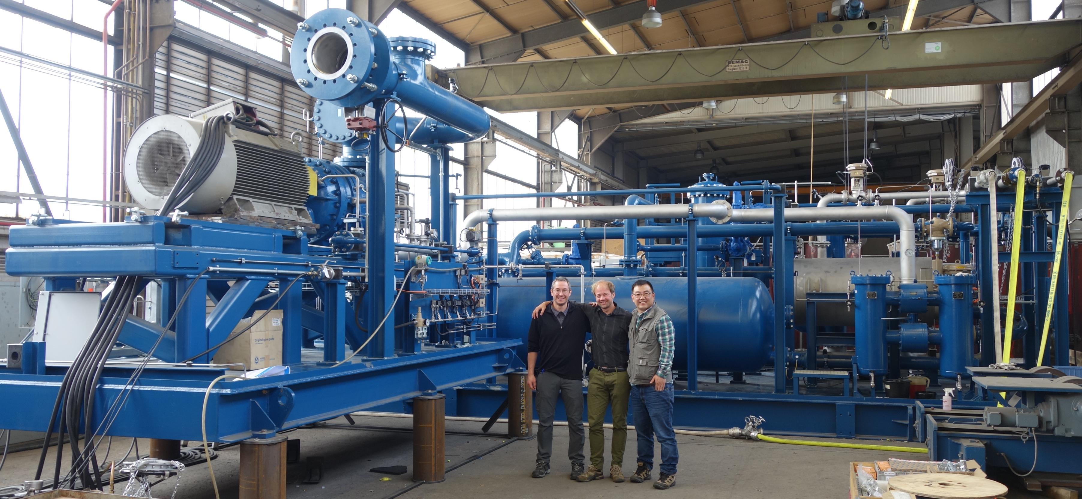
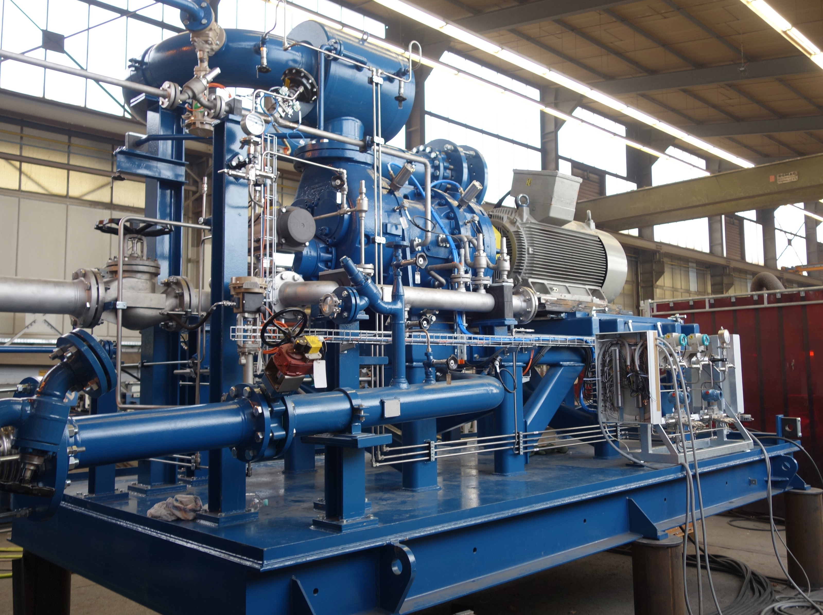
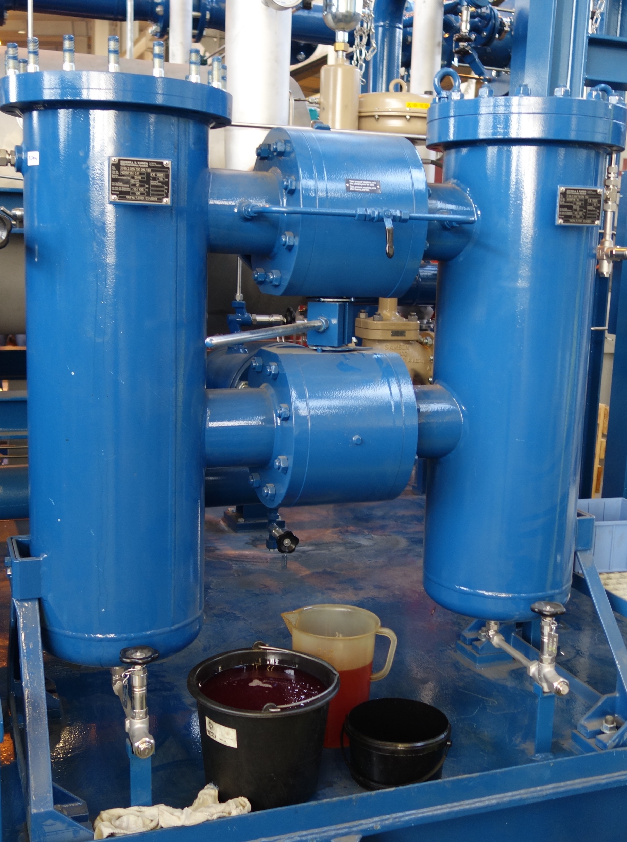
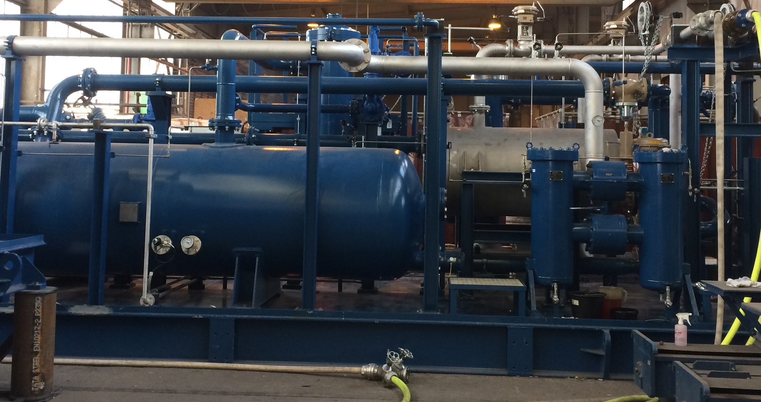
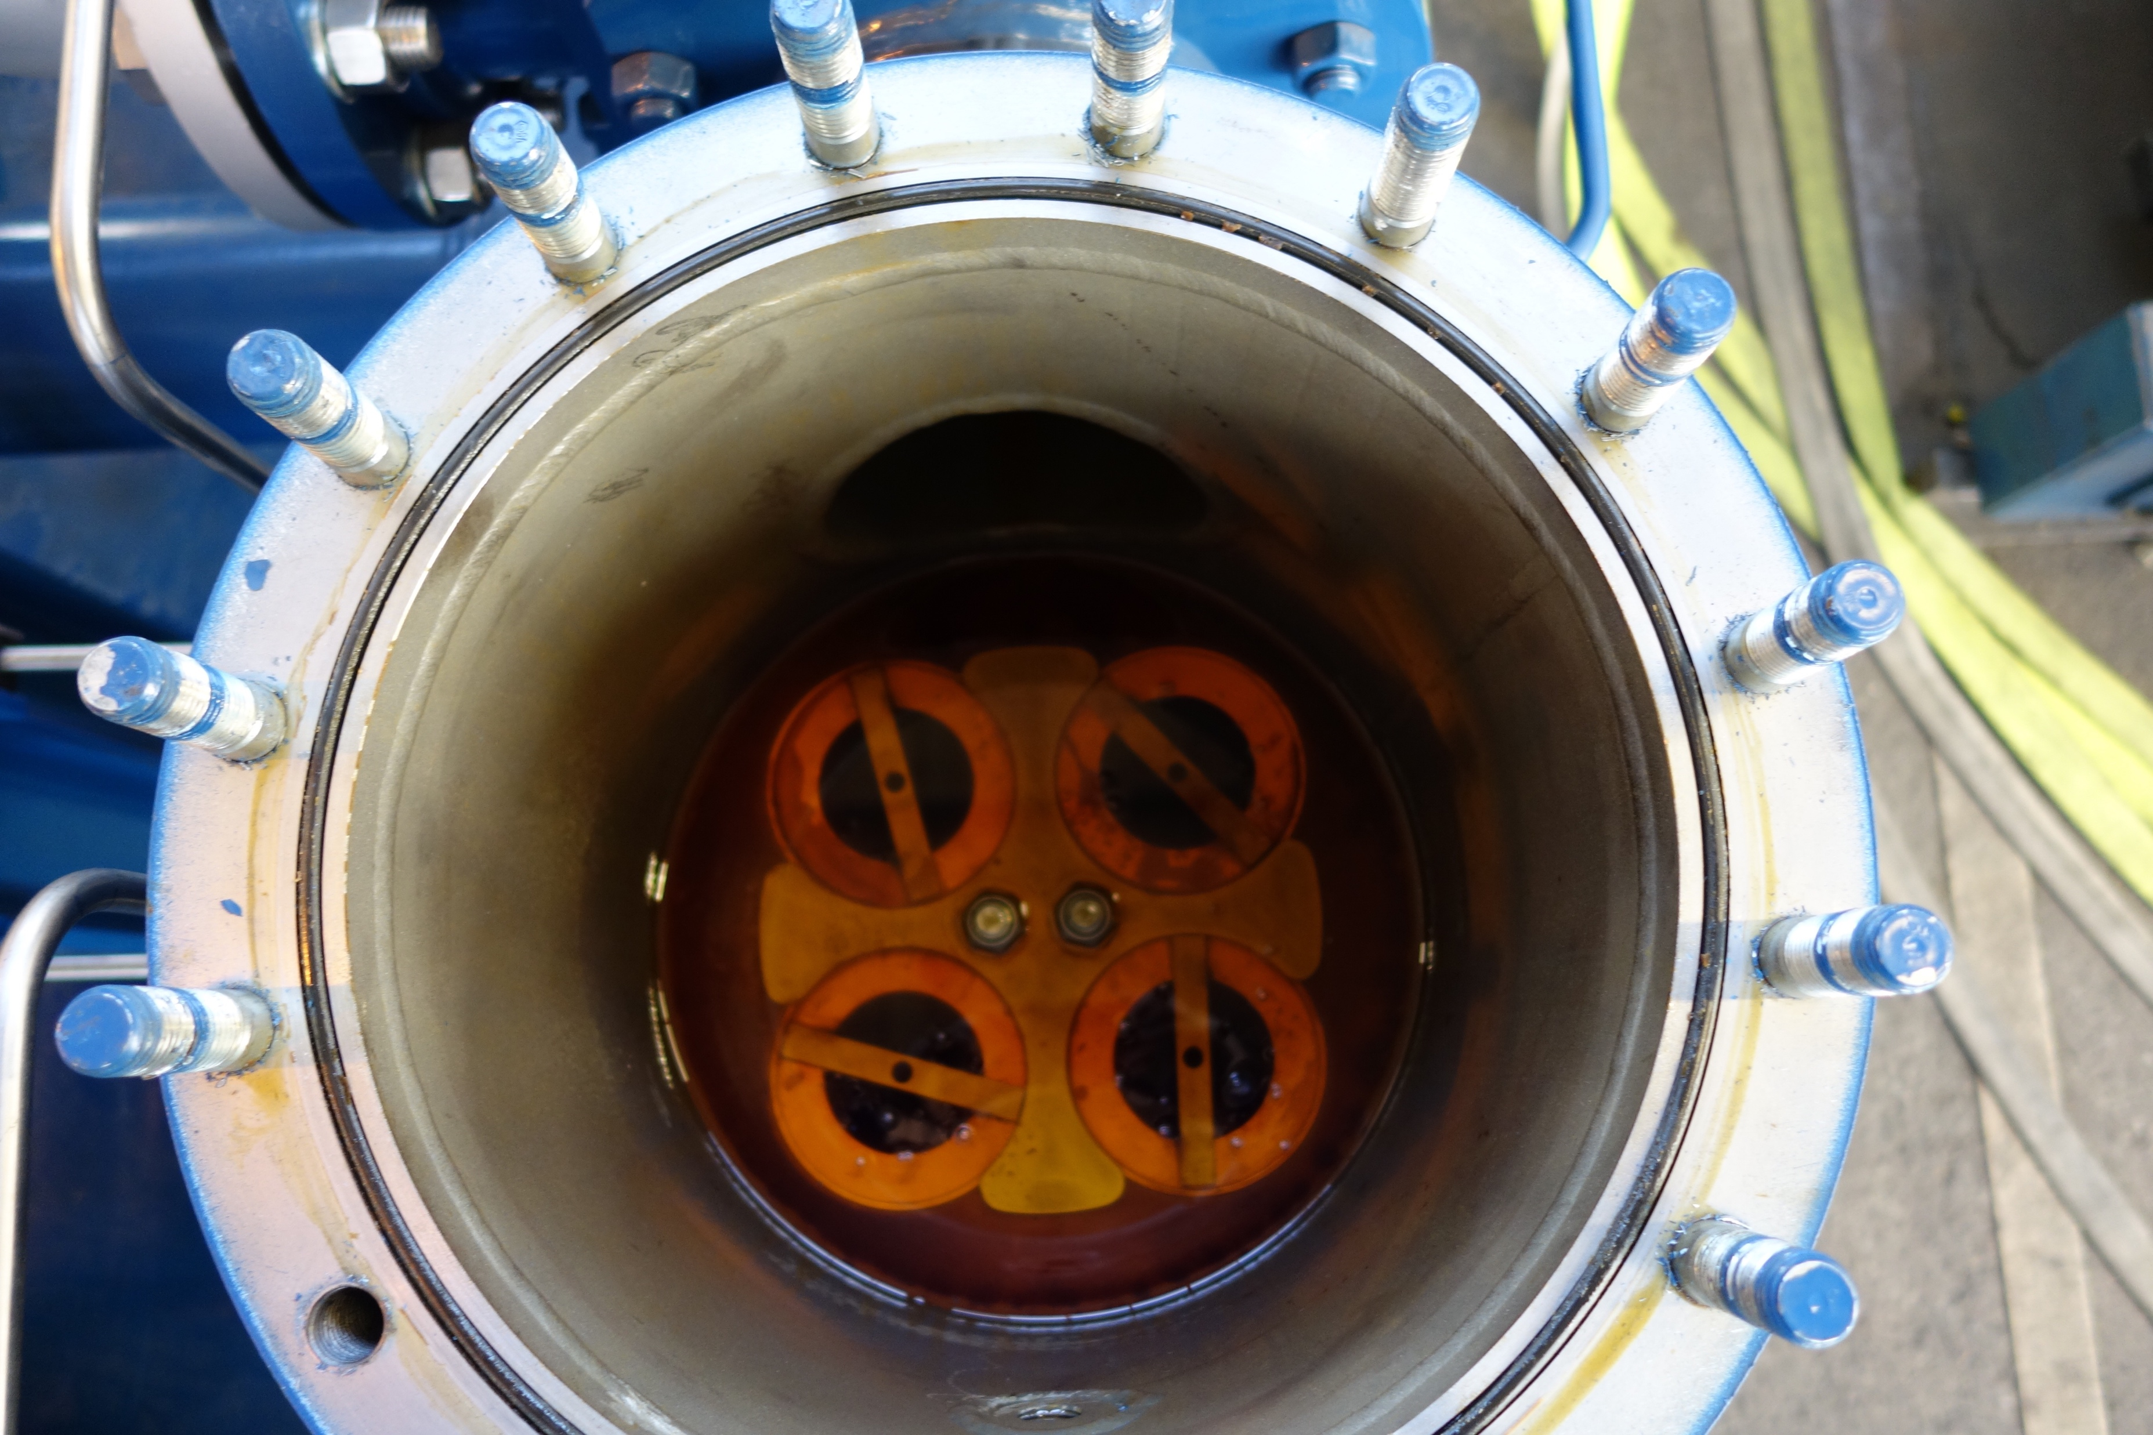
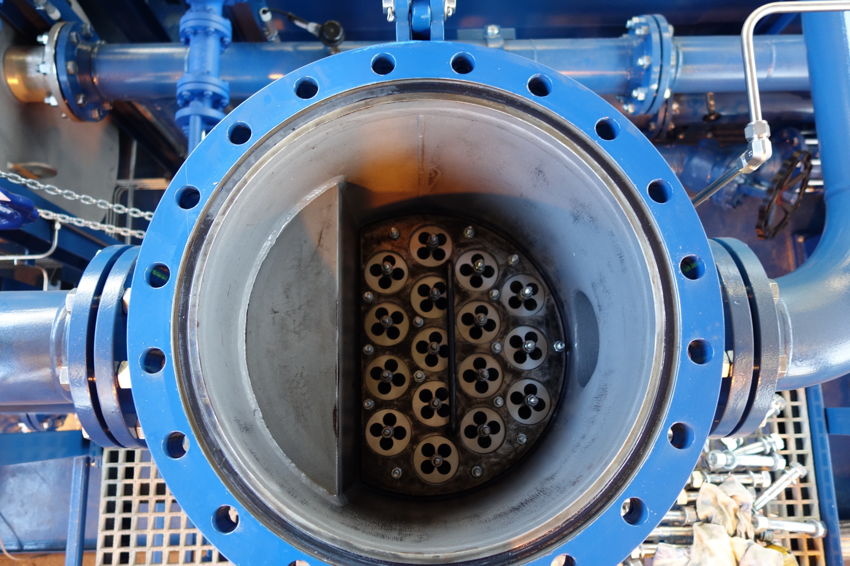
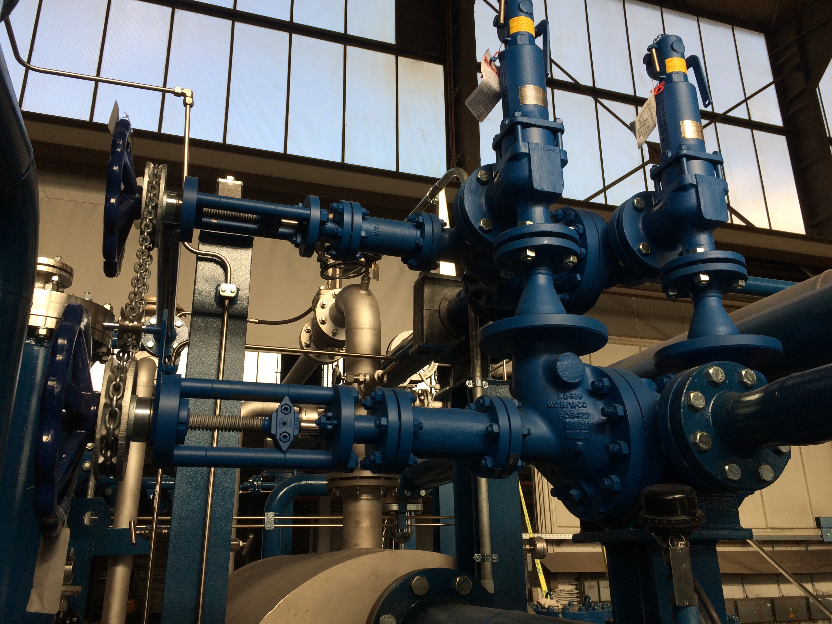
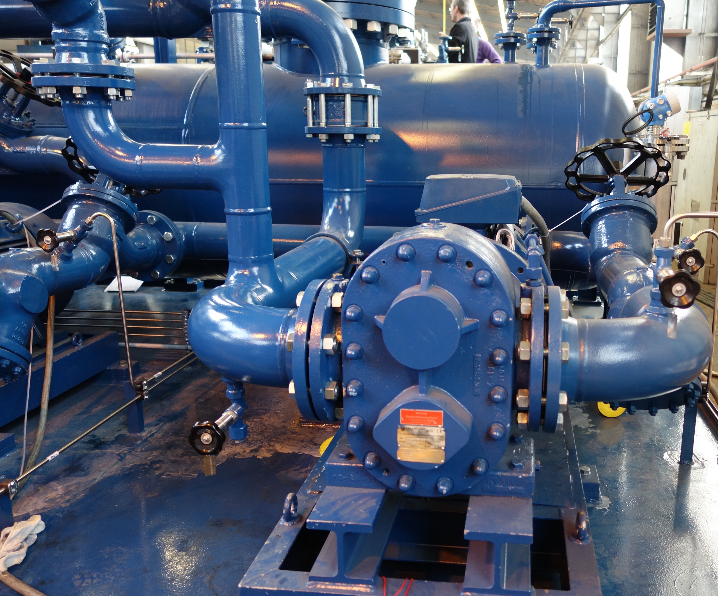
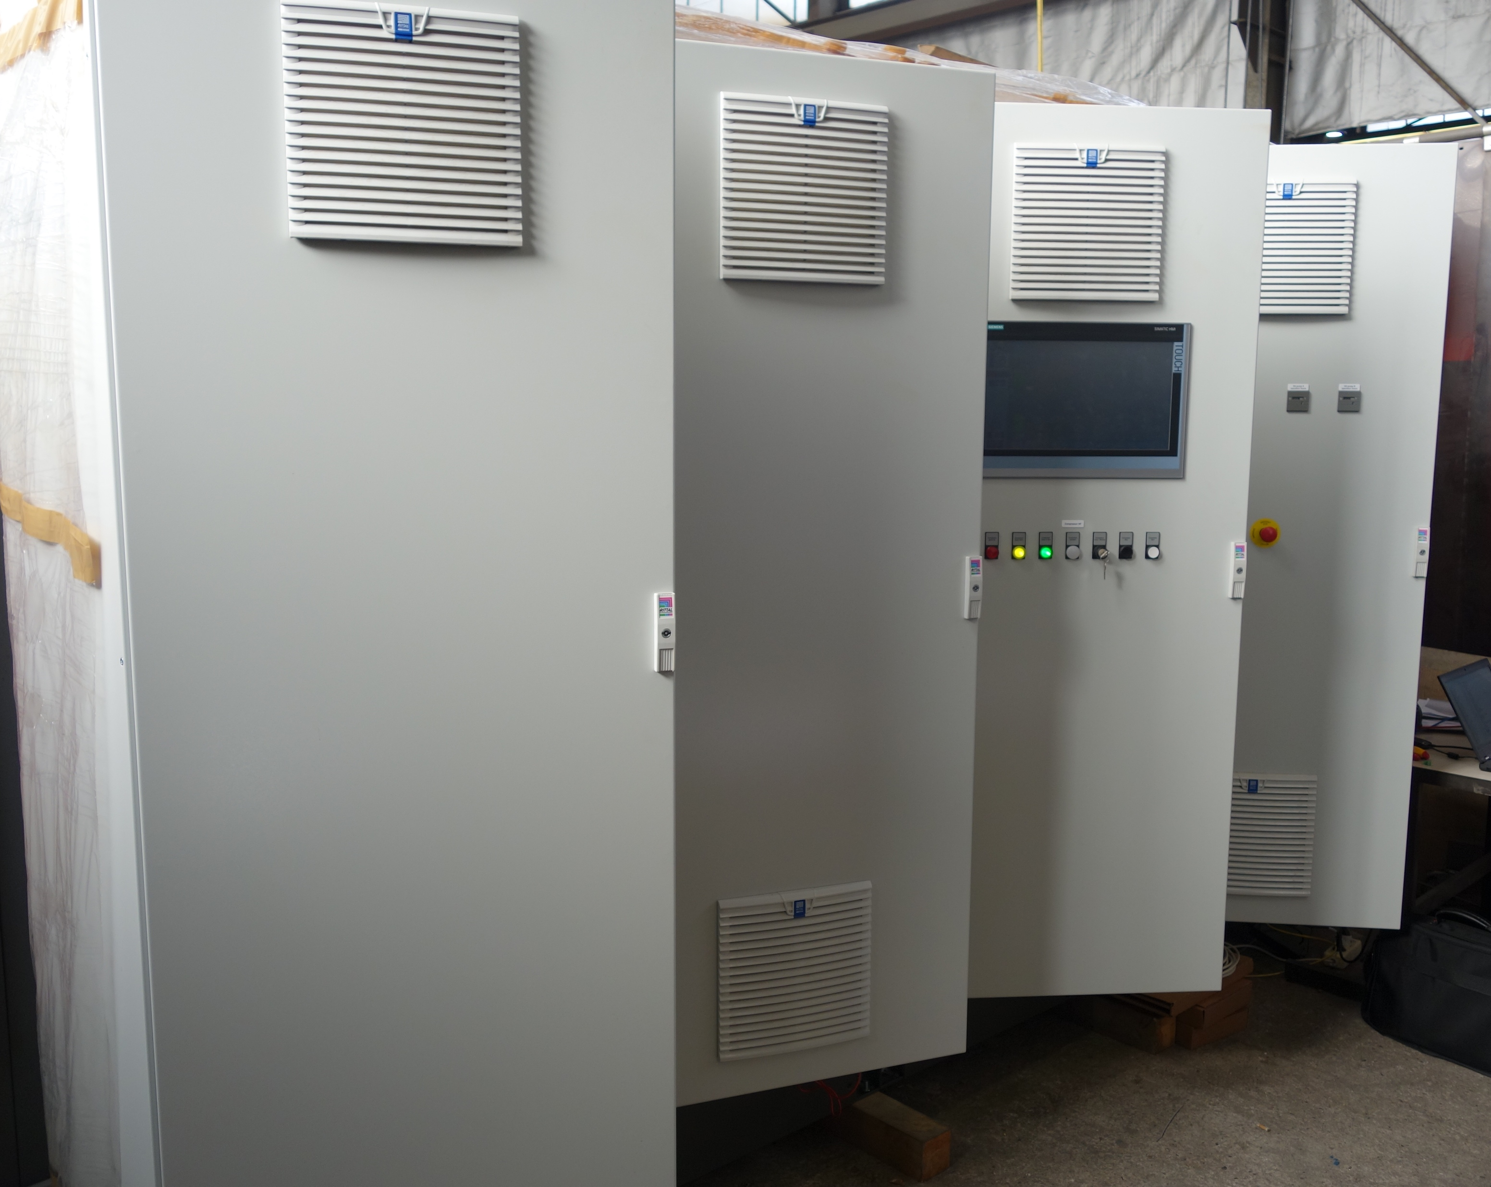
(2.2) Project status-Pictures
HP skid and HP gas & oil skid functional test

Slide 15
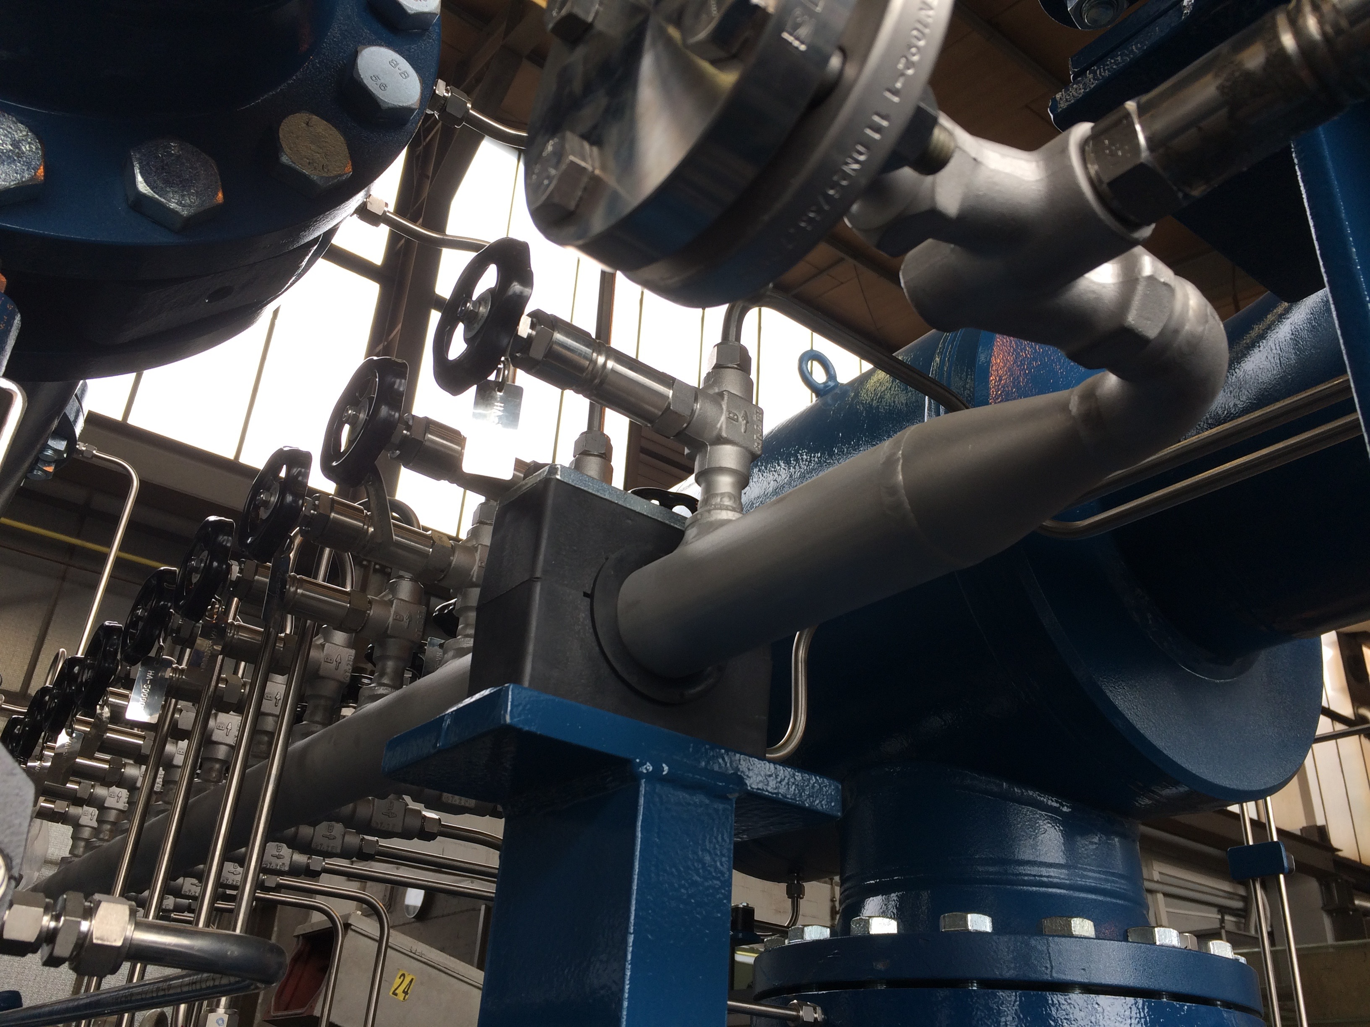
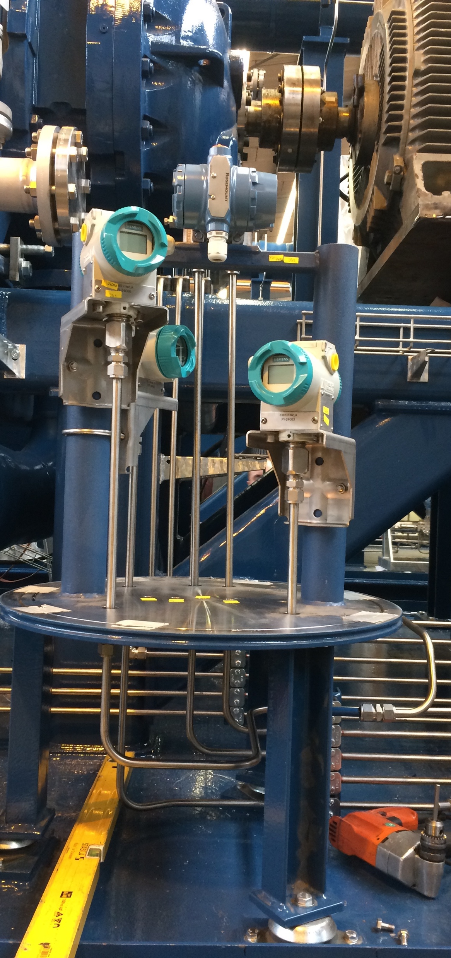
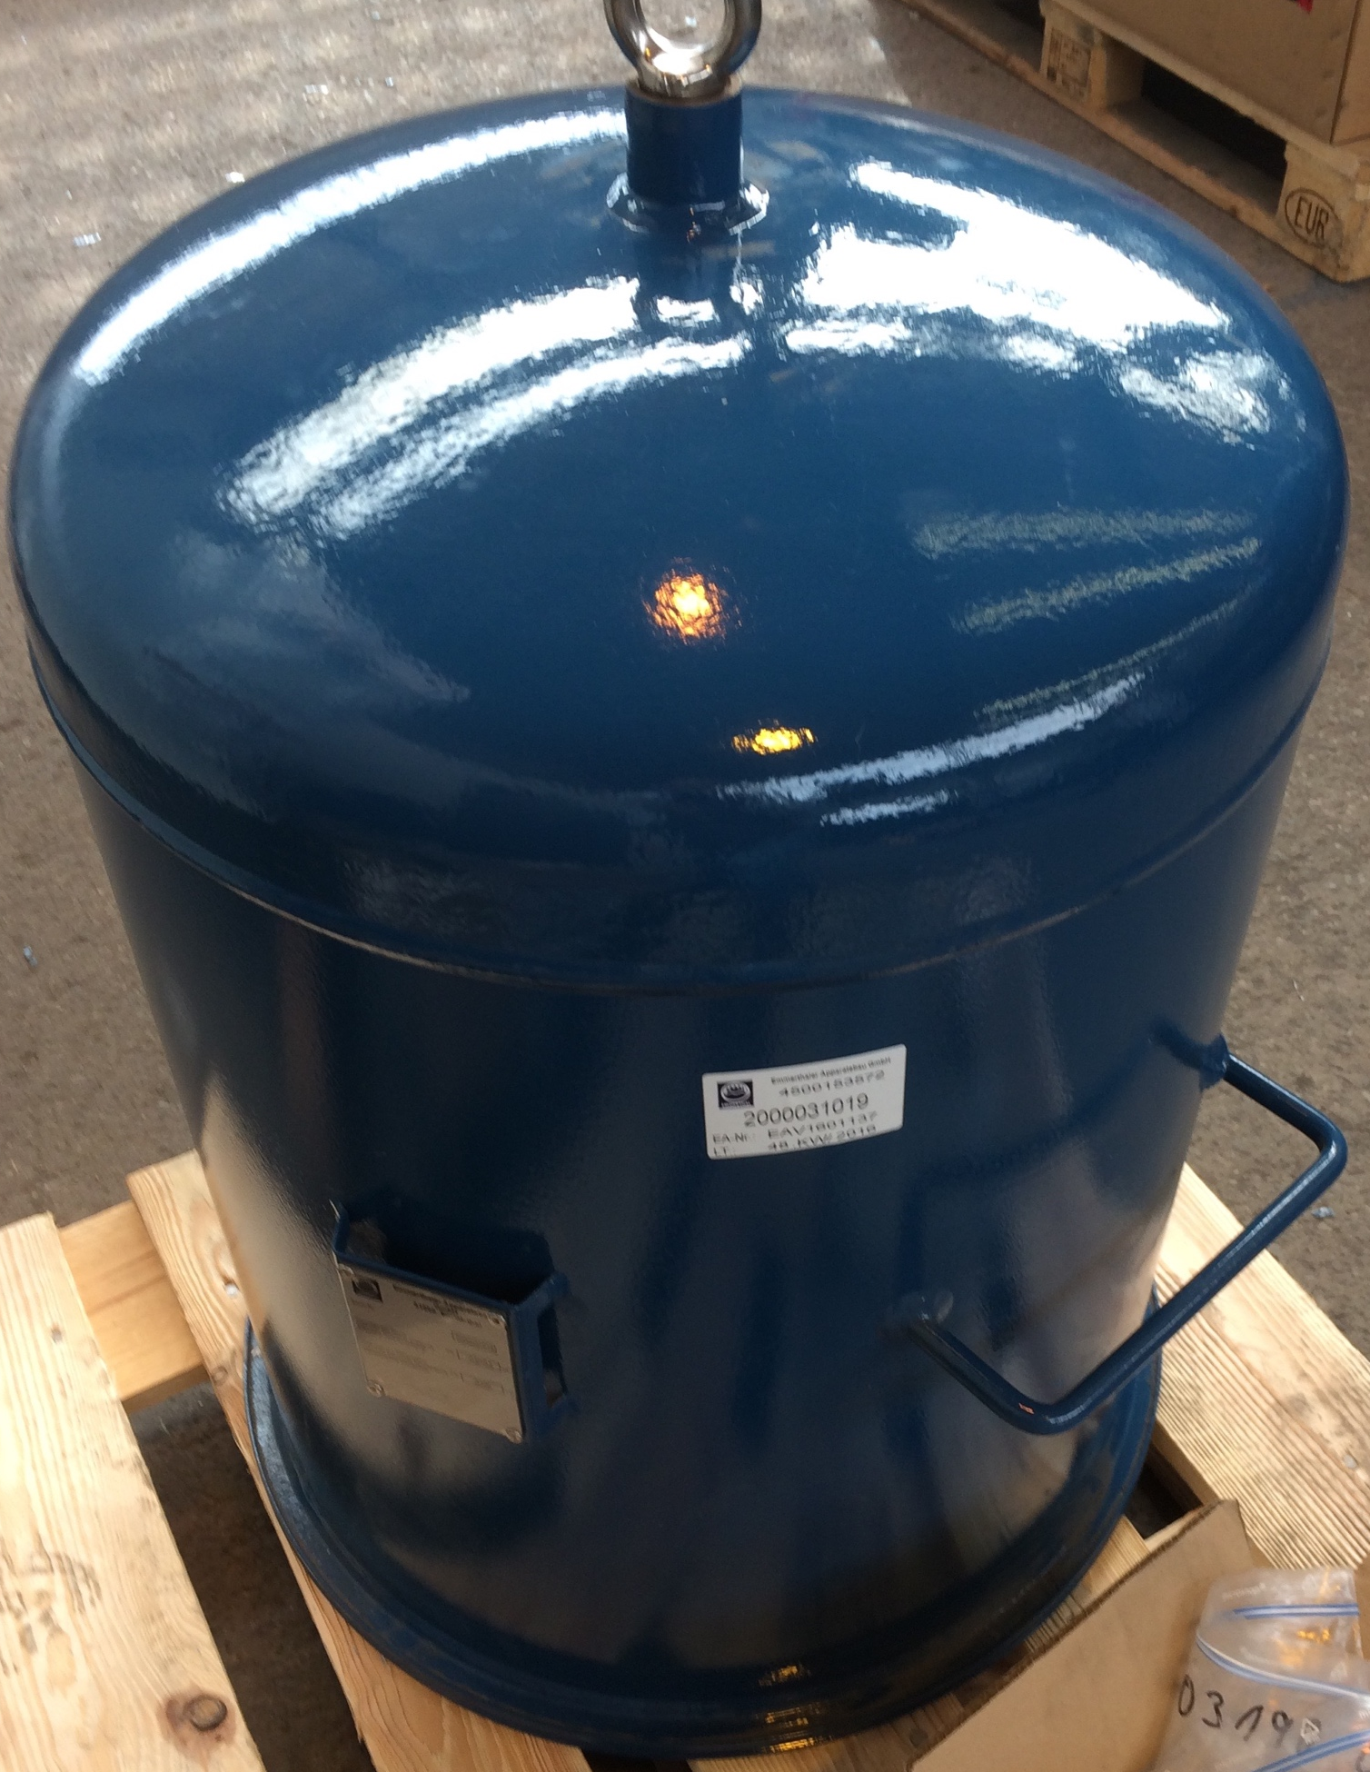
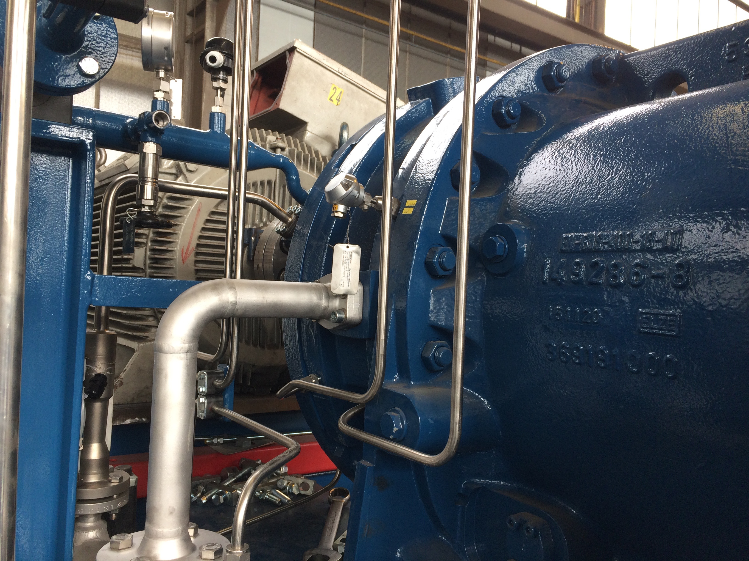
(2.2) Project status-Pictures
Helium guard system for SP compressor

Slide 16
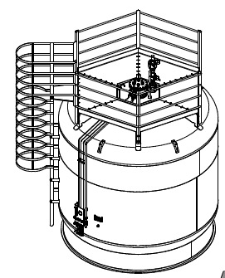
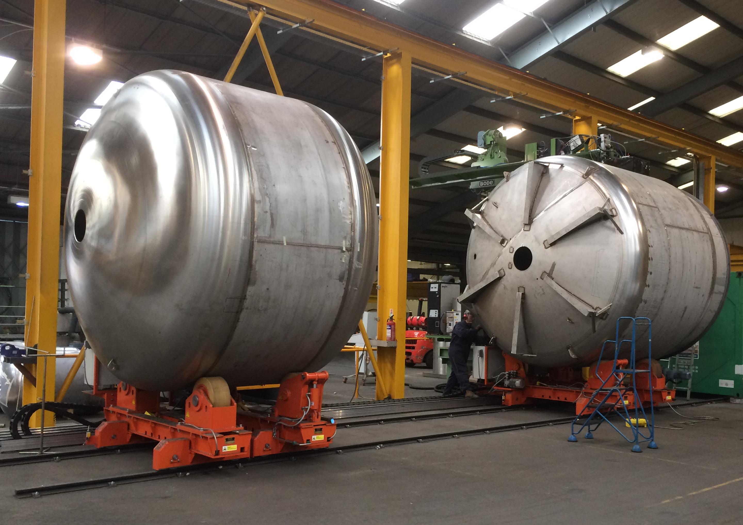
(2.2) Project status-Pictures
20’000 Dewar at the factory

Slide 17
(2.3) Project status-Installation & Commissioning Plans
Installation plan
Installation Readiness Review (28-29 March 2017)
Installation compressor system (May-Aug 2017)
Installation cold box system (Aug-Dec 2017)
Commissioning plan
Pre-commissioning compressor system (Aug-Nov 2017)
  Warm compressor system function and performance test with Helium
  Without connection to the cold box
  S2ND and 100 hours continuous and stable operation
Pre-commissioning cold box system (Dec 2017 – Jan 2018)
Commissioning (Jan-June 2018)
  Cold box function tests
  Cold box transient operation tests
  Cold box performance tests (Stage two first, then Stage one)
Start-up (June-July 2018)
Acceptance test (July-Aug 2018)

Slide 18
Outline
System Overview
Project Status
Conclusion
Upcoming Activities

Slide 19
(3) Conclusion
Design is completed
Fabrication is well under way (almost completed)
Installation and Commissioning will start soon
Project is on schedule

Slide 20
Outline
System Overview
Project Status
Conclusion
Upcoming Activities

Slide 21
(4) Upcoming Activities
Compressor skids delivery at May 2017
ESS utilities available at July 2017
Cold box delivery at August 2017
ACCP acceptance test at August 2018

Slide 22


Slide 23
Extra slides

Slide 24
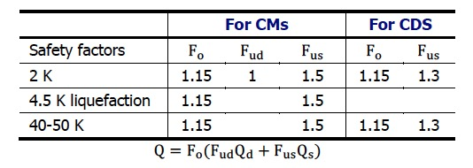
Heat loads and safety factors
Heat loads
Operation modes |  | 2 K |  |  |  | 4.5 K liqu. | 50 K | Exergy efficiency | Customers/Users
 |  | Isothermal, W |  | Non-isother, W | Total | Static | Static
 |  | Static | Dynamic | Static | W | g/s | W | η
Stage 1 (2019-2023) | Nominal | 845 | 1007 | 627 | 2478 | 6.8 | 8551 | 24% | 13 (Spoke) + 9 MB + 21 HB + CTL (385 m) + 43 VB
 | Turndown | 845 | - | 627 | 1472 | 6.8 | 8551 | 18%
Stage 2 (2023-) | Nominal | 1166 | 1060 | 824 | 3050 | 9.0 | 11380 | 26% | 13 (Spoke) + 9 MB + 35 HB + CTL (505 m) + 57 VB
 | Turndown | 1166 | - | 824 | 1990 | 9.0 | 11380 | 21%
Safety factors
CM heat load is predicted by IPNO
CDS heat load is predicated by ESS
24

Slide 25
Exergy Efficiencies
Exergy efficiencies at various operation modes of both stages
Flow parts exchange
Warm compressor control
Floating pressure cycle
VFDs for SP&LP and CCs
Only HP and T3 in operation
VFDs for SP&LP

Slide 26
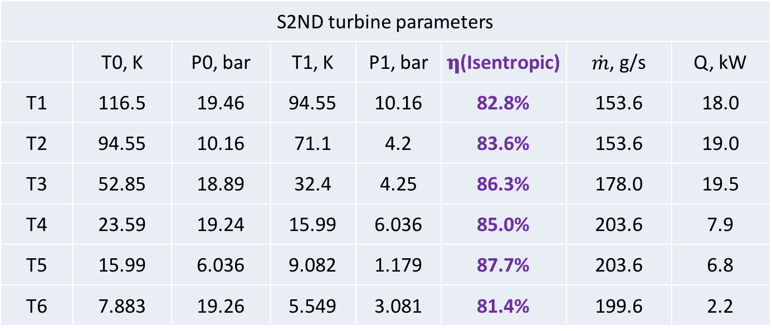
Turbines
S2ND turbine parameters
 | T0, K | P0, bar | T1, K | P1, bar | 𝛈(Isentropic) | $\dot{m}$, g/s | Q, kW
T1 | 116.5 | 19.46 | 94.55 | 10.16 | 82.8% | 153.6 | 18.0
T2 | 94.55 | 10.16 | 71.1 | 4.2 | 83.6% | 153.6 | 19.0
T3 | 52.85 | 18.89 | 32.4 | 4.25 | 86.3% | 178.0 | 19.5
T4 | 23.59 | 19.24 | 15.99 | 6.036 | 85.0% | 203.6 | 7.9
T5 | 15.99 | 6.036 | 9.082 | 1.179 | 87.7% | 203.6 | 6.8
T6 | 7.883 | 19.26 | 5.549 | 3.081 | 81.4% | 199.6 | 2.2

Slide 27
Heat Exchangers
S2-Norminal design
 |  | TW, K | TC,K | ΔT, K | LMTD | NTU
HEX1 | HP | 313 | 116.5 | 7.1 | 8.4 | 23.8
 | MP/LP/VLP | 305.9 | 106.7 | 9.8
HEX2 | HP | 116.5 | 72.3 | 9.8 | 4.1 | 10.8
 | MP/LP/VLP | 106.7 | 71.1 | 1.2
HEX3 | HP | 72.3 | 52.83 | 1.2 | 1.5 | 13.5
 | MP/LP/VLP | 71.1 | 51 | 1.83
HE4 | HP | 52.83 | 33 | 1.83 | 1.0 | 20.3
 | MP/LP/VLP | 51 | 32.56 | 0.44
HE5 | HP | 33 | 23.6 | 0.44 | 0.8 | 12.8
 | LP/VLP | 32.56 | 22.27 | 1.33
HE6 | HP | 23.6 | 9.274 | 2.08 | 0.8 | 18.1
 | LP | 21.52 | 9.082 | 0.192
HE7 | HP | 9.274 | 7.876 | 0.192 | 0.9 | 4.1
 | LP | 9.082 | 5.445 | 2.431
HE8 | HP | 5.549 | 5.406 | 0.104 | 0.4 | 2.6
 | LP | 5.445 | 4.414 | 0.992
HE9 | HP | 5.406 | 4.5 | 0.992 | 0.4 | 2.4
 | Subcool | 4.414 | 4.407 | 0.093

Slide 28
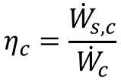






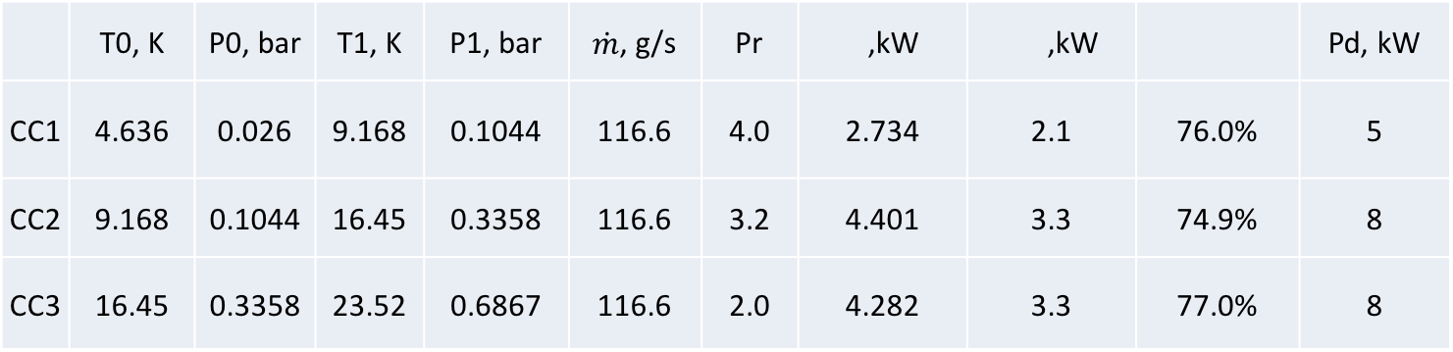
Cold Compressors
$${\dot{W}}_{s,c}$$
 | T0, K | P0, bar | T1, K | P1, bar | $\dot{m}$, g/s | Pr | ,kW | ,kW |  | Pd, kW
CC1 | 4.636 | 0.026 | 9.168 | 0.1044 | 116.6 | 4.0 | 2.734 | 2.1 | 76.0% | 5
CC2 | 9.168 | 0.1044 | 16.45 | 0.3358 | 116.6 | 3.2 | 4.401 | 3.3 | 74.9% | 8
CC3 | 16.45 | 0.3358 | 23.52 | 0.6867 | 116.6 | 2.0 | 4.282 | 3.3 | 77.0% | 8
$${\dot{W}}_{c}$$
$$η_{c}$$
$$η_{c}=\frac{{\dot{W}}_{s,c}}{{\dot{W}}_{c}}$$
$$η_{c}$$
Compressor isentropic efficiency
$${\dot{W}}_{s,c}$$
The power required by a reversible compressor operating under the same conditions as the actual compressor
$${\dot{W}}_{c}$$
The power required by the compressor

Slide 29
2 K Test Circuit
CV32891 controls PI32890 (probably constant around 1.22 bara)
EH32891 equals the non-isothermal heat load (constant)
EH32890 is set to a constant value
EH31890 equals total isothermal load minus EH32890 (simulates number of CMs attached)
CV31890 controls LI32890

