Slide 1
Charge and Schedule
of the 15th TAC meeting
5-7 April 2017, Lund
Roland Garoby
https://indico.esss.lu.se/event/578/overview

Slide 2
TAC-related News…
TAC membership (1/3)
New members
Name | Institution | End of term
Syratchev, Igor | CERN, Switzerland | 2019
Koscielniak, Shane | TRIUMF, Canada | 2019
Petersen, Bernd | DESY, Germany | 2019
Mueller, Roland | Helmholtz Zentrum Berlin, Germany | 2019
Berthe, Cyrille | GANIL, France | 2019
Neuhaus, Jurgen | TUM, Germany | 2019

Slide 3
TAC-related News…
TAC membership (2/3)
Prolonged members
Name | Institution | End of term
Gerigk, Frank (co-chair) | CERN, CH | 2018
Heron, Mark (co-chair) | Diamond, UK | 2018
White, Karen | SNS, USA | 2018
Ferguson, Phillip (co-chair) | SNS, USA | 2018

Slide 4
TAC-related News…
TAC membership (3/3)
Continued members
Name | Institution | End of term
Facco, Alberto (TAC chair) | INFN Legnaro, Italy | 2017 (2020)
Lombardi, Alessandra | CERN, CH | 2017
Mosnier, Alban | CEA, France | 2017
Weise, Hans | DESY, Germany | 2017
Futakawa, Masatoshi | JAEA, Japan | 2017
Broome, Tim | Retired ISIS | 2017
Wohlmuther, Michael | PSI, CH | 2017
Török, Szabina | MTA EK, Hungary | 2017
Perlado, Manuel | ETSII, Spain | 2017
Butzek, Michael | FZJ, Germany | 2017

Slide 5
TAC-related News…
Changes to TAC
Redistribution of members’ competencies:
Accelerator: 8
Target: 8
ICS: 4
New co-chair for ICS (Mark Heron)
Extension of t-TAC field to the “Bunker”

Slide 6
Questions to the TAC for its 15th meeting
Accelerator
a1) Are there any significant technical issues seen in the STS work?
a2) Is there any orphaned scope identified?
a3) Are the interface between the STS work and other work packages properly defined and addressed?
a4) Are there any issues seen in the STS work as it transitions from project construction to operations?
a5) Comment upon the risks and options for improving the proposed solution for an initially reduced beam power of 3 MW.
a6) Do you see any significant increase in total project cost, up through and including the installation of deferred components, and, in that case, can you suggest mitigations?
a7) Do you consider the presented solution for the RFQ cooling circuit adequate, and does it remove the concerns formulated at the TAC meeting one year ago?

Slide 7
Questions to the TAC for its 15th meeting
Target
t1) Is the presented design of the tuning beam dump sufficiently robust and versatile?
t2) Comment on the decision to postpone pursuing the option of operating the target station without a proton beam window.
t3) Is the process for identifying and allocating safety functions sufficiently comprehensive and balanced in order to assure a reliable and safe operation of the target station?
t4) Is the presented approach for definition of the “ready for beam” signal sound and well balanced? Are all relevant process parameters selected with appropriate thresholds?
t5) Many of the target station systems are about to transition from final design to manufacturing, as exemplified by presentations of the target wheel drive unit and the cryogenic moderator system. The committee is asked to give specific as well as general recommendations with respect to this new phase of the project.
t6) Comment on the chosen technical solutions for the neutron beam extraction system and the instrument bunker.

Slide 8
Questions to the TAC for its 15th meeting
ICS
c1) Are technical choices for the MTCA platform appropriate and sufficient?
c2) Have the major technical obstacles for deploying the digital platform been identified and addressed?
c3) Are the features of EPICS 7 addressing the needs of the facility and are they ready for deployment and operation at ESS/ICS?
c4) Will the planned development, testing, and approval procedures allow for sufficiently high quality to ensure reliable operation?
c5) Have all the major installation activities for commissioning and operation been identified and their needs addressed?
c6) Is the relative priority and ordering of tasks appropriate and reasonable considering the commissioning/operation plans?

Slide 9
Additional considerations
General questions
Have the recommendations and concerns of the previous TAC meeting been properly addressed?
Additional suggestions/comments and recommendations?
Planning
A preliminary version of the Committee report is expected on Friday 7, April.
The final report is expected before the end of April.
The Chairman will orally present the TAC#15 report to the Council on June 1-2 in Warsaw (PL).

Slide 10
Agenda TAC#15: Wednesday 5 April 2017
Meeting on construction site
Dinner at

Slide 11
Agenda TAC#15: Thursday 6 April 2017 (morning)
Meeting at
Medicon Village

Slide 12
Agenda TAC#15: Thursday 6 April 2017 (afternoon)
Meeting at
Medicon Village

Slide 13
Agenda TAC#15: Friday 7 April 2017
3.25 hours TAC session: additional Q&As and presentations are possible
Optional private close out to the ESS management

Slide 14
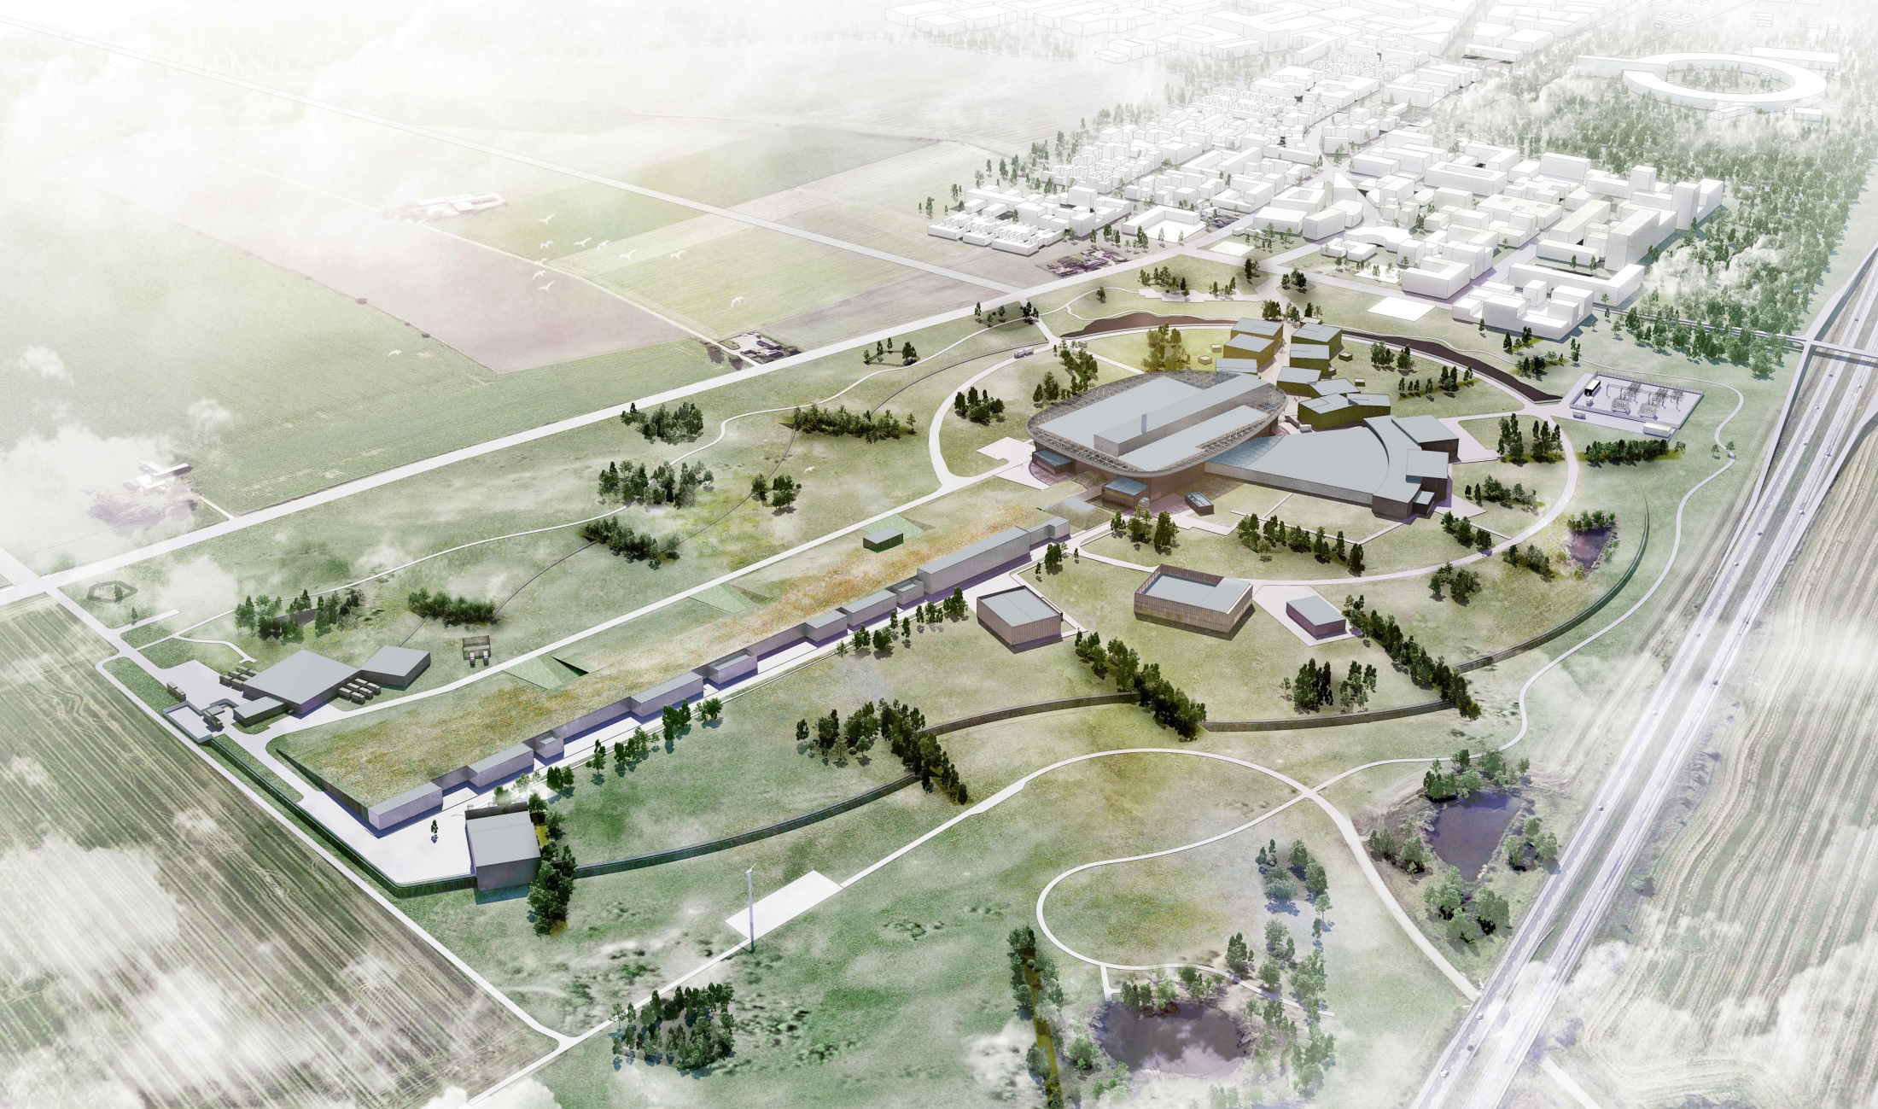
Thank you for being here.
We look forward to your advice!

