Slide 1
ACCSYS TAC 15
Mats Lindroos on behalf of ACCSYS staff and IK partners
www.europeanspallationsource.se
April 2017

Slide 2
Accelerator Division – Scope
Accelerator Technical performances
Key parameters:
    -2.86 ms pulses
    -2 GeV
    -62.5 mA peak
    -14 Hz
    -Protons (H+)
    -Low losses
    -Minimize energy use
    -Flexible design for mitigation and future upgrades
Design Drivers:
High Average Beam Power
5 MW
High Peak Beam Power
125 MW
High Availability
352.21 MHz
704.42 MHz
2.4 m
4.6 m
3.8 m
39 m
56 m
77 m
179 m
Target
Source
LEBT
RFQ
MEBT
DTL
Spokes
Medium β
High β
HEBT & Contingency
75 keV
3.6 MeV
90 MeV
216 MeV
571 MeV
2000 MeV
First beam at 572 MeV in June 2019
5 MW capacity for 2023
RF sources for HB part is the scope contingency for accelerator – VE talk!

Slide 3



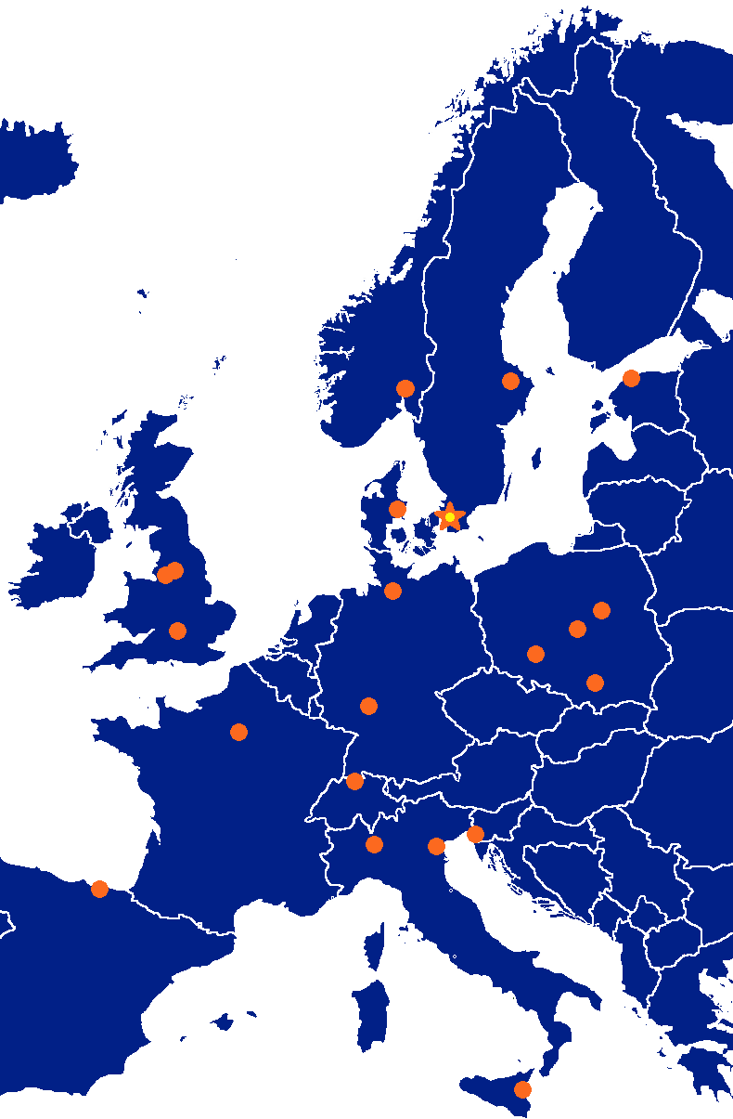



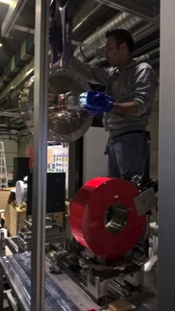




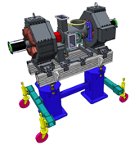


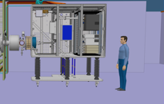



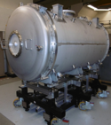
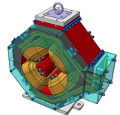

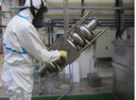

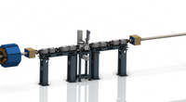




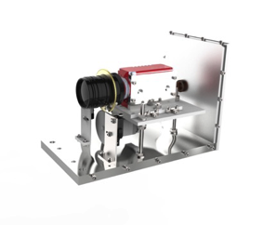
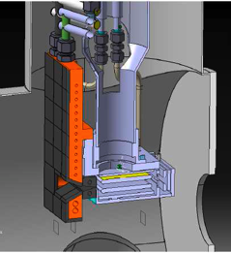
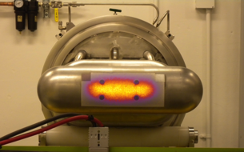

Accelerator Collaboration - Accelerator
352.21 MHz
704.42 MHz
2.4 m
4.6 m
3.8 m
39 m
56 m
77 m
179 m
Target
Source
LEBT
RFQ
MEBT
DTL
Spokes
Medium β
High β
HEBT & Contingency
75 keV
3.6 MeV
90 MeV
216 MeV
571 MeV
2000 MeV

Slide 4

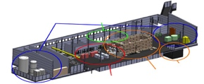



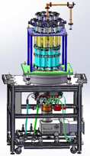
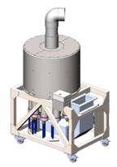



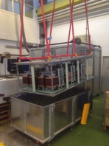
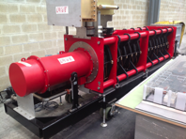
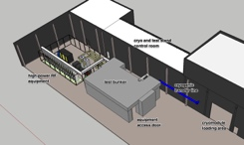
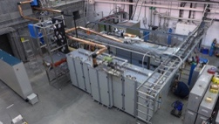
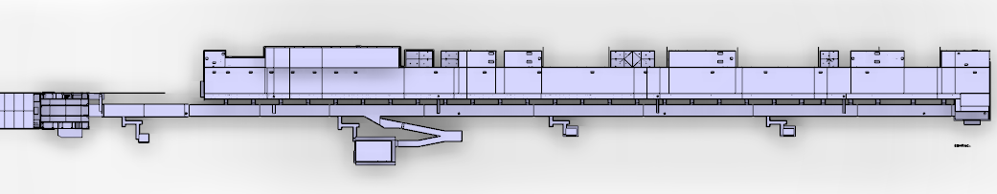









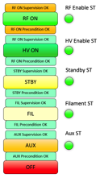


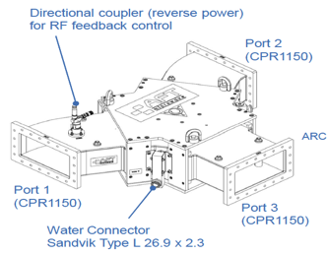
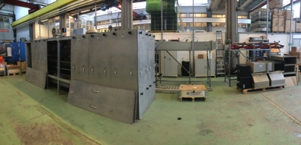
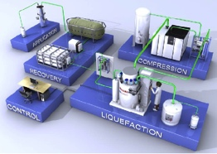

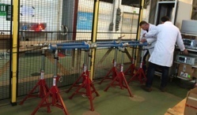

Accelerator Collaboration – RF and STS
Concept, courtesy of GRE (UK)

Slide 5
High Level Schedule – ACCSYS Project
2016
2017
2018
2019
2020
2021
2022
NCFE
RFI ISRC & LEBT
RFI
MEBT
START RFQ MACHINING
RFI
RFQ
RFI
DTL5
SC LINAC
2 GeV
READY
SPOKE CM
TESTING STARTS
Spoke & Elliptical
cavities and cryomodules
SPOKE & MB CM
PRODUCTION
LAUNCHED
MB CM
TESTING STARTS
1-11 HB CM INSTALLED
12-21 HB CM INSTALLED
SC LINAC
570 MeV
READY
TOSHIBA/CPI/THALES KLYSTRON
PROTOTYPE DELIVERED
TECHNICAL STOP
TECHNICAL STOP
RF
CPI/THALES AND L3 IOT
PROTOTYPES DELIVERED
DECISION IOT OR
KLYSTRON FOR HB LINAC
RF SYSTEM
FOR MB
READY
TOTAL: 519 M€
CDS INSTALLATION
STARTS
Cryogenics
ACCELERATOR
CRYOPLANT
COMM./READY
CDS COMMISSIONED
BEAM COMM. COMPLETED FOR NCFE but DTL5
Commissioning
START RFQ COMMISIONING
BEAM COMM. COMPLETED FOR ISRC-> MEBT
FIRST PROTONS ON TARGET
1370 MeV PROTONS
AVAILABLE
2 GeV PROTONS AVAILABLE

Slide 6
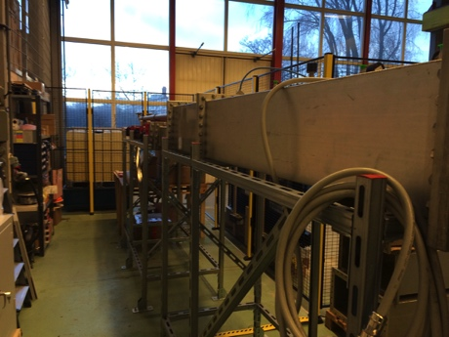
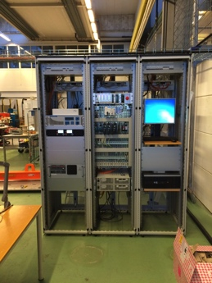
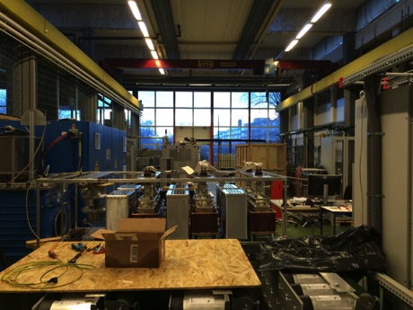
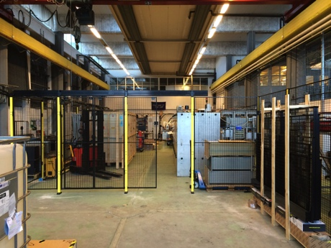
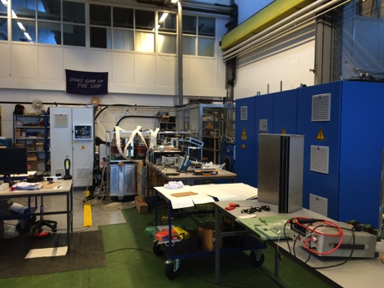
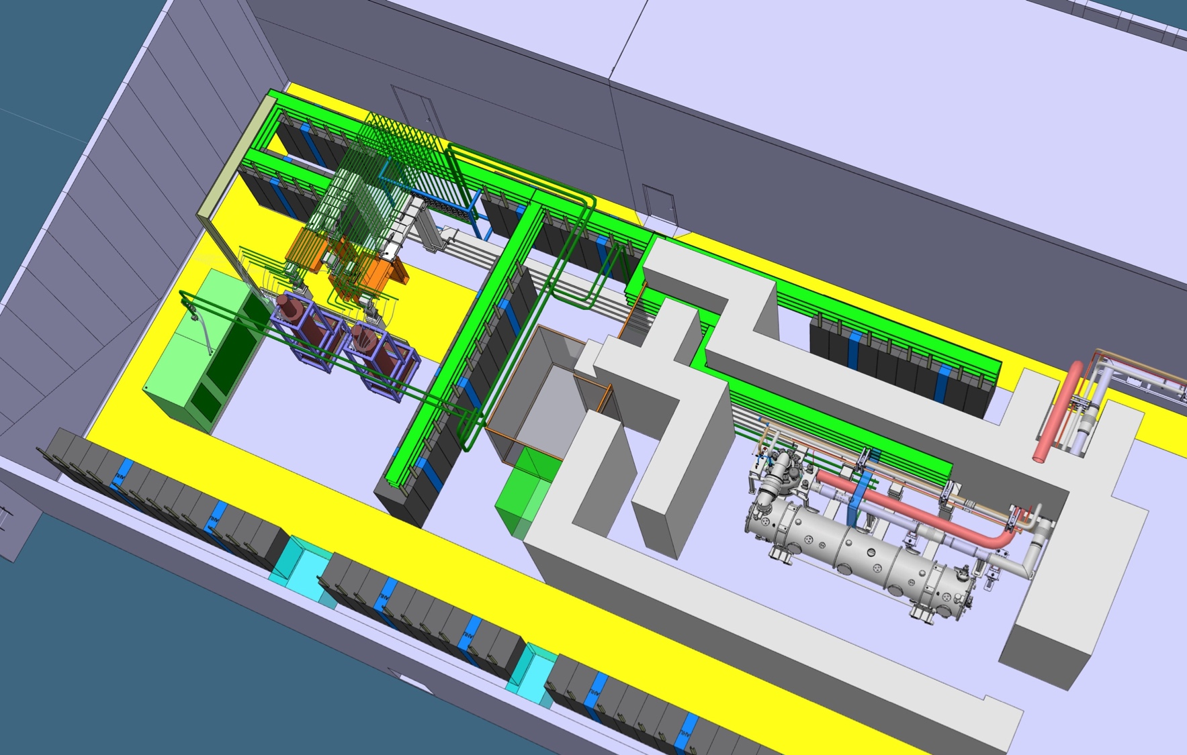
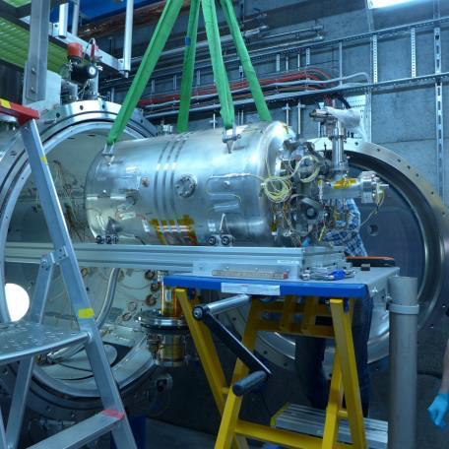
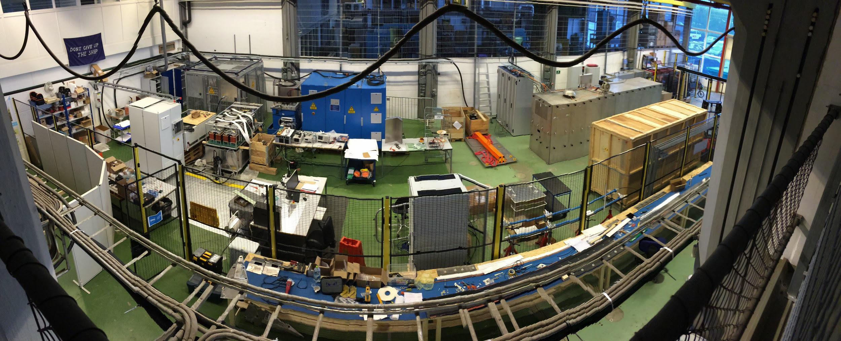
Test Stands 1, 2 and FREIA – Getting our hands dirty!

Slide 7
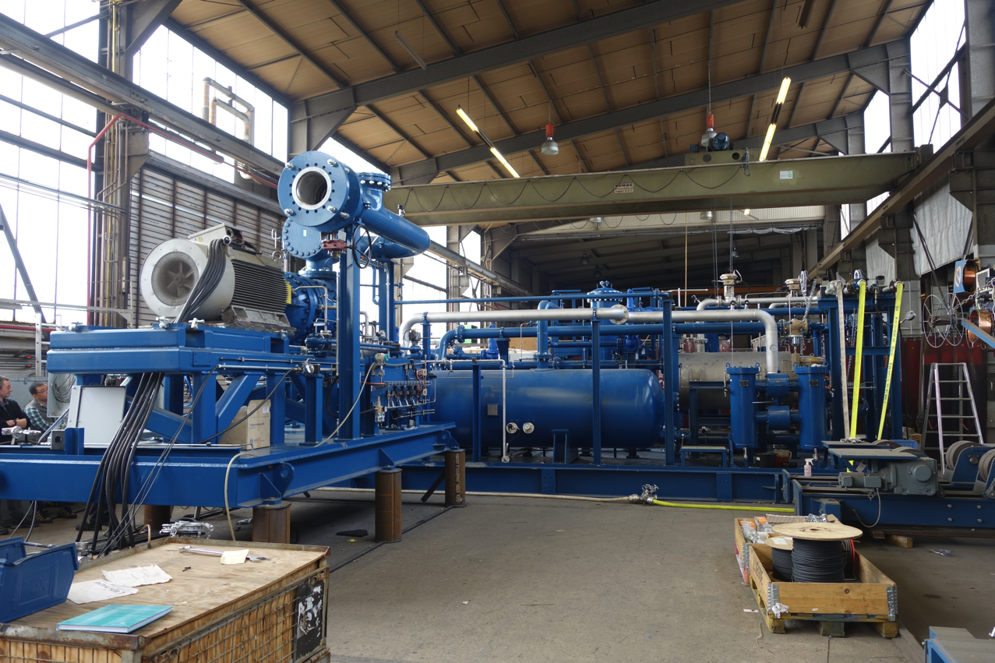
ACCP High Pressure He Compressor & Oil Removal System at Vendor

Slide 8
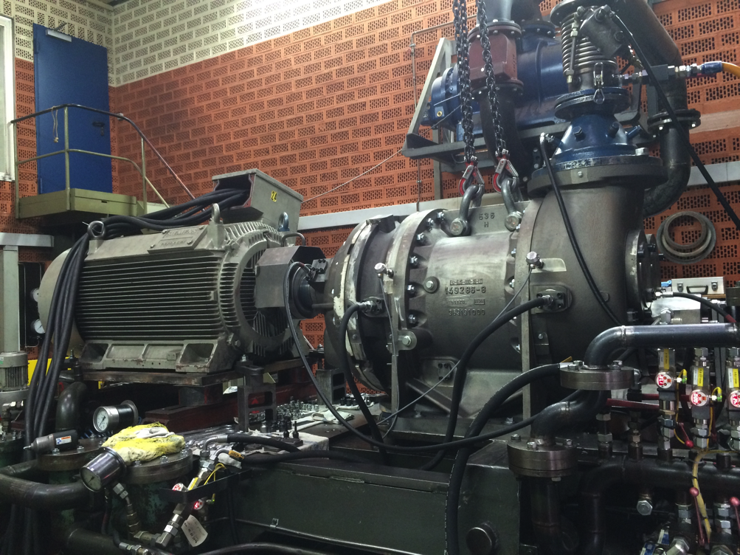
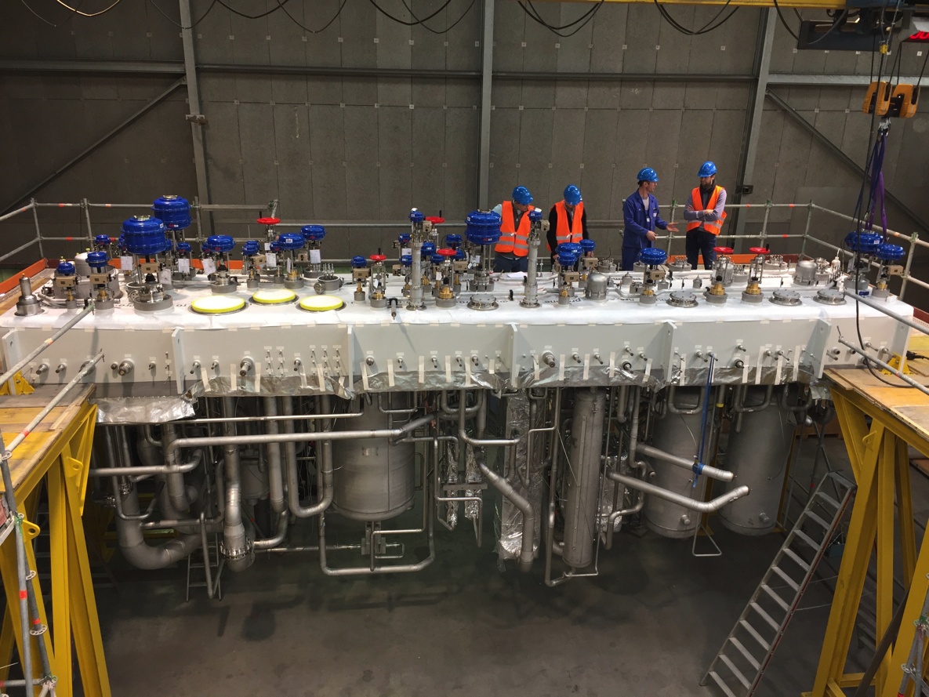
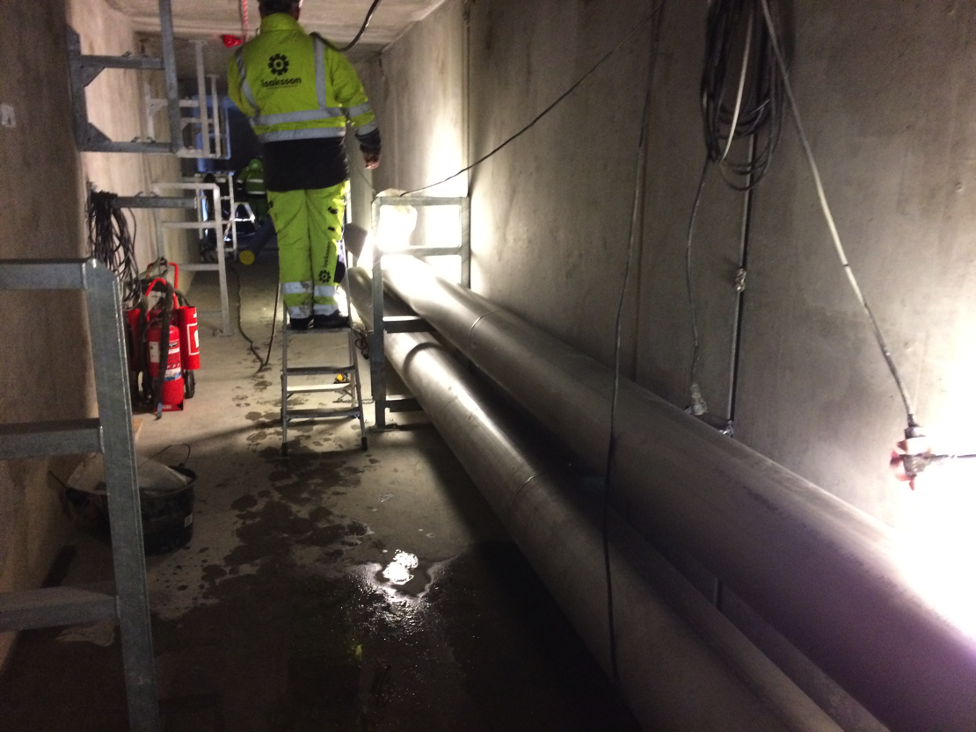
Cryogenics
Cryogenic Systems – Successful FAT of all Aerzen screw , warm piping installation under-way on site and cold box upper plate under production

Slide 9
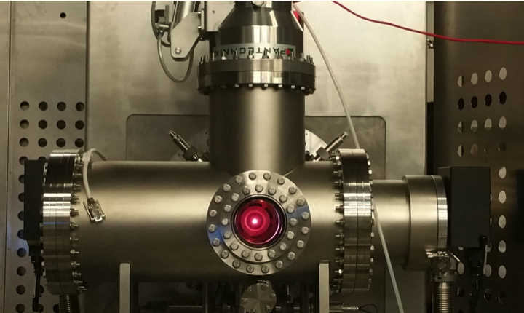
First plasma in the ion source in Catania – now operating a nominal parameters

Slide 10
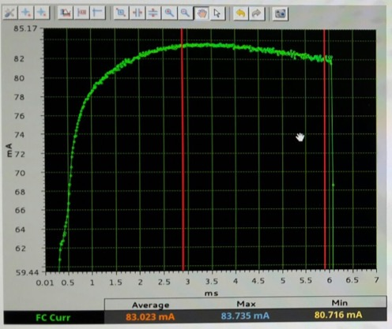
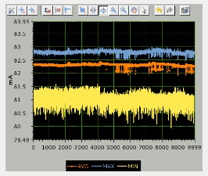
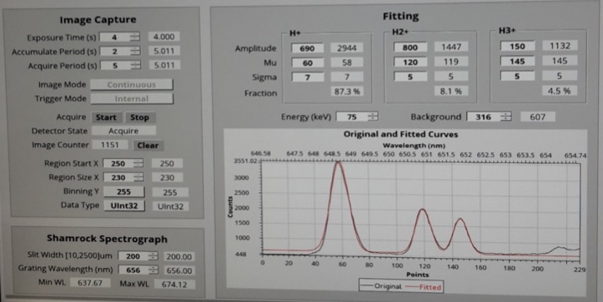
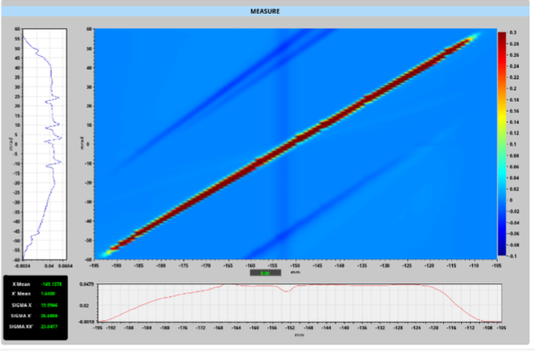
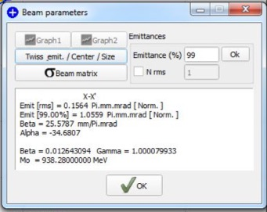
Proton Fraction: 83% (> 75%)
Preliminary beam characterization
Extracted beam: 82 mA (close to goal:90 mA,to be obtained with larger extractor& Alumina wall)
Pulse stability: ±1% (better than ±2%)
Pulse repeatability: ±1.8% (< ±3.5%)
Emittance: 1.06 π.mm.mrad (< 1.8)
Max divergence: 55 mrad (< 80)

Slide 11

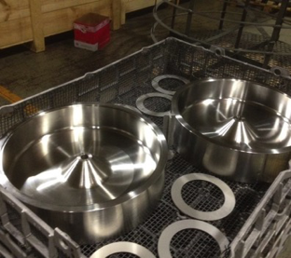
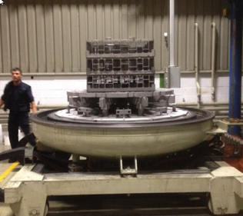
WP3: MEBT
Buncher Cavity Production and Heat Treatment

Slide 12
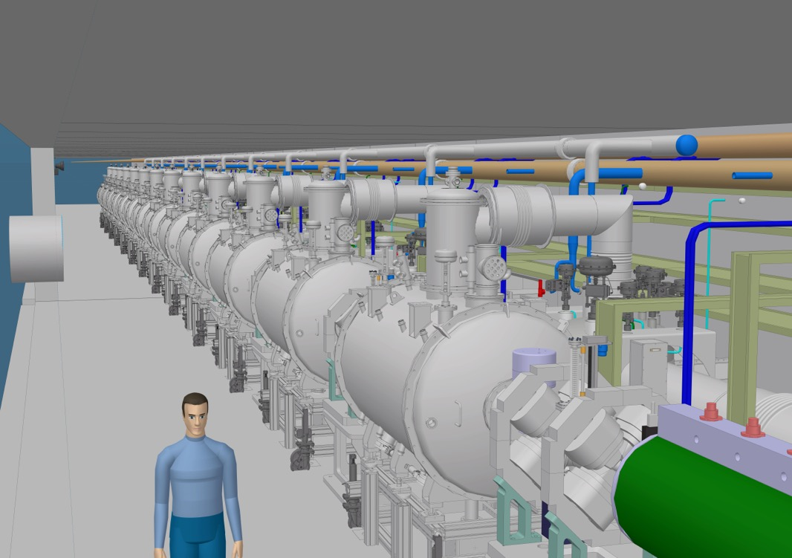
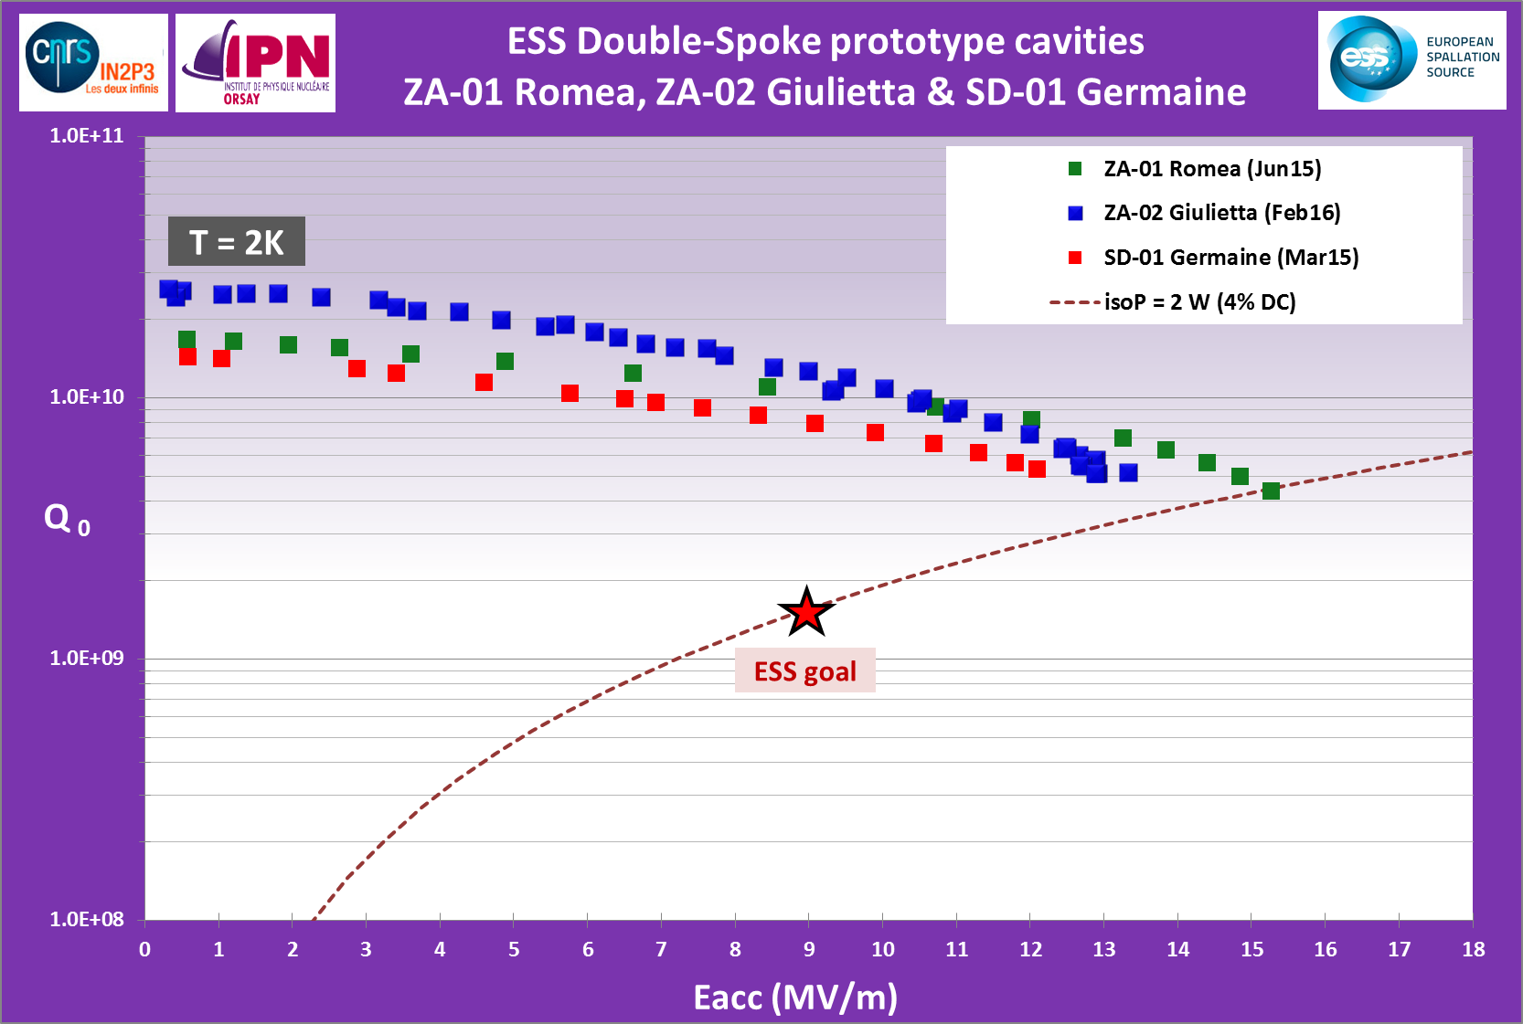
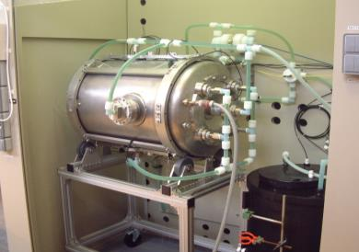
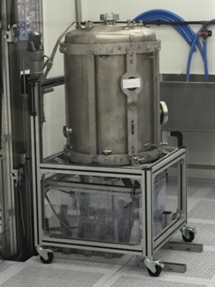
Spoke Cavities design & prototype performances
Spoke cavity prototype test results (Jan15 – Feb16):
Excellent performances, well within specifications (both on Eacc & Qo)
Pcav<0.5W
Chemical etching
Ultra pure water
high pressure rinsing

Slide 13
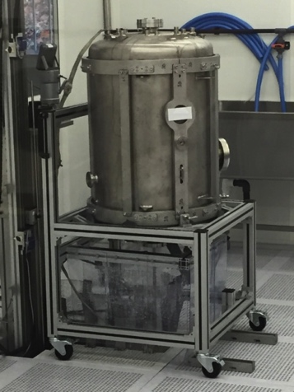
Spoke Cavities design & prototype performances
Spoke cavity prototype test results (Jan15 – Feb16):
Excellent performances, well within specifications (both on Eacc & Qo)
Pcav<0.5W
Chemical etching
Ultra pure water
high pressure rinsing

Slide 14




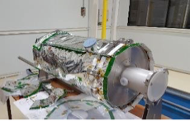




Ellipticals
Highlights
WP5 Elliptical Cavities and Cryomodules:
  Medium Beta P01 Cavity result
Notes:
36 medium beta cavities and 84 high beta cavities:
Following the recent good results obtained with MB-IOT, this technology could become the baseline for high beta. An improvement of the collector would be needed.
* Even if the klystron collectors should be able to sustain twice the average power, an improvement of the collector would be needed.

Slide 15




INFN LASA MB Cavity Test
Soft Multipacting barrier
The INFN LASA cavity was successfully tested @ 2 K, exceeding the ESS specifications.
Power Rise @ 2 K
A soft MP barrier was easily conditioned.
This barrier matches with simulations.
HOM near 5th machine line
100 W CW cryo power,
i.e. 16.7 MV/m @ Q₀ 5 10⁹
f = 1741.8 MHz (> 19 MHz from machine line)
Δf < 1 MHz from simulations (f =1742.4 MHz).

Slide 16


WP12 Vacuum Systems
BTM Delivery
1st Prototype LWU at ESS
2nd Prototype LWU at Daresbury
ELLETRA Quadrupole at CERN for testing

Slide 17




WP 17 – 660kVA modulator design
SML topology tested succesfully for 120 KVA prototype
3.8m
Compact
Retractable HV oil tank for easier access
2.3m
Integrated oil spill bin
1.4m
All in one frame with permanently mounted wheels for easy transportation
Total footprint: 3.8m x 1.4m
(planned was 5.5m x 1.6m, i.e. 40% less);
Total weight: < 4 tons (without oil);
Total volume of oil: ~ 2200 litters;
Preparation of “Build to Print” documentation for tendering:
Completed: → Detailed Electrical Schematic; → 3D CAD drawings; → Bill Of Materials (BOM);
Ongoing: → Technical Specification writing; → PDR is foreseen for early October
HV module

Slide 18







WP8 Prototypes
Thales/CPI IOT vacuum part
All three Klystron Prototypes Complete (CPI, Thales and Toshiba)
CPI klystron arriving on ESS site
Thales/CPI IOT Input cavity part
L3 IOT Complete

Slide 19
A lot of progress but also some issues:
Halt of procurement for ESS at IPN Orsay
  Delays for spoke section
Halt of procurement for ESS at ESS Bilbao
  Delays for RF for NC linac
Remaining procurement issues at Elettra
  Delays for RF and magnet power supplies
Significant effort needed to coordinate with CF and Skanska to “get going on site”
Delays will require a new integrated installation, testing and commissioning schedule based on realistic RFI dates
  New integrated plan will be resource loaded and will serve as basis for CR for missing installation budget

Slide 20



EV Graph
(* No InKind included)
Current Status
Cost Variance has by end of Feb slipped to -1.8 M€.
Main negative contributors to the CV are: Power converters, Beam Diagnostics, Beam Delivery and Cryogenics
Schedule variance is slipping to -17.4 M€.
Main negative contributors to the SV are: Power Converters, NCFE, RF Systems, Vacuum, Cryogenics and Beam Diagnostics

Slide 21

Cumulative Variances
(* No InKind included)

Slide 22
Safety - summary of on-going work
Design study (EIS) of the helium collection header - on-going. Results and progress of the study can be found at ESS-0102357
Installation safety support
  Coordination of safety training for AD employees involved in installation activities
  Work and Safety Coordination Plan (WSCP) available on ESS-0085649
    Main objective: to identify the list of preparatory and organizational measures required prior to the start-up of the installation activity to be carried out by the contractor, as well as the list of associated hazards and safety control measures to be implemented
  First draft of the installation responsibility matrix available on ESS-0093460
    Main objective: to define the roles and responsibilities of the main stakeholders involved in the accelerator installation activities to be performed on site.
  General information for contractors coming on the ESS site ESS-0093892
    Main objective: to communicate the minimum and essential information to the contractors prior to the start-up of their activities on site
Radiation safety and licensing
  Application for installation – safety analysis for accelerator systems and allocation of radiation safety functions, also safety related systems when possible – complete and available under ESS-0051474 and ESS-0051694
  Application of 1st stage beam commissioning – safety analysis is on-going
Operational limits and conditions (OLC) for 1st stage beam commissioning
  A working group formed, lead from accelerator division.
  First draft will be ready by the end of May

Slide 23

Accelerator Systems Assurance - including Quality Assurance & Quality Control
Accelerator’s WPs and Partners collaborate through:
Agreements e.g. Supply Agreements, IKC Agreements/Technical Annexes
planning, weekly Skype, monthly progress review and reporting
Technical Reviews e.g. Design Reviews (PDR, CDR), Installation Readiness Review, System Acceptance Review)
Status: Approx. 30 Partners, 50 Agreements, and 50 Technical Reviews completed (~50%) – IRRs started in March 2017
The Purpose is to assure engineering products are designed, constructed and delivered in accordance with:
technical requirements & specifications
regulations and directives
standards
The Systems are:
buildings and infrastructure
Linac, RF and major supporting systems (cryo, vacuum etc.)
installation work
operations and maintenance ‘systems’ – competencies, manuals, test equipment, spares
Systems Assurance is achieved by:
assure product quality (QA) - planning, contracting, project and engineering management by WPs & Partners
control product quality (QC) - inspection & test during manufacture, assembly and installation
engineering verification of requirements, including FAT and SAT
operational validation, during Commissioning Phase

Slide 24


ESS Accelerator
Quality Assurance & Control
ESS MS
ESS Management System
(ESSMS)
Partner’s Management
& Quality Systems
ESS-001122
Programme Plan for ESS
ESS-0005380
Construction Phase Management Plan
ESS-Partner
Agreement
including SoW / ‘Technical Annex’
ESS-0001156
ACCSYS Project Plan (Construction Phase)
ESS-0037830
PQP Template
e.g.
ISO 10000
Quality Plan
ESS-0033583
ACCSYS PQP
(Construction Phase)
ESS-Partner
PQP

Slide 25
Design Reviews
  A total of 38 Design Reviews were held in 2016 with an additional 30 – 35 expected in 2017
  So far in 2017 we have held
    Raster System CDR2
    Beam Physics High Level Review
    NPM PDR
    MEBT CDR ( Mechanical and assembly)
    LTS2-CDS CDR
    PRL PDR
    Gamma Blocker PDR
    Magnet power Converters PDR2
  We expect to finish all PDRs & CDRS this year
  We are starting Installation Readiness Reviews (IRR) and System Reviews
    ACCP IRR held in March – RF Cell System review to be held at the end of April

Slide 26
Risk Status
In preparation for Risk workshop at ESS for ACCSYS
  WP3, 4,5, 7, 8, 17 and Installation are subject to evaluation
  Out of this we shall select the 5 most important ones to present at the meeting
  We will shall not select the five top ones at exonaut (unless they are still valid or not redefined)

Slide 27
Current Risk Status risk DB
Event | Potential Impact* | Probability | Mitigation measures | Retirement date
In-kind contributors do not meet scope and schedule requirements | Quality Schedule | 4 | communicate regularly with IKC inform work status to the project Yearly formal audit of WP progress
Unidentified design faults are not prototyped and fail in production | Schedule Quality | 4 | PDR/CDR prior to manufacturing All WPs undergo a yearly audit
Suppliers do not deliver on time with right quality/quantity, e.g. klystrons, modulators, CMs, | Quality Schedule | 4 | PDR/CDR prior to manufacturing Make sure QA/QC plans are in place
Inadequate ability to deal with on-site adjustments during construction as well as during operations | Quality Schedule | 3 | Improve installation planning Follow up on needed space for workshops on site

Slide 28
Examples of new risks identified
Event | Potential Impact* | Probability | Mitigation measures | Retirement date
ICS not supporting digital platforms used in prototypes, up to 15 FTE years increase for BD and RF, or schedule delays | Quality Schedule |  | Freeze designs as planned so that project goals can be achieved (installation and commissioning), and upgrade during early ops to achieve operations goals (maintainability and availability); or 2. immediately add engineering resources to assist with migration, debugging and re-verification of systems, and also add engineering/tach resources to install and integrate systems in less time
Magnet power converter - delays in production due to tight schedule | Schedule Quality |  | Strong implication on staff , recruit additional staff
RF power stations for spokes - lack manpower resources at ESS for production Modulators RFQ/DTL - lack manpower resources at ESS for production Modulators Medium Beta - lack manpower resources at ESS for production | Quality Schedule |  | Recruit additional staff
Late delivery of CDS (part 1 and 2) | Quality Schedule |  | carefully evaluate manufacturing time schedule and contractors WS for detailed planning, broken down activities, man h to finalization inc. dependencies Resource allocation

Slide 29
Current Accelerator top 3 cost risks
Risk: The cost of the RF hardware is significantly above estimates.
Mitigation:
    Purchase prototypes to help verify costs
Risk: The Elettra in kind contribution for the spoke RF transmitter will be more expensive
Mitigation:
    Propose Change of technical solution with Elettra
    Close communication with Elettra on final cost numbers
MUCH REDUCED!
Risk: The IK piping installation comes in above estimations (Tunnel & Gallery)
Mitigation:
    Develop Basic engineering as basis for more detailed scope and cost quantifications

Slide 30
Planned to be presented at IKRC 12
No. | ESS Project | Country | Type of Agreement | Accronym | IKC No. | WP Description | Date (to be) endorsed at IKRC
15 | ACCSYS | UK | IKC | STFC Daresbury | AIK 12.1 | Linac Warm Units (LWU) | 2017 Q2
2 | ACCSYS | Spain | IKC | ESS-B | AIK 3.1 | MEBT | 2017 Q2
170 | ACCSYS | France | IKC | CEA | AIK 5.5 | Technical support to the installation and commissioning | 2017 Q2
9 | ACCSYS | UK | IKC | STFC Daresbury | AIK 5.7 | High-beta elliptical cavities, fabrication and testing | 2017 Q4
5 | ACCSYS | Spain | IKC | ESS-B | AIK 7.5 | Medium Beta Beam Stop System | 2017 Q2
3 | ACCSYS | Spain | IKC | ESS-B | AIK 8.1 | RF for warm Linac | 2017 Q2
23 | ACCSYS | Italy | IKC | Elettra | AIK x.x | Technical Support to the Installation and Commissioning | 2017 Q2
200 | ACCSYS | Grecce | ? |  | AIK x.x | Will now be done via a procurement rather than IK | 2017 Q2

Slide 31
Open Contributions/ Planned Procurement
11.7 | Beam Diagnostics | Target grid and aperture monitors (electronics and mech parts) |  | Lund colab and proc. mech | Lund contract, Proc start asap.
11.8.5.6 | RF amplifiers | Medium-beta klystrons |  | AIK 8.8 | Tender in progress, March (36 in total, batches of 6)
11.8.5.7 | RF amplifiers | High-beta klystrons or IOTs |  | AIK 8.9 | Tender Q4 2017
11,15 | Electrical support | Cables, power distribution cabinets |  | AIK 15.1 | steep wise approach
11,16 | Cooling support | Design, construction, installation of piping |  | AIK 16.1 | steep wise approach
11,16 | Cooling support | Design, construction, installation of cooling skids |  | AIK 16.2 | steep wise approach
11.17.6 | Modulators | High-beta modulators |  | AIK 17.5 | VE, 3 Mw, 84-44 , inc support eq

Slide 32
Installation: Status in a nutshell
Current plan for the ESS accelerator installation foresees 30 consequent months of installation
(started in Jan-2017).
Accelerator installation occurs first, in need to develop support functions (otherwise developed and supported centrally). Requires significant (not foreseen in the AD installation team personnel nor budget).
Currently the AD installation team utilizes the AD Test Stand safety procedures according to the “best practice” rule

Slide 33
Accelerator Division (AD)
– Site Organization
BAS-U framework
ESS management
Accelerator Installation
Manager
Nick Gazis
AD and ESS central Installation Services
(ISC workgroup, etc.)
RATS AreaSuper
hiring process
Inst-Test-Commis. Plan
(MS Project)
Eugene Tanke
QA/QC
Kent Wigren
Mechanical
Mechanical
Mechanical
Safety Team
Duy Phan
Area Supervisors
and ES&H
Area Supervisor Tunnel (G01) &
FEB (levels 090 & 100)
Dennis de Wit
Area Supervisor Gallery (G02 incl.Test Stand 2)
Marcus Green
Electrical
Utilities
Electrical
Utilities
Area Supervisor Cryobuildings (G04)
Ila Sjoholm
Electrical
Utilities
RF
other..
Indeed everyone is responsible for safety
el
System Leader 1
util
other..
mech
System Leader 2
AREAS
Other..
other
Task masters (Installation Support Team)
System Leader 3, 4..

Slide 34




Some Lessons learned in matters of safety
Good progress in the preparation of documentation
Work and Safety Coordination Plan (WSCP) ESS-0085649
Main objective: to identify the list of preparatory and organizational measures required prior to the start-up of the installation activity to be carried out by the contractor, as well as the list of associated hazards and safety control measures to be implemented.
Installation responsibility matrix ESS-0093460
Main objective: to define the roles and responsibilities of the main stakeholders involved in the accelerator installation activities to be performed on site.
General information for contractors coming on the ESS site ESS-0093892
Main objective: to communicate the minimum and essential information to the contractors prior to the start-up of their activities on site
Incident/accident reporting form ESS ESS-0095940 (temporary)
Main objective: to report incident/accident happening in the frame of the installation activities to be carried out on site

Slide 35
Installation schedule stubs, RF gallery and Tunnel – 30 months to do all!

Slide 36
New integrated Installation, Test and Commissioning schedule
We have agreed with ESS Project manager to only change RFI dates when we have signed contracts for manufacturing
  Until then we work with original estimates in P6 from 2013 planning
We know we have delays which aren’t reflected in the schedule e.g. the RFI date for the RFQ will shift 3.5 months
  Identified delays, is Not available for schedule relaxation in other sub projects / IK partners
We will now create an integrated plan for installation, testing and commissioning using our “best estimate” for RFI dates
  This enables accurate resource planning for installation
  Permit a credible overall coordination between projects and decision on what and when to start with beam
  We are open with these plan with IK partners but we ask all IK partner to make a best possible effort to keep original dates to avoid a “tsunami” of deliveries towards the end of the installation period

Slide 37
Next 6 months
Create a new integrated installation, testing and commissioning schedule for accelerator based on “best estimates” for RFI dates
Complete all remaining IK contracts and launch the remaining open activities as ESS procurements
Start move to site for AD staff and resolve remaining issues (e.g. budget) for installation
Continue and strengthen coordination with IK partners
Launch the first system reviews and installation readiness reviews

Slide 38
Backup slides

Slide 39
Milestones (1/2)
ID | Name | Baseline | Current Forecast | Δ since last month (days) | Float | Impact/Action
A20162350 | LEVEL2.2G.ACCSYS.WP03.Start RFQ machining | 30-jul-16 | 1 Jan-17 | 0 |  | Completed
A20161610 | LEVEL1.1G.ACCSYS.WP08.Thales and Toshiba and CPI/ Klystron Prototypes delivered | 1-jun-16 | 1 Feb-17 | 0 |  | Completed
A50070 | LEVEL1.1G.ACCSYS.WP08.CPI/Thales and L3 IOT prototypes delivered | 30-sep-16 | 19 Apr-17 | 0 | -110 | Impact is only on post 2019 High Beta CMs
A20141060 | LEVEL1.1G.ACCSYS.WP04.WP05.Spoke & MB CM production launched | 23-dec-16 | 1 Mar-17 | 0 | -38 | Obsolete. Will be split into 2 milestones
A20161740 | LEVEL1.1G.ACCSYS.WP05.MB CM testing starts | 2-Oct-17 | 22 Nov-17 | 0 | -37
A50060 | LEVEL1.1G.ACCSYS.WP08.Decision IOT or Klystron for High Beta Linac | 3-Jan-18 | 28 Mar-18 | 0 | -60 | Impact is only on Post 2019 High Beta CMs
A20141410 | LEVEL1.1G.ACCSYS.WP11.Accelerator cryoplant ready for CDS | 11-jun-18 | 1 Jun-18 | -1 | 3

Slide 40
Milestones (2/2)
ID | Name | Baseline | Current Forecast | Δ since last month (days) | Float | Impact/Action
A20161580 | LEVEL1.1G.ACCSYS.WP02.Start RFQ commissioning | 16-jul-18 | 7 Dec-18 | 3 | -89 | This is a knock-on effect from the start of RFQ machining. If delivery date of RFQ is met, this will also be met
A20161620 | LEVEL1.1G.ACCSYS.WP02.Beam commissioning completed for ISRC-LEBT-RFQ-MEBT | 08-oct-18 | 11 Mar-19 | -10 | -100
A20161630 | LEVEL1.1G.ACCSYS.WP02.Beam commissioning completed for NCFE but DTL5 | 25-feb-19 | 14 Oct-19 | -43 | -138 | Replanning with INFN Legnaro underway to return to baseline date
A49760 | LEVEL1.1G.ACCSYS.WP08.RF system for MB ready | 13-may-19 | 22 Oct-19 | -14 | -64 | Replanning of WP8 underway to optimize schedule & move this milestone back
A20141030 | LEVEL1.1G.ACCSYS.First Protons on Target, 570 MeV | 28-jun-19 | 1 jul-19 | 0 | 0
A20161650 | LEVEL1.1G.ACCSYS.WP05.1-11 High Beta Cryomodules installed | 02-jun-21 | 02-jun-21 | 0 | 0
A20161660 | LEVEL1.1G.ACCSYS.WP05.12-21 High Beta Cryomodules installed | 04-jul-22 | 04-Jul-22 | 0 | 0
A20141040 | LEVEL1.1G.ACCSYS.Accelerator installed for 2.0 GeV | 23-sep-22 | 23-sep-22 | 0 | 0

Slide 41

Schedule Variance (SV)
(= Earned – Planned)
Cum SV is -17.4 M€. Main contributors are:
  Power Converters: -2.8 M€, delays in the delivery of the 330kVA modulator from Ampegon and issuing the call for tender/contracts for the Medium Beta 660kVA modulators
  NCFE: -3.3 M€, P6 schedule not up to date. Some activities in the MEBT WU not reported on.
  RF Systems: -1.9 M€,
  Vacuum: -2.8 M€, P6 needs to be updated once TA has been signed. Frame work agreement still not in place.
  Cryogenics: -1.9 M€, CDS-el & CDS-sp manufacturing late (IKC). Warm piping G02 design shifted
  Beam Diagnostics: -1.2 M€, replanning still ongoing but major part done.

Slide 42

Cost Variance (CV)
(= Earned – Actuals)
Cum CV is -1.8 M€. Main contributors are:
  Power Converters: -721 k€, increase on actual cost can be justified on the basis of the "build-to-print" design of the 660kVA modulators (one consultant working full time) and new equipment that has been purchased ahead of time for testing the HV modules, treat the oil, etc.
  Beam Delivery Systems: -300 k€, Mismatch between plan and payments schedule to Aarhus University.
  Beam Diagnostics: -621 k€, arrival of big invoices not in sync with EVM reporting
  Cryogenics: -567 k€, 2 invoices came unexpected this month (not in P6) - Linde for ACCP installation and Powerheat for warm piping change order. More consultant hours than planned for.

Slide 43
Analysis of CVs Exceeding Thresholds
Work Package: 11.6 Beam Delivery Systems; CV = -300 k€; CPI = 0.67
Cause: Mismatch between plan and payments schedule to Aarhus University.
Impact/consequence: None
Recoverable: Yes
Corrective actions: Plan beyond currently active activities to match payment schedule more closely.
Notes:
I steg 1, inkludera bara denna och kommande 2 slides som de är. Långsiktigt skulle man kunna tänka sig att denna genererades, dvs om man är utanför tröskelvärdena så la QV/nprinting till slides med SV/SPI ifyllt.

Slide 44
Analysis of CVs Exceeding Thresholds
Work Package: 11.17 Power Converters; CV = -721 k€; CPI = 0.73
Cause: Delays in issuing the call for tender/contracts for the Medium Beta 660kVA modulators (ESS Bilbao has declined the IKC. Procurement to be taken in charge be ESS). The increase on actual cost can be justified on the basis of the "build-to-print" design of the 660kVA modulators (one consultant working full time) and new equipment that has been purchased ahead of time for testing the HV modules, treat the oil, etc. This earlier investment will be compensated in the future by a price reduction in the modulators and associated testing equipment.
Impact/consequence: The delays on the procurement of the 660kVA modulators will have an impact on the RFI dates of the RFQ, DTL but this impact has already been taken into account in the replanning, although not yet updated in P6. The impact on Medium Beta Linac commissioning derives from the fact that the last 2 modulators will be ready for installation in June 2019. This has not been unfortunately updated in P6, reason why the cost variance is still high.
Recoverable: No
Corrective actions:
Notes:
I steg 1, inkludera bara denna och kommande 2 slides som de är. Långsiktigt skulle man kunna tänka sig att denna genererades, dvs om man är utanför tröskelvärdena så la QV/nprinting till slides med SV/SPI ifyllt.

Slide 45
Analysis of CVs Exceeding Thresholds
Work Package: 11.7 Beam Diagnostics; CV = -621 k€; CPI = 0.89
Cause: Effects of ongoing replanning. Although major part of replanning is done, some line items that still need to be updated has not been reported as started, hence underestimating earned value. Some large invoices also also arrived in February, which may not be in sync with EVM reporting. A smaller portion of this is also unplanned scope (e.g. vacuum components for Catania test, and hardware support from external company on the backup platform).
Impact/consequence: TBD when replanning is finsihed. Expect it is manageable.
Recoverable: Expect most of this is recoverable.
Corrective actions: Finishing replanning of work package.
Work Package: 11.11 Cryogenics; CV = -567 k€; CPI = 0.97
Cause: 2 invoices came unexpected this month (not in P6) - Linde for ACCP installation and Powerheat for warm piping change order. More consultant hours the planned needed
Impact/consequence: None
Recoverable: Yes
Corrective actions: Replanning in P6.
Notes:
I steg 1, inkludera bara denna och kommande 2 slides som de är. Långsiktigt skulle man kunna tänka sig att denna genererades, dvs om man är utanför tröskelvärdena så la QV/nprinting till slides med SV/SPI ifyllt.

Slide 46
Analysis of SVs Exceeding Thresholds
Work Package: 11.3 Normal Conducting Front End; SV = -3 363 k€; SPI = 0.66
Cause: The P6 schedule is not up to date and some of the activities are inconsistent with the IKC schedule. Some of the activities are not reported by the MEBT WU. The new baseline planned for Q1/Q2 2017 will correct some of these schedule variances. The real variances cannot be reported at this stage.
Impact/consequence:
Recoverable: Some of the variances will be recovered through rescheduling.
Corrective actions: Reschedule according to the IKC schedule and apply mitigations where possible.
Work Package: 11.4 Spoke cavities and cryomodules; SV = -1 075 k€; SPI = 0.89
Cause: Delay in procuring cavity, power coupler, cold-tuning system and cryomodule components.
Impact/consequence: Delay of 6 months in the delivery of the last Spoke cryomodule in Lund (December 2018 to June 2019)
Recoverable: No
Corrective actions: Launch call-for-tender of individual components of the cryomodule instead of whole package.
Reduction of the time to assemble and prepare the cyomodule, no margin at all.

Slide 47
Analysis of SVs Exceeding Thresholds
Work Package: 11.7 Beam Diagnostics; SV = -1 236 k€; SPI = 0.83
Cause: Effects of ongoing replanning. Although major part of replanning is done, some line items that still need to be updated has not been reported as started, hence underestimating earned value. Some large invoices also also arrived in February, which may not be in sync with EVM reporting. A smaller portion of this is also unplanned scope (e.g. vacuum components for Catania test, and hardware support from external company on the backup platform).
Impact/consequence: TBD when replanning is finsihed. Expect it is manageable.
Recoverable: Expect most of this is recoverable.
Corrective actions: Finishing replanning of work package.
Work Package: 11.8 RF Systems; SV = -1 912 k€; SPI = 0.88
Cause:
Impact/consequence:
Recoverable:
Corrective actions:

Slide 48
Analysis of SVs Exceeding Thresholds
Work Package: 11.10 Test Stands; SV = -458 k€; SPI = 0.93
Cause: Artefact from WP replanning
Impact/consequence: None
Recoverable: Yes
Corrective actions: None
Work Package: 11.11 Cryogenics; SV = -1 883 k€; SPI = 0.93
Cause: SV has improved since last months but still quite high
1) CDS-el (IKC) manufacturing late (~940 kEUR delay)
2) CDS-sp (IKC) manufacturing late (~90 kEUR delay)
3) Warm piping G.02 design shifted (~440 kEUR delay)
Impact/consequence: Behind schedule
Recoverable: 1) and 2) yes
3) no, but not impact on critical path
Corrective actions: Speed up during production / installation later

Slide 49
Analysis of SVs Exceeding Thresholds
Work Package: 11.12 Vacuum; SV = -2 820 k€; SPI = 0.65
Cause: Working on procurement of the blank-orders for the vacum components and Vacuum Catalog parts . The in kind work is on track as the hiring and the work progress on the support of the accelerator, Target and NSS in-kinds are on track too. P6 needs to be updated once the TA is signed (today mismatch between P6 activities and reality).
Impact/consequence: The in kind is buying small quantities of vacuum instrumentation following the ESS specifications to keep the work on track.
Recoverable: Yes, no issues.
Corrective actions:

Slide 50
Analysis of SVs Exceeding Thresholds
Work Package: 11.14 Magnets; SV = -776 k€; SPI = 0.88
Cause: Design, engineering of magnets Q8, D1 and C8 not started due to focus on finalizing the tendering documentation for Q5/6/7 and C5/6 magnets. Tendering of magnets Q5/6/7 and C5/6 delay partially due to change of design from pulsed to DC as well as due to administrative issue (tendering process in Italy).
Impact/consequence: Design of magnets Q8, D1 and C8: 6 months delay, no impact on final delivery dates foreseen yet.
Magnets Q5, Q6/7 and C5/6: Impact on final delivery expected 9 months delay with respect to the originally planned dates.
Recoverable: Q8, D1 and C8 magnets: yes
Q5, Q6/7 and C5/6: not at this point.
Corrective actions: Rescheduling and possible mitigations will be considered after the tendering process for Q5/6/7, C5/6 has started and after design of Q8, D1, C8 started. P6 schedule will be updated accordingly.

Slide 51
Analysis of SVs Exceeding Thresholds (continued)
Work Package: 11.17 Power Converters; SV = -2 893 k€; SPI = 0.49
Cause: 1)- delay in the delivery of the 330kVA modulator from Ampegon. 2)- delays in issuing the call for tender/contracts for the Medium Beta 660kVA modulators. 3)- The RFQ/DTL modulators offers have been received but due to administrative reasons from ESS Bilbao procurement, the selection of the supplier will take a bit later than expected (until end April 2017). 4)- discrepancies between P6 and the signed IKC TA schedules:- magnet power converters due to some delays by Elettra in issuing the technical specifications for tendering; RF power stations for spoke cavities due to delays in signing the IKC TA by Elettra/INFN.
Note: call for tenders cannot start before the TA's are signed.
Impact/consequence: 1)- 330kVA Ampegon modulator is now foreseen to be delivered to Uppsala test stand by end March. 2017. 2)- The delays on the procurement of the 660kVA modulators will have an impact on the RFI dates of the RFQ, DTL. 3)- For the magnet power converters, the delays at this stage are minimal. 4)- For the RF Power Stations for the spokes, the delay on RFI dates (about 5 months with respect to the TA agreement) leads to the 5 last units being delivered by end July 2019, assuming that the call for tender can be launched by Elettra in April 2017
Recoverable: 1) Yes, 2) No, 3) Yes, 4) No

