Slide 1
TAC 15 - ICS overview
Integrated Control Systems
Henrik Carling
ESS/ICS
Date: 2017-04-01

Slide 2
TAC 15 - Integrated Control Systems
  ICS project overview and status
  Activity highlights since last TAC
  In-kind status
  Response to previous TAC recommendations
  Conclusion

Slide 3
TAC 15 - Integrated Control Systems
  ICS project overview and status
  Activity highlights since last TAC
  In-kind status
  Response to previous TAC recommendations
  Conclusion

Slide 4
ESS/ICS high level description
The Integrated Control System Division (ICS division) is responsible for the control systems within the ESS facility including controls for accelerator, target, neutron scattering systems and conventional facilities. In addition, the nature of the control system makes it suitable for implementing a Machine Protection System and a Personnel Safety System, protecting personnel from some hazardous situations that can occur in the facility.
The control system complexity is very high: 1600 kPv
  SNS 600 kPv, DLS 2000 kPv, FRIB 400 kPv
Facility availability goals are very high - ICS plays a key role for availability
Some new approaches will be implemented at ESS/ICS
  Full scale deployment of EPICS 7
  Full scale deployment of MTCA.4 - new innovative technology
  Ambitious approach to automation of control system configuration
  High performance requirements on the MPS to ensure availability

Slide 5





Introduction/recap ICS Project scope
Work package 01 Management and administration
Work package 02 Software Applications
Work package 03 Software core
Work package 04 Hardware core
Work package 05 Machine protection
Work package 06 Equipment
Work package 07 Control system infrastructure
Work package 08 Physics
Work package 09 Personnel safety systems
Work package 10 Integration - Accelerator
Work package 11 Integration - Target
Work package 12 Integration - Instruments
Work package 13 Integration - Conventional facilities
Work package 14 Test Stands
Work package 20 Installation
Software
Electronics
Infrastructure
Safety & protection

Slide 6
ESS ERIC
BOARD OF DIRECTORS
DIRECTOR GENERAL
MACHINES DIRECTORATE
SCIENCE DIRECTORATE
PROJECT SUPPORT & ADMINISTRATION DIRECTORATE
CONVENTIONAL FACILITIES
ACCELERATOR
NEUTRON INSTRUMENTS
GENERAL SERVICES
Operations, ES &H and QA
TARGET
NEUTRON TECHNOLOGIES
HUMAN RESOURCES
Communication
SYSTEMS ENGINEERING
SCIENTIFIC ACTIVITIES
FINANCE
INTEGRATED CONTROL SYSTEM
SCIENTIFIC PROJECTS
COMMUNICATIONS & EXTERNAL RELATIONS
ENGINEERING & INTEGRATION SUPPORT
DATA MANAGEMENT SOFTWARE CENTRE
INFORMATION TECHNOLOGY
LEGAL
SUPPLY, PROCUREMENT & LOGISTICS

Slide 7
ICS Project overview - highlights
Highlights
  Project proceeding into installation phase *
  Recruitment and consultant procurement activities are progressing *
    The commercial framework for Integration services is being evaluated
  EAC and Value engineering exercises made. Potentially affecting scope for ~9.2 M€*
  Operations planning and review completed in 2016-10 *
  Creation of infrastructure group and transfer of resources from the controls software group done *
  Reorganization of scope in software work packages 02, 03, 07 and 08*
  Many in-kind activities progressing according to plan. A few new in-kind opportunities pursued *
    In-kind manager started
  Material to SSM review delivered, work for next application is expected to start immediately
  Radiation monitor purchase request for PSS1 is completed
  First formal release of the ICS handbook [link], EPICS trainings procured and scheduled
  * = more details in slides below or separate presentations

Slide 8
ICS Project overview - issues
Issues
  Several ICS work packages continue flagging too low resource capacity to keep plan. Recruitments and consultant procurements are ongoing
  Projections of in-kind volume shows that it will be difficult to reach the 50% ICS in-kind goal
  Trying to recover delays (partially) caused by in-kind issues (Switzerland) which makes stakeholders nervous
  No (effort) budget set aside for SSM application work in current plan. This can be a significant “competitor” for resource allocation during 2017
  Long delays at Swedish migration authority for processing residence permits for non-EU employees restricts travel and is an obstacle to activities

Slide 9
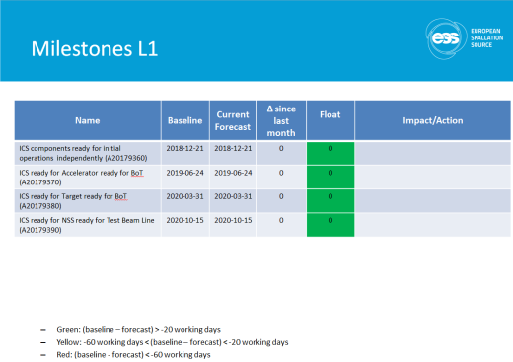
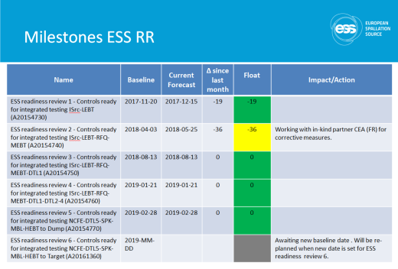
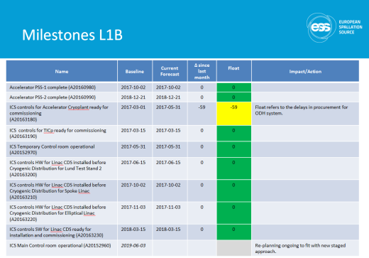
Project plan
Re-made project plan finalized in 2016-09
New plan being integrated and implemented
Few issues with the plan as of yet
Meanwhile, scope changes have occured
  Work packages 02, 03, 07 and 08 have merged
  A ”value engineering” exercise is ongoing
  The transition to initial operations has been planned
Current focus is installation planning

Slide 10






ICS Project Status by work package
Snapshot from w1713
WP-02 Software Applications - Project clean-up is ongoing
WP-03 Software core - Focus on performance and maintainability
WP-04 Hardware core - Focus on the standard digital platform blocks other activities
WP-05 Machine protection - Very good progress at the moment. But a lot of work remains
WP-07 Controls infrastructure - The workload is high but we are able to cope
WP-08 Physics - Currently good flow of information
WP-09 Personnel safety systems - Potential delays with ODH systems installations
WP-10 Integration - Accelerator - Resource limitations is impeding progress speed
WP-11 Integration - Target - Issues hard to solve despite involvement from stakeholders
WP-12 Integration - Instruments - Good progress but potential resourcing problems
WP-13 Integration - CF - Slower on-site progress due to poor communication
WP-14 Test Stands - Technician recruitment restarted
WP-20 Installation - Directives to start the plan received from ESS PMO

Slide 11
Estimate at completion - unplanned cost
Item | M € | Comment
Budget At Completion | 78.2
Installation cost | 4,2 | Scope was never considered in the old ICS plan. Estimated during the replanning exercise in 2016-H1.
Management | -0,5 | Savings expected from trips and other expenses
Software | -0,4 | Savings expected after the replanning exercise
Deployment and commissioning support | 0,4 | 0,8M€ are now planned as cash to be used during 2017
Accelerator Integration | 1,9 | To cover orphan scope or known unknowns detailed during the replanning exercise in 2016-H1
Total Forecast Variance | 5,6
Estimate At Completion | 83,8

Slide 12
Risk register
Event | Potential Impact* | Probability | Mitigation measures | Retirement date
[109] IKC-IFE-LCR Procurement of equipment for the LCR halted | Schedule | 5 | [Avoid by] ESS solving the VAT issue with Norway. ICS to pay in cash the €30K VAT to avoid delays. | 2017-Q2
[76] All MTCA activities are financed with cash. | Cost, Schedule | 4 | [Avoid by] Support ESS top management in the actions with the Swiss authorities. | 2017-Q4
[104] Missing complete interface agreements with stakeholders | Cost, Function, Schedule | 4 | [Avoid by] Engagement of group leaders and division heads. | 2017-Q4
[105] Missing catalogue of accelerator failures | Function, Schedule | 4 | [Avoid by] Engagement of division heads; empowerment of Machine Protection champion. | 2017-Q4
[99] Controls have to be reworked during Accelerator FAT | Cost, Function, Schedule | 4 | [Prevent by] Apply systems engineering processes to cope with “schedule pushing” and to avoid missing functional needs . | 2018-Q4
* Potential impact should be characterized by cost, schedule, function or quality, or … impact
Expected value of ICS cost risk = 4.5 M€ (from 2017-01-01 to 2019-12-30)
Date for most recent risk workshop: 2016-11-02 next ws: 2017-06

Slide 13
ICS Organization
2017-04
Henrik Carling
Division head
Wojtek Fabianowski in-kind manager
Thilo Friedrich
Systems engineer
Henrik Carling (act)
Controls infrastructure
Anna Gillberg
Team assistant
Annika Nordt
Safety and protection
Daniel Piso
Hardware and integration
Hector Novella
Deputy project manager
Susanne Regnell
Controls Software
Timo Korhonen
Chief engineer
Alessio Curri
ICS administrator
Alberto Toral
Technician
Angel Monera
FPGA Engineer
Benedetto Gallese
Integrator
Ben Folsom
PhD student
Claudio Rosati
Software engineer
Benjamin Bertrand
Software engineer
Denis Paulic
PLC Engineer
David Brodrick
Integrator
François Bellorini
Integrator
Emanuele Laface
Accelerator physicist
Jan-Åke Persson
Senior software engineer
Remy Mudingay
Infrastructure engineer
Manuel Zaera-Sanz
PLC Engineer
Javier Cerejo
PhD Student
Jeong Han Lee
Integrator
Juan Esteban Müller
Software scientist
Karin Rathsman
Senior scientist
Susann Skarin
Network administrator
Morteza Mansouri
Safety Engineer
Joao Martins
Integrator
Nick Levchenko
Integrator
Ricardo Fernandes
Senior software engineer
Consultants
Viktor Fred
Electrical engineer
Riccard Andersson
PhD student
Julen Etxeberria
Junior controls engineer
Tomasz Brys
Integrator
Fredrik Luthander
Software engineer
Open positions (2)
Jonny Svärd
Software engineer
Stuart Birch
Senior safety engineer
Simone Farina
Embedded systems egineer
Krisztián Löki
Integrator
Yong Kian Sin
IEC61508 engineer
Niklas Claesson
Integrator
Oliver Talevski
Embedded engineer
Szandra Kövecses
Technical coordinator
Alexander Söderqvist
Integrator
Open positions (1)
Open positions (2)
Employee
Consultant
Temporary employee
Consultant
off-site
Position under consideration

Slide 14
Main priorities in 2017
Machine directorate
Project execution (ESS remains “schedule-driven”) with continuous improvement of organization for installation and start of move of offices to the site
Submission of required information for the Installation Permit to SSM
Conclusion of first value engineering - implementation of decisions
Preparation of plan for Initial Operations with Review in May and submission to Council in June.
ICS goals and priorities
Capacity expansion at high but sustainable rate
Expand new and manage existing in-kind activities, manage in-kind goal
Process development, tracking and compliance
Improve documentation - structure, traceability, quality

Slide 15
TAC 15 - Integrated Control Systems
  ICS project overview and status
  Activity highlights since last TAC
  In-kind status
  Response to previous TAC recommendations
  Conclusion

Slide 16
Operations planning and review

Slide 17
ESS operations review 2016-10
An operations planning and review was made in 2016
This was a very useful exercise for improving strategy
The workflow followed a functional development path
  Requirements analysis
  Functional description to satisfy requirements
  Organizational solution for functions
  Organization estimation
The following slides show some of the conclusions
One of the more important conclusions is that a control system project ”never ends”

Slide 18
ICS Operation responsibilities (1)
Normal operation tasks ensuring that ESS machine availability criteria are met
  Maintaining the Integrated control system
  Problem solving for control system issues
  Performing unplanned maintenance and repairs with minimum downtime
  Performing preventive maintenance to ensure highest possible availability and performance
  Planned updates, enhancements and upgrades
  Tuning and refining the machine protection systems
  Obsolescence and version management of running systems
  Ensuring that competence is maintained in all areas of control system technology essential for the operation
  Providing training on the control system for new personnel or control system upgrades
For safety related systems
  Ensuring safe operation through the PSS
  Providing training on the safety related parts of the control system
  Performing preventive maintenance to ensure highest possible availability
  Assisting calibration of critical monitors (ODH, radiation etc)
  Ensuring that all safety and licensing requirements are met
  Organizing and driving recurrent certifications/validations of the PSS
  Planning and assisting cyber security assessments

Slide 19
ICS Operation responsibilities (2)
Extension and optimization tasks
  Extending the Integrated control and safety systems to accommodate instrument expansion
  Monitoring the machine status to avoid damage to sensitive equipment
  Facilitating tuning and optimizing machine performance, availability and cost-effectiveness of operation
  Simplifying and improving operator interfaces to the machine
  Executing controlled enhancements to the integrated control system software
  Developing the control system, taking advantage of new technology, improving performance, increasing reliability and decreasing operational costs
Services to other divisions
  Provide software, firmware and hardware development infrastructure
  Provide standardization
  Competence and training in EPICS, FPGA firmware, Standard controls hardware platform
  Regular functional safety training sessions to ESS staff relevant for the understanding and operation of Machine Protection and Personnel Safety Systems

Slide 20
Benchmarking
ICS has been extensively benchmarked against three facilities
  The Spallation Neutron Source (SNS) at Oak Ridge National Laboratory in Tennessee, USA
  The Diamond Light Source (DLS) at the Harwell Science and Innovation Campus in Oxfordshire in the UK
  The Facility for Rare Isotope Beams (FRIB) that is a facility still under construction at the Michigan State University, Michigan, USA.
The three facilities have been selected for their relative similarity to ESS
Through benchmarking ICS has built confidence in the estimates for the organization sizing in our own operations estimates.

Slide 21
Needed competences for ICS Operation
The following competency areas are needed in the ICS division
  Accelerator/beam physics modelling
  Analog and digital electronics engineering
  Computing and networking infrastructure, digital communication
  Data network performance/security administration, cyber security
  Databases, database administration, storage and throughput engineering
  Electrical engineering, electrical and mechanical installation
  Electronics manufacturing (PCB) and testing
  EPICs family of software (EPICS, CSS etc.)
  Expertise in certification of safety critical systems according to IEC61508
  FPGA and similar dynamic electronics, for instance fast mission critical interlock systems
  IEC61508 Automation, Controls, Electrical and cyber security expertise for safety critical PLC systems
  Industrial automation hardware and software, field-busses
  Knowledge of the existing facility, laboratory facilities, etc.
  Management and project management skills
  Operating systems - kernel level, real-time systems
  RAMI, STPA (System Theoretic Process Analysis) and functional safety analysis methods
  Safety engineering according to IEC61508, IEC61511 and other standards (STPA, etc.)
  Software development (C/C++/Java, UI, Web)
  Software development environments (continuous delivery platforms etc.)
  Software verification and validation

Slide 22
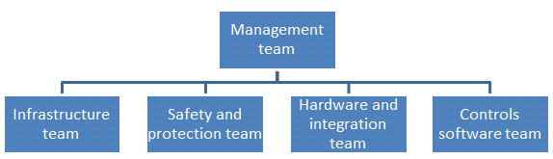
Proposed organizational solution
The following line organizational units can take the ICS responsibilities in a matrix organizational context
  ICS Management team
  ICS Controls software team
  ICS Hardware and integration team
  ICS Safety and protection team
  ICS Infrastructure team
Flat hierarchy ensures short communication paths and high efficiency

Slide 23
Operations estimate summary
The ESS ICS is a highly complex control system
  Fully integrated control system for Accelerator, Target, Instruments, Site infrastructure with very high availability requirements, deployment innovative technology, an ambitious approach to automation of control system configuration and high performance requirements on the MPS to ensure availability
The function and scope for the operation of ICS has been identified with an analysis for the needed capacity and competence
An organizational solution for supplying the required competence and capacity is proposed supported by analyses and benchmarking comparisons
  Total steady state FTE’s: 52 (5632 k€)
  Operations cost: 1468 k€

Slide 24
Value engineering initiative

Slide 25
Charge for ESS Value engineering
Identify value engineering and cost saving measures that could be taken to ensure ESS construction project success
  Include approved budget, forecast, and orphan scope items
Segregate findings into measures that should be implemented immediately and those that can be delayed until later and only taken if the budget situation warrants
For delayed items, a latest date to take the measure should be set

Slide 26
Value engineering initiative
ICS has identified several value engineering opportunities and are taking actions

Slide 27
ICS Value engineering summary
35 Internal savings/deferrals 5.0 M€ / 3.9 M€
29 Dependent savings/deferrals >2.8 M€
10 General savings/deferrals >2.5M€
Simplified calculation
  ICS EAC is 84,5 M€
  Recommended deferral/saving = 9,2 M€ => 11%
Next steps
  Establish number of ICS supported instruments end of 2019
  Detail Accelerator Beam instrumentation savings/deferrals
  Work closer with Accelerator savings/deferrals
  Work to reduce installation costs

Slide 28
Phased approach for ending construction
2013
2014
2015
2016
2017
2018
2019
2020
2021
2022
2023
2024
2025
2026
2027
ICS components ready for initial operations
?ICS ready for instruments early science
?
ICS ready for Accelerator ready for BoT
ICS ready for Target ready for BoT
ICS ready for NSS ready for TBL
Operations
Construction
Initial Operations
13 FTE´s to Init-Ops
26 FTE´s to Init-Ops
9 FTE´s to Init-Ops
4 FTE´s to Init-Ops
52 FTE´s to Operations

Slide 29
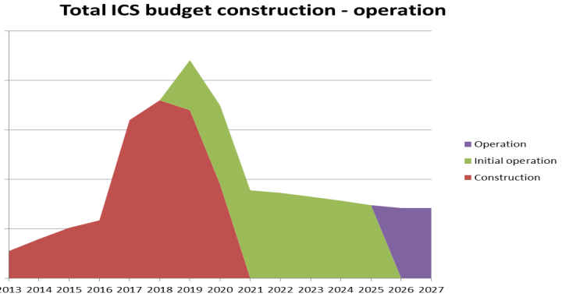
Initial Operations planning
Ongoing planning for 2019-2025
  Very detailed for 2019
  Less detail for 2020-2021
  High Level for 2022-2025
Estimate commissioning and initial operations phase activities
Create WBS, effort, milestones and budgets
Use Primavera P6 entry or Excel Template
Make Construction and Operations estimates meet

Slide 30
Other significant activity highlights

Slide 31
Software scope reorganization
A reorganization of software scope has been imitated and partially executed
  Work unit 2.1 “Software infrastructure” - most scope moved to work package 07
    Software Quality Assurance
    Configuration and Orchestration
    Collaborative tools
    Software deployment
      Continuous integration, deployment environment management, testbed and simulation environment
    Software quality assurance => work package 03 & SW group (line)
  Work unit 2.2 “Operation tools” - split between work packages 03 and 08
    Scripting environment => work package 07 (infrastructure parts) & work package 08 (application parts)
    GUI/HMI: Control System Studio, Broadcast builder framework => work package 03
    Specialised GUI:s: MPS configuration, Post Mortem Diagnostics, Operation Sequencer => work package 03
  Work unit 2.3 “ICS Diagnostics” - mainly moved to work package 07
    Centralised logging => work package 07
    Software performance management:
      Monitoring work package 07
      Runtime testing (SW)
    Diagnostic tools; scope to be defined
      ILL has a “common GUI” for diagnostic tools developed throughout the organisation.
      CERN started working on a common system wide diagnostic tool some years ago.

Slide 32
ICS reporting and meeting schedule
A meeting and communication structure has been implemented during the period
Reporting and decisions now follow a specific, predictable flow
Some adjustments still need to be made
Machine/ESS meetings
ETB
MMT
MMT
IKM
ETB
MMT
IKM
IPR
ICS review
ETB
MMT
Monday
Tuesday
Wednesday
Thursday
Friday
Saturday
Sunday
ICS Meetings
Project meeting
Decision forum
ESS Planning
Project meeting
M
T
W
T
F
S
S
M
T
W
T
F
S
S
Risk and quality
M
T
W
T
F
S
S
Week 1
Week 2
Week 3
Week 4
WPM Bi- weekly report and GL Summary
IKM Bi- weekly report and GL Update
WPM Bi- weekly report and GL Summary
IKM Bi- weekly report and GL Update
ICS weekly report
ICS weekly report
ICS weekly report
ICS weekly report
Reporting
In CHESS

Slide 33
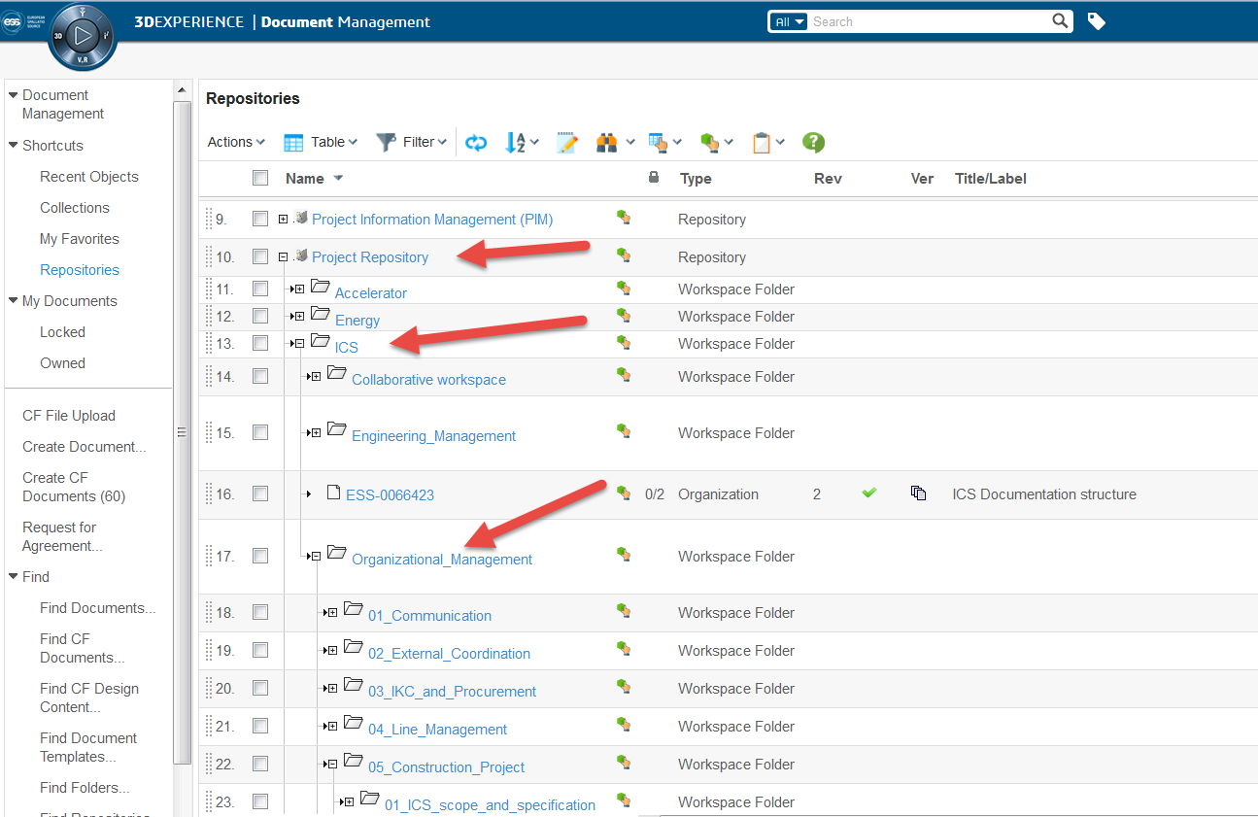
ICS documentation management
Significant effort has been made to launch the documentation structure in the ESS documentation management system
Compliance still needs to be improved but the ICS structure has served as model for all ESS organizational documentation structure

Slide 34
TAC 15 - Integrated Control Systems
  ICS project overview and status
  Activity highlights since last TAC
  In-kind status
  Response to previous TAC recommendations
  Conclusion

Slide 35










ICS in-kind status 2017-04
  PSI: Delayed due to contractual difficulties - re-alignment planned and steep ramp-up at PSI
  TUT Ethercat: On track/FPGA based IOC: Target for next IKRC/Cyber security: On track
  IPNO: Cost discrepancy discussion almost finalized, target for next IKRC
  CEA: Re-focus the CEA team on the RFQ, de-prioritizing the second Ion-source/LEBT
  ESS Bilbao: MEBT controls project on track, dependency on Accelerator
  ZHAW: On track
  INFN Legnaro: Cost,scope discussions finalizing. Target for next IKRC
  IFE: MCR: On track, target for IKRC/Logbook and Alarms: On track/Network: Cost discrepancy
  ÚJV Řež: Very slow progress
  Atomki: No progress
  STFC: Activity but no contract
  Łódź: Discussion on RF scope starting up

Slide 36
ICS in-kind status
Red arrows indicate projects where we are targeting signed documents for IKRC 11 (2016-12)

Slide 37
ICS in-kind portfolio development
ICS is continuously expanding the in-kind agreed and potential values by elaborating already known contributions and also finding new scope for partners to contribute
With increased clarity from the “new” project plan completed during the summer, we expect to be able to be more systematic in developing new in-kind opportunities
When analyzing the total in-kindable scope in the plan, we currently seem to see a limit at ~22 M€ which is 14 M€ short of the ICS in-kind goal. We will continue investigating new approaches for reaching the in-kind goal

Slide 38
ICS In-kind partners
Partner Institutes
Atomki, Hungary
CEA, France
CNRS/IPNO, France
Elettra, Italy
ESS Bilbao, Spain
IFE, Norway
INFN Catania, Italy
INFN Legnaro, Italy
PSI, Switzerland
STFC, UK
Tallinn Technical University, Estonia
ÚJV Řež, Czech Republic
University of Łódź , Poland
Uppsala University, Sweden
ZHAW, Switzerland
Agreement signed
Agreement waiting for signature
Early discussions
Collaboration agreement

Slide 39
TAC 15 - Integrated Control Systems
  ICS project overview and status
  Activity highlights since last TAC
  In-kind status
  Response to previous TAC recommendations
  Conclusion

Slide 40
Responses to TAC 14 recommendations
Integrated Control Systems
Recommendation 1
ICS should give priority to execution of technical work over search for further IK agreements
Response
ICS has continued expanding the in-kind portfolio, but with the focus of finalizing in-kind collaborations that are necessary complements to ESS stakeholders (mainly Accelerator and Target) for control system purposes. Examples of this are ESS Bilbao, CNRS/IPNO and ÚJV Řež.
A (partially) BrightnESS financed in-kind manager has started in 2016-11 and is now fully up and running which helps coordination and creation of new in-kind opportunities.
New contracts are considered, but mainly through the “extend collaboration” model which reduces risks and costs.
Recommendation 2
ICS should ensure they provide complete input for integrated installation planning and implementation
Response
The installation planning is in focus and will be presented separately at this TAC.

Slide 41
TAC 15 - Integrated Control Systems
  ICS project plan overview, status and issues
  Activity highlights since last TAC
  Organizational management
  In-kind status
  Response to previous TAC recommendations
  Conclusion

Slide 42






Project status - summary
Integrated Control Systems
Achievements
  Project proceeding into installation phase
  Recruitment and consultant procurement activities are progressing
    The commercial framework for Integration services is being evaluated
  EAC and Value engineering exercises made. Potentially affecting scope for ~9.2 M€
  Operations planning and review completed in 2016-10
  Creation of infrastructure group and transfer of resources from the controls software group done
  Reorganization of scope in software work packages 02, 03, 07 and 08
  Many in-kind activities progressing according to plan. A few new in-kind opportunities pursued
    In-kind manager started
  Material to SSM review delivered, work for next application is expected to start immediately
  Radiation monitor purchase request for PSS1 is completed
  First formal release of the ICS handbook [link], EPICS trainings procured and scheduled

Slide 43
Project status - summary
Integrated Control Systems
Issues
  Several ICS work packages continue flagging too low resource capacity to keep plan. Recruitments and consultant procurements are ongoing
  Projections of in-kind volume shows that it will be difficult to reach the 50% ICS in-kind goal
  Trying to recover delays (partially) caused by in-kind issues (Switzerland) which makes stakeholders nervous
  No (effort) budget set aside for SSM application work in current plan. This can be a significant “competitor” for resource allocation during 2017
  Long delays at Swedish migration authority for processing residence permits for non-EU employees restricts travel and is an obstacle to activities

Slide 44
ICS vision and mission statements
ICS vision statement
ESS operated efficiently, reliably and safely, with a control system that everyone loves
ICS mission
The ICS division shall provide and maintain world-class and cost-efficient control, protection and safety systems and services for the ESS facility.
The division shall develop competence and innovative solutions that can be shared in the community through open processes

