Slide 1
Digital Platform system overview, variants and status
Daniel Piso Fernández
Hardware & Integration Group Leader
www.europeanspallationsource.se
5 April, 2017

Slide 2
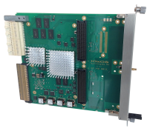
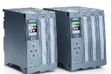
Overview Three layer strategy - control systems at ESS
Signal speed
A custom made microTCA board with a powerful FPGA and a CPU. A FPGA framework constitutes the development environment. The CPU runs EPICS
The digital platform includes
Hardware - a custom made single board computer based on MTCA for applications with data acquisition exceeding 100 kHz.
Firmware - FPGA will have a complete application development environment, such that the firmware development is standardize the interfaces between the FPGA and the CPU through the PCIe bus.
Software - The CPU will run EPICS and ICS provides the integration needed for all the applications and different FMC IO modules
Kernel drivers
User Space drivers
EPICS Device Support
10 MHz
1 MHz
100 kHz
Digital platform
10 kHz
1 kHz
EtherCAT I/O modules that are connected to commercial or open-source EtherCAT master controllers which are in turn connected to the EPICS based control system
100 Hz
EtherCAT
10 Hz
Slower signals are handled by industrial automation (PLC) for reliability and cost reasons. The standardized platform for ESS applications comes from Siemens
1 Hz
0.1 Hz
Industrial automation (PLC)

Slide 3
Overview High-Level Requirements
The ESS standard form factor for high-speed digital acquisition is mTCA.4. The standard is new and still needs some work in different areas
Maintainability
Interoperability
Long-term sustainability.
The main requirements driving the design of the digital platform are:
At 2.86 ms pulses@14 Hz : 4% duty cycle it is a lot of raw data
Local processing will be used, but also there is a substantial need for data correlation and troubleshooting.
Interfaces to Beam Interlock System are crucial
We have collected needs for Acquisition (ADC sampling) up to ~1 GSPS

Slide 4
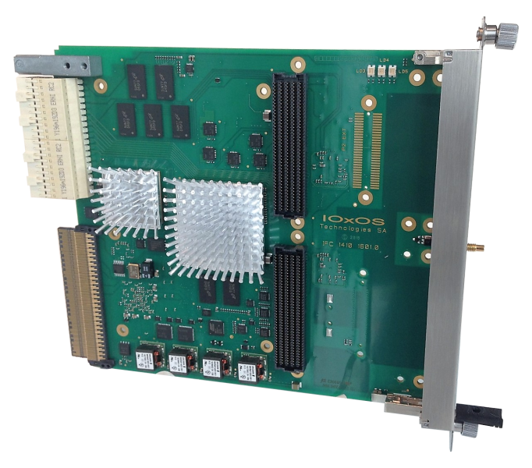
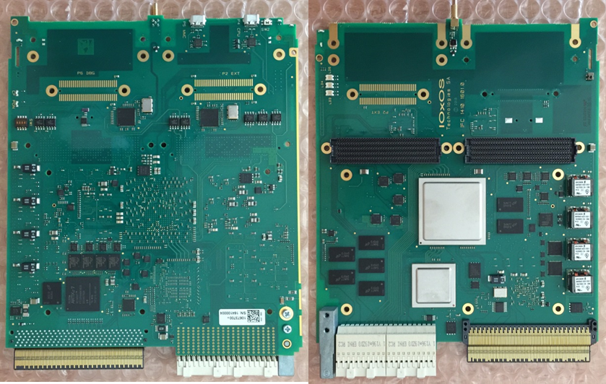
Digital Controller Board for ESS
The Digital Controller Board will be designed in two variants
One dual FMC carrier – IFC1410
One with 10 channel analog I/O through Zone 3 and single FMC slot –IFC1420
Main characteristics:
Freescale QorIQ T2081 processor
Dual HPC VITA-57.1-compliant FMC slots
Xilinx Kintex UltraScale KU040
2x XFI 10G Ethernet links
AMC Interface
Port 0: AMC.2-compliant gigabit Ethernet link with the processor
Ports 4-7: AMC.1-compliant PCI express x4 Gen3 link with the FPGA Processing Unit
Ports 12 to 15: point-to-point LVDS links with the FPGA Processing Unit
Port 17 to 20: shared bus M-LVDS links with the FPGA Processing Unit
IFC1410 applies to
RF Local Protection System
Faraday Cup
Emittance Meter Unit
Wire Scanner, etc.
IFC1420 applies to
Beam Position Monitor
Low Level RF
Backup solutions have been identified

Slide 5
In-kind deliveries
ESS/PSI
 |  | Deliverable | Responsible | Comments
Hardware | IFC1410 | IFC1410 Technical Proposal and Development Plan | ESS | Done
 |  | IFC1410 Preliminary Design Review Report | ESS | Done
 |  | IFC1410 Critical Design Review Report | ESS | Done
 |  | TOSCA III Training Session | ESS | Done
 |  | IFC1410/RXI1460 prototype delivery | PSI | Done
 |  | Initiate procurement of IFC1410 and RXI1460 production | PSI | Done
 |  | Series production of IFC1410 and RXI1460 - Batch 1 | PSI
 |  | Series production of IFC1410 and RXI1460 - Batch 2 | PSI
 |  | Series production of IFC1410 and RXI1460 - Batch 3 | PSI
 | IFC1420 | IFC1420 Technical proposal and development plan | PSI | Done
 |  | IFC1420 Preliminary design review report | PSI
 |  | IFC1420 Critical design review report | PSI
 |  | IFC1420 prototype delivery | PSI
 |  | Initiate procurement of IFC1420 | PSI
 |  | Series production of IFC1420 - Batch 1 | PSI
 |  | Series production of IFC1420 - Batch 2 | PSI
 |  | Series production of IFC1420 - Batch 3 | PSI
Software/firmware | IFC1410 | IFC software/firmware starter pack | PSI | Done
 |  | EPICS on IFC1410 platform | PSI | Partially Done at ESS
 |  | IFC1410 EPICS maturation support | PSI
 |  | IFC1410 ICS integration support | PSI
 |  | IFC1410 device drivers test report | PSI
 |  | IFC1410/IFC1420 test environment | PSI | First Hardware sent to PSI
 | IFC1420 | Porting of starter pack to IFC14xx series | PSI
 |  | IFC1420 device drivers test report | PSI

Slide 6
IFC1410 Status
9 x IFC_1410 units delivered to ESS
IFC_1410 User Guide review in progress. First release expected in w1712
Allocation of components for serial production (2017-06) is in progress.
Firmware:
Use of ESS Bitbucket repository for source code sharing (drivers, kernel and FPGA firmware)
ADC_3110 XUSER Oscilloscope application delivered to ESS
Deployment of a GIT repository for source code sharing between PSI and IOxOS. Repository structure jointly defined with PSI

Slide 7
IFC1420 Status
PDR held on w1713 at PSI
Preliminary functional and mechanical assessment of DAQ_1430 (mezzanine implementing the ADC/DAC function)
Electrical schematics in progress
FPGA firmware compatible with IFC_1410 with exception of ADC backend interface that has to control two additional ADC channels (compared with the 8 implemented in the ADC_3110). The implementation of this modification will start after being approved in PDR
Prototypes scheduled on w1724 (2017-06-12 ~ 16)

Slide 8
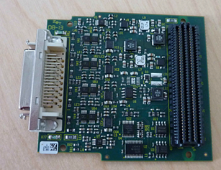
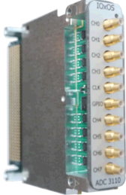
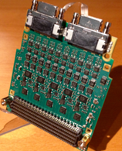
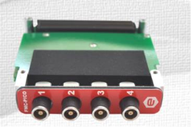
Variants Digitizers
d-tAcq ACQ420
VITA57.1 FMC with Low Pin Count (LPC interface)
Low Pin Count (LPC) single ended interface
4 channels 20-bit ADC (LTC1377). 1/2 MSPS, per channel
Front-end instrument per-amplifier (AD8251)
+/- 10V input range
ADC_3110/3111
Single-width FMC ANSI/VITA57.1 HPC Mezzanine card
Latest generation TI ADC ADS42LB69 / ADS42LB49. Up to 250 MSPS, 14/16 bit version
10 front panel SSMC coaxial connectors assigned as :
8 AC coupled analog Input
1 External clock Input
1 Multi-purpose FPGA programmable In/Out
ADC_3112
Single-width FMC VITA57.1 HPC Mezzanine card
Quad channels ADC (TI ADC ADS5409) 12-bit 900 MSPS (up to 1000 MSPS with minor de-rating)
Interleaving multiplexer-buffer for dual channels ADC 12-bit 1800 MSPS (up to 2000 MSPS with minor de-rating)
Differential Inputs with software selectable Differential /Single-ended
ADC_3117
Single-width FMC VITA57.1 HPC Mezzanine card
20 channels ADC 16-bit/14-bit 5 MSPS
Two analog outputs driven from 16-bit DAC8563T
FMC-Pico-1M4
Single-width FMC VITA57.1 LPC Mezzanine card
Quad input channels ADC 1 MSPS, 20-bit, for current measurements (from pA to mA)
Inputs floating +-300 Volts insulation

Slide 9
Status: Hardware IFC1410
Id | Stage | Deliverable | Date | Responsible | Status
1.0 | Planning | IFC1410 Technical proposal and development plan | 2016-05-02 | ESS | Done
1.1 | Planning | IFC1410 Preliminary design review report | 2016-06-01 | ESS | Done
1.2 | Planning | IFC1410 Critical design review report | 2016-09-05 | ESS | Done
1.3 | Execution | TOSCA III training sessions | 2016-09-24 | ESS | Done
1.4 | Execution | IFC1410/RXI1460 prototype delivery | 2016-10-31 | PSI | Done
1.5 | Execution | Initiate procurement of IFC1410 and RXI1460 production | 2017-01-16 | PSI | Done
1.6 | Execution | Delivery of IFC1410 and RXI1460 - Batch 1 | 2017-08-01 | PSI | On track
1.7 | Execution | Delivery of IFC1410 and RXI1460 - Batch 2 | 2018-01-02 | PSI | On track
1.8 | Execution | Delivery of IFC1410 and RXI1460 - Batch 3 | 2018-05-02 | PSI | On track

Slide 10
Status: Hardware IFC1420
Id | Stage | Deliverable | Date | Responsible | Status
2.0 | Planning | IFC1420 Technical proposal and development plan | 2016-06-01 | PSI | Done
2.1 | Planning | IFC1420 Preliminary design review report | 2016-07-04 | PSI | Delayed
2.2 | Planning | IFC1420 Critical design review report | 2016-10-10 | PSI | Delayed
2.3 | Execution | IFC1420 prototype delivery | 2017-01-09 | PSI | Delayed
2.4 | Execution | Initiate procurement of IFC1420 production | 2017-03-06 | PSI | Delayed
2.5 | Execution | Delivery of IFC1420 - Batch 1 | 2017-08-01 | PSI | Probable Delay
2.6 | Execution | Delivery of IFC1420 - Batch 2 | 2018-02-01 | PSI | On track
2.7 | Execution | Delivery of IFC1420 - Batch 3 | 2018-06-01 | PSI | On track

Slide 11
Integrated control system
Thank you for your attention

