Slide 1
Digital platform deployment plan and risks Integrated Control Systems
Henrik Carling
ESS/ICS
Date: 2017-03-27

Slide 2
Introduction
The ICS digital platform is a standardized platform for high speed data acquisition
The platform should cover ICS’s control system needs and also be useful for hosting application specific use cases (RF, Beam instrumentation)
The needs of stakeholders in terms of functionality and volume has been investigated and discussed. This has been an approximative process since not all systems are designed yet.
The ICS digital platform is developed and delivered through an in-kind collaboration with PSI, Switzerland
The deliveries cover the ”full platform”; hardware, firmware framework and operating system including drivers
The ICS/PSI in-kind project was agreed in 2016-09. Contractual difficulties between ESS and Switzerland has stalled the timely execution of parts of the project according to plan
During the contractual hold-ups, ICS has in some cases self-performed parts that were on the critical path
The contractual problems have recently been resolved and the full project is now ready to start after a re-alignment of plans for the parts where ICS has self-performed

Slide 3
Project plan (1)
The in-kind project plan with its detailed milestones and status
Due to the contractual problems, parts of the project are delayed

Slide 4
Project plan (2)

Slide 5
Typical configurations
Some typical configurations have been modelled for different use cases

Slide 6
Stakeholder volume estimation
Early data to the project suggested the following volume need from stakeholders
The volume envelope below was aligned with the budget of the in-kind project

Slide 7
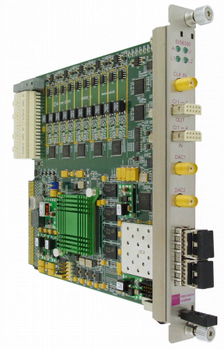
Other digital platforms supported by ICS
Development and prototyping of some systems has already started even before the standardized digital platform was available
Notable stakeholders are the Accelerator low-level RF group and the Accelerator beam instrumentation group
In some cases the maturity of the prototyping and development in combination with the ESS schedule will mean that systems will need to be deployed on alternate digital platforms
The most notable such platform is the Struck SIS8300 MTCA digitizer, for which ICS will support deployment
ICS and stakeholders are working on how to optimize the deployment plan for alternate/standard platforms to optimize standardization, schedule, cost and risks
Long term, the intenton from all stakeholders is to port all systems to the standardized digital platform. A plan for this is being worked on

Slide 8
Backup solutions
During 2016, ICS’ stakeholders requested that a backup solution should be defined that could be deployed in case of technical failures of the IFC 14x0 platforms
The intention was to have a clear strategy for the event of unsurmountabe technical problems with the IFC14x0 platforms
The backup solutions could also (if they were readily available) be used for early prototyping before the IFC14x0 was available at ESS and in-kind partners

Slide 9
Backup solutions
The following table summarizes the technical platforms involved in the backup strategy discussion
One important decision point was the form factor for the solution. ICS has standardized on MTCA.4
A decision was made for the CAENels and IFC1211 as backup platforms considering
Cost factor for the platform
Cost factor for the infrastructure (form factor)
Balance and extent of deployment of a back-up solution
Cost factor for manpower/maintenance cost of a backup solution
Lifetime expectancy for backup solutions

Slide 10
Possible backup solutions IOxOS 1211 and CAENels
This was not a trivial decision
Cost factor for the platform
Cost factor for the infrastructure (form factor)
Balance and extent of deployment of a back-up solution
Cost factor for manpower/maintenance cost of a backup solution
Lifetime expectancy for backup solutions
There may be a breakpoint where the additional manpower of developing on the CAENels solution outweighs the cost of VME crates

Slide 11
Risks
A risk analysis has been made for the digital platform project
Overall, the risk level does not seem higher than for many other sub-projects at ESS

Slide 12
Integrated control system
Thank you for your attention

