Slide 1
Vacuum Control System
Hilko Spoelstra
Vacuum Systems Engineer
Vacuum System Section – STS/AD
www.europeanspallationsource.se
23 March, 2017

Slide 2
Outline
Overview
Requirements
Interfaces
Vacuum Control System in more detail
Status as today
Conclusion
Note: The presentation will focus mainly on the vacuum control system for the LINAC. Target and Instruments are still not on the same detailed phase as the Accelerator although the concept is assumed to be the same for all systems.

Slide 3
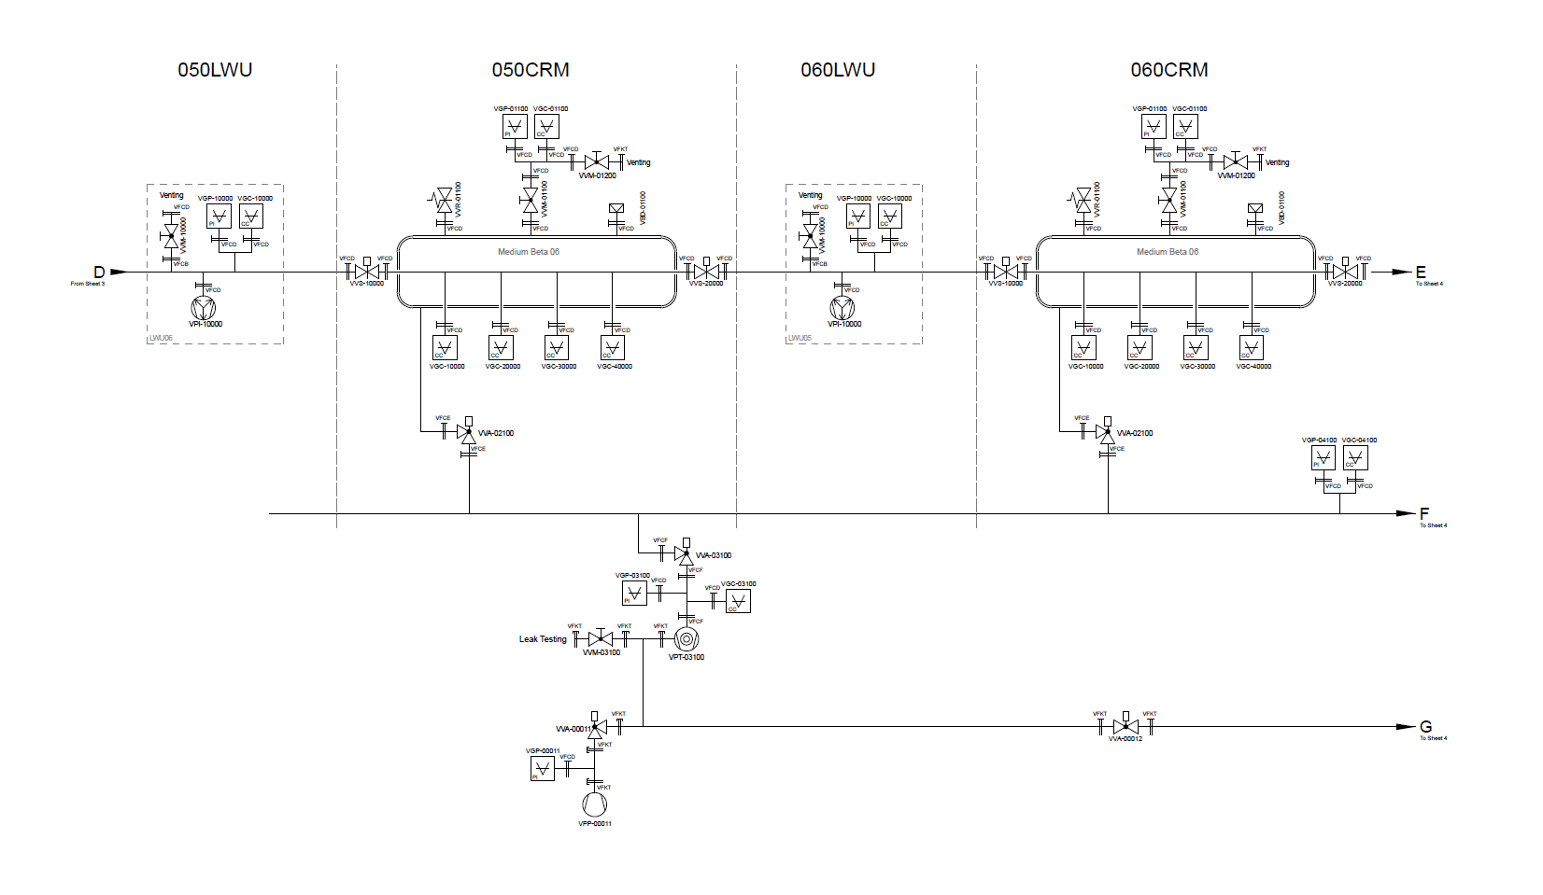
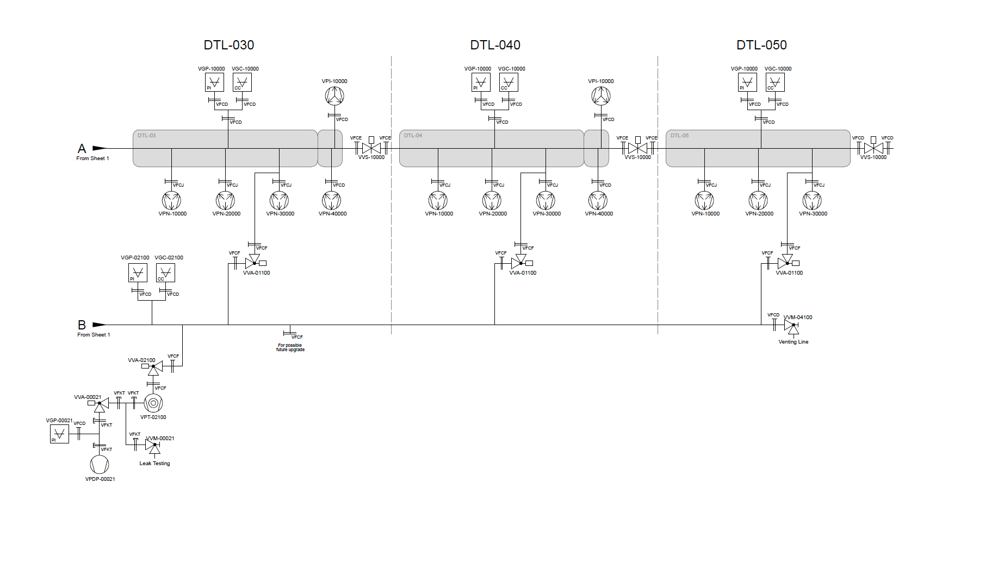
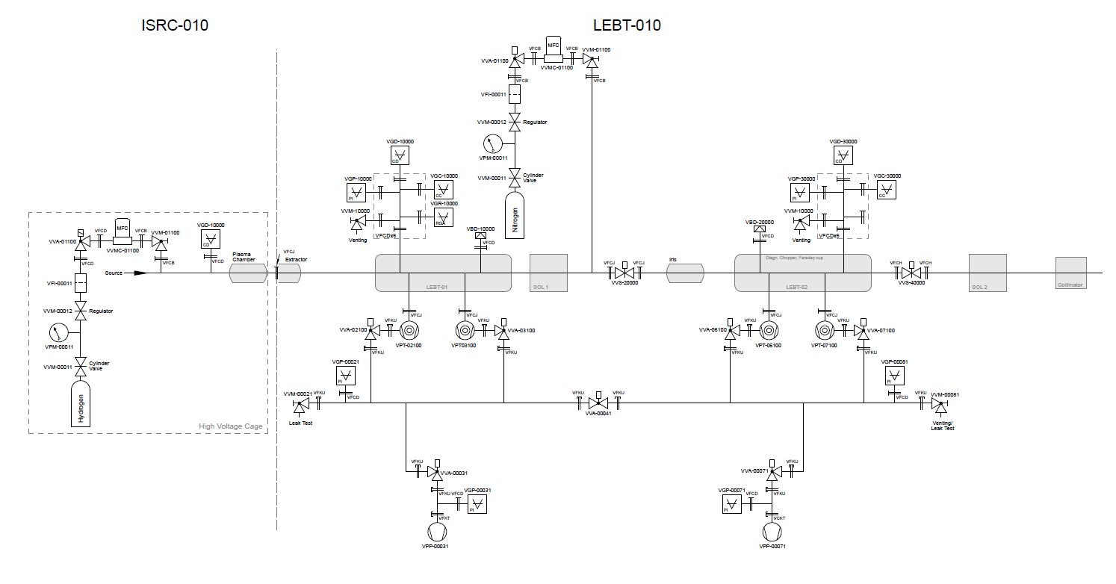
LINAC Vacuum System
Source
LEBT
RFQ
MEBT
DTL
Spokes
Med. β
High β
HEBT

Slide 4
Vacuum Equipment Summary for the accelerator
Standardization of vacuum equipment through the Framework Agreement (FA), which is in process now
FA contract to be signed by the middle of May 2017
Single suppliers for each type of equipment
Framework agreement even applicable for our in-kind STFC Daresburry and CEA Saclay.

Slide 5
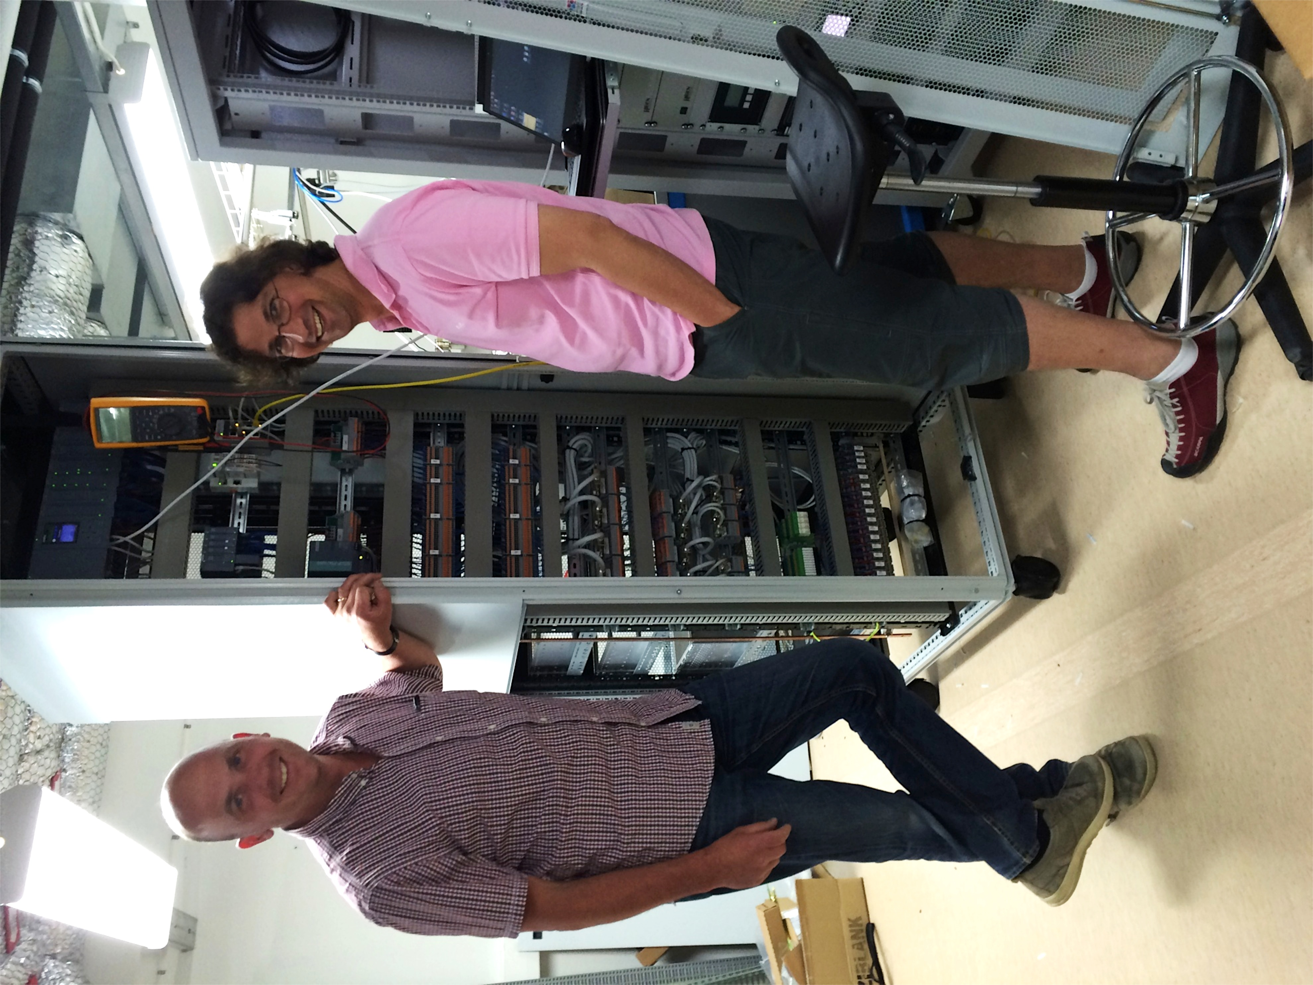
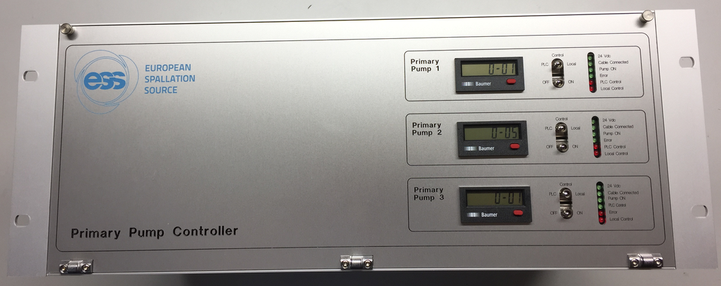
Vacuum Control System
Complete in-house design for racks and controls
Vacuum Group - > Hardware and Electronic design (EPLAN)
Integrated Control System -> PLC and EPICS IOC programming
Common approach for all vacuum systems, Accelerator, Target and Neutron Instruments

Slide 6
Requirements
The vacuum control system shall be able to:
Control the complete vacuum system remotely through different access points
Act in a safe way on abnormalities in the vacuum system (internal or external sources)
Display and archive the status and readouts from all the vacuum instrumentation. Ex: gauges, pumps and valves
Archive the vacuum pressure for the entire LINAC during the event of a power failure
Provide an interface to the Machine Protection System (MPS)

Slide 7
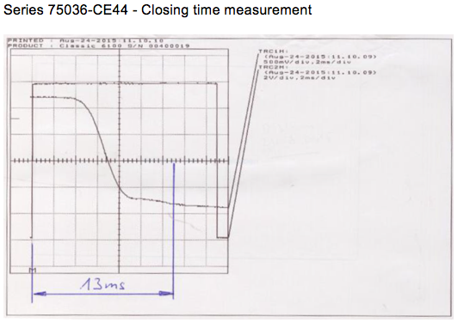
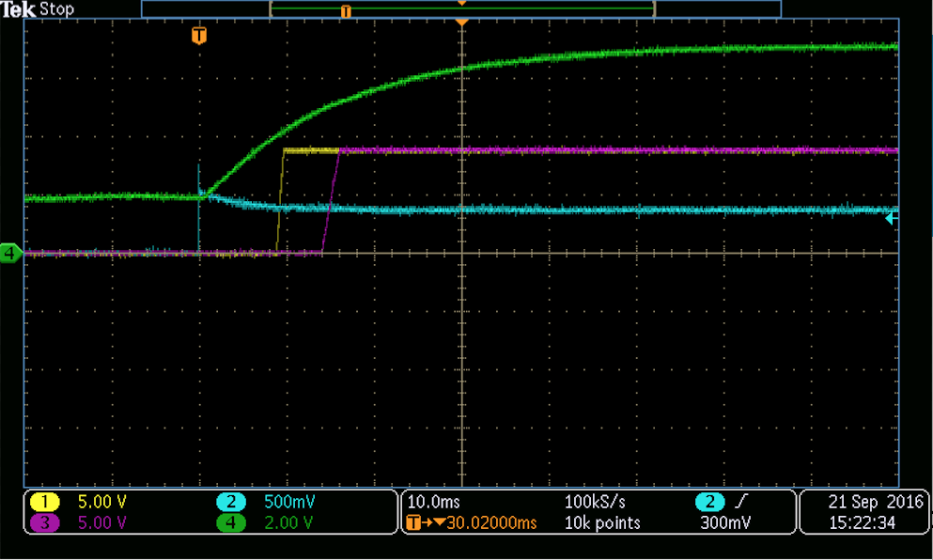
Design criteria
Vacuum is a relative slow system:
Response time for interlocks on gauges > 10 ms.
Response time for normal gate valves > 1 s (fast valves ≈ 15 ms.)
No electronics allowed in the accelerator tunnel - All control electronics must be separated from their devices (pumps, gauges, etc.)
Controllers will be installed in control racks in radiation safe locations in the Gallery and FEB rack area (distance up to 100 m)

Slide 8
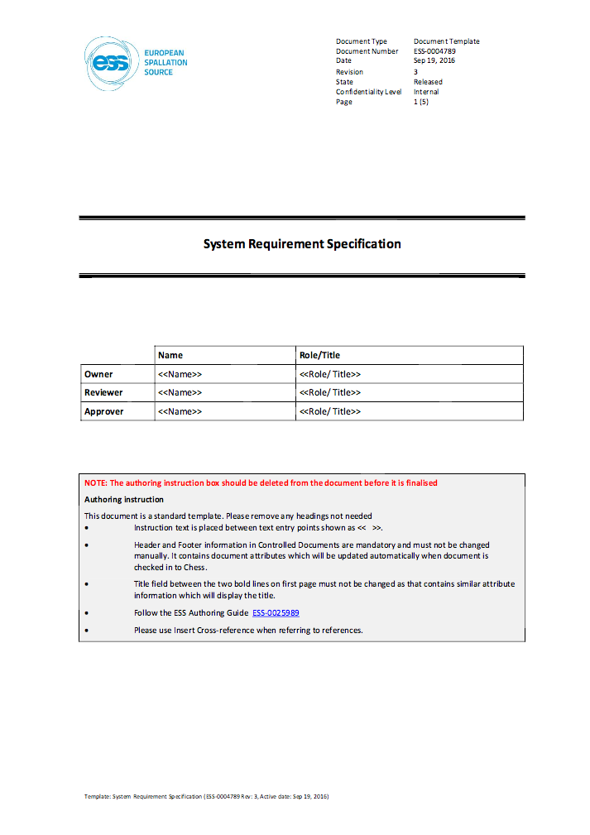
Interfaces
Integrated Control System
Vacuum Skeleton - ESS-0004789 - System Requirements Specification
Vacuum Skeleton - ESS-0004790 - Concept Of Operation
Vacuum Skeleton - ESS-0004793 - Interface description
Vacuum Skeleton - ESS-0061017 - System Verification Plan
Machine Protection System
Machine Protection and Vacuum System Interface Control Document (to be released in CHESS soon)
Electrical support
Rack Requirements/Power requirements
Rack Location
Cable database
RF system
One interlock signal for each gauge on all RF couplers (exact interface tbd.)

Slide 9
Interface: Vacuum Operation PLC & EPICS
Vacuum Control Architecture
PLC:
-Drive controller -Local protection
-Data Acquisition -Beam Permit
EPICS:
-Control panels, trending
-Real-time Data Acquisition
-Data Logging
-Serial communication with the Controllers
Network Communication

Slide 10
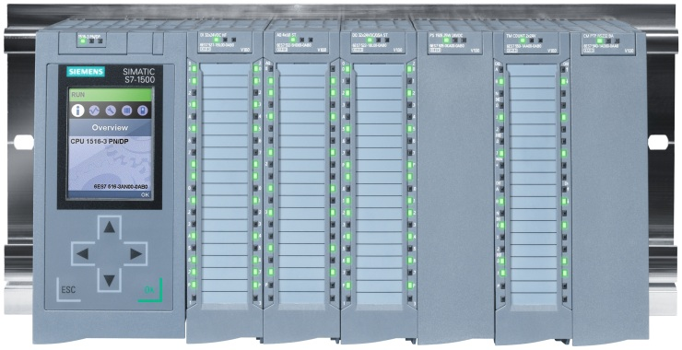
Sector Gate Valves and MPS
Automatic closure of the sector gate valves is triggered by configurable output relays from specific gauge and pump controllers
Signals will be mixed according a voting plan programmed within the PLC
MPS system looks at Vacuum Beam Permits and sector gate valves
MPS PLC System
Redundancy
24 Vdc
Vacuum Interlock PLC
Beam Permit 1
Beam Permit 2

Slide 11
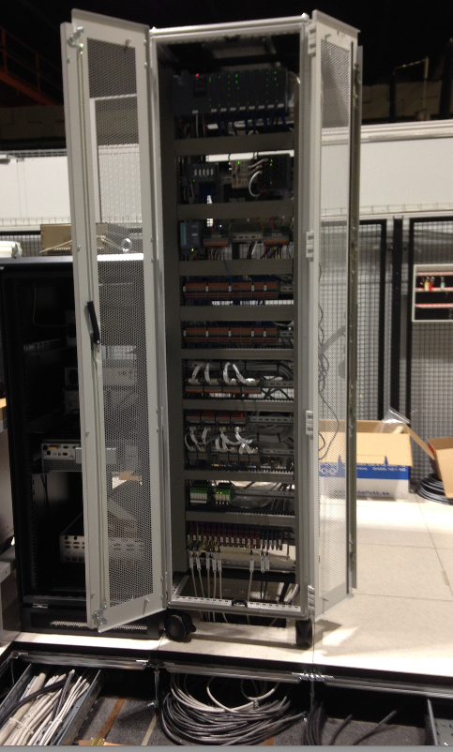
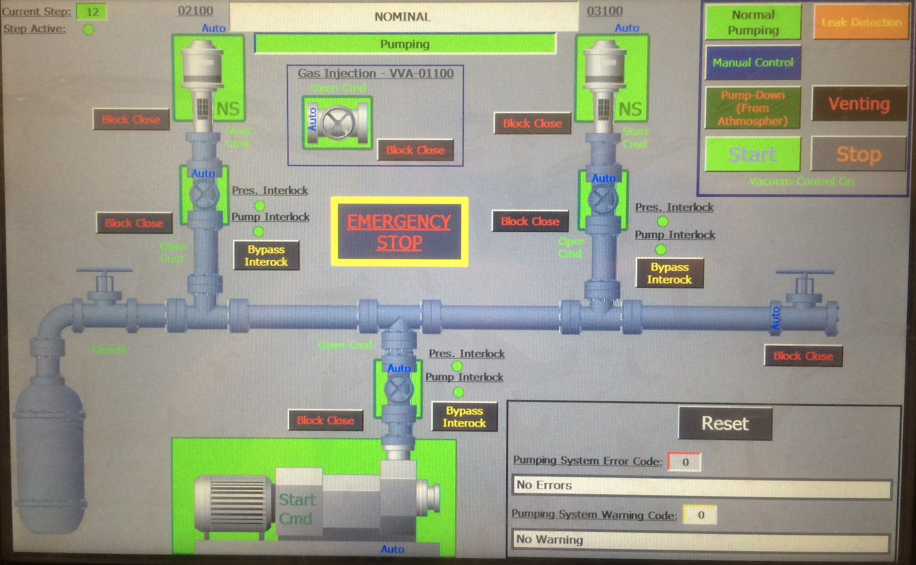
Status as today
Prototype vacuum control rack
Designed and assembled at ESS
Successfully installed by ESS at in-kind partner institute IFNF Catania for testing on the LEBT
Controls through EPICS
It is the base concept for all vacuum control racks
Second prototype is planed for Q2
Framework Agreement for the racks and Vacuum Equipment to be in place
Taking in account the ESS Electrical Standardization Catalogue

Slide 12
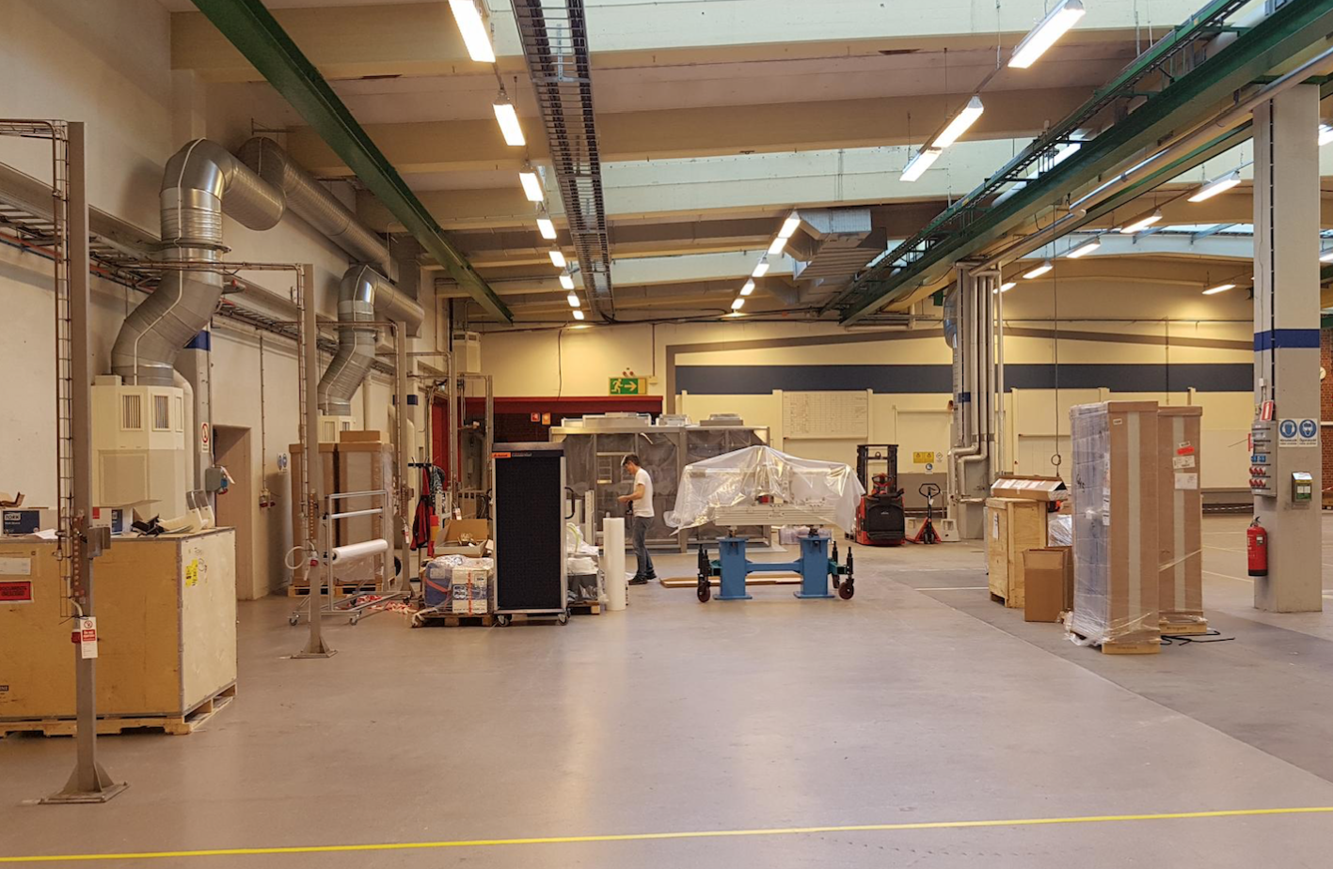
Status as today (cont.)
Facility Breakdown Structure and ESS naming in place for all LINAC vacuum parts
Working on the detailed design of the 54 control racks in EPLAN
Cable database ready
Rack assembly space in RATS will be started Q2 2017
Assembly of the racks
Preliminary rack tests

Slide 13
Conclusion
The ESS vacuum control system is designed in-house by the Vacuum Group and the Integrated Control System Group
All interfaces were listed and clear definitions of the requirements done
The vacuum control system is based on PLC and EPICS IOC
EPICS for the control screens, configuration and post-analysis
PLCs handle safety functionality in the vacuum system
The first prototype vacuum control rack was designed and assembled by the ESS Vacuum group and ICS and installed successfully at our in-kind partner institute, INFN in Catania
Next step: set up and start up of the vacuum rack assembly area at RATS

