Slide 1
Cryogenics at the European Spallation Source
Philipp Arnold
Section Leader Cyogenics
Work Package Manager Cryogenics
www.europeanspallationsource.se
Date

Slide 2
Outline
Where in ESS do we have cryogenics
Who works for cryogenics
What is the status of the cryogenic equipment

Slide 3
(1.1) System overview – block diagram
Pure Helium
Gas Storage
Standalone Helium Purifier
Helium Recovery System
Target Moderator
Cryoplant
Accelerator
Cryoplant
20 m³ LHe Tank
5 m³
LHe Tank
Test & Instrument Cryoplant
Target Cryodistribution System
LHe Mobile Dewars
Test Stand Cryodistribution System
Cryodistribution System for Elliptical Linac
Cryodistribution System for
Spoke Linac
LN2 Storage Tanks
Hydrogen Circulation Box
Elliptical
Cryomodules
Spoke
Cryomodules
LN2 Mobile Dewars
Instruments & Experiments
Test Stand Lund 2
Hydrogen Moderator
Notes:
ACCP: 3kW @ 2K, 11kW @ 40K, 270 l/h Liquefaction → special plant, power consumption in MW range, big industrial compressors, sophisticated CC system
TICP: 76W @ 2K, 420W @ 40K, 6 l/h Liquefaction → plant well in the standard range
TMCP: 32kW @ 15-20K → very large again, some challenges but not terribly sophisticated process, compared to ACCP
Large and sophisticated cryo-distribution system for all plants and their consumers

Slide 4
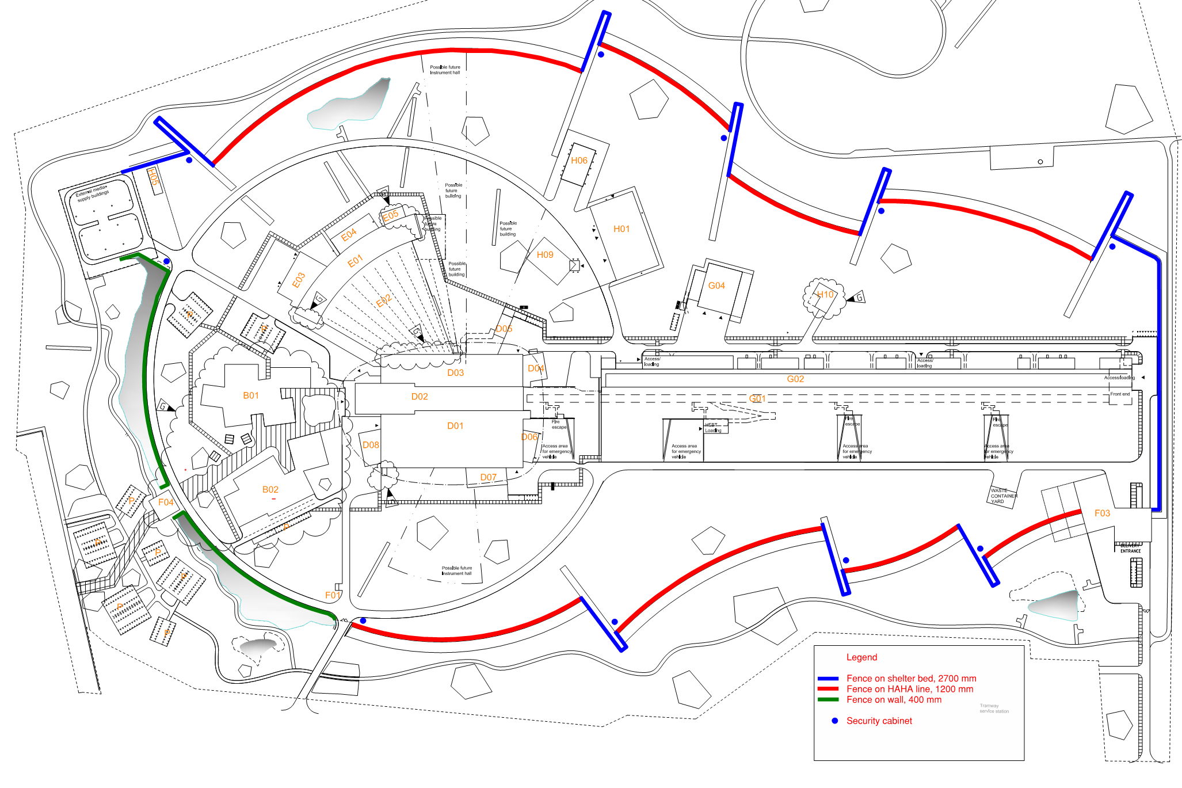
(1.2) Cryogenics at the site - overview
Neutron Instrument Halls
Cryogenic Moderator Room
Cryo Compressor Building
Coldbox Building and
Cryomodule Teststand
Accelerator Tunnel

Slide 5
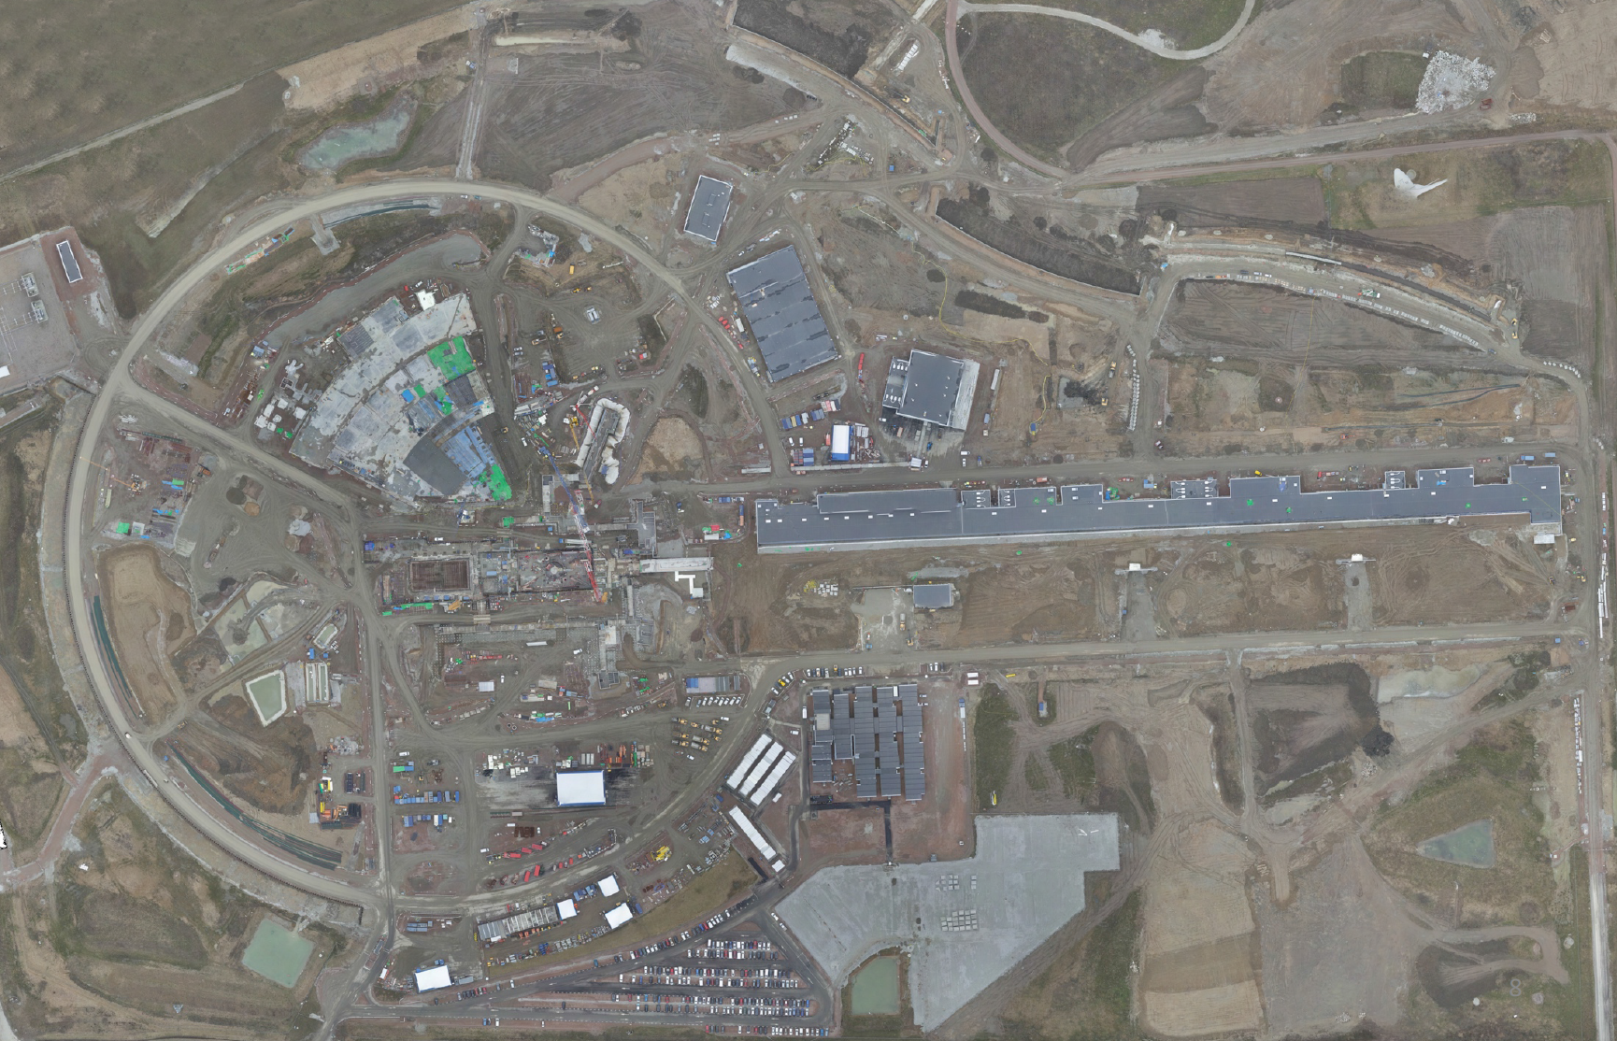
(1.3) Cryogenics at the site - aerial view
Cryo Compressor Building G.04
Coldbox Building G.02

Slide 6
Outline
Where in ESS do we have cryogenics
Who works for cryogenics
What is the status of the cryogenic equipment

Slide 7
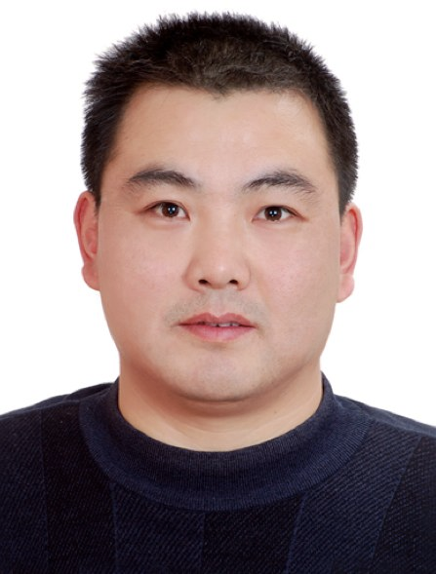
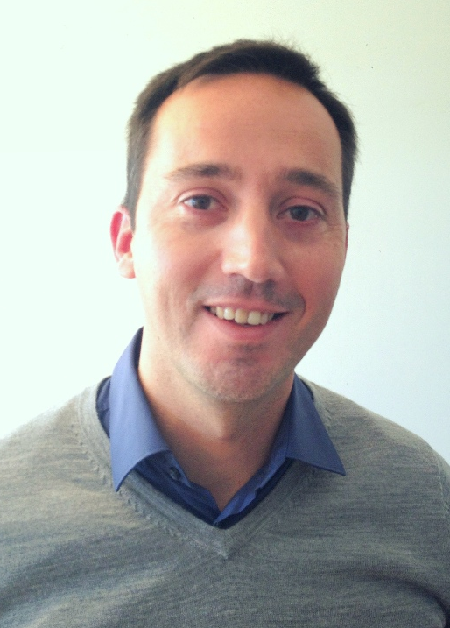
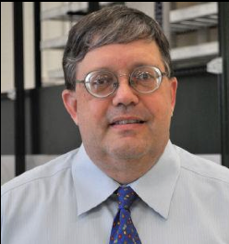
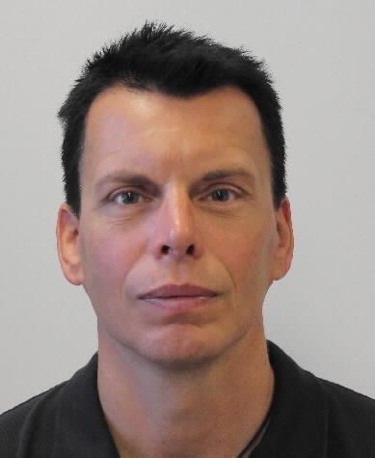
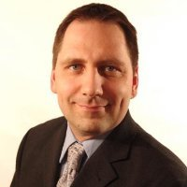
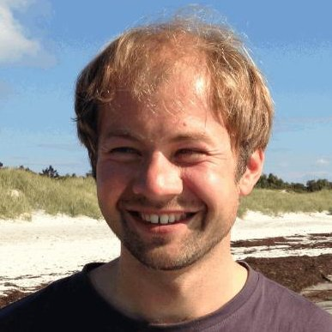
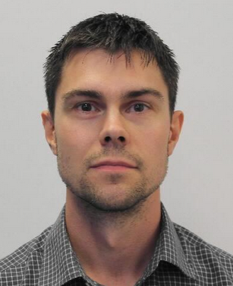
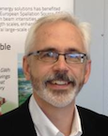
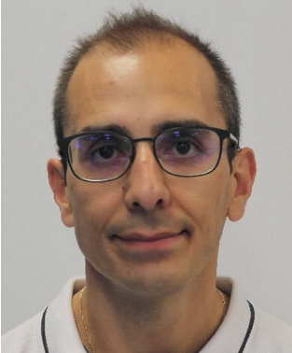
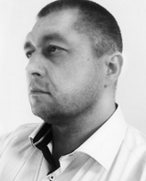
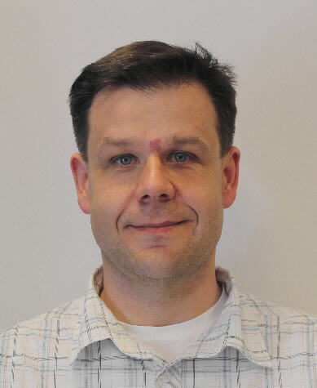
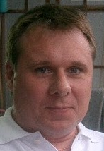
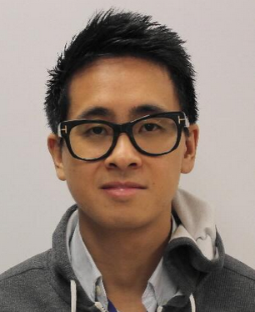
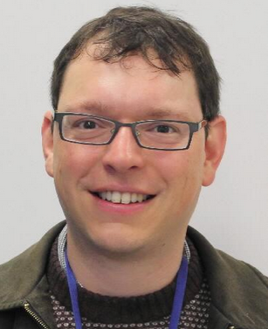
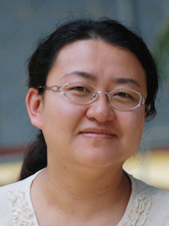
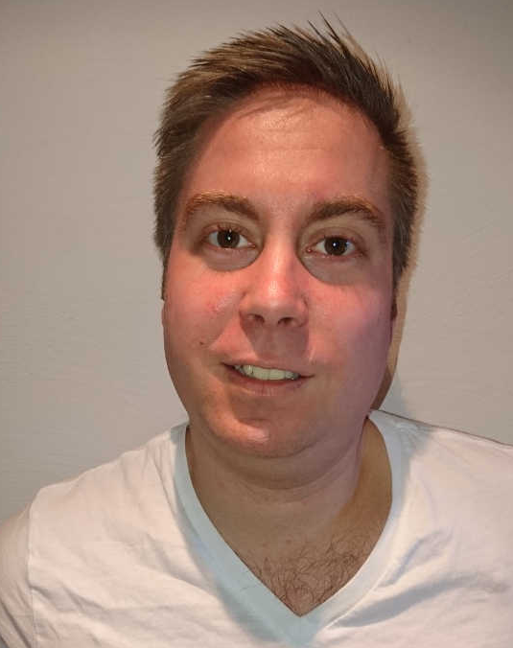
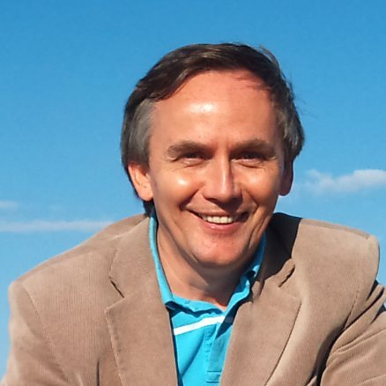
(2.1) Cryogenic Team
Cryogenic Section
…and other important contributors
Nuno Elias
Cryomodules
John Weissend II
STS Group Leader
Philipp Arnold
Section Leader,
TICP Project Engineer
Ila Sjöholm,
Installation Supervisor
Wolfgang Hees
CF Interfaces
Xilong Wang
ACCP Project Engineer
Jesper Ringner,
Target - CMS
Jarek Fydrych
CDS Project Engineer
Johnny Råström Cryogenic Operator
Cryogenic Operator
Cryogenic Operator
Anton Lundmark
Piping, Tanks
John Jurns
TMCP Project Engineer
Benedetto Gallese, ICS
Alex Holmes
Science, SE
Xiaotao Su
Cryogenic Engineer
Mattias Olsson Cryogenic Operator
Piotr Tereszkowski
Designer
Cryogenic Operator
Cryogenic Operator
Duy Phan
Safety, ODH
…and many more

Slide 8
(2.2) Staffing for Cryogenic Section

Slide 9
Outline
Where in ESS do we have cryogenics
Who works for cryogenics
What is the status of the cryogenic equipment

Slide 10
(3.1) High Level Schedule

Slide 11
(3.2) Work Unit Status
Work Unit and Name | Supplier | Status
11.11.3 ACCP | Linde Kryotechnik, CH | Manufacturing
11.11.4 TICP | Air Liquide Advanced Technologies, FR | Manufacturing
11.11.5 TMCP | Linde Kryotechnik, CH | Detail Design
11.11.6.1 CDS-LTS2 | Wroclaw University of Science and Technology, PL | Contracting manufacturer
11.11.6.2 CDS-el |  | Contracting manufacturer
11.11.6.3 CDS-sl | IPNO, FR | Contracting manufacturer
11.11.6.4 CDS Integration (CDS-CM) | Not yet selected | Not yet started
11.11.7 CMS (Target, WP3) | Forschungszentrum Jülich, DE | Detail Design
11.11.8 Warm Interconnecting Piping | Powerheat AB, SE | Manufacturing, installation
11.11.9.1 PHS | UBH, UK | Manufacturing
11.11.9.2 LN2 tanks and supply | Air Liquide Gas AB, SE | Kick-off
11.11.9.3 Helium supply | Strandmöllen AB, SE | Contract signed
11.11.10 N2 and He support for NSS | Not yet selected | Conceptual design

Slide 12
Summary
After CERN and DESY the cryogenic system at ESS is one of the major installations in Europe with a demanding technical scope
A good cryogenic team is already in place (5 engineers, 1 technician, 2 consultants) but has to be expanded and operational experience to be built up
WP11 is one of the first out on the site, installation started January 2017
Slight schedule variances can be managed so project critical path not impacted
Currently in total no budget overrun and no technical showstoppers
Questions?

