Slide 1
WARM LINAC
VACUUM SYSTEM
Simone Maria Scolari
Vacuum System Engineer
Vacuum System Section – STS/AD
www.europeanspallationsource.se
22 March, 2017

Slide 2
Outline
Warm Linac general overview
LEBT vacuum system: interfaces and status
RFQ vacuum system: interfaces and status
MEBT vacuum system: interfaces and status
DTL vacuum system: interfaces and status
Conclusion

Slide 3
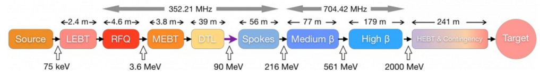
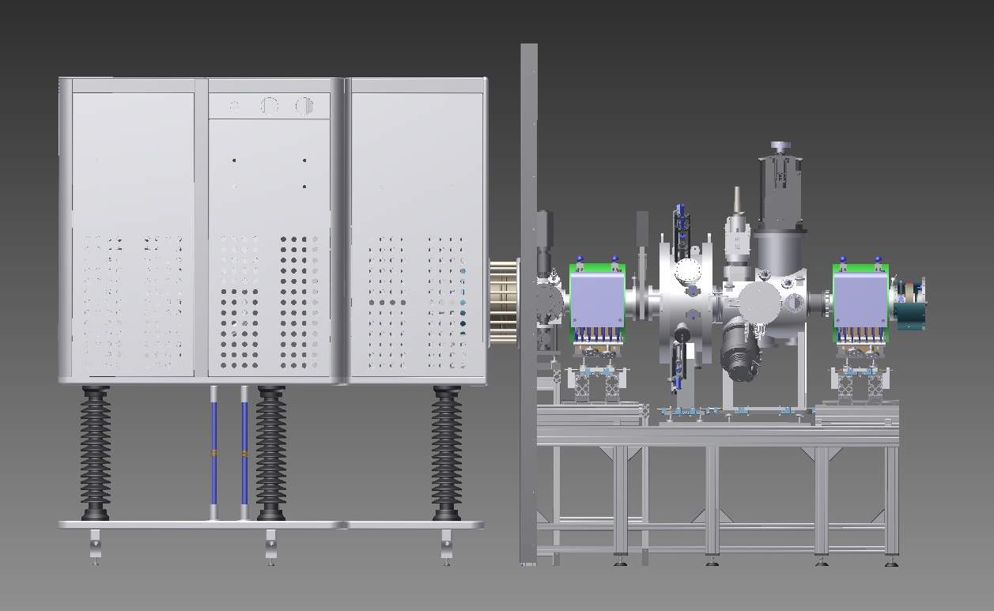
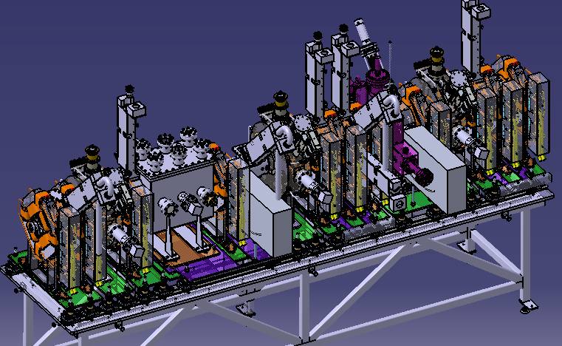
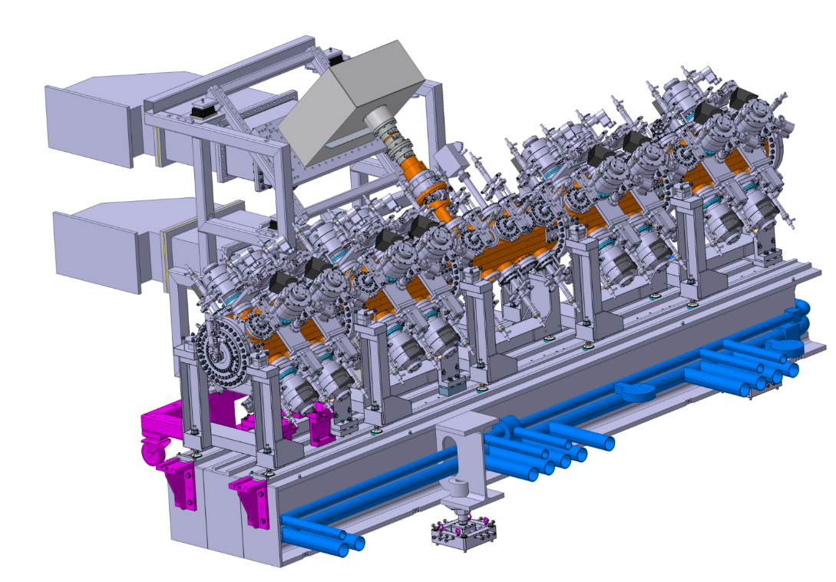
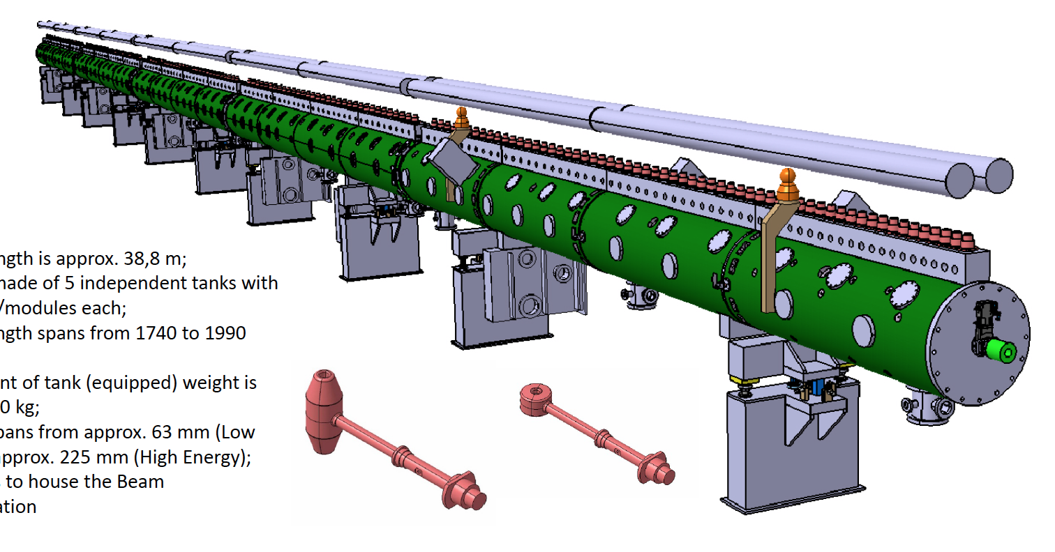
Warm LINAC overview
LEBT:
- Designed at INFN Catania
- ESS responsible for vacuum system design
RFQ:
- Designed at CEA
- ESS responsible for vacuum system design
MEBT:
- Designed at ESS Bilbao
- ESS reviews vacuum system design
DTL:
-Designed at INFN Legnaro
- ESS responsible for vacuum system design

Slide 4
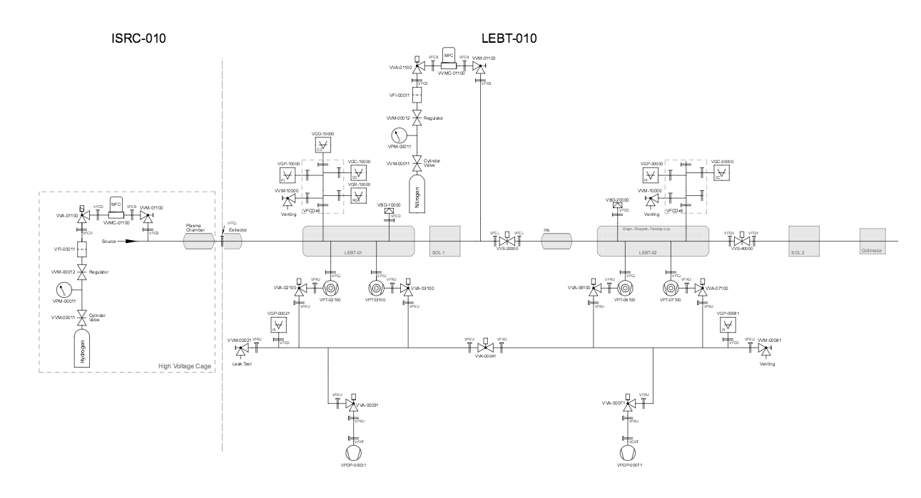
LEBT vacuum system: overview and interfaces
Vacuum components:
Rough Vacuum manifold (2 primary pumps)
Two sets of two turbomolecular pumps
Two gas injection points
Two sets of gauges
RGA
IS and LEBT Vacuum Schematics
Interfaces:
Downstream interface with RFQ (gate valve before collimator)

Slide 5
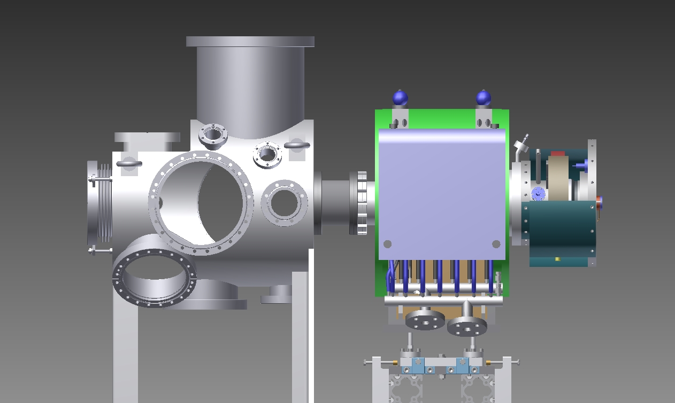
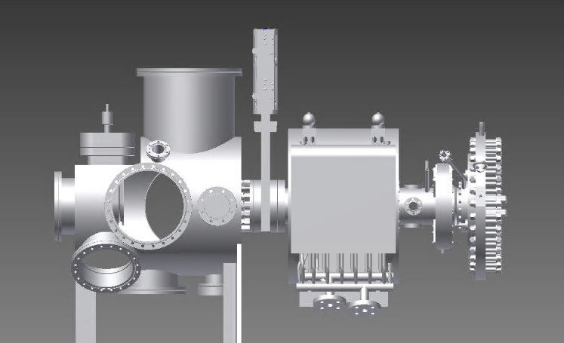
LEBT status: vacuum open points
Different configuration of the LEBT end part in Catania and in the tunnel.
Two options for BI-box and the valve connection:
- Welding of a new flange in the tunnel
- Customized adapter
Catania configuration
Tunnel configuration
H₂ injection requested to be raised to 10 sccm (from 5 sccm). Impact on pressure at RFQ to be evaluated.
Notes:
(Good point, explain we have access to RGA and control data…)

Slide 6
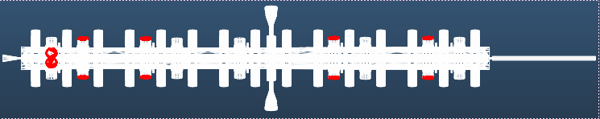
RFQ vacuum system: overview and interfaces
Vacuum components
Rough vacuum system
Turbomolecular pumps
Gauges
RGA
LEBT
Section 1
Section 2
Section 3
Section 4
Section 5
MEBT
Outgassing and pumps:
OGR: 5E-10 mbar l/s/cm²
Gas: 50% H₂ and 50% N₂
Pumping speed: 345 l/s (H₂) ; 340 l/s (N₂)
Interfaces:
Upstream: LEBT collimator
Gas in: 2E-05 mbar l/s
Downstream: MEBT
Gate valve on RFQ
Implementation gate valves on TMPs ports TBD.
Failed pumps

Slide 7
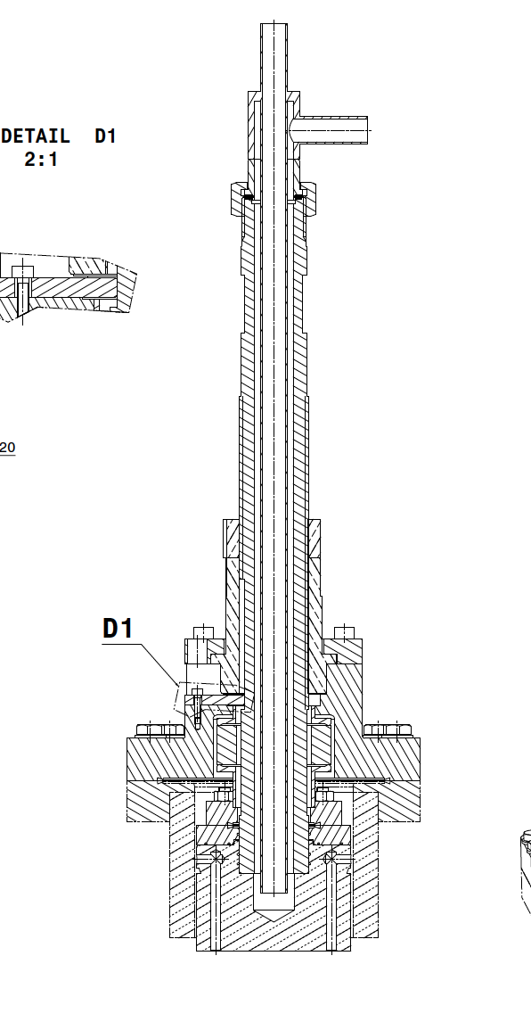
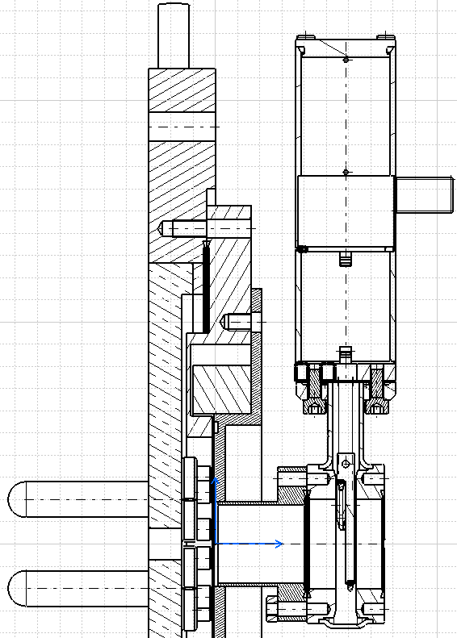
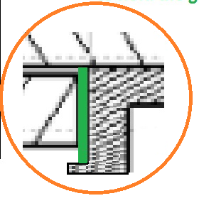
RFQ status: vacuum open points
TUNERS: Definition on He leak check procedure on the brazing connections (lessons learned from SNS and SLAC).
ESS requirements (ESS VHB):
- Hydrostatic test (x1.5 maximum design pressure)
- Baking to remove water from possible cracks,
- Leak check
Water inlet
Air
Vacuum
Brazing
ACCT brake at RFQ exit plate.
- ESS proposal of a flat gasket accepted
- Test to evaluate the required closing force to be executed envisaged at ESS
ACCT

Slide 8
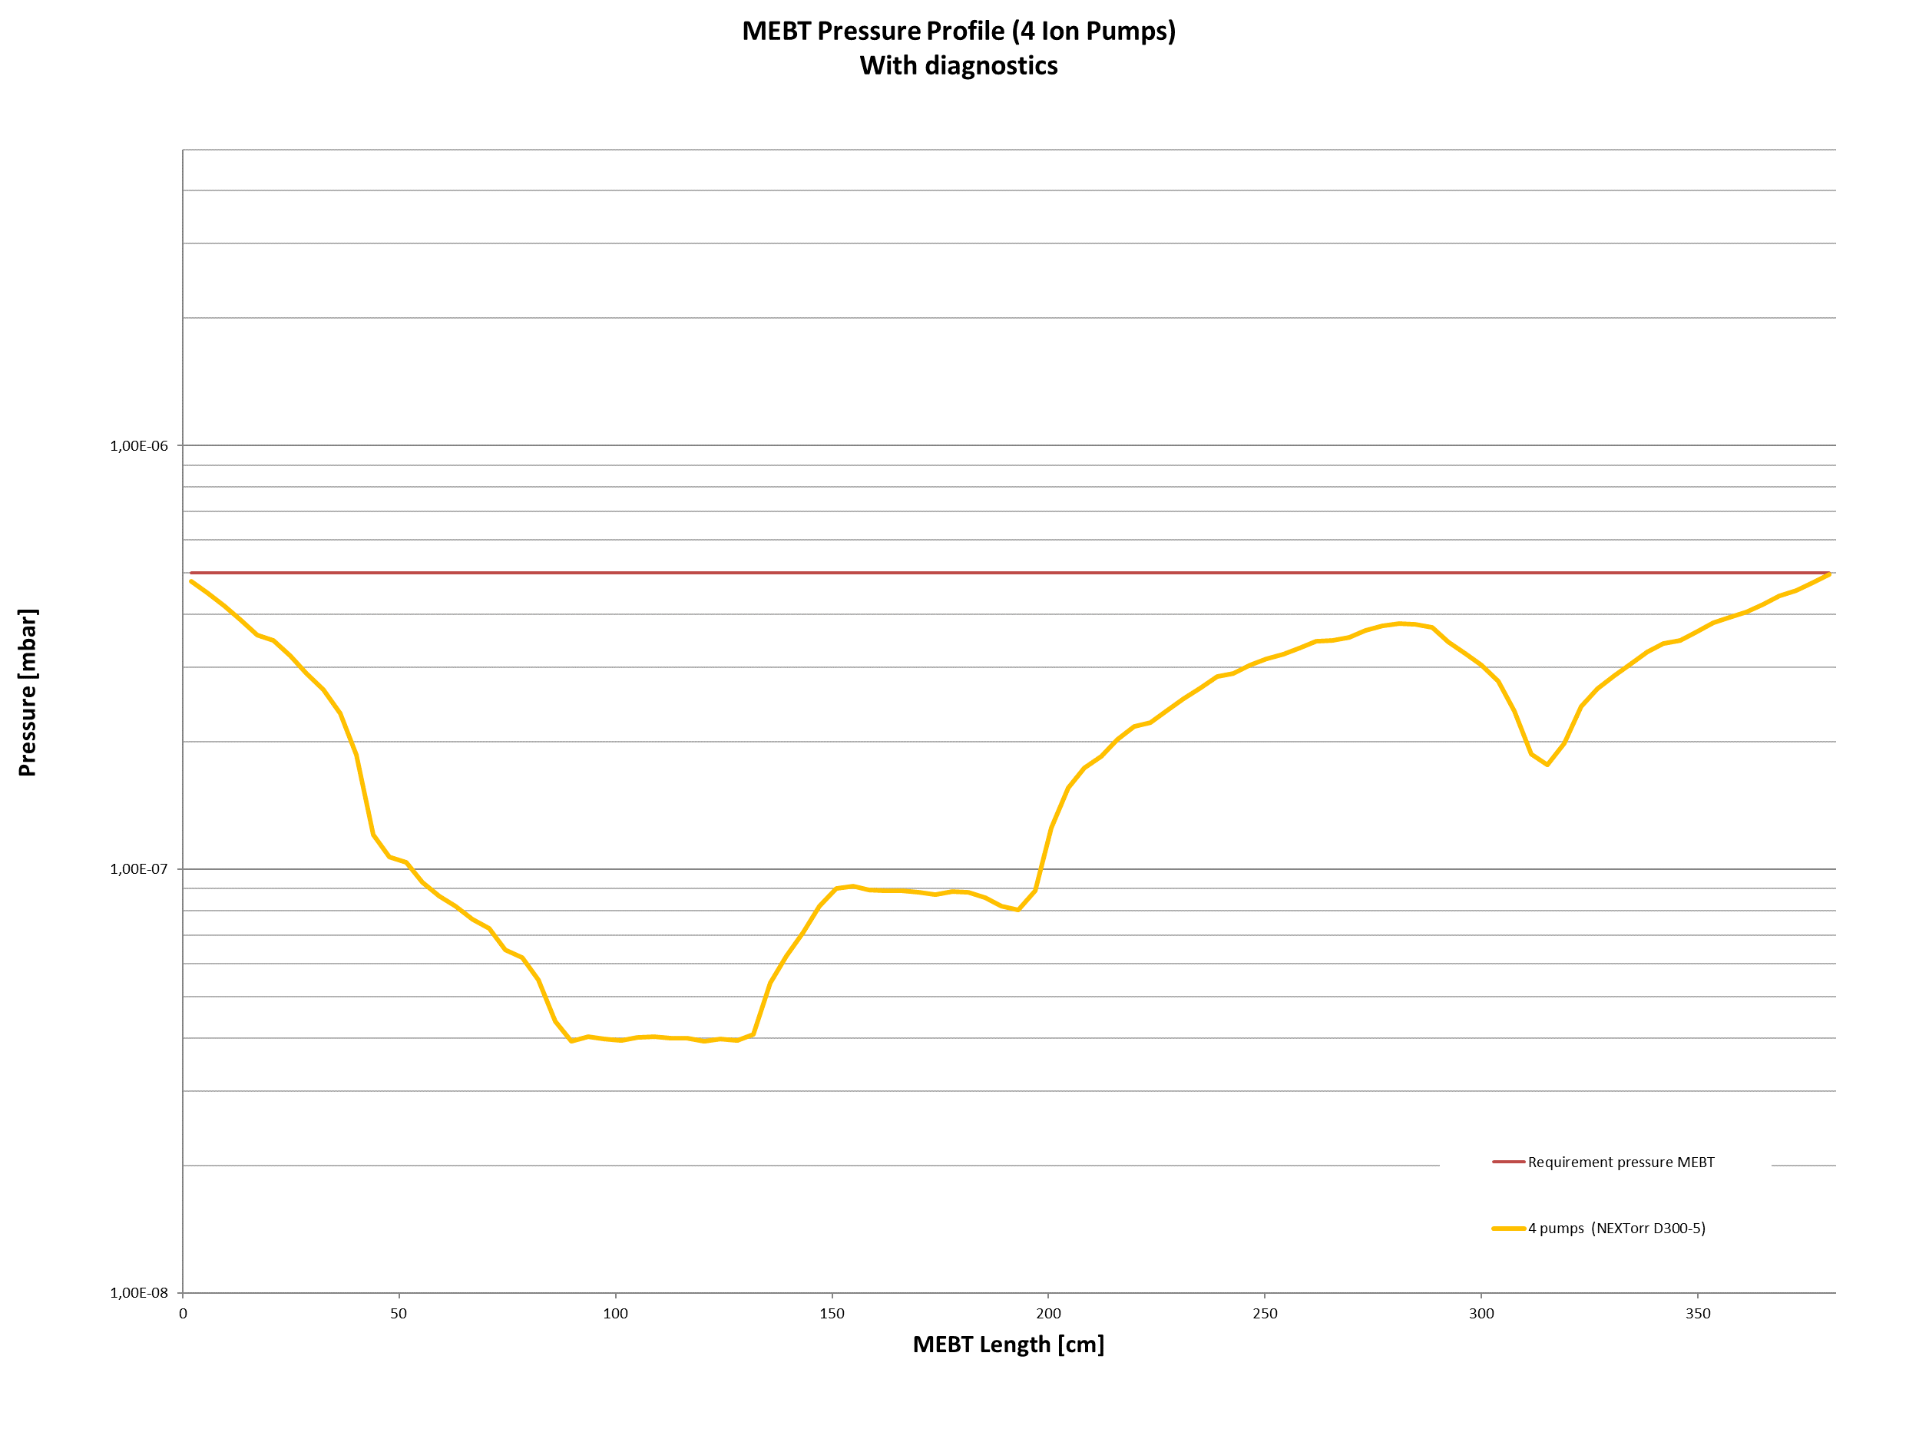
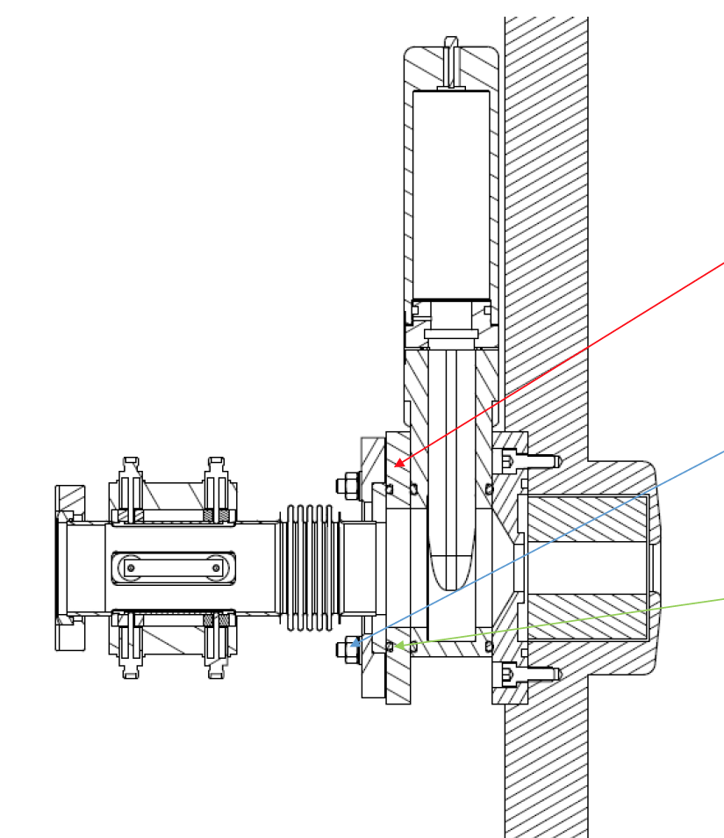
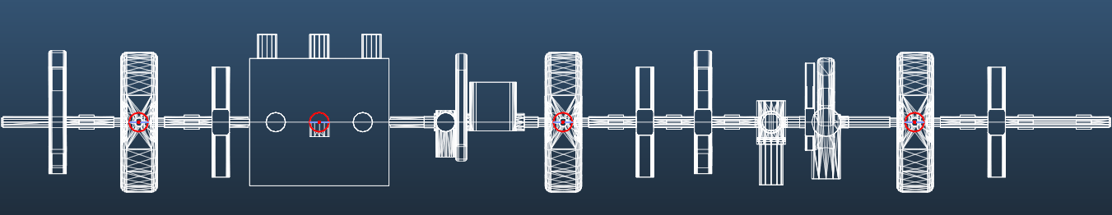
MEBT Vacuum System: overview and interfaces
ESS ERIC provides testing capabilities for outgassing.
Test performed:
- Black coating
- Graphite
- EMU grid
- EPDM
ESS Bilbao responsible for vacuum design and MolFlow simulations.
Vacuum components:
Pump-down system
NEG pumps
Gauges
MEBT-DTL interface
Interfaces:
Upstream: RFQ (valve sits on RFQ
Downstream: DTL (valve sits on DTL and it’s an insertable valve)

Slide 9
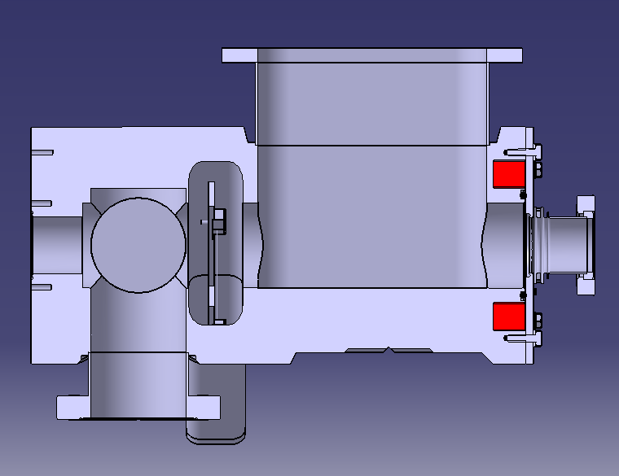
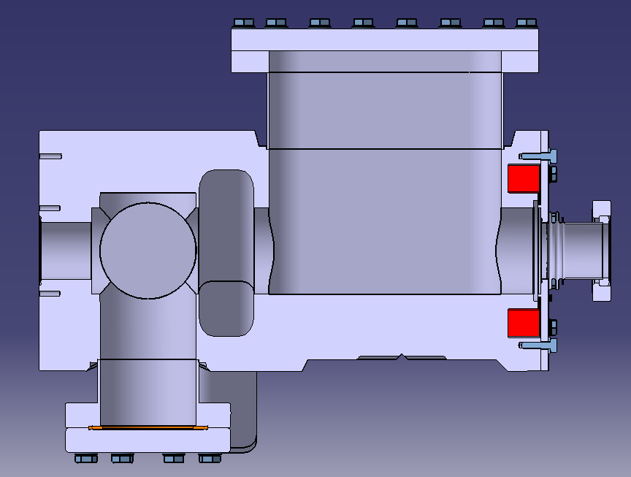
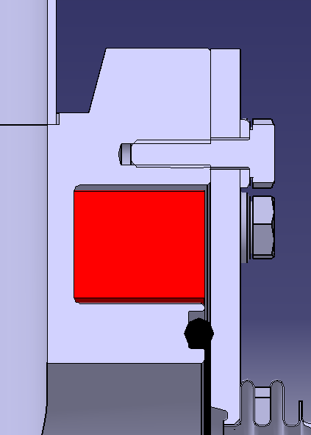
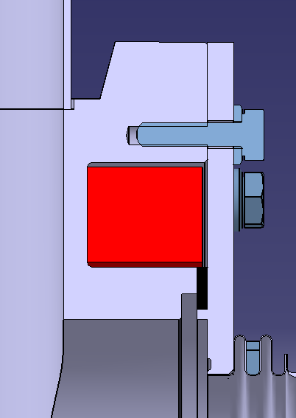
MEBT status: vacuum open points
Outgassing test campaign to be concluded:
- Braided cables with connectors used in the chopper box shall be tested
EPDM gasket for ACCT brake on the dump box: Circular/flat gasket
Circular section gasket
ESS Bilbao courtesy
Flat gasket

Slide 10
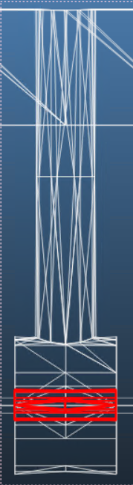
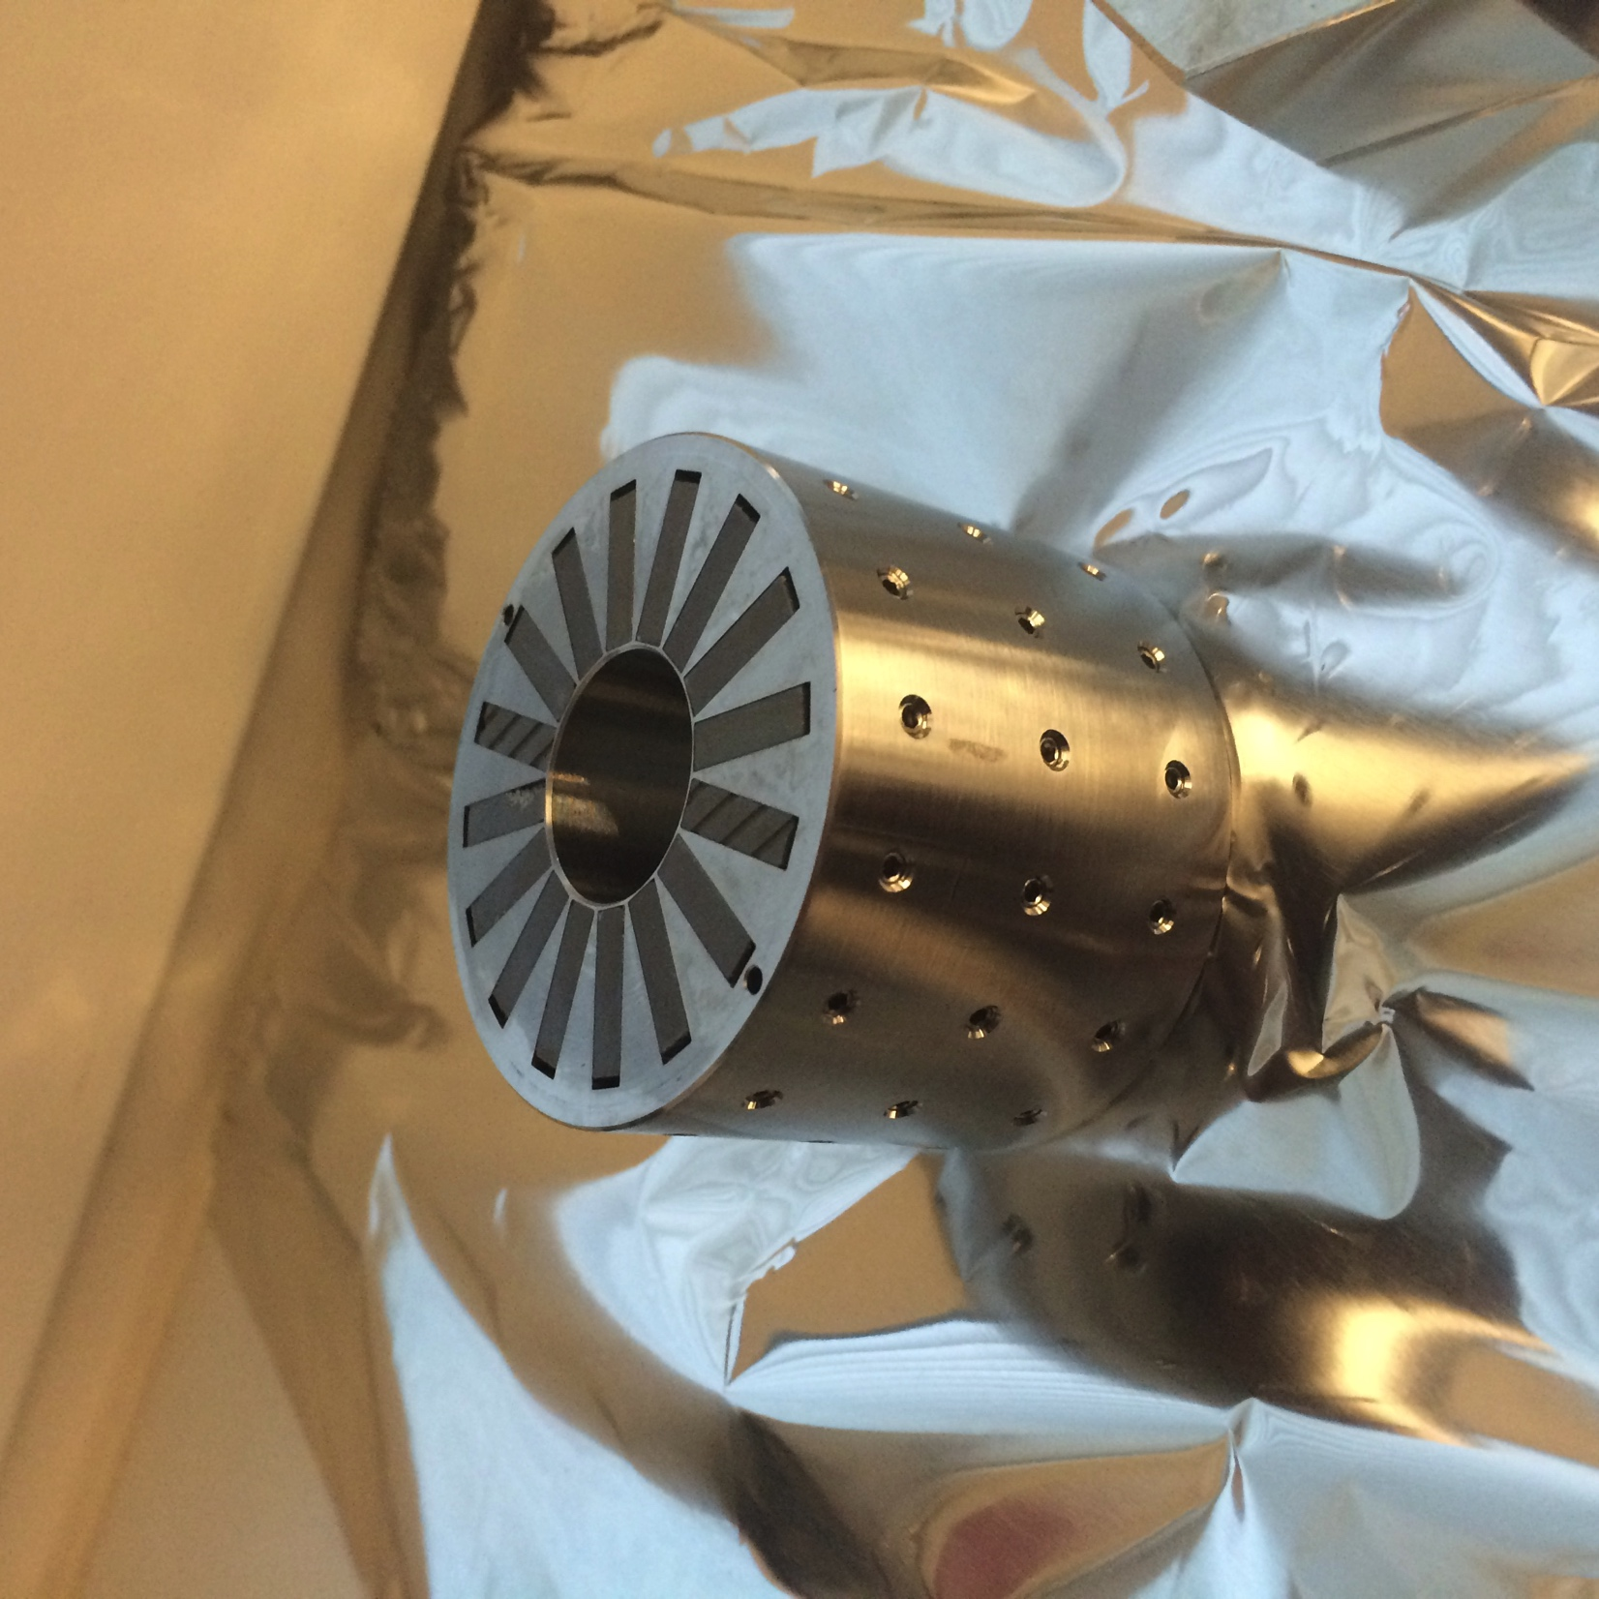
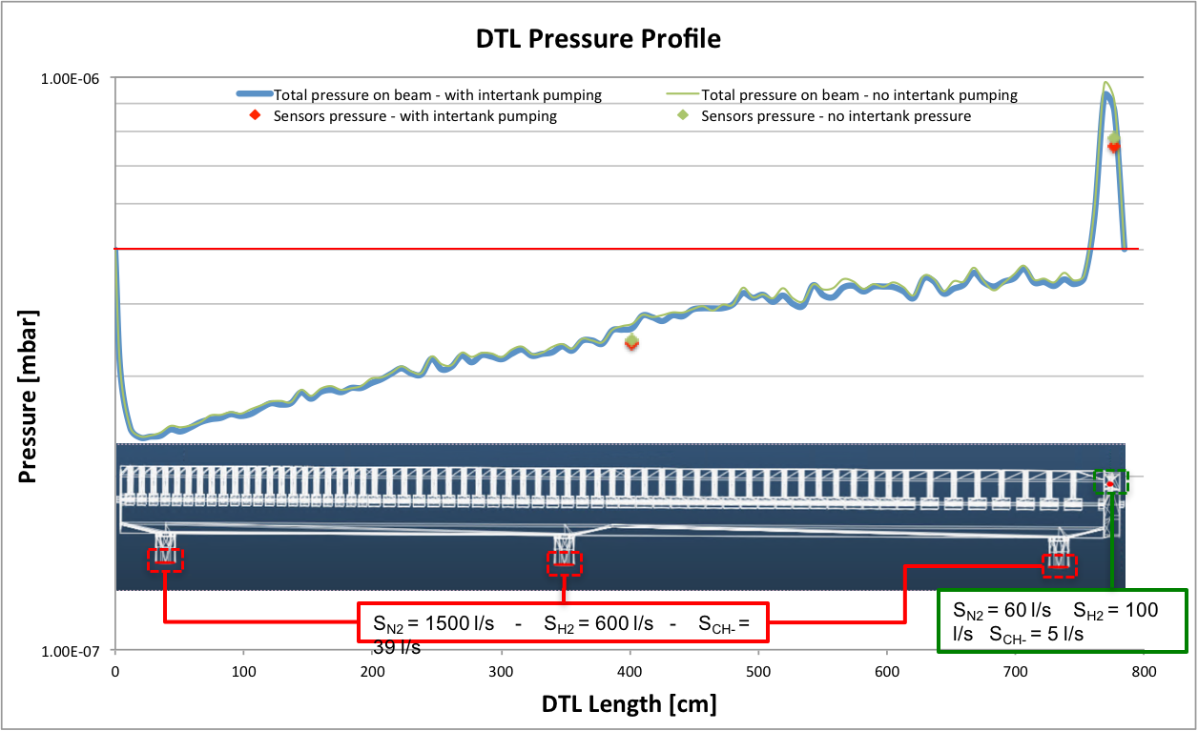
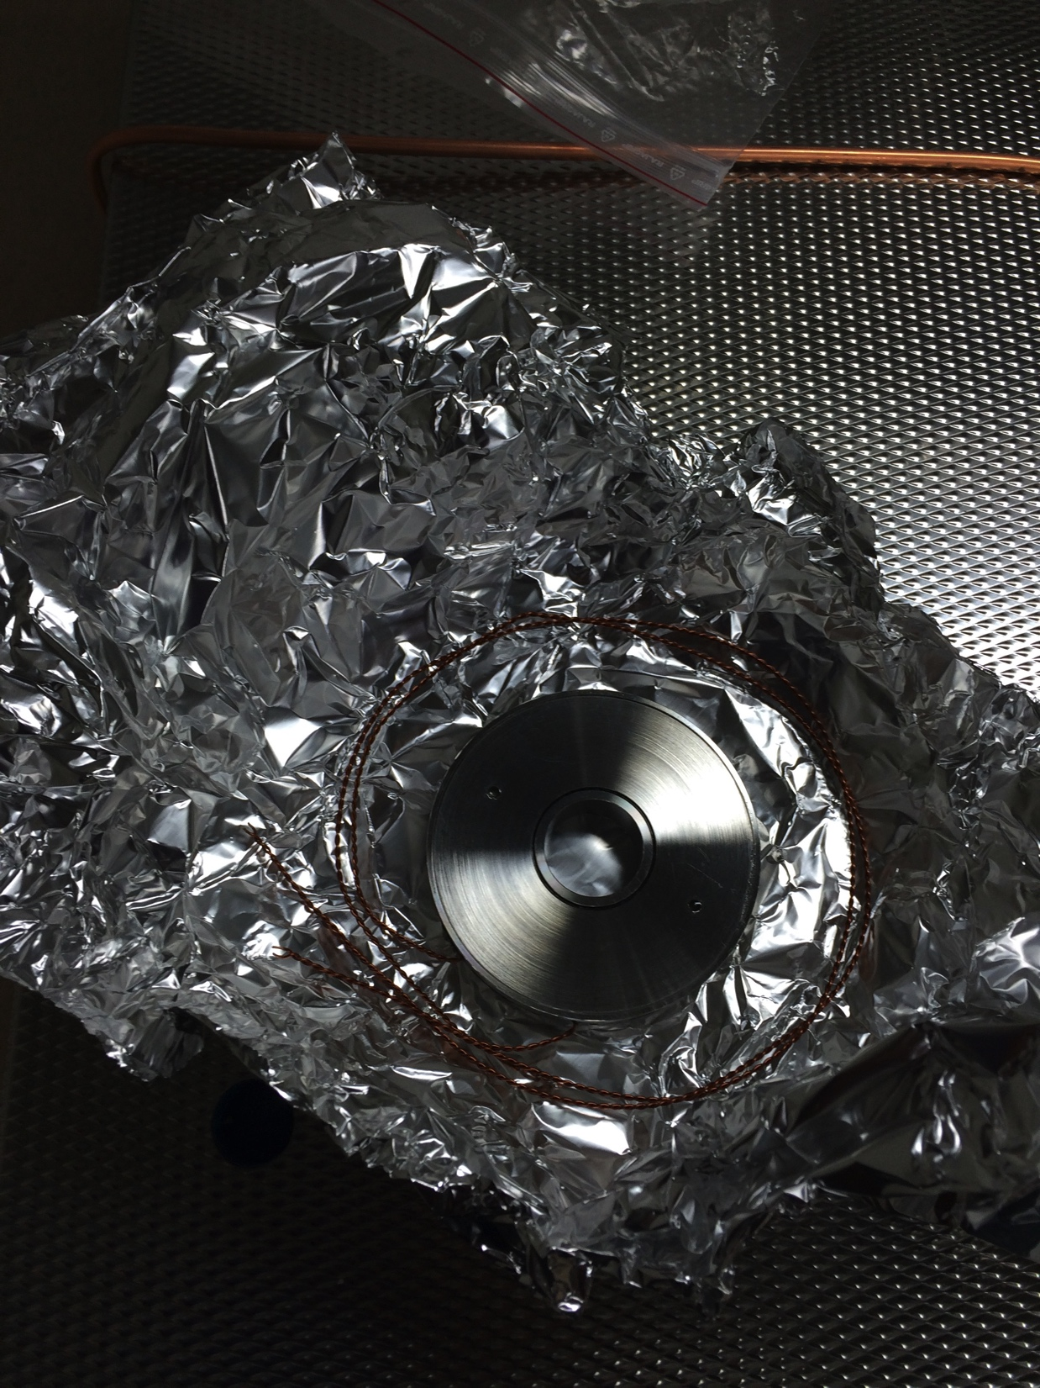
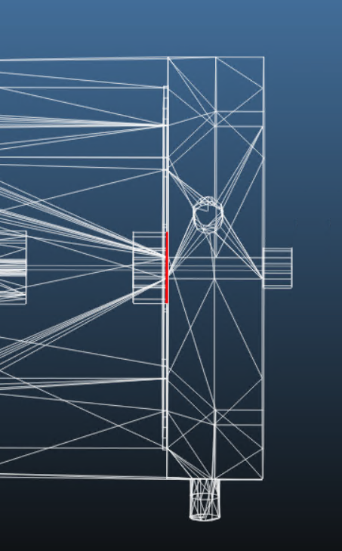
DTL Vacuum System: Overview and interfaces
Outgassing tests and Molflow simulations carried out at ESS.
Critical tested components: PMQs and ACCT
PMQ
Vacuum components per tank:
Pump-down system (carts)
NEG pumps (both in the tank and the inter-tank)
Gauges
ACCT
Interfaces:
Upstream: MEBT (insertable gate valve on DTL)
Downstream: LEDP (All metal gate valve on DTL intertank)
Due to high gas load of epoxy insulation, a bake of each ACCT is envisaged.

Slide 11
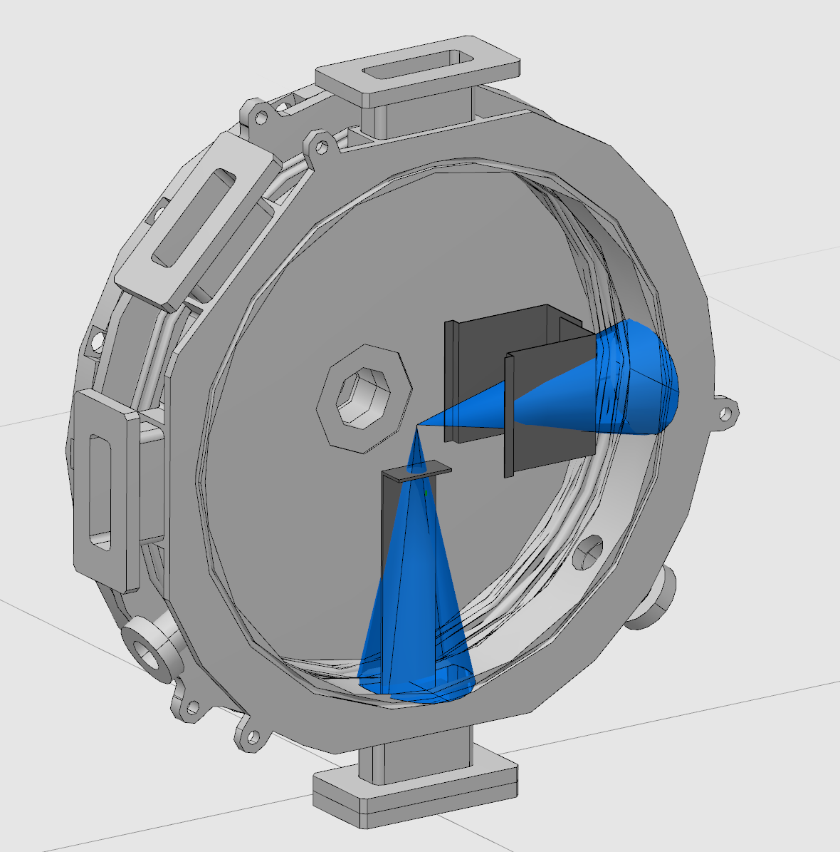
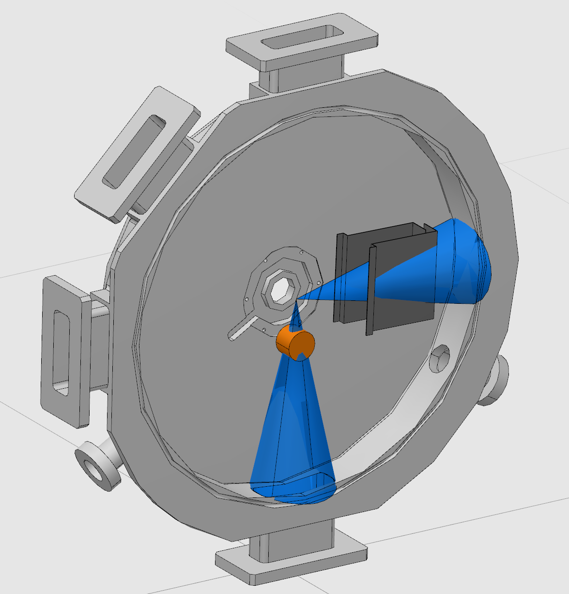
DTL status: vacuum open points
ACCT cleaning and bake-out procedure before installation.
Black coating for NPM in the DTL inter-tanks: two different solutions depending on installation schedule of Faraday cup.
Before FC installation
Leak check procedure for the water cooled stems.
After FC installation

Slide 12
Conclusions
Vacuum system design has been carried out with a strong collaboration with in-kind partners.
All polymeric materials have been tested for outgassing before approval.
The pressure requirements are fulfilled in all the warm LINAC sections.
Some integration issues still exist but they are not critical.

