Slide 1
VE accelerator April 2017 for TAC
E. Bargallo, M. Eshraqi, F. Gerigk, W. Hees, M. Lindroos,
S. Molloy, D. Phan, A. Sunesson, J. Weisend and the AD collaboration
www.europeanspallationsource.se
April 2017

Slide 2
Accelerator Division – Scope
Accelerator Technical performances
Key parameters:
    -2.86 ms pulses
    -2 GeV
    -62.5 mA peak
    -14 Hz
    -Protons (H+)
    -Low losses
    -Minimize energy use
    -Flexible design for mitigation and future upgrades
Design Drivers:
High Average Beam Power
5 MW
High Peak Beam Power
125 MW
High Availability
352.21 MHz
704.42 MHz
2.4 m
4.6 m
3.8 m
39 m
56 m
77 m
179 m
Target
Source
LEBT
RFQ
MEBT
DTL
Spokes
Medium β
High β
HEBT & Contingency
75 keV
3.6 MeV
90 MeV
216 MeV
571 MeV
2000 MeV
First beam at 572 MeV in June 2019
5 MW capacity for 2023
RF sources for HB part is the scope contingency for accelerator

Slide 3
Final proposal
The ACCSYS project has conducted a detailed value engineering exercise in order to reduce or defer overall project cost. A Value Engineering Team carried out this work in consultation with ACCSYS Work Package Managers and In-Kind Partners.
The detailed value engineering items are shown in the attached spread sheet (Appendix 1). Those items in green are being proposed by ACCSYS as Value Engineering changes. All together ACCSYS has identified:
  Savings: 11.818 MEuro
  Deferral: 27.818 MEuro
  Total Cost Reduction - 39.636 MEuro

Slide 4
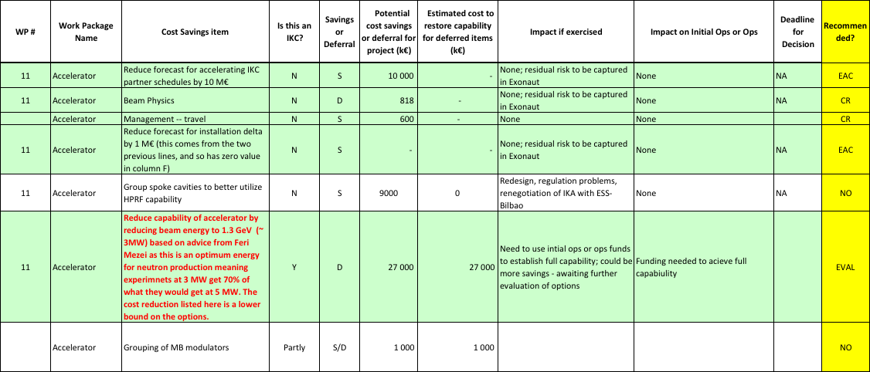
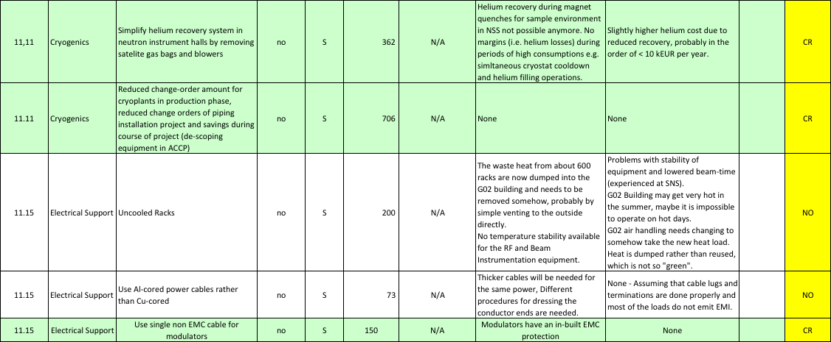
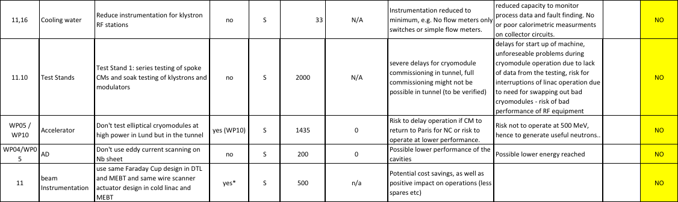
VE AD 2017

Slide 5
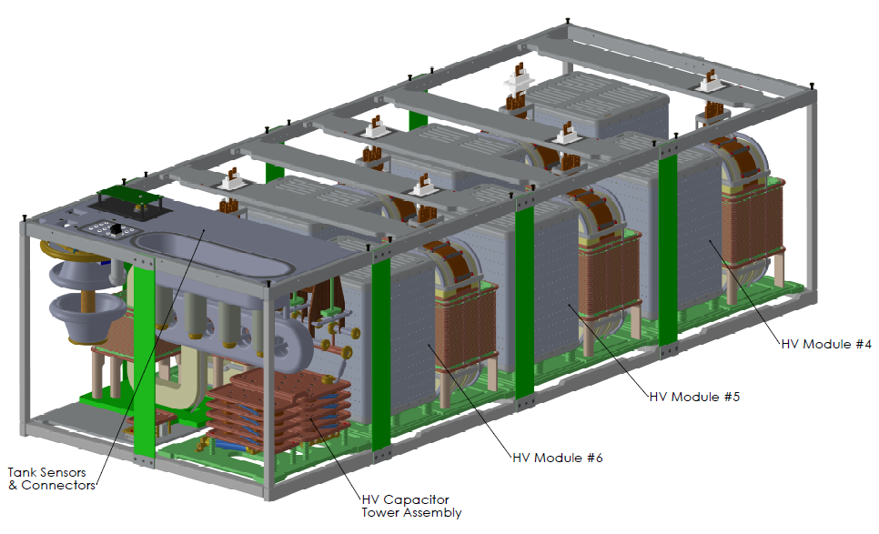
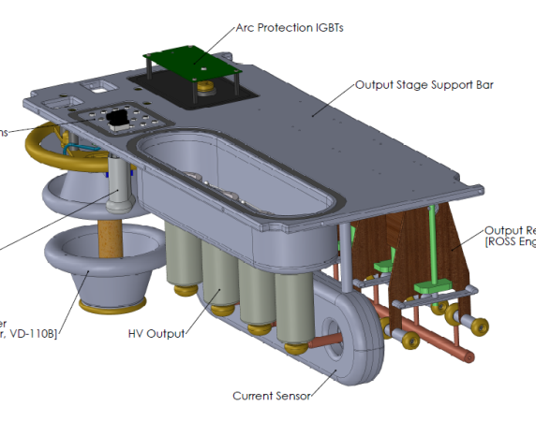
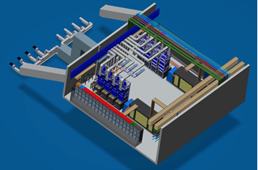
Sharing modulators in MB linac
(i.e. 6 klystrons per modulator instead of 4 per modulator)
Schedule issues:
Redesign of the HV output stage (HV sockets, HV relays and current sensors) -> Delays in procurement by about 3 months;
Space issues:
HV oil tank would be longer by about 0.5m. Available space with current layout already very limited:- all components (modulators, klystrons, water skids) are placed on the transversal direction of the gallery;
Different types of modulators (maintenance issues):
The modulators of the RFQ/DTL would be different from those of the medium beta; therefore not interchangeable anymore;
HV output stage
(of oil tank assembly)
HV cable routing issues (modulators to klystrons) :
The number of klystrons per modulator per stub would not match evenly (8 klystrons per stub, not 6);
This would have the following consequences:
  routing of HV cables in the gallery would need to be redesigned;
  need to pass 2 HV cables from one modulator to the next stub, requiring much longer cables (their length is critical due to the energy they store, going into klystron in case of arcing);
  lose symmetry / modularity of the layout;
Layout of one stub in the RF gallery

Slide 6
Options
Reduce the beam current
  Savings achieved by reduction in HPRF capacity
    A single tetrode (instead of two) for each SPK cavity
    ~50% reduction in modulator count in MBL and HBL
      Stay with one amplifier per cavity throughout the linac.
Reduce the beam energy
  Option #1: Defer HBL HPRF purchase
    Leaving the last 10 (of 21) HBL CM’s unpowered results in 3 MW
  Option #2: Defer HBL cryomodule assembly
    Reduce the HBL CM scope from 21 to 11
    Also takes advantage of the option #1 savings

Slide 7
Proposed solution
Beam current reduction ruled out:
  Impacts felt everywhere in the linac
  Savings reduced due to the need for RF-matching at the couplers
  Reclaiming the 5 MW scope could only be done in one large, complex, costly, step
Beam energy reduction:
  Plays to the strength of a linac
    I.e., addition of extra acceleration in the future is simple
  Little or no effect on other systems
  Reclaiming scope can be done gradually, with each step having a positive impact for our users

Slide 8
Proposed solution
Initially-reduced beam power → 3 MW
Remove RF capability for final 10 CM’s
Do *not* defer CM purchase
  Tear-down and set-up of CM production line is considered too expensive
Regain scope in chunks
  One CM at a time (4 RF cells)

Slide 9
Scope deferrals RF systems
DEFERRALS (27.05 M€ + tbc € for LLRF svaings )
Cash: 40 fewer high power RF amplifiers – 12.6 M€
Cash: 10 fewer high power Voltage supplies – 11 M€
Cash: LLRF cash savings tbc k€ (needs feedback ICS)
In-kind: 40 fewer circulator/loads – 1.75 M€ (UK)
In-kind: 40 fewer sets arc detectors and switches – 800 k€ (UK)
In-kind: 40 fewer LLRF systems to be assembled – 500 k€ (PEG)
In-kind: Install less RFDS – 400 k€ (IFJ PAN)
All In-Kind require changes to IKA’s
PROPOSED DESCOPING FROM EAC FOR PEG AND UK (1.4 M€):
Reassign UK to buy cavity coupler arc detectors – 900 k€ (CR 11.000066.1 value – 40 H beta pairs)
Reassign PEG to provide electron pick-ups – 500 k€ (not including the final 40 cavities)
Values to be confirmed and verified
These too require changes to IKA’s

Slide 10
Installation of deferred RF
In the gallery this can happen any time, provided the gallery space is not used for something else
In the tunnel (electron pick-ups, arc detectors) have to wait for a shutdown, unless the targeted cavities are not in the tunnel. Then it will be simpler
Estimated time of installation ca 40/84 (48%) of original estimated high beta installation time, or 12 months

Slide 11
Impact on IOT/klystron decision
The plan is to start tendering high beta amplifiers early 2018
The value engineering does not impact this decision

Slide 12
AD SRF schedule

Slide 13
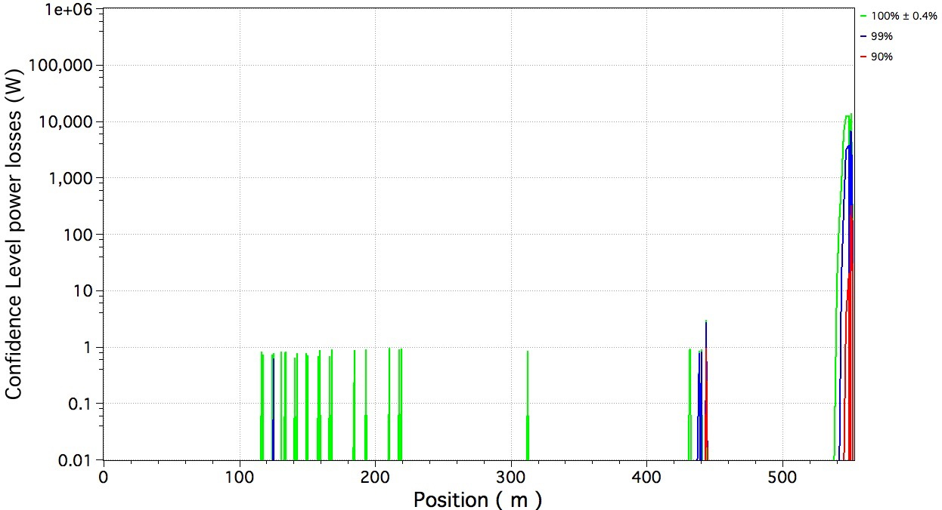
Preliminary error study results
Tracking 2.3E8 particles (10E6 over +230 linacs) from the start of spoke to the target shows no dramatic losses in the linac or extended-HEBT. Errors included are input beam errors, quads and cavities.
Losses seen at ~550 m
are inside the monolith
and could be reduced.
None of the linacs have a loss beyond this value
Only 1% of linacs have a loss beyond this value
Only 10% of linacs have a loss beyond this value

Slide 14
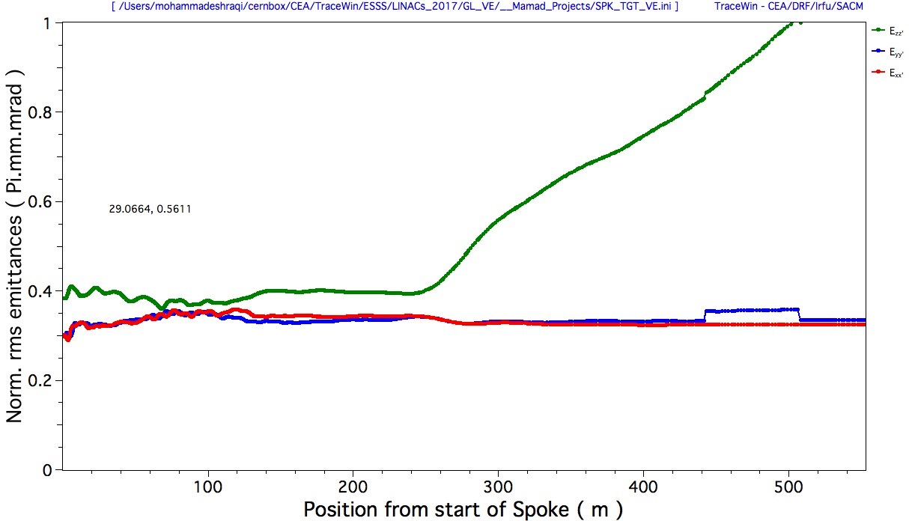
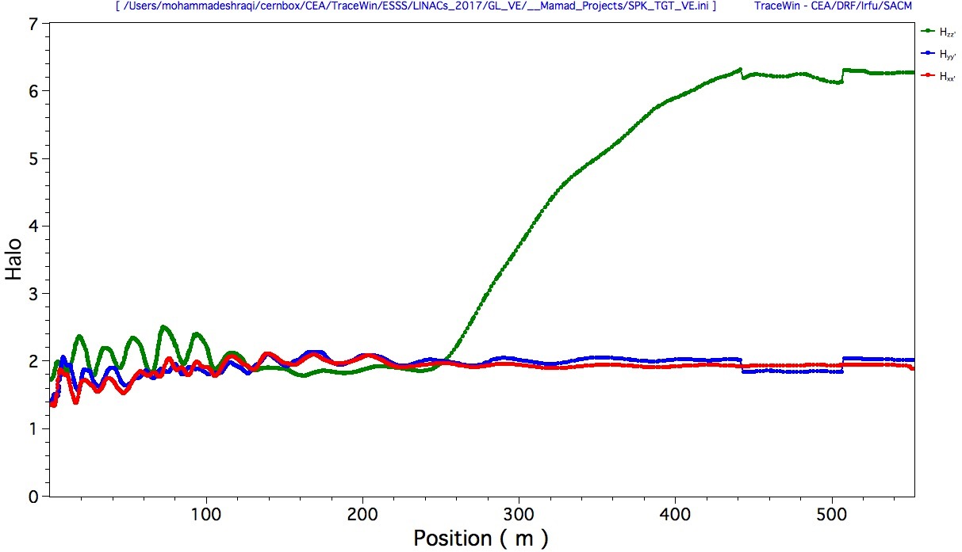
Beam Dynamics (Emittance and Halo)
There is almost no emittance growth in the linac, in the transferline the longitudinal emittance increases due to lack of any external focusing
Longitudinal
Horizontal
Vertical
Emittance
Longitudinal
Horizontal
Vertical
Halo

Slide 15
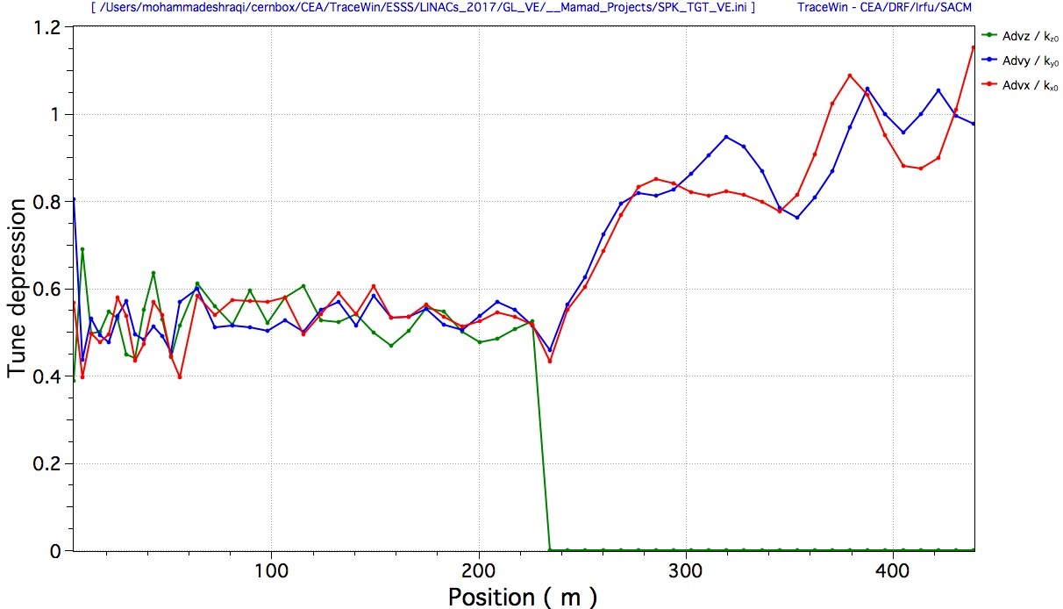
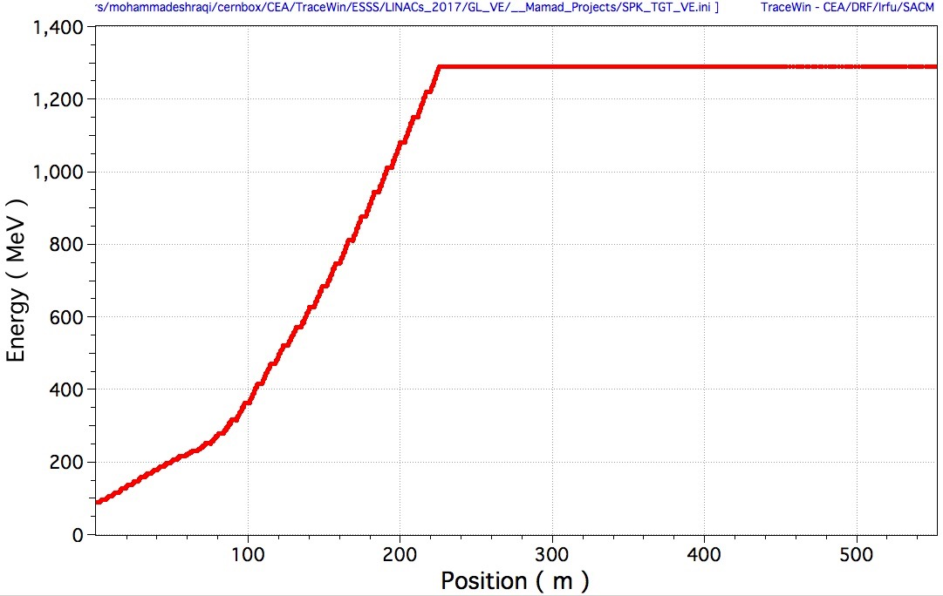
Tune depression and Energy
Tune depression is always above 0.4 to avoid resonances.
Longitudinal
Horizontal
Vertical

Slide 16
Commissioning
Commissioning (Beam commissioning) of the HB cavities will be slightly faster due to fewer number of cavities needing phase scan and RF adjustments.

Slide 17
Beam loss in unpowered HB cavities
Case 1: Cavities at room temperature
  As a first rough estimation about the accelerating mode of the cavities, The Q0 of our medium beta cavities at room temperature is 9800 which gives a band width of about 70kHz. If we consider that we need about 10 times the band width to keep the cavity transparent to the beam, the frequency at warm would need to be about 700 kHz away from 704.42MHz.
  The natural frequency shift from room temperature to the operating temperature at 2K is about 1 MHz (thermal expansion). So it seems that there is about 300 kHz margin considering the accelerating mode of the cavity.
  The beam lines of the LINAC are far away from the cavities at warm, but the HOM that may cause any trouble when cavities are at warm need to be studied
Case 2: Cavities at 2K
  We can detune the cavities by more than 100 kHz, more than enough to put the cavity transparent to the beam (the main mode). The HOMs are required to be at least 5 MHz away from the main mode, still giving a safety margin of 2 up to the 5th harmonic (1761 MHz).
Case X:
  Storing the HB cryomodules in the klystron gallery, there the RF of these HB CMs would have been.
Courtesy: Enrico Cenni, Pierre Bosland, Felix Schlander, Christine Darve

Slide 18
Conclusions
The VE process remains open – first identified savings at accelerator are now being implemented for accelerator
We have chosen the de-scoping option to not install RF for the last 10 HB cryomodules
  All HB CMs will be built as saving is marginal today and it looks as it would be very difficult to re-launch production
  Should we install “unpowered” CMs or leave them in the gallery?
  We don’t think using one modulator for 6 cavities in the medium beta linac should be maintained – any comments?
  Anything else we should study further?

Slide 19
Back-up slides

Slide 20
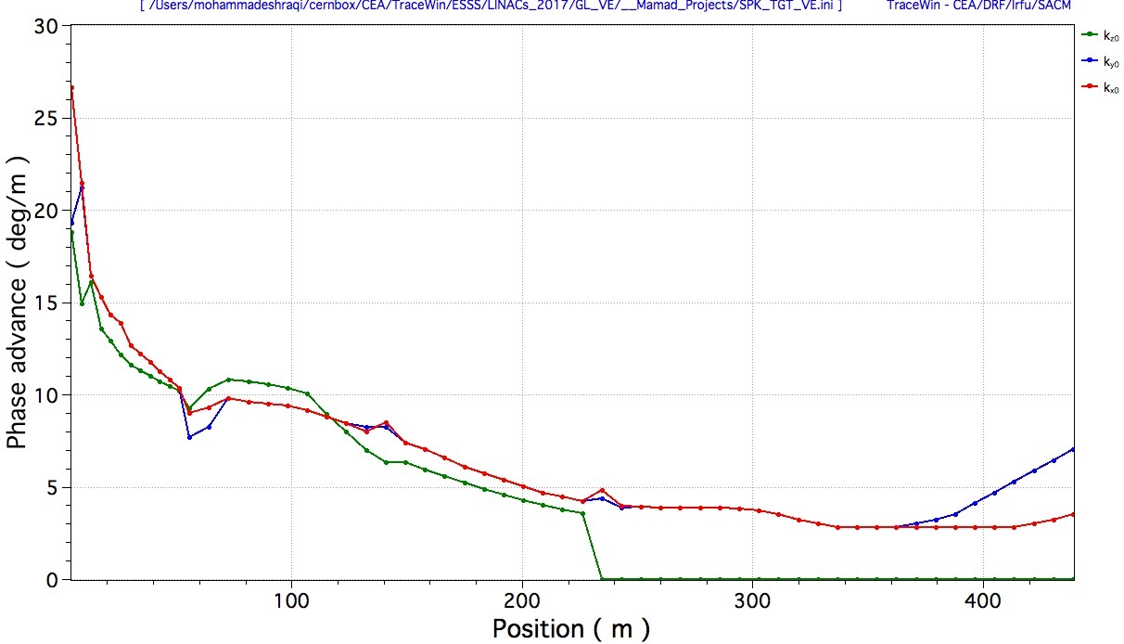
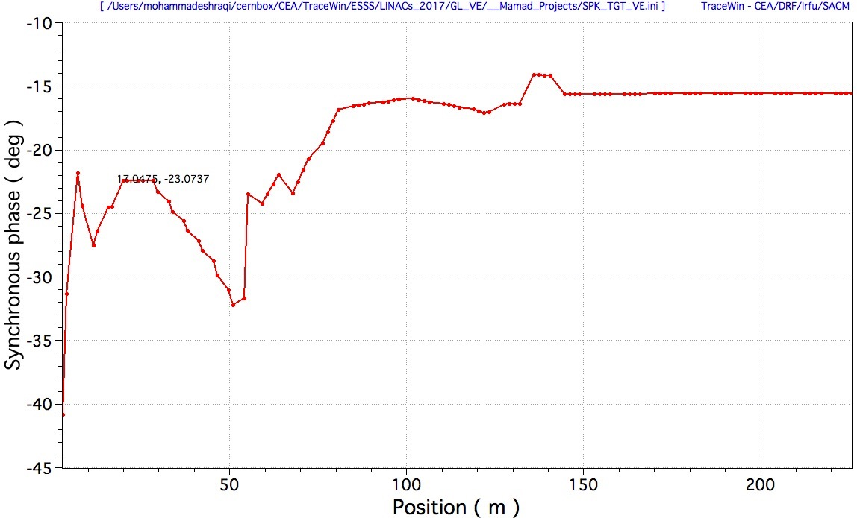
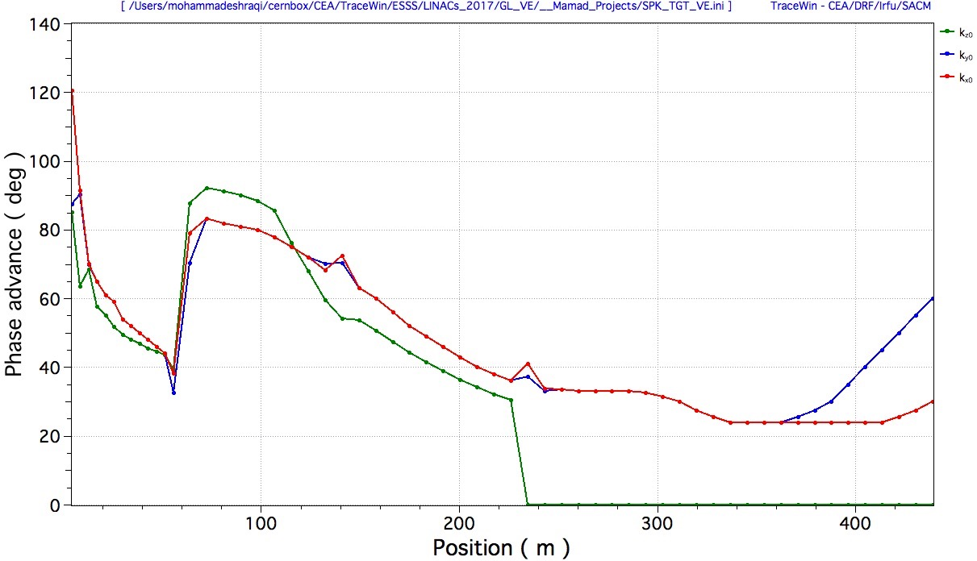
Beam Dynamics (Design)
Phase advance per meter is continuous
Longitudinal
Horizontal
Vertical
Phase advance period is limited to 90 degrees
Sync Phase is above 20 in Spoke and above 15 in MBL

Slide 21
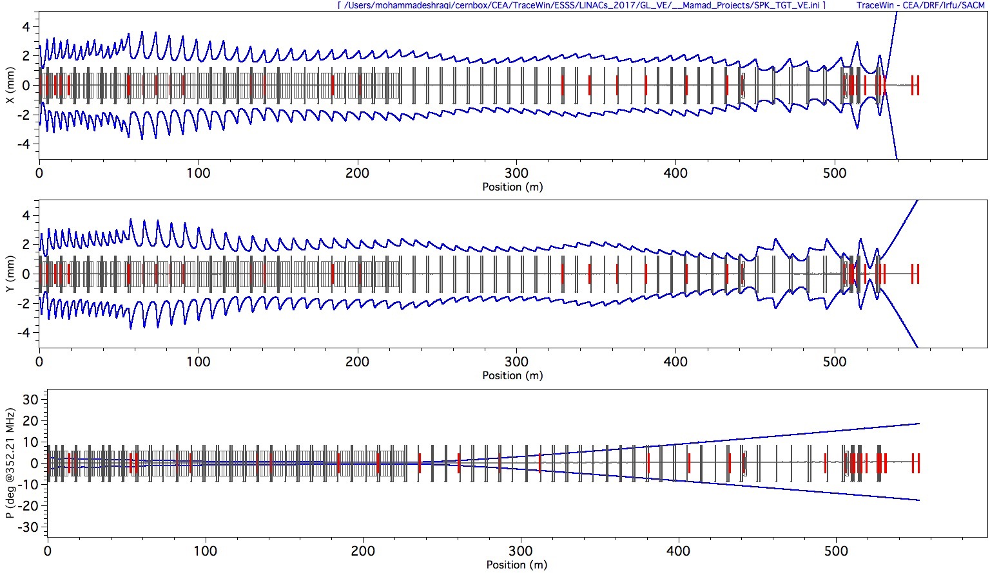
Beam Dynamics (Envelopes)
The lattice is adjusted to the input beam from DTL, and the phase advance in the extended transferline is adjusted to match the lower energy beam to the dogleg

Slide 22
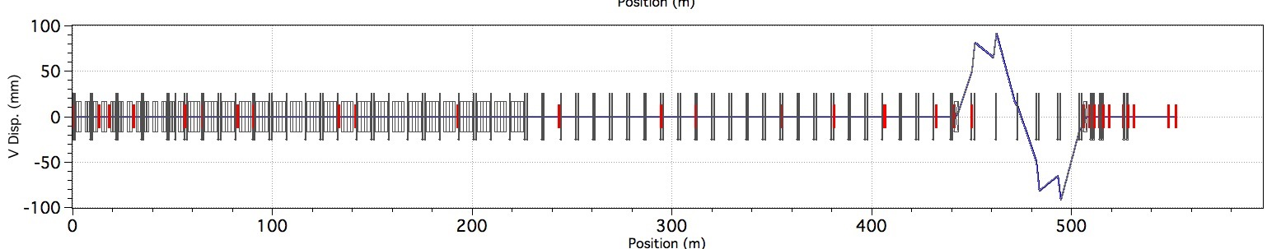
Beam Dynamics (Dispersion)
The Dogleg quads are adjusted to make it achromat

Slide 23
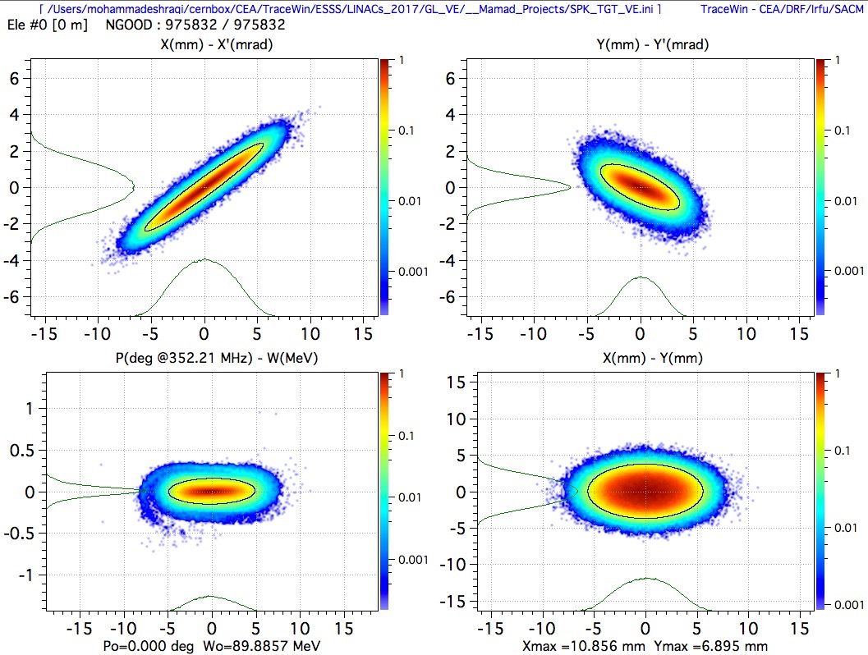
Beam Dynamics (Input beam from DTL)
The beam tracked from the RFQ input to the end of the DTL is used for simulations

Slide 24
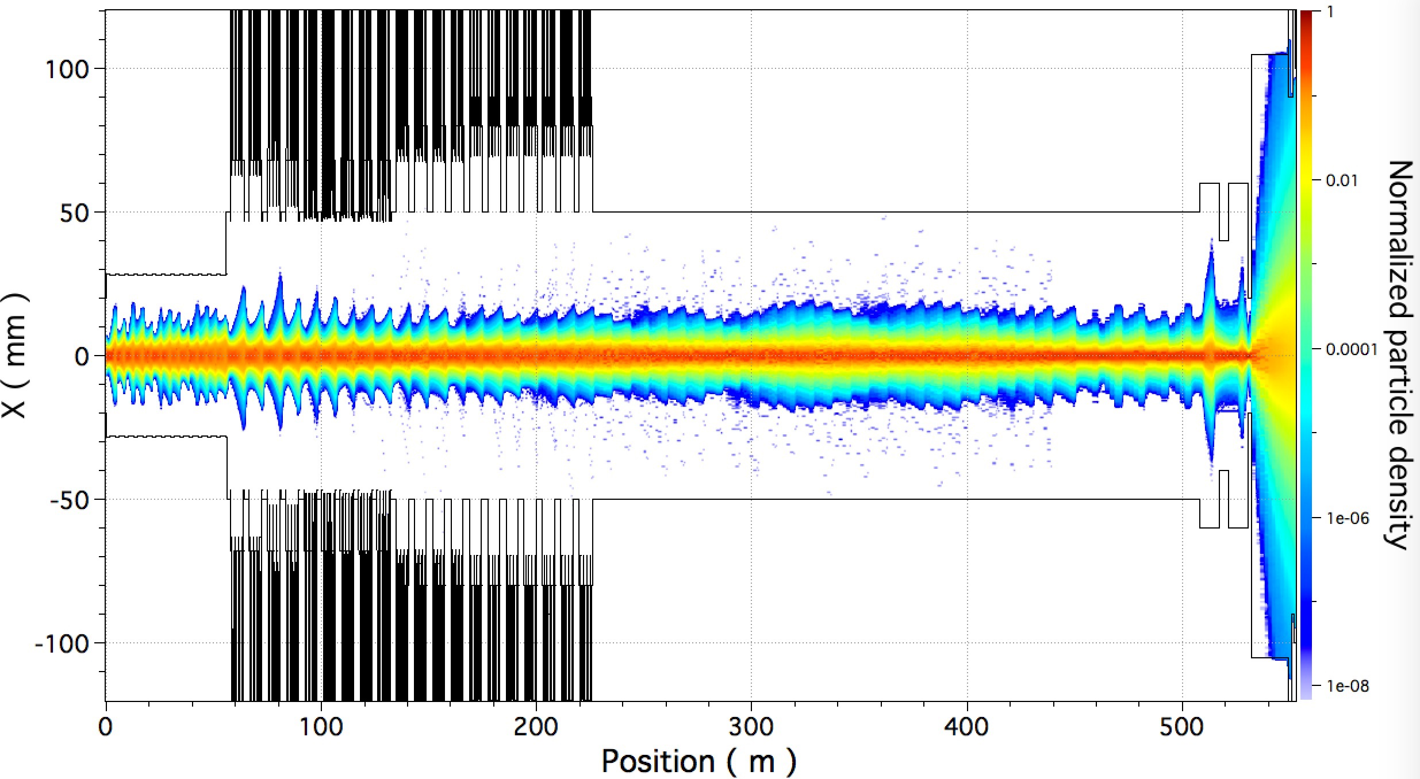
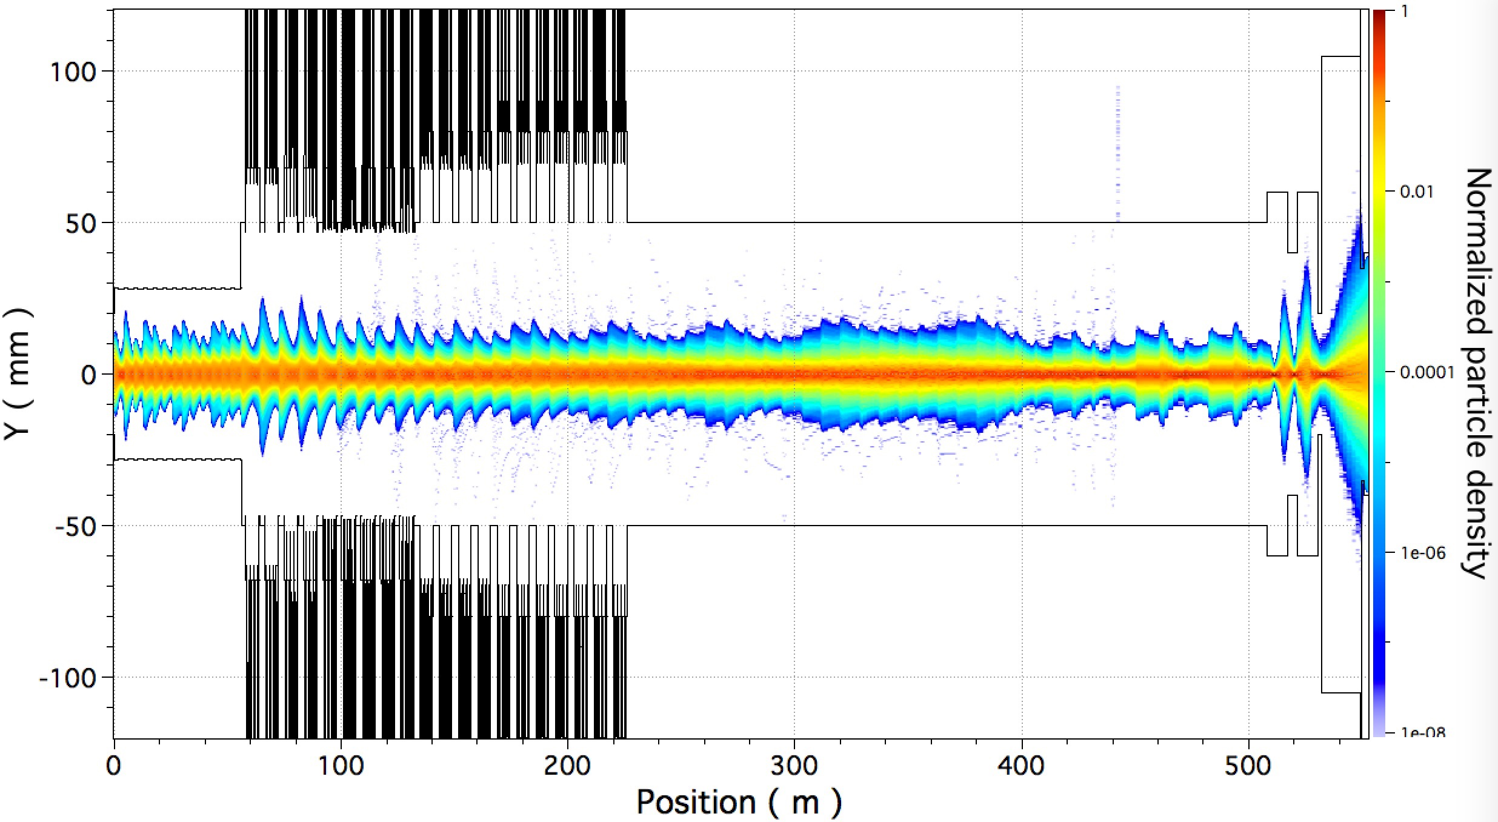
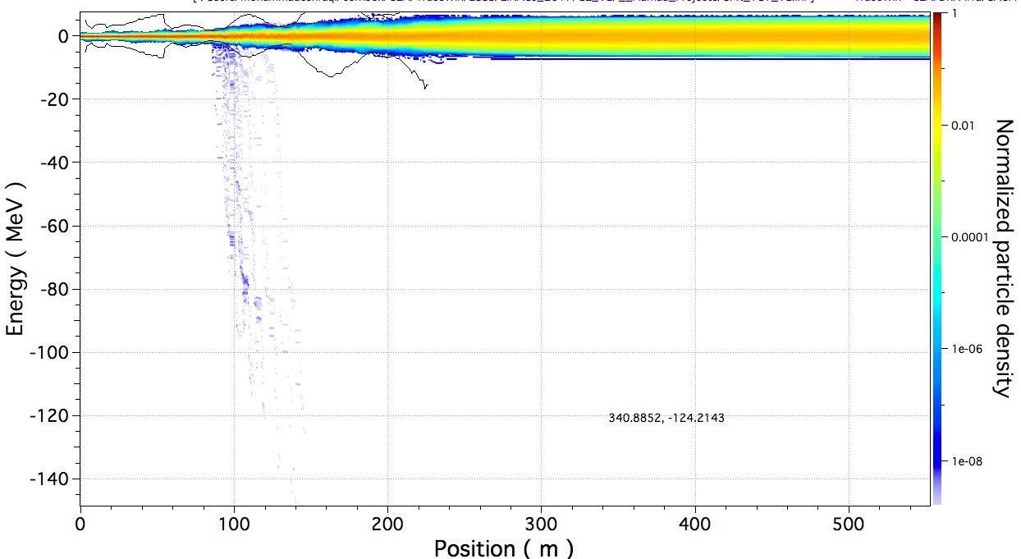
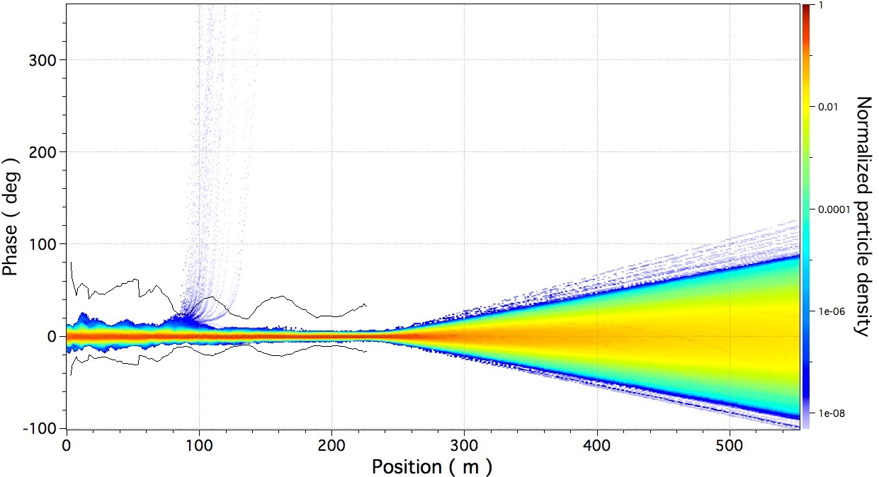
Beam density with errors

Slide 25
LLRF, Polish Electronic Group (PEG)
Deliver 44 completed high beta LLRF systems
Keep full delivery of PEG hardware for 84 HB systems
Do not assemble 40 last LLRF systems (deferral ca 400 k€ in-kind)
Do not buy last 40 COTS LLRF hardware (deferral tbc cash)
Reassign task: Electron pick-up to be made by PEG, cost ca 500 k€ for the whole linac except the last 40 cavitites (impacts 1000 k€ on CR 11.000066.1)

Slide 26
RF distribution system, Huddersfield Univ
Deliver 44 complete high beta RFDS
Deliver complete stub RFDS (to be installed first)
40 fewer sets circulator/load (deferral 1750 k€ IK)
40 fewer kits arc detectors/shutter switches (deferral 800 k€ IK)
Waveguides, directional couplers, bellows awarded
Reassign UK to buy cavity coupler arc detectors for all except the last 40 cavities (Impacts 900 k€ on CR 11.000066.1)

Slide 27
Interlock systems, MTA Atomki
Deliver 44 complete high beta interlock systems
40 fewer systems (deferral 1040 k€ IK estimated, budget for contribution is being revised)

Slide 28
Installation, IFJ PAN Krakow
Install 40 less RFDS in gallery (deferral 411 k€ IK)
Defer installation of 40 last is estimated to
  IOT/Klystron (514 k€)
  Modulator 10 last (93 k€)
  LLRF installation (21 k€)
  Interlock (103 k€)
Not yet discussed – frees up IFJ PAN manpower for other work

Slide 29
Comments
It is worth reviewing the logic of not choosing certain items:
Moving to uncooled racks was not chosen
  Rack procurement is already underway and stopping the process would add schedule delay with a resultant cost increase.
  Additionally, a number of racks, roughly 4 – 5 per row would still need water cooling to meet the operating temperature requirements of the equipment they contain. These separate water cooled racks will cost more than the rack design currently chosen. These factors along with the relatively small amount of savings envisioned resulted in this item not being chosen.
Eliminating full testing of cryomodules prior to installation into the tunnel was not chosen
  As the adverse impact this would have on schedule and technical risk.
  Additionally, no real cost savings is possible from eliminating the testing of spoke cavity cryomodules at Uppsala University due to the presence of an existing signed contract which largely already been paid for in cash from ESS.
Powering more than one cavity with a single klystron was not chosen (today) due to the technical difficulties associated with such an approach. We consider the proposal a “safe” option but we will continue to study alternatives which could save more money.
  The TAC wants to get involved
Current limitation of the modulators have reduced the saving on the usage of fewer modulators for the medium linac

Slide 30
IK partners
We have queried our In-Kind Partners (which produce roughly 50% of all accelerator content) regarding possible savings and changes to existing In-Kind agreements.
Since in many cases funding has already been assigned to institutes and Universities, reducing the IK partners scope would in many cases mean having to work with that partner to find additional effort to which the allotted funding could be applied.
This could result in not saving any real money and could in fact add cost to the project due to the additional effort required by the ESS and IK staff to implement these changes.
We are still keeping this option open but it requires a good dialog close coordination with IK partners to assure that possible savings aren’t “lost in the VE process for IK”

Slide 31
Coupling Two MB Cavities; Need for a phase shifter
  A phase shifter which can change the phase (length of the waveguide) by 180 degrees is needed between the splitter and the cavity as there is no relation between the energy of the particles and the constant distance between the cavities and the beam being non-relativistic.
    The relativisitc beta of the beam (properly accelerated) at the entrance is 0.58 and at the end is 0.78
  The same phase shifter is used to adjust the field amplitude in the cavities. Several factors are affecting the field in the cavity, external coupling, the R/Q (which is linked to the TTF) and manufacturing tolerances.
  Qx changes, random and systematic:
  Systematic due to variation of the TTF:
  In MBL the proposal is to feed 2 cavities from one klystron, the systematic variation in Qx due to TTF could be neglected
  Random due to machining of the coupler, affecting the coupling to the cavity:
  In MBL the proposal is to feed 2 cavities from one klystron, the systematic variation in Qx due to TTF could be neglected

Slide 32
Coupling Two MB Cavities: Dynamic phase changes
  As the phase shift between cavities is adjusted by modifying the waveguide lengths (static), any energy difference would cause a phase error in second cavity.
  Depending on the frequency and energy difference this could be significant.
  Depending on the temperature difference and the length of the waveguides, different cavities fed by the same source, could have a phase error, requiring phase scans as the temperature of the tunnel or the stubs change.

Slide 33
Coupling Two MB Cavities: Operability and speed of tuning
These phase shifters are mechanical 3-stub tuners, their reaction time is in the order of seconds
  A phase scan which requires tens of measurements would take several minutes per cavity.
  A second complication; Usually a phase scan is performed by shutting down (blanking or detuning) the downstream cavities, in the case of coupled cavities both cavities are powered together and this will make the phase scan more challenging and more time consuming.
Info we have from these stub-tuners:
  Phase tuning can be achieved by off the shelf 3-stub phase shifter is > 45 degrees
SNS RFTF
  At SNS there are studies and tests performed on power splitting to 9 cavities, this is done using mechanical phase shifters. “The mechanical phase shifter design has been found to be better for building higher power phase shifters if slow control is allowed. ”
  How fast we can change the control points is an important factor.
Courtesy: Yogi Rutambhara, Morten Jensen, Yoon W. Kang

