Slide 1
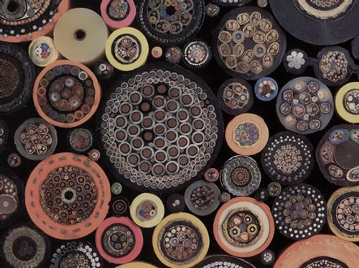
Rack cabinets and cable plant
TAC 2017
WP 15 Electrical Support
Evangelia Vaena, Electrical Engineer

Slide 2
outline
Overview of the rack layout - Mechanical design, space allocation and cooling solution
Accelerator cable plan installation strategy description

Slide 3
Rack locations
846 racks, distributed in 3 different buildings

Slide 4
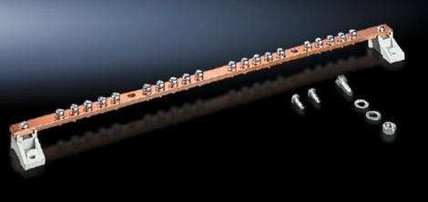
General Rack Design
ONE rack size for all the applications and the buildings, documented in ESS-0085079
Size 2200 mm high (47U), 1000 mm deep and 600 mm wide (19 inches),colour RAL 7035
Glass Front Door
Doors shall be lockable with a handle
Front and back mounting rails. The rack units (U) of the rack are defined by the pre-threaded holes
The protection class IP20
3 U reserved in all the racks for an internal PDU
1 U for the ICS patch panel
2 earthing bars, the one connected to the equipotential bonding bar (PB) and the other one connected to the EMC grid through the gallery floor pads or the wall mounted grounding bus bar
Cable entries : top of the cabinet, sealing of the cable openings will be performed with brush type sealants

Slide 5
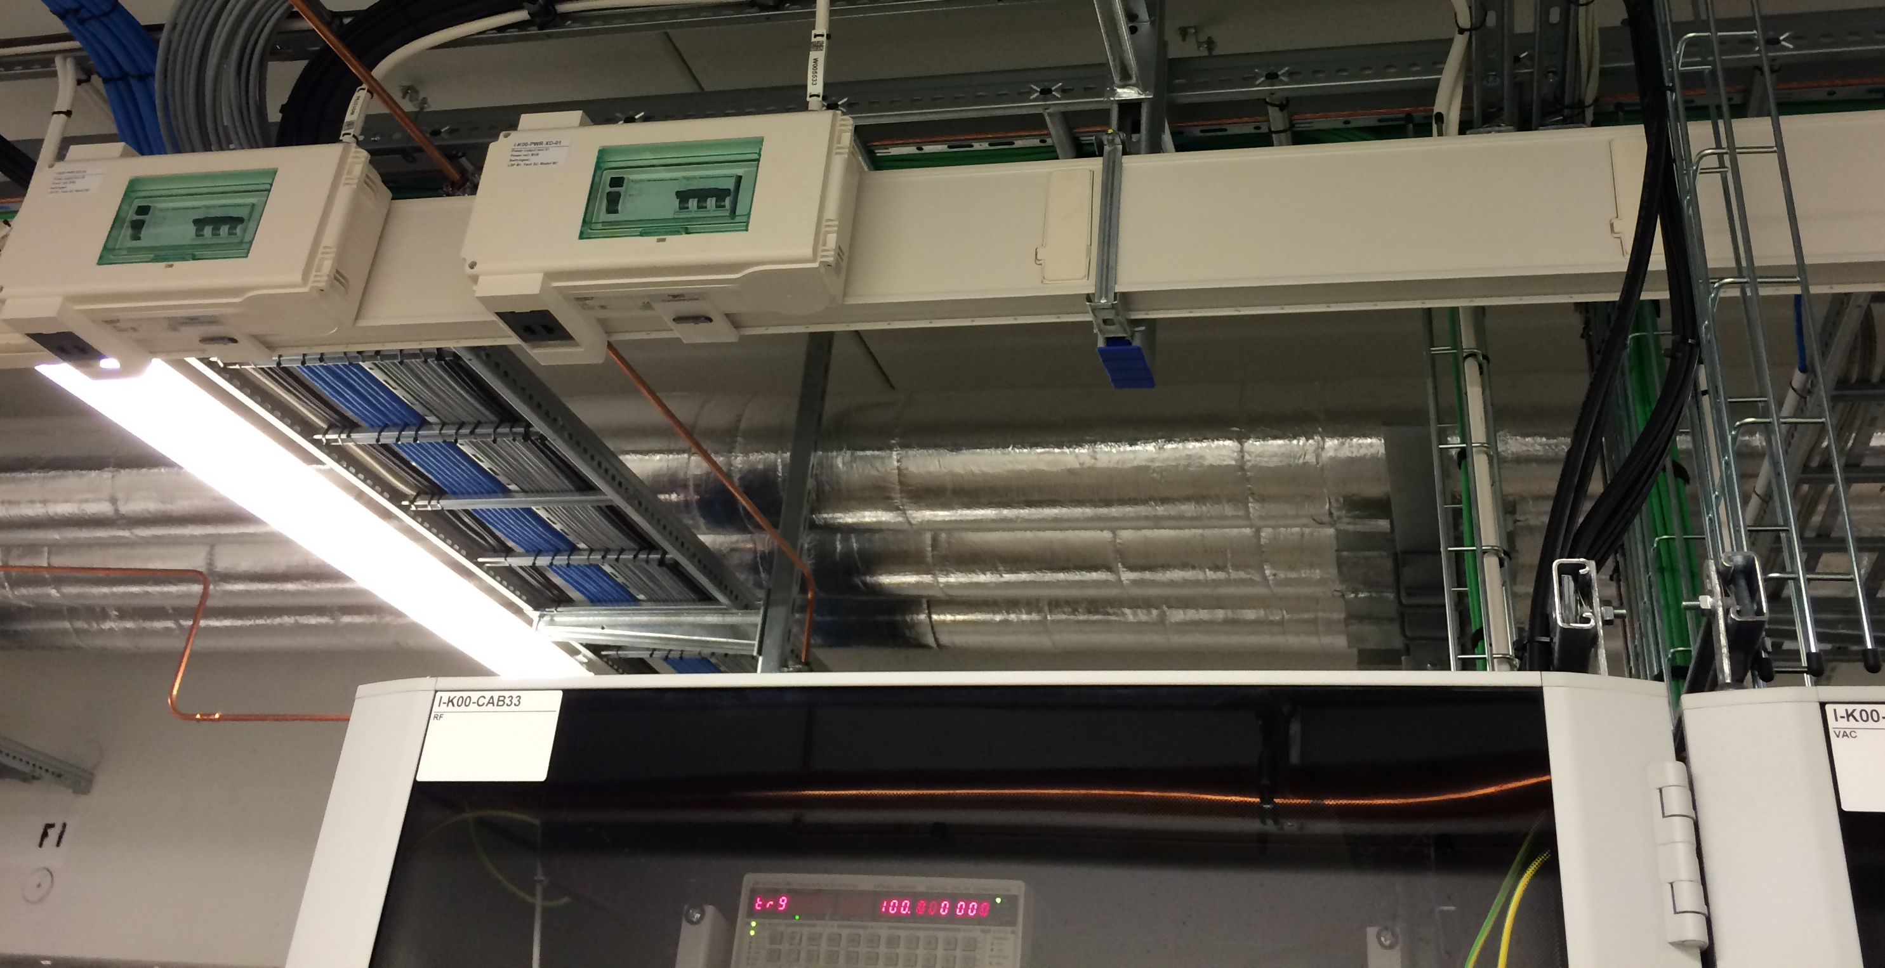
General Rack Design
All racks are supplied by a 400 V AC, 3-phase, mains supply.

Slide 6
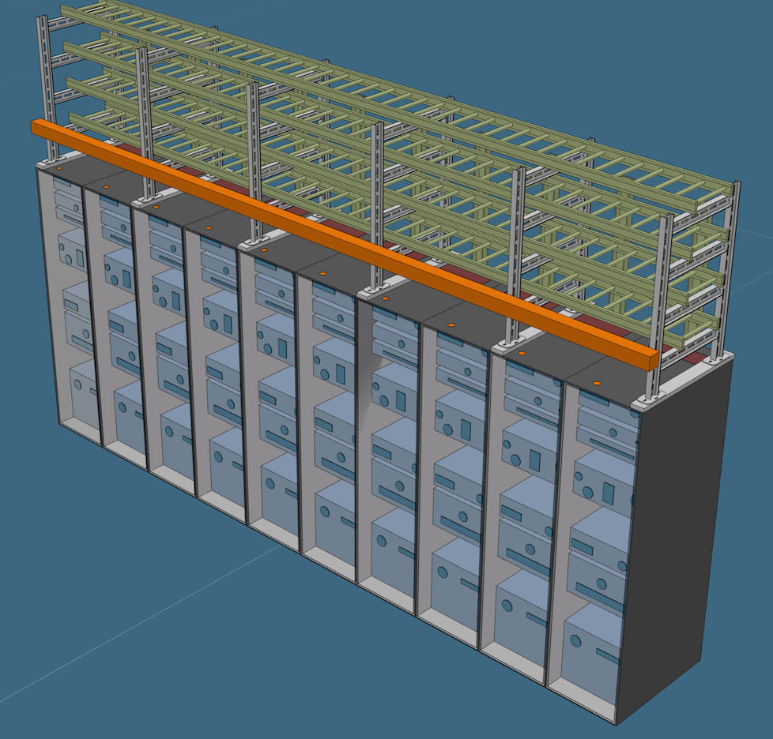
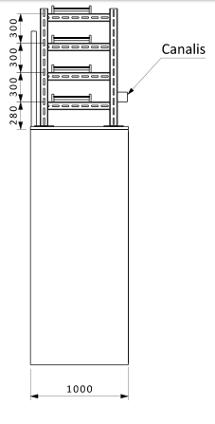
Rack Rows
The vast majority of the racks fitted together side-to-side forming rows.
The rack row will also carry a frame structure that holds all the cable trays and the power distribution bus bar trunking system.

Slide 7
rack spreadsheet
rack space allocation per system
Rack row and rack naming
conventional power, UPS and dissipated heat per rack

Slide 8
rack cooling

Slide 9
rack cooling

Slide 10
feb

Slide 11
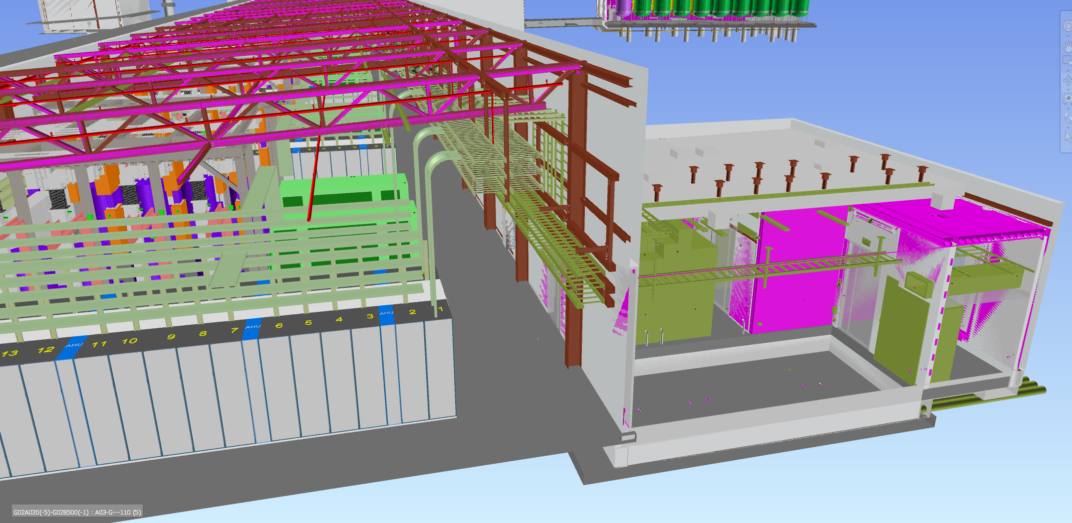
klystron gallery

Slide 12
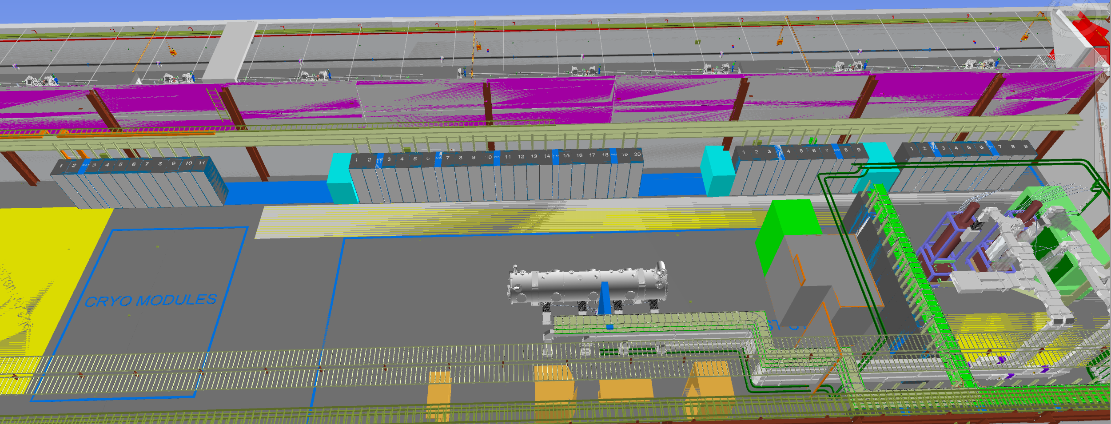
hebt area

Slide 13
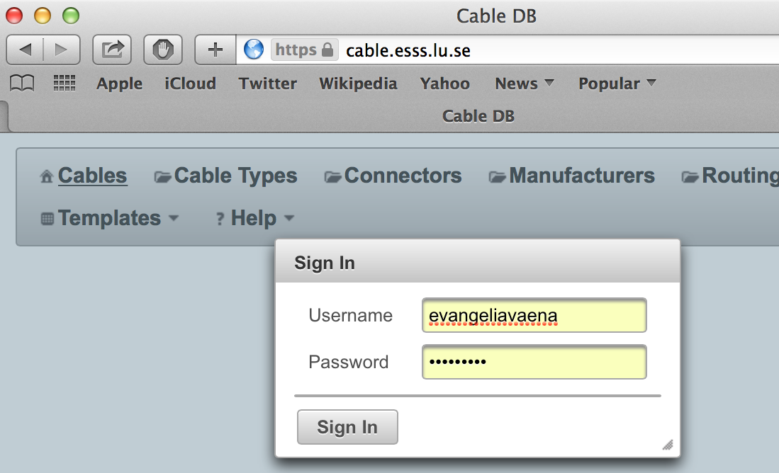
Cable installation
The management of the cable plant will be done through the ICS cable database :(https://cable.esss.lu.se/)
The cables shall be low smoke, halogen free following the ESS safety rules.
The Cable Database (CDB) supports the tracking, configuration and naming of cables in all phases of the ESS project (design, installation, operation, shut downs). It is interconnected to the other two main ICS applications (e.g. CCDB and naming tool) to enable these to successfully perform their domain specific businesses.

Slide 14
what does the cDb do?
single point of truth
not an endless collection of excel files
revision control
unique cable name/number
centralised cable types and connectors management
easier procurement
all choices available to everyone, less components
cable database
complete, integral image of the status of rack, cable and field devices
Repository for connection diagrams, quality forms, installation details
routing information and implementation oriented to optimise installation
Accessible to everyone
Easy to cross check information uploaded by other engineering disciplines

Slide 15
workflow for creation of cables and preparation of pulling campaigns
WP XX registers devices in naming tool
WP XX is uploading the new cable instances
WP 15 is allocating space on the cable trays for the new cable instances
WP 15 is adding the length of the cable in the cdb
WP XX is approving the cable path and length
WP 15 is purchasing most of the cables and connectors
WP 15 is preparing the cable lists for the electrical contractor
WP XX
WP 15 is pulling the cable and installing the connectors
WP 15
WP XX is terminating the cable
there will be exceptions!

Slide 16
Cable installation preparation- Documentation for installer
1. cable lists according to installation slots (RF cells). This document guides the contractors to organise their installation teams. It will also contain information showing which cable drum will be used for each cable instance. Each drum should have a unique identification code, and mapping to the cable instances that are planned to be pulled from the specific drum. Minimum information:
2. Drawings of the cable trays- named (this is the name to be added to the “cable routing column above).
3. Termination diagrams.
As an example the documentation handed over for the cryoplant cable installation:

Slide 17
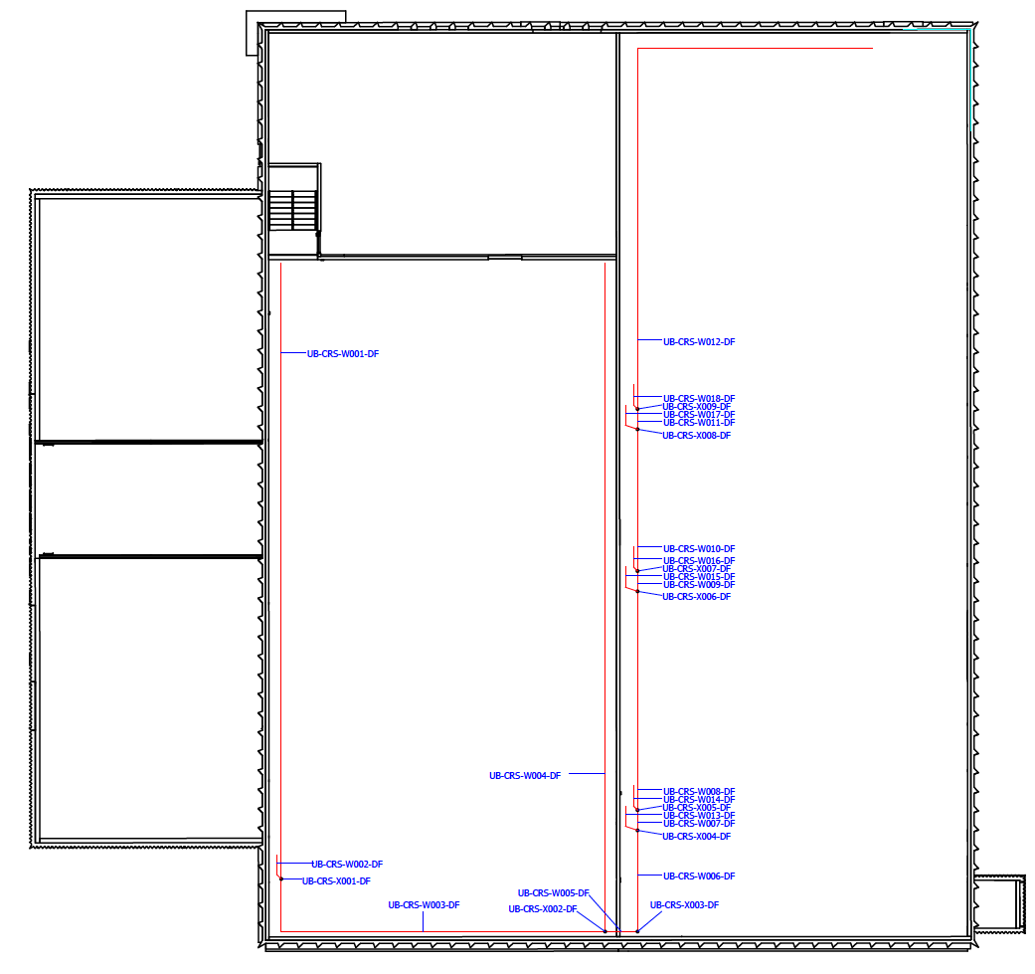
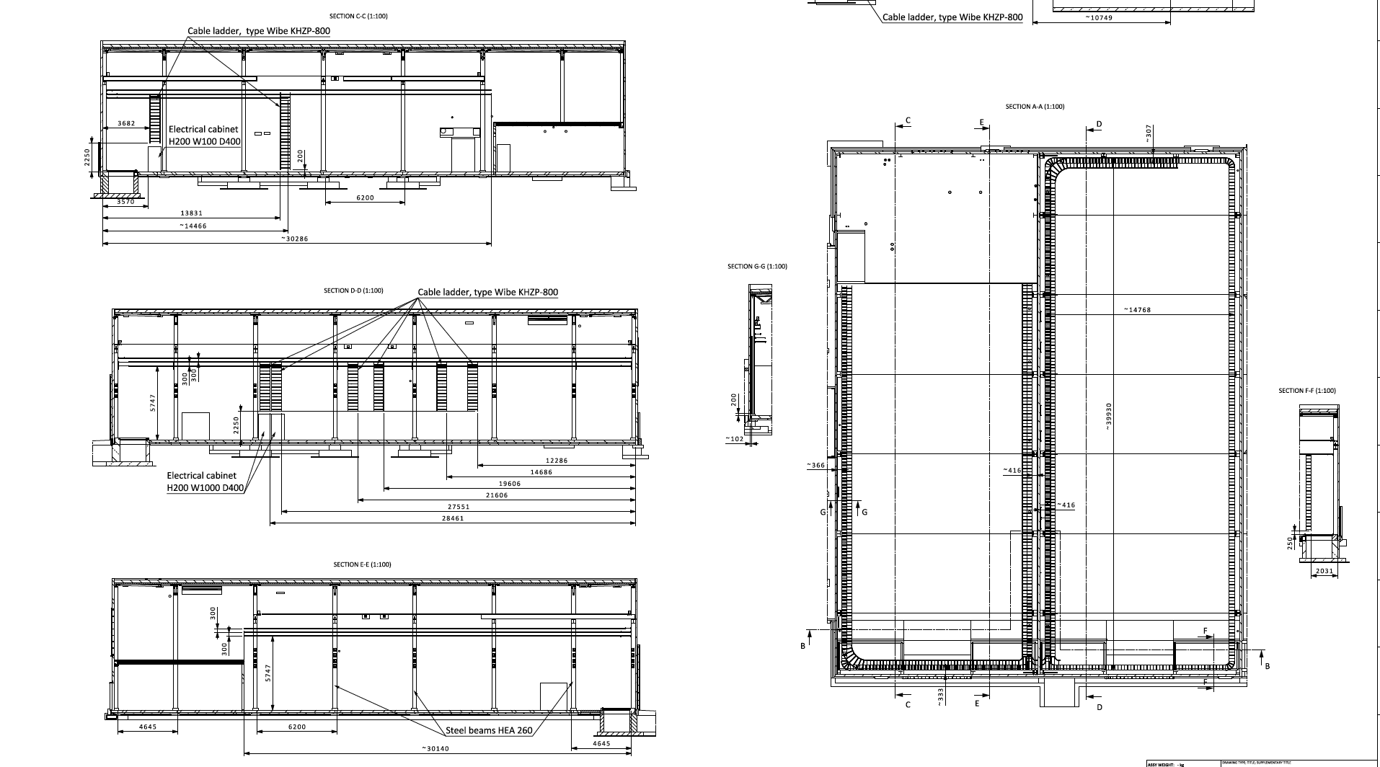
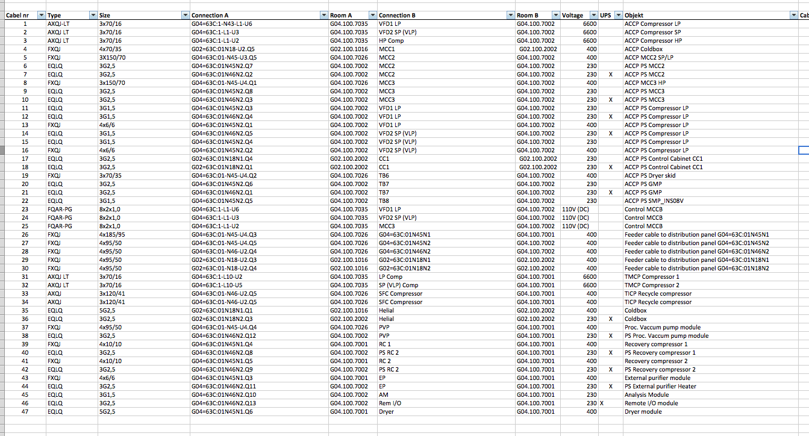
example of cable tray drawings for cryo plant

Slide 18
next steps
Rack Vendor selection (this week)
Enhance cable database with new functionalities
Framework agreement for cables and connectors (April)
Cryo Plant electrical installation (April-May)
Tunnel and FEB cable tray and grounding installation (June)
Contractor for gallery electrical installations and cable pulling

Slide 19
questions?
thank you for your attention!

Slide 20
back up slides
Number of Racks | System
20 | NCFE
42-shared | Cryomodules sharing with Cryo-Distribution Line
43 | Beam Instrumentation
428 | RF Systems
42- shared | Cryo- Distribution Line - sharing with cryomodule controllers
54 | Vacuum
44 | Power Converters
3 | Raster Magnets -A2T
36 | Personal Safety Systems
49 | Machine Protection Systems
23 | ICS- Integration Racks
23 | Test Stand 2
5-7 | Target Safety Systems
772
Building | Rack capacity- Space reserved per building
FEB | 54
Gallery | 708
HEBT | 49
TS2 | 26
GSA | 9
 | 846

Slide 21
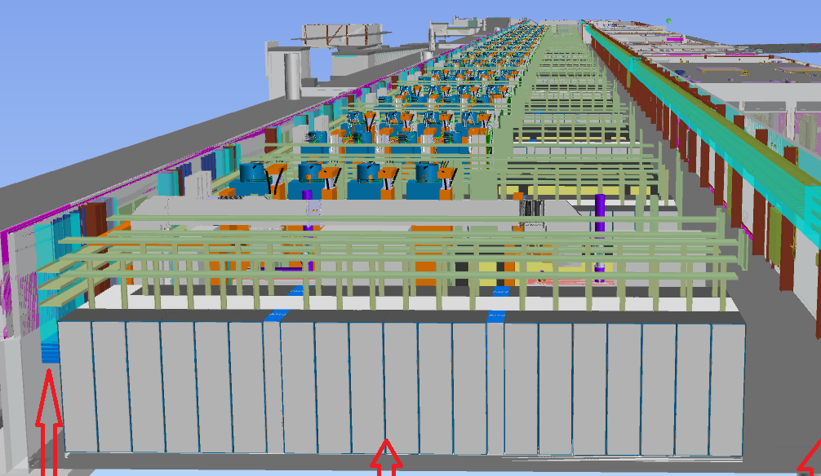
Rack row cooling-advantages of the hot aisles
Symmetrical configuration of racks and in-row coolers that provides homogenous air flow in front of all the racks
it covers all the air flow needs due to the different heat loads and temperature stability.
Redundancy mode is considered in case of failures of in-row-coolers.
It allows a variation of fan speeds depending on the heat loads in the different sectors and provides options for energy savings.
energy consumption for 8 coolers at 80% fan speed: 1,9kW
status of coolers can be monitored at the control room

Slide 22
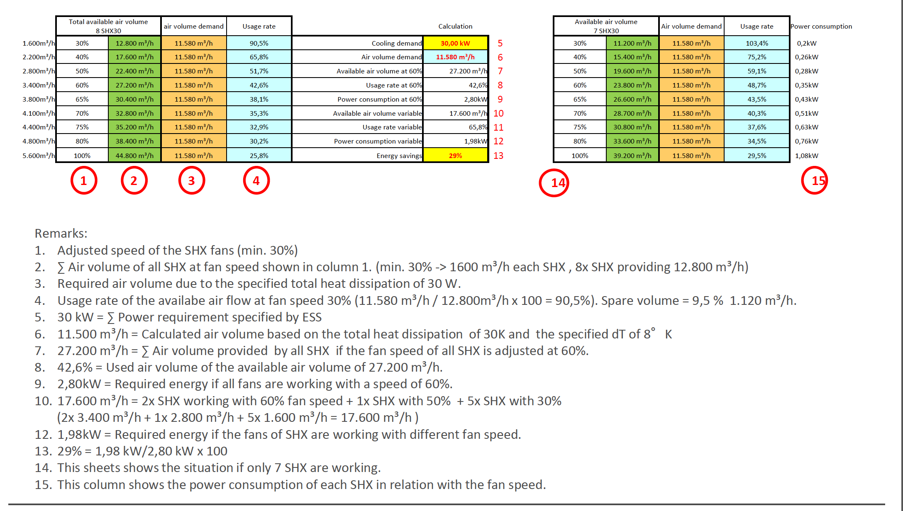
Heat management- cooling design-how it works

Slide 23
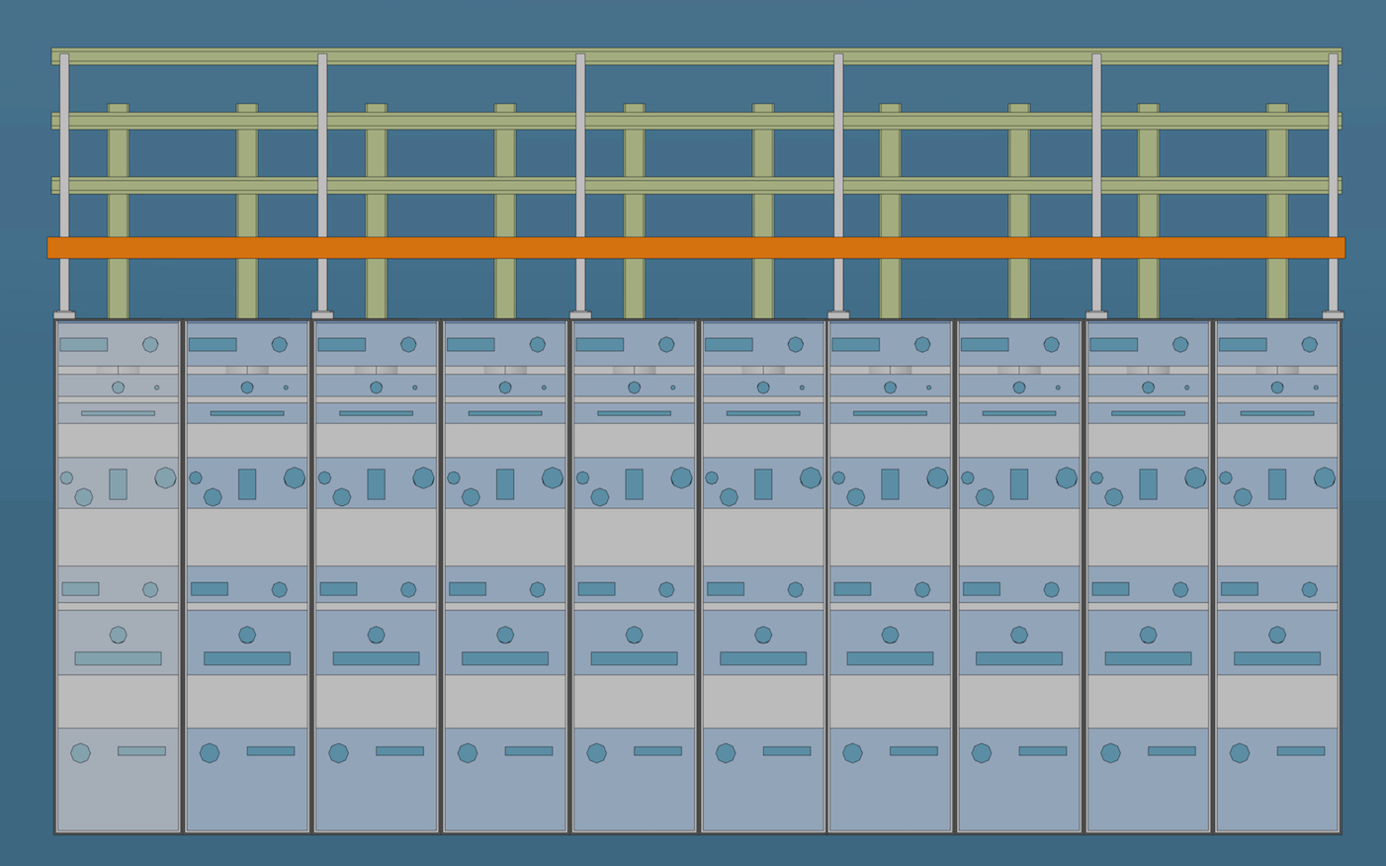
integrated design for one rack row

Slide 24
cable labeling
The cable name is automatically produced from the cable database.
The cable tags shall be white, “tie-on” type, halogen free. The inscription (in printed characters) shall have a minimum height of 4 mm, be black in colour, perfectly legible. ICS cables will use yellow tags. The labels shall be installed at the following points:
1. Two ends of the cable
2. Once every 20m
3. Every time they enter a new room through a sealed penetration.

Slide 25
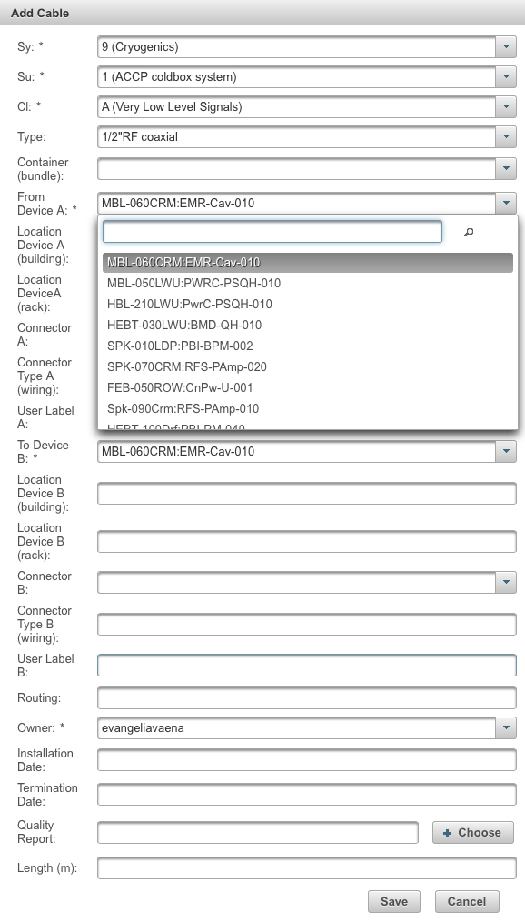
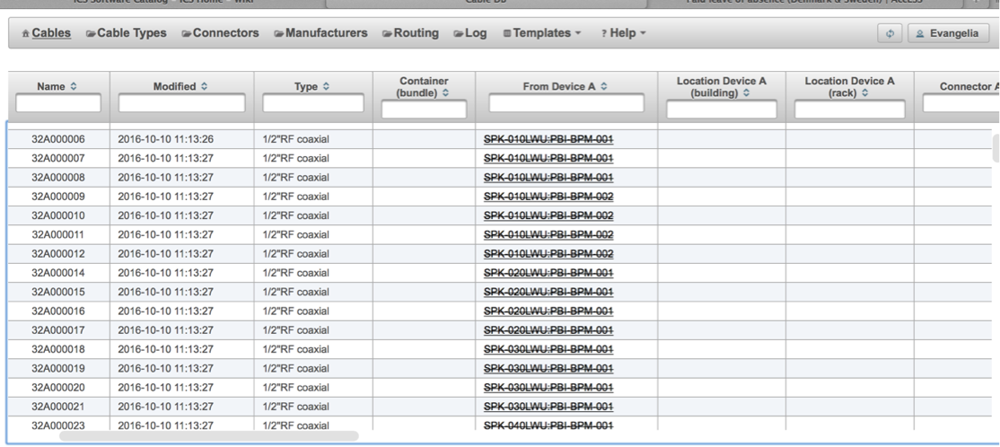
What does the cdb do?
creation cable instances- automatic naming
to create a new cable the 2 ends should be registered in the naming tool
Extra information (connector, termination diagrams, quality reports can be added later
one-by-one or batch uploads (with the cdb template)
cable routing

Slide 26
