Slide 1
ODIN – Tollgate 2
NSS status and meeting objectives
Shane Kennedy
NSS Project Leader
European Spallation Source ERIC
www.europeanspallationsource.se
24th February 2017

Slide 2
The 15 NSS Project Instruments
All are funded to be world leading in 2023
Instrument Class | Instrument | Costbook Value (M€) | Performance targets (@ 2MW)
Large Scale Structures | LOKI (Broad band SANS) | 12.19 | 5 x D22 & 20 x SANS2D
 | SKADI (General Purpose SANS) (+SONDE funds) | 11.50 | 4 x D22
 | ESTIA (Focusing Reflectometer) | 11.80 | Conventional mode: ~ 100 x D17 High intensity mode: 1cm² samples = seconds
 | FREIA (Liquids Reflectometer) | 13.2 | 30 x FIGARO, INTER
Diffraction | DREAM (Bispectral powder diffractometer) | 13.66 | > 10 x POWGEN or WISH
 | HEIMDAL (Hybrid diffractometer) | 13.55 | ~ 50 x GEM, ~ 8 x new POLARIS
 | MAGIC (magnetism single crystal diffractometer) | 13.10 | Cold: > 100 x worlds best, Thermal: 1mm³ crystals = 10 min
 | NMX (Macromolecular crystallography) | 11.67 | > 10 x LADI & Biodiff
Engineering & Industrial | BEER (Engineering diffractometer) | 14.99 | world leading in strain scanning, unique flexibility
 | ODIN (multi-purpose imaging) | 11.60 | world leading for high resolution, > 10 x best for TOF methods
Spectroscopy | BIFROST (extreme environment spectrometer) | 13.45 | > 10 x THALES & MACS
 | C-SPEC (cold chopper spectrometer) | 16.50 | 100 x IN5 (w RRM)
 | T-REX (bispectral chopper spectrometer) | 16.85 | 3 x 4-SEASONS, 3 x IN5
 | VESPA (vibrational spectroscopy) | 12.0 | 10 x VISION (ΔE = 130 meV)
 | MIRACLES (backscattering spectrometer) | 13.53 | 2 x BASIS and DNA
Total cost book value |  | 199.59
With a further ~ 53 M€ investment ESS will more than double the performance of these instruments

Slide 3
NSS project scope, budget and priorities
Outcome of ESS ERIC Council meeting (5th - 6th December 2016):
Reduction of NSS project scope to 15 instruments approved*
Authorization for Science Director to approve Neutron Instruments passage through Tollgate 2
Noted by council:
  Plan for eight instruments for start of user operations in August 2023
  All 15 instruments will view the upper moderator (giving freedom to optimize a lower moderator for new applications in the future)
* Includes provision for NSS to draw up to 15.1 M€ from ESS contingency if necessary to complete the project

Slide 4
Planned order of commencement of operation of first 8 instruments (August 2023)
Matching early success in delivery of scientific outputs with the capacity of Lead In-Kind partners to deliver on schedule (ISIS, PSI, FZJ, LLB, HZG/NPI, TUM/PSI, TUM/LLB & DTU lead consortium).
Instrument Class | Sub-class | Candidates
Large Scale Structures | Small Angle Scattering | LOKI (ISIS) or SKADI (FZJ)
 | Reflectometry | ESTIA (PSI) or FREIA (ISIS)
Diffraction | Powder Diffraction | DREAM (FZJ) or HEIMDAL (ÅU)
 | Single crystal diffraction | MAGIC (LLB) or NMX (ESS)
Engineering | Strain scanning | BEER (HZG/NPI)
 | Imaging and tomography | ODIN (TUM/PSI)
Spectroscopy | Direct Geometry | C-SPEC (TUM) or T-REX (FZJ)
 | Indirect Geometry | BIFROST (DTU), MIRACLES (Bilbao), VESPA (CNR)
Instruments in bold type to be operational by Aug 2023
Italic:
backups in case of delays

Slide 5



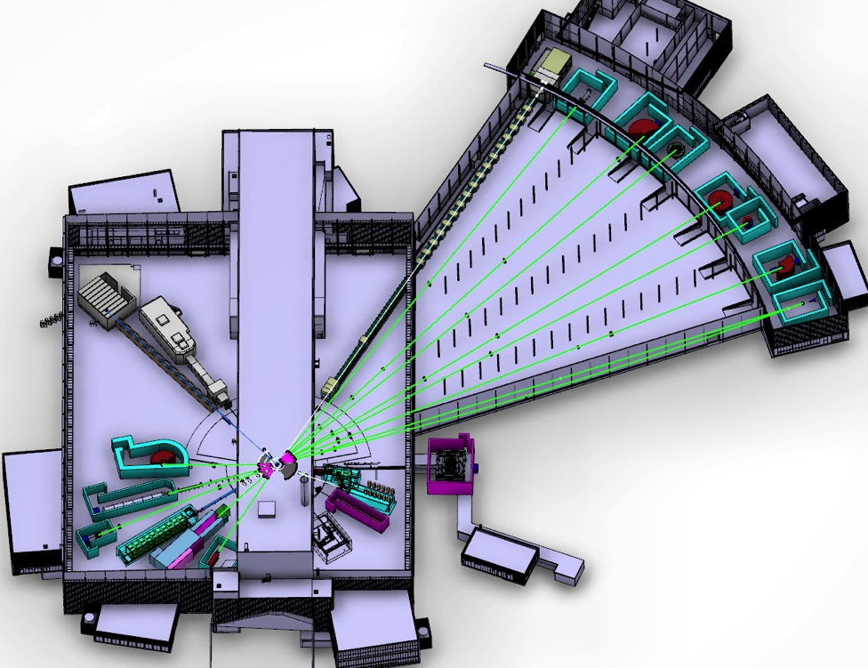









NSS Neutron Instrument positions:
December 2016
Two instruments have moved once;
ESTIA; E1 -> E2 – for cleaner view of source
DREAM ; S4 -> S3 – for more space
SKADI has moved twice;
from E8 -> E5 – for more space
from E5 -> E3 – to allow more space for ANNI
ESS Lead Partners for instrument construction
+
Nuclear Physics Institute
NMX
BEER
C-SPEC
BIFROST
MIRACLES
MAGIC
DREAM
ODIN
T-REX
HEIMDAL
VOR
LoKI
VESPA
FREIA
SKADI
ESTIA
50 m
100 m
150 m
ESS In-Kind Partners also collaborate on sample environment, data management systems etc.
ESS Instrument Layout (June 2016)

Slide 6
Neutron Instruments: Phase 1 schedule
2016-17 | May | Jun | Jul | Aug | Sep | Oct | Nov | Dec | Jan | Feb | Mar | Apr
LOKI (P2)
SKADI
ESTIA
FREIA
NMX (P2)
MAGIC
HEIMDAL
DREAM
BEER
ODIN
C-SPEC
BIFROST
MIRACLES
T-REX
VESPA
10/5
20
29
10
14-15/6
20
29
17
22-23/6
19
31
31
8
14
17/6
14
7
5
24
12-13/9
7
3
STAP
scope-setting
TG2
12
24
21
28
8
27
ICB
IKON11
ICB
SAC
COUNCIL
IKON12

Slide 7
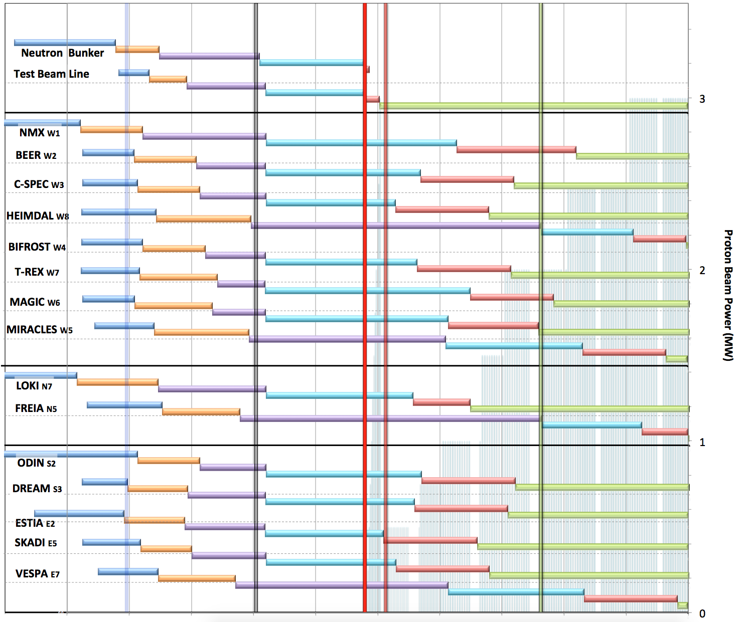

Neutron Beam Instrument Construction
Working Schedule: V3.0, 9th December 2016
Current date
Access to NSS areas
Ready for Beam on Target
Hot Commission
instruments
Start User Program
Early bldg access dates;
Monolith (D02) 7 Feb ’19
North (D03) 1 Nov ‘19
East (D01-E) 6 Jan ’20
South (D01-S) 2 Mar ‘20
West (4 areas)
  Guides (D03-W) 1 Nov ‘19
  Guides (E02-2) 15 Oct ’19
  Guides (E02-1) 27 Apr ‘19
  Caves (E01) “
West sector
Provisionally aligned with Accelerator planning
ESS internal working schedule:
still under discussion with the ERIC Council
North sector
East and South sectors
Preliminary Design
Detailed Design
Manufacturing & Procurement
Installation & Integration
Hot Commissioning/Early science
Operation
2016 2017 2018 2019 2020 2021 2022 2023 2024 2025
Installation for most instruments begins in Q2/2019 with in-monolith optics
Access to other “instrument construction areas” will be later (see top left panel)

Slide 8
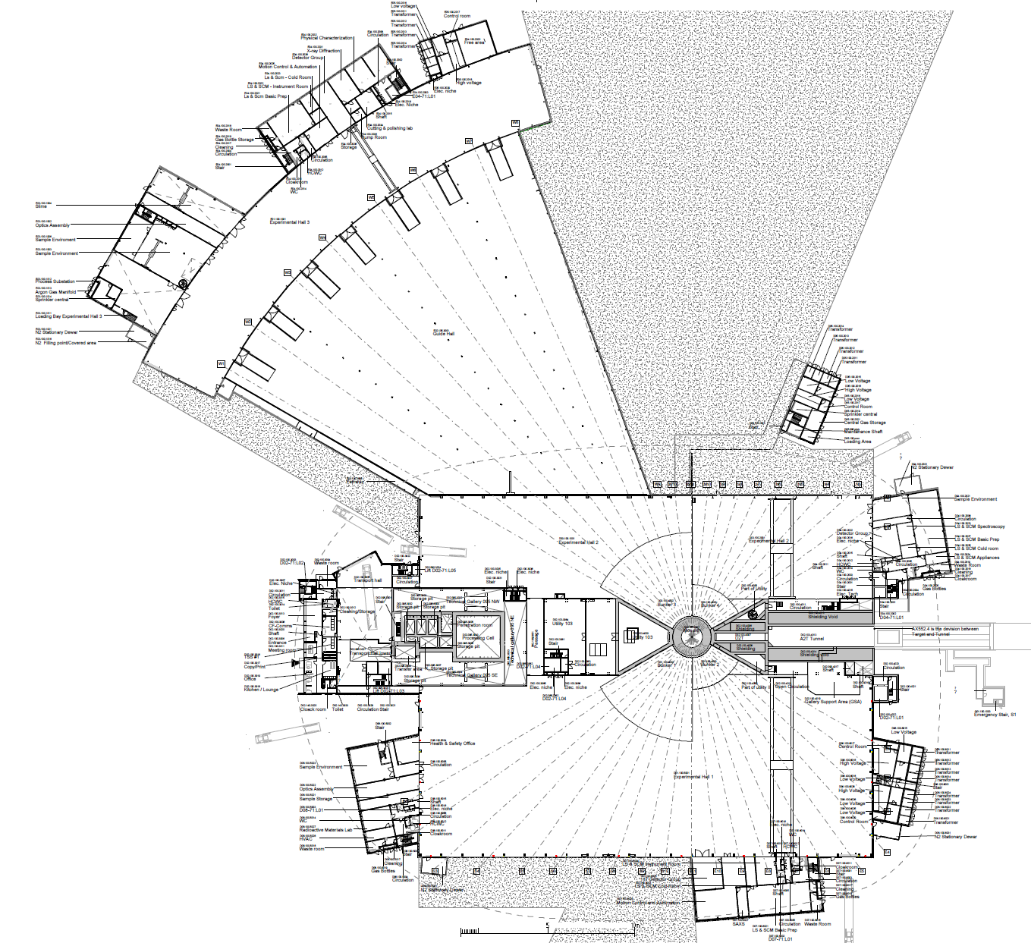
2019/2020: NSS Proposed Access Dates (Excludes Full Access Dates)
1
D08 RML Lab – Early Access 10-Jan-19 (Level 1b MS)
E05
2a
E01 – Full Access 27-Apr-19 (Level 1 MS)
E04
2b
E02 Area 1 – Partial Access 27-Apr-19 (Level 1 MS)
3
D03 Bunker – * Early Access 03-Jun-19 (Level 1 MS)
E01
2a
4
D01 Bunker – * Early Access 14-Aug-19 (Level 1 MS)
E03
2b
5
E02 Area 2 – Partial Access 15-Oct-19 (Level 1b MS)
6
D03 Main Hall – Partial Access 01-Nov-19 (Level 1b MS)
E02
7
D01 Main Hall Ph 1 – Partial Access 06-Jan-20 (Level 1b MS)
Exact Location of Final De-Lineation Point TBC
5
8
D01 Main Hall Ph 2 – Partial Access 02-Mar-20 (Level 1b MS)
D05
D04
Additional Area Made Available for Storage of Blocks (D03) for NSS: 01-Sep-19
6
3
D03 Cranes Operational: 13-Aug-19
4
D06
D08
8
Additional Area Made Available for Storage of Blocks (D01) for NSS: 01-Oct-19
1
7
D01 Cranes Operational: 28-Oct-19
Area Under Review for Possibilities of Early Access for NSS
D07

Slide 9
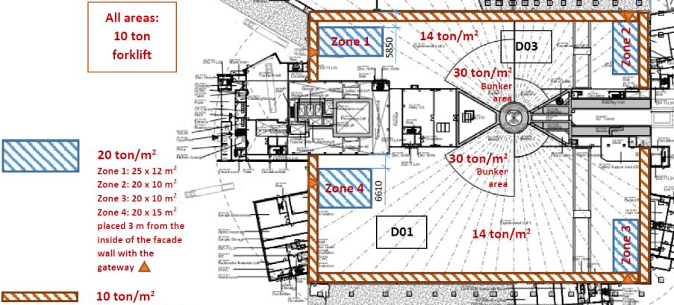
NSS Floor loading limits
Under the bunker (D02 & inner parts of D01 & D03); 30 t/m²
In the rest of D01 & D03
      In general (under guides & instrument caves); 14 t/m²
      Around perimeter (3 metres from wall); 10 t/m²
      Staging areas (near truck access doors); 20 t/m²
In E01 & E02 (long instruments in west sector); 20 t/m²
Reduced in February 2017

Slide 10
NSS Project; Neutron Instrument project phases
Proposal and Planning
Design and Construction
Installation and Commissioning
Instrument Proposal
Phase 0
Preparation for Design
Phase 1
Preliminary Design
Phase 2
Detailed Design
Phase 3
Manufacturing and Procurement
Phase 4
Installation and Integration
Phase 5
Hot Commissioning
Deliverables
Science case covering scientific relevance, impact and usage
Conceptual design with credible estimates of performance
Preliminary costing.
Deliverables
Conceptual design updates
Prototyping
Definition of facility requirements and interfaces
Clarification of institutional responsibilities
Resource planning
Deliverables
Scientific and technical requirements
Technical design concept
Delivery plan for all phases (including hot commissioning)
Delivery Schedule covering all phases
Resource plan
Staging plan for later enhancements
Budget with contingency at 10% of cost to complete
Deliverables
Complete definition of all major technical components
Completion of detailed plan for Phase 3
Refined plan for phase 4
Refined Resource plan
Refined delivery schedule, with critical path items and dependencies
Refined budget with contingency at 10% of cost to complete
Deliverables
Procurement and manufacture of all major technical components
Completion of detailed plan for phase 4
Site preparation
Refined plans for phase 5 and for staging
Refined Resource plan
Refine instrument delivery schedule
Maintain budget with contingency at 10% of cost to complete
Deliverables
Construction of physical infrastructure on site.
Assembly and installation of technical components
Integration and testing of technical components
Installation, integration and testing of Personnel Safety System
Submission of application for approval to hot commission
Formal project completion
Deliverables
Verification of performance of Personnel Safety System
Proof of compliance with radiation dose limits
Critical performance demonstration of basic functionality
Scientific performance demonstration
Friendly user experiments
Completion of technical and user manuals
Tollgate 1
STAP review
SAC recommendation
NSS recommendation
STC approval
Tollgate 2 (PDR)
Preliminary Design Review
STAP review
NSS
scope review
assign cost book value
Approval by SD
Tollgate 3 (CDR)
Critical Design Review
STAP review
ICB review
NSS approval
Tollgate 4 (IRR)
Installation Readiness Review
ICB review
NSS approval
Tollgate 5 (SAR)
Safety systems acceptance review
NSS approval
Tollgate 6 (ORR)
Operations readiness review
NSS approval

Slide 11
Tollgate 2 Process
TOLLGATE 2 MEETING: evaluation of
final technical design concept,
scientific scope,
project budget,
schedule and
resource plan
TOLLGATE 2 REVIEW possible outcomes:
No major problems: implement recommended changes and revise baseline documents, before moving instrument project into Phase 2 (< 3 months allowed).
Major problems: continue in Phase 1 and prepare for a second TG2 review (< 6 months allowed).
Review committee report submitted to Science Director within two weeks of TG2 meeting

Slide 12
Objectives for this meeting
• scientific parameters -that it will meet the stated performance criteria (TPM),
• engineering -that it is feasible to build with all of the appropriate interfaces,
• safety and licensing -that it meets the requirements for safe operations and licensing
• budget -that it can be built within the budget,
• schedule -that it can be built and made ready for hot commissioning in the required timeframe
• management -that the instrument consortium has the capability and sufficient resources to deliver according to their plan.
• Operation and maintenance – that it can be operated (incl. performing experiments using samples and sample environment) and maintained.
(ESS-0051706)

Slide 13
Phase 2: detailed design (1/2)
Aim: To bring the design of the Neutron Instrument components to a state of readiness for Manufacturing and Procurement (M&P).
Essential achievements:
Complete detailed design of all major components coherently so as to minimize risk of incompatibilities and need for redesign work as the Project moves into Phase 3: M&P.
Detailed planning for M&P. Note Phase 2 does not include M&P.
Exception: where long lead-time procurements add considerable risk to project schedule.
Approval to begin early M&P: by NSS Project via Neutron Instruments Lead Engineer (Gabor Laszlo).
Detailed planning for Phase 4: Installation and Integration.
Technical Annexe for whole of project to be completed within 3 months of Phase 2
Draft Template for the TA is available (to be finalized within 2 weeks)

Slide 14
Phase 2: detailed design (2/2)
Notes on Phase 2:
Careful scheduling of Phases 3 & 4 ensures resource planning for M&P processes (e.g. FAT & SAT), site preparation, installation and system integration, cold commissioning activities and licensing processes.
Critical dependencies should be identified and a critical path analysis should be performed in this phase.
Support from the NSS Project Office will include construction managers under leadership of the NSS Construction Engineer.
The NSS Construction Engineer will develop and maintain an integrated installation plan that takes into account the procurement schedules for all Neutron Instruments, CF building schedules, and resource allocation.

Slide 15
NSS Project management
Director for Science
Andreas Schreyer
ESS Technical Board
Chair: Roland Garoby
Project Leader: Shane Kennedy
Deputy Project Leader: Oliver Kirstein
Instrument Collaboration Board
Chair: Andreas Schreyer
Safety and Licensing:
Lead: Arno Hiess
Neutron Instruments:
Lead Scientist: Ken Andersen
Lead Engineer: Gabor Laszlo
In-Kind Office:
Lead: Michela Del’Anno Boulton
Integration Activities:
Lead: Zvonko Lazic
Planning:
Lead: Sofie Ossowski
SSM application
Partner coordination
Neutron Bunker
Budgets & workflow
LOKI (ISIS)
ODIN (TUM/PSI)
Safety Systems analysis & design
Requirements & Standards
Schedule
SKADI (FRJ)
BEER (HZG/NPI)
Memoranda of Understanding
ESTIA (PSI)
Risk Management
Systems Engineering
Four Instrument Classes
Large scale structures
Engineering & imaging
Spectroscopy
Diffraction
C-SPEC (TUM)
Technical Annexes
FREIA (ISIS)
T-REX (FZJ)
In-Kind Collaboration Agreements
Conventional Facilities
DREAM (FRJ)
BIFROST (DTU)
Target Project
HEIMDAL (ÅU)
MIRACLES (ESS Bilbao)
Instrument Class Co-ordinator (scientist) assigned to each instrument
NMX (ESS)
VESPA(CNR)
MAGIC (LLB)

Slide 16
NSS Project Integration Support
Integrated Systems
Neutron Bunker
Beam inserts
Choppers
Transport optics
Vacuum systems
Shutters
Shielding
Cranes
Penetrations
Services
Controls & sensors
Remote handling
Safety systems
Integrated Processes
In-kind agreements
Technical annexes
Project Management
    Tollgates
    Schedule
    risk
Installation planning
TBA
Iain Sutton
Gabor Laszlo
Antonio Bianchi

Slide 17
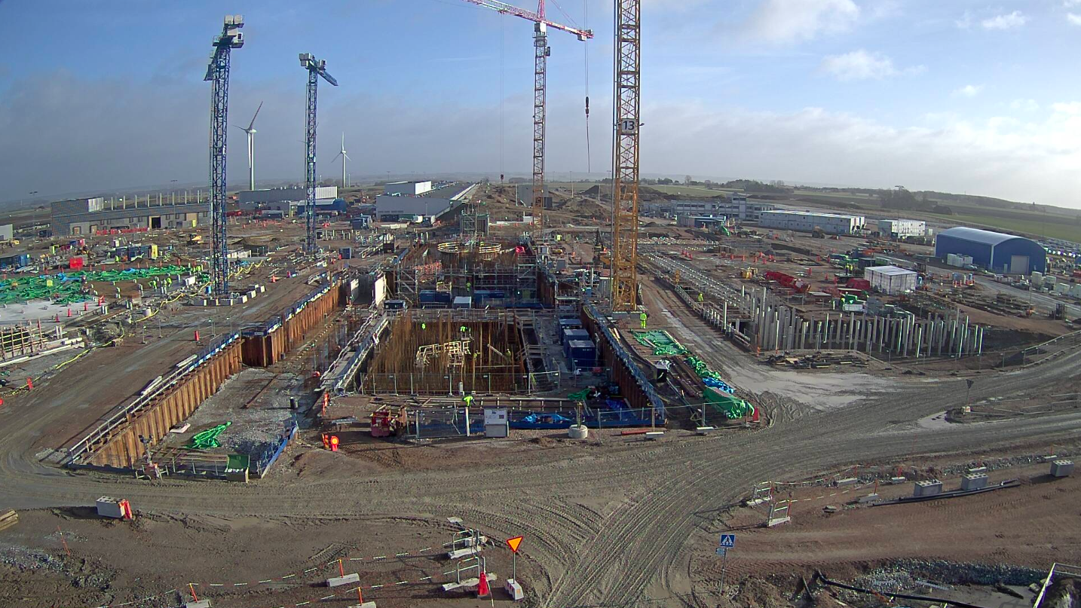
Central Utilities Building (CUB)
LINAC
Site
Offices
East sector Instruments
South sector Instruments
West sector (160 m) Instruments
Target
February 2017

Slide 18
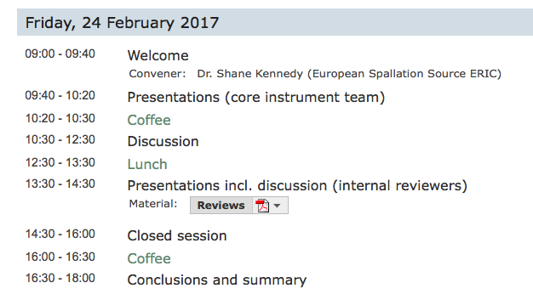
Agenda for ODIN TG2 meeting
Friday 24th February 2017

Slide 19
NSS provisions for ODIN
Local workshops and workshop support for on-site installation from early 2019
Chemistry laboratories and sample handling facilities includes RML in D08 from 2020
Sample Environment: NSS Sample Environment pool to include possibility of high pressures, high and low temperatures & high magnetic fields

Slide 20
Objectives for this meeting (1/2)
High level questions:
has adequate planning been done to move the project into Phase 2?
is the proposed budget consistent with the proposed scope?
does the preliminary design satisfy the requirements?
is the presented baseline technically sound?
has anything been forgotten or neglected?
where several In-kind partners are collaborating - are roles and responsibilities adequately defined and agreed?
(ESS-0043330)

Slide 21
Objectives for this meeting (2/2)
Low level questions:
have safety-related aspects been appropriately considered?
to what extent have appropriate connections been made with the critical project interfaces, such as software, data storage hardware and sample environment?
Has the instrument context been appropriately considered in terms of physical interfaces, such as bunker, beam extraction, ICS etc. ?
to what extent have available engineering standards been implemented appropriately?
are the cost and duration estimates reasonable?
to what extent has the team planned appropriately for the risks, both technical and otherwise?
to what extent have Reliability and Maintenance aspects been appropriately considered?
(ESS-0043330)

