Slide 1





T-REX Toll Gate 2
Time-of-flight Reciprocal space EXplorer
A bispectral chopper spectrometer for
magnetism, material science and soft matter
Nicolò Violini, Jörg Voigt, Earl Babcock, Zahir Sahli, Günter Kemmerling, Klaus Bussmann, Thomas Brückel
Andrea Orecchini, Alessandro Paciaroni, Marco Zanatta, Pietro Tozzi, Francesco Sacchetti
Hans Kämmerling,
Achim Heynen
Lund, 8th March 2017

Slide 2
Outline of TG2 presentation
ConOps / T-REX Scientific Scope
Overview of Science Case
“project” vs “full scope” after SSM
Overview of T-REX layout & PBS & P&ID
      upgrade stages from IOSP doc
      QA COnOps and IOSP-SP
SysReq / T-REX HLSR in connection to Scientific Scope
  Functional requirements for High Level Components
  QA SysReq
PSDD / Description of Preliminary Design
  Interfaces with monolith and bunker and neighbors
  Key components and areas
  Performance at 2 MW
QA PSDD
WPS + IOSP / Instrument life-cycle
  Schedule
  Risk analysis
  QA WPS and IOSP-IO
Address issues from reviews

Slide 3
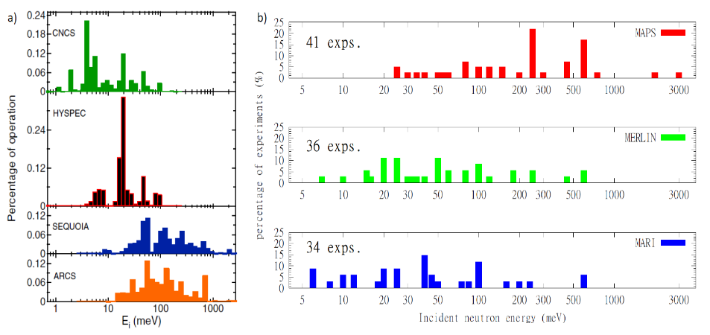
A spectrometer for a broad user community
Wide energy and Q range
Instrument configurations
energy resolution
Q resolution
polarization analysis
Sample environment
Predict trends and developments
5D mapping
= more chances
of early success
20-30% +
30%-40%
SNS
ISIS
3

Slide 4
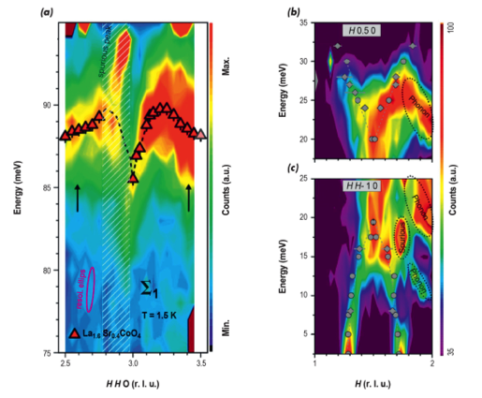
Order at high temperature ➔High energy excitations
Interplay lattice, charge, spin ➔ Distinguish excitations
Resolving gaps and zone boundary behavior
Line shapes
Identify spurions with PA
35
30
90
25
20
Thermal energy range (beyond 100 meV)
indispensable!
85
25
20
80
15
10
Hour glass magnetic spectrum in La_{2-x}Sr_{x}CoO₄.
ILL Science highlight
Y. Drees et al., Nat. Comm. 4:2449
5
75

Slide 5
Functional Materials: Multiferroics
Very good energy resolution
Good Q resolution
Test ground for theory (line shape …)
IN5: Ba₃NbFe₃Si₂O₁₄
Loire et al., PRL 106, 207201 (2011)

Slide 6
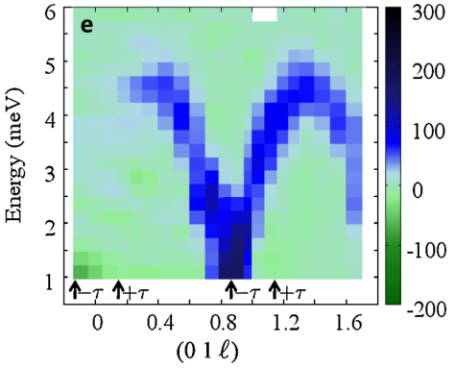
Functional Materials: Multiferroics
Very good energy resolution
Good Q resolution
Test ground for theory (line shape …)
High Intensity, High Resolution
&
Polarization Analysis
IN5: Ba₃NbFe₃Si₂O₁₄
Loire et al., PRL 106, 207201 (2011)
PA: now TAS; future: T-REX

Slide 7
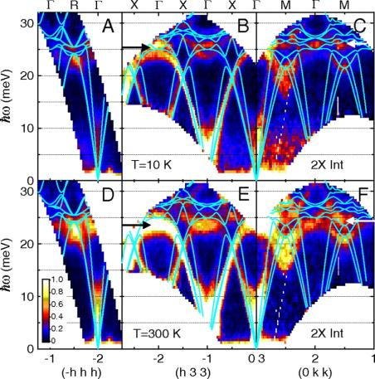
Functional Materials
Thermoelectrics: Electron-Phonon coupling: Line shape at high energy
Ion Transport: QENS at large momentum transfer + PA (H, Na, Li, Cl, N, …)
Olivier Delaire et al. PNAS 2011;108:4725-4730
W. Paulus et al, JACS 130, (2008), 16080
Thermal energies to tens of µeV
+
large Q
From lattice dynamics
to diffusive motion

Slide 8
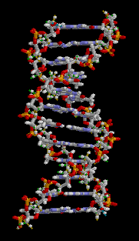
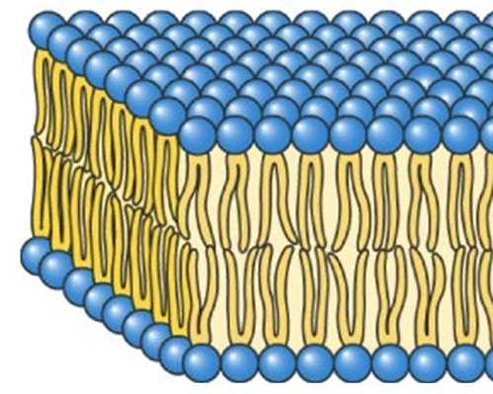
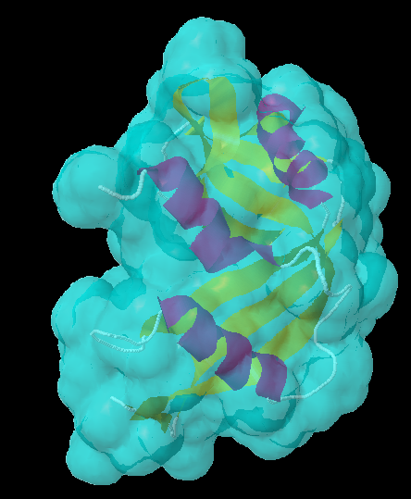
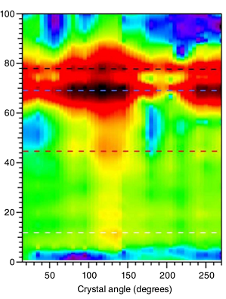
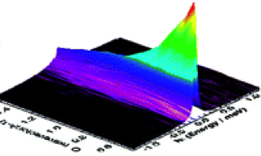
Soft Matter & Life Science
Dynamics in bio-molecular components:
Proteins, DNA, RNA and lipid membranes are central to cellular function.
Biological functions are governed by their dynamical character, particularly on the picosecond time-scale.
Frequency (cm⁻¹)
Diffusional and relaxational motions
Widely studied by QENS
T-REX:
  Cold E_{i} and δE down to 20 μeV
  PA
Vibrational collective motions.
…Purely Inelastic Scattering
New topic
Thermal E_{i}
Flux limited
Crystal Angle (degrees)

Slide 9
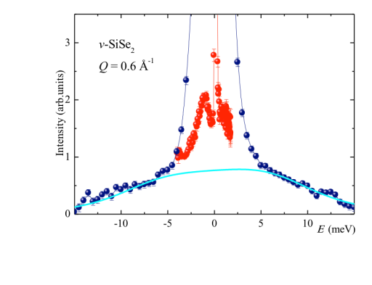
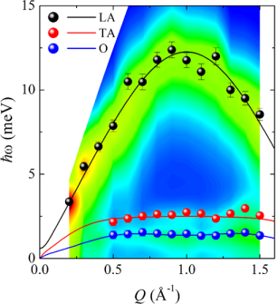
INS close to forward direction
collective coherent
excitations in glasses
Zanatta et al.,
J. Phys. Chem. Lett. 2013, 4, 1143−1147
Tof-Tof
BRISP

Slide 10
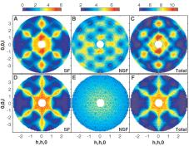
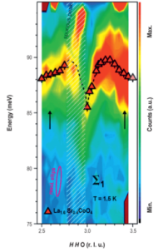
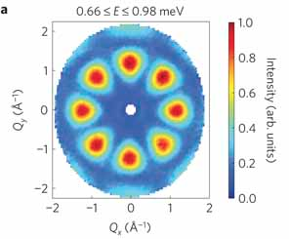
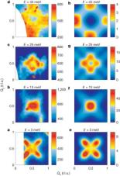


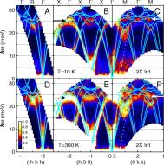
T-REX “Full scope” Science Cloud

Slide 11
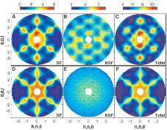
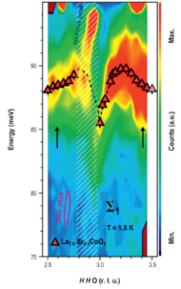
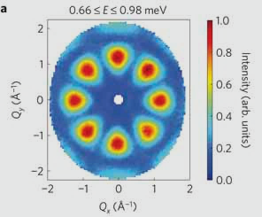
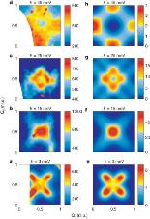

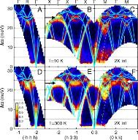
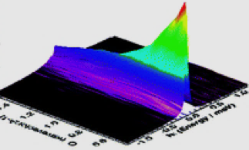
“Project scope” agreed at SSM

Slide 12
Project scope vs Full scope as agreed at SSM
It was agreed that the instrument presented as configuration 2 in the scope-setting report will form the basis of the scope and budget for T-REX. It will be world-leading at 2MW beam power when it comes online by an order of magnitude or more and has a technically straightforward upgrade path to full scope.
5D mapping
Polychromatic experiments
+ PA unique feature

Slide 13
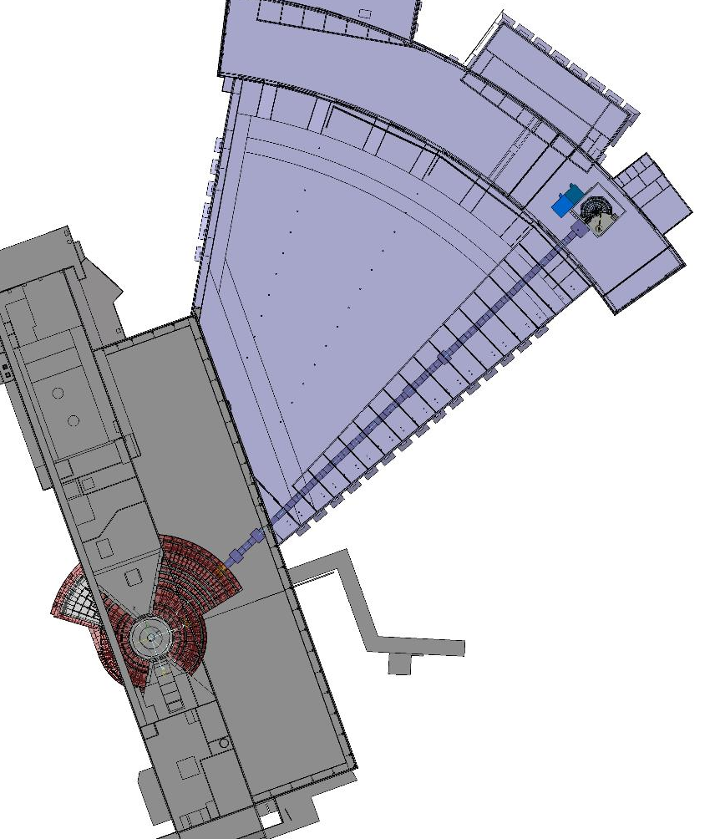
T-REX layout project scope
E02
D03
E01

Slide 14
T-REX Product Breakdown Structure
High resolution pdf available in Indico
ESS standard nomenclature
11 High Level components
Nearly 200 Low Levels components
Baseline structure for SysReq and Budget

Slide 15
PBS – a few more details
Description of components follows in section ‘key components & areas’

Slide 16
PBS – a few more details
Description of components follows in section ‘key components & areas’

Slide 17
network
control
hardware
media
High resolution pdf available in Indico

Slide 18
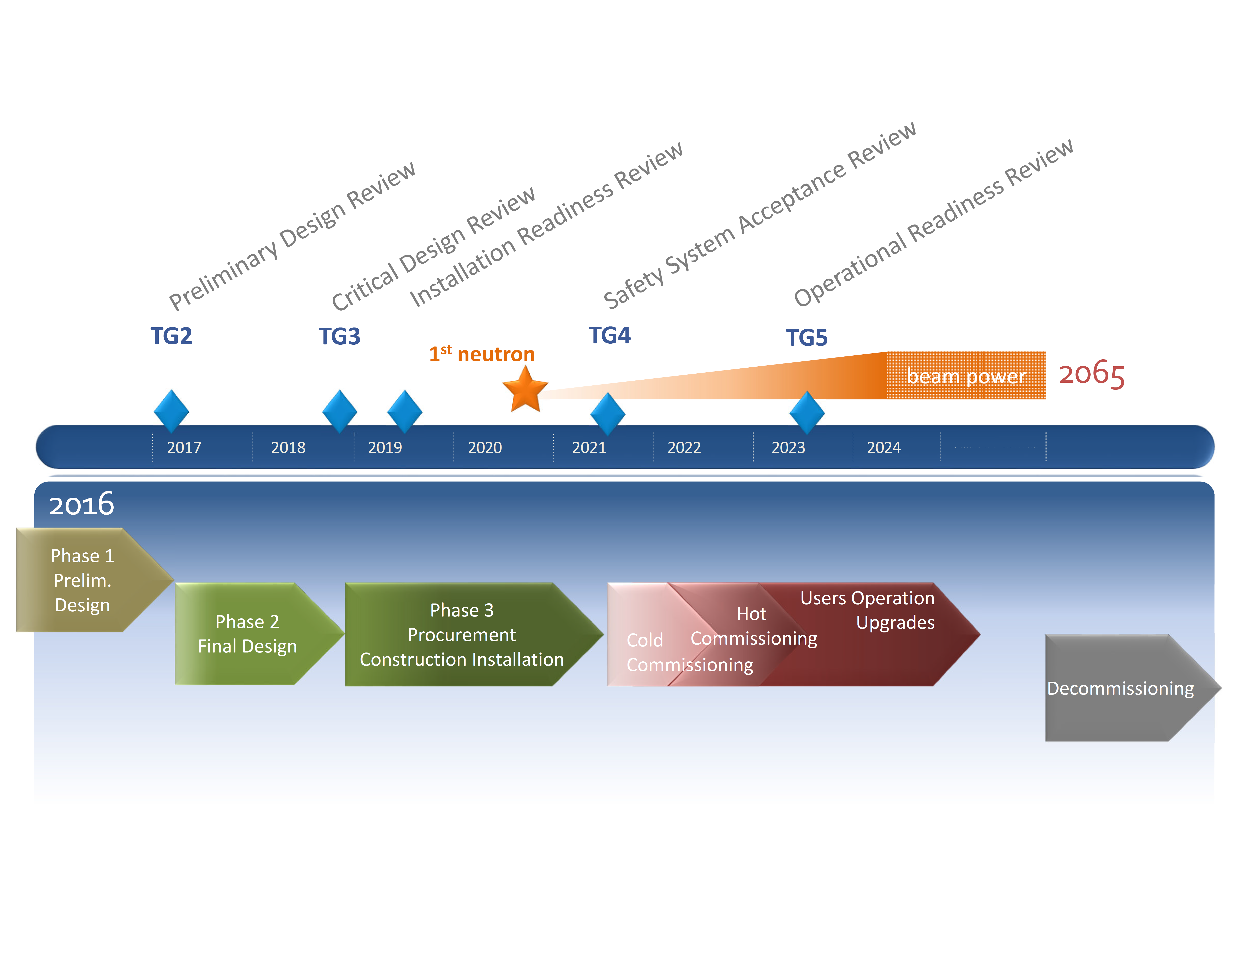
T-REX life cycle (wrong numbering of TGRs)

Slide 19
T-REX life cycle (correct numbering of TGRs)

Slide 20
Budget

Slide 21
Upgrade stages to full scope
PROPOSED START
Increase Detectors coverage up to 2.2 sr
Sample Environment Equipment
+T0C
4-P choppers
Not mentioned in IOSP document
Faster choppers
Supermirror analyser
+2.3 M€ MG
+4.9 M€ ³He
+1.667 M€
+240 k€
~ 0.5M€
~ M€
~ M€
2022
2022
2024
When available
2025
2022

Slide 22
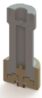

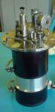
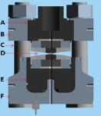
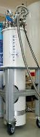
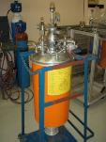
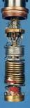

Sample Environment Priorities (Cost + ESS pool based)
Project scope
Full Scope
Future upgrade
Orange cryofurnace
CCR
ILL Furnace
Clamp cells < 3 GPa
6kV HV supply
3He Sorption Stick
Humidity Chamber
Vertical cryomagnet 7T (1) Paris-Edinburgh Cell (1)
Gas cells < 1 GPa (2)
Gas Handling (2)
IR furnace (1)
ES Levitator
Pump & Probe set-up
+250k€
+219k€
+1200k€
Rely on ESS-pool on day 1
Top-down, side access possible
Magic PASTIS < 1m diameter
Sample area shall enable installation of XL SEE
<1000 kg, height < 1.7 m, d < 0.8 m

Slide 23
More Questions about
ConOps and IOSP (Staging Plan) ?

Slide 24
Science driven High Level Requirements / Design Goals
1 | Diffusion and relaxations High Tc SC/materials | Incident Energy Range | 2 meV - 160 meV
2 | small gaps/ lineshape/QENS Magnetism/materials | Elastic energy resolution (FWHM) | 1% at 2 meV 3% at 100 meV
3 | Ion transport/phonons/ diffusion | Q range | 0.05 Å⁻¹ – 10 Å⁻¹ 0.05 Å⁻¹ – 15 Å⁻¹ (full scope)
4 | Single x-tals | Q resolution (FWHM) | 0.05 Å⁻¹ at 80 meV tailored to needs
5 | Magnetic s. Factor/ disorder | Minimum 2ϑ_{S} | 1°
6 | Single x-tals + powders | Beam size | 10mmx30mm
7 | Single x-tals | Beam profile | flat
8 | Magnetism/Single x-tals | Polarization Analysis | X-Y-Z
9 |  | S/N | maximum

Slide 25
S/N requirement (not in SysReq doc)
Energy or time domain
Which subframe?
E_{i} ≥ 50 meV
Which TOF?
Beyond V and Al phonon cut-off
Sample conditions? 10% V
Cold to reduce energy up-scattering
Consider scattering from SEE
Sample inherent background
Better discrimination of ‘unwanted’ features:
PA and large angle detectors
Taking Signal from Vitess/McStas simulations
S= 5·10⁴ n/s
Noise from MCNP simulations for MAGIC
N= 4 n/s/cm² x 100 cm² x 0.01 (detection efficiency)
S/N 10⁴ expected !!no validation in project scope!!
?? Beam stop, skyshine, groundshine, cross talks, neutronics calculations ??
From M. Arai IKON 12 presentation
HRC

Slide 26
Functional Requirements
Beam Transport and Conditioning System
n’s wavelength transport: 0.7Å – 6.5 Å
band selection (continuous): Δλ = 1.67Å
suppression (rate): others to 10⁻⁴
resolution: 0.5% < δλ/λ < 3%
ToF resolution selection 10 µs < δt/t < 80 µs
Beam size 10mm x 30mm (W x H)
tailor to sample
profile flat
collimation λ dependent from +/- 0.25° to +/-1° improvable +/- 0.25°, +/-0.5°
profile smooth
polarization flipping ratio shall ≥ 20
monitors time resolution of 2 µs
S/N breaking the LoS
brilliance transfer should be 100%

Slide 27
Functional Requirements
Sample Exposure System
Sample positioning: a ± 0.1 mm, p ± 0.1 mm
rotation: a ± 0.5°, p ± 0.1°
Sample Environment Equipment XL SEE
diameter < 1 m
weight < 2 t
4 m free height from sample
Interface with Instrument Control

Slide 28
Functional Requirements
Scattering Characterization System
Sample-detector distance: 3 m ± 1 mm
Large solid angle: vertical -15° to +25°
horizontal +1° to +70° (project scope)
Minimum angle: 1°
Time resolution (FWHM): ≤ 5 µs
PSD Positional resolution (FWHM): 20 mm x 20 mm x 10 mm
Detection Efficiency: ≥ 70 % at 1.8 Å
average 74 %, 1.6 Å < λ < 5 Å
Count Rate: <10⁴ Hz/cm²
Neutron Selectivity: <10⁻⁶ gamma detection prob.
Noise: <10⁻⁴ events/s/cm²
Vacuum ≤ 10⁻⁶ mbar
Prevention of secondary scattering
Scattered beam polarization flipping ratio shall ≥ 20
~ 20 m²
-36° to +144° (full scope)

Slide 29
Functional Requirements
Beam Transport and Conditioning System
Choppers (not requested in SysReq doc)
Wavelength rejection: others
ToF resolution achieve 10 µs (M choppers) → max frequency
100 µs (P choppers) → max frequency
selection: 10 µs - 80 µs → given L_{M}/L_{P}
Frame overlap avoidance
Frequency stability, precision
Position precision
Vacuum HV
Interface with the other BTS sub-systems (→ beam quality)
with the other systems and subsystems (→ materials)
+ Non functional requirements:
Reliability Accessibility Maintenance Integration
Safety

Slide 30
High Level Scientific Requirements
The instrument shall allow data to be collected to minimum energy transfer of 20 µeV.
The instrument shall allow data to be collected to maximum energy transfer of 140 meV.
The instrument shall allow data to be collected to minimum wavevector transfer of 0.05 Å⁻¹.
The instrument shall allow data to be collected to maximum wavevector transfer of 10 Å⁻¹.
The instrument shall match the size of the neutron beam to the size of the sample, assuring the homogenous illumination of rotating samples.
The instrument shall allow data to be collected to minimum scattering angle of 1°.
The instrument shall allow the analysis of neutron spin polarization.
The instrument shall allow the energy resolution to be optimized for the experiment.
The instrument should allow the Q resolution to be optimized for the experiment.
The instrument should be capable of providing elastic energy resolution of 1% at incident energy of 2 meV.
The instrument should be capable of providing energy resolution of 3% for an energy transfer of 100 meV.
The instrument should be capable of providing a Q resolution in elastic scattering condition of 0.05 Å⁻¹ at incident energy 80 meV.
The instrument should allow data collection from samples < 10² mm³ volume.
The instrument should maximize the signal-to-background (S/B) ratio in the scattering pattern.
The instrument shall allow the control of the physical and thermodynamical condition of the sample.
The System’s design shall provide the space and flexibility necessary to host and drive the staging process to achieve the full scientific scope.
T-REX should serve the user, science and instrumental development program without interruptions during source operation.

Slide 31
More Questions about
System Requirements Doc?

Slide 32

Layout
E01
E02
D03
Bunker
Monolith
Proton Beam

Slide 33
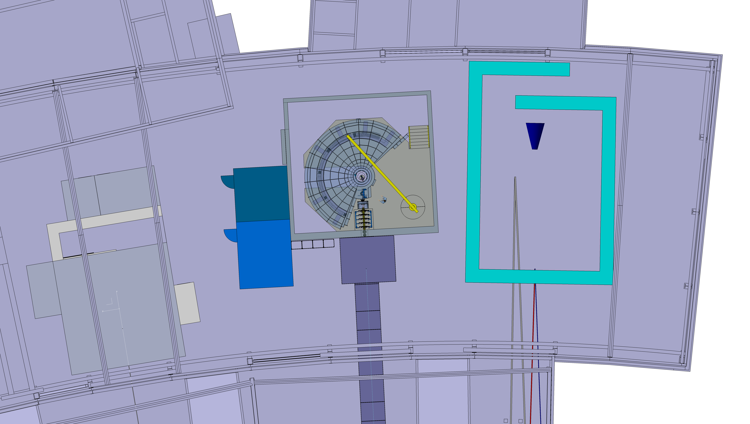
Neighbours E01

Slide 34
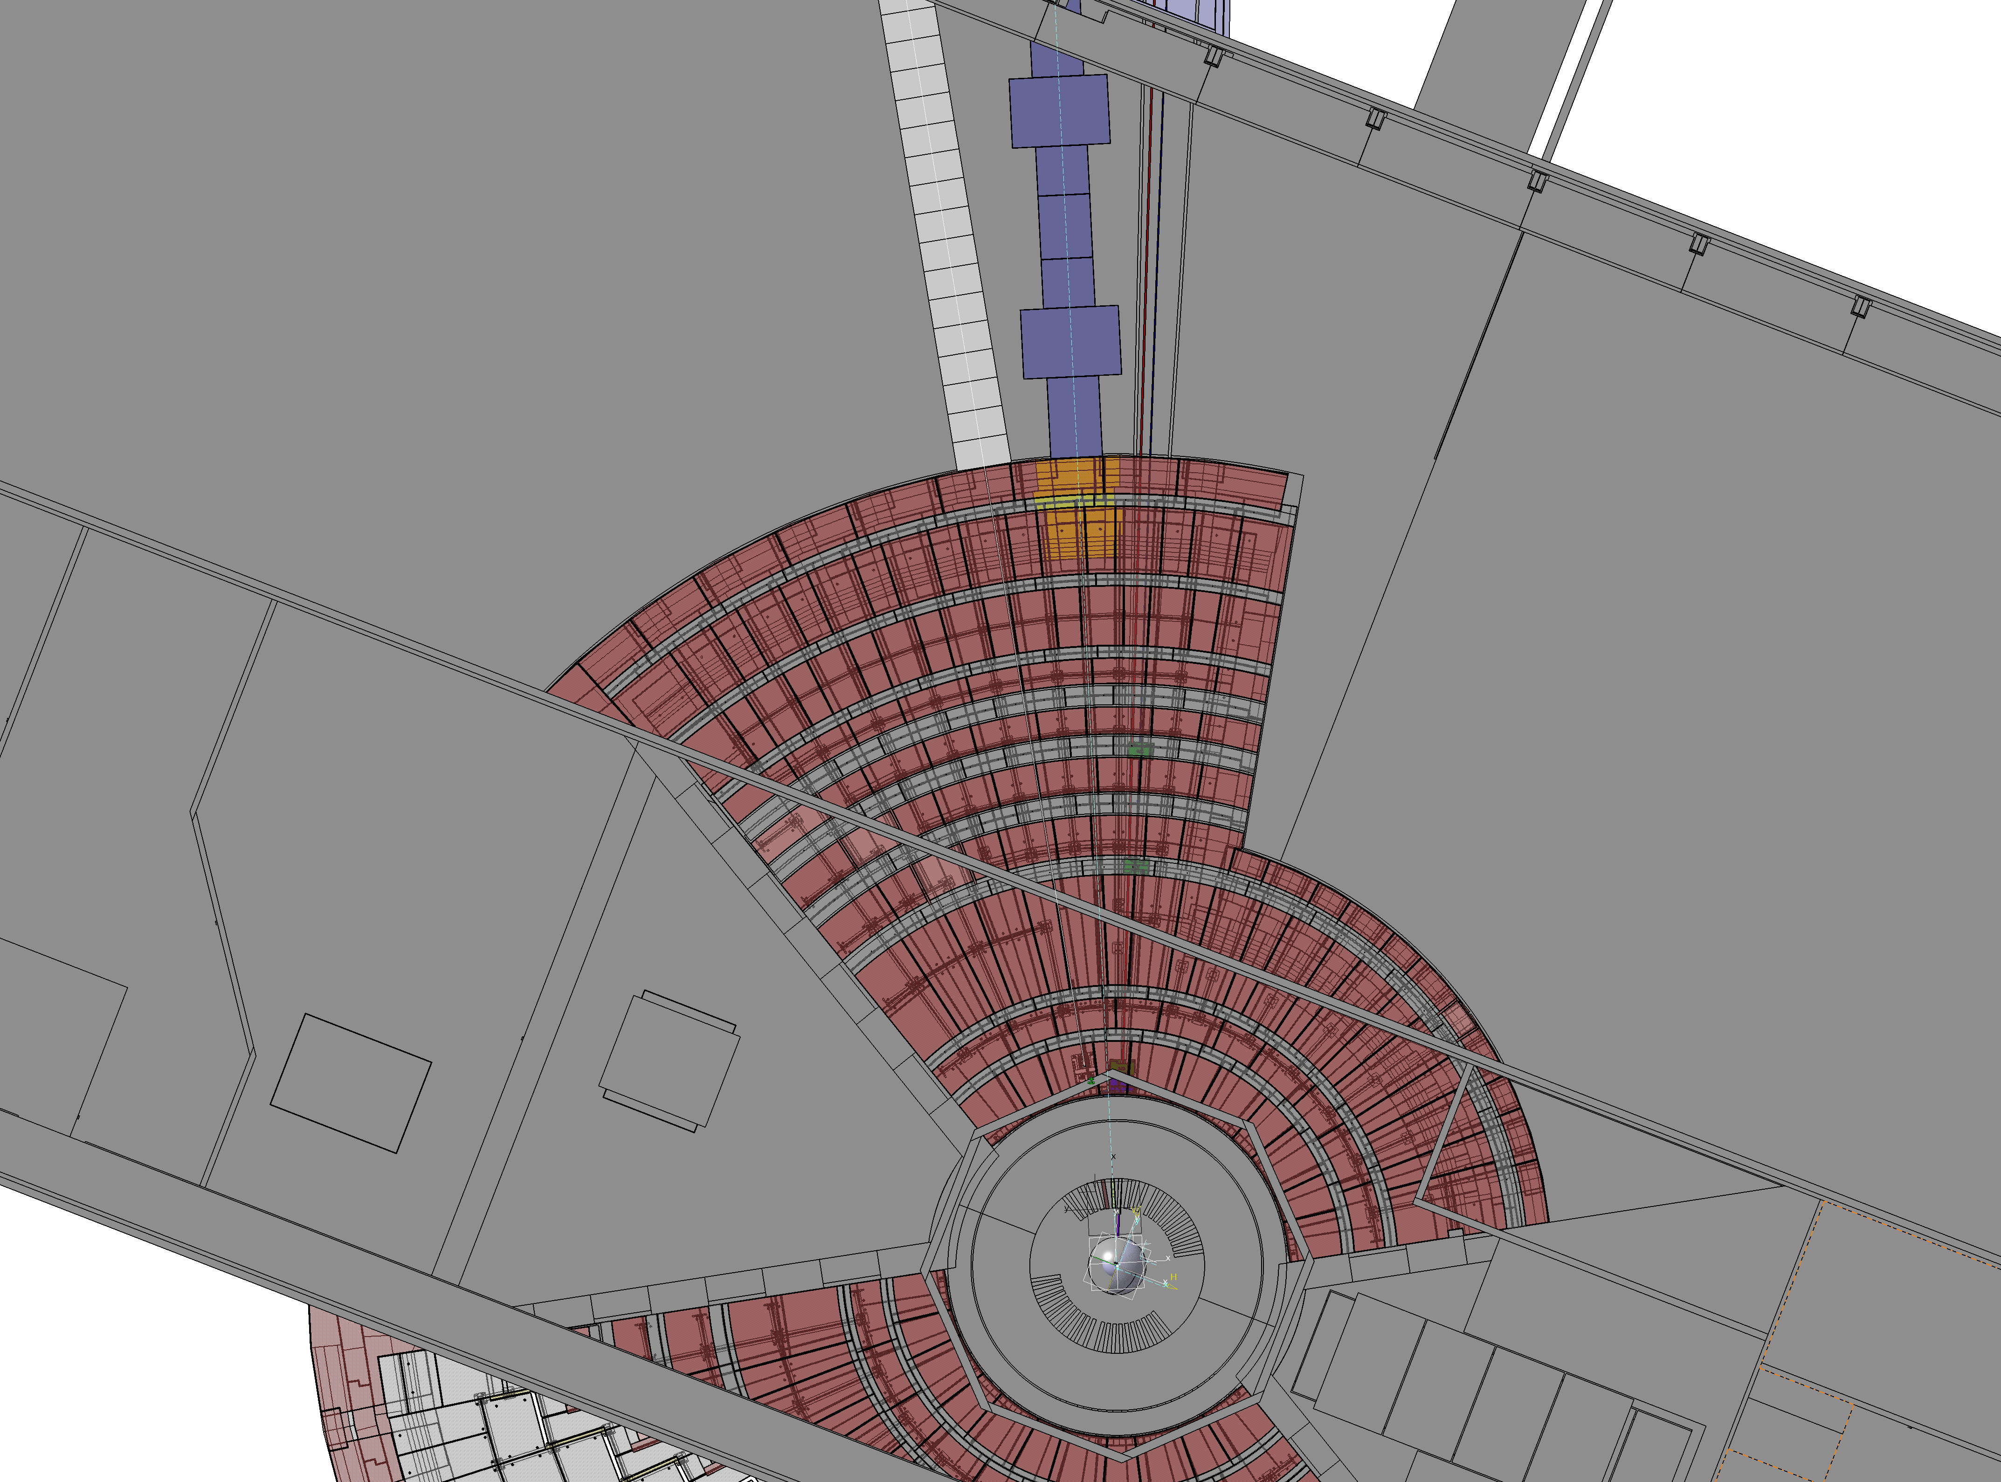
Shielding footprint D03
W6 MAGIC
W7 T-REX
W8 HEIMDAL
D03

Slide 35
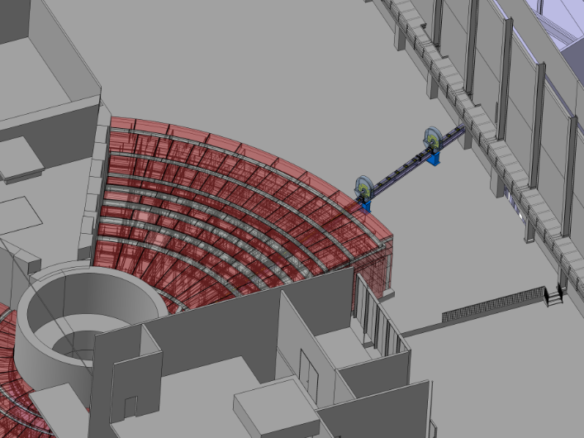
Layout – D03
BWC 2
at 40 m
BWC 1
at 32 m
Monolith, Bunker, D03 with Bandwidth Choppers BWC 1 and BWC 2

Slide 36
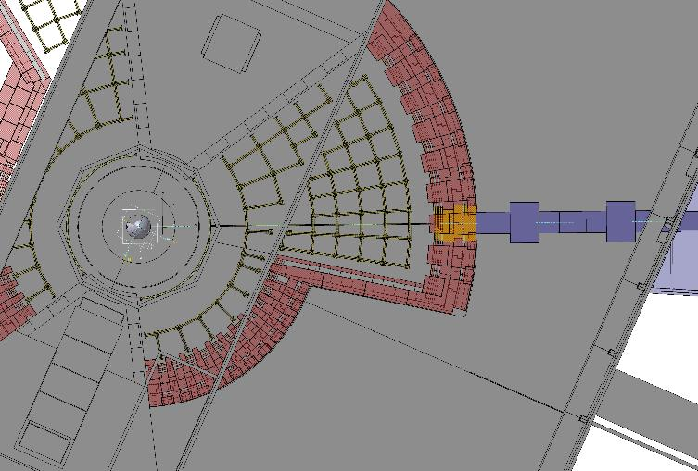
2D view monolith + D03

Slide 37
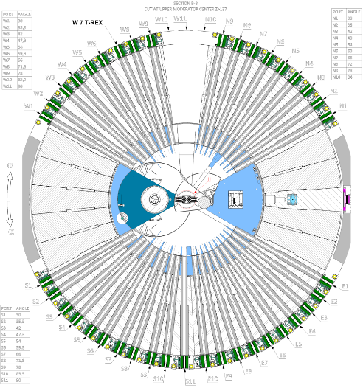
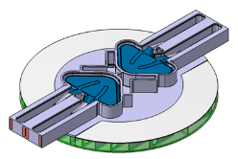
Target- monolith interface
W7 T–REX
Proton Beam
Upper Moderator
Monolith: Cut at upper Moderator Center

Slide 38
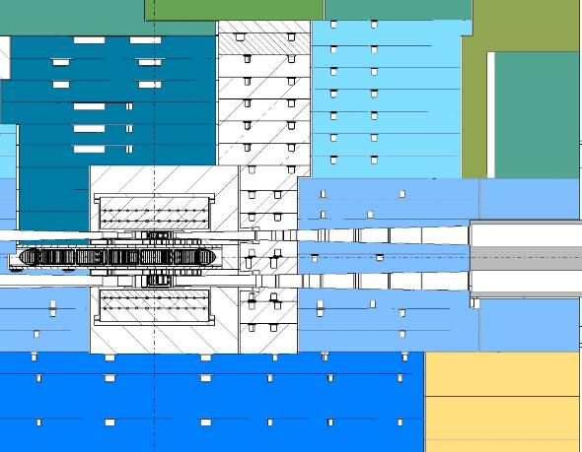
Target- monolith interface
Upper
Moderator
T –REX
centreline
Target Wheel

Slide 39
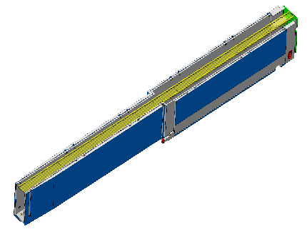
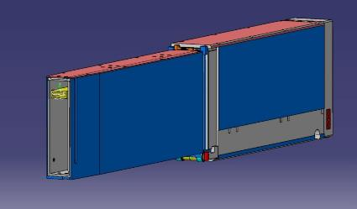
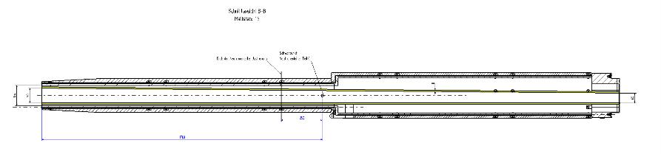
In-monolith insert (not in project scope)
Neutron Beam Optics Assembly
Entrance | 30 mm x 90 m (HxW)
Exit | 46 mm x 60 mm (HxW)
Thickness of the walls | 8 mm
Material | Al or Cu
NBOA Drawings delivered to ESS in Jan ‘17

Slide 40
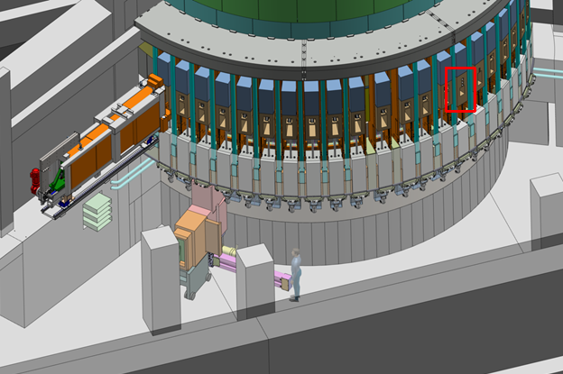
Light shutter system
Integrates the Cold Neutrons Extraction system
Drawings and model ‘ESS-0092689’
200 mm

Slide 41
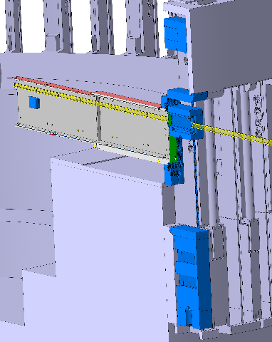
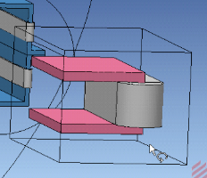
Light shutter system
Integrates the Cold Neutrons Extraction system
Drawings and model ‘ESS-0092689’
Guide
Bender + guide
Polarizing bender
+ guide
200 mm
braked
vertical
servo
50 µm
pos resolution
Saturation field
1 kG

Slide 42
Neighbours inside bunker
Proposed position of T0 chopper
Proposed position of heavy shutter
Close collaboration and follow up with neighbours and CG

Slide 43
T0 chopper (not in project scope)
To be installed if operational experience shows that it is necessary
Phase 1 study for DREAM (Neutronics + engineering)
ESS Chopper group:
Prototype development envisaged possibly at FZJ, managed by Dariusz Zielinski
Proposal of provision in project scope:
Make easier later installation/alignment inside bunker
Removable guide section of equal-size
Bottom part of the CHIM, +50k€
Further development for installation outside bunker (may not fit into neutron guide 60 mm x 85 mm WxH)

Slide 44
Heavy shutter inside bunker
From Gàbor Laszlo – IKON12 Feb 2017

Slide 45
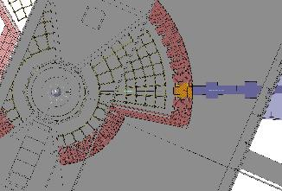
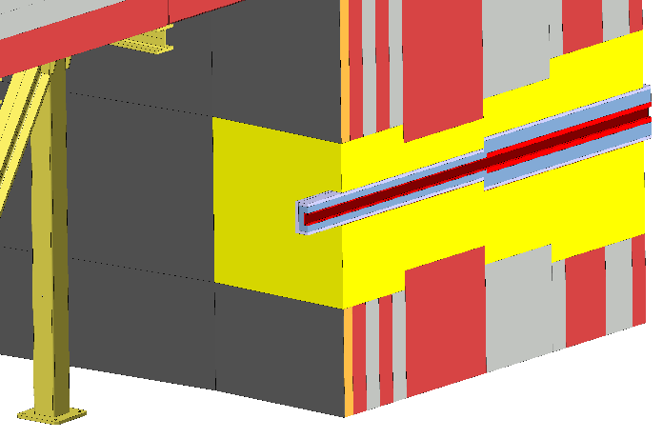
Bunker feed-thru
Neutron Optics Drawings delivered to ESS
in Feb 2017 → bunker procurement
Guide Support and alignment tbd

Slide 46
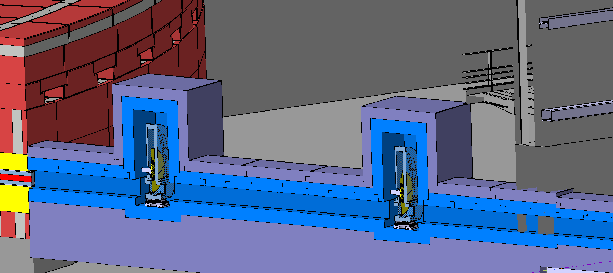
BW choppers + shielding D03
Access to choppers
Horizontal split CHIM
load limit 14 t/m²
28 m
32 m
40 m
45 m

Slide 47
Layout
E01
E02
D03
Bunker
Monolith
Proton Beam
Notes:
comment e02
next slides e01

Slide 48
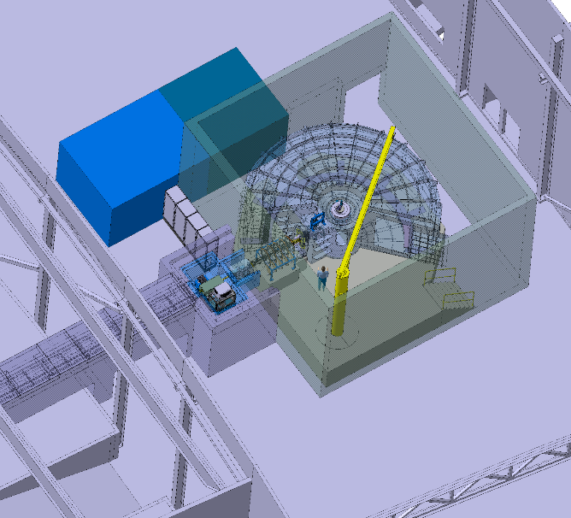
3D view of T-REX in E01

Slide 49
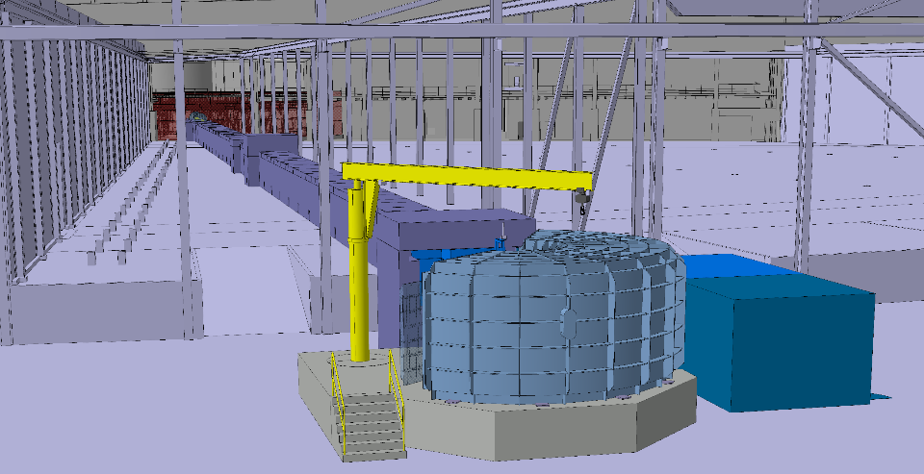
T-REX (view from E01 – without exp. cave)

Slide 50

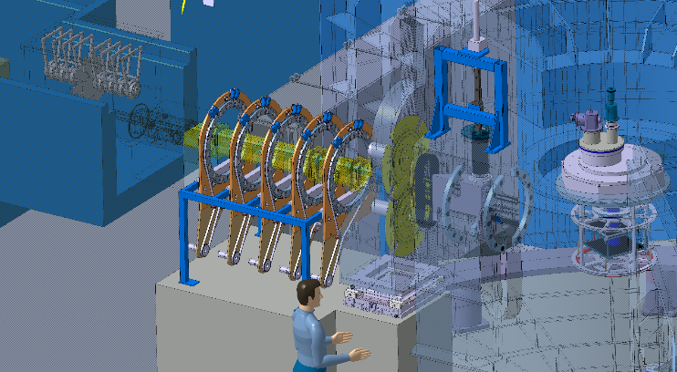
Around the sample area
Neutron beam
centreline
Adiabatic Field rotation
M chopper
Primary beam Collimators
FAN chopper
sample
Flange
Vessel/chopper
Guide field
x-y-z
MAGIC
PASTIS

Slide 51
PBS – a few more details (a remind of slides 15-16)
Neutron guide
Choppers
Collimators/slits
Polarization Equipment
Monitors
Shielding

Slide 52
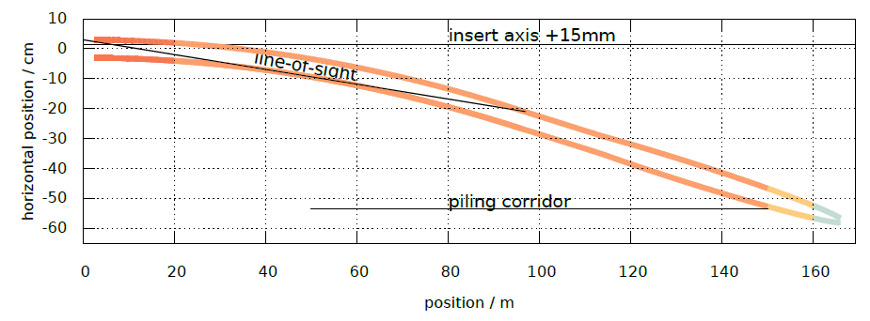

Neutron guide (baseline) from “Report on Neutron Optics”
From back tracing option
insert axis -17 mm
Notes:
LoS
axis
piling corridor
ESS standard
robust design
m-index optimal for cost and profile

Slide 53
Substrates (baseline) from “Report on Neutron Optics”
metallic
Borkron N-BK7
borofloat
100 years lifetime
Neutron losses
Needs revision after
new document ‘ESS-0097645’
metallic
Borkron N-BK7
OK with ‘ESS-0039408’
Notes:
vitess simulation give order of magnitude of neutron losses
substrates lifetime
met 10^19
bk7 10^17
borofloat 10^16

Slide 54

Brilliance transfer (Vitess calculations) from “Report on Neutron Optics”
It looks worse than it is!
30 mm beam height challenging with 30 mm moderator
Optimal for collimated thermal beam – Q resolution
Using focus-to-focus
Same flux expected from 6cm moderator (intrinsic gain) for cold neutrons
McStas calculations to validate
Current design top moderator

Slide 55
Neutron guide (alternatives 1)
from “Report on Neutron Optics”
Breaking LoS earlier may reduce shielding cost
Breaking LoS at bunker wall costs 1 order of magnitude at 100 meV n. energy

Slide 56
Neutron guide (alternatives 2)
from “Report on Neutron Optics”
Breaking LoS with vertical kink
Supermirrors m=6 needed
Low performance expected
MCNP calculations needed moderator emission and background at sample

Slide 57

Cold Neutrons Extraction System
2000
5500
6000
shutter
Insert axis
curve
60
45
optics axis -17mm
12
light
0.4°
Radius of curvature 7.16 m
400 Si wafers of 150 µm
m=4 supermirror
Front view
46 mm
60 mm
L=50mm
Notes:
butterfly 1 vs butterfly 2
minor changes
accept lower performance in cold range 1-2 y

Slide 58



Expected cold-n extraction performance
Vitess
2D POS
2Å
2D DIV

Slide 59
Choppers overview
Notes:
Lp Lm
PC 4 slits
MC 2 slits

Slide 60
Choppers Group Review
T0 chopper outside bunker
FAN chopper
FAN chopper development
M chopper 336Hz challenging
Magnetic field limits at the M chopper
PBS and WBS and budget for provision of T0 chopper
Early procurement is strongly advised
Notes:
restrict presentation to critical aspects
development for T0 outside
development of FAN integration into ESS
lifetime of carbon fiber disks

Slide 61


FAN chopper enables QENS @ ps
Umbra shadows > t_{M} (~20 µs)
Penumbra shadows < 2/f_{M} (< 5.95 ms)
➔ 5º < blade size < 30º , large freedom for device layout
14 Hz
170
M-chopper
165
Fan chopper
160

Slide 62

First tests at LET @ ISIS
Proof of principle with a prototype not designed for LET
Issues:
Synchronization with source
Encoders
Blade width not adapted
Change synchronization scheme
Test in Jülich with Stroboscope
From Rexroth to Beckhoff control
Refine mechanical setup
Instrument specific device compatible with ESS standards
Follow-up/communicate with ESS CG
1 2 3 45 678

Slide 63

Primary beam collimators
Clean up the divergence profiles
Vacuum compatible
Guide field compatible
2D collimation with honeycomb
or 1D collimation with soller
Al foils 0.1mm Gd paint
99 cm
NIMA 489, 304 (2002)

Slide 64

Beam shaping slits
Reduce beam size < 10 mm x 30 mm
Compact (along the beam)
Vacuum compatible
Magnetic field compatible
Al frame
Ceramics tracks
Piezo actuators
B₄C blades

Slide 65
Polarization Equipment of T-REX
Magic PASTIS
Polarizing bender
guide field along the guide (20 Gauss)
³He cell

Slide 66

Guide field
Inside bunker
+40 mm from centerline 10⁶ n/s/cm²
Outside bunker
NdFeB -20-30% magnetization in 2 years
(see MAGIC simulations MCNP)
potential alternative
risk mitigation drawings of bunker feedthru
Soft
NdFeB
magnets
Soft iron sheet
5 mm
Iron yoke
85 mm
≥ 200 mm
60 mm
Al coils
j=2A/mm²
Al/Cu substrate 8mm
Power supply
Construction cost and schedule to be investigated
Or other permanent magnets?
Al Vacuum casing 10mm

Slide 67


Exchange Unit
Neutron Guide / Polarizer
Development for TOPAS
Construction drawings available
Minor modifications needed
Neutron Guide
Polarizer

Slide 68



Thermal neutrons Polarizer
Magicbox
Mirrors
Laser
System
³He-Cell
Oven
Includes Adiabatic Fast Passage
Does not need ³He supply
TOPAS

Slide 69
Adiabatic Field Rotation
between Fan Chopper and M Chopper
Larger distance and less feedback to/on PASTIS
X or Y or Z guide field from M chopper to sample
Rotation of Hallbach magnet rings for transverse directions + solenoid for longitudinal
Direct Double Helix (DDH™) around beam tubes/collimators
Rotation around [111] direction of Hallbach magnet array
Adiabatic rotation

Slide 70

MAGIC PASTIS
X-Y-Z analysis
Development for TOPAS
Construction drawings available
Needs ³He support lab/staff to provide ³He cells, needs set of cells
Reduce blind spots/
adapt to detectors gaps /
Adapt to detector height

Slide 71

Load Lock system / sample change
Independent vacuum system/environment for sample change
15 min recovery 10⁻⁴ mbar
Common vacuum during measurements
Last window at M chopper
Simple

Slide 72
Neutron Beam Monitors
Vacuum compatible
<15mm thickness
2D readout
Gas supply (depends on provider ³He, Ar, CO₂,N₂)
CDT Design
Monitor 1
Monitor 2
Monitor 3

Slide 73
Shielding outside the bunker
MCNP model of T-REX available
Calculations are CPU demanding, source-code license not available yet
Use of the ‘thermsource’ (spectra at 2m) is envisaged
Access to SC possible
Vitess: 10³-10⁴ n/s/cm² on substrate 0.1-10Å - 20cm concrete
MCNP MAGIC: 10⁴n/s 1eV-1GeV – 50 cm concrete
Within LoS
Fast neutrons / Spallation
Outside LoS
Gammas from th. n’s capture Ti
< 14 t /m²
Present layout exceeds
5 t /m²
< 20 t /m²

Slide 74

Shielding Experimental Cave
1 μSv/h
2.3 m
0.3 m
concrete
8 m
11 m
1 μSv/h
No direct view →
thermal flux
≤10⁹ n/s converted in gammas
by 3 cm³ FeCd
6 m high walls
Load = 4.5 t/m²
160 μSv/h
18 μSv/h
8 μSv/h
10.5 m
0.2 μSv/h

Slide 75
From IKON12 – M. Arai
Main hall @ J-PARC
Previous experience has a value

Slide 76
From IKON12 – M. Arai

Slide 77
From IKON12 – M. Arai
High energy neutrons eliminated either by T0 chopper or a curved guide
Ex. Los 28m, 40m instrument
T0 and curved guide are not perfect → use their combination in full scope
Gain from larger distance to source
Longer source pulse ~ 10 ms prompt flash affects 14meV<Ei<28meV

Slide 78
PBS – a few more details (a remind of slides 15-16)
Detector Vessel
Detectors
Get Lost tube Beam Stop
Radial collimator

Slide 79



Detector Vessel
10⁻⁶ mbar
Stainless steel 10 mm
Magnetic req.
2m R from sample
Access from lateral door
Inside:
Primary collimator,
Holding field,
PASTIS / SEE,
Radial collimators,
Detectors,
Get lost tube, beam stop

Slide 80
Vacuum system for Detector Vessel
pumps
4 roots
3 turbo
1 screw
1 cryo
< 2 h to restore

Slide 81


Multi-GRID detectors (baseline)
MG @ CNCS
Size = half of “8-pack” module
Installation June-July 2016
Test at spectrometer
Operation for 6+ months
Side-by-side comparison to He3
User experiments
Prototype under construction
20-24 ¹⁰B₄C layers
6 x 1 µm, 10 x 1.25 µm, 4 x 2 µm
to reach 45-48% efficiency @ 1Å
Fairly compares to ³He at 6 bar
Pure Al frames

Slide 82



Multi-GRID detectors (baseline)
Full scope needs
100 modules = 5 banks x 20 modules
Project scope
40 modules = 2 banks x 20 modules
20 columns
96 rows
CNCS
prototype
2mm gap
1mm gap

Slide 83
Multi-GRID detectors (baseline)
1 bank = 1 box
AlMg4.5Mn
Thickness of the Walls
  Sides 7 mm
  Top 10 mm
  Bottom 10 mm
  Back 5 mm
  Front 2 mm
  Ribs 2 mm
2200 mm
36°
Inner Radius 3000 mm
sample

Slide 84


Multi-GRID detectors (baseline)
Pressure
500 mbar
Stress
< 75N/mm²
Deformation
< 1.5 mm

Slide 85

³He detectors (alternative)
Alternative within budget and minimum scientific impact
Full scope:
368 1” PSD tubes, 2.2 m high
23 x ‘16 packs’
Project scope (based on todays price information)
144 tubes, 9 packs
6 bars
Construction drawings available for mechanics
Vacuum compatible
Potential issue with detection rate req. >400KHz/tube from 10% sc. Vanadium
Needs new construction or tubes assembly
TOPAS
Design

Slide 86


Get-lost tube / Beam stop
4 Å data
Neutronics calculations needed to define materials and dimensions
Normal guide
Cave shielding
3m
with primary
collimator
MAGIC
presentation at TG2
2x

Slide 87


Radial Oscillating collimator
R_{in} = 50 cm
R_{out}= 70 cm
Vertical -25°to +15 °
Horizontal -149°to +41°
Full scope detector coverage
Kapton foils 50 µm
+50 µm
Gd2O3 or ¹⁰B paint
1 °separation
Oscillation
+/- 5 °
0.1 Hz

Slide 88
Performance @2MW
3x IN5 same config.
6x 4-SEASONS same config.
2 anticipated choppers configurations:
High Flux
5·10⁶ n/s/cm² @ 10 meV
2·10⁶ n/s/cm² @ 60 meV
Calculation method:
‘Vitess OT6’ x gain factors x B.T. Ratio x 2/5
High Resolution
3% el en resolution at Ei 100 meV
1% el en resolution at Ei 2 meV
++PA available on day 1
50% detector coverage is
less critical for thermal neutrons
Butterfly 2 moderator is more critical for cold neutrons
x RRM
4-SEASONS
IN5
AMATERAS
LET
CNCS

Slide 89



Detection area vs scientific impact
IN5 equivalent resolution at longer wavelength
making qbits
Cr₈ rings
Baker, Nat Phys (2012)
Cold-n energy
HR ( E , Q )
4D INS
Spin correlations
Q-range is the limiting factor

Slide 90

T-REX first day
TOPOLOGY
Highlight: Haldane chains using Multiple energy scales
Inter-chain interactions
Low neutron energy
Human telomere
sequences
polymers
nanostructured
materials
Intra-chain interactions:
High neutron energy
Life Science
Topology
Materials Science
DNA, RNA
conformation
Ion-conductivity
Oriented
Crystals
of proteins
thermoelectrics
Formation of defects
Condensed Matter
Entanglement
Crystals
Quantum phase transitions
Higgs Mechanism
Superconductors
Insulators transitions
K. Bera et al.,
PRB 91, 144414

Slide 91
More Questions about
Preliminary System Description?

Slide 92
T-REX life cycle

Slide 93
T-REX schedule available (MS project format)

Slide 94
Tailoring installation to access plan
Inserts to be installed Mar-’19
E01 - access
Apr-’19
In bunker
Nov ‘19-May ’20
From cave
back towards bunker

Slide 96
Critical dates/MS of T-REX project
Detector Vessel -- Early procurement necessary --
Q2/2017 Preliminary Engineering design and interfaces
Q3/2017 Final design (WPS progress MS 6 Mar-18)
Q2/2019 Delivery at ESS (WPS progress MS 17 Apr-20)
Q4/2019 Commissioning
Detectors -- Early procurement? --
Q2/2017 MG prototype available for tests
Q1/2018 engineering design
Choppers -- Early procurement advised --
Q1/2018 engineering design
Q1/2018 contract signed
Neutron Optics inside bunker -- Early procurement under consideration --
Q4/2017 engineering design
Q2/2018 contract signed
Neutron Optics outside bunker & Shielding
Q2/2018 engineering design
Q4/2018 contract signed

Slide 97


Detector Vessel : Schedule & Experience
 | T -REX | TOPAS
Material | Stainless steel | Stainless steel
Vacuum | < 10⁻⁵ mbar | < 10⁻⁵ mbar
Height | 3250 mm | 3200 mm
Diameter | 8500 mm | 6500 mm
Volume | 85 m³ | 75 m³
Horizontal det. angles | -36°- 144° | -30° - 140°

Slide 98
Timeline Detector Vessel –
scenario 1 manufacturing at FZJ
Access to E01
Vessel delivered
6 months later at the earliest

Slide 99
Timeline Detector Vessel – scenario 2 external procurement
Need for early procurement independent from scenarios

Slide 100
Timeline Detectors : MG production (ESS)
Scenario:
T-REX detectors manufactured after completion of C-SPEC detectors (project scope)
Installation Readiness Review
05/20
Detector Vessel is delivered at ESS
07/20
Half 2, 2019
Half 1, 2020
Half 2, 2020
Half 1, 2021
Half 2, 2021
Finish
06/22
Half 1, 2022
Coating production
10/19 - 05/20
Assembly
06/20 - 07/21
Procurement
10/19 - 02/20
Installation
09/20 - 10/21
Commissioning
06/21 - 06/22

Slide 101

Timeline Choppers
Design
Construction
Assembling
Test
Q2 2017
Q3 2019
Clearly need for early procurement

Slide 102
Timeline Optics and Shielding
Access to D03
Start
01/17
Finish
02/21
Mar '17
Jun '17
Sep '17
Dec '17
Mar '18
Jun '18
Sep '18
Dec '18
Mar '19
Jun '19
Sep '19
Dec '19
Mar '20
Jun '20
Sep '20
Dec '20
Neutronics Final Design
01/17 - 09/17
Engineering Drawings
10/17 - 03/18
optics
Engineer Drawings of mechanical structure
03/18 - 06/18
Conceptual Design
01/17 - 06/17
Procurement
06/18 - 12/18
Production
01/19 - 01/20
transport to Lund
01/20 - 02/20
MCNP final simulations
07/17 - 10/17
Assembly & alignment
03/20 - 06/20
Report
10/17 - 11/17
Engineering Drawings
11/17 - 09/18
Procurement
09/18 - 03/19
transport to Lund
07/20 - 08/20
shielding
Construction
04/19 - 07/20
installation
08/20 - 10/20

Slide 103
Risk Analysis / technical risks

Slide 104
Risk Analysis / cost risks

Slide 105
Risk Analysis / schedule risks

Slide 106
Hot commissioning draft: validation of requirements
Validation of PSS and dose levels
Neutron Beam validation (needs a plan with/from NOSG):
Validate beam characteristics upstream\downstream choppers
At sample: validate beam with monitors, validate divergence with rocking curve of crystal
Fine alignment may be needed afterwards
Calibration with standard samples V,
measure S/N
Measure first inelastic features from standard samples
Validate flipping ratio:
Cold neutrons: bender polarize, ³He cell polarizer analyze, using monitors
Thermal neutrons: ³He cell polarizer using Heussler crystals, using detectors
PASTIS setup requests a set of measurements x,y,z from ZrTi or similar

Slide 107
Hot commissioning draft: scientific performance
Well known samples to test inelastic capability: e.g Pb or Be, Ni, Fe, MnF₂, RbMnF_{3,} single x-tals to test PSD capabilities and acquisition rates, map resolution ellipsoid
Friendly users
Troubleshooting and problem solving, challenging experiments, early success strategy
Enroll into the user programme

Slide 108
More Questions about
Work Package Specification or
Hot commissioning?

Slide 109
Thanks for your attention

Slide 110
Detectors Group review
Plan adequate shielding of beam focusing and transmitted beam
1 deg minimum angle is challenging due to background
local instantaneous flux 1e4n/s/cm2 saturates 3He
Detection efficiency is a “should”
WPS doc says that detector tech decision has not been made
Is detector an early procurement?
Issues to be addressed afterTG2:
Kapton foils in the radial collimator
Monitors requirements in SysReq doc

Slide 111
SAD review
Increase sample to cave ceiling distance to 3.5 - 4 m (cryomagnet + stick)
Magnetic field limits at M chopper position (detailed design, nice to know already now to set requirements of compensated magnet)
Concerns about the cave access, maybe not enough space for rolling SEE. Get lost tube and beam stop may be in the way.
PSD doc says racks are inside the cave

Slide 112
Motion Control

Slide 113
NOSG Review
Optics
New document ESS-0097645 to be used for calculations of substrates lifetime
Shielding
Discuss background issues during TG2
Docs do not say why the MCNP calculations are not ready
In first approximation background conditions similar to MAGIC
Out of LoS shielding could be calculated from Vitess simulations

Slide 114
Choppers Group Review
T0 chopper outside bunker
FAN chopper
FAN chopper development
M chopper 336Hz challenging
Magnetic field limits at the M chopper
PBS and WBS and budget for provision of T0 chopper
Early procurement is strongly advised

Slide 115
Preparation meeting for TG2 of T-REX
The signal-to-noise ratio (S/N) of the instrument is a key performance parameter for the instrument. This needs to be reflected in both the high-level scientific requirements and the high-level system requirements, where it needs to be quantified. Please prepare a proposal for presentation and discussion at the review on how you might wish to quantify the S/N and the value to state in the requirements. This is important as it will drive many of the design choices being made over the coming months.

Slide 116
Ken Andersen Review

Slide 117
T-REX Competitive to all existing DGCS
@ Ei = 3 meV
30 µeV < δE < 90 µeV
Intensity
≤ 10⁹ n/s
@ Ei = 100 meV
3 meV < δE < 6 meV
Ei range from 2 to 160 meV

Slide 118
T-REX unique with 5D mapping
instrument | E_min | E_max | ϑ_min | ϑ_max | ϕ_min | ϕ_max | L_SD | ΔΩ | max Q
AMATERAS | 1 | 80 | 5 | 110 | -16 | 23 | 4 | 1.2 | 10.2
4-SEASONS | 5 | 300 | -35 | 84 | -25 | 27 | 2.4 | 1.9 | 16.1
CNCS | 0.5 | 80 | -50 | 140 | -16 | 16 | 3.5 | 1.9 | 11.7
HYSPEC | 3.6 | 60 | 2 | 135 | -7 | 7 | 4.5 | 0.6 | 9.9
SEQUOIA | 8 | 2000 | -30 | 60 | -18 | 18 | 5.5 | 1.0 | 31.1
ARCS | 10 | 1500 | -28 | 135 | -27 | 26 | 3 | 2.6 | 49.7
MAPS | 15 | 2000 | 3 | 60 | -15 | 15 | 6 | 0.5 | 31.1
MERLIN | 7 | 2000 | -45 | 135 | -30 | 30 | 2.5 | 3.3 | 57.4
LET | 0.5 | 30 | -40 | 140 | -30 | 30 | 3.5 | 3.3 | 7.2
IN4C | 10 | 100 | 13 | 120 | -15 | 15 | 2.5 | 1.0 | 12.0
IN5 | 0.2 | 25 | -12 | 135 | -20 | 20 | 4 | 1.8 | 6.4
IN6 | 2.35 | 4.87 | 10 | 115 | -15 | 15 | 2.5 | 1.0 | 2.6
T-REX |  | 160 |  | 144 |  |  |  |  | 16.7
5D mapping
Polychromatic experiments
+ PA unique feature

Slide 119
T-REX Competitive solid angle
MERLIN/LET
T-REX
Full Scope
4-SEASONS/CNCS/IN5
AMATERAS
SEQUOIA/IN4C/IN6
Project scope
PANTHER
hot commissioning
2018
MAPS/
HYSPEC

Slide 120
Shielding: ESS-cost calculation process
… “agreed process with ESS management that should provide a 10% error bar on the positive side meaning that the safety shielding budget should not increase by more than 10% with the available information” …
 | Steel ( m ) | Concrete ( m )
< 28 m | bunker
28 m < L < 45 m | 0.35 | 0.3
45 m < L < 50 m | 0.25 | 0.3
50 m < L < 162 m | 0.18 m < x < 0.28 according to m-index | 0.6
162 m < L < 172 m | Experimental Cave
Engineering design ?
Potential savings communal shielding

Slide 121


Expected performance
NO NEGATIVE IMPACT ON THE SCIENCE CASE
Brightness
Brightness

