Slide 1
SKADI TG2 Feeback
Andrew Jackson
SANS Instrument Class Coordinator
www.europeanspallationsource.se
10 March, 2017

Slide 2
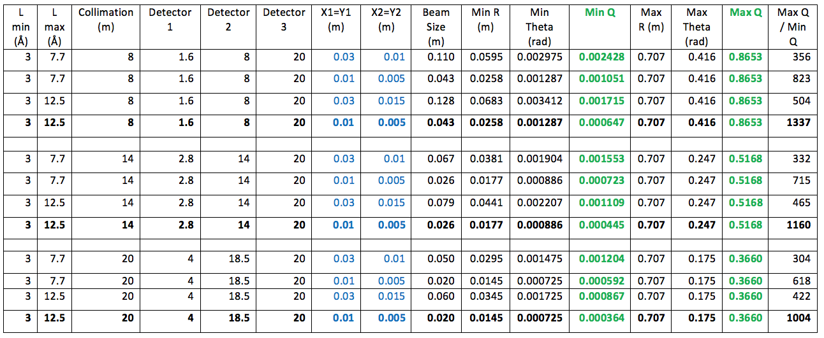
Q range / Bandwidth / Frame Overlap
$$Δt=\frac{Δλ∙D}{3.96}$$
${Δt}_{max}(14Hz)$ = 4.78 Å
Rear detector at 59.1 m ->
${Δt}_{max}(7Hz)$ = 9.56 Å
In order to meet HLR3 7Hz operation will be needed at 8m collimation.
Frame overlap/chopper leakage needs to be considered – could be done by having plan as to where a frame overlap mirror could be placed if operational experience shows it is a problem.

Slide 3
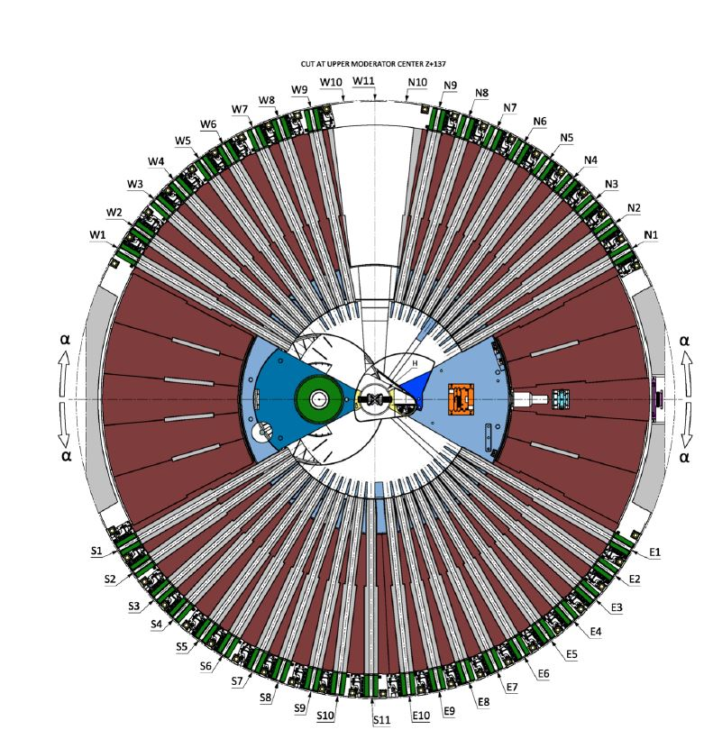
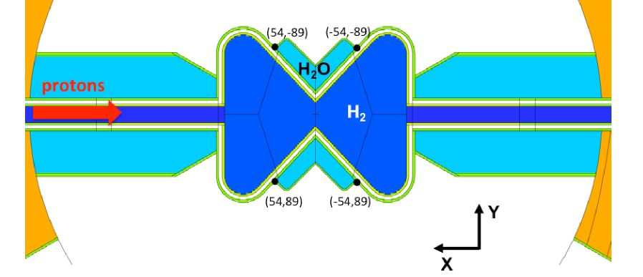
SKADI Beam Path
ESS - 0068256 23.09.2016
Beam extraction with respect to top moderator coordinates
X = 54mm
Y = -89mm
Z = 137mm
Z Rot = -42°
SKADI guide needs to point to ISCS here
SKADI – E3-Port
SKADI – E3-Port

Slide 4
High-Resolution requirement & choppers
15%
Standard-resolution configuration
High-resolution science requirement
ΔQ/Q
Δλ contribution
Δθ contribution
log Q

