Slide 1
ConOps and requirements
Rasmus Toft-Petersen
Liam Whitelegg

Slide 2
Bifrost motivation
Triple-axis spectrometer
Mono Flux | 10⁷-10⁸ n/s/cm²
Spatial angle | 0.015 steradians
Energy transfer | Single value
Bifrost
aims to perform
efficient overview studies with triple-axis flux:
Polychromatic beam,
large detector angular coverage and multiple analyser energies
makes this possible!
Time-of-flight
spectrometer
Mono Flux | 10⁵-10⁶ n/s/cm²
Spatial angle | 3 steradians
Energy transfer | Continuous
BIFROST
Poly Flux | 10⁹-10¹⁰ n/s/cm²
Spatial angle | 0.1 steradians pr. Ef
Energies pr Q-channel | Continuous
SE performance | Great

Slide 3
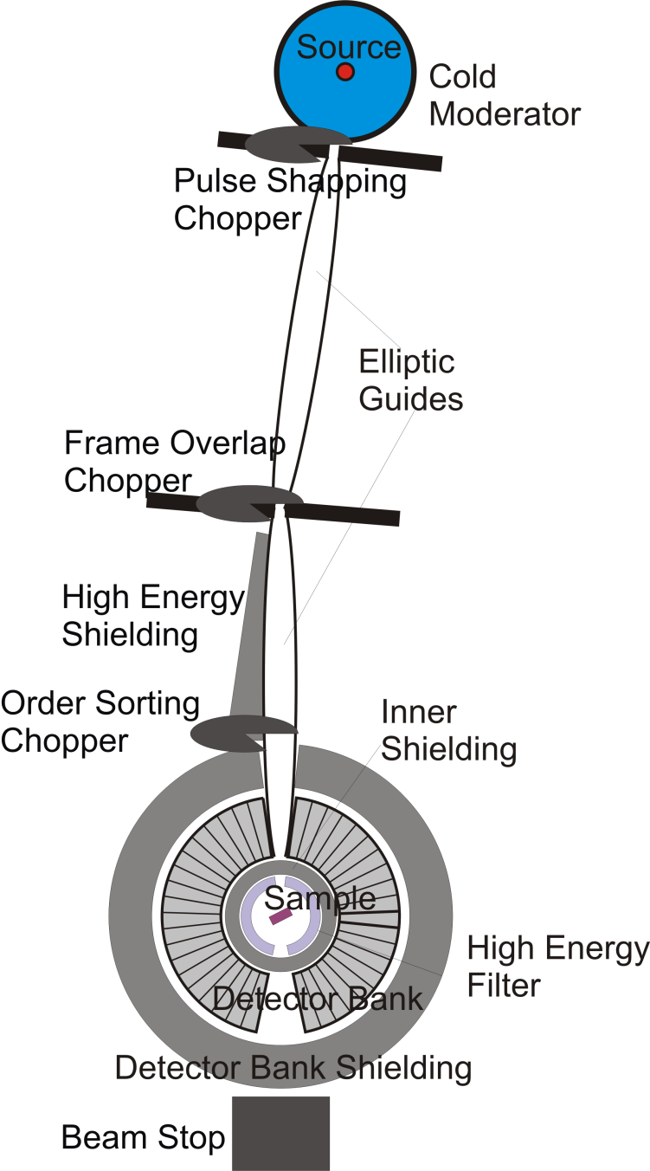
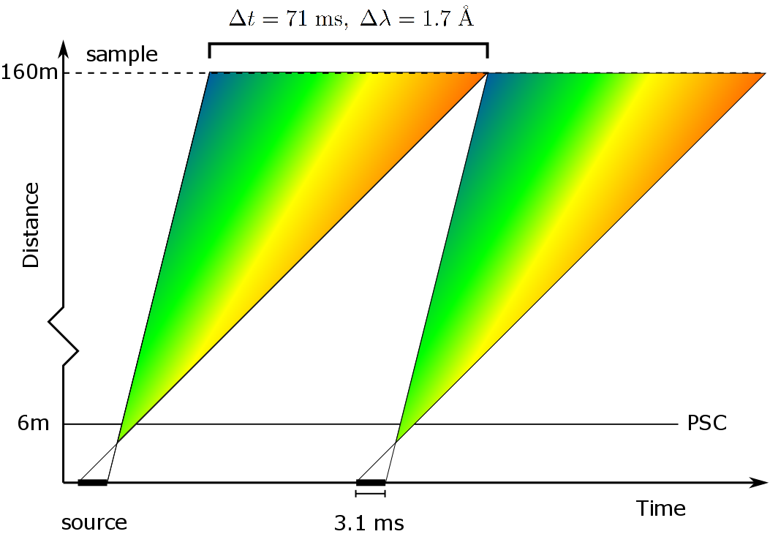
Operating principle: primary spectrometer

Slide 4
Scientific requirements
- ConOps
Flux optimization by 1-2 orders of magnitude (with similar resolution)
Flexible resolution in the entire dynamic range
Allow for single exposure mapping capabilities
Optimize for sample environment (field, pressure, composition)
Allow a large dynamic range
Allow for polarization (not in scope)
Allow a large Q-range to be reached at large energy transfers (not in scope)

Slide 5
High level system requirements

Slide 6
Preliminary System Design

Slide 7
Guide

Slide 8
Our choice for the BTCS
Good BG on CSPEC: 5 cts/s on 25 m^2
Good BG on Bifrost: 0.1 cts/s on 0.01 m^2 (Much better than impressive Thales per flux)
Prompt pulse on Bifrost:
MAGIC have 5 n/s/cm2 (Uwe Filges). Assume the same for Bifrost and 100 %
scattering at sample and 100 % detection. Overly pessimistic, but gives
0.01 cts/s on 0.01 m^2.
Lose LoS once, save shielding costs and minimize BG risks
Pancake moderator – optimise for vertical divergence of +/- 0.75 degrees
Standard spectroscopy + angular resolution of 2nd spectrometer:
optimise for +/- 0.75 degrees horizontal divergence (more is fine – divergence jaws)
Optimize for 1x1 cm^2 beam spot
PSC performance + feeder: VS after gamma shutter
Retain respectable BT at 1.2 Å if at little cost – improves science case
All this is price-optimized in guide bot, where we used quote based prices for Borkron,
aluminum-substrate and coating values. Number of alternative guides tested: 10⁵

Slide 9
Benchmark guide
Single ellipse after feeder
is our base of comparison.
Not chosen, due to:
1) T0 choppers needed
2) Increased guide and
shielding costs
BT maximum is 75 % and
short wavelength
performance good. Straight is good

Slide 10
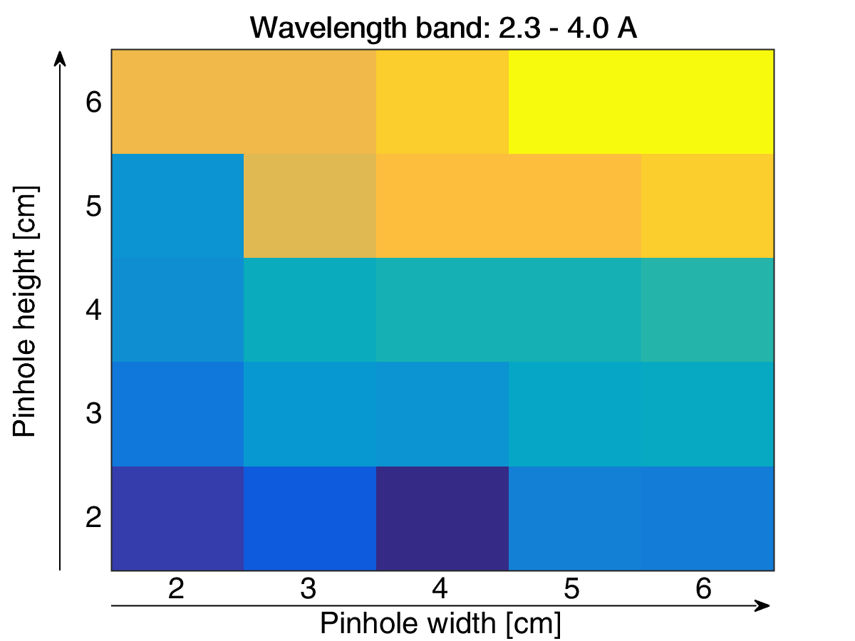
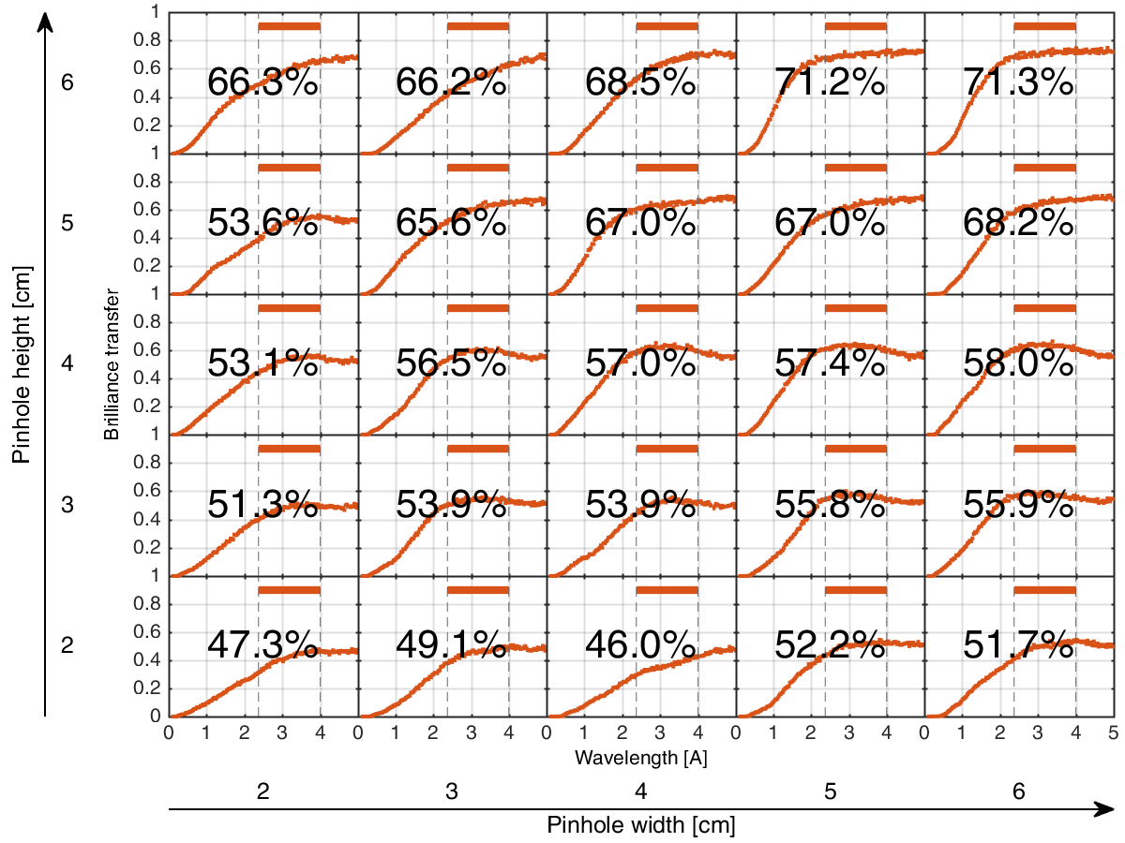
Virtual source
Using this general benchmarkguide and this phase space we minimize VS size to
optimize chopper performance and limit the prompt pulse
– an optimum for VS dimensions is found at 3x5 cm. These dimensions are fixed
in future simulations!
This limits maximum BT to around 66 % - new benchmark value

Slide 11
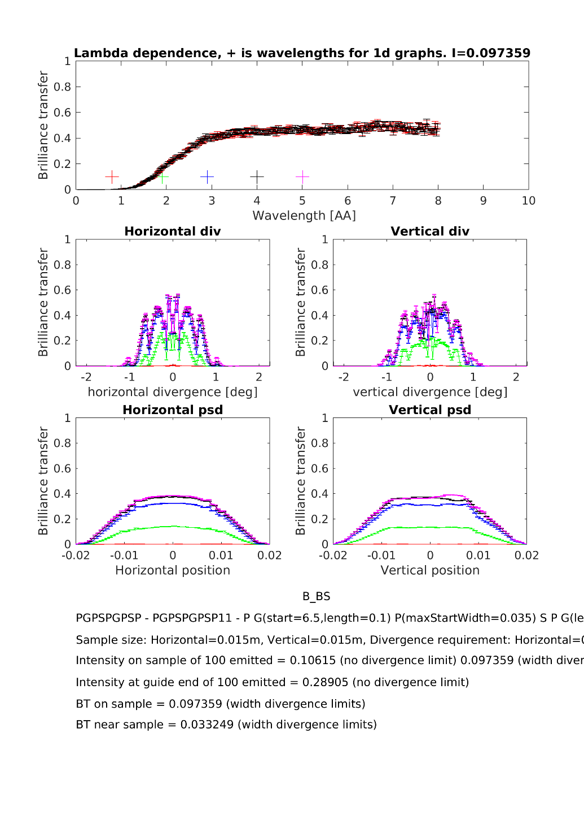
Killing the PPS guide
The ellipse dimesions are limited
by the bunker wall – we lose
too much!
Short wavelength performance
terrible, even at 2 Å we
lose too much

Slide 12
Kinked guide – a contender

Slide 13
Kinked guide – a contender
Lose LoS at 50 m
and still retain 60 %
That’s more like it!
Lovely phase space.
This guide led the race
at the end of 2016
Take a hit on biological
shielding budget

Slide 14
Dark horse - curved guide
NMX strategy
mitigates
fast neutron
risk

Slide 15
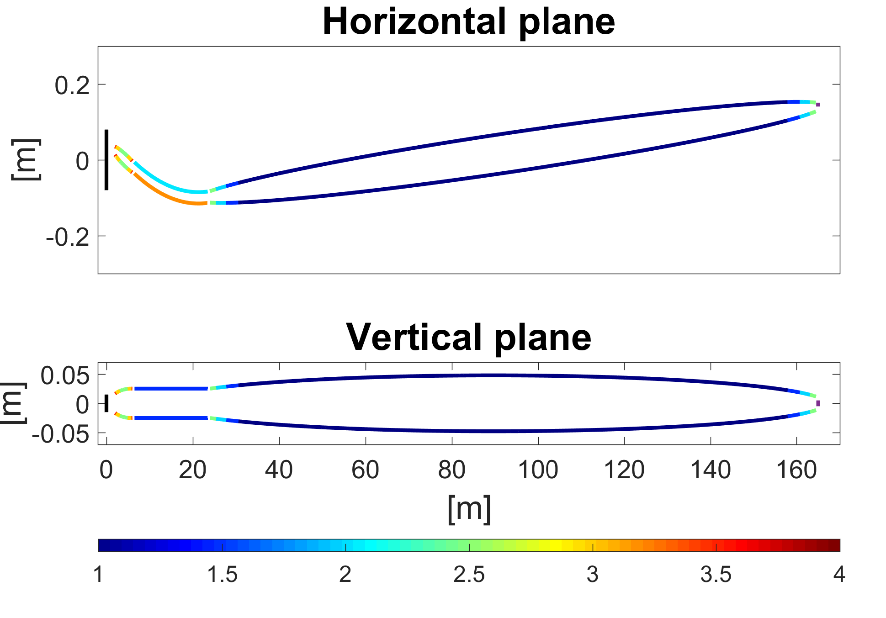
Curved guide - to scale
Cheap too!
Minimizes amount
of metal substrate
Rumor from Böni:
Metal substrate
prices declining!
Optimize in the
interval 1.5-4 Å!

Slide 16
Optimization results
Workhorse-range near optimal
for guide losing LoS
Decent thermal component
8*10⁹ n/s/cm² at 3 MW
20 times Thales
10 % of main flux at 1 Å – a science case stealer

Slide 17
Curved guide -

Slide 18
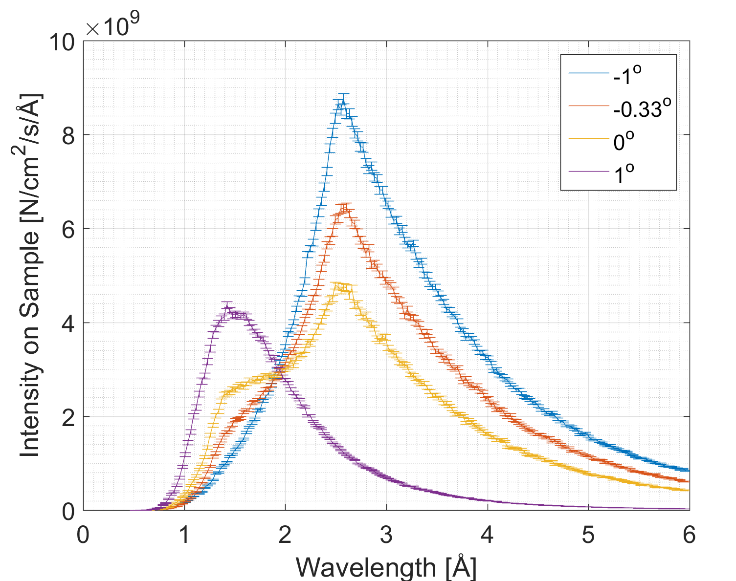
Curved guide -

Slide 19
Shielding

Slide 20
Shielding – prompt pulse
Prompt pulse irrelevant after 50 m. Rodion made a simple function describing the
DREAM spectrum from Valentina Santoro. Fully open and with loss of LoS
He used a worst case scenario of a parallel beam exiting the bunker – 10 x 10 cm^2

Slide 21
Kinked case
In the kinked case,
20 cm of steel and
50 cm of concrete
is enough in
this worst case

Slide 22
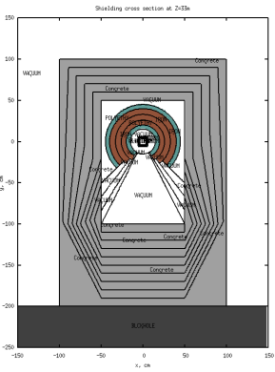
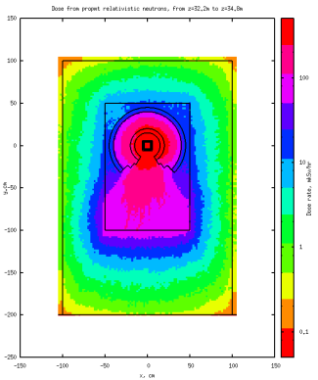
Bonus possibility
We need a concrete plinth in the D03 hall anyway. Make it a staircase and save steel…
Once the numbers are in (2 m source term ran through new guide)
– we optimize the geometry and start simulating

Slide 23
Preliminary conclusions for the
fast neutrons
In case of the kinked guide with prompt pulse outside bunker
wall, 3x5 cm aperture, divergent beam:
20-25 cm of steel – 50 cm of concrete
In case of losing LoS inside the bunker:
Depends on how you do it, but just by reducing the
magnitude of the prompt pulse by 2 orders of magnitude
gamma shielding requirements will dominate
Note: FLUKA simulations of the curved guide system from 2-50 m
is on the to-do list in 2017. However, the 5 cm strategy is kept

Slide 24
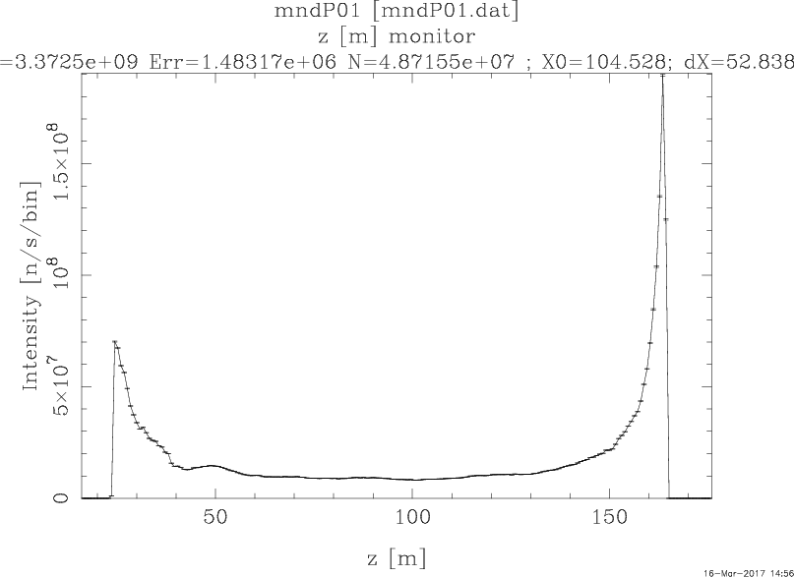
Turning to gammas
The easy part: Getting an idea of the number of lost neutrons pr m of guide – use McStas
This is basically the requirements
as a function of beamline
distance

Slide 25
Hard part: Hard gammas
Rodion looks at the incident and reflected neutron wavefunction at each layer,
and calculates the probabilty of reflection and transmission of the entire multilayer.
This gives the fraction of loss in the coating and hence hard gamma intensity from
Nickel and Titanium. He takes surface roughness into account.

Slide 26
Rodions results
We lose more neutrons
to the coating than we
originally thought. More
hard gammas at m = 1,
the advantage of having
m = 1 is slightly reduced
but nothing to panic about

Slide 27
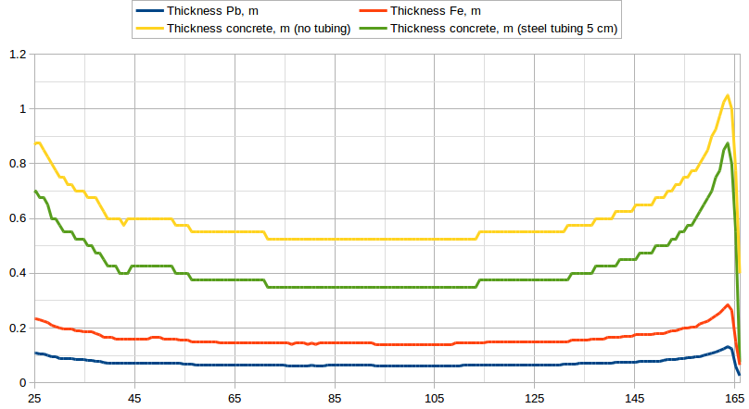
Shielding for gammas in D03
28.5-35 m: 15 cm of steel, 50 cm of concrete (Poly sandwiched – see liam)
35-45 m: 10 cm of steel, 50 cm of concrete (Poly sandwiched –see liam)
45-145 m: Economic steel/concrete mix (Liam)
145-162 m: 100 mm of lead, 30 cm of concrete (Liam)

Slide 28
Choppers

Slide 29
Chopper system
Three 14 Hz chopper
One double disc
face to face
Pulse Shaping Chopper
(PSC)
PSC determines
energy resolution of
primary spectrometer
Two FOC’s remove
unwanted frames
from PSC
One BW chopper
tailors the bandwidt
for long PSC opening times

Slide 30
Chopper system
PSC – double disc - face to face
CHIM: Horizontal split – Carbon fiber? – boron?
FOC’s CHIM: Horizontal split – Carbon fiber - boron
BW - CHIM: Horizontal split – Carbon fiber - boron

Slide 31
Radiation near monolith - Uwe
Failing high speed chopper near monolith
has a possibly huge impact, maintenance
uncertain.
Getting a number for absorbed energy
without biological weighting Wb:
MAGIC: Many neutrons above 2 MeV - Wb = 10
Some neutrons between 0.1-2 – Wb = 20
Some thermals as well – Wb = 5
We use an average of 10 – so MAGIC delivers
75 Gy/h neutrons and gammas – 400 kGy/year
Assume larger cross section for Bifrost –
1 MGy/year.
Macroscopic dose: 1 Megajoule per kilo!

Slide 32
Seal simulations - Stuart
Dose grows heavily
with beamport size
Very handwavy, but
using the beamport
dimensions of Bifrost
3x5 cm^2
We guestimate a
worst case cubic power law
300 Gy/h at the beamport
1.6 MGy/Year
Dose a disc center more
tricky – assume 5 Gy/h
30 KGy/Year
2 Gy/h for 6x6 cm^2
3600 Gy/h for 6x6 cm^2
50 Gy/h for 3x3 cm^2

Slide 33
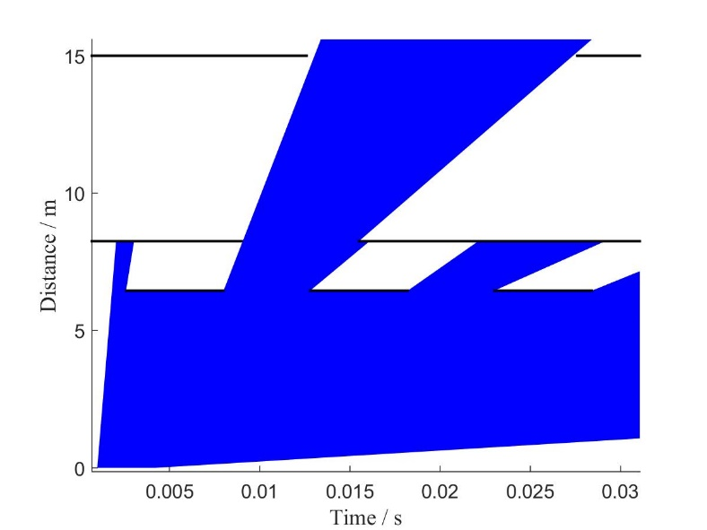
CFRP chopper disc
Counterwieght with balancing
screws: Epoxy 1
Coated area: Epoxy 2
Workhorse area subjected to
The range 1 MGy/year
Whatever happens if a counterweight
fails at 210 Hz, it can’t be good!
Can we fix broken guide? Etc.

Slide 34
Epoxy science from CERN
Epoxy durability under radiation
vary quite a bit.
Which ones are/can be used?
Àirbus cites 1 MGy, which
over an order of magnitude too little
Jülich: Kein problem
How freely can epoxy be chosen?
We would love a carbon fiber disc,
but what if we cant have it?

Slide 35
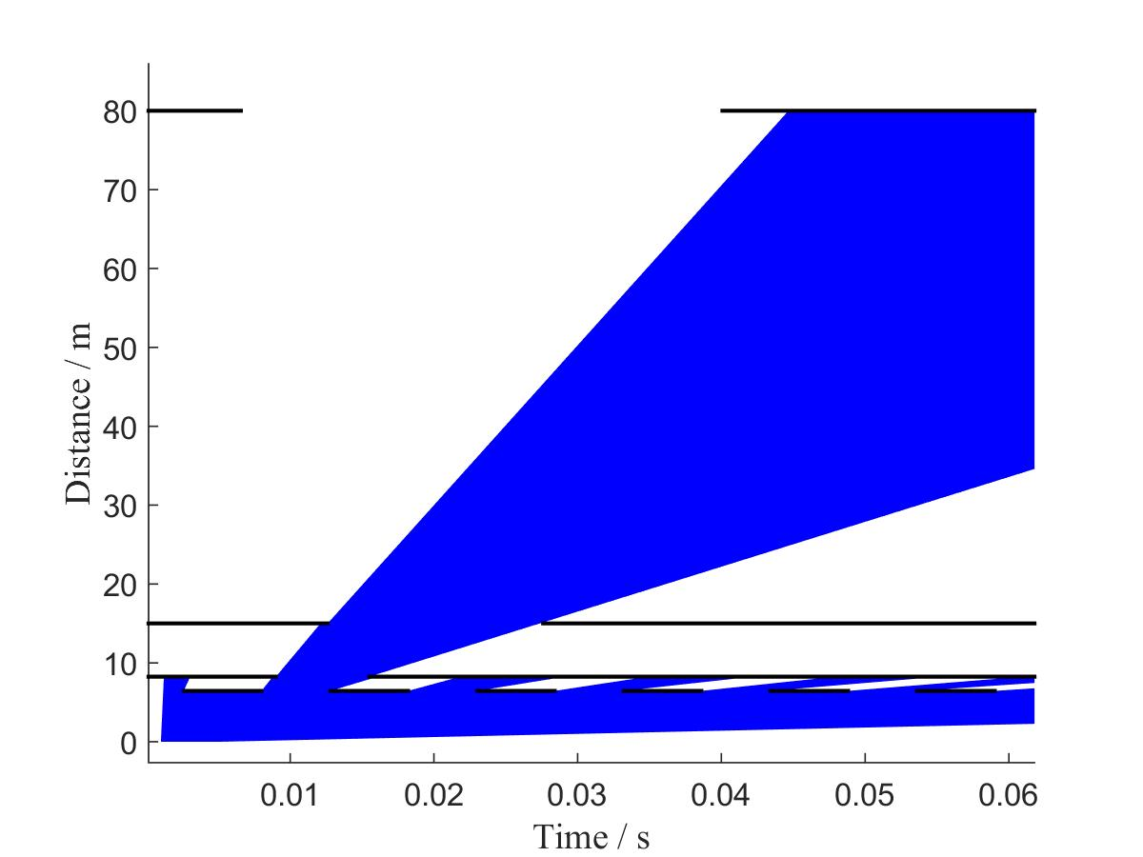
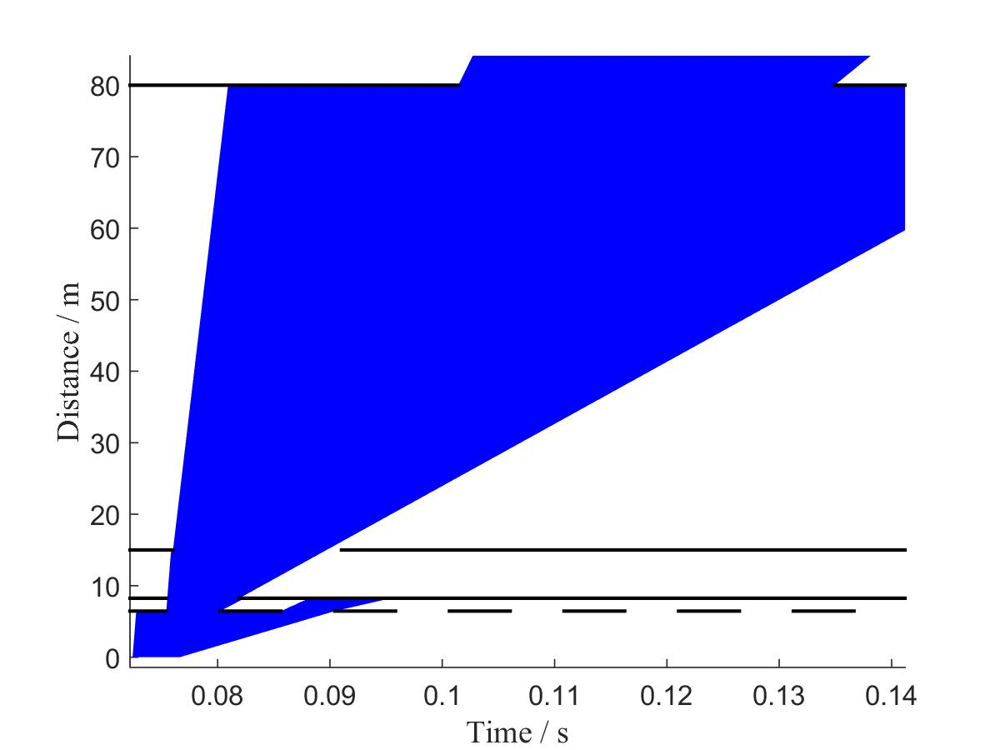
Mitigation
Primary risk: Violent chopper breakdown
Mitigation 1: ESS dialogue with Airbus to make them use the right epoxy
Mitigation 2: If this proves impossible, switch to aluminum discs and accept a hit
maximum frequency.
These should be coated with B or Gd, whatever bears the minimum risk of losing coating
due to radiation (Annoying and expensive but not catastrophic). Operating range: 1-6 Å

Slide 36
Beamline Overview

Slide 37
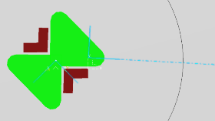
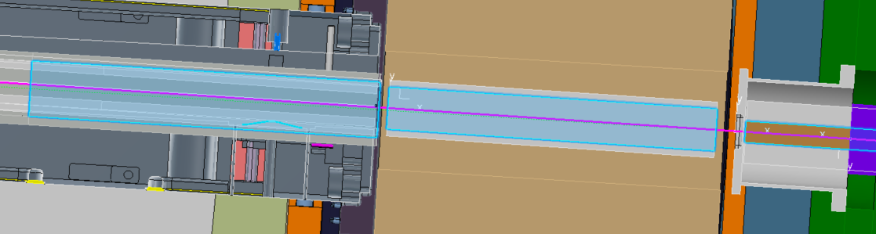
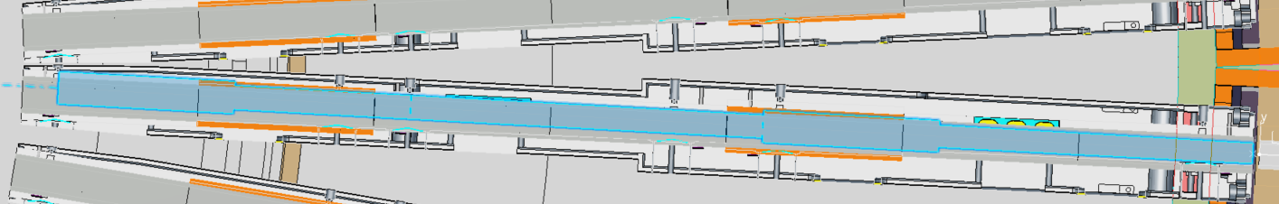
Beam Extraction
Elliptical guide starts @2m from TCS
Guide split into three sections within;
  Moderator Insert
  Bridge Beam Guide
  PSC Chim
Each section above is separated with windows
Insert currently starts 2m from source, not TCS
  Update on Tuesday
Also, potential interference issues highlighted
  Possible modifications required

Slide 38
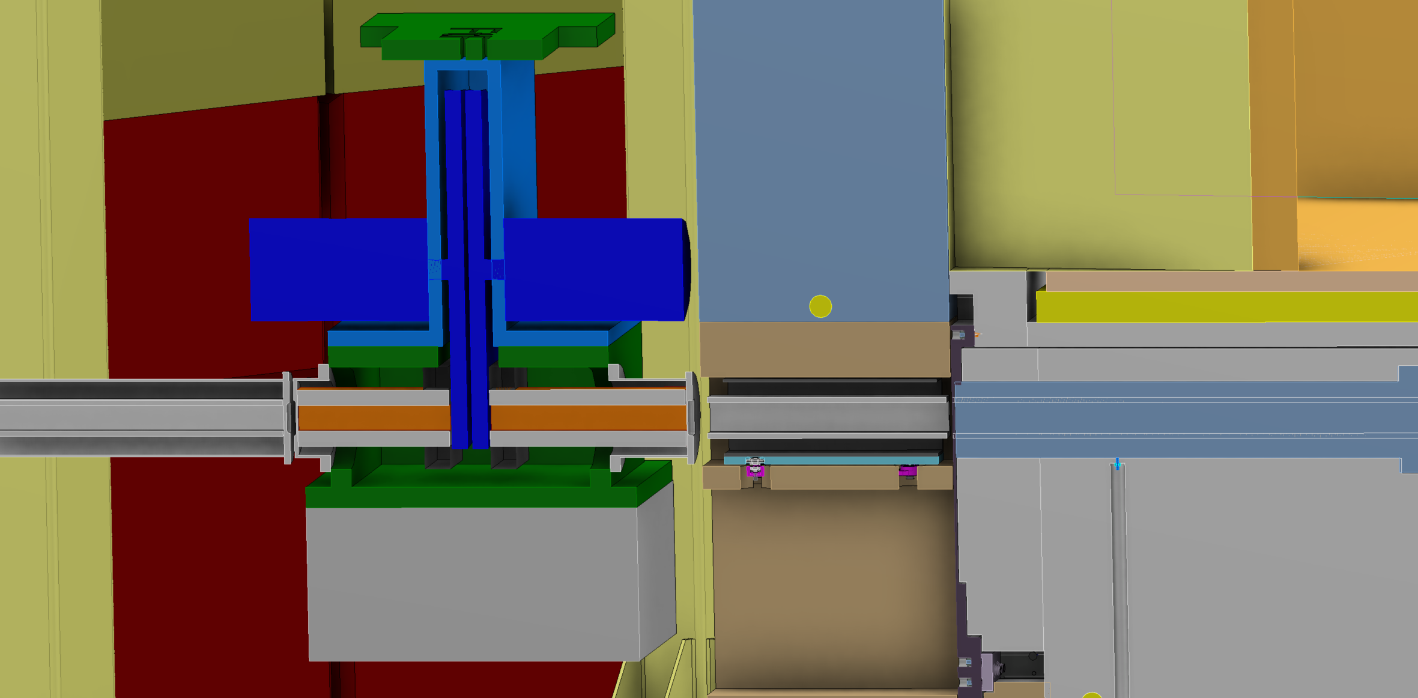
Pulse Shaping Chopper
Positioned @ 6.45m
Double disc, multiple frequencies
Guided lifting system to manoeuvre past monolith lip
Beam monitor positioned just downstream
Thick Cu guide (&/or W apertures) within CHIM to minimise fast neutron transport

Slide 39
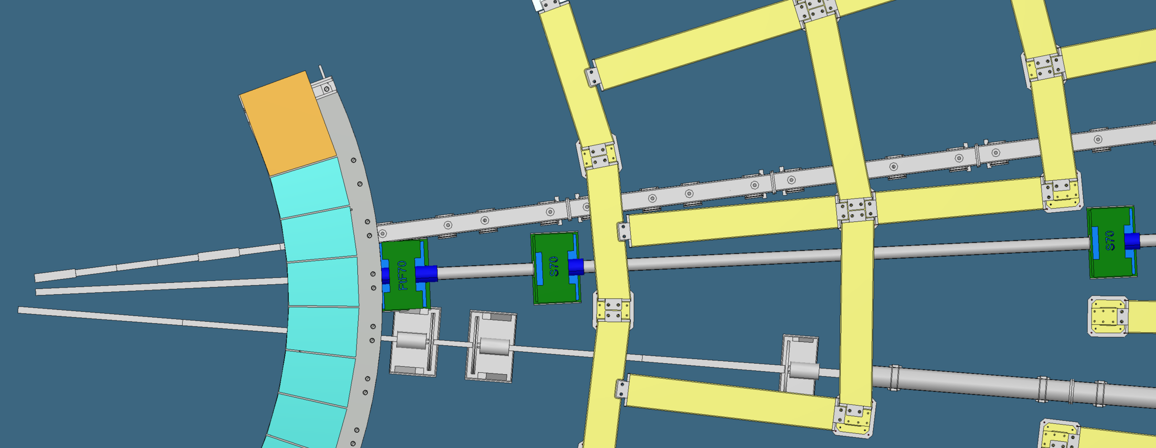
Bunker Integration
C-Spec bunker chopper positions currently unknown
  Minor clash with C-Spec guide housing
Miracles bunker chopper types and positions unconfirmed
  The below is latest model, but not positioned correctly
  Choppers actually 0.5m further downstream
  Anticipating minor clash, so future discussions necessary
Show Screenshot of bunker pillars and miracles choppers

Slide 40
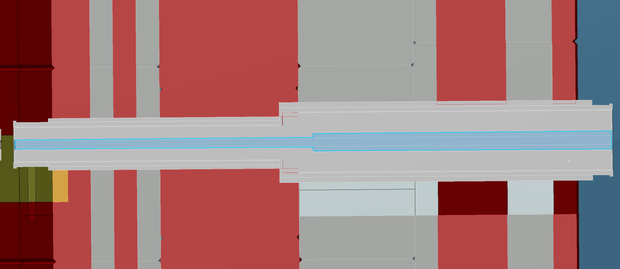
Bunker Wall Feedthrough
Tungsten collimation block just before feedthrough guide
Contains start of elliptical section
To be aligned and installed as per NSS guidance
Have yet to confirm aperture details with bunker team

Slide 41
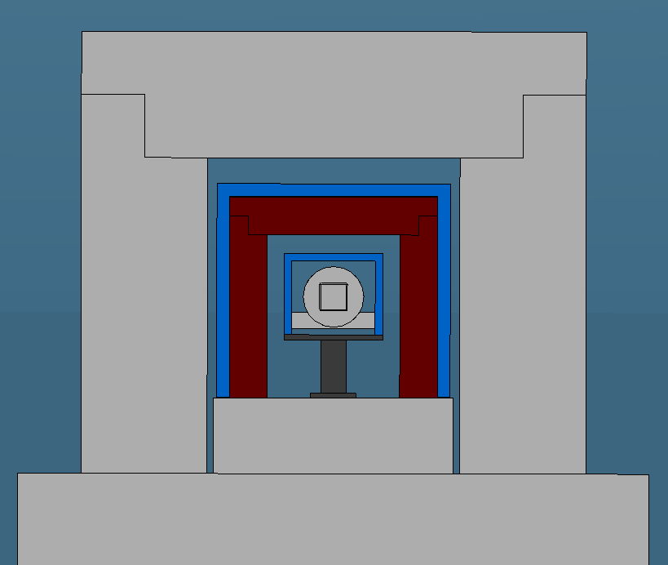
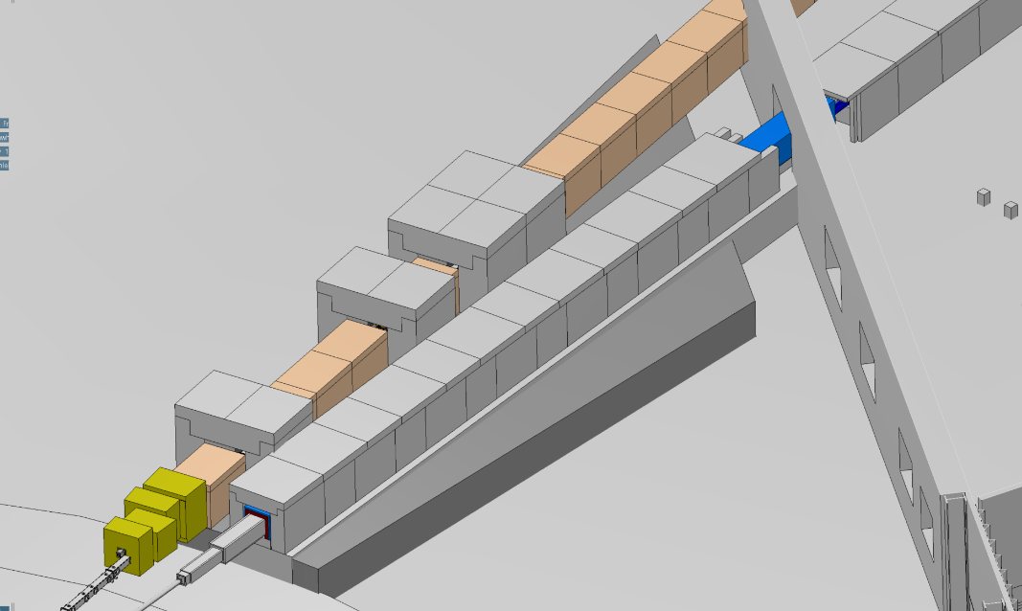
DO3 Guide Shielding
First 25m from start of bunker wall is expanding elliptical guide
Assume DO3 floor raised by 1.3m
Layered shielding, from guide housing;
  50mm Poly
  150mm Steel @ 28.5m to 35m, 100mm Steel from 35m on
  500mm Concrete
Additional poly layer being considered between steel and concrete

Slide 42
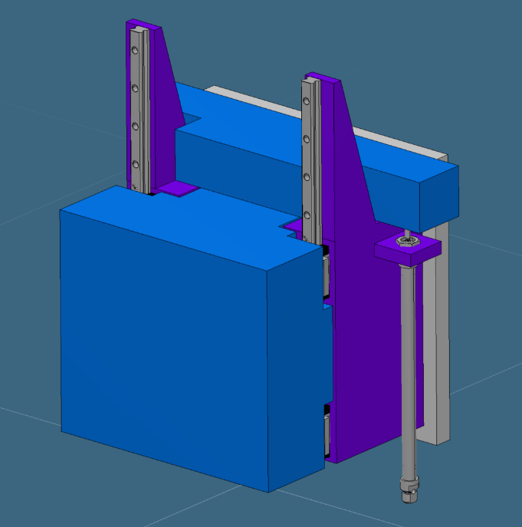
Thermal Beam Shutter
Positioned just after 50m in DO3
Thin neutron absorber followed by gamma suppression layer
Total depth along beam estimated at 80mm
Pneumatically operated and designed to fail safe
PSS linked
Potential to collaborate with NMX
Need to re-assess shielding in designated location

Slide 43
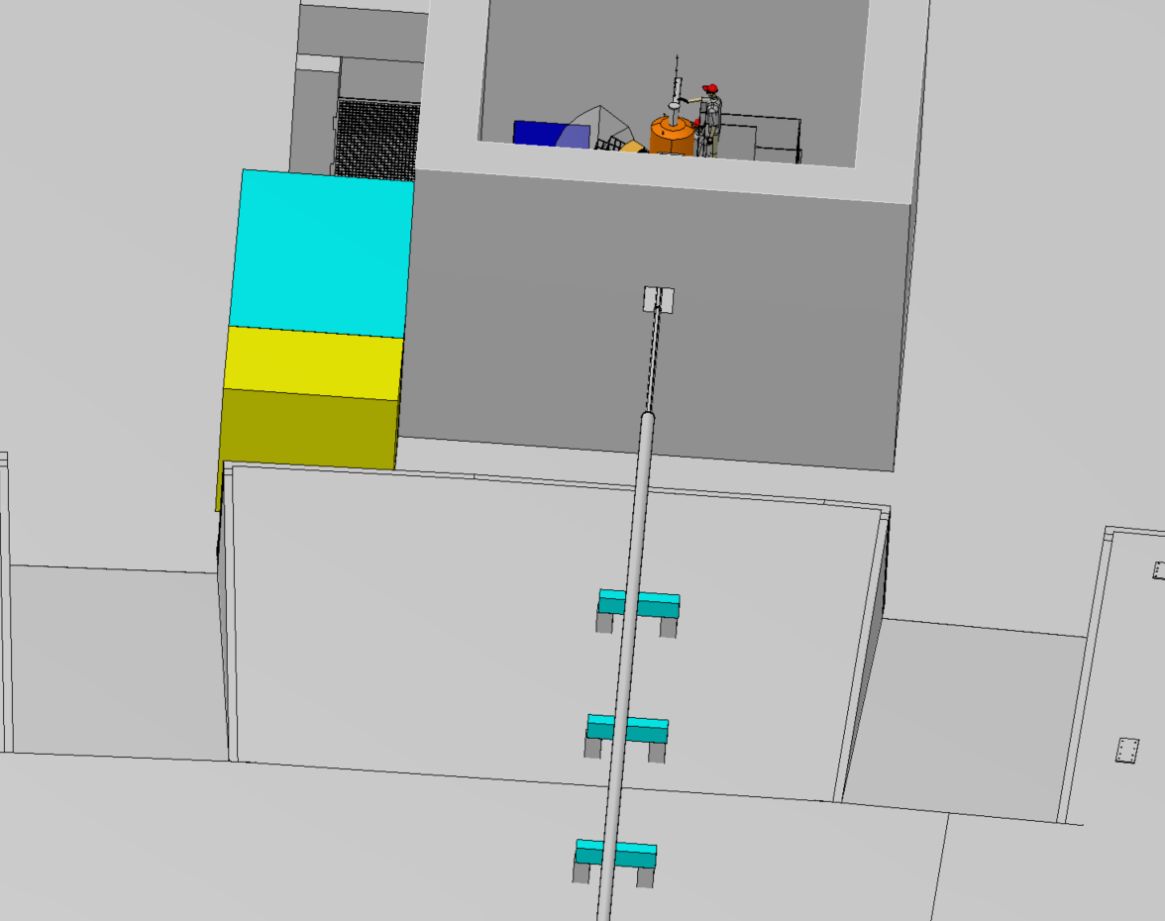
EO2 Guide Assembly
Whilst bending horizontally, the guide stays well within piling corridor

Slide 44
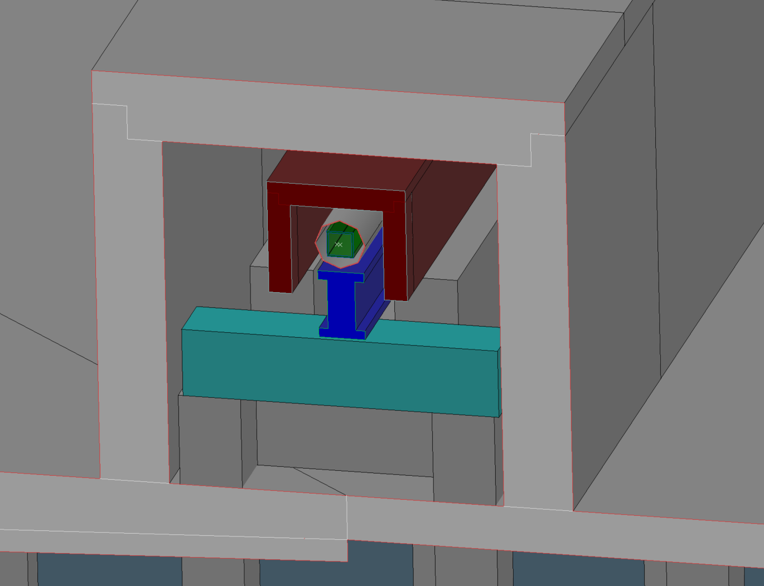
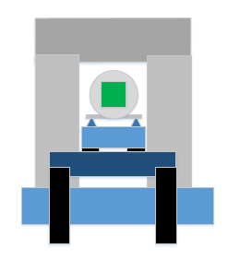
EO2 Guide Assembly (to 137m)
Guide will be supported on beams straddling the piles
2 shielding options currently being considered
  100mm steel sat on concrete base & 300mm concrete outside piles
  650mm concrete outside piles
Currently considering costs
Requires further simulations

Slide 45
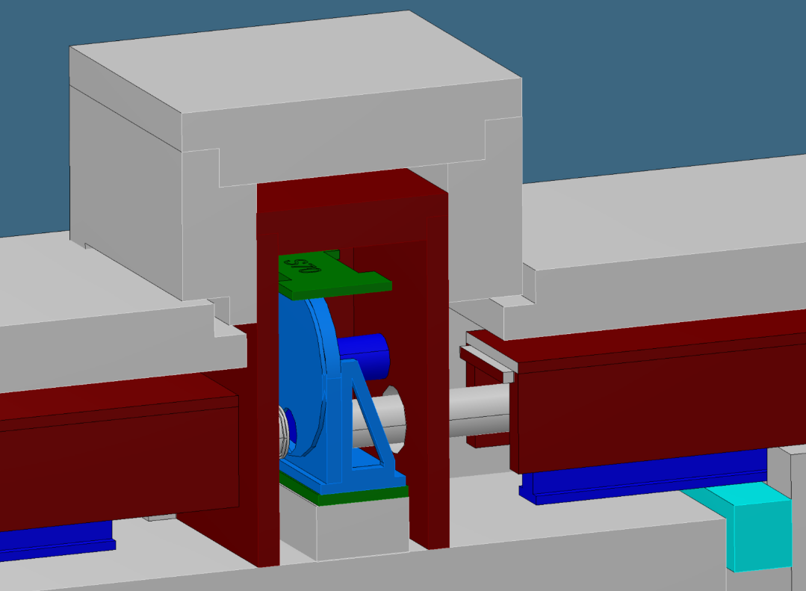
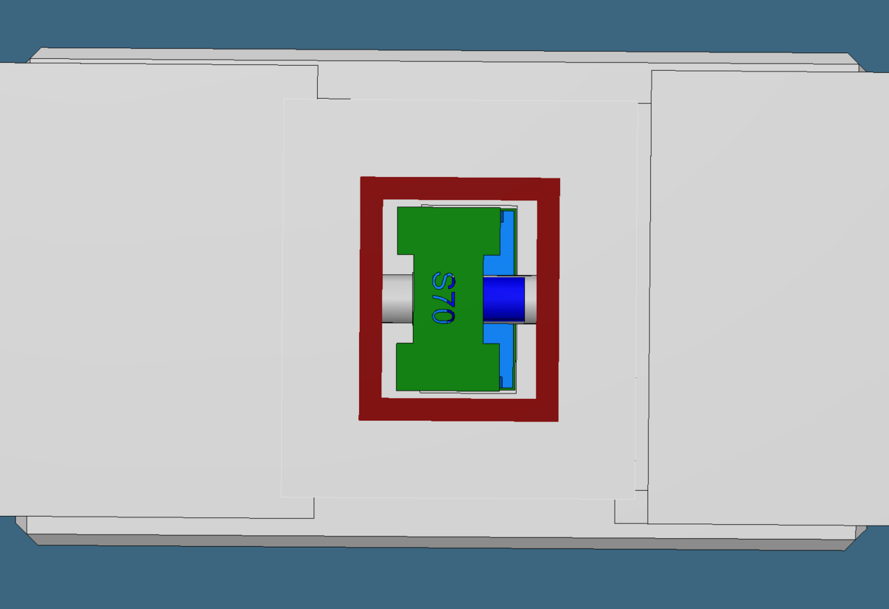
BWC Assembly
Positioned at 79m
Single disc, 14Hz
Currently considering 100mm Fe and 300mm concrete shielding
Weight of shielding = 28 tonnes

Slide 46
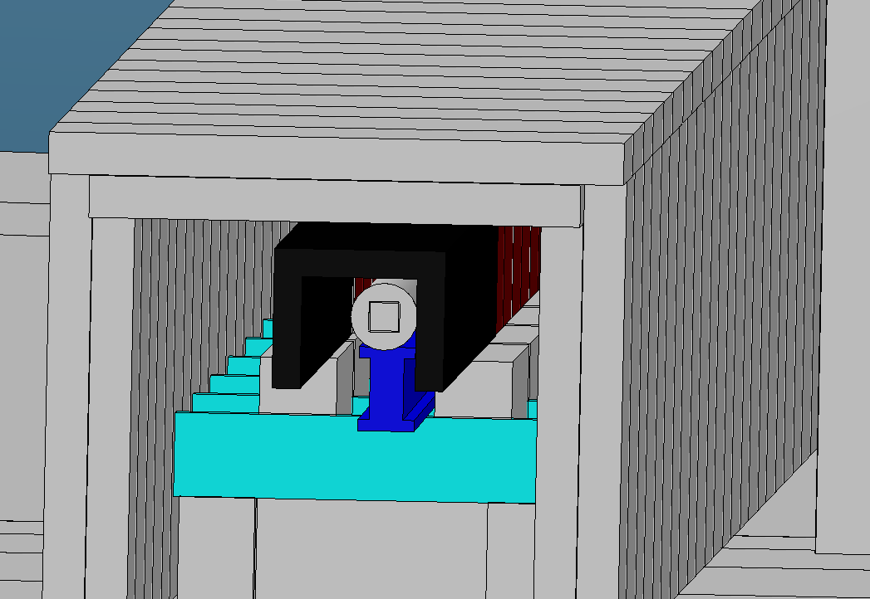
EO2 Guide Assembly (final 25m)
Guide will continue to be supported on beams straddling the piles
Focussing ellipse section starts
Upgrades could include polarisation pit here, so shielding to be non-magnetic and modular
Shielding = 100mm lead (to replace steel) & 300mm concrete
3 sets of divergence jaws from 152 to 160m

Slide 47
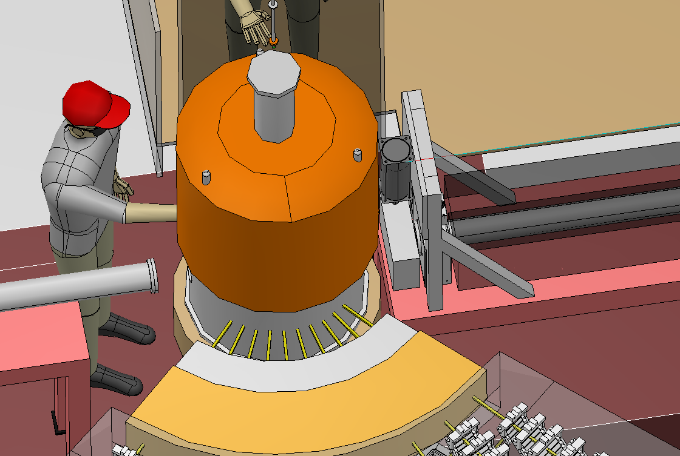
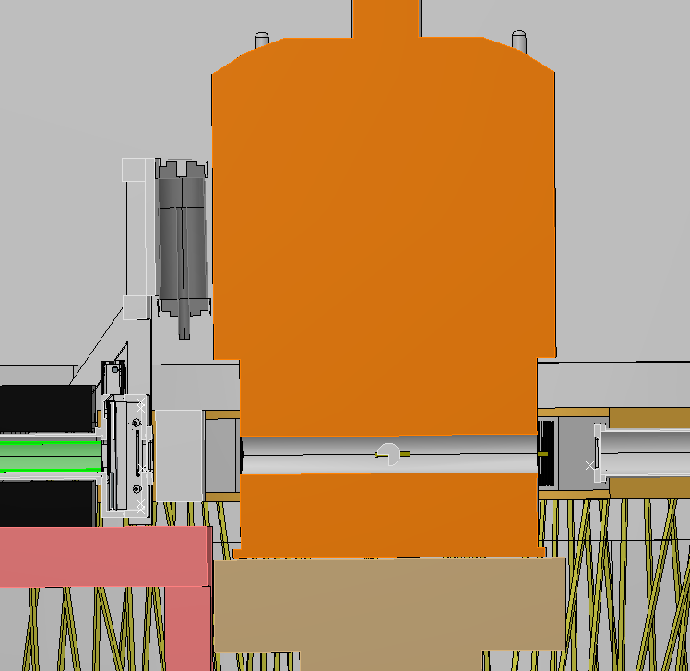
Sample Position
Sample slits just before beam
Sample stage, with 5 tonne capacity and 1 rotational axis (around z)
Any height adjustment to be through adapter blocks
Guide pins to ensure vertical, safe lifts
Lead shutter at sample position to protect from active guides/windows etc.
Lead needed along guide to reduce gamma background on detectors.

Slide 48
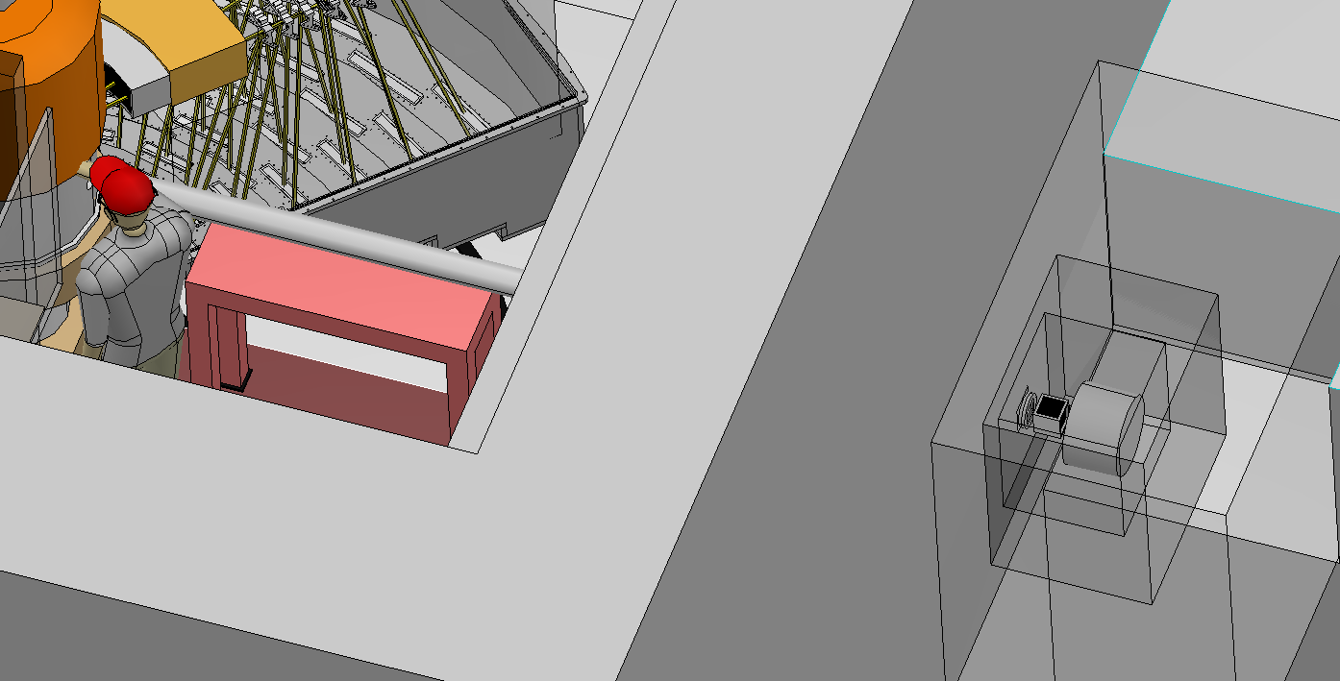
Beam Stop Assembly
Long get-lost tube to be used to minimise instrument back ground
Ability to change tube length, dependant on sample environment being used
Vac pipe lined with poly and incorporating B4C masks
Poly beam stop sits outside the cave
Beam stop encased with Pb & concrete
2D radial collimator to minimise
backscatter

Slide 49
Secondary spectrometer

Slide 50
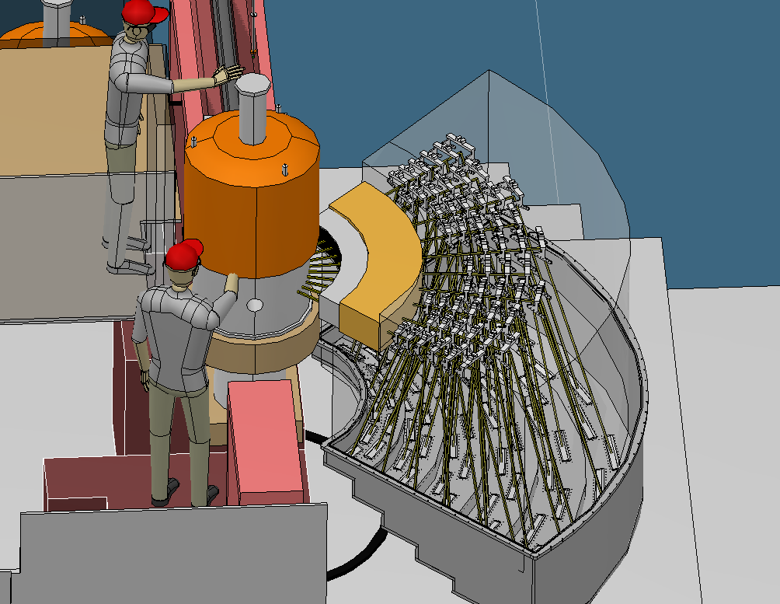
Compact secondary spec
Spectrometer
vacuum tank
Be filter
Radial
collimator

Slide 51
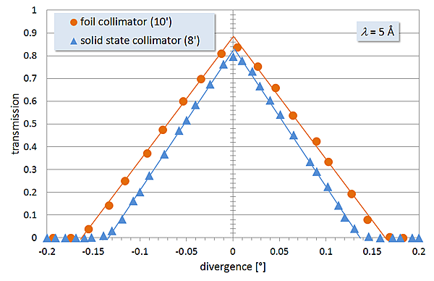
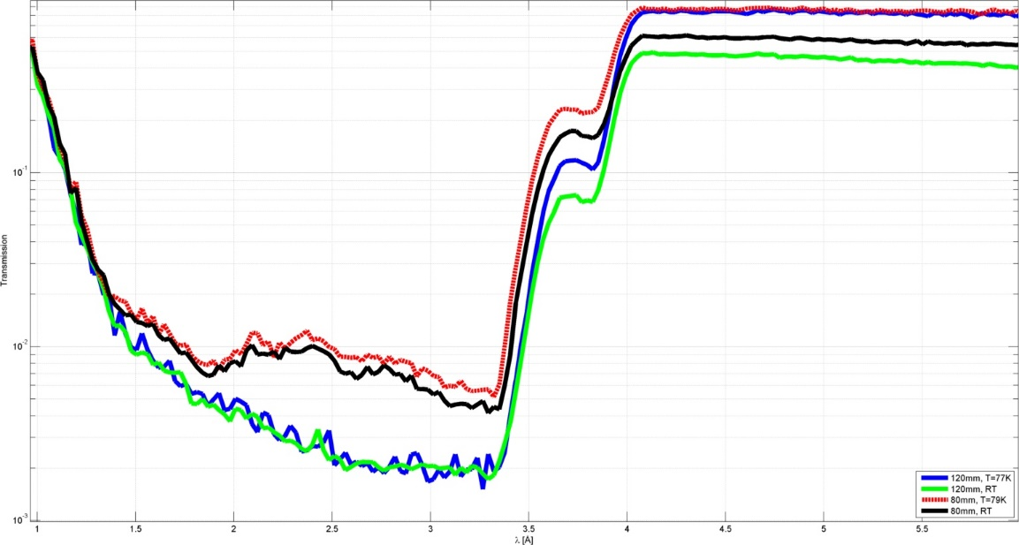
Filter and collimator
Radial collimator removes
VTI background, to be
replacable with wide angle
p-analyzer
Be-filter should be translatable
out of the plane for alignment
and high energy tests.

Slide 52
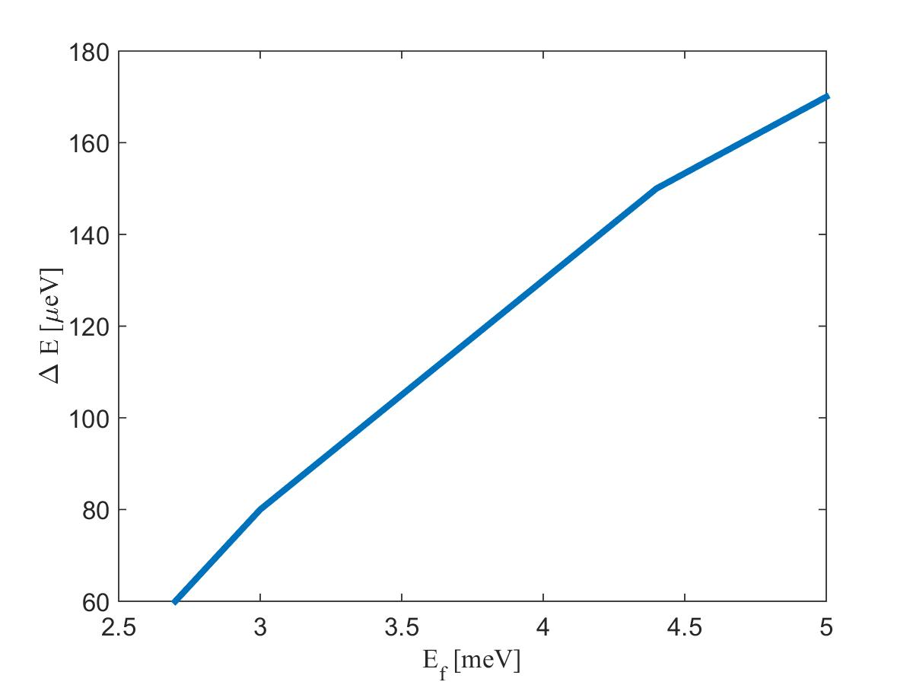
Analysers
Only 4 analyzers in scope.
We need minimum and maximum
energies (resolution and intensity)
Cut 4.4 and 3.4 meV for the price
of 150 k€ - 1st priority if contingency
allow it. A lot of work for peanuts.

Slide 53
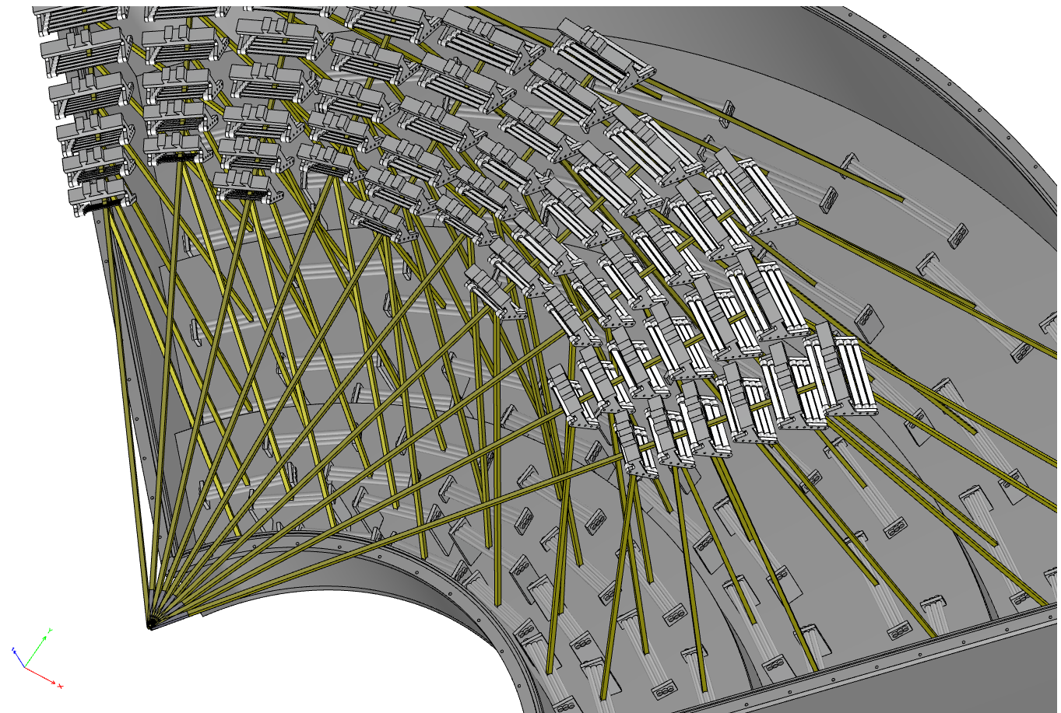
Analyzers

Slide 54
Coverage

Slide 55
Cross talk shielding
Aggressive cross talk shielding
Two options:
1) Optimistic close packing
2) Paranoid
We go for paranoid

Slide 56
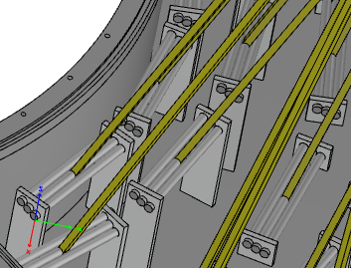
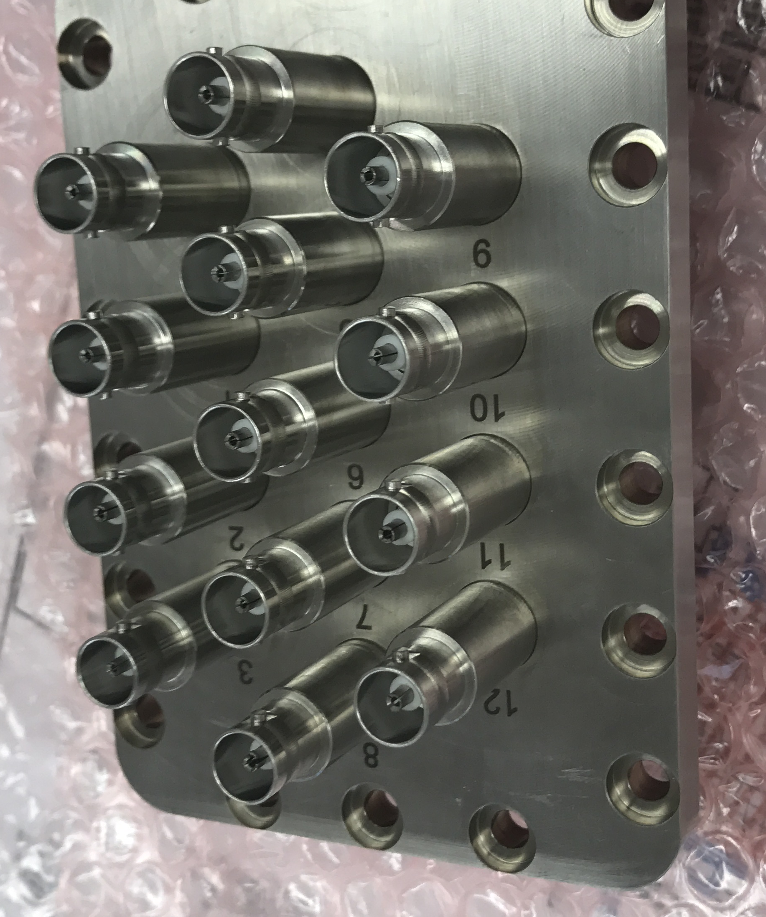
Detectors – problem 1
Option 1: Have detectors in High vacuum with
feedthrough flanges. Commercial(ish) solution
Advantage: Flexibility
Disadvantage: Need high vacuum (paschen minimum)
Low accessibility

Slide 57
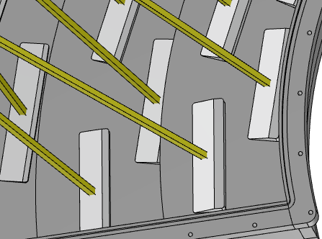
Detectors
Option 2: Detectors in air
Advantage: Safe, simple, easy, accessible
Disadvantage: Inflexible, aluminum and air in the beam (not really a problem)

Slide 58
Detectors
Option 3: Weld detectors onto vacuum tight flanges
Advantage: Detectors can be in low quality vacuum
Disadvantage: Price, inaccessible, and stricter
tank deformation requirements

Slide 59
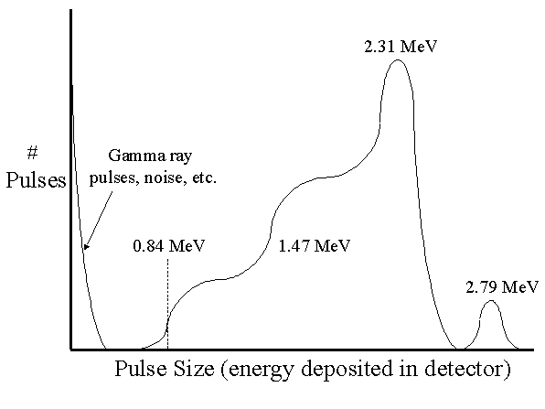
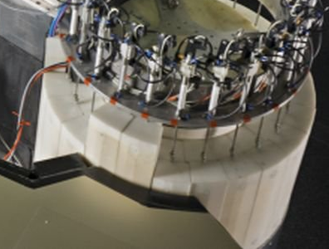
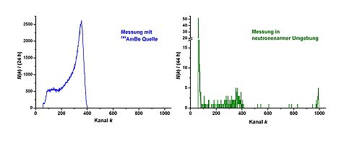
Background – problem 2
Gammas give background – we will
have an unprecedented amount
Neutron mean free path in air is 10 m
Aluminum Bragg peaks. We have a neutron
gas -> paranoid shielding

Slide 60
Background strategy
Thales TAS gets down to roughly 1-3 cts/min on a single tube detector
Bifrost could get 30-50 cts/min integrated – by scaling.
However, we have an evacuated beam path and are much
more stationary than a TAS – only one relevant moving part.
Design a paranoid beamstop – avoid airscattering of primary beam
Design detectors to anticipate both Al- and substrate gammas
Thorough shielding, use doglegs, use boron in high-flux areas, flexible cadmium
where necessary in low flux areas – even Gd-paint
Focus on interfaces: Filter/tank, HV-feedthough, cables
We hope for 5 cts/min, would increase our gain factor even further

Slide 61
Radiation issues at Bifrost
Rasmus Toft-Petersen

Slide 62
Dose limits for supervised area
1. The expected annual biological full body dose to a person from normal operation and likely accidents, during the time the room is accessible, is between 1 mSv and 6 mSv.
2. The expected annual dose to lens or eye of a person from normal operation and likely accidents is between 15 mSv and 45 mSv.
3. The expected annual dose to a persons’ hands, feet, ankles or skin form normal operation and likely accidents (H2 event), is between 50 mSv and 150 mSv.
4. Removable surface contamination is not significant from a radiological point of view

Slide 63
Peak dose limits
Dose limits in an hour – one sample change operation:
75 uSv on extremities – our limit for a sample change: 25 uSv
25 uSv on lens of eye – our limit for a sample change : 8 uSv
2 uSv on full body (SAD) our limit for a sample change : 2 uSv
Assume that we handle the loaded cryostat on top for 60 seconds
Assume sample out in the open for 15 seconds:
Out in the open is 20 times more intense than top-handling and thus comprise the majority of the dose.
2 mSv handled out in the open for 15 sec gives 8 uSv to the lens of the eye assuming 30 cm distance.

Slide 64
Logic for identifying problems
Include all isotopes but focus on repeated offenders in typical science cases:
Magnetic elements or High-Tc
High activation cross section
Exclude half lives below 15 min (vanadium, aluminum – difference between normal
TAS and Bifrost is 1 hour more of waiting)
Exclude half lives well over 5 years (low activity – problem for user, not for Bifrost)
Focus on gamma emitters
This narrows down the list. For instance - Points 2 and 4 makes Ni-63 irrelevant
but not Co-60. A few surprises: Cobalt and silver are user problems, not Bifrost problems
Focus on Manganese (nuisance), Lanthanum (a real problem) and
Iridium (possible deal breaker)

Slide 65
List of typical compounds
Mn2Si3 ☹ (60%)
LaSrCuO4 ☹ ☹ (50 %)
Ba3InIr2O9 ☹ ☹ ☹ (30 %)
LiMnPO4 ☹ (50 %)
LiCuSbO4 ☺
CuCoSbO6 ☺
CaCrO3 ☺
Co2VO4 ☺
Fe2VO4 ☺
DyTiO3 ☺
TbMnO3 ☹ (30 %)
TbNi2B2C2 ☺
YBaCuO4 ☺
CsCuCl4 ☺
TbPO4 ☺
LaFeAsO ☹ ☹ (50 %)
NbCo2O6 ☺
CoTa2O6 ☺
Ce3Pd20Si6 ☺
Gd3Ga5O12 ☺
Ce3Cu4AsO2 ☺
URuSI ☺
☹ ☹
☹ ☹ ☹
☹

Slide 66
Worst case analysis
Probability of bad element: 25 %
Probabilty of near-full flux: 60 %
Probability of large crystal with more than 1 g of isotope: 35 %
Overall – 1/20 will be problematic
Conclusion:
2 mSv/h an acceptable worst case, if only done 10 times a year:
80 uSv on lens, 200 uSv on hand.
1/500 of regulation – plenty of room within Swedish law.
There will be a few cases exceeding this dose rate:
Examples: 1 cm^3, 10^10 n/s/cm^2, 10 days of irradiation, after 1 h:
LSCO: 3 mSv/h - LiMnPO4: 3 mSv/h (Down after 6 hours)
Ba3InIr2O9 : 6 mSv/h – (1 mSv after 2 weeks!)
20 g copper sample holder – 5 mSv/h

Slide 67
Dealing with the radation
Keep activity in the cave
Design for manual handling of cryostat (ambitius sample environment)
Employ permanent shielding around sample position
– limit body dose (contrary to TAS)
Schedule problematic Mn experiments before sample environment changes
Schedule problematic La experiments at the end of cycle
(1 weekend cool down)
In extreme cases, be able to remove sample environment from a distance
to a shielded place where more complex handling is feasible
with more vertical space and retaining access to sample table

Slide 68
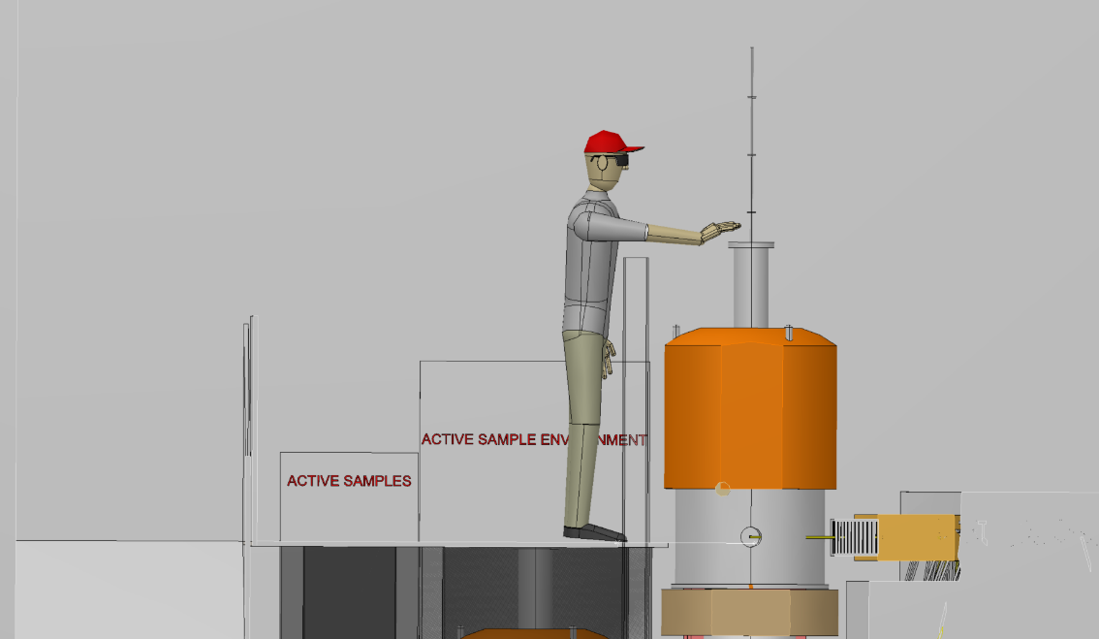
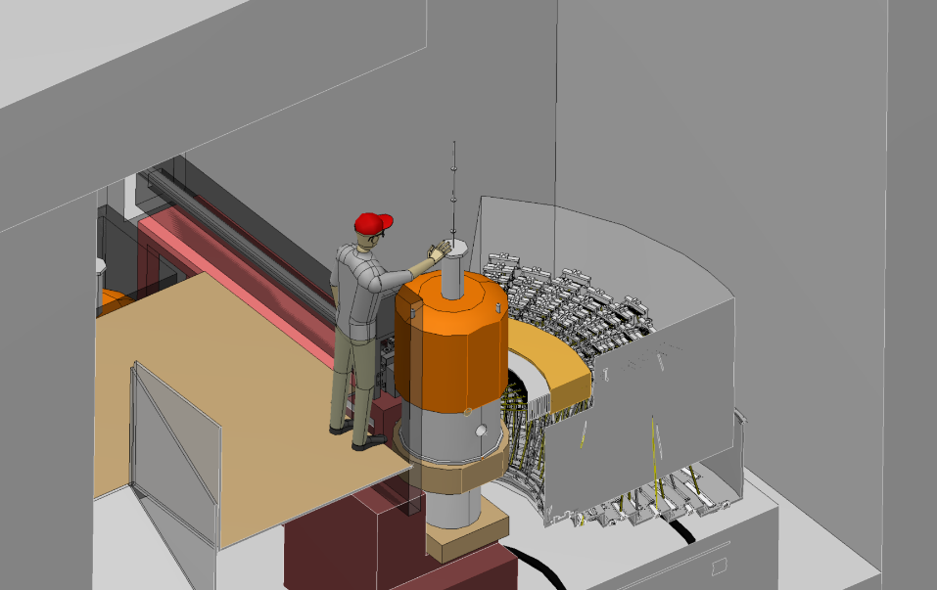
Sample Change
Samples to be assessed before experiment for potential activation
If active samples or SE possible, entrance to be conducted with health physics monitoring
If levels are reasonable, then the sample can be removed and changed in situ
Access to the magnet flange is from the upper level, behind 100mm lead shield
Body core is behind shield, limiting exposure to extremities
Once the sample is out of the magnet, it can be dropped into a shielded casket nearby
Casket can then be stored in the sample cemetery
Spare sample sticks can then be utilised for next sample

Slide 69
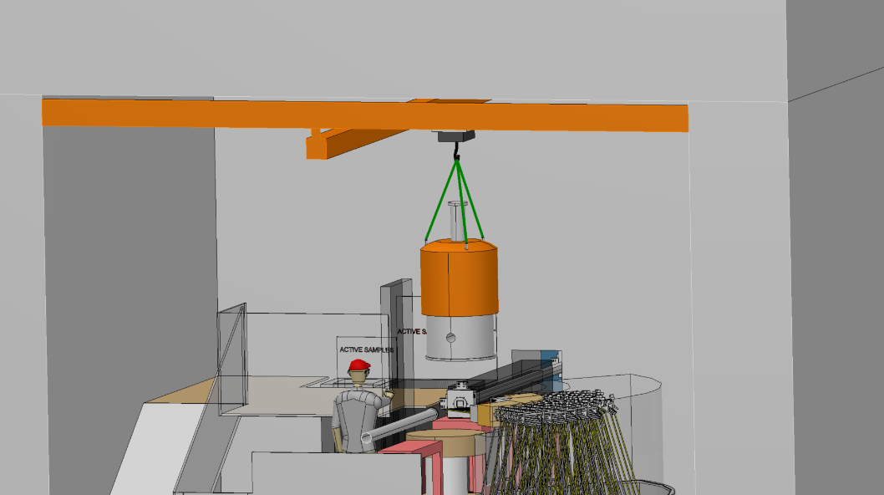
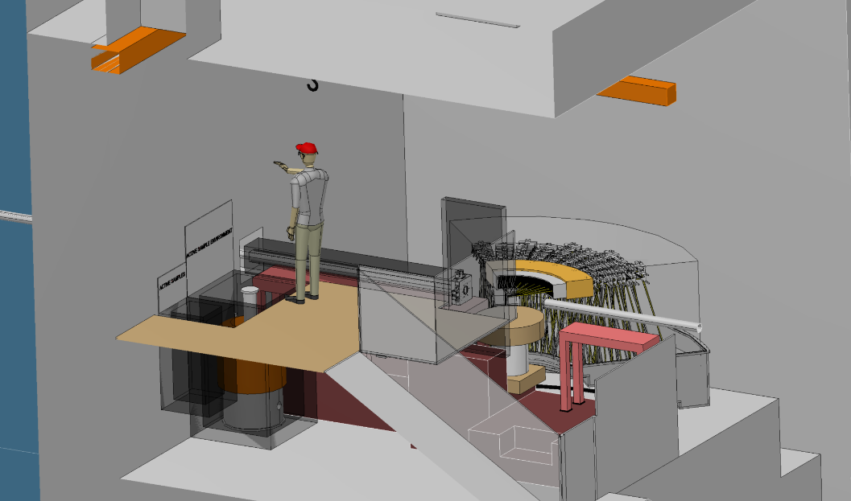
Sample Change
New procedure available for when higher activation is expected or measured
Magnet to be craned to designated magnet storage area remotely
  Crane operator stood in designated areas with clear visibility
  Guide pins to ensure safe and controlled crane operation
  Lifting frame attached to magnet (before experiment) allowing hook engagement
Designated area to be encase equipment within lead shielding
Benefits of this area include;
  Unrestricted access around the cave whilst activation decays
  More space, crane height etc. to design jigs, temporary shielding and procedures

Slide 70
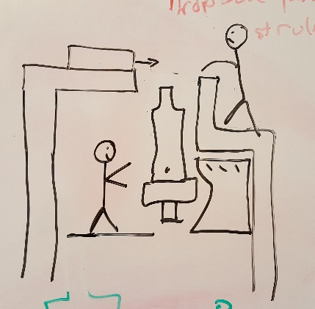
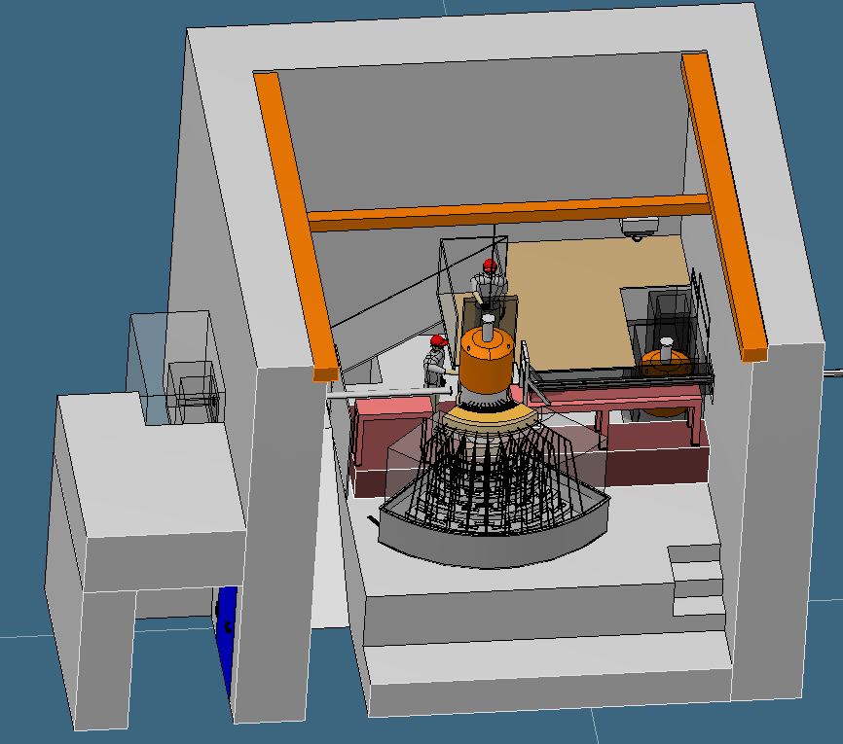
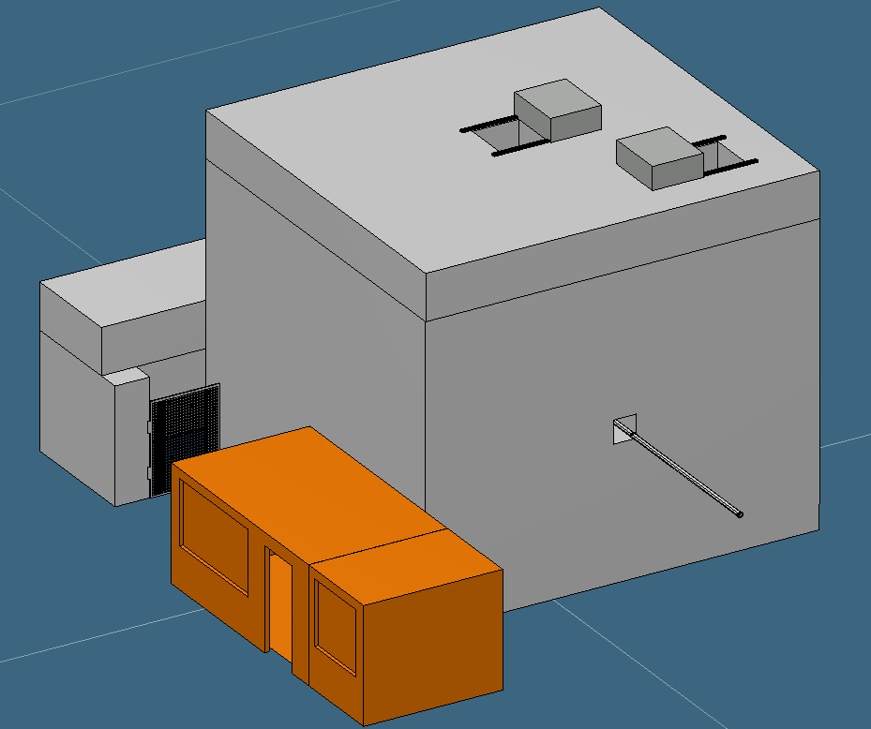
Cave – Design Assumptions
General sample change frequency = 2 to 3 days
Polarisation upgrade anticipated, hence non-magnetic environment
Samples and SE will become active
  Active items contained within cave
  Procedure for moving and storing active SE within cave required
  Procedure for changing and storing active samples required
Cd in the beam is likely, hence H1 event
Predominant SE = 15T Magnet
Consistent floor loading of 20t/m²

Slide 71



Cave Information
Internal footprint = 6m (along beam) x 6.5m
Baseline shielding = 1m thick concrete with boron lining
Heights (from EO1 Hall Floor)
  Internal = 6.45m
  To top of roof = 7.45m (+ handrails/access hatches)
Cranage options – EO1 Hall Crane and Internal, 2 Tonne Crane
Entrance through labyrinth (neutron door + access restricting door)
Currently two access hatches in the roof for SE
Total weight of shielding = 613T (21.1T/m²)

Slide 72


Cave Integration
No integration issues foreseen with C-Spec, Miracles currently an unknown
Considering moving the control hutch into EO2
Sample prep area to be added
7.5m+ from back wall

Slide 73
Work Package Specification

Slide 74
Project Partners
Total of 5 project partners, each responsible for specific components
Simplified breakdown summarises as below;
DTU & CPH - 3 923 k€
  Sample Exposure System, Slit Systems, Vacuum Tank and Cave Infrastructure
PSI - 3 700 k€
  Optics and housings, Analysers and Be Filter
LLB - 2 600 k€
  Choppers, Detectors, Beam Monitors and some Sample Environment Kit
IFE - 2 878 k€
  All Biological and Guide Shielding, Beam Stop and Neutron Collimators

Slide 75
Risks – Old Version
Submitted version was too pessimistic
Also requires splitting into;
  Function
  Cost
  Schedule
Risk | Categories | Prob. | Effect | Risk Level | Mitigation | Responsible
Delay in Monolith or Bunker delivery | Budget & Schedule | 4 | 5 | 20 | Keep up-to date with NSS schedules | ESS
Unexpected hall or bunker floor deformations | Budget, Schedule & Function | 3 | 5 | 15 | Design for future maintenance and large adjustment range | ESS & Instrument Team
Budget over-runs | Budget & Function | 3 | 5 | 15 | More contingency moved to DK budget so cash, not in-kind. | Instrument Team
Inadequacy of beamline shielding | Budget, Schedule & Function | 2 | 5 | 10 | Contingency space left in high-risk areas, verified calculations | ESS & Instrument Team
Activation of long half-life samples & components | Budget, Schedule & Function | 2 | 5 | 10 | In cell, hot storage area to be designed. Restriction on materials within cave | Instrument Team
Late delivery of detectors | Budget, Schedule & Function | 3 | 3 | 9 | Early procurement | Instrument Team
Delay in PSC or FOC delivery | Budget & Schedule | 2 | 4 | 8 | Prioritise design and procurement | Instrument Team
Changes to integration features i.e. Bunker, Monolith, | Budget & Schedule | 2 | 4 | 8 | Keep up-to date with NSS design changes | ESS
Delay in delivery of key optic components | Budget & Schedule | 2 | 4 | 8 | Early design confirmation and procurement | Instrument Team
Malfunction of key component within Bunker | Budget, Schedule & Function | 2 | 4 | 8 | Design for robustness and maintenance. Significant testing before installation. | Instrument Team

Slide 76



Risks - Updated

Slide 77
Schedule - Milestones
ID | Progress Milestones | Projected Date
1 | Start Phase 2 (Detailed Design) | May-17
2 | Optics Early Procurement TG3 | Sep-17
3 | Start Phase 3 (Procurement) | Mar-18
4 | Divergence Jaws Delivery | May-19
5 | Analysers Delivered | Jul-19
6 | Sample Table Delivery | Jul-19
7 | Start Phase 4 (Installation) | Aug-19
8 | EO1 Guide Installed | Sep-19
9 | Detectors Delivered | Sep-19
10 | Vacuum Tank Delivery | Oct-19
11 | EO2 Guide Installed | Nov-19
12 | Bunker Guide Installed | Dec-19
13 | Thermal Shutter Installed | Dec-19
14 | Cave Installed | Dec-19
15 | DO3 Guide Installed | Jan-20
16 | Choppers Delivered | Jan-20
17 | Beam Stop Installed | Feb-20
18 | Bunker Work Complete | Mar-20
19 | Guide Shielding Installed | Apr-20
20 | Detector Installation | Nov-20
21 | Installation of Detector Electronics | Mar-21
22 | Spectrometer Assy Complete | Jun-21
23 | Cold Commissioning Complete | Jan-22
24 | PSS Installed | Mar-22
25 | Start Phase 5 (Hot Commissioning) | Jun-22
Changes to original submission in red
ID | External Milestones | Projected Date
1 | Monolith Insert Delivered to ESS Site | Nov-18
2 | Monolith Insert Ready for Installation | Mar-19
3 | Access to EO1 | Apr-19
4 | Access to EO2 Area 1 | Apr-19
5 | Access to EO2 Area 2 | Oct-19
6 | Access to West Sector Bunker | Nov-19
7 | Access to DO3 | Nov-19
8 | Bunker Closed | May-20
9 | First Beam to Target | Oct-20
10 | Instrument Commissioning Beam | Feb-21
11 | Scheduled User Run | Aug-23

Slide 78
Schedule – Early Procurements
The monolith insert installation and bunker closure milestones are seen as key.
In order to keep on schedule, early procurement of the following items are required;
  Feeder optics
  In-bunker guide
  Bunker wall feedthrough
  PSC and both FOCs
One mini TG3 to cover all of the above?

Slide 79
Budget
Phase 1 included in documentation

Slide 80
Staging Plan

Slide 81

Calibration and normalization
Gold foil for flux (tricky with white beam)
Vanadium line widths and normalization
Steep phonon for Q-resolution?
Use known magnet dispersion to look at resolution effects
Try to resolve phonons in Germanium
Try putting on a magnet and resolve a gap closing with field

Slide 82
Early science – cold
Observing a Higgs
Amplitude mode
at H = 0 in high pressure

Slide 83
Early science – near thermal
What can we
learn if we
could follow
this through
Tc?!
High-Tc

Slide 84

But let’s see!

Slide 85

Staging – magnet, polarization
S-bender and cryoflipper
just before last focusing section
of the guide where divergence is low
After sample, we consider
Heusler or wide-angle polarizer
LLB is looking into feasibility

