Slide 1
Luminescent Materials for
Proton Beam Imaging
Thomas Shea
Cyrille Thomas
Young Joong Lee
Monika Hartl
And the Luminescent materials collaboration
www.europeanspallationsource.se
26 April, 2017

Slide 2
Layout
Large Collaboration
Luminescent Coating Development
Planning and Project Schedule

Slide 3
Large Collaboration
Luminescent Coating Development
ESS BI: project lead, support in all areas
ESS Target Division and NSS: Material scientists: advise, environment and material lifetime calculations, R&D luminescent materials
Oslo University: measurements, XRD, low energy proton beam, photo-luminescence, thermal characterization
HV: Develop coating process, prepare samples, industrialisation of process
BNL: BLIP (isotope facility), high energy proton Irradiation test (under RADIATE collaboration)
GSI: heavy ion facility irradiation, expertise in luminescence materials
SNS: high power target, share expertise, common interest
Stony Brook University: coat SNS target, process and material development
Los Alamos National Lab: Post Irradiation exam, XRD, High energy Proton beam
J-Parc: proposed collaboration, low energy ions facility,

Slide 4
Luminescent Coating Requiremements
The photon yield: predict signal signal intensity and signal to noise ratio and related image quality
The emission spectrum: the photons wavelength (or energy) is of prime importance.
  It should be in an efficient range for the readout image systems
  It should be on a different from the proton beam induced fluorescence of the (residual) gas environment.
The luminescence lifetime: should be less or much less than 1µs in order to perform a still image of the beam on the moving target
Radiation tolerance: the luminescence properties should remain sufficient to permit minimal imaging performance along the life of the coated component
The temperature dependence: the luminescence yield at should be understood. The SNS coating has a strong dependence on temperature, and at 473K its luminescent yield is dramatically reduced
Luminescence from secondary particle: neutron, gamma, and other hadron particles may distort the beam density profile
Mechanical properties: compatibility with the coating process and strength of the coating
Vacuum compatibility: outgassing rate of the material should be acceptable for the vacuum system

Slide 5
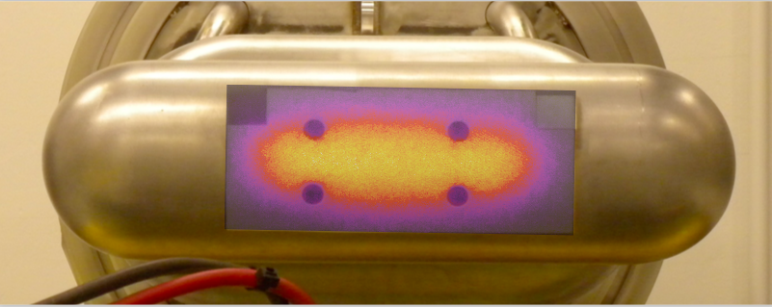
Candidate Materials
SNS material:
  Al2O3:Cr
Additional materials:
  Y2O3: successfully plasma coated (HV)
  Y2WO6: successfully produced (ESS)
  lanthanide doped Y₂WO₆
  Y2O3:Pr / Y2O3:Ce
  Others

Slide 6
Luminescent Material Down-Selection
Current Status
0
Coating process compatibility
Luminescence Properties
Radiation Tolerance
Industrial Coating process
0
Radiation Tolerance
Spectrum ≢ gas spectrum
?
Ideal Material
∞
Luminescence Lifetime
1
Luminescence Yield
0
∞
0
∞
0
1
Temperature dependency
SNS Al2O3:Cr (Not anymore produced)
Vacuum Compatible
HV Al2O3:Cr (SNS like)
Y2O3, Y2WO3 and doped materials
More materials in the pipeline
0
∞

Slide 7
SNS material luminescent properties
Photo-luminescent and proton-luminescent spectra
Investigation on ‘oxygen lines’:
Sharp lines at 777nm and 426nm
Short lifetime (<1µs)
Almost constant intensity along lifetime of the material
O lines
He lines
O lines
Spectral measurement on end of life and freshly installed SNS Target
Ruby lines measured and characterised
Proton and photo emission spectrum comparable

Slide 8
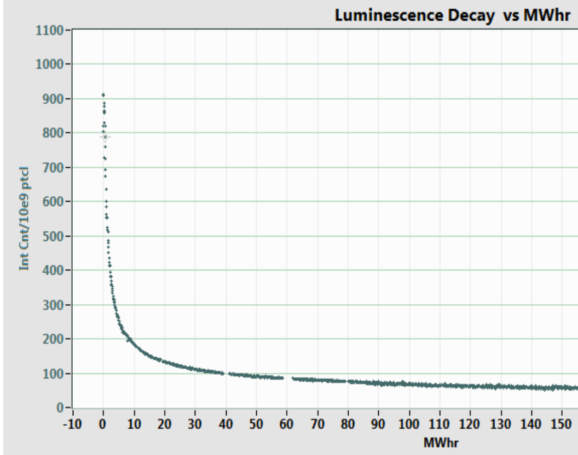
Irradiation with no activation
SNS luminescence vs. dose
Heavy ion irradiation of SNS coupon at GSI
lifetime
Thermal effect on luminescence
SNS TIS intensity
Structure and composition
SNS coupon sample
Degradation from heavy ions
10¹² U -> 1.8 10⁻³ DPA
0.002 DPA
0.1 DPA

Slide 9
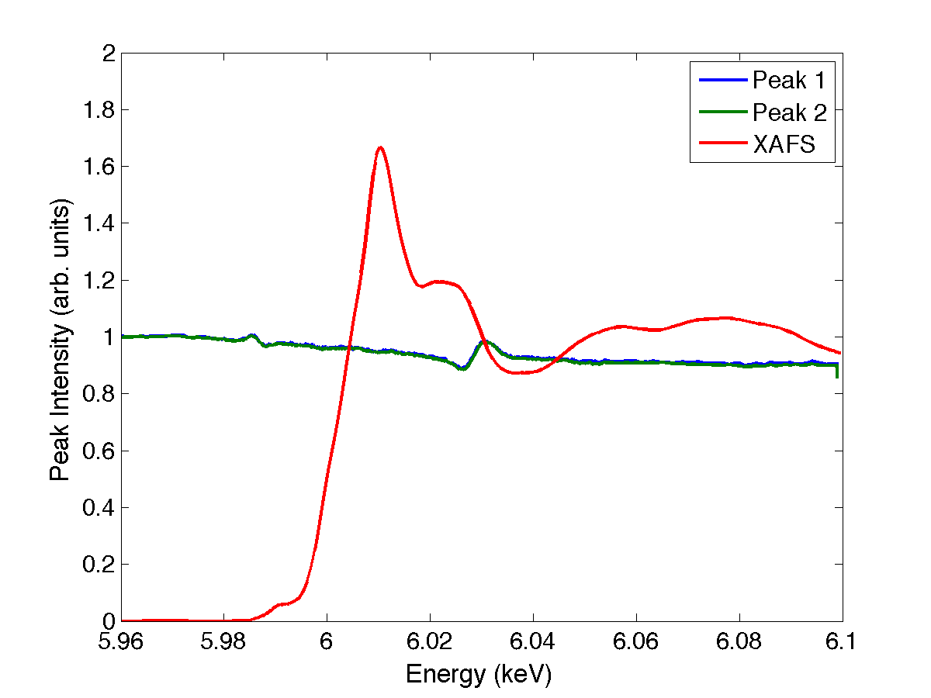
Structure and composition
XASF performed at MAX II
ISIS user labs:
X-ray fluorescence spectroscopy:
Al₂O₃ 95.208 %
P₂O₅ 0.563 %
Cr₂O₃ 3.791 %
“P” might influence the structure formed upon spraying
  Further investigation needed:
  Knowledge to produce precursor powder!
XASF and XEOL
XRD (Olso):
Expected Cr³⁺
Structure: octahedral
Al₂O₃ -> 2Al + 3/2 O₂
Reduction to be thought the cause of Oxygen lines observed in the SNS spectrum, supported by literature on luminescent material, but not yet demonstrated
Tools in place for the determination of the structure and composition
9

Slide 10
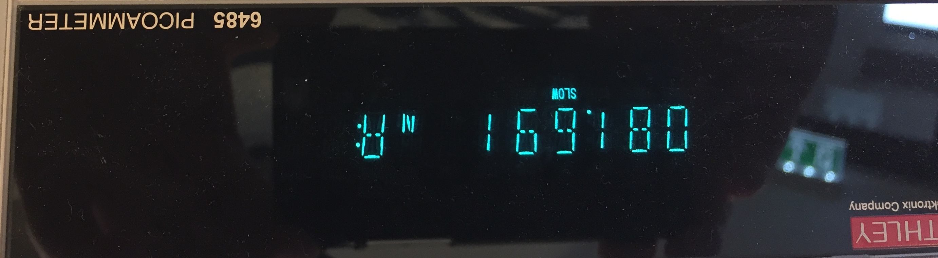
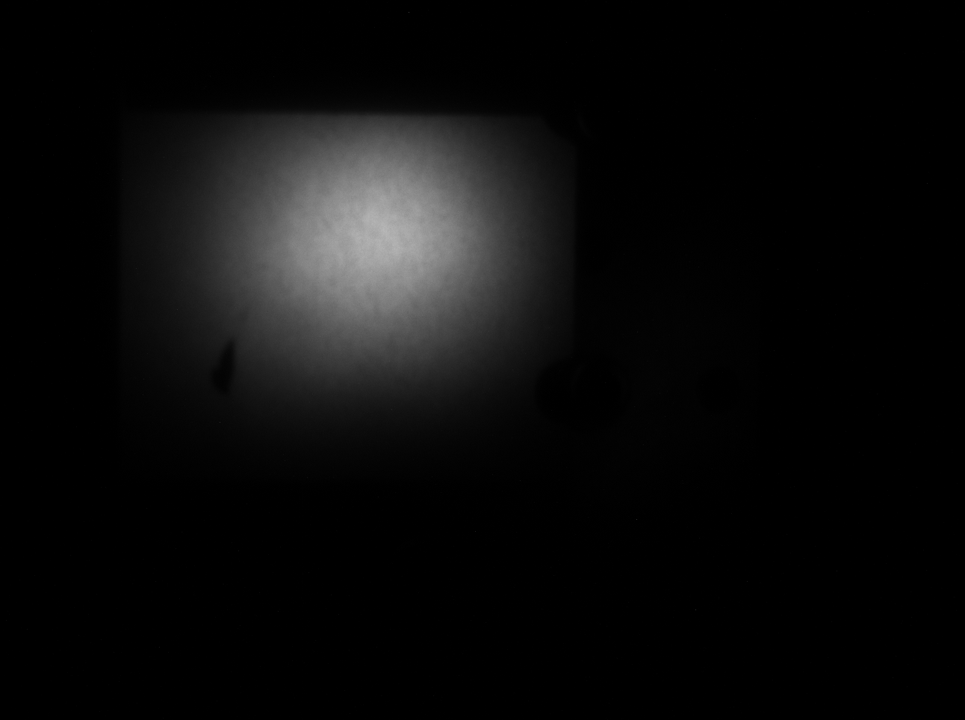
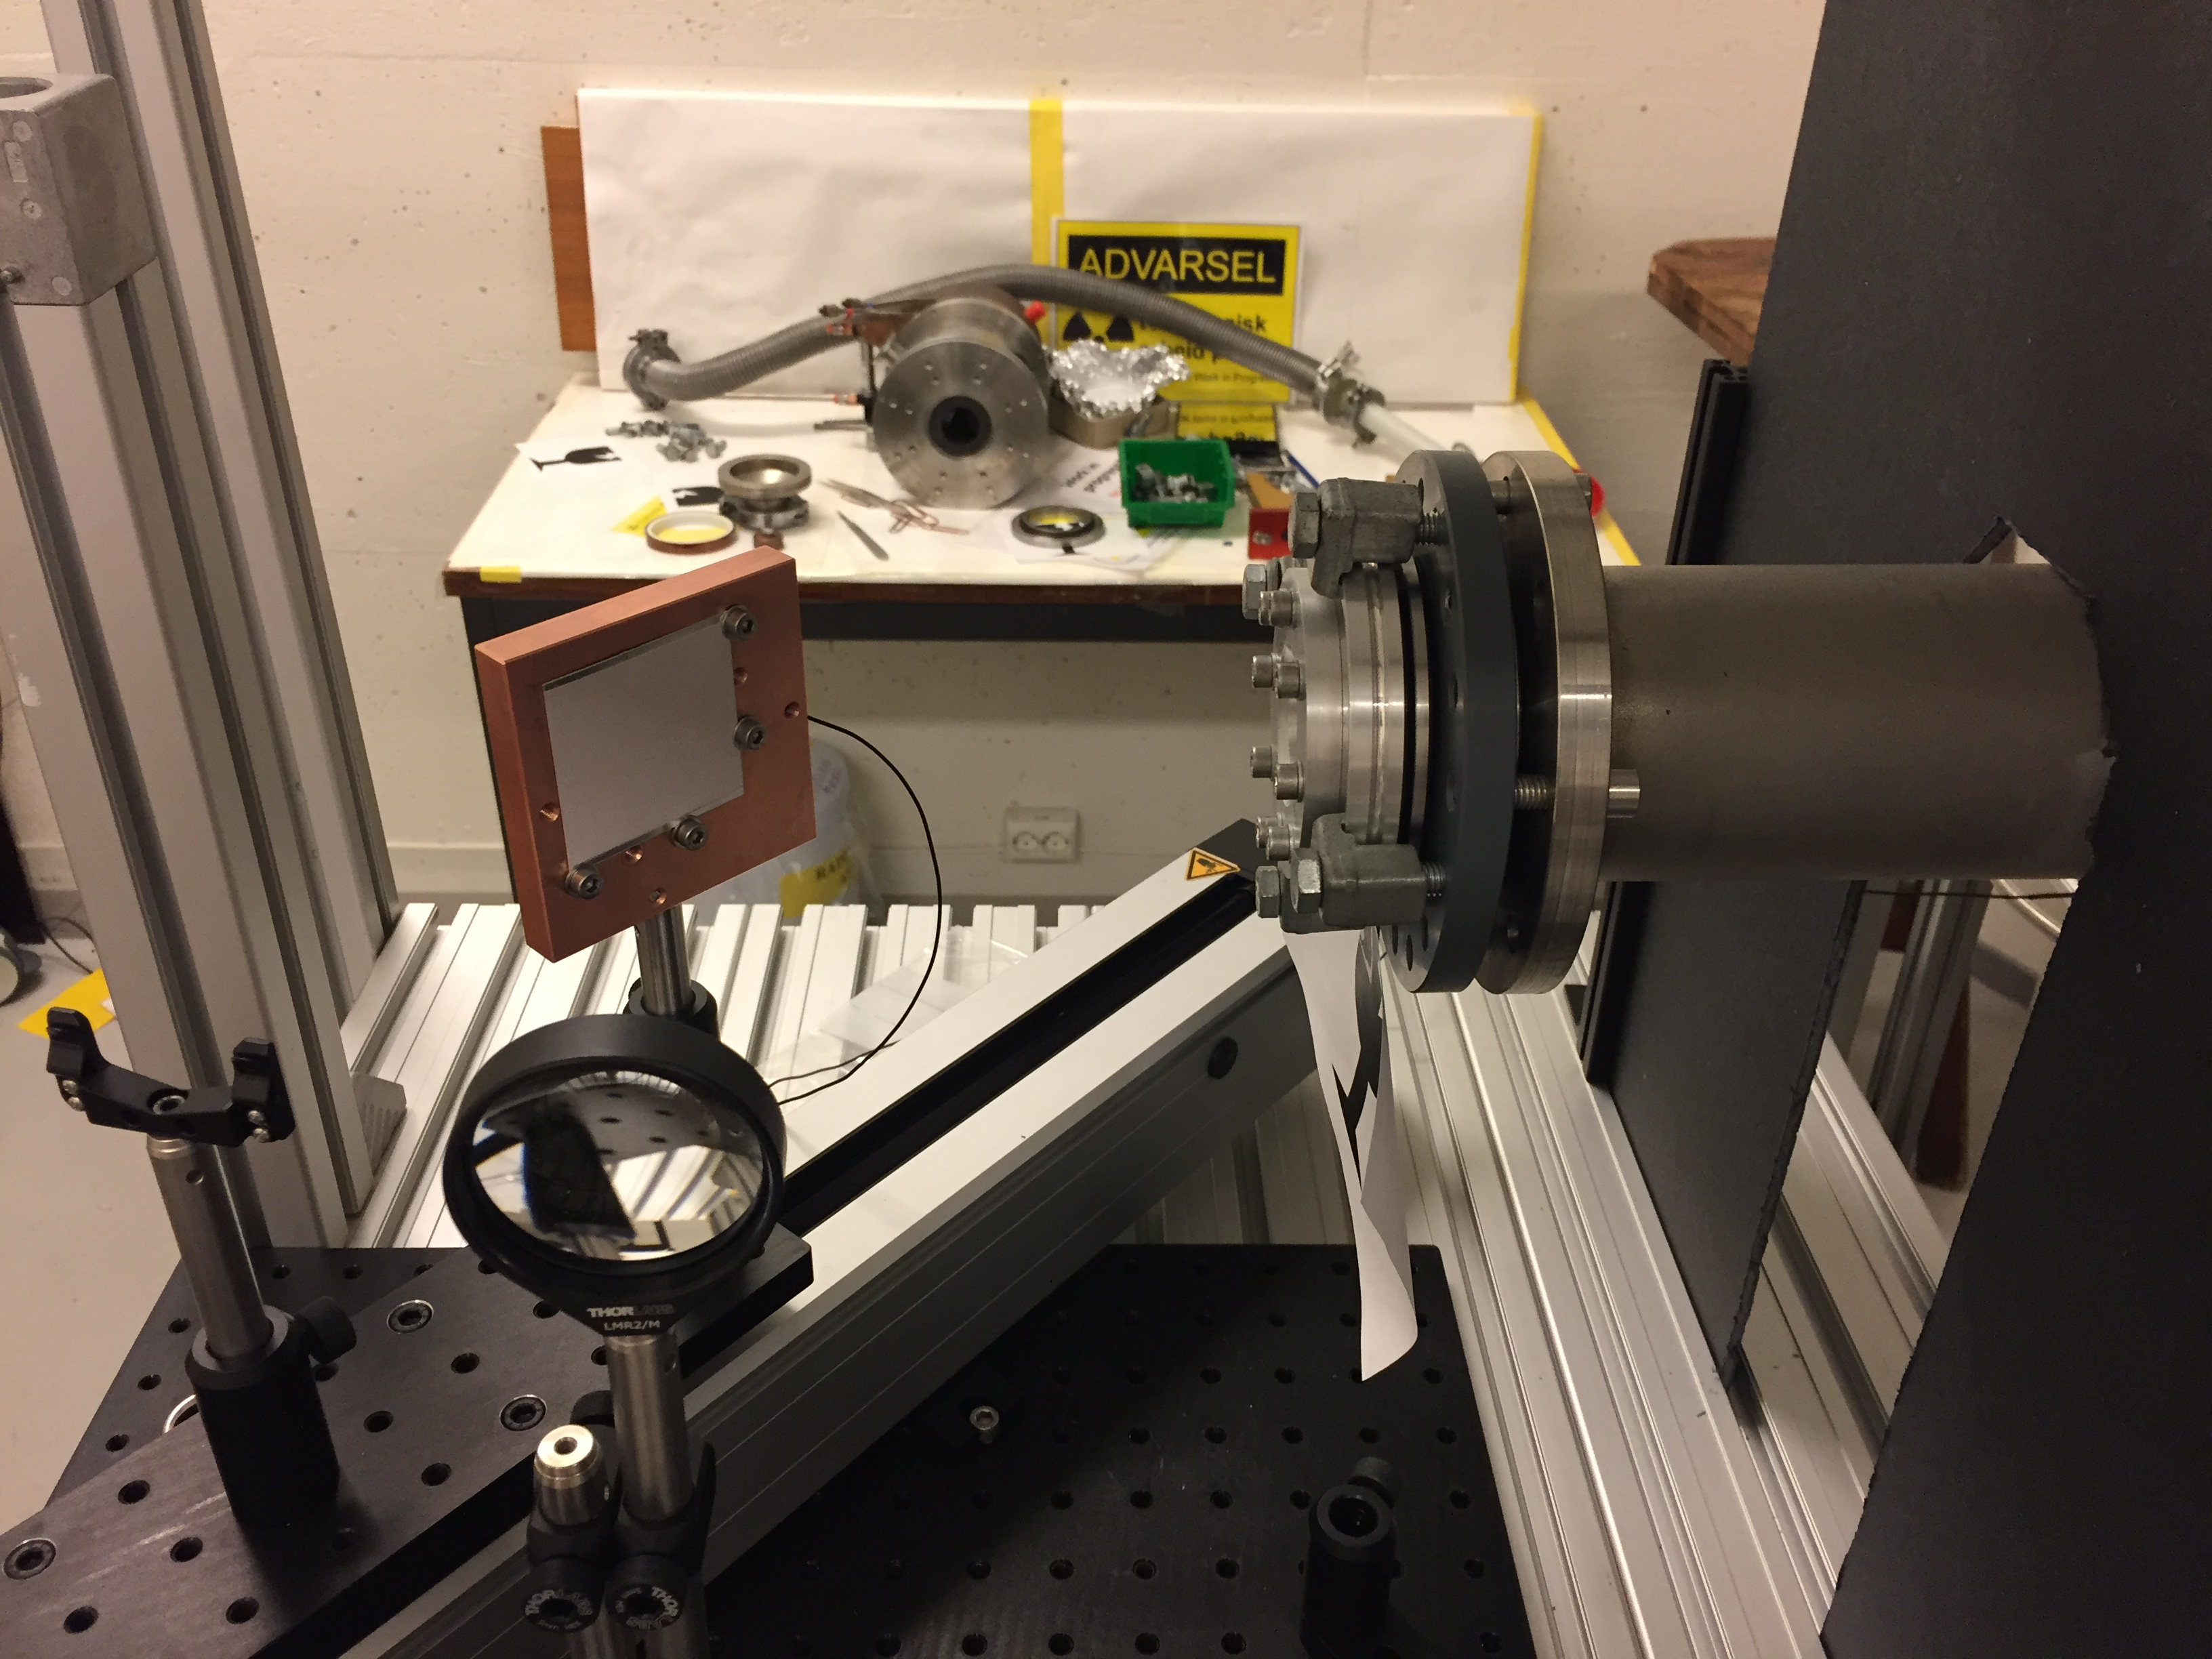
Oslo Cyclotron
Low energy proton beam
Current reading
Image of the beam
New OCL FC (ESS – Oslo) 19/04/2017
HV coated sample
OCL proton port
Preliminary result
Consistent with SNS data
Camera view axis
Fibre coupling lens
to spectrometer

Slide 11
Y₂WO₆: powder characterisation
Powder produced at ESS (Monika Hartl)
Image of the proton on pellet sample (OCL)
Photo-luminescence (ESS LED / Oslo Spectrometers)
Proton luminescence

Slide 12
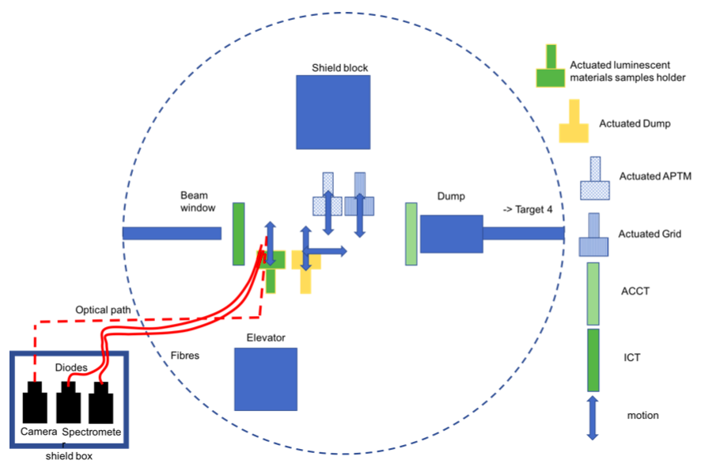
Proposal for Los Alamos
Characterization with ESS-like beam
Presented to committee this month for beam time Fall 2017
800 MeV p

Slide 13
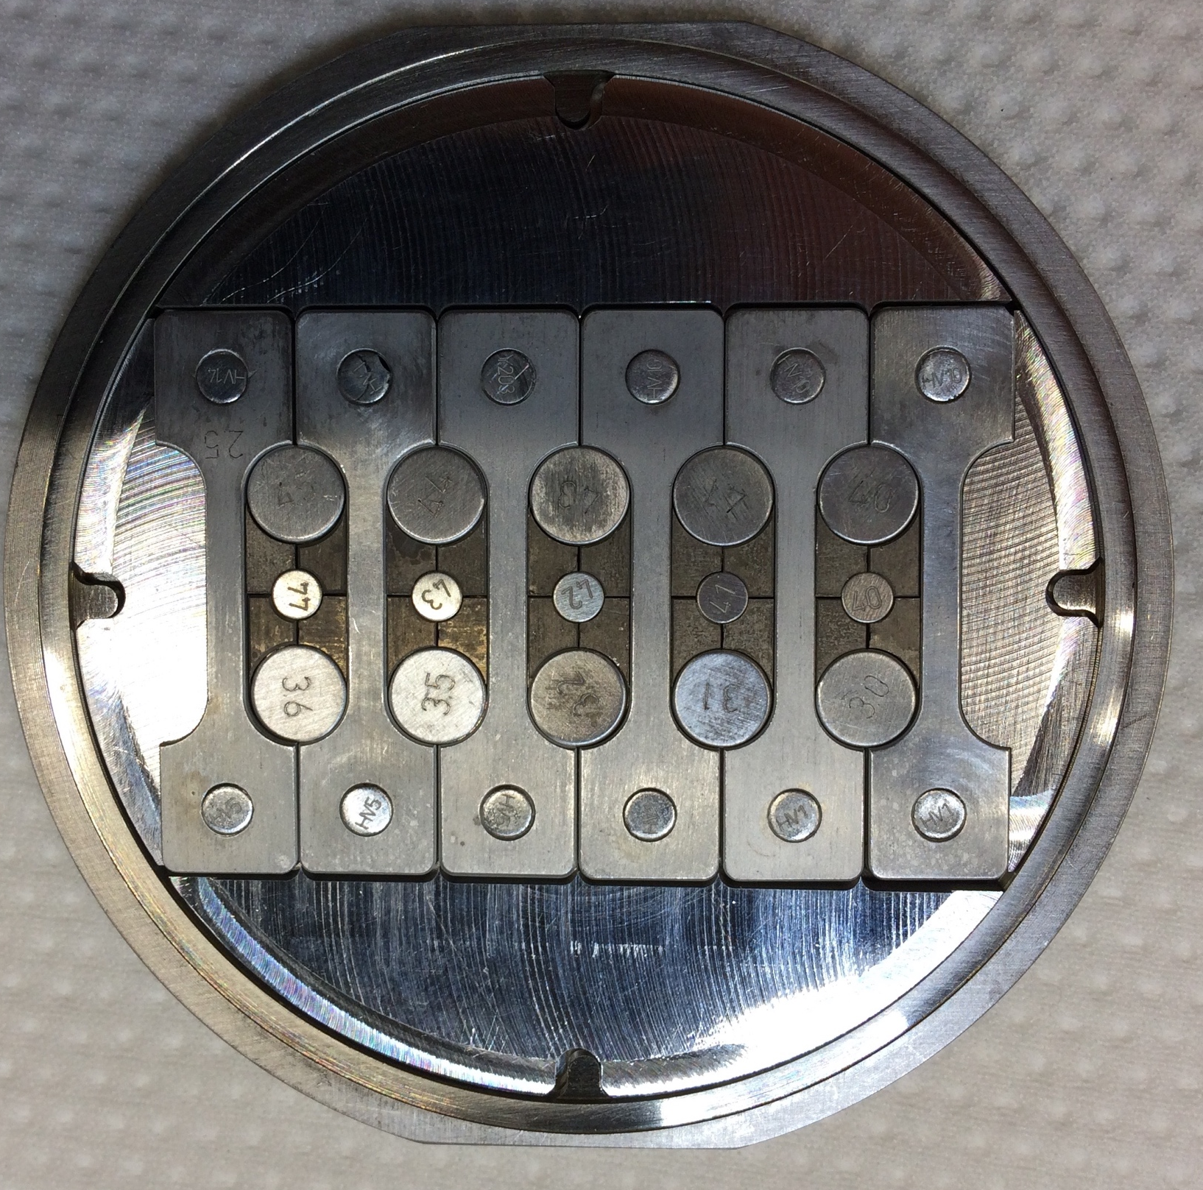
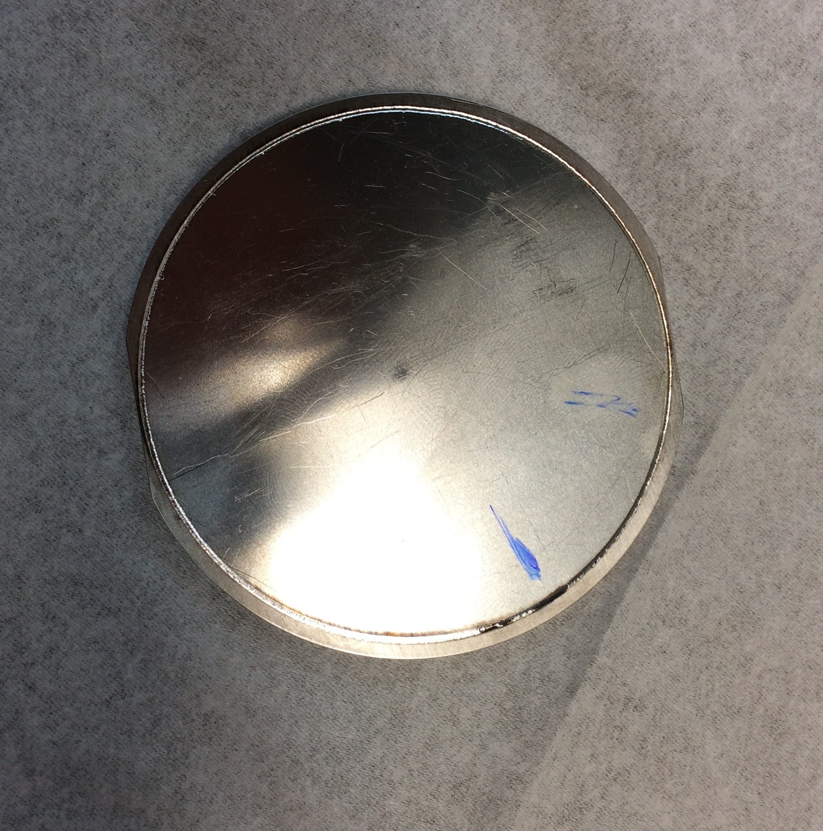
Irradiation Campaign, with activation
Under RADIATE collaboration, coated samples on Al from HV: Al₂O₃:Cr and Y₂O₃
  Cassette produced (assembles and sealed 04/04/2017)
  All cassettes passed QA tests and are now allowed to be irradiated
    Critical milestone reached!

Slide 14
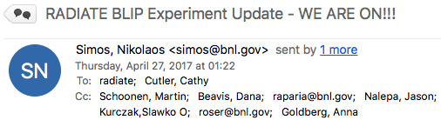
Latest News
Dear Colleagues
I am pleased to inform you that as 6:55 PM the BIG RaDiATE Experiment at BLIP is on with 180 MeV and 140 uA beam on target.
…

Slide 15
Thank you

Slide 16
Coating Development Schedule
2016
2017
2018
2019
2020
PDR ✓
CDR
Mock-up Ready
SAR
PIE (LANL)
New TW and PBW Spray
GSI √
TW and PBW Spray
TW and PBW Spray
Ion beam
HiRadMat ✓
Dump Spray
BLIP Irradiation
SNS Target Coating
New Dump/ screens Spray
BLIP: cassette ready for irradiation ✓
SNS Target Coating ✓
Present time

Slide 17
Imaging Systems Team
Oslo University:
Håvard Gjersdal, Ole Rohne, Martin Jaekel, Erik Adli
ESS:
Cyrille Thomas, Thomas Shea
Monika Hartl, Yong Joong Lee
Collaboration, Coordination
HV:
Shrikant Joshi
Produce Samples
Develop Industrial Process
Coating of the Target, PBW, DumpL
Imaging System
Design
Production
Luminescent Material Coating Development
Qualify Material
Industrial Coating Process

Slide 18
Down-selection
The down selection process will go through several phases:
Phase 1: Material selection and evaluation of process compatibility:
  Material identification, compatibility with thermal spray, compatibility with mechanical requirements.
Phase 2: Refinement of the deposition process, performance of factory floor testing:
  Sprayed sample and refinement of the coating process, and verification of the photo-luminescence
Phase 3: Photoluminescence Characterisation:
  Photoluminescence study: time resolved and spectra, vacuum compatibility, photoluminescence temperature dependence.
  As complementary studies, and for later irradiation test, the most promising material candidates should also have structural measurements records. This can be done by means of X-ray Diffraction techniques, Neutron Diffraction Techniques, and eventually SEM imaging.
Phase 4: Irradiation with no or minimal activation:
  Proton luminescence yield and spectrum, low energy proton beam, but also at high energy beam.
  Characterise radiation tolerance: thermo-mechanical studies, and luminescence properties
Phase 5: Irradiation with significant activation:
  Irradiation with neutron and protons, aim to mimic radiation environment of ESS
  Qualify the material for high power target after PIE, phases 3 and 4
  Phase 6: Industrialization:
  Final phase: documents the industrialised process for the preparation and coating of the selected material on the TW, the PBW, and the Dump (Dump surface and / or screens)

Slide 19
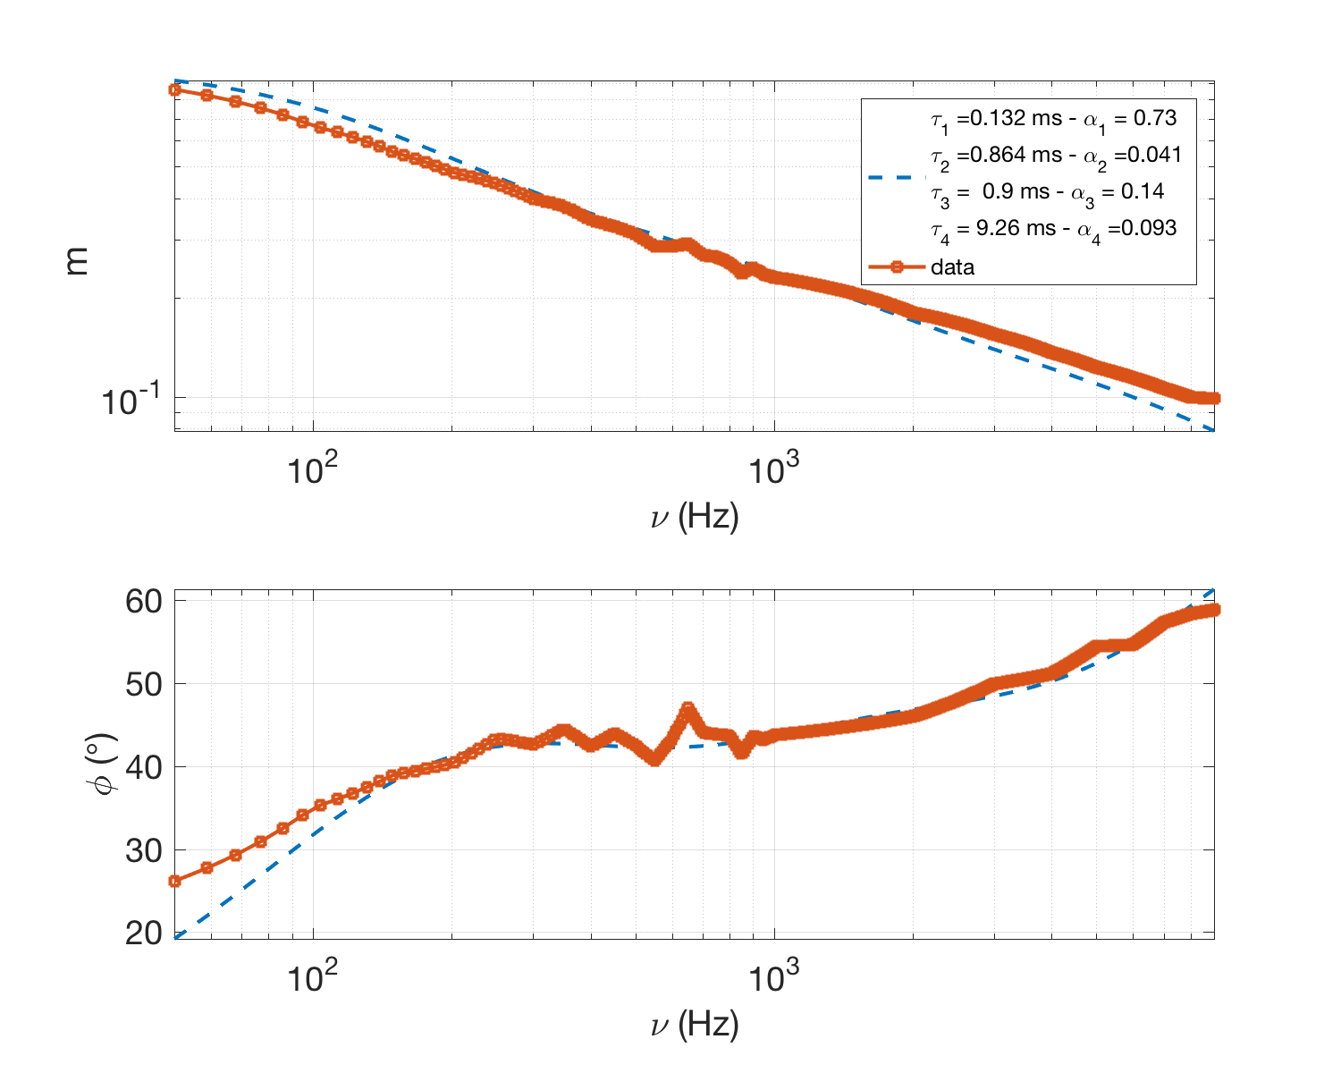
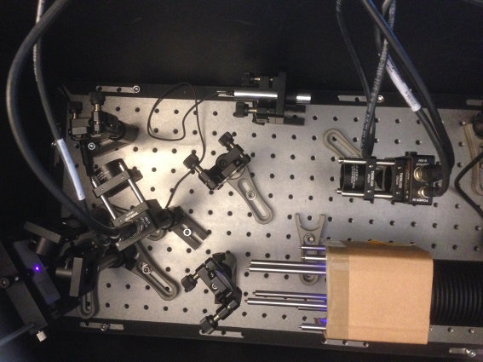
Luminescence lifetime
Bench test setup at ESS
D₁
D₂
Source
Sample
BS
Emission spectrum lifetime:
  Mean decay value 1.15ms
  Too large compared to pulse width (2.8ms)

Slide 20
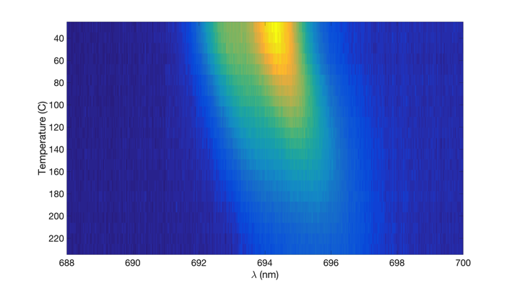
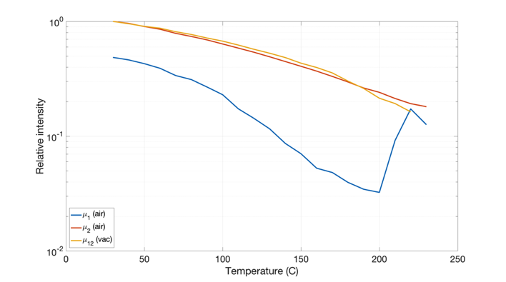
Temperature dependency
In-vacuum and in-air setup (ESS Vacuum Group):
Controlled sample heater + Spectrometer
Measure Outgassing
Measure Photon Yield at nominal Target temperature
Found same properties of the photo- proton- emission spectra vs. temperature:
  Large drop photon yield at Target operating temperature: 200 degrees C
Proton excitation (OCL)
Courtesy H. Gjersdal
70% drop at 200 C
Thermal: Air and Vacuum

Slide 21
Irradiation Campaign
Post Irradiation Examination:
  XRD, TEM, (PNNL) awaiting for confirmation
    XANES, XAS, complementary analysis of the material (BNL, Diamond synchrotron sources, proposal to be submitted in May2017)
  Proton excitation emission spectrum and imaging (LANSCE)
    Proposal submitted, awaiting for confirmation of acceptance and dates for the experiment
      Validation of the coated materials for the ESS target
      Characterisation of the spectrum and eventually oxygen lines and reduction process hypothesis

Slide 22
New Candidate Material
Preliminary testing: ESS baked powders
  Photoluminescence spectrum (ESS – Oslo)
  Proton Luminescence spectrum (OCL – Oslo cyclotron)
Coating development: method and preparation by HV (S. Joshi - University West)
  Proton spectrum and image
  Irradiation

Slide 23
Next to come …
Method and preparation for the industrial process for coating the Al₂O₃:Cr materials
Qualification for the Al₂O₃:Cr coatings after PIE of the BLIP irradiation campaign:
  Decide which material may be coated on the Target Wheel and Proton Beam Window
Characterisation of the new materials:
  Proton luminescence spectra yield, and spectra at target temperature (200° C)
  Photo-luminescence lifetime
  Irradiation campaign
Method and preparation for the industrial process for coating the new materials, starting with Y₂WO₆ and lanthanide doped Y₂WO₆
Develop the combustion gun for in-situ coating of the target

