Slide 1
Standard for remote management of electronics
Hinko Kocevar
and
Hooman Hassanzadegan
www.europeanspallationsource.se
27 April 2017
Notes:
<number>

Slide 2
This is work of..
Rafael A. Baron (initial idea and hardware design)
Hooman Hassanzadegan (Ethernet Module hardware design)
Hinko Kocevar (EPICS support)
<number>
Notes:
<number>

Slide 3
Purpose of the Ethernet Module
ESS BI section and RF group are both developing some customized electronics in the form of new units. The Ethernet Module (EM) can then be used to provide network connectivity for these units.
The EM can measure temperature and voltage from multiple points. Moreover, it provides a general-purpose digital IO port and an EEPROM for storing settings, S/N etc.
The current EM design is based on the BI and RF interlock requirements.
The ACCT Interface Units uses the EM for measuring supply voltages and temperatures at various locations within the unit.
BPM front end shall use the EM for monitoring purposes.
The EM has been successfully tested at ESS.
EM shall be proposed to be used in WS front end and LO distribution units.
<number>
Notes:
<number>

Slide 4
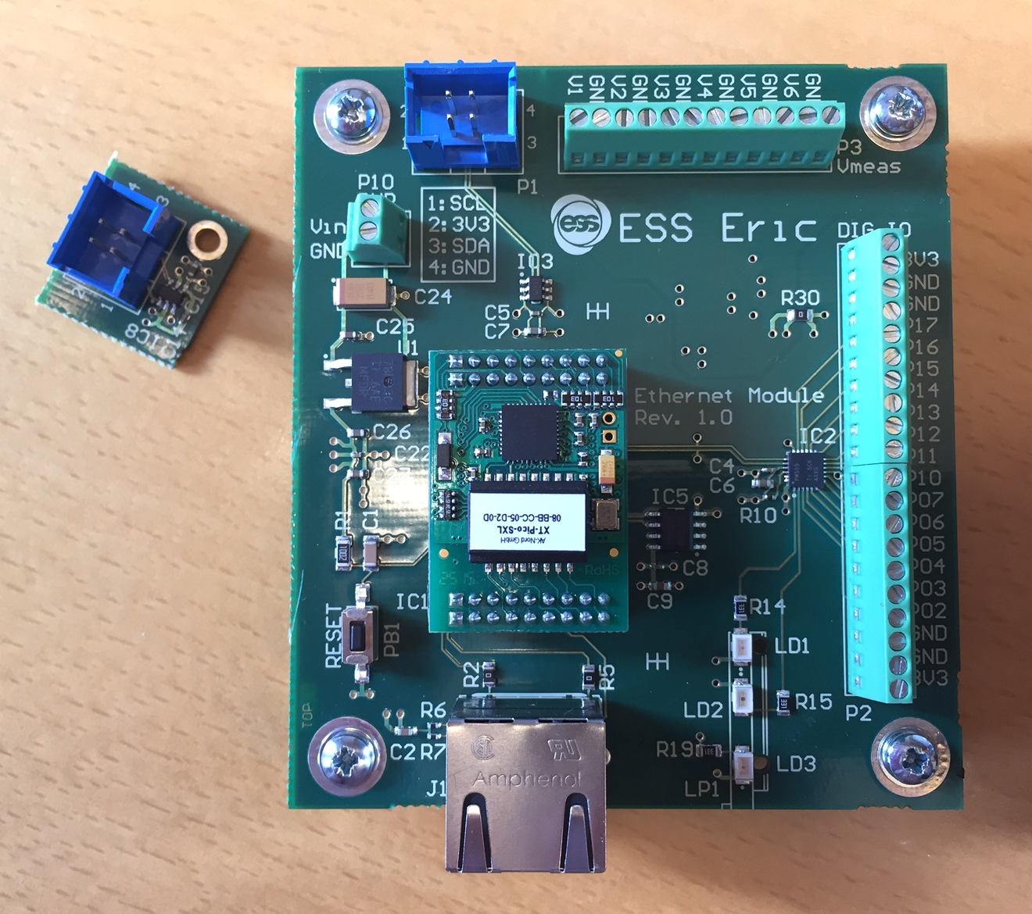
Ethernet Module hardware overview
The Ethernet Module hardware provides:
Network connection (RJ45)
1 on-board and 6 external temperature sensors
Port expander including 14 GPIOs
2 on-board and 6 external voltage measurements
256 k bytes of EEPROM
Connection to external devices through I2C bus
Small form factor
On-board linear voltage regulator
Separate power/ground planes for the analog and digital circuitry
Programmable LEDs
<number>
Notes:
<number>

Slide 5
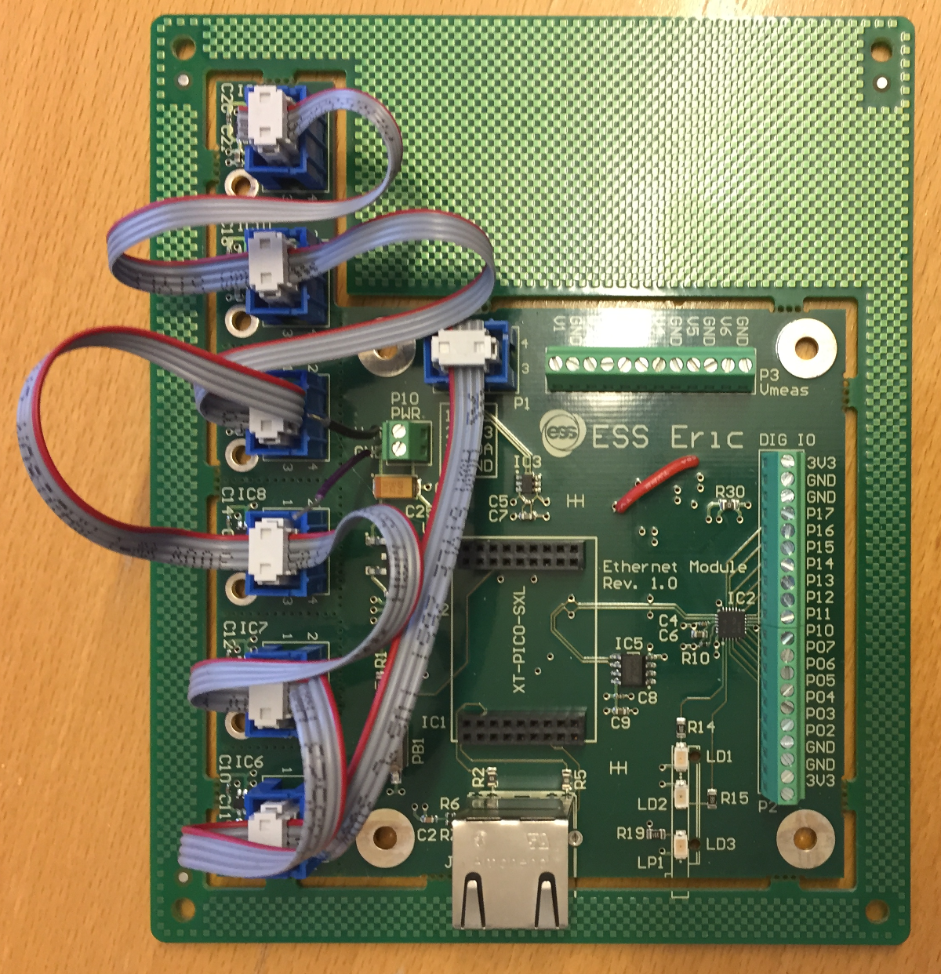
Ethernet Module usage
Standalone
<number>
Notes:
<number>

Slide 6
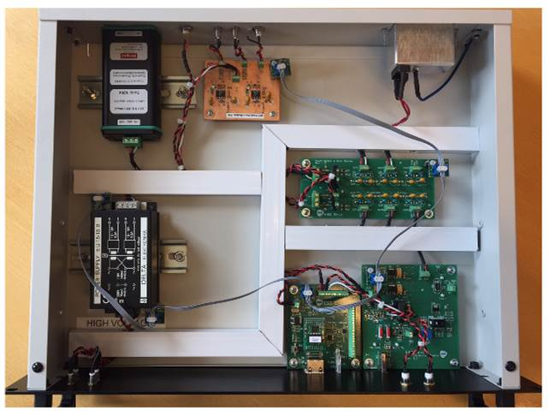
Ethernet Module usage
BCM front end
<number>
Notes:
<number>

Slide 7
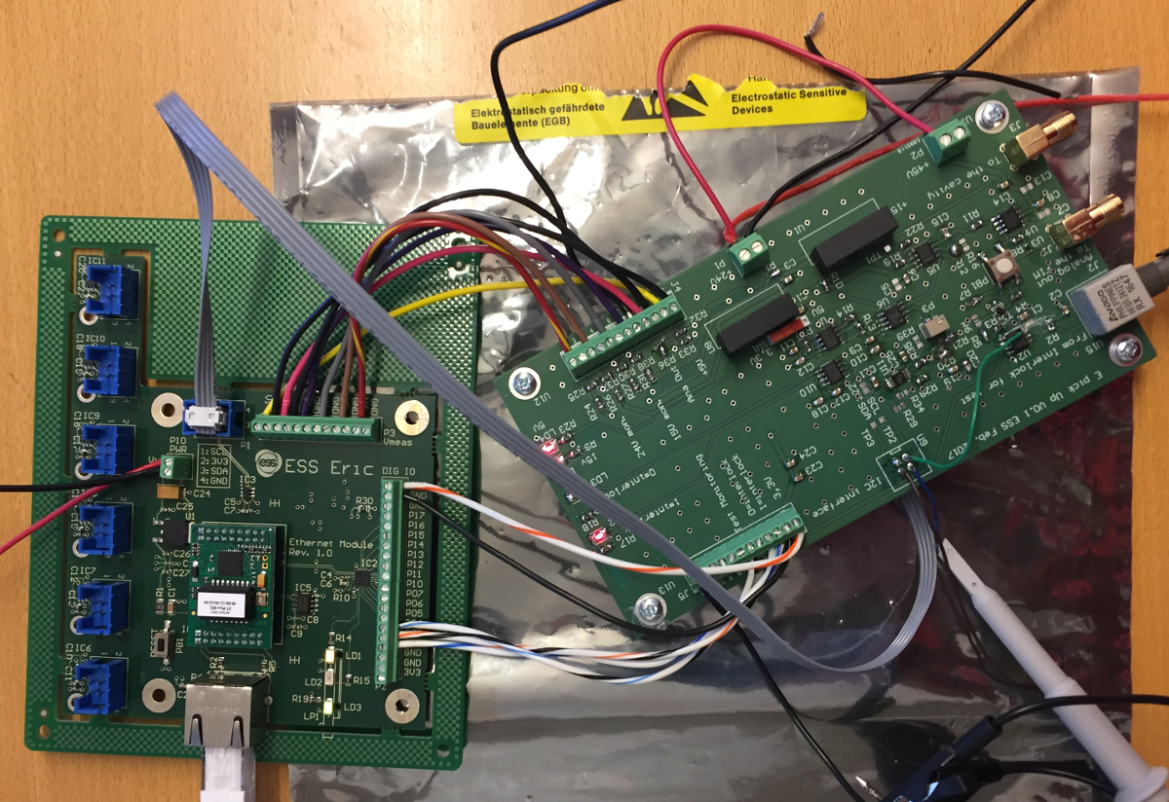
Ethernet Module usage
RF pin diode and E pick up
<number>
Notes:
<number>

Slide 8
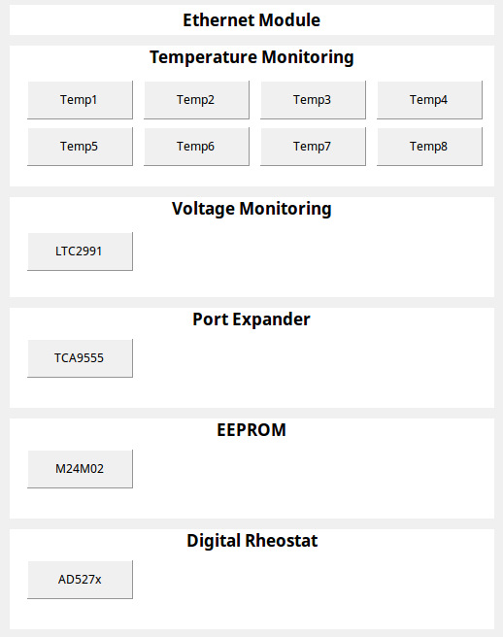
Ethernet Module software overview
EPICS support for Ethernet Module allows:
Remote control of the Ethernet Module
Based on EPICS asynPortDriver
Configurable number of devices
Readout of all attached temperature sensors
Control of port expander GPIO pin direction and level
Readout of all measured voltages conversion factor and offset
Reading and writing to EEPROM
Controlling digital rheostat
<number>

Slide 9
Ethernet Module temperatures
Readout of up to 7 temperature sensors
One sensor is on-board
Up to 6 additional sensors can be scattered inside the chassis
<number>

Slide 10
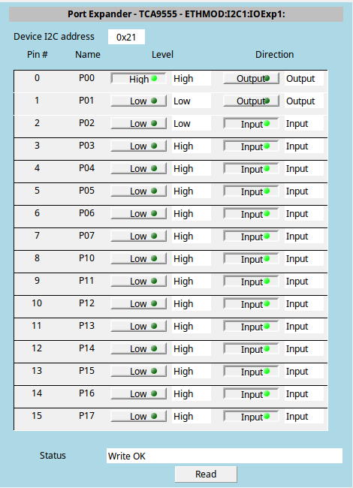
Ethernet Module GPIO
Control of port expander GPIO pin direction and level
Individual GPIO pin can be either input or output
When set to output user can control the level of the individual GPIO
<number>

Slide 11
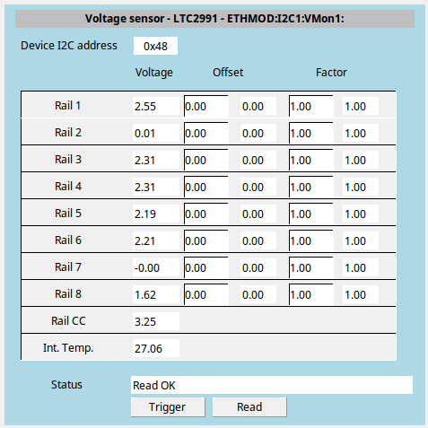
Ethernet Module voltages
Readout of up to 6 voltages (Rail 1 - 6)
Fixed on-board 3.3 V and monitoring voltage (Rail 7 & 8)
Includes internal temperature and detected Vcc (Rail CC & Int. Temp.)
<number>

Slide 12
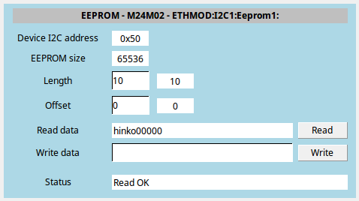
Ethernet Module EEPROM
EEPROM can be written to and read from
Can be used for serial number of the unit Ethernet Module is installed in
Or for storing arbitrary application specific data (calibration factors)
<number>

Slide 13
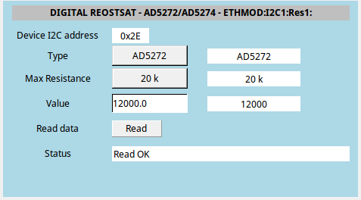
Ethernet Module rheostat
Control of digital rheostat (resistor)
Used in RF application
Example of adding external I²C device to the Ethernet Module
<number>

