Slide 1
AD Installation
Organization & Safety
Dr. Eng. Nick Gazis
Accelerator Installation Manager
www.europeanspallationsource.se
3rd ESS Beam Diagnostics Forum – 26 April 2017

Slide 2
Index
AD site organization & descriptions
AD safety involvement and early safety lessons learned
Available AD installation services & support
Needed centralized services & support

Slide 3
Accelerator Division (AD)
– Site Organization
BAS-U framework
ESS management
Accelerator Installation
Manager
Nick Gazis
AD and ESS central Installation Services
(ISC workgroup, etc.)
RATS AreaSuper
hiring process
Inst-Test-Commis. Plan
underway in P6
QA/QC
Kent Wigren
Mechanical
Mechanical
Mechanical
Safety Team
Duy Phan
Area Supervisors
Skanska and ES&H
Area Supervisor Tunnel (G01) &
FEB (levels 090 & 100)
Dennis de Wit
Area Supervisor Gallery (G02 incl.Test Stand 2)
Marcus Green
Electrical
Utilities
Electrical
Utilities
Area Supervisor Cryobuildings (G04)
Ila Sjoholm
Electrical
Utilities
RF
other..
Indeed everyone is responsible for safety
el
System Leader 1
util
other..
mech
System Leader 2
AREAS
Other..
other
Task masters (Installation Support Team)
System Leader 3, 4..

Slide 4
Area Supervisor System Leader
(Area BAS-U/P supervision & potential deputy is being discussed
Abiding with the ES&H rules and regulations (including BAS-U/P)
Role appointed by the ESS AD
Maintains the area responsibility on site (he is the Territorial Safety Officer)
Physically present on site during works
Safety representative for the works/actions performed in his area
Safety representative for the workers working in his area
Member of the safety team
Specific safety representative for e.g. fire safety responsibility (hot works education etc. needed)
Generates Area Hazard Analyses (AHA)
included in the Work & Safety Coordination Plan (WSCP)
Issues/revokes access to his area to all the concerned people
(installation teams, IKCs, contractors, etc.)
Role appointed by the WP
Leads and manages the installation team of the relevant WP
Selects and defines techs and installation team members along with their actions
Plays the role of the technical expert on site
(can be physically on site) for the components of the relevant WP
Responsible for performing all on-time scheduled activities
Receives and signs (commissions) the deliveries for his/hers systems of responsibility
Generates Job Hazard Analyses (JHA)
Generates and owns the Work & Safety Coordination Plan
(with help from the Area Supervisors)

Slide 5
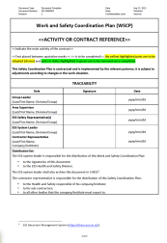






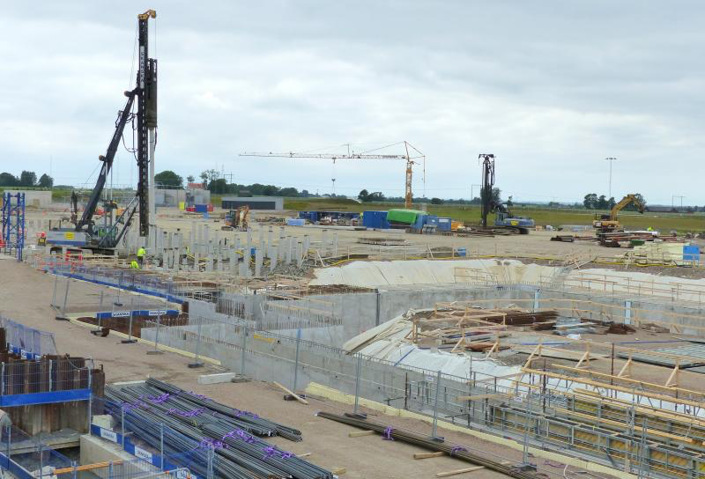
Involvement in the accelerator installation activities, in collaboration with ES&H and Skanska
Today
ESS
1. Support in the preparation of safety templates (e.g. JHA, AHA, WCSP)
2. Participation to the pre-work visit
(System Leader, IKC/contractor representative, Area Supervisor, Safety team)
3. Coordination of safety training
(e.g. BAS-U/P, safety harness, first-aid)
ES&H Division
Contractor
ESS
Accelerator Division
Safety procedures
4. Review of safety documentation (e.g. JHA, AHA, WCSP)
5. Support in the definition of control measures
ESS-Skanska
6. Interface between AD and ES&H
Soon
(8) Preparation of online training courses
(9) ……………………….
7. Participation to regular safety inspections on site
AD Safety Group

Slide 6
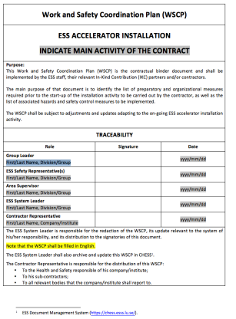
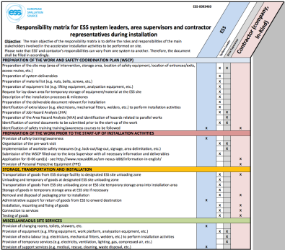
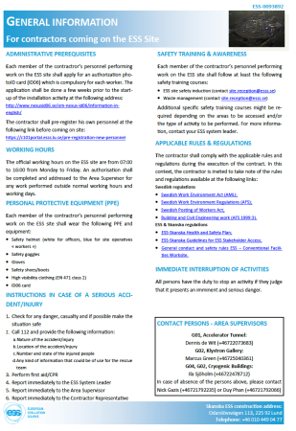
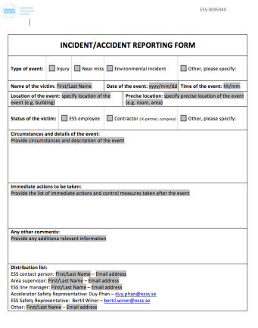
Good progress in the preparation of documentation
Work and Safety Coordination Plan (WSCP) ESS-0085649
Main objective: to identify the list of preparatory and organizational measures required prior to the start-up of the installation activity to be carried out by the contractor, as well as the list of associated hazards and safety control measures to be implemented.
Installation responsibility matrix ESS-0093460
Main objective: to define the roles and responsibilities of the main stakeholders involved in the accelerator installation activities to be performed on site.
Basic introduction for newcomers on the ESS site ESS-0093892
Main objective: to communicate the minimum and essential information to the contractors prior to the start-up of their activities on site
TIA is implemented in ESS for accident reporting
Temporary incident/accident reporting form ESS-0095940
Main objective: to report incident/accident happening in the frame of the installation activities to be carried out on site

Slide 7
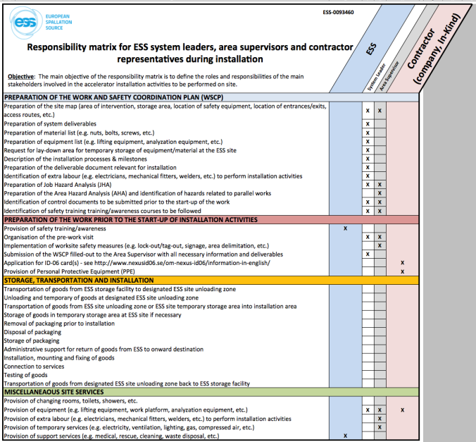
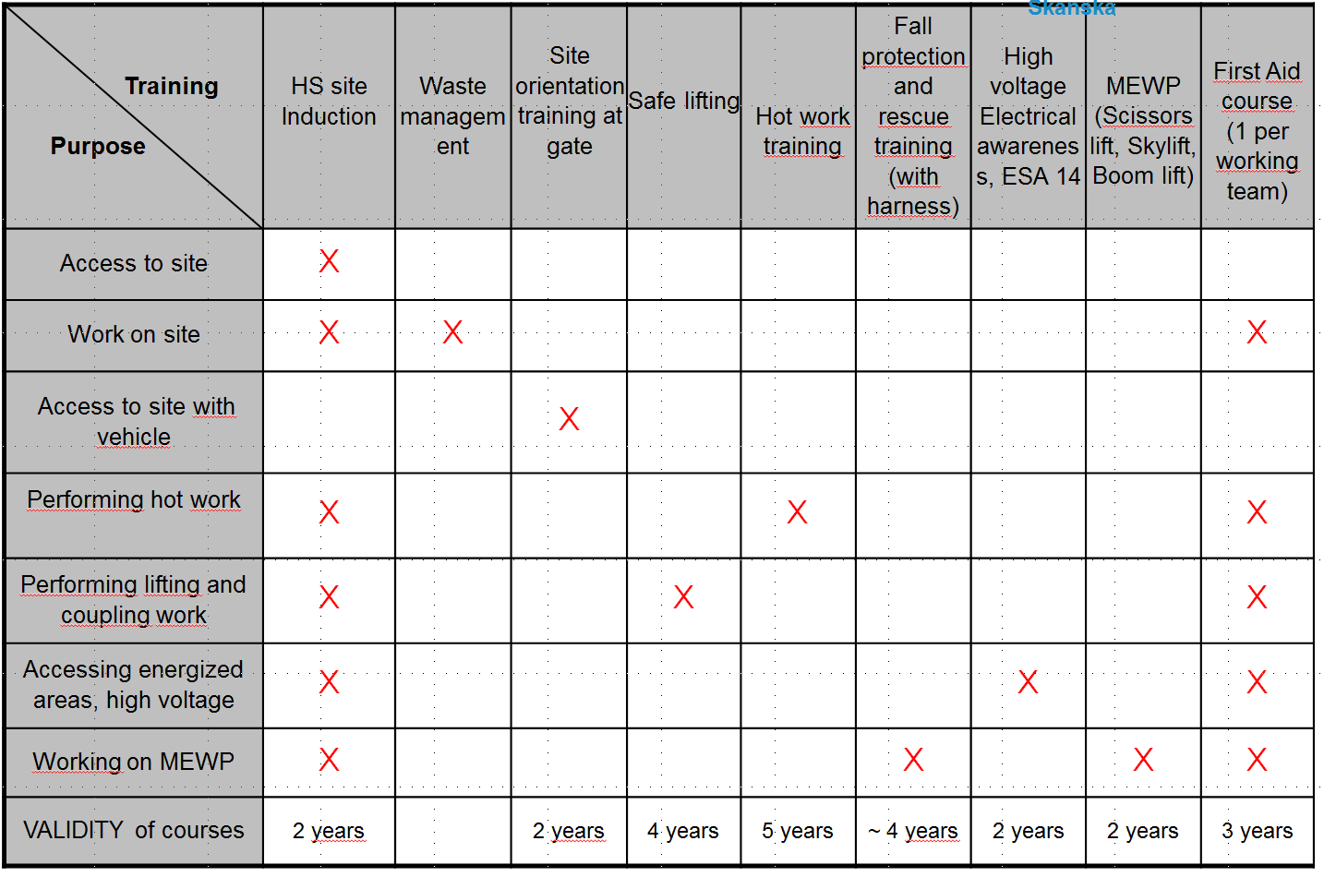
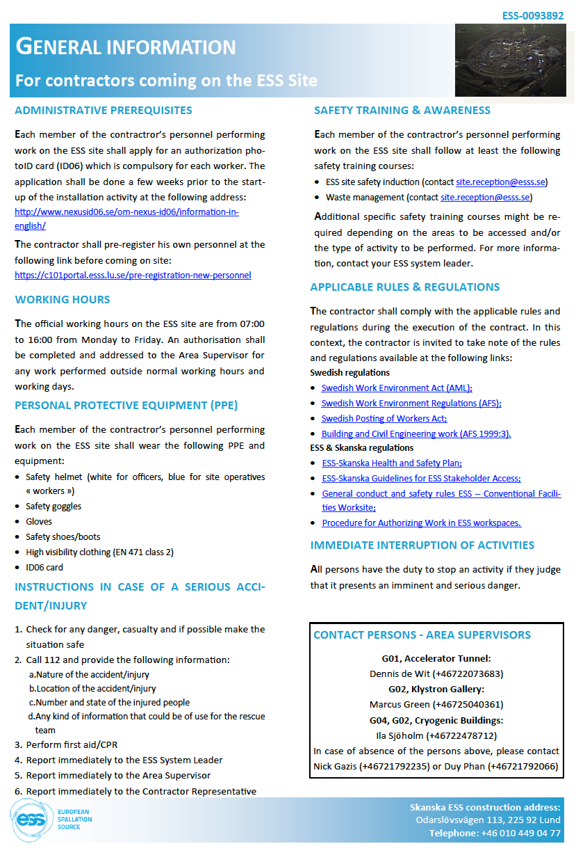
Lessons learned in matters of safety
Temporary AD responsibility
matrix available at ESS-0094909
Temporary AD safety training matrix
until ESS centralized becomes available
Temporary intro/orientation sheet until ESS centralized becomes available
More support from Central Divisions is needed on:
Issuing and management of work permits
(incl. BAS-U deputy for Skanska subcontractors)
Organization of safety trainings but also validation of safety training taken abroad (outside Sweden)
Implementation of TIA procedure on ESS-wide basis for reporting incident/accident on site
ESS procedure for working outside normal working hours, shift works, work during weekends, etc.

Slide 8
Installation Services available on-site from the AD Area Supervisors
AD will provide installation services and support on-site to facilitate the WP installations. These resources will be available from the AD Area Supervisors, following the WP’s requests as documented in the WSCP by the System Leaders (for each WP).
Logistics:
  The System Leader(s) document in the WSCP all needs for logistics and transportation.
  Contact ESS Logistics (Jorgen.Larsson@esss.se and/or Jan.Lundin@esss.se) to organize IKC shipments to ESS Lund. All transportation and logistics of the WP shall be supervised/organized by ESS Logistics.
Alignment:
  The System Leader(s) document in the WSCP all alignment needs.
  Contact ESS Survey and Alignment Group (Fabien.Rey@esss.se) to detail the alignment steps.
Electrical installations:
  The System Leader(s) contact the AD electrical group (Frithiof.Jensen@esss.se) for all electrical-related installation support.
Vacuum installations:
  The System Leader(s) contact the AD vacuum group (Marcelo.JuniFerreira@esss.se) for all vacuum-related installation support.
Controls:
  The System Leader(s) contact ICS (Hector.Novella@esss.se) for all controls-related installation support.
  Installation support*:
  *Please, refer to next slide for details on the available installation support.
  The System Leader(s) document in the WSCP all needs/support on technicians, manpower, services and tooling on-site during their installation.
  Contact AD Installation team (Nick.Gazis@esss.se and Area Supervisors of Slide 10) to detail planning of the installation support.

Slide 9
Installation Support available on-site from the AD Area Supervisors – (1/2)
AD will provide installation support on-site to facilitate the WP installations. These resources will be available from the AD Area Supervisors, following the WP’s requests as documented in the WSCP by the System Leaders (for each WP).
Installation teams (manpower):
  The System Leader(s) document in the WSCP all needs for technicians and manpower for installation.
  After agreement with the Area Supervisors, technicians and manpower (upon availability) can be assigned directly under the command of the System Leaders (only during the installation of the relevant WPs).
Design teams:
  The System Leader(s) document in the WSCP all design needs for 2D-drawings and installation maps.
  After agreement with the Design Integration workGroup (AD-DIG) and upon availability of the design engineers, installation related drawings can be provided.
Electronics, tooling and consumables support:
  The System Leader(s) document in the WSCP all needs for electronics, tooling and consumables (e.g. network analyzers, hand-tools, bolts & nuts, shims, temporary support frames, air-pads etc.).
  After agreement with the Area Supervisors, basic electronics, tools and consumables can be available on-site, following the WSCP.
  Please, verify availability with the Area Supervisors.
  It is strongly advised to the WPs to organize and come on-site individually with their needed electronics, tooling and consumables – keep in mind that no-workshop/no-electronics lab is available on-site (but it will be available in close proximity).

Slide 10
Installation Support available on-site from the AD Area Supervisors – (2/2)
Industrial machinery support:
  The System Leader(s) document in the WSCP all needs for industrial machinery (pallet-jacks, lifting devices, truck-rents, scaffolding, etc.).
  After agreement with the Area Supervisors, industrial machinery can be available on-site, following the WSCP.
  Please, verify availability and use-process with the Area Supervisors.
  The WP can be requested to fund its specific requests via PCC code, after agreement with the Area Supervisors.
Industrial services support:
  The System Leader(s) document in the WSCP all needs for industrial services support (storage, workshop, lay-down areas, etc.).
  After agreement with the Area Supervisors, ESS central services can be provided on-site (waste management, air supply, WiFi, electricity, storage, workshop, lay-down areas, etc.), following the WSCP instructions.
Shielding and sealing materials:
  The System Leader(s) document in the WSCP all needs for shielding and sealing (fire or other) material.
  After agreement with the Area Supervisors, the ESS-approved shielding and sealing materials can be provided, following the WSCP.
Training courses and certifications:
  The System Leader(s) document in the WSCP all needs for training courses and certification related to installation.
  The WP have to comply to the certification requested by the Area Supervisors
  (according to the applicable Swedish legislation and ESS local rules).
  The WP will fund entirely the required training courses, according to their installation needs.
Installation infrastructure:
  AD will provide power (general locations), area lighting, fire extinguishers and local first aid stations

Slide 11
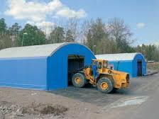
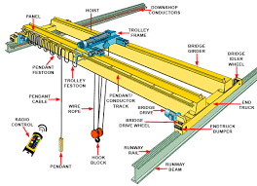
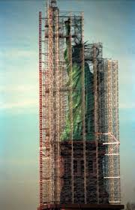
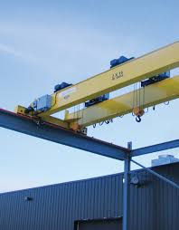
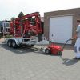
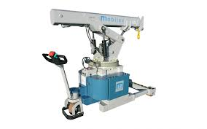
Procurement example:
AD first equipment purchases for installation
Priority | Item | Lead time |  |  | Total Qty | Supplier
1 | Mobilev crane 2T (to be used for warm linac) |  | 12 weeks |  | 1 | http://www.mobilev-cranes.uk/
1 | FEB hatch crane |  | 6-12 weeks |  | 1 | http://www.munck-cranes.se/
1 | FEB hatch crane beam |  | 6-12 weeks |  | 1 | http://www.munck-cranes.se/
1 | Storage/work tents |  | 6 weeks |  | 3 | https://hallbyggarna.se/
1 | Scaffolding FEB hatch |  | 2 weeks |  | 1 | http://www.heab.se/
2 | Forklifts
2 | Tow tracktor |  | 4-6 weeks |  | 3 | www.multi-mover.eu/
2 | Transport trollys |  |  |  | 6 | https://www.ajprodukter.se/

Slide 12
Benchmarking
AD has benchmarked both the AD site organization and the AD installation services & support following the proven professional practices and tactics of other facilities such as CERN, Fermilab, SNS & BNL
CERN references:
  Plan intervention, engineering change requests (ECR), module installation manual & duty cycles, Experimental Areas Co-ordination meetings (CMS, ATLAS), Field Support Units (FSU) organization, plans d’Implantation, etc.
Fermilab:
  Fermilab Engineering Manual, October 2015, FEM v.2.0
  Fermilab Environment, Safety and Health Manual (FESHM),
  http://eshq.fnal.gov/manuals/feshm/
SNS references:
  D.Olsson Nov.6-8 (2001), ORNL_Accelerator_Systems_Division_Progress_and_EAC
  D.Olsson Mar.10-12 (2003) ORNL_ASD_Resources_and_Progress
BNL references:
  G.Fries, Mar.30 (2017) NSLS-II Accelerator Installation & Lessons Learned
  However, several issues remain open,
  to be fulfilled from central ESS functions (see next slides)

Slide 13
Open Issues for
ESS central functions, safety & security
Waste management on-site seems time consuming so waste bins and local garbage points have to be introduced near the AD buildings
Centralized workshop is needed to cover ad-hoc installation modifications/needs
Centralized accommodation for IKC personnel is needed
Permanent system for fire detection and evacuation alarm will NOT be available during installation period due to system-Warranty issues: Urgent need to centrally procure and place a temporary system (new extra cost, time limitations, etc.)
Assign BAS-U deputies (from Skanska or ESS-central) to each AD Area Supervisor:
The Area Supervisors are needed to work for the accelerator installation and not
(CF’s/Skanska’s/other’s) subcontractors’ coordination
Definition of Rules & Regulations for shift work is needed (not yet available in ESS)

Slide 14
Open Issues for
ESS central functions, safety & security
AD plans and works to provide to IKC a lot of Safety and Security related services that gradually need to be provided by central functions:
Card access system control & security, card readers administration
Communications on-site (limited to AD buildings)
Accommodations and work insurance for IKC
In-house technicians
PPE & safety training (for most, if not all!)
Tunnel HVAC and ventilation during installation?
(for human comfort and extraction of toxic fumes and gases arising from welding activities)
  Tunnel evacuation alarm in the tunnel → needs to be implemented (ESS-0102354)
  Temporary evacuation alarm in the gallery?
Agreed hole drilling and machine fixations, primarily in the tunnel but also in the gallery
Stub installation!
Stub: underground and confined space that needs to be installed, shielded & sealed
→ still the stub installation test is far from being done..
Testing & commissioning rules (e.g. ISRC could preliminarily run under “Test Stand” rules)

Slide 15
Last slide
Status in a nutshell
Current plan for the ESS accelerator Installation foresees 30 consecutive months of installation
(started in Jan-2017); to be succeeded by Testing and Commissioning phases consequently
Accelerator installation occurs first, in need to develop support functions (otherwise developed and supported centrally). Requires significant resources (not foreseen in the AD installation team personnel nor budget).
Currently the AD installation team utilizes the AD Test Stand safety procedures according to the “best practice” rule

Slide 16
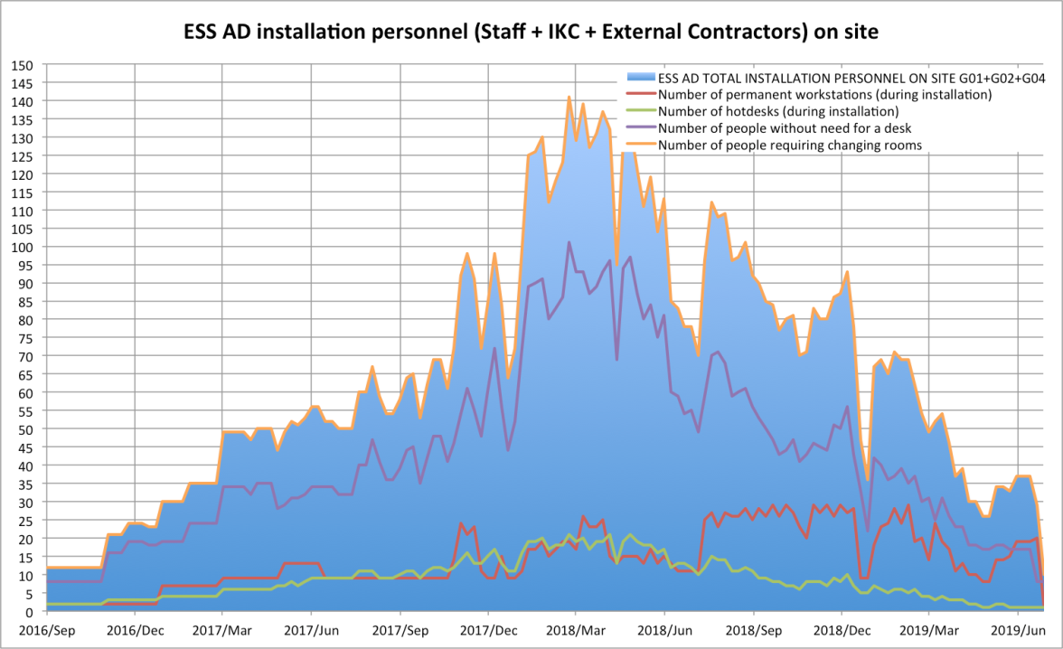
Accelerator Division (AD)
– Installation Plan & Manpower on site
SPARE SLIDE
AD installation plan ESS-0055889
02-May-2017 Full Access to G01 Linac Tunnel and FEB level 090
27-Feb-2017 Partial Access to G02 Gallery Technical Area
01-Sep-2017 Partial Access to first part of G02 Gallery (FEB level 100) with 4 first stubs
23-Oct-2017 Partial Access to following part of G02 Gallery with the following 6 stubs
01-Jan-2018 Partial Access to following part of G02 Gallery with the following 11 stubs
31 Mar. 2018 Full Access to entire G02
AD preliminary site-office needs
(changing rooms included accordingly)
Starting in January 2017:
21 accelerator staff are gradualy moving on-site and 17 more hotdesks are reserved for installation people needs
Draft –in progress

Slide 17
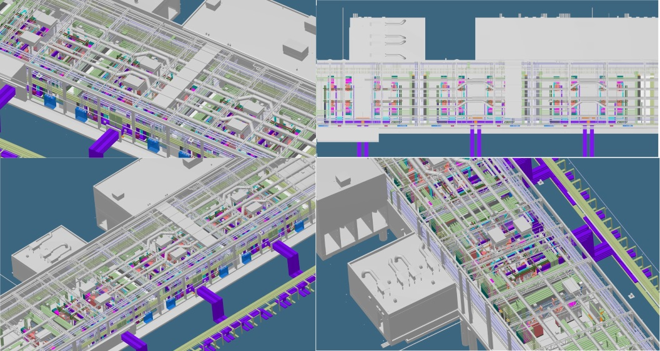
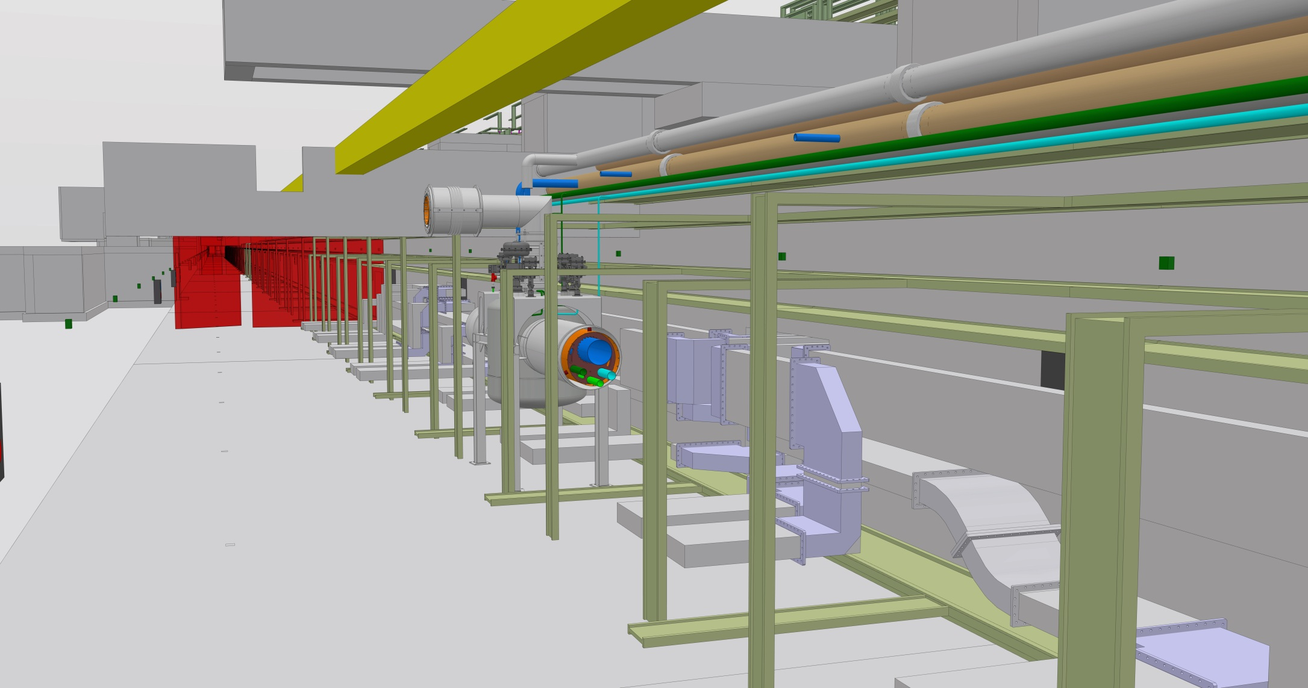
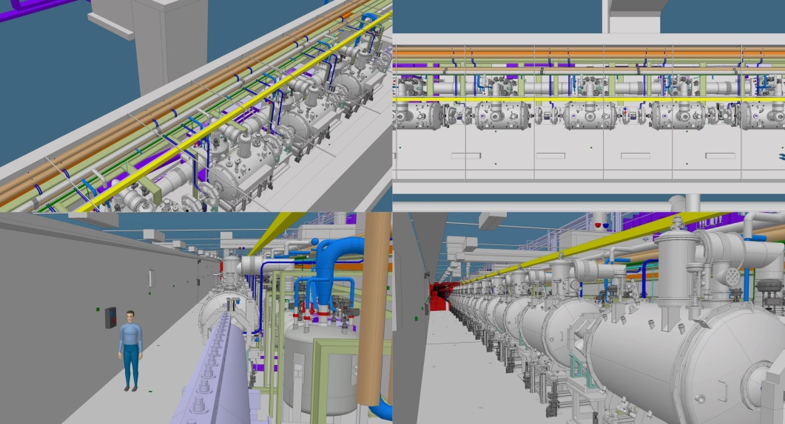
Example:
General steps of tunnel installation
SPARE SLIDE
Current tunnel installation sequence:
Marking
Hole Drilling
Water-cooling pipes installation (inclduing dedicated supports)
Cable trays and grounding bus bar installation (inclduing dedicated supports)
Phase Reference Line (PRL) installation
Stubs (trays, waveguides, cables) installation
NCL and CDS
CryoModules (CMs) and LWUs.
High level of complexity is evident so efficient coordination is explicit!

Slide 18
AD installation sequence
SPARE SLIDE
Slide courtesy of Eugene Tanke
Water pipes
Top cable trays
Cryo distribution line
Cryo valve box
Cryo valve box line
Distribution cable trays
Critical Point:
Planning might be compromised,
if the installation sequence is perturbed.
Mitigation:
Maintain the full access dates as agreed
Definition and simulations (3d model) of the installation sequence
Availability of Task Masters and other installation services
Coherent archiving of installation documentation on a central ESS level
Goal:
Ensuring the installation sequence and plan
Bottom cable trays

Slide 19
Accelerator Division (AD)
– Indicative tunnel installation
SPARE SLIDE
Slide courtesy of Eugene Tanke
Phases related to Installation, Testing and Commissioning (ITC) have been defined in ESS-0025640*:
  ITC Phase A: Installation
  ITC Phase B: Local testing without beam and without ICS
  ITC Phase C1: Local testing without beam, with ICS
    Local test including controls, e.g. controlling a power supply
  ITC Phase C2: Integrated testing without beam, with ICS
    End to end test including controls, e.g. controlling a power supply, concomitant magnet, water cooling, interlocks etc
  ITC Phase D1: Testing diagnostics with beam
    Will typically make use of a “probe” beam
  ITC Phase D2: Beam commissioning
    Goal during this phase is to prepare and deliver the required beam

