Slide 1
ICS Update
@ 3rd ESS Beam Diagnostics Forum
Simone Farina & Jeong Han Lee
Integrated Control System Division
www.europeanspallationsource.se
2017-04-26

Slide 2
Outline
MicroTCA overview;
MicroTCA infrastructure:
MTCA crates;
MTCA Carrier Hub;
Power Modules;
Advanced Mezzanine Cards:
MRF Event Receiver;
CPU cards;
IOxOS IFC1410/IFC1420;
Software Stacks / Showcase

Slide 3
MicroTCA Overview
Glossary:
MicroTCA : Micro Telecommunication Computing Architecture
MCH : MicroTCA Carrier Hub
  manages the other boards, provides interconnection switch capabilities, clock distribution, etc
PM : Power Module
CU : Cooling Unit
AMC : Advanced Mezzanine Card
  basic constituent of the MTCA system, can provide support for a RTM
RTM : Rear Transition Module
  provides real estate area for additional electronics
MMC : Module Management Controller
  monitors the status of the AMC
MCMC : MicroTCA Carrier Management Controller;

Slide 4
MicroTCA Overview
Why MicroTCA ?
“MicroTCA is a modular standard.
By configuring highly diverse collections of AdvancedMCs in a MicroTCA Shelf, many different application architectures can be easily realized.
The common elements defined by MicroTCA are capable of interconnecting these AdvancedMCs in many interesting ways—powering and managing them, all at high efficiency and low cost.”

Slide 5
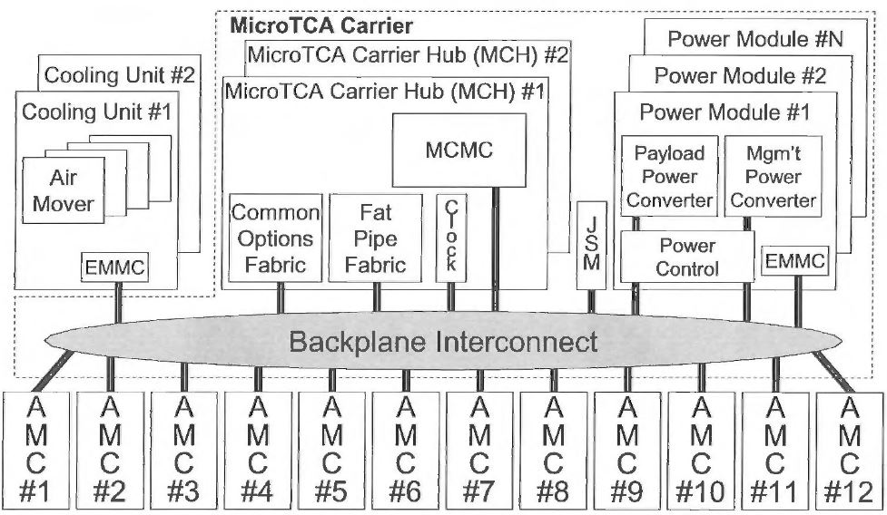
MicroTCA Infrastructure

Slide 6
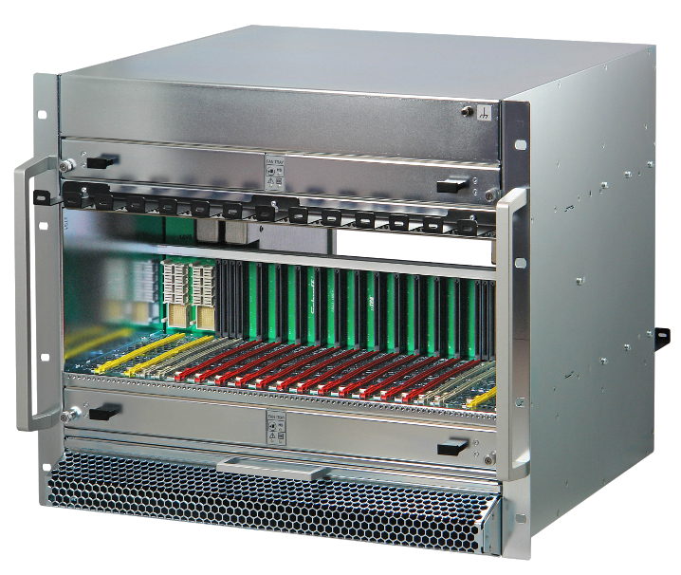
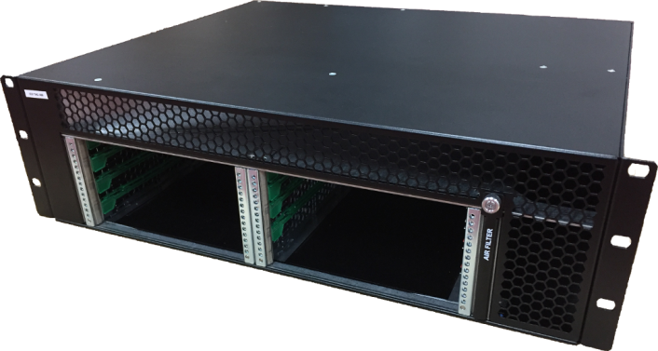
MicroTCA Chassis (1)
Need to support 2 different chassis types:
12 slots 9U for systems requiring more than 6 AMCs and/or more than 4 RTMs;
6 slots 3U to reduce the number of racks deployed.
Front to rear cooling scheme
Tradeoffs:
Supported Components | 9U | 3U
MCH(s) | 2 | 1
PM(s) | 4 (3+1) | 2
CU(s) | 2 (push-pull) | 2 (pull only)
AMC(s) | 12 | 6
RTM(s) | 12 | 4

Slide 7
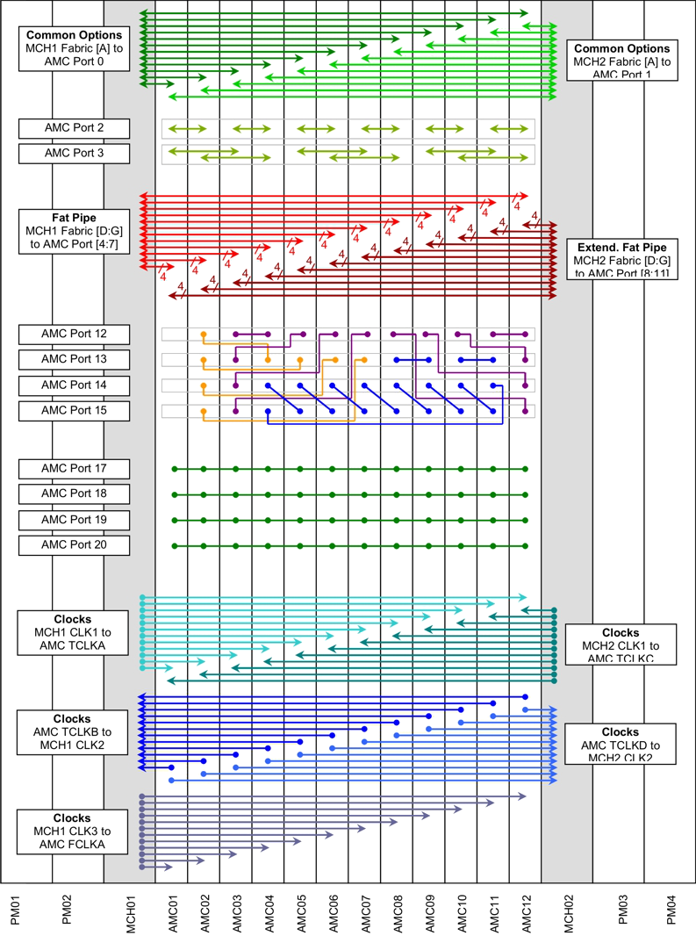
MicroTCA Chassis (2)
9U backplane interconnections:
2 GbE links (1 towards each MCH)
2 high speed AMC to AMC links (BP specific)
Redundant PCIe 4x
4x LVDS type AMC to AMC links (BP specific)
8x MLVDS lanes
4x AMC Clock input lines (2 for each MCH)
1x FAT Pipe Reference CLK

Slide 8
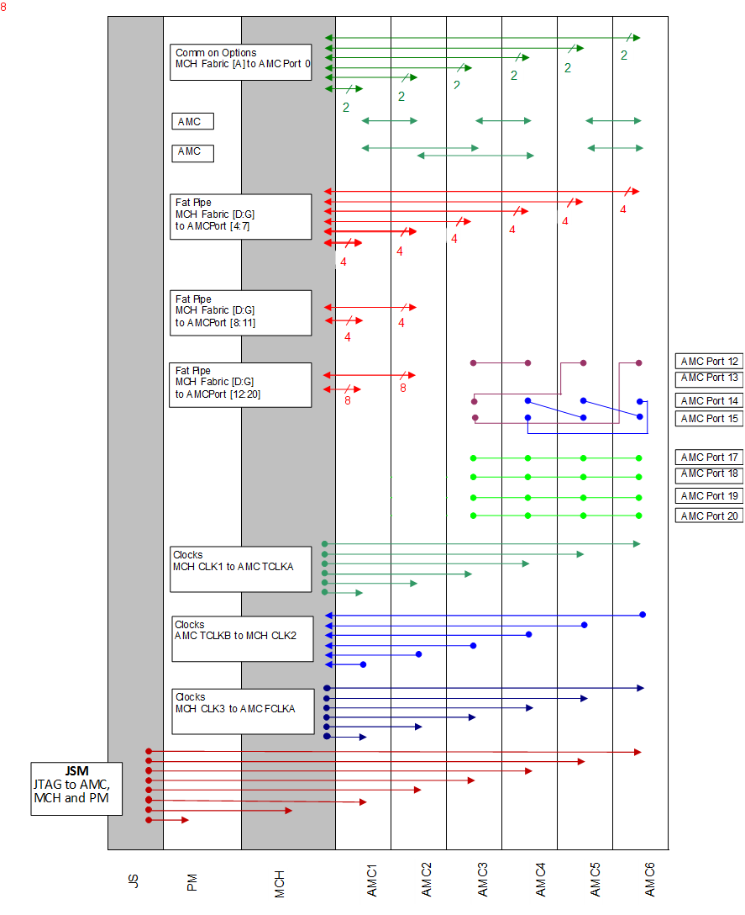
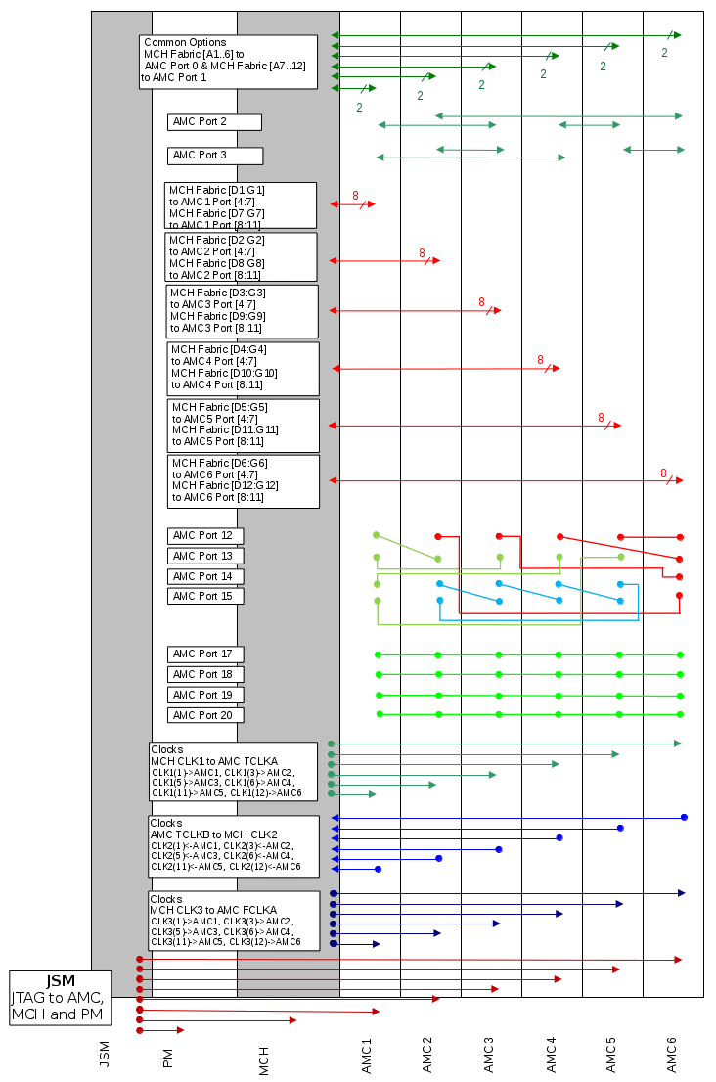
MicroTCA Chassis (3)
3U backplane interconnections:
2 GbE links
2 high speed AMC to AMC links (BP specific)
PCIe 8x and 4x
4x LVDS type AMC to AMC links
8x MLVDS lanes
2x AMC Clock lines
1x FAT Pipe Reference CLK
New backplane design (available week 26):
PCIe 8x to all AMCs
4x LVDS AMC to AMC provided to all slots
8x MLVDS lanes span all AMCs

Slide 9
MicroTCA Chassis (3)
3U backplane interconnections:
2 GbE links
2 high speed AMC to AMC links (BP specific)
PCIe 8x and 4x
4x LVDS type AMC to AMC links
8x MLVDS lanes
2x AMC Clock lines
1x FAT Pipe Reference CLK

Slide 10
MicroTCA Chassis (3)
Old COTS design
3U backplane interconnections:
2 GbE links
2 high speed AMC to AMC links (BP specific)
PCIe 8x and 4x
4x LVDS type AMC to AMC links
8x MLVDS lanes
2x AMC Clock lines
1x FAT Pipe Reference CLK
New backplane design (available week 26):
PCIe 8x to all AMCs
4x LVDS AMC to AMC provided to all slots
8x MLVDS lanes span all AMCs

Slide 11
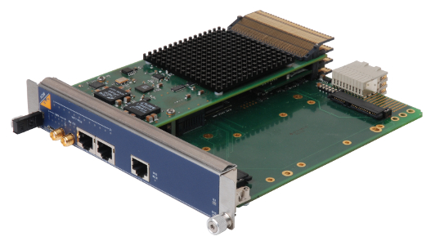
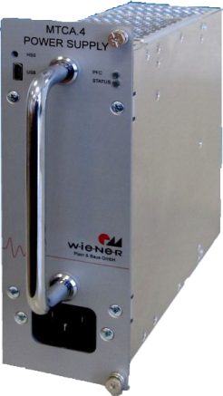
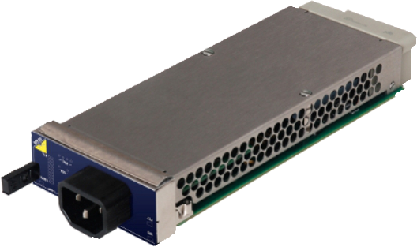
MicroTCA MCH & PM
MicroTCA Carrier Hub :
N.A.T. , MCMC implementation offers broad compatibility
PCIe gen.3 48 port switch;
GbE switch;
Clock input/output on backplane CLK1 and CLK2 plus front panel SMA;
IPMI message forwarding on GbE;
Power Modules:
Wiener (1KW)
N.A.T. (600W)
Both will be used. Choice according to:
Noise requirements;
Redundancy;

Slide 12
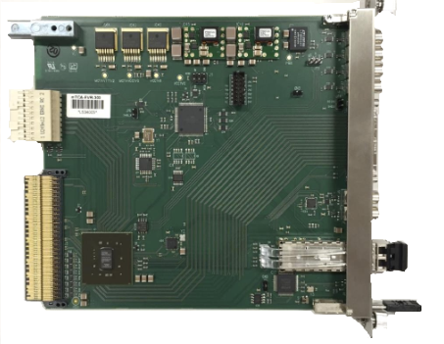
MicroTCA AMC boards: EVR
Timing system based on Micro-Research Finland products:
clocks from/to TCLKA/TCLKB
driving/receiving differential triggers AMC RX/TX ports 17 to 20 (MLVDS)
24 differential lanes to RTM (no RTM designed yet)
front panel 4 x TTL outputs, 2 x TTL inputs (to be replaced by UIO modules)
VHDCI front panel connector for IFB-300 interface box
Delay compensation and feedback

Slide 13
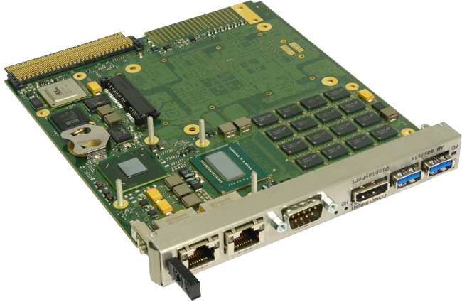
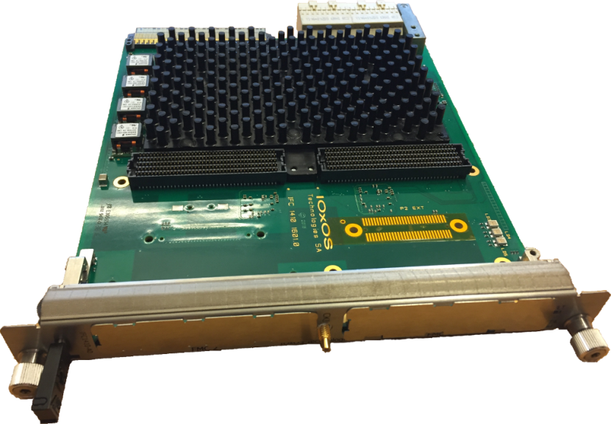
MicroTCA AMC boards: CPU
Concurrent Technologies AM900:
Intel i7 x86-64 architecture
Up to 16GB DDR3 memory
PCIe upstream
IOxOS IFC1410/1411:
T208x Freescale PPC architecture
2GB DDR3 memory
PCIe EP (upstream capability under development)
Xilinx Kintex Ultrascale FPGA
FMC support (2 HPC IFC1410 / 1 HPC IFC1411)
ADC onboard (10ch IFC1420 only)
RTM support (D1.4 IFC1410 / A1.1 IFC1411)

Slide 14
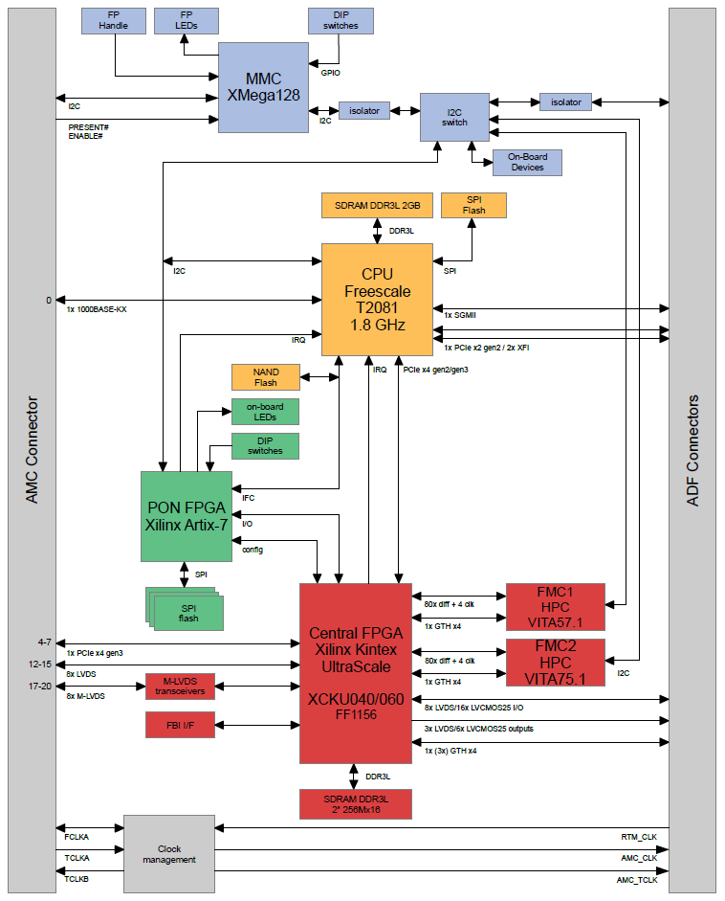
MicroTCA AMC boards: IFC14xx
IFC1410
block diagram :
MMC & sensors section;
PPC CPU section;
Configuration
management;
Main FPGA/application
specific section;

Slide 15
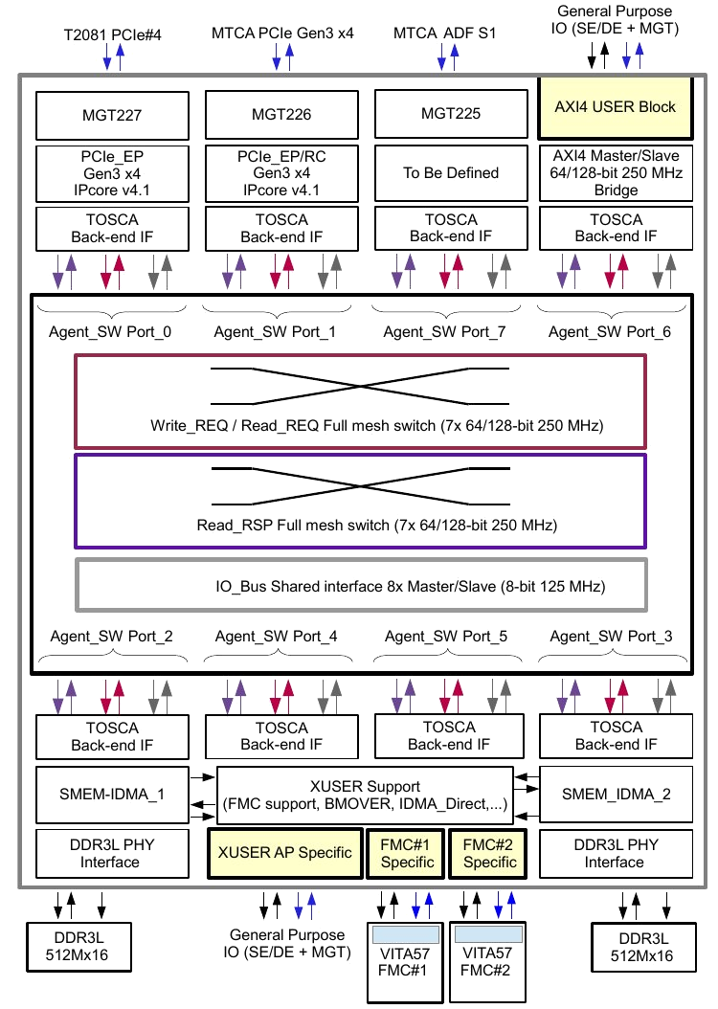
MicroTCA AMC boards: IFC14xx
IFC1410 Firmware infrastructure:
Separate Data and Control interconnect infrastructure;
Data:
Full mesh switch;
Every agent SW has two master and slave interfaces for request and response communications;
Communication based on PCIe TLPs
IO Control:
Shared parallel bus;
Master and slave interfaces for each agent switch;
Round Robin arbiter to assign bus mastership

Slide 16
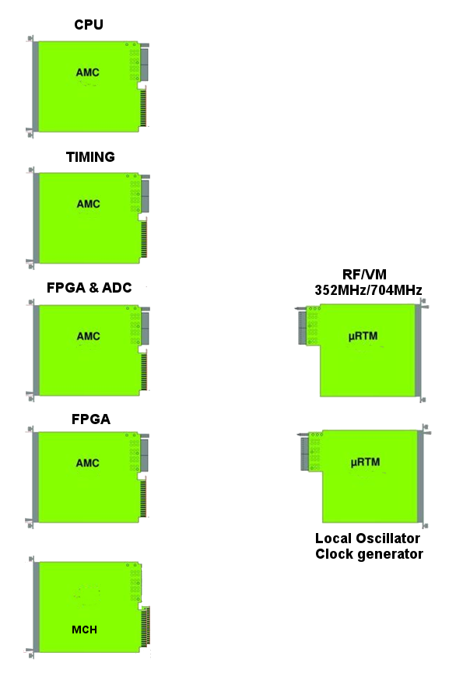
MicroTCA system example
Ethernet
Control (PCIe)
Timing:
Triggers
Gets synchronization info from external device and provides:
Clocks
Signals from:
PowerAmp
Cavity
PreAmp
VM
clock to MCH
triggers to all AMCs
machine configuration settings
Timing
MCH:
Monitors AMCs status, distributes clocks and provides interconnections
Interlock
CPU:
Manages a subset of AMCs
LO
configures and collects data from AMCs
runs EPICS IOCs
AMC & RTM:
Application specific. May provide interlocks and information to MPS
LAN
Phase reference

Slide 17
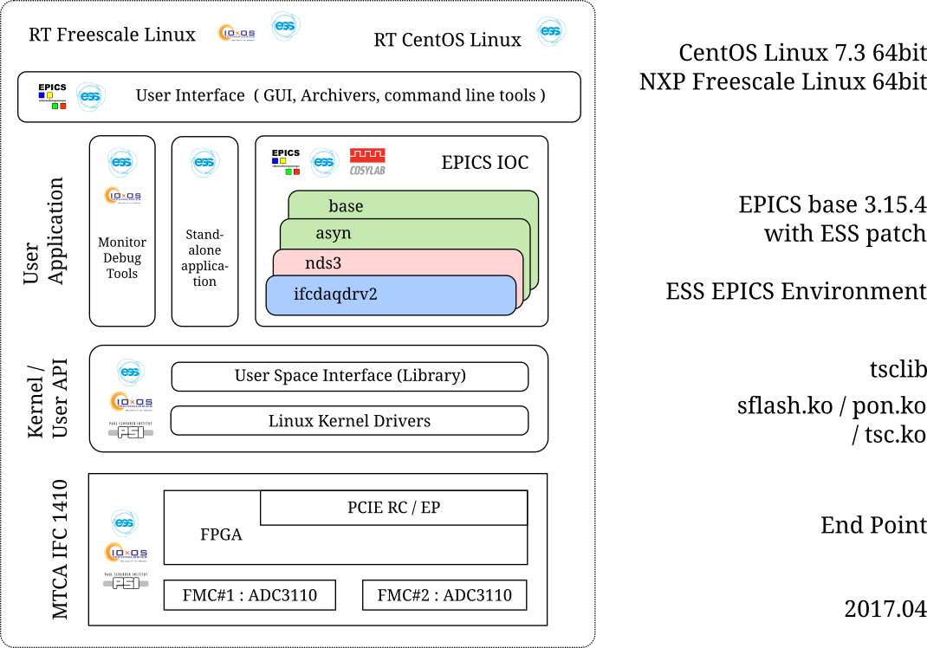
MTCA Software Stacks / 2017.04

Slide 18
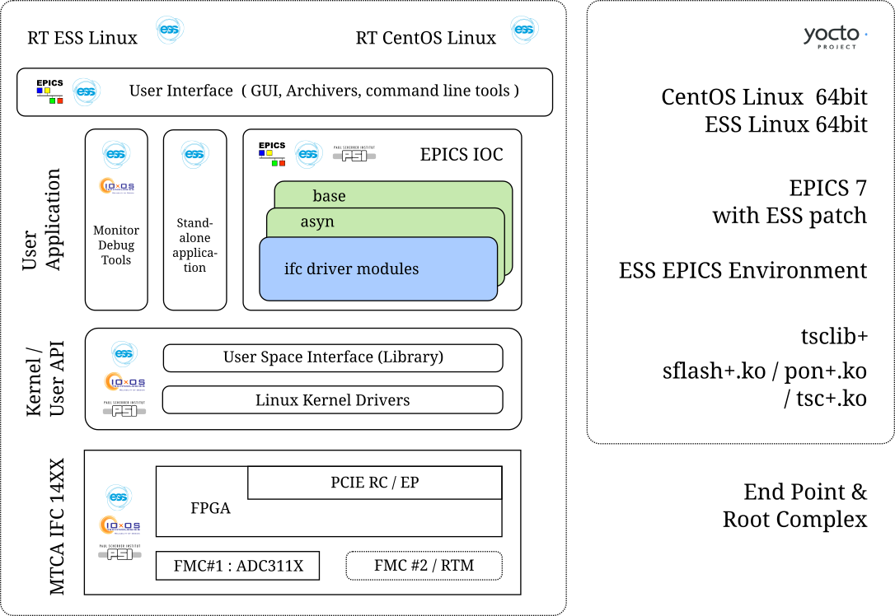
MTCA Software Stacks / Plan

Slide 19
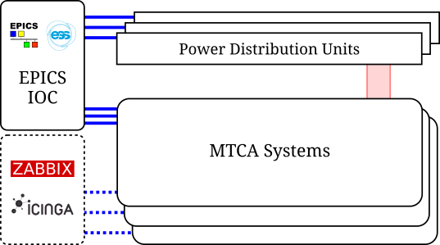
MTCA Systems Monitoring / Plan
MTCA Infrastructure Monitoring System
Slow > 1 Hz
Read Only (very limited Write)
Most PDUs support SNMP
MTCA MCH supports
  RCMP (IPMI)
  SNMP
EPICS modules
  ipmiComm (SLAC)
  devSNMP (FRIB)
  snmpLib (RAON)
Existent Open Source Tools
  ZABBIX
  ICINGA

Slide 20
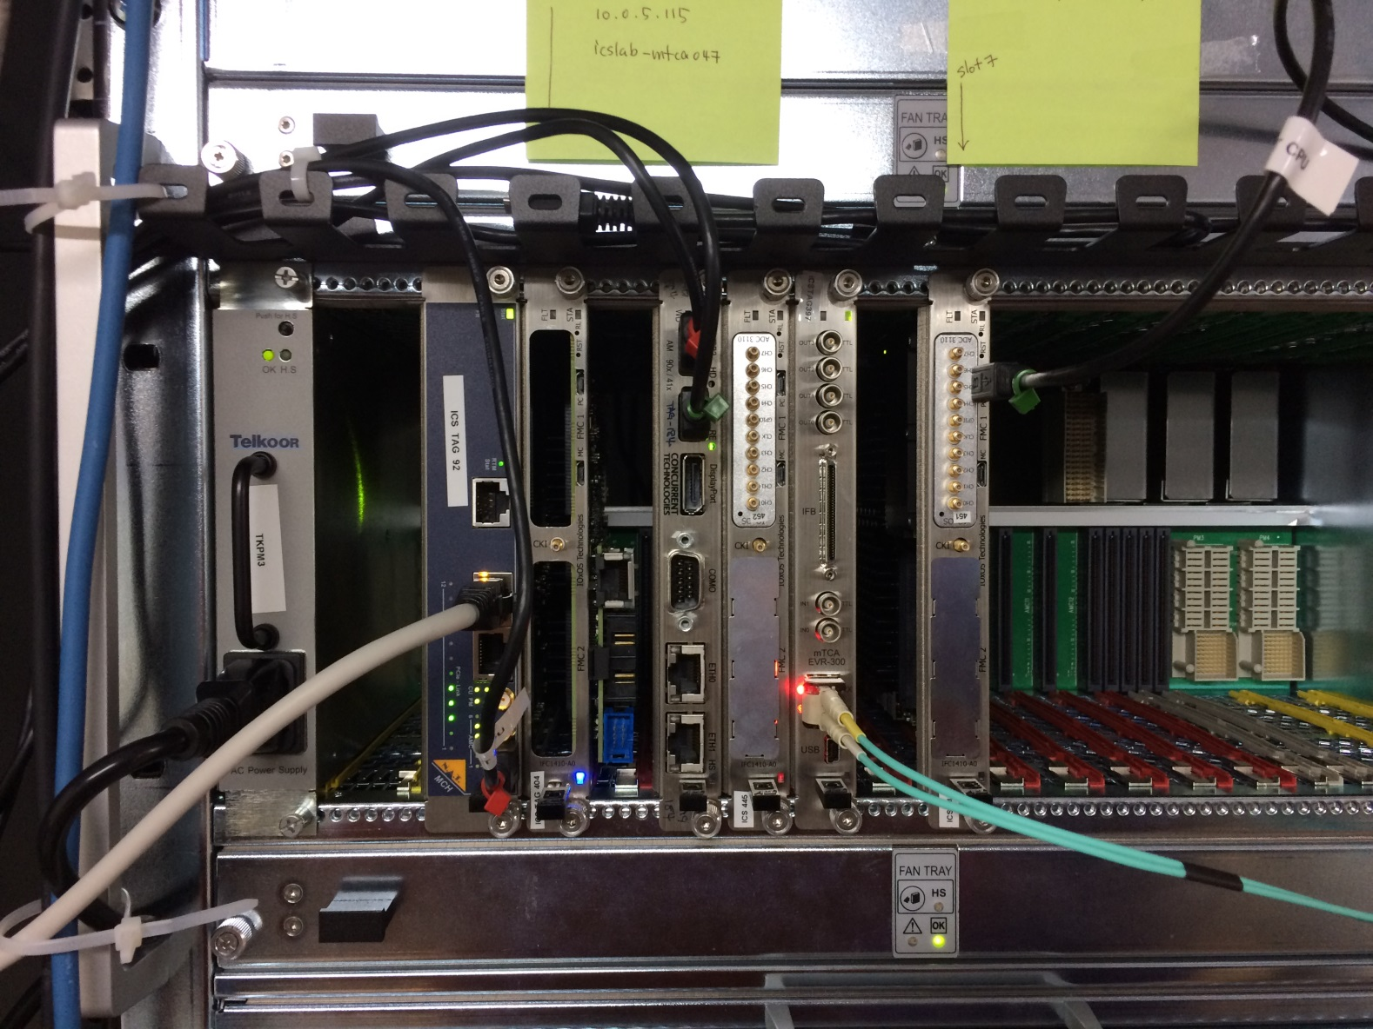
MicroTCA system Showcase

