Slide 1
Instrument Projects and Status
NID-DMSC Integration Meeting
3rd February 2017
Ken Andersen

Slide 2
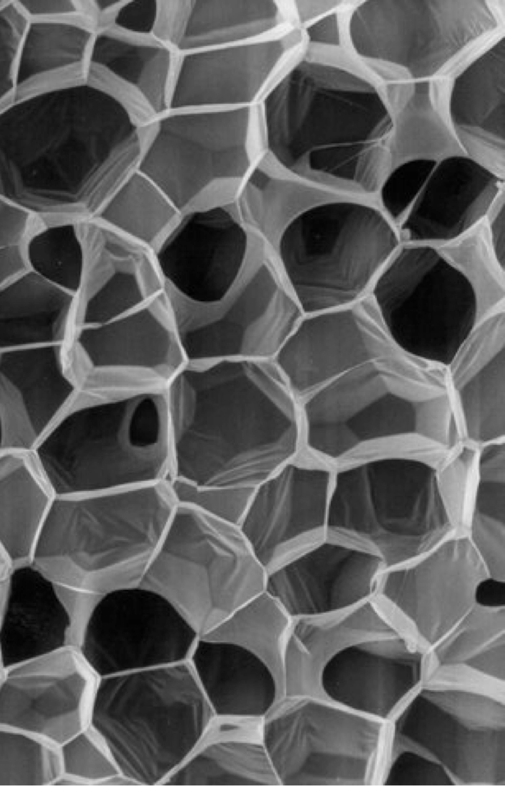
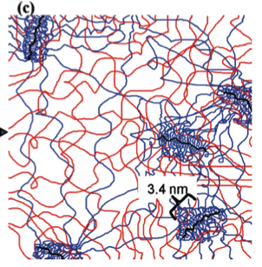
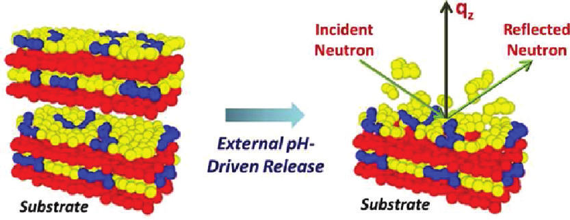
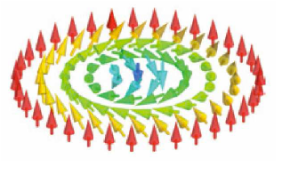
Large-Scale Structures: 4+2 instruments
Small Angle Neutron Scattering (SANS)
Coordinator: Andrew Jackson
Reflectometry
Coordinator: Hanna Wacklin
Accessing length-scales up to μm
Surfaces, membranes and interfaces
ESTIA: Small-sample reflectometer for magnetism and soft matter
Lead scientist: Artur Glavic (PSI)
IK partners: PSI (100%)
LoKI: Broad-band SANS for soft matter, materials and bio-science
Lead scientist: Andrew Jackson (ESS)
IK partners: ISIS (100%)
FREIA: Kinetics reflectometer for liquid surfaces and soft matter
Lead scientist: Hanna Wacklin (ESS)
IK partners: ISIS (100%)
SKADI: High-resolution versatile SANS
Lead scientist: Sebastian Jaksch (FZJ)
IK partners: FZJ (50%), LLB (50%)
Bio-SANS: SANS for biology
Proposal from 2012 & 2013
GI-SANS: Grazing-Incidence SANS for structured surfaces and interfaces

Slide 3
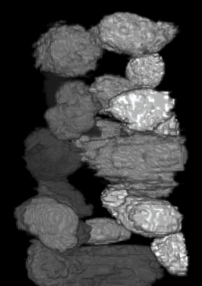
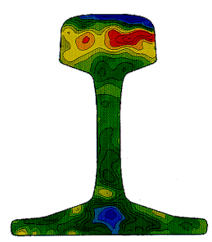
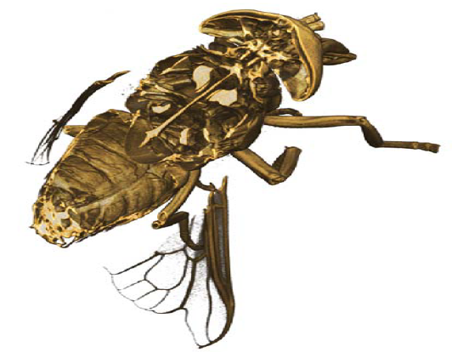
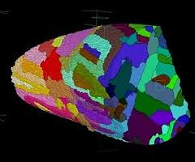
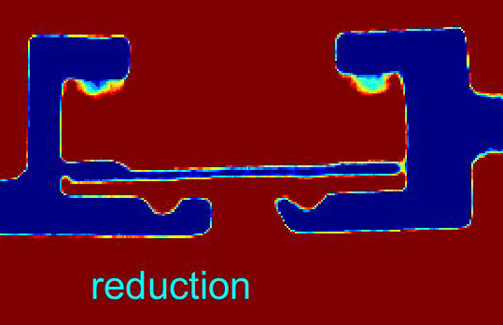
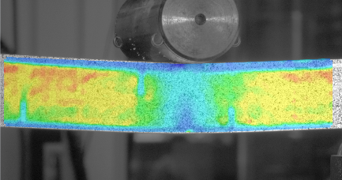
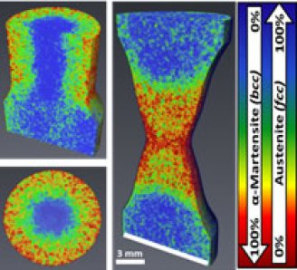
Imaging & Engineering: 2+2 instruments
Instrument class coordinator: Markus Strobl
Imaging: rapidly developing real-space technique, resolution down to few μm
Engineering: strains and structure of engineering components
ODIN: Multi-purpose imaging beamline
Lead scientist: Michael Lerche, TUM
IK partners: TUM (55%), PSI (35%), ESS (10%)
BEER: Engineering materials diffractometer
Lead scientists: Jochen Fenske (HZG), Premysl Beran (NPI)
IK partners: HZG (50%), NPI (50%)
Test beamlines: integration testing, method developments, moderator characterisation
Fundamental, particle & nuclear physics: origins of matter and the universe
Test Beamlines: Both at HZB and at ESS
Lead Scientist: Robin Woracek (ESS)
ANNI: Fundamental & particle physics
Proposal from 2015

Slide 4
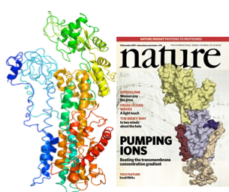
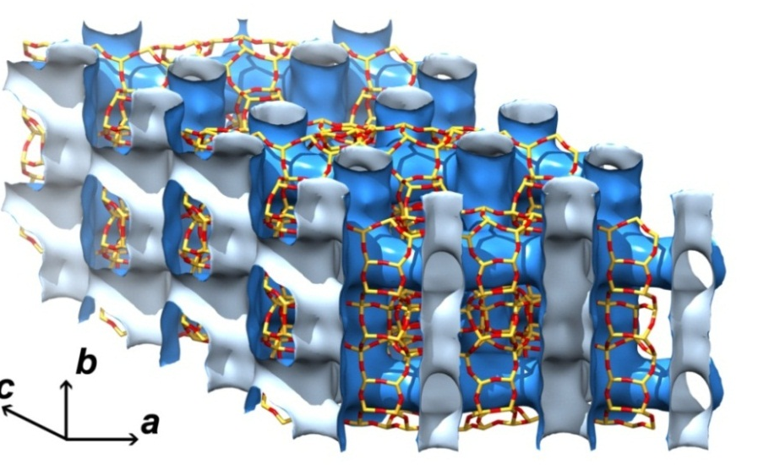
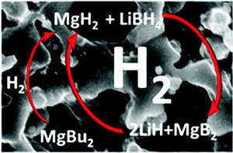
Diffraction: 4+1 instruments
Instrument class coordinator: Werner Schweika
Powder Diffraction
Single-Crystal Diffraction
Structural characterisation of materials
Determination of complex structures
DREAM: General-purpose powder diffractometer
Lead scientist: Mikhail Feygenson (FZJ)
IK partners: FZJ (76%), LLB (24%)
MAGiC: Magnetism diffractometer
Lead scientist: Xavier Fabrèges (LLB)
IK partners: LLB (61%), FZJ (23%), PSI (16%)
HEIMDAL: Thermal powder diffractometer
Lead scientist: Mogens Christensen (ÅU)
IK partners: ÅU (30%), PSI (35%), IFE (35%)
NMX: Macromolecular crystallography
Lead scientist: Esko Oksanen (ESS)
IK partners: Wigner/EK/BRC (38%), LLB/IBS (8%), UiBergen (19%)
ESPRESSO: High-pressure diffraction
Proposal from 2015

Slide 5
Spectroscopy: 5+3 instruments
Direct-Geometry Spectroscopy
Coordinator: Pascale Deen
Indirect-Geometry Spectroscopy
Coordinator: Jon Taylor
General-purpose chopper spectrometers
Crystal-analyser instruments
CSPEC: Cold chopper spectrometer
Lead scientist: Pascale Deen (ESS)
IK partners: TUM (50%), LLB (50%)
BIFROST: Single-crystal spectroscopy
Lead scientist: Rasmus Toft-Petersen (DTU)
IK partners: DK (24%), PSI (28%), LLB (21%), IFE (24%), Wigner (3%)
T-REX: Bispectral chopper spectrometer
Lead scientist: Nicolo Violini (FZJ)
IK partners: FZJ (75%), CNR (25%)
VESPA: Vibrational spectroscopy
Lead scientist: Daniele Colognesi (CNR)
IK partners: CNR (75%), ISIS (25%)
VOR: Broadband chopper spectrometer
Proposal from 2013
MIRACLES: Backscattering spectroscopy
Lead scientist: Felix Villacorta (ESS-Bilbao)
IK partners: ESS-Bilbao (TBD), KU (1-TBD)
Neutron Spin-Echo Spectroscopy
Coordinator: Melissa Sharp
Highest resolution achievable with neutrons
HR-NSE: Ultra-high resolution spin-echo
Proposal from 2013 and 2015
Mushroom: Small-sample kinetics spectroscopy
2

Slide 6
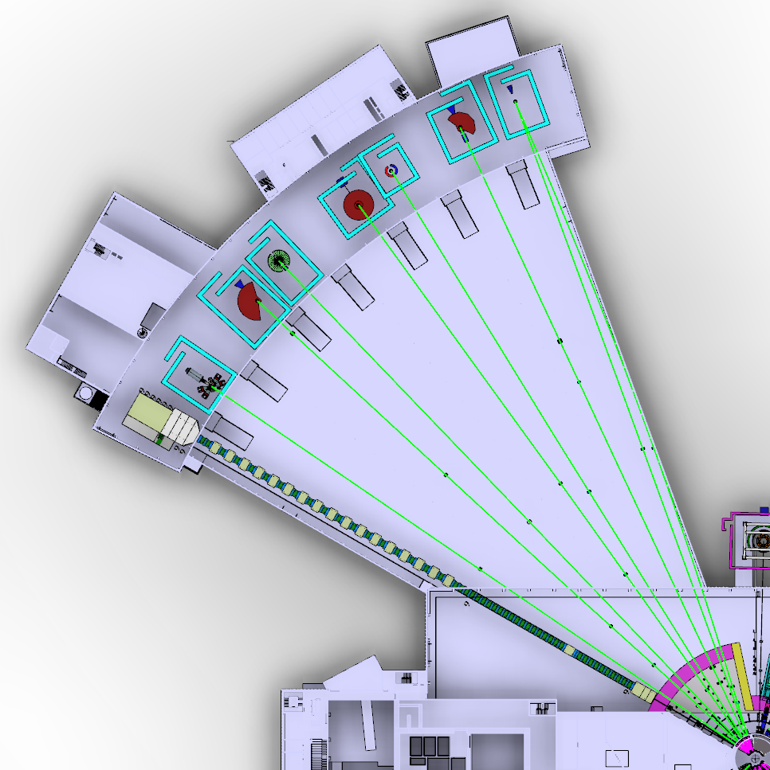
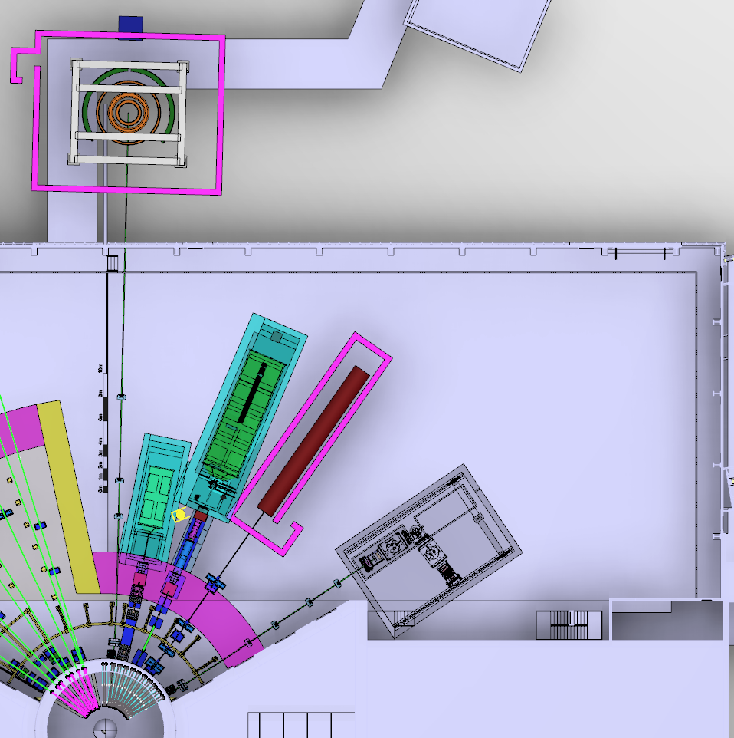
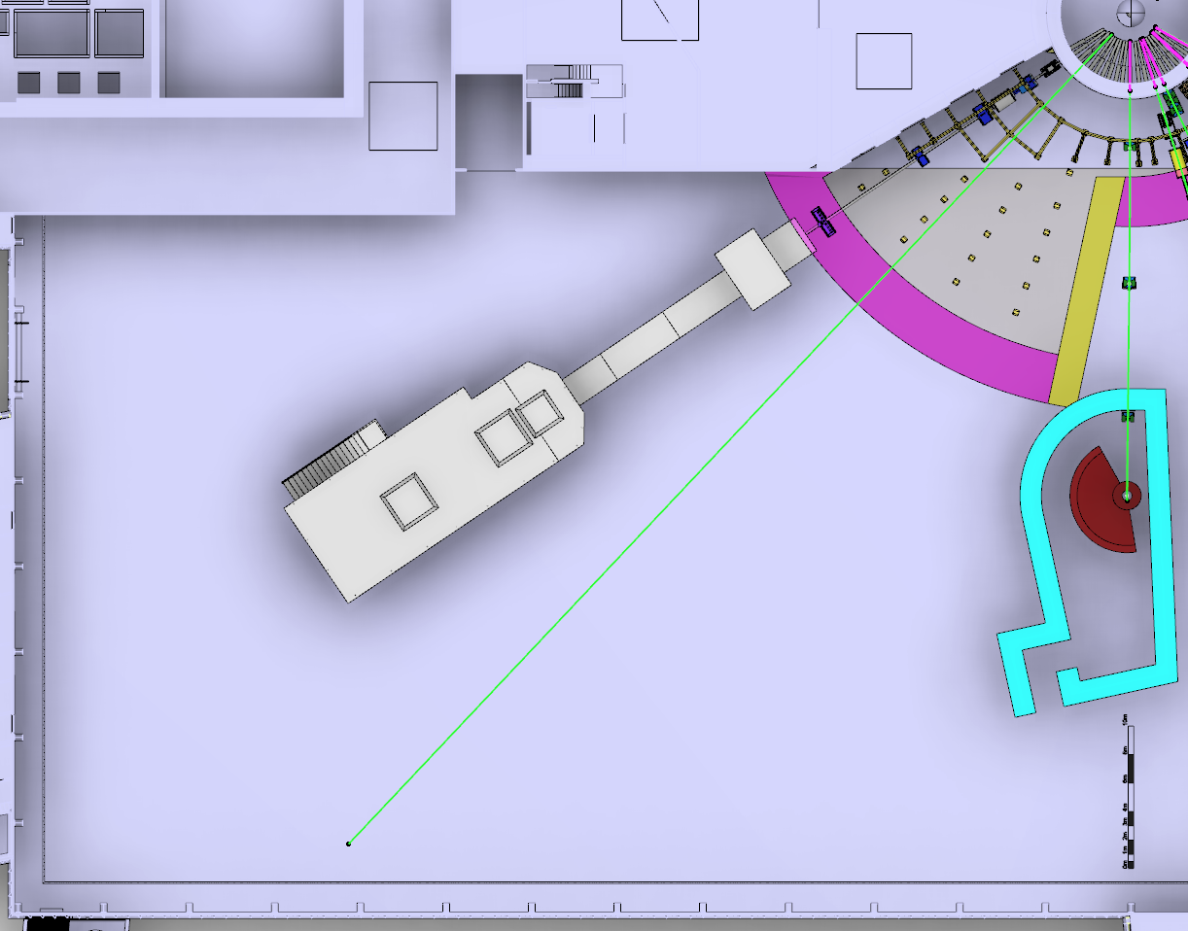
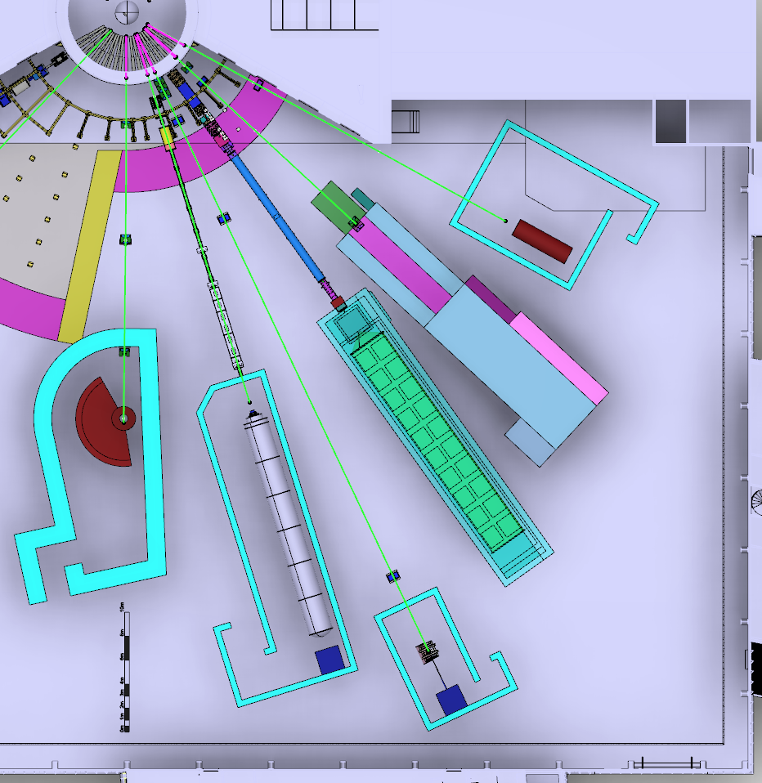
15-Instrument Suite
HEIMDAL – Powder Diffractometer
T-REX – Bispectral Chopper Spectrometer
MAGIC – Magnetism Diffractometer
MIRACLES – Backscattering Spectrometer
BIFROST – Extreme-Environments Spectrometer
CSPEC – Cold Chopper Spectrometer
BEER – Engineering Diffractometer
NMX – Macromolecular Crystallography
LOKI – Broadband SANS
FREIA – Liquids Reflectometer
ESTIA – Magnetism Reflectometer
SKADI – Low-Q SANS
VESPA – Vibrational Spectroscopy
ODIN – Imaging
DREAM – Powder Diffactometer

Slide 7
Instrument Ramp-up
Instrument | 2014 | 2015 | 2016 | 2017 | 2018 | 2019 | 2020 | 2021 | 2022 | 2023 | 2024 | 2025 | 2026 | 2027 | 2028 | 2029 | 2030
LOKI
ODIN
NMX
ESTIA
DREAM
MAGIC
BEER
CSPEC
BIFROST
T-REX
SKADI
HEIMDAL
FREIA
VESPA
MIRACLES
VOR
HR-NSE
ANNI
GI-SANS
ESPRESSO
Bio-SANS
Mushroom
5MW
user programme start
4MW
3MW
2MW
beam on target
1MW
scope-setting
Tollgate 2
Construction Project
Hot Commissioning
Beam on Target

Slide 8
NSS Project; Neutron Instrument project phases
Proposal and Planning
Design and Construction
Installation and Commissioning
Instrument Proposal
Phase 0
Preparation for Design
Phase 1
Preliminary Design
Phase 2
Detailed Design
Phase 3
Manufacturing and Procurement
Phase 4
Installation and Integration
Phase 5
Hot Commissioning
Deliverables
Science case covering scientific relevance, impact and usage
Conceptual design with credible estimates of performance
Preliminary costing.
Deliverables
Conceptual design updates
Prototyping
Definition of facility requirements and interfaces
Clarification of institutional responsibilities
Resource planning
Deliverables
Scientific and technical requirements
Technical design concept
Delivery plan for all phases (including hot commissioning)
Delivery Schedule covering all phases
Resource plan
Staging plan for later enhancements
Budget with contingency at 10% of cost to complete
Deliverables
Complete definition of all major technical components
Completion of detailed plan for Phase 3
Refined plan for phase 4
Refined Resource plan
Refined delivery schedule, with critical path items and dependencies
Refined budget with contingency at 10% of cost to complete
Deliverables
Procurement and manufacture of all major technical components
Completion of detailed plan for phase 4
Site preparation
Refined plans for phase 5 and for staging
Refined Resource plan
Refine instrument delivery schedule
Maintain budget with contingency at 10% of cost to complete
Deliverables
Construction of physical infrastructure on site.
Assembly and installation of technical components
Integration and testing of technical components
Installation, integration and testing of Personnel Safety System
Submission of application for approval to hot commission
Formal project completion
Deliverables
Verification of performance of Personnel Safety System
Proof of compliance with radiation dose limits
Critical performance demonstration of basic functionality
Scientific performance demonstration
Friendly user experiments
Completion of technical and user manuals
Tollgate 1
STAP review
SAC recommendation
NSS recommendation
STC approval
Tollgate 2 (PDR)
Preliminary Design Review
STAP review
NSS
scope review
assign cost book value
Approval by SD
Tollgate 3 (CDR)
Critical Design Review
STAP review
ICB review
NSS approval
Tollgate 4 (IRR)
Installation Readiness Review
ICB review
NSS approval
Tollgate 5 (SAR)
Safety systems acceptance review
NSS approval
Tollgate 6 (ORR)
Operations readiness review
NSS approval

Slide 9
2016-17 | May | Jun | Jul | Aug | Sep | Oct | Nov | Dec | Jan | Feb | Mar | Apr
LOKI
SKADI
ESTIA
FREIA
NMX
MAGIC
HEIMDAL
DREAM
BEER
ODIN
CSPEC
BIFROST
MIRACLES
T-REX
VESPA
10/5
20
29
10
14-15/6
20
29
17
22-23/6
19
31
31
8
14
17/6
14
7
5
24
12-13/9
7
3
12
24
21
28
8
27
IKON11
ICB
SAC
COUNCIL
IKON12
STAP
scope-setting
TG2

Slide 10
Neutron Instruments Division Organisation in Operations
Division Head
2 team Assistants
Large-Scale Structures Group Leader
Diffraction Group Leader
Spectroscopy Group Leader
Engineering & Methods Group Leader
6 Hall Coordinators
N₁ instruments
2N₁ instrument
scientists
N₁ instrument
support staff
N₂ instruments
2N₂ instrument
scientists
N₂ instrument
support staff
N₃ instruments
2N₃ instrument
scientists
N₃ instrument
support staff
N₄ instruments
2N₄ instrument
scientists
N₄ instrument
support staff
1 fundamental
physics
instrument
2 instrument
scientists
1 instrument
support staff

Slide 11
Neutron Instruments Division Organisation in Operations
Division Head
2 team Assistants
Large-Scale Structures Group Leader
Diffraction Group Leader
Spectroscopy Group Leader
Engineering & Methods Group Leader
6 Hall Coordinators
N₁ instruments
2N₁ instrument
scientists
N₁ instrument
support staff
N₂ instruments
2N₂ instrument
scientists
N₂ instrument
support staff
N₃ instruments
2N₃ instrument
scientists
N₃ instrument
support staff
N₄ instruments
2N₄ instrument
scientists
N₄ instrument
support staff
1 fundamental
physics
instrument
2 instrument
scientists
1 instrument
support staff
Current Staffing:
Andrew Jackson
Hanna Wacklin
Werner Schweika
Esko Oksanen
Pascale Deen
Rasmus Toft-Petersen
Melissa Sharp
Monika Hartl
Markus Strobl
Robin Woracek
Ken Andersen

Slide 12
Neutron Scattering Systems (NSS) Project
Director for Science
Andreas Schreyer
ESS Technical Board
Chair: Roland Garoby
Project Leader: Shane Kennedy
Deputy Project Leader: Oliver Kirstein
Instrument Collaboration Board
Chair: Andreas Schreyer
Safety and Licensing:
Lead: Arno Hiess
Neutron Instruments:
Lead Scientist: Ken Andersen
Lead Engineer: Gabor Laszlo
In-Kind Office:
Lead: Michela Del’Anno Boulton
Integration Activities:
Lead: Zvonko Lazic
Planning:
Lead: Sofie Ossowski
SSM application
Partner coordination
Neutron Bunker
Budgets & workflow
LOKI (ISIS)
ODIN (TUM/PSI)
Safety Systems analysis & design
Requirements & Standards
Schedule
SKADI (FZJ)
BEER (HZG/NPI)
Memoranda of Understanding
ESTIA (PSI)
Risk Management
Systems Engineering
Four Instrument Classes
Large scale structures
Engineering & imaging
Spectroscopy
Diffraction
C-SPEC (TUM)
Technical Annexes
FREIA (ISIS)
T-REX (FZJ)
In-Kind Collaboration Agreements
Conventional Facilities
DREAM (FZJ)
BIFROST (DTU)
Target Project
HEIMDAL (ÅU)
MIRACLES
(ESS Bilbao)
Instrument Class Co-ordinator (scientist) assigned to each instrument
NMX (ESS)
VESPA(CNR)
MAGIC (LLB)

